Slide 1
Shader Code

Slide 2
Shading Background

Slide 3
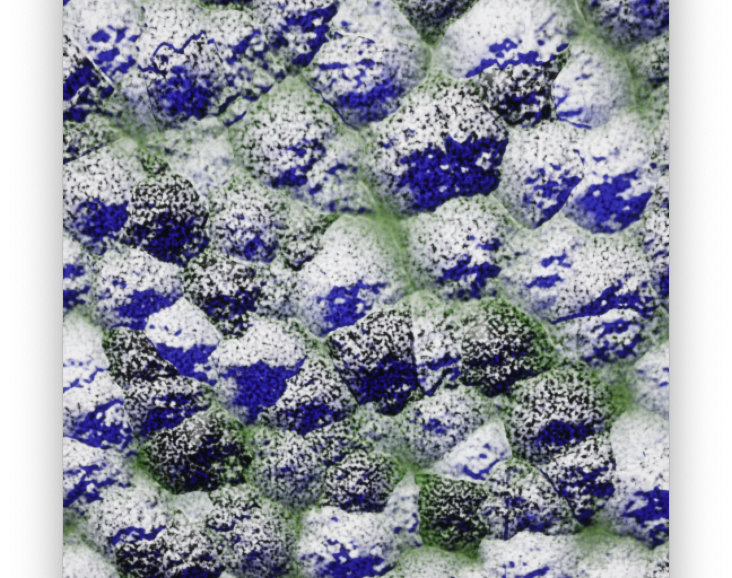
What is a Shader?
A shader is a small program, written in a GPU-domain-specific language.
Shaders were originally used to compute surface appearance and shading.
The term “shader” is now used for any GPU computation, usually with an identifying word to tell you what kind.
For example, a vertex shader does computation for every vertex in a polygonal model, even if that computation has nothing to do with the surface appearance.

Slide 4
Shader History
Testbed [Whitted and Weimer 1981]
  Renders span buffer with all the parameters you need to compute your shading, then runs a program on every pixel to compute the shading. Origin of deferred shading used today.
Shade Trees [Cook 1984]
  Introduces the term “shader.” Shaders for displacement, surface, light, and atmosphere as an expression in a single line of code.
Image Synthesizer [Perlin 1985]
  Adds control flow (loops and branches), turning shading into a true programming language. Also introduces Perlin noise.
Building Block Shaders [Abram and Whitted 1990]
  Describes shaders as a visual network of blocks. The basis of all visual shader programming, including UE5’s Material system, among many others.
RenderMan [Hanrahan and Lawson 1990]
  Used in decades of Pixar movies. Responsible for many of the terms and choice of functions seen in shading languages today.
PixelFlow [Olano and Lastra 1998]
  The first high-level shading language on graphics hardware. Introduces some of the data types used today (earlier shaders were just single-precision float), but shaders were the surface/light/atmosphere from RenderMan and Shade Trees. HP demoed working hardware at SIGGRAPH conference, but cancelled project before any shipped.
Interactive Multi-Pass Procedural Shading [Peercy et al. 2000]
  Assembly-like on existing fixed-function hardware. RenderMan on (never-finished) commercial hardware
Vertex Programs [Lindholm et al. 2001]
  Assembly-like. The first PC GPU shading language.
RTSL [Proudfoot et al. 2001]
  High-level shading on GPUs. Introduces GPU shading stages of vertex, pixel, etc. Led to NVIDIA’s Cg, which led to HLSL.
The Direct3D 10 System [Blythe 2006]
  Geometry shaders

Slide 5
Common Shading Stages
Vertex Shader
  Computes where each vertex will land on the screen.
(Rasterize) — not programmable
  Collects triples of vertices into triangles, and figures out which pixels are covered.
Pixel Shader
  Computes a color per pixel.
Compute Shader
  Performs general-purpose computation.
Vertex
Memory
Rasterize
Compute
Pixel

Slide 6
Less Common Shading Stages
Vertex
Hull
Hull
  Runs at each triangle or quad. Determines tessellation factors.
(Tessellate) — not programmable
  Turns one primitive into many as part of a smooth surface patch.
Domain
  Where do new vertices generated by the tessellation stage go?
Geometry
  Runs per triangle. Can make more triangles and compute new vertex locations. Suffers from poor performance on some GPUs.
Tessellate
Memory
Domain
Compute
Geometry
Rasterize
Pixel

Slide 7
Other Shader Stages
Mesh Shaders
Ray Tracing
New hardware commonly introduces new shading stages.
Games usually avoid using for anything other than non-critical eye candy until the minimum expected GPU (aka minspec) can be expected to support them
Task
Ray Generation
Mesh Generation
Any Hit
Traversal
Mesh
Intersection
Rasterize
Pixel
Miss
Closest Hit

Slide 8
Writing Shaders
DirectX High Level Shading Language (also OpenGL GLSL)
  HLSL is a direct descendent of Stanford RTSL & NVIDIA Cg
There are lots of HLSL resources online
HLSL is C-like language, with familiar statement syntax:
  if / for / switch, struct, function call/declaration, #define / #if, . . .
  Many extensions to support common shading operations.
It has some C++ features (comment syntax and function overloading), but most C++ features not in C are missing (classes, templates, etc.).

Slide 9
HLSL
Brief overview

Slide 10
Vector Types
HLSL has built-in types for 2D, 3D, and 4D vectors, commonly used for position or color.
  float2, float3, float4
  Also other basic types: e.g., int2, int3, int4
These are initialized using any combination of enough components.
  float2 f2 = float2(1, 2);
  float3 f3 = float3(f2, 0);
  float4 f4 = float4(3, f2, 4);

Slide 11
Vector Operators
Swizzle operations rearrange components.
  f4.xyz, f4.wxzy, f4.wwww
  Standard order is xyzw or rgba (can’t mix .xr).
Operations apply per component.
  So a+b =
  float3(a.x+b.x, a.y+b.y, a.z+b.z)
Built-in functions exist for common vector math.
  dot(a,b), cross(a,b), distance(a,b), length(a), normalize(a)

Slide 12
Matrix Types
Built-in types also exist for matrices up to 4x4.
  float4x4, float3x4, float4x2, etc.
Construct from any mix of components or vectors.
  float4x4 m4 = float4x4(v0,v1,v2, 0,0,0,1);
Constructing a smaller matrix from a bigger one keeps top/left elements
  float3x3 m3 = float3x3(m4);

Slide 13
Matrix Operators
Operations apply component-wise.
  Addition gives standard matrix addition
  Multiplication is element-by-element, not the same as matrix multiplication.
There are built-in functions for common matrix operations.
  mul(mat,mat), mul(mat,vec), mul(vec,mat)
  transpose(mat), determinant(mat), inverse(mat)

Slide 14

Built-in Functions
Find on HLSL reference pages!
  Interactive graphs of some of these
Blending
  saturate, clamp, step, smoothstep, lerp
Repeating
  floor, frac, fmod
Special Purpose for Common Shading Operations
  reflect, refract, texture
Derivatives (Pixel Shaders Only!)
  ddx, ddy, fwidth
  ddx(a) = ∂a/∂x (pixel-to-pixel change in “a”)
  Have to use chain rule for ∂a/∂b

Slide 15
UE5 Shaders

Slide 16
Forward Shading
Depth Pre-Pass
Forward Pass
Not a shading stage, but one way to use the shaders for rendering. Computes color for each object as it is rendered.
Used primarily in UE5 for VR and transparency .
Optional Depth Pre-Pass
Only processes the stages through Rasterize.
Generates depth for front-most surface.
Can improve performance by allowing the GPU to skip the actual shading computation in the next pass for surfaces that are not visible.
Forward Shading Pass
Processes all of the stages for each object.
Computes color as you render each object.
Vertex
Vertex
Hull
Hull
Tessellate
Tessellate
Domain
Domain
Geometry
Geometry
Rasterize
Rasterize
Pixel

Slide 17
Deferred Shading
Depth Pre-Pass
Base Pass
Deferred Pass
Alternate way to use the shading stages for rendering.
Optional Depth Pre-Pass
Same as in forward shading. Can avoid work on hidden surfaces.
Base Pass
Processes all of the stages for each object.
Only computes shading parameters.
A RenderTarget/Texture holding the shading parameters is called a G-buffer.
Deferred Pass(es)
Renders a shape like a screen-filling quad that covers every pixel you want to process (or uses a compute shader).
Runs a pixel shader using the data saved in the base pass.
Vertex
Vertex
Quad Vertex
Hull
Hull
Tessellate
Tessellate
Domain
Domain
Geometry
Geometry
Rasterize
Rasterize
Rasterize
Base Pixel
Deferred Pixel

Slide 18
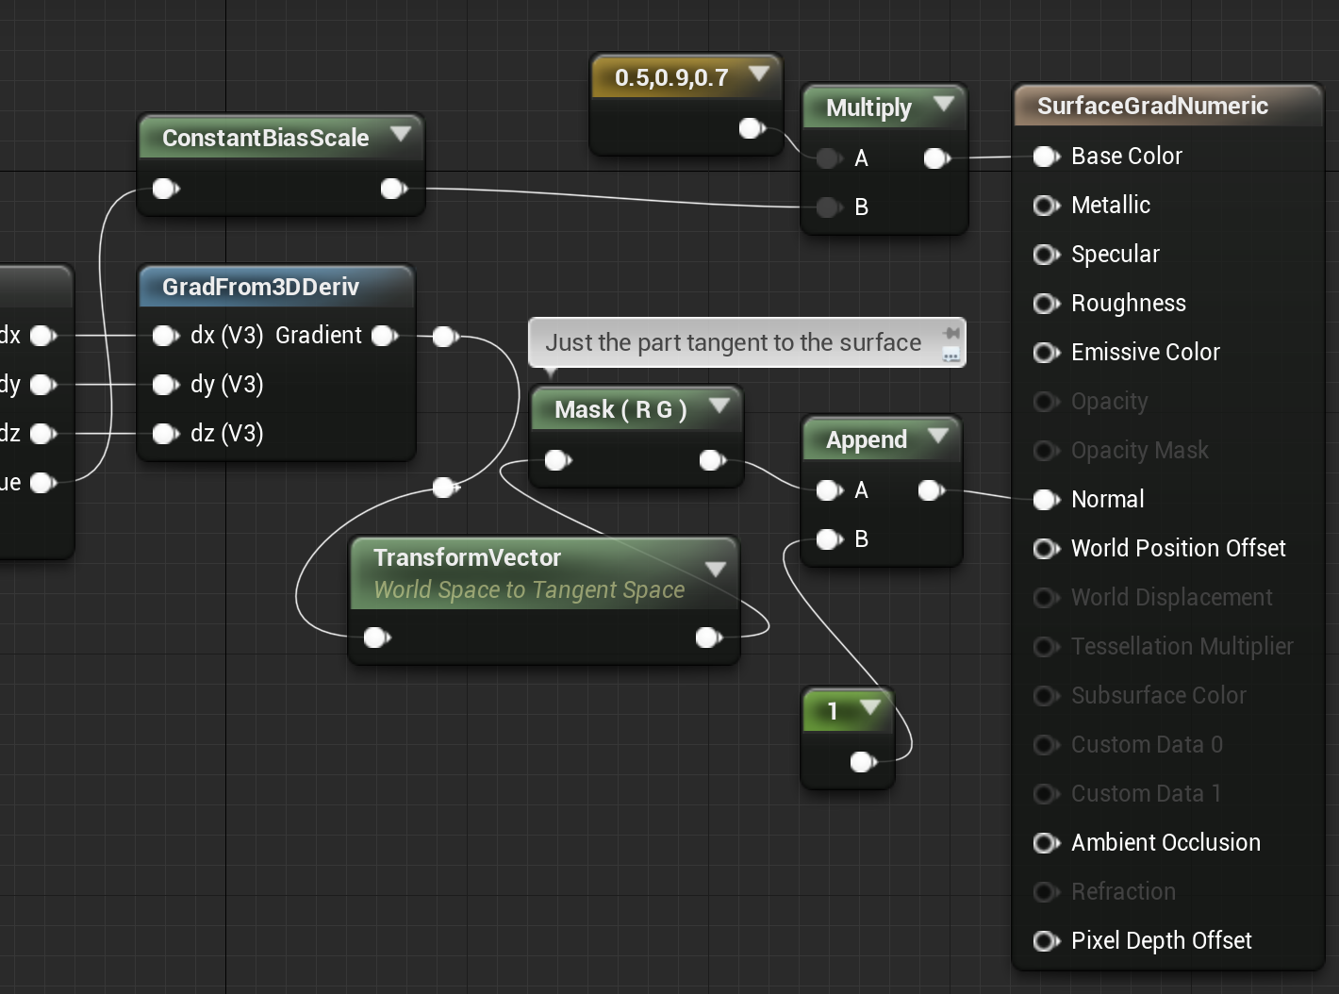
UE5 Materials
Compiled to HLSL for deferred shading
Vertex Shader
Anything connected to World Position Offset or World Displacement.
Anything attached to the input of a VertexInterpolator node.
Base Pass Pixel Shader
Everything else goes into the G-buffers during the base pass.

Slide 19
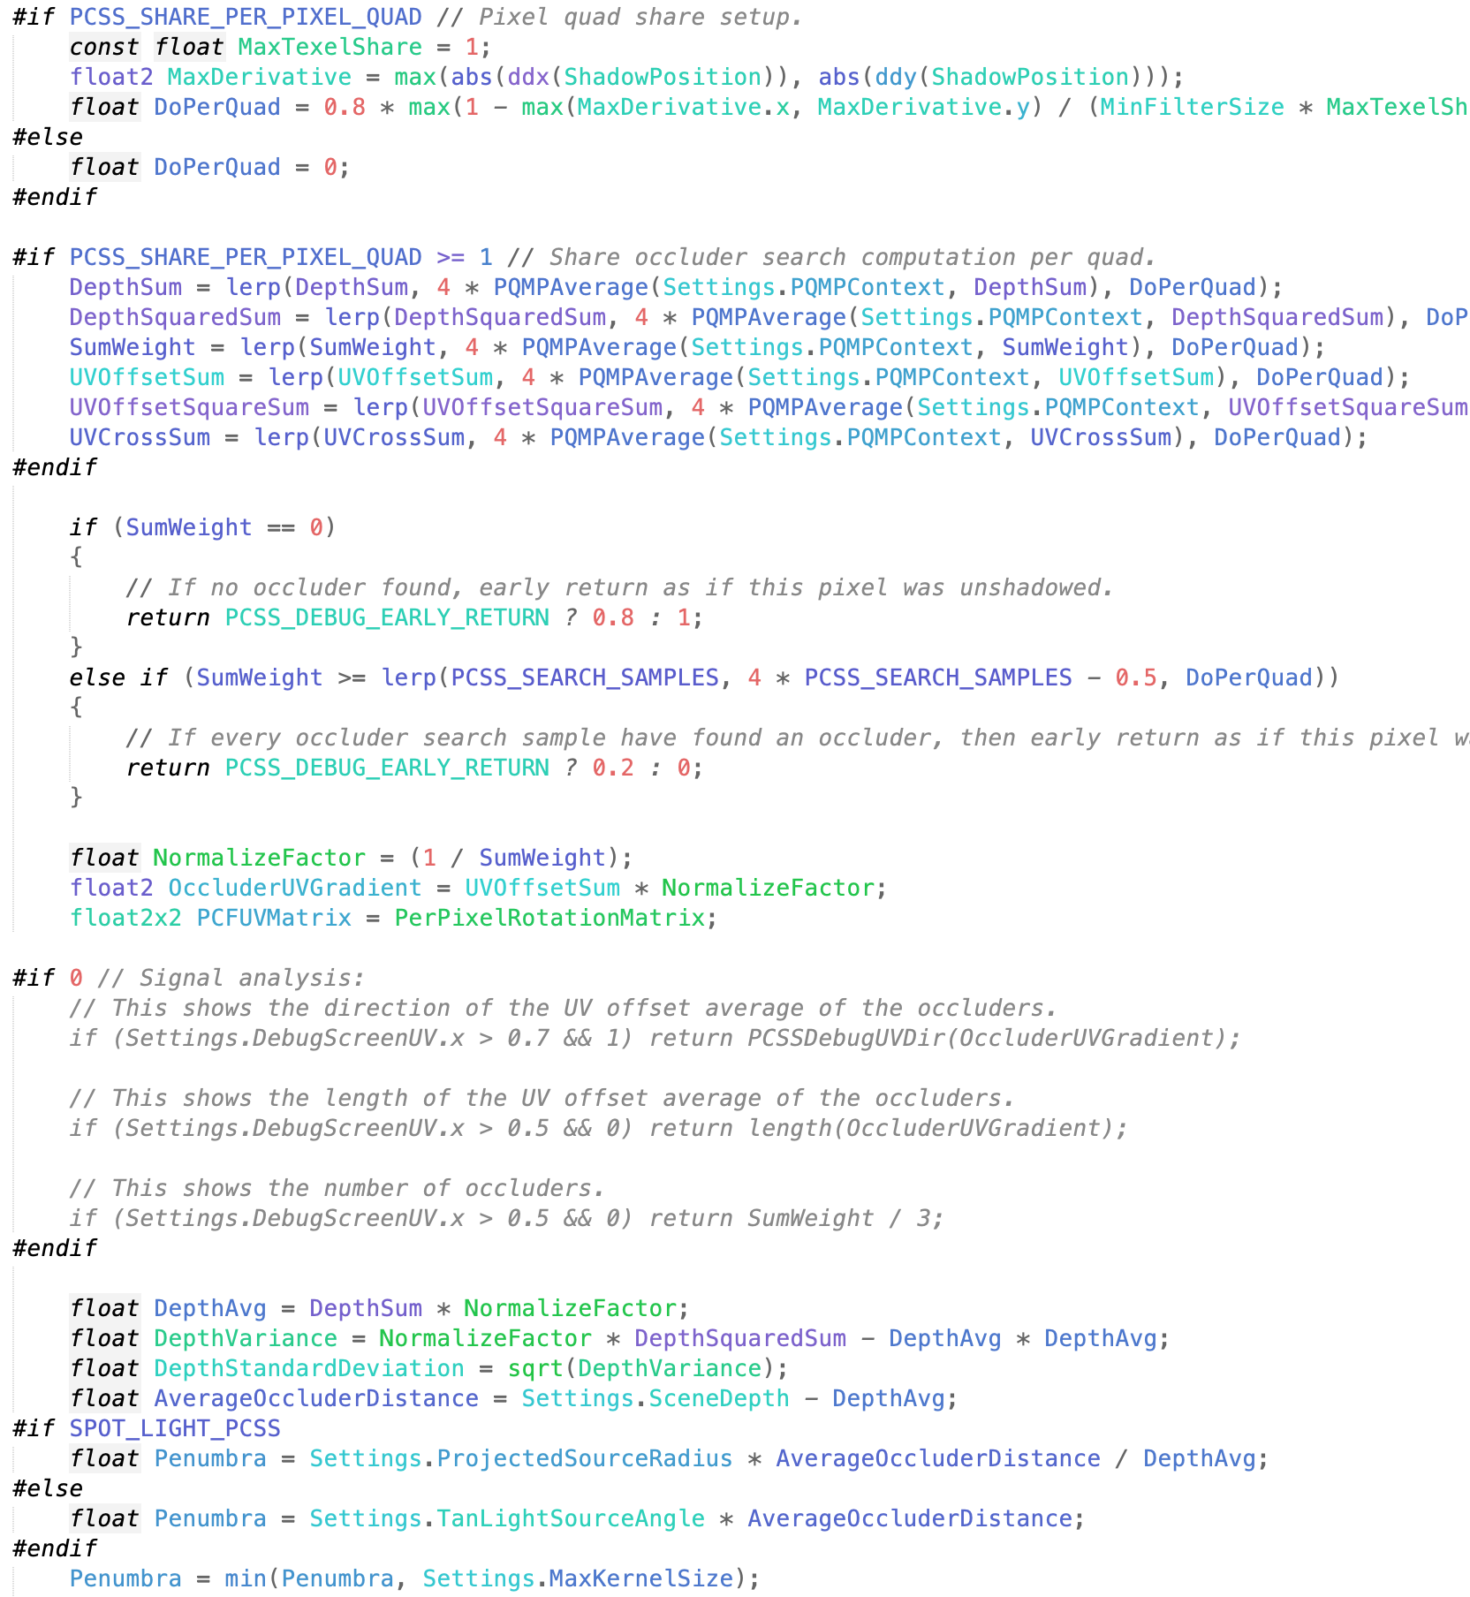
UE5 Shading Language
UE5 shader files (on all platforms) are written in a dialect of HLSL.
HLSL code is translated if necessary
E.g. to GLSL or Apple’s Metal Shading Language

Slide 20
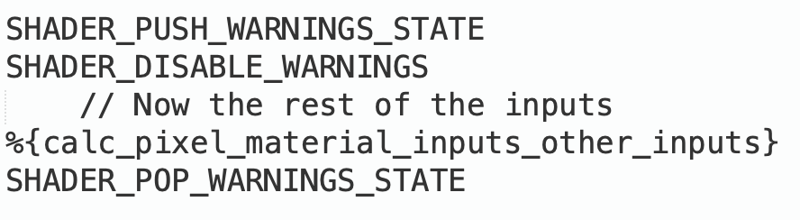
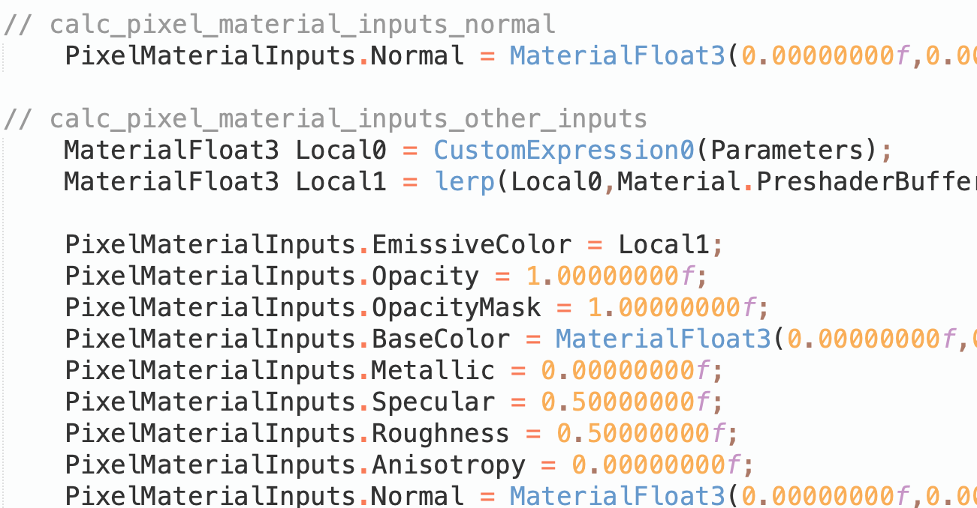
UE5 Shader Internals
Engine shader files live in Engine/Shaders.
  .ush files = Unreal Shader Header
  .usf files = Unreal Shader File
MaterialTemplate.ush is the boilerplate template for all Materials.
  %{…} = Where new code bits go.
  Material Editor > Window > Shader Code > HLSL Code = Where you can see the code that’ll be used.

Slide 21
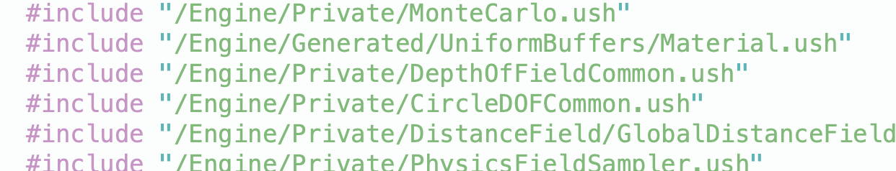
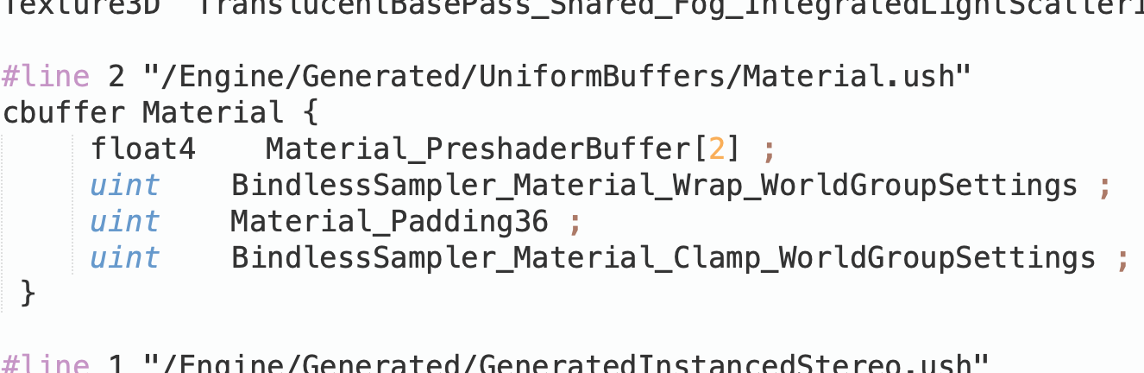
Deep UE5 Shader Details
The HLSL Code just shows the template bits.
MaterialTemplate.ush has #includes (including generated ones that don’t even have a file.
Set the r.DumpShaderDebugInfo console variable to 1 (in the Cmd box)
Force the shader to recompile.
  Can even just move a node in the Material Editor and then click “Apply”.
  Set r.DumpShaderDebugInfo back to 0 to avoid filling up your disk with shader files.
In your project, look in Saved/ShaderDebugInfo for any of the TBasePassPS files.

Slide 22
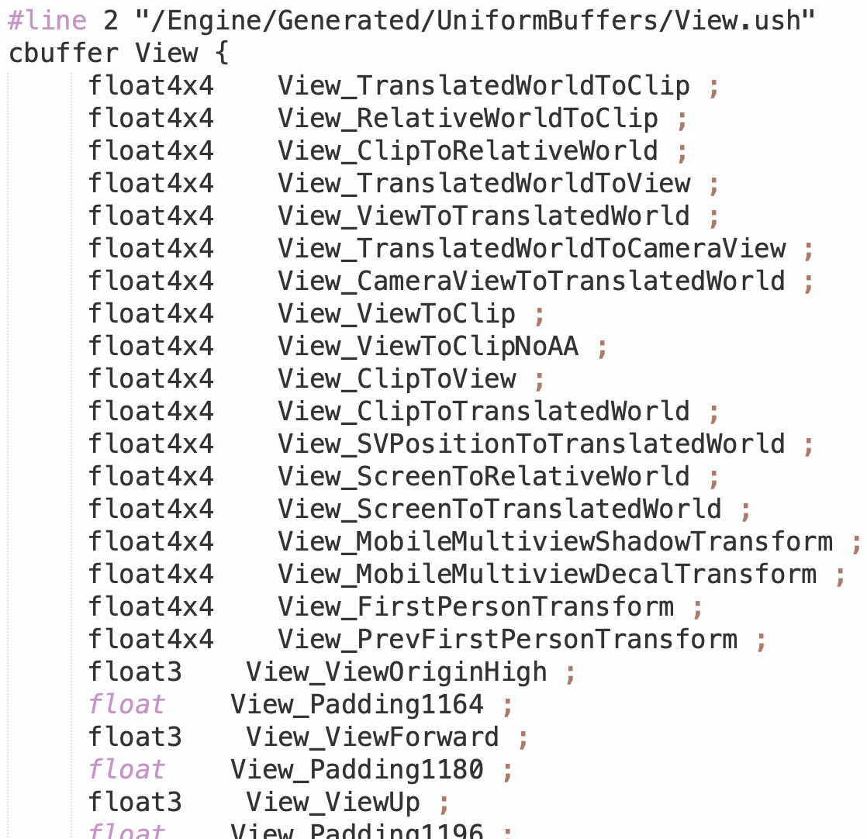
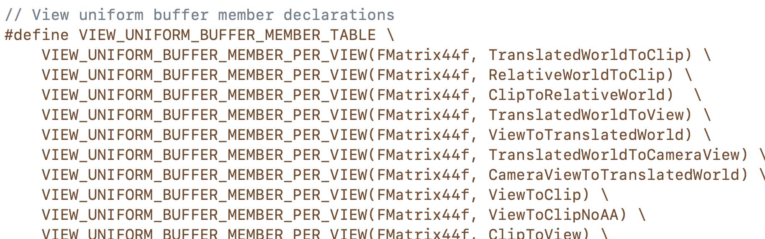
Getting Data into Shaders (Cbuffers)
Constant Buffers
Fast, same values for every pixel/vertex.
  Constant across pixels, not from frame to frame, or necessarily even from object to object.
Used for Primitive and View structs. Definitions must match in CPU and shader code.
UE5 defines in C++ code, then auto-generates shader code to match (e.g., View struct is defined in SceneView.h).
How to find out that the View struct is defined in SceneView.h?
Find something reasonably unique looking in the shader definition (e.g., TranslatedWorldToClip).
Search for it in .h files (or .h and .cpp).
In this case, a single .h file hit is the right place!

Slide 23
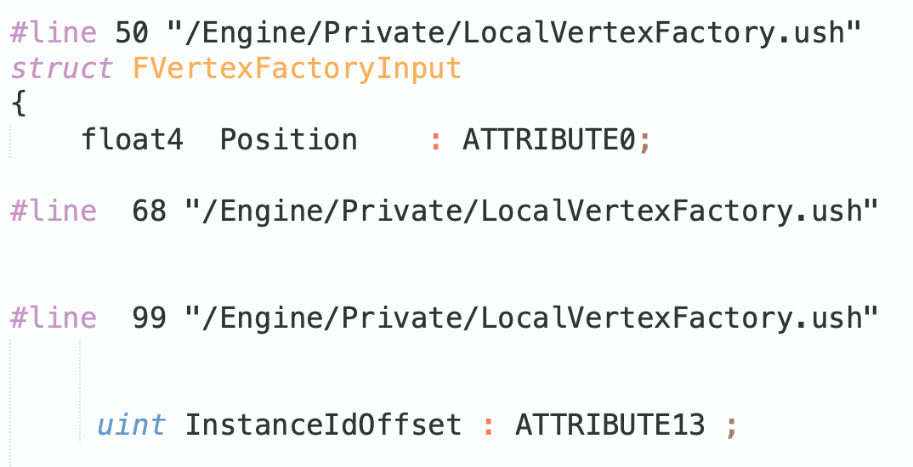
Getting Data into Shaders (Vertex Data)
Vertex Buffers
Struct of data per vertex, optionally containing position, normal, UV coordinates, etc.
Array of these for the CPU, one element per thread in the vertex shader.
Vertex buffers are generated by UE5 vertex factories.
Index Buffers
Array of integers.
GPU uses to tell which vertices go together.

Slide 24
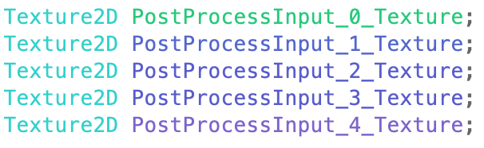
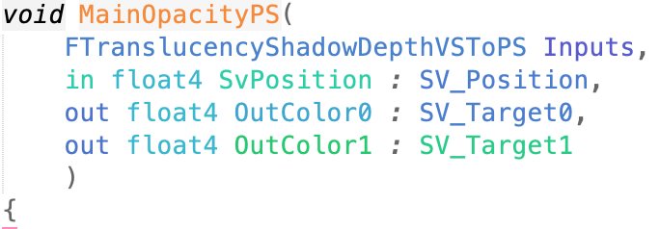

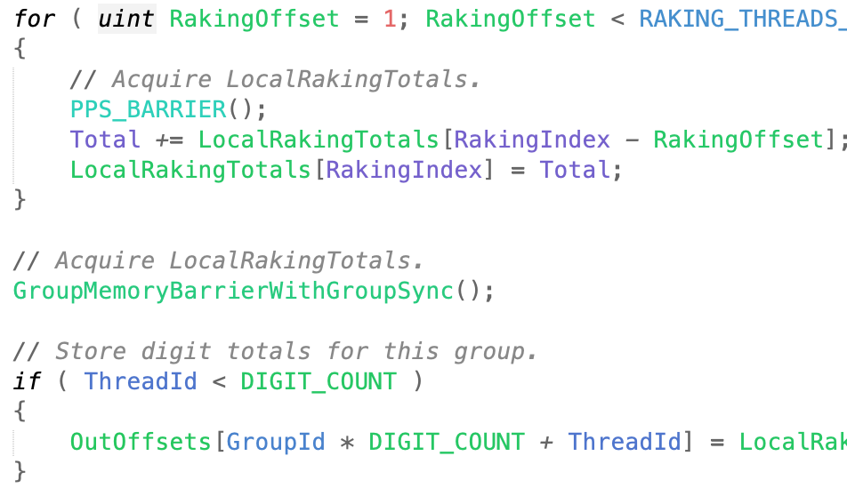
Getting Data into Shaders (Buffers and Textures)
Large memory buffers can have multiple views.
Shader Resource View (SRV): Read Only
  Texture2D, Texture3D, etc.
Render Target View: Write Only
  Limited number of outputs per pixel shader.
Unordered Access View (UAV): Read/Write
  Buffer<uint>.
  Access as array from shader.
  Atomic access functions if there might be overlap.
GPU may need to do a transition or resolve to change access type and to make sure all writes are done before you start reading or all reads are done before you write.

Slide 25
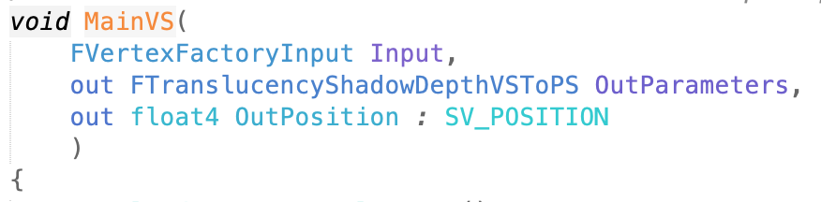
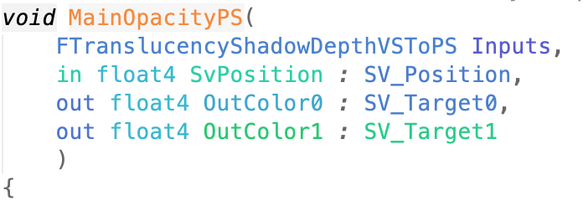
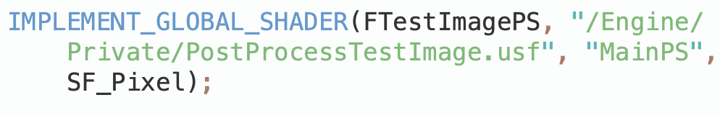
Shader Functions
Each shader stage = function.
  Usually with a name like “MainVS” for a vertex shader, or “MainPS” for a pixel shader, but that’s just UE5 convention.
UE5 Internal IMPLEMENT_*_SHADER macro
  Shader class
  Shader .usf file
  Function name in the usf
  Shader type

Slide 26
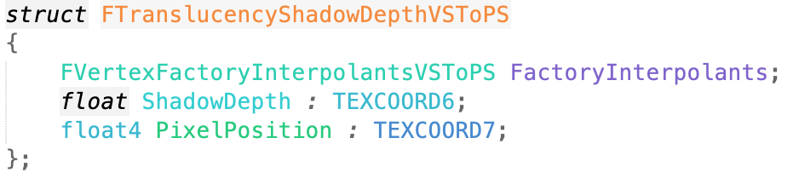
Shader Stage I/O
Input
  Parameters or struct.
  Label with special hardware semantics.
    Tells the GPU if this parameter has special meaning.
Output
  “out” parameters, struct or function return value.
  Label with semantics.
Output from one stage should match input to next.

Slide 27
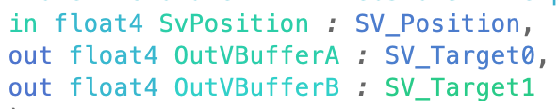
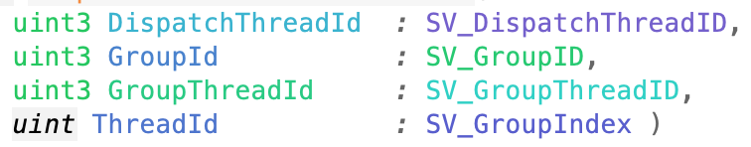
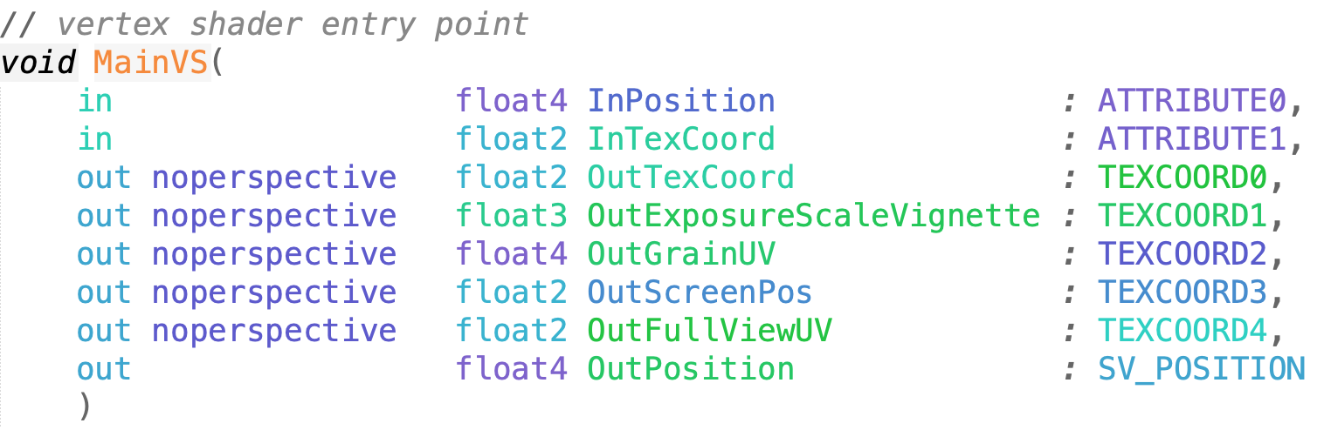
Hardware Semantics
Vertex Input
  Position, Texcoord, Color, …
    Convention, but no meaning to GPU.
  SV_VertexID (SV = system value).
Vertex Output
  SV_Position (used by rasterizer).
Vertex to Pixel
  On some GPUs, this is limited by the number of hardware interpolators.
  Make sure you don’t run out by using some semantic tag for every vertex-to-pixel parameter with size up to float4 (e.g. TEXCOORD3 for some OutScreenPos)
Pixel Output
  Color (RGBA) or SV_Target* for many.

