Slide 1
Advanced Plugins

Slide 2
Modules and Plugins

Slide 3
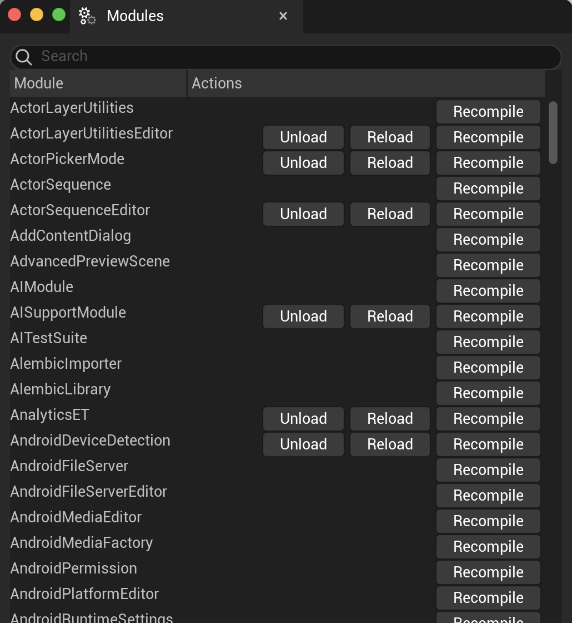
Modules
The Unreal Engine is structured as modules, each compiled separately and dynamically loaded.
(Most) modules can be loaded, unloaded, or recompiled without needing to restart the engine.
Each module has its own Build.cs file, an interface derived from IModuleInterface, and uses the IMPLEMENT_MODULE macro to declare the module name and add the necessary initialization code.

Slide 4
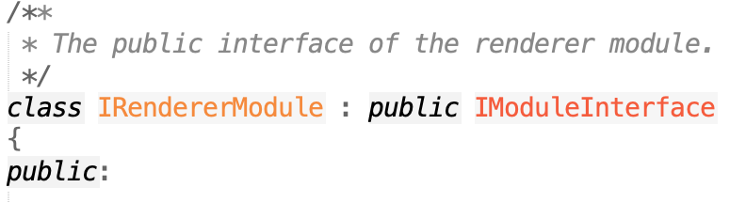
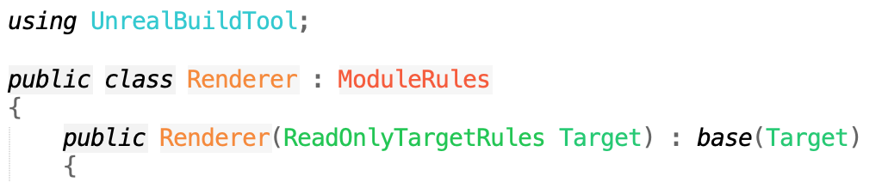
Module Discovery
In RenderInterface.h: Interface derived from IModuleInterface
So . . . how does the engine know what’s in a module?
To explicitly use functions or classes in other modules, you must add the other module as a dependency in your Build.cs.
Look for a MODULE_API macro, #include of a module interface header, or Build.cs to find the module name.
In Renderer.cpp: Add module implementation code
In Renderer.Build.cs: Module build code

Slide 5
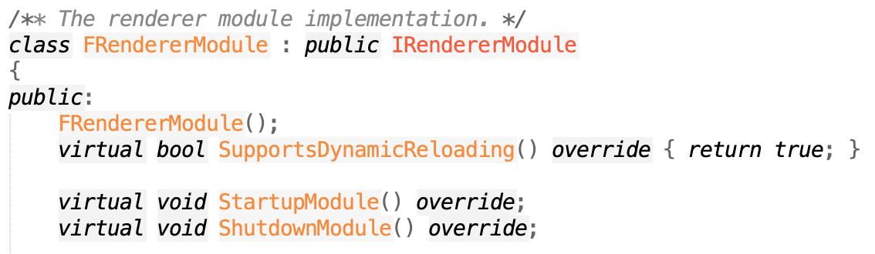
Module Discovery
In RenderModule.h: Module class, including overrides for StartupModule and ShutdownModule
Many modules rely on automatic discovery. To register your plugin you can:
Register delegate functions on load.
A Default Object is constructed for every UObject. Registration code in the constructor run on load.
Accessible as ClassName::StaticClass()
Can also do it in StartupModule.
Register directly with another module.
Use UnrealBuildTool reflection macros (UCLASS, UFUNCTION, UPROPERTY, …) , which generate registration code.

Slide 6
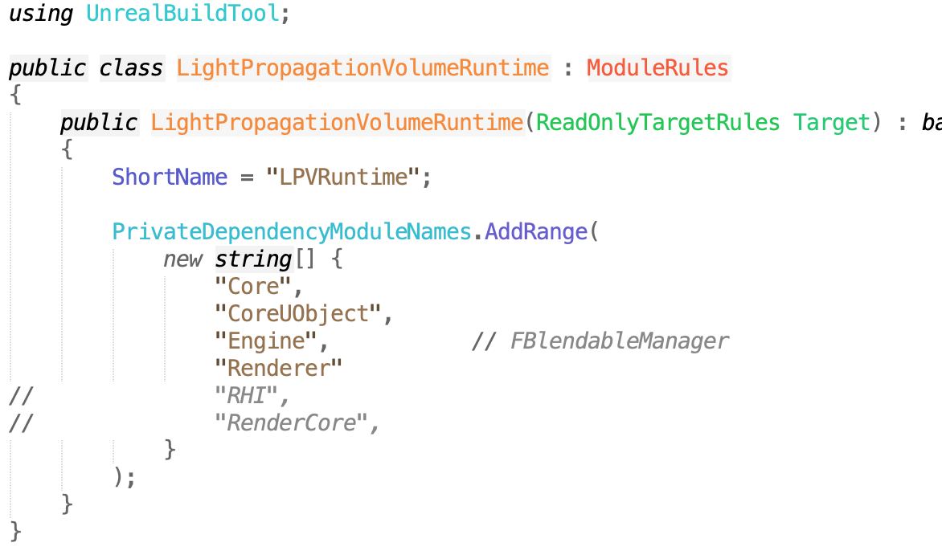
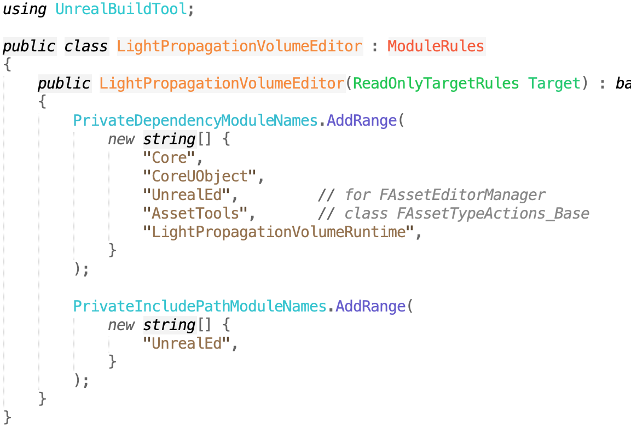
Modules and Plugins
Plugins are modules and add functionality in the same way as core engine modules.
Plugins can:
Declare functions another module can call.
Declare types or functions that will be found through one of the engine discovery methods (UnrealBuildTool macros, new delegates, etc.).
Most plugins will either be a single module, or one for code only needed in the Editor, and a separate one for code needed at game runtime.

Slide 7
What Can Plugins Do?

Slide 8
Plugins by Example
Experimental/AppleVision
Experimental/ChaosCloth
Experimental/StereoPanorama
Experimental/CodeEditor
Experimental/BackChannel
Experimental/BlueprintStats
Experimental/Shotgun
Experimental/SkeletalReduction
Experimental/VirtualProductionUtilities
Experimental/PythonScriptPlugin
Experimental/AlembicImporter
Experimental/ChaosNiagara
Experimental/FieldSystemPlugin
Experimental/ChaosSolverPlugin
Experimental/Phya
Experimental/ImagePlate
Experimental/SimpleHMD
Experimental/PixelStreaming
Experimental/VirtualCamera
Experimental/ProxyLODPlugin
Experimental/ControlRig
Experimental/AR
Experimental/BlastPlugin
Experimental/Gauntlet
Experimental/PlatformCrypto
Experimental/RemoteSession
Experimental/AppleImageUtils
Experimental/GeometryCache
Experimental/CharacterAI
Experimental/HTML5Networking
Experimental/RawInput
Experimental/GeometryCollectionPlugin
Experimental/CodeView
Developer/AnimationSharing
Developer/CodeLiteSourceCodeAccess
Developer/KDevelopSourceCodeAccess
Developer/Concert
Developer/ActorLayerUtilities
Developer/RenderDocPlugin
Developer/BlankPlugin
Developer/UObjectPlugin
Developer/VisualStudioCodeSourceCodeAccess
Developer/VisualStudioSourceCodeAccess
Developer/SubversionSourceControl
Developer/CLionSourceCodeAccess
Developer/OneSkyLocalizationService
Developer/XCodeSourceCodeAccess
Developer/PerforceSourceControl
Developer/NullSourceCodeAccess
Developer/GitSourceControl
Blendables/LightPropagationVolume
Portal/LauncherChunkInstaller
ScriptGeneratorPlugin/Resources
MovieScene/ActorSequence
MovieScene/MatineeToLevelSequence
MovieScene/SequencerScripting
MovieScene/LevelSequenceEditor
Enterprise/DatasmithContent
Enterprise/VariantManagerContent
Lumin/MagicLeapCamera
Lumin/MagicLeap
Lumin/MagicLeapScreens
Lumin/MagicLeapMedia
Importers/USDImporter
VirtualProduction/Takes
FX/Niagara
FX/HoudiniNiagara
FX/NiagaraExtras
Runtime/CableComponent
Runtime/RuntimePhysXCooking
Runtime/LeapMotion
Runtime/Database
Runtime/ProceduralMeshComponent
Runtime/WindowsMixedReality
Runtime/Spatialization
Runtime/ResonanceAudio
Runtime/WebMMoviePlayer
Runtime/Steam
Runtime/SunPosition
Runtime/MixedRealityCaptureFramework
Runtime/OpenXR
Runtime/WindowsDeviceProfileSelector
Runtime/LocationServicesIOSImpl
Runtime/WebBrowserWidget
Runtime/AndroidMoviePlayer
Runtime/ApexDestruction
Runtime/CustomMeshComponent
Runtime/AndroidPermission
Runtime/Oculus
Runtime/EditableMesh
Runtime/Synthesis
Runtime/ReplicationGraph
Runtime/SoundUtilities
Runtime/LocationServicesAndroidImpl
Runtime/MobilePatchingUtils
Runtime/Firebase
Runtime/SoundMod
Runtime/Nvidia
Runtime/WindowsMoviePlayer
Runtime/PreLoadScreenMoviePlayer
Runtime/HTTPChunkInstaller
Runtime/MeshReconstruction
Runtime/nDisplay
Runtime/AudioCapture
Runtime/OptionalMobileFeaturesBPLibrary
Runtime/SignificanceManager
Runtime/AR
Runtime/Advertising
Runtime/GameplayAbilities
Runtime/MIDIDevice
Runtime/AnimDistanceMatching
Runtime/ExampleDeviceProfileSelector
Runtime/SoundVisualizations
Runtime/IOSDeviceProfileSelector
Runtime/PhysXVehicles
Runtime/AppleMoviePlayer
Runtime/AndroidDeviceProfileSelector
Runtime/LinuxDeviceProfileSelector
Runtime/LocationServicesBPLibrary
Runtime/ArchVisCharacter
Runtime/PacketHandlers
Runtime/GoogleVR
Runtime/GoogleCloudMessaging
Runtime/TimeSynth
Runtime/Analytics
Runtime/AnimationBudgetAllocator
Tests/FbxAutomationTestBuilder
Tests/ScreenshotTools
Tests/EditorTests
Tests/RuntimeTests
Tests/FunctionalTestingEditor
Animation/LiveLink
Animation/LiveLinkCurveDebugUI
Slate/SlateRemote
NetcodeUnitTest/NetcodeUnitTest
NetcodeUnitTest/NUTUnrealEngine4
Compositing/OpenColorIO
Compositing/Composure
Compositing/LensDistortion
Compositing/OpenCVLensDistortion
ScriptPlugin/Resources
ScriptPlugin/Source
ScriptPlugin/Binaries
ScriptPlugin/Intermediate
AI/AISupport
AI/HTNPlanner
Online/OnlineSubsystem
Online/OnlineSubsystemOculus
Online/OnlineSubsystemGoogle
Online/OnlineSubsystemAmazon
Online/IOS
Online/Android
Online/OnlineSubsystemTwitch
Online/OnlineSubsystemSteam
Online/VoiceChat
Online/OnlineFramework
Online/OnlineSubsystemFacebook
Online/OnlineSubsystemNull
Online/OnlineSubsystemUtils
Performance/PerformanceMonitor
2D/Paper2D
Messaging/MessagingDebugger
Messaging/TcpMessaging
Messaging/UdpMessaging
Editor/FacialAnimation
Editor/SequenceRecorder
Editor/MobileLauncherProfileWizard
Editor/MaterialAnalyzer
Editor/BlueprintMaterialTextureNodes
Editor/AssetManagerEditor
Editor/GameplayTagsEditor
Editor/EditorScriptingUtilities
Editor/CryptoKeys
Editor/MeshEditor
Editor/MacGraphicsSwitching
Editor/PluginBrowser
Editor/GLTFImporter
Editor/SpeedTreeImporter
Editor/DataValidation
Media/MfMedia
Media/AndroidMedia
Media/MediaCompositing
Media/TimecodeSynchronizer
Media/MediaPlayerEditor
Media/MediaFrameworkUtilities
Media/AudioCaptureTimecodeProvider
Media/ImgMedia
Media/MediaIOFramework
Media/LinearTimecode
Media/WmfMedia
Media/AvfMedia
Media/WebMMedia
Media/AndroidCamera
The best way to see what is possible, and how to do it, is to look at the many engine plugins in Engine/Plugins.
Process:
Find a plugin that does what you want.
Look at its code to see what functions and/or UObject classes it uses or extends.
Search the rest of the plugins and core engine for more examples using the same.
Look for common code (and identify what code you don’t need).
Multiple examples help show what is necessary.
Look for simple examples, or ones closest to what you plan to do.

Slide 9
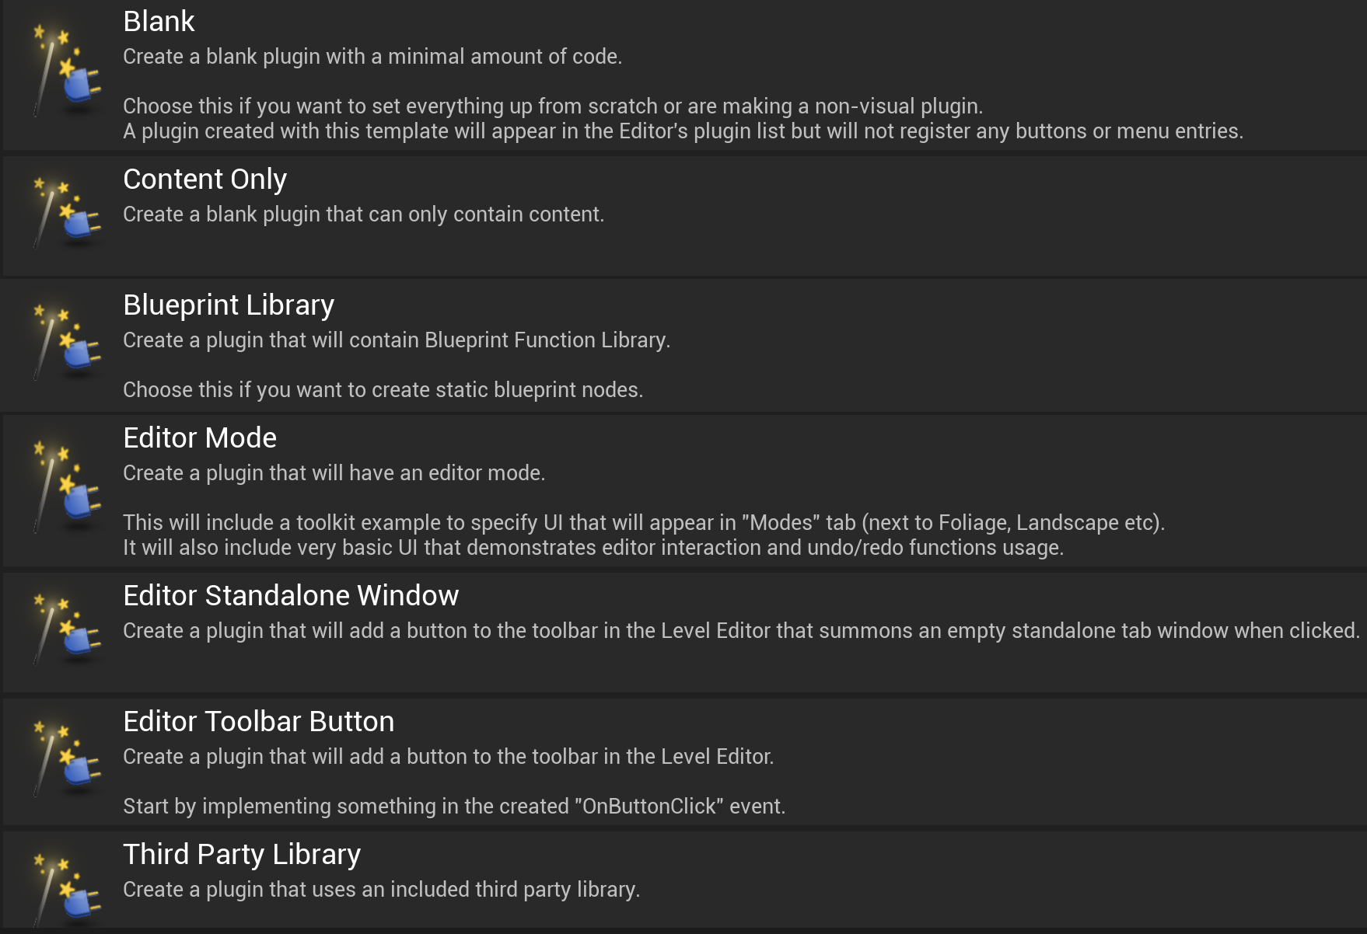
Plugin Templates
Unreal provides templates for a few of the common template types

Slide 10
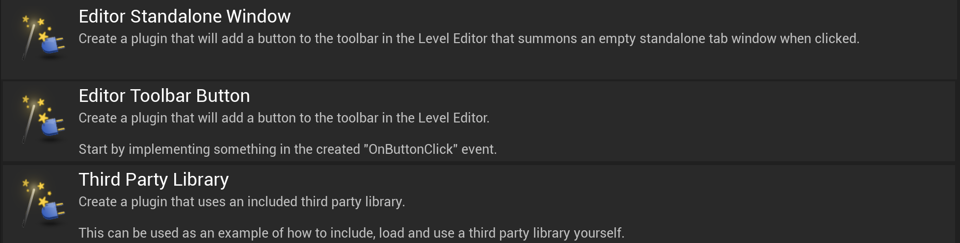
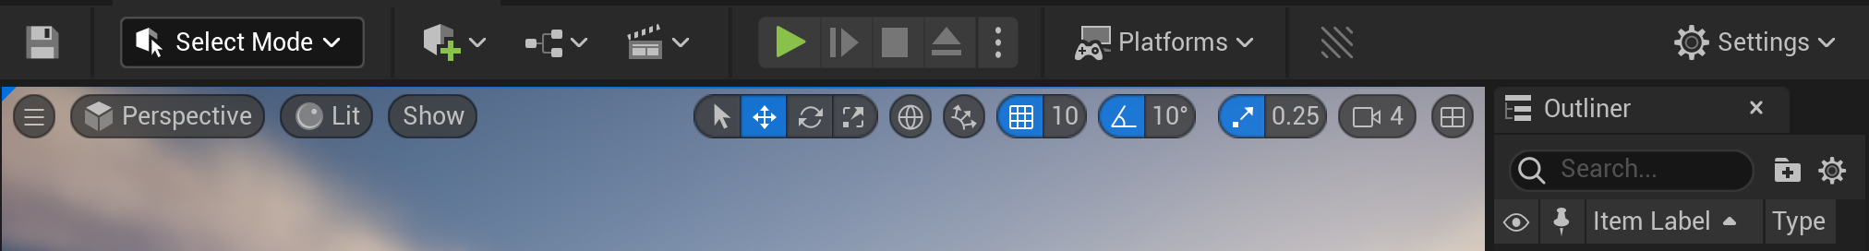
Toolbar Buttons
Create new buttons in the top toolbar of the Editor.
The easiest way to get the basics is to look at the template code.
To implement:
Derive a class from TCommands<FToolbarCommands>.
Register it in StartupModule.

Slide 11
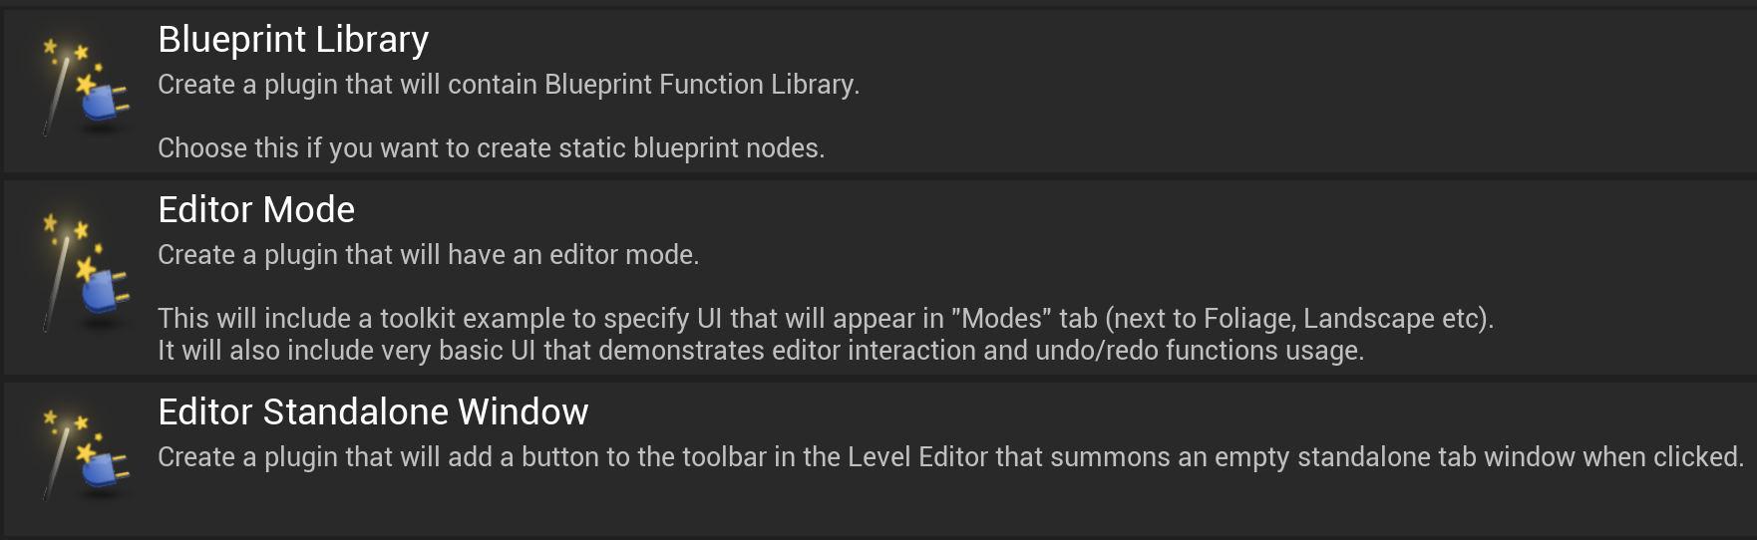
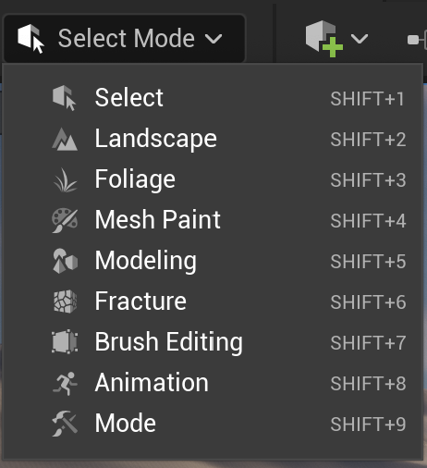
Editor Modes
Add a new Editor mode, like Foliage, etc.
This one also has a template when creating a new plugin.
To implement:
Derive classes from FEdMode and FModeToolkit.
Search for the following in Engine/Plugins to find other, more complete examples:
MeshEditor
ControlRig
SteamAudio
Paper2D

Slide 12
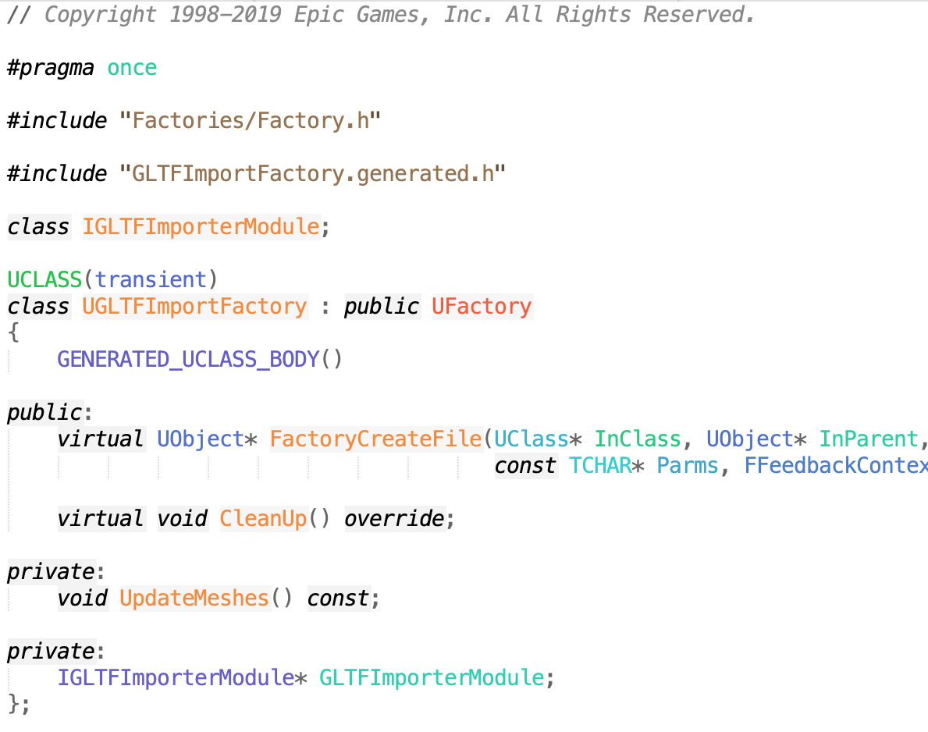
File Importers
A file importer plugin will allow you to import files by dragging them into the Content window or by using the Import button.
To implement:
Derive class from UFactory.
Override UFactory import functions.
Register extensions supported in the constructor.
There is no template for this one, but you can look for existing plugins that add new file importers. GLTF is one example. From that, look for other plugins with FactoryCreateFile:
AlembicImporter
MagicLeapMedia
USDImporter
Several in Media

Slide 13
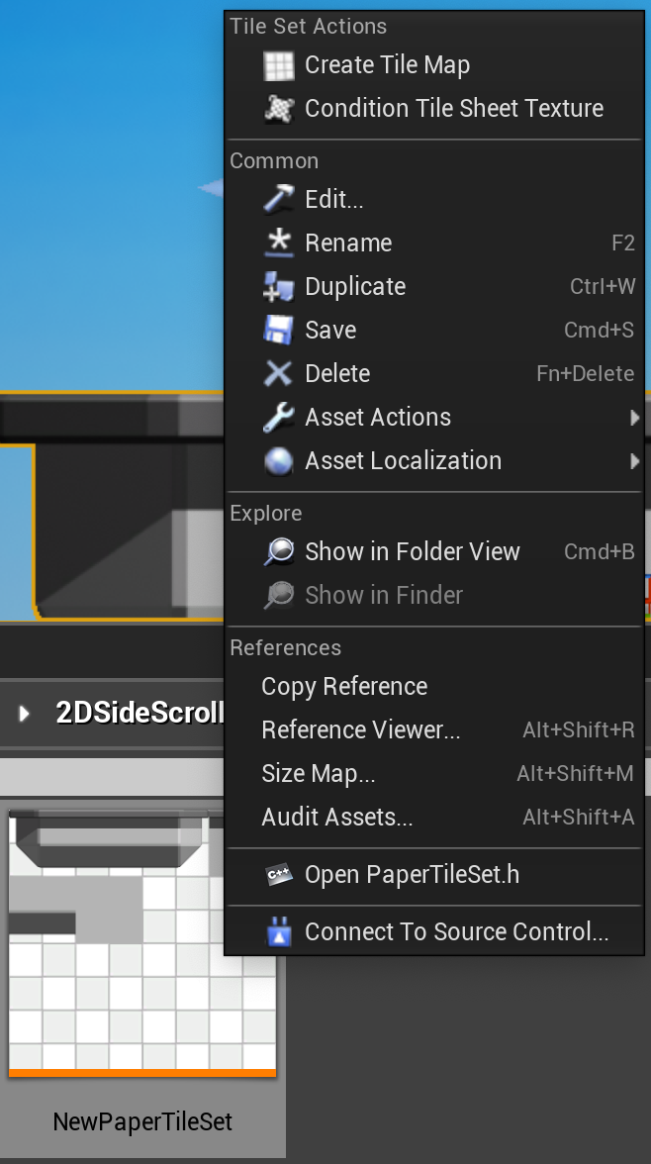
Asset Actions
Plugins can add new operations on existing assets, available through the right-click context menu.
To implement:
Create a new class derived from IAssetTypeActions or FAssetTypeActions_Base.
Override GetActions.
How to find examples:
Find an example like Paper2D.
Search for the action name in the menu, with spaces removed (CreateTileMap).
This search leads to example at FTileSetAssetTypeActions.
Given that, search for GetActions for examples in other plugins.

Slide 14
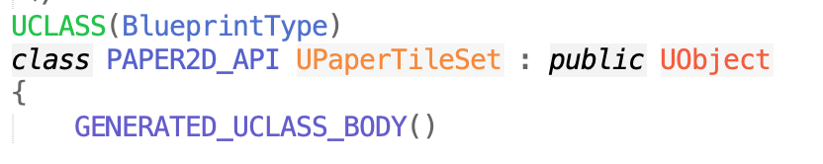
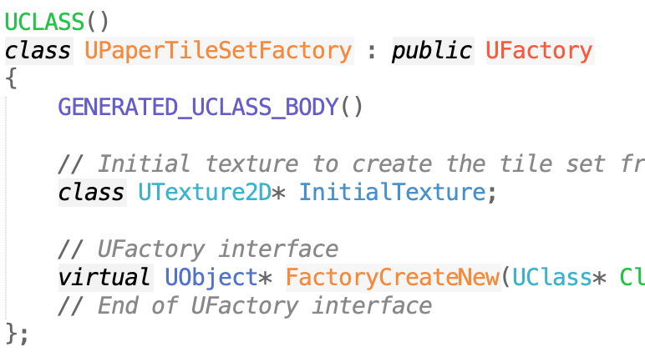
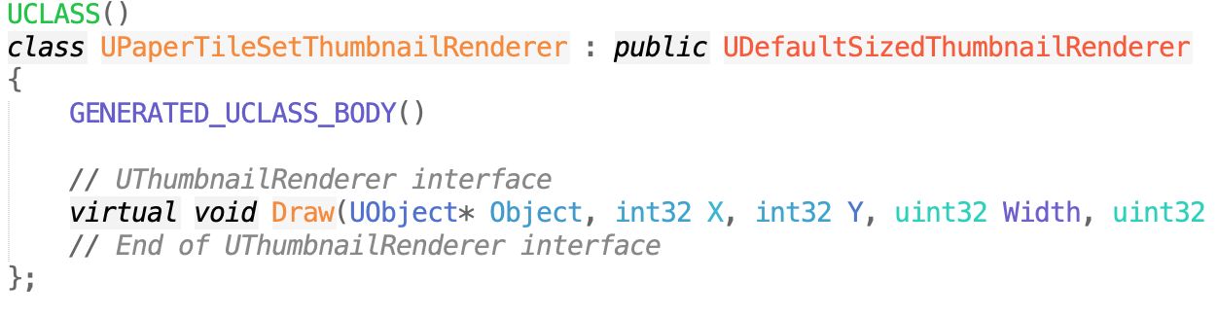
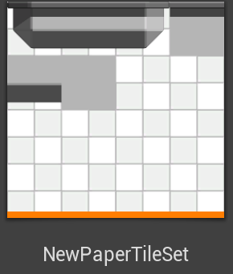
New Asset Types
Plugins can create new asset types can appear in the Content window and be used by Actors and components.
To implement:
Derive from UObject.
Add UFactory class implementing FactoryCreateNew and/or Importer Factory.
Optional: ShouldShowInNewMenu.
Add IAssetTypeActions class to customize name.
Add UThumbnailRenderer class if you want a custom icon.
How to find:
Paper2D is a good starting example again.
Once found, there are 50+ other plugin types.

Slide 15
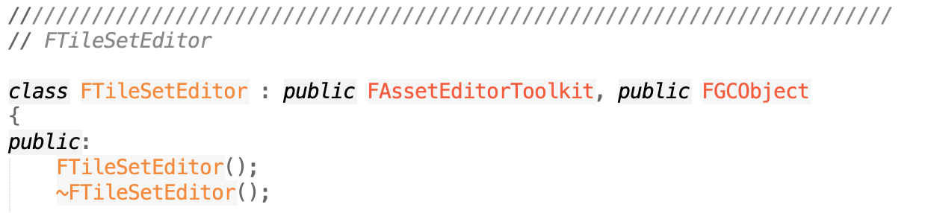
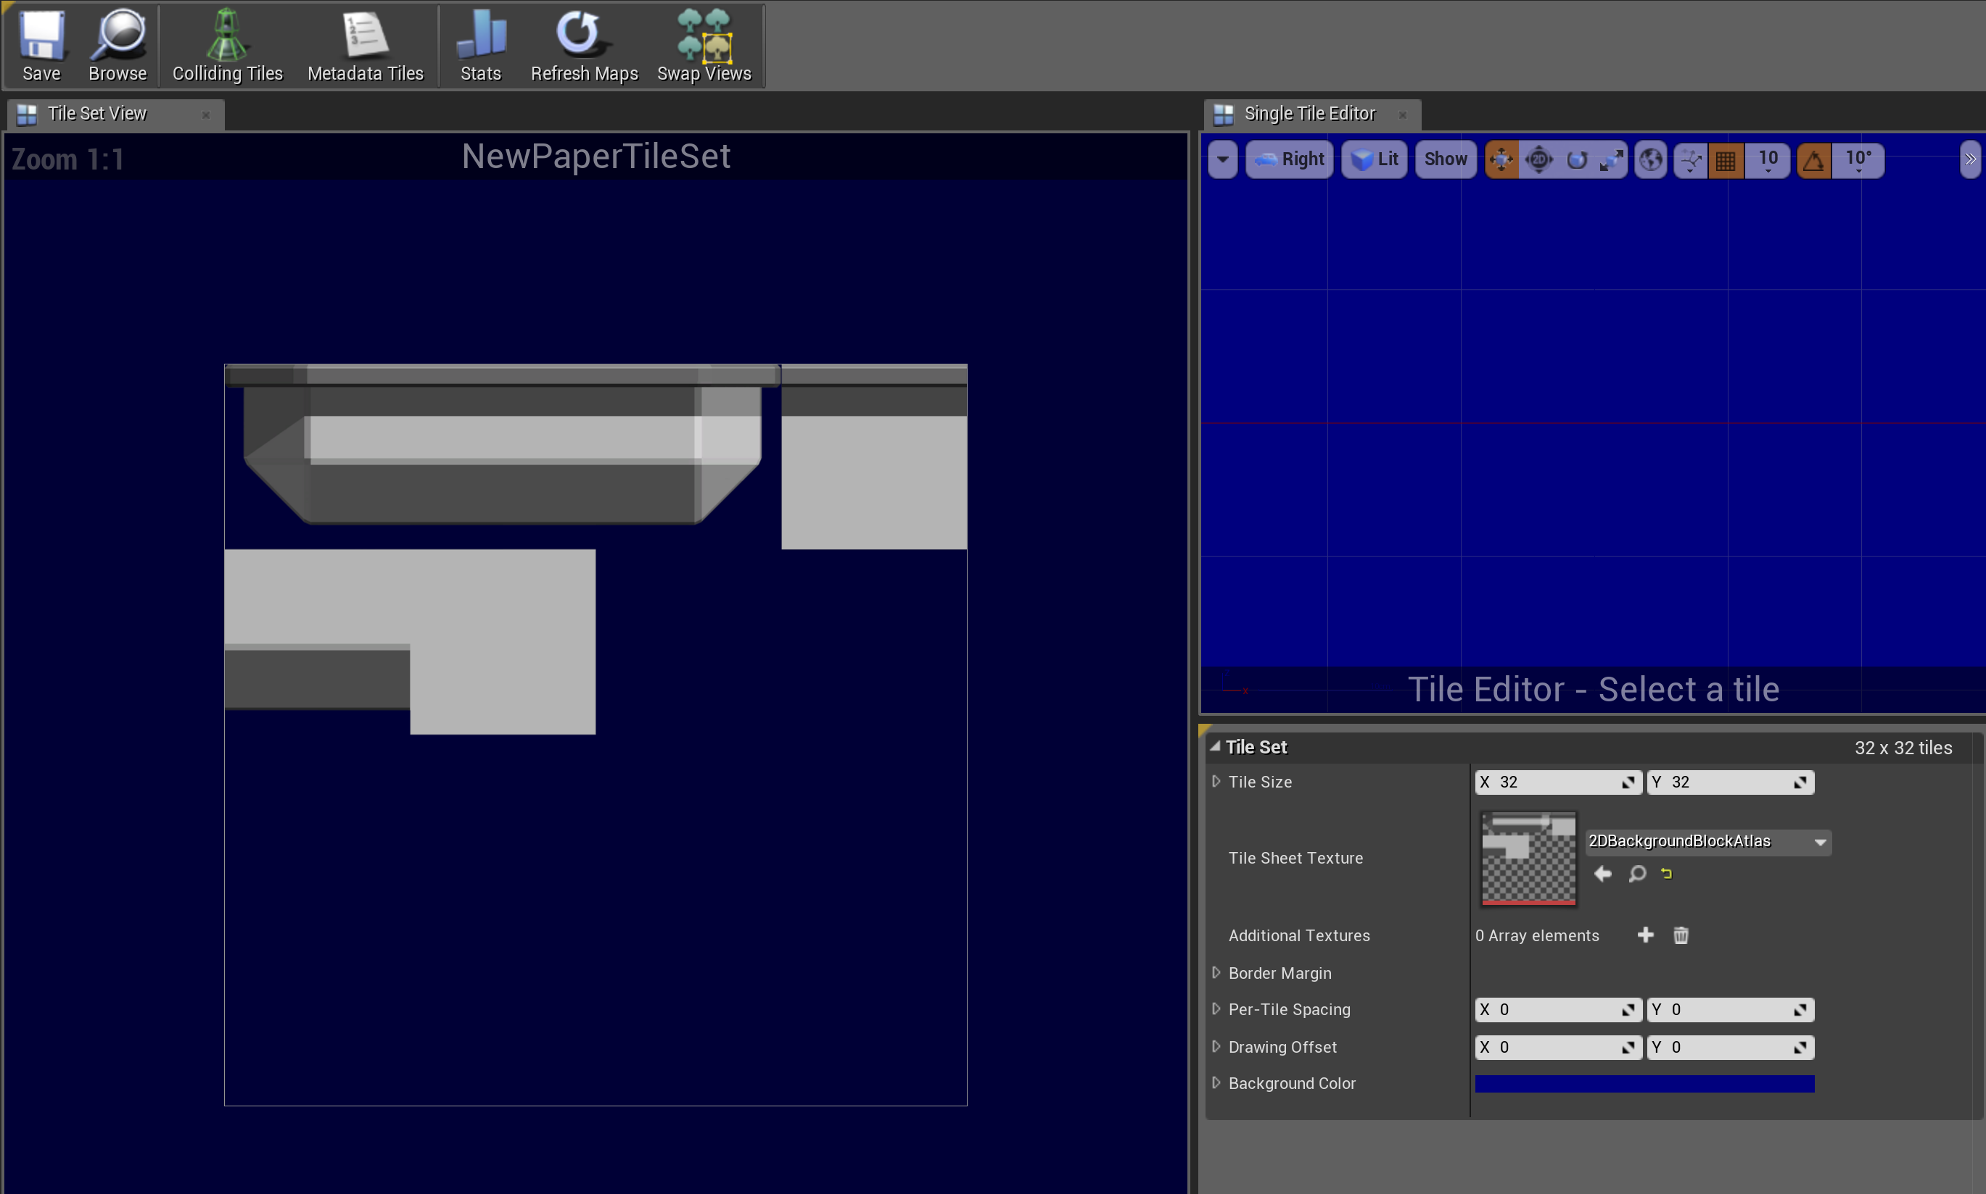
Asset Editor
Any new asset gets a default asset editor window that just opens a Details window on any exposed UPROPERTY data.
Use the “hidecategories” UCLASS tag to hide properties you don’t want to show up, like parent class properties.
You can make a new custom asset editor by extending FAssetEditorToolkit.
Building a new asset editor can be quite involved, essentially a mini-app for editing an asset, with its own window, tabs, and widgets.

Slide 16
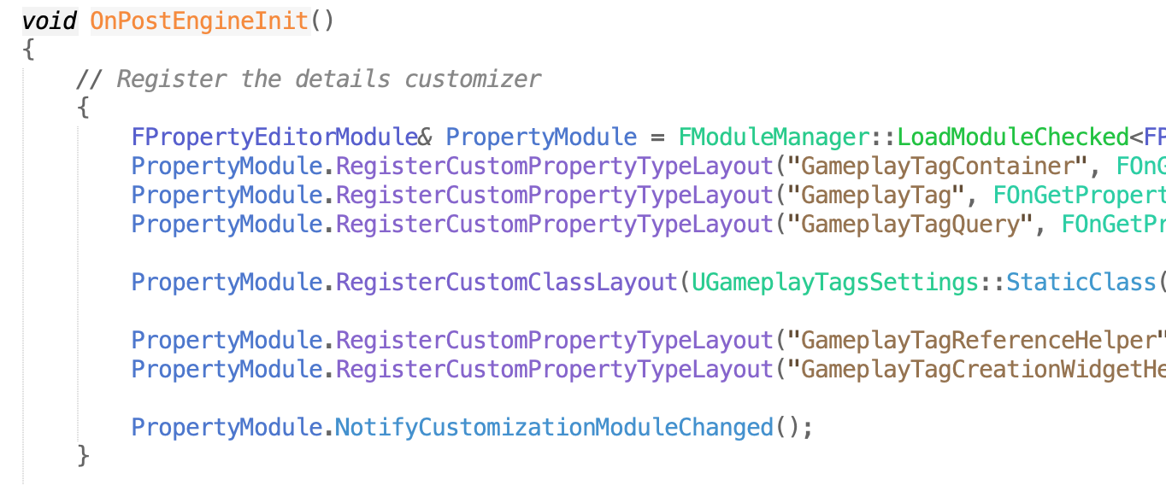

Details Panel Widgets
Instead of a full asset editor, for simple types you can create a new Details panel widget.
Derive a new class from IPropertyTypeCustomization.
Register by calling RegisterCustomPropertyTypeLayout.
Good examples can be found in GameplayTagsEditor.

Slide 17
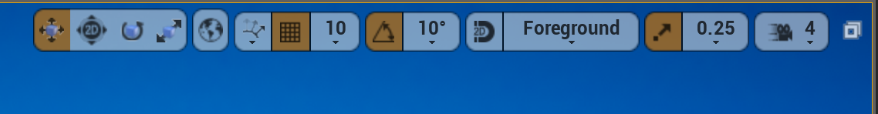
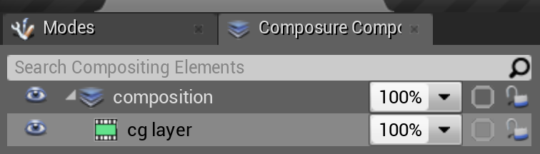
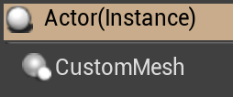
More…
Look through the Plugins and Engine Modules for other things that can be extended with plugins:
New snapping modes
New viewport buttons
New windows/tabs
New components
Postprocessing
. . .

