Slide 1
Navigating a Large Codebase

Slide 2

What is a Large Codebase
The Unreal Engine is
  40M lines of C++ in 155K files
  1.3M lines of C# in 6.2K files
  401K lines of shader code in over 1500 files
And you didn’t write it.
No one person did.

Slide 3
Tools of the Trade

Slide 4
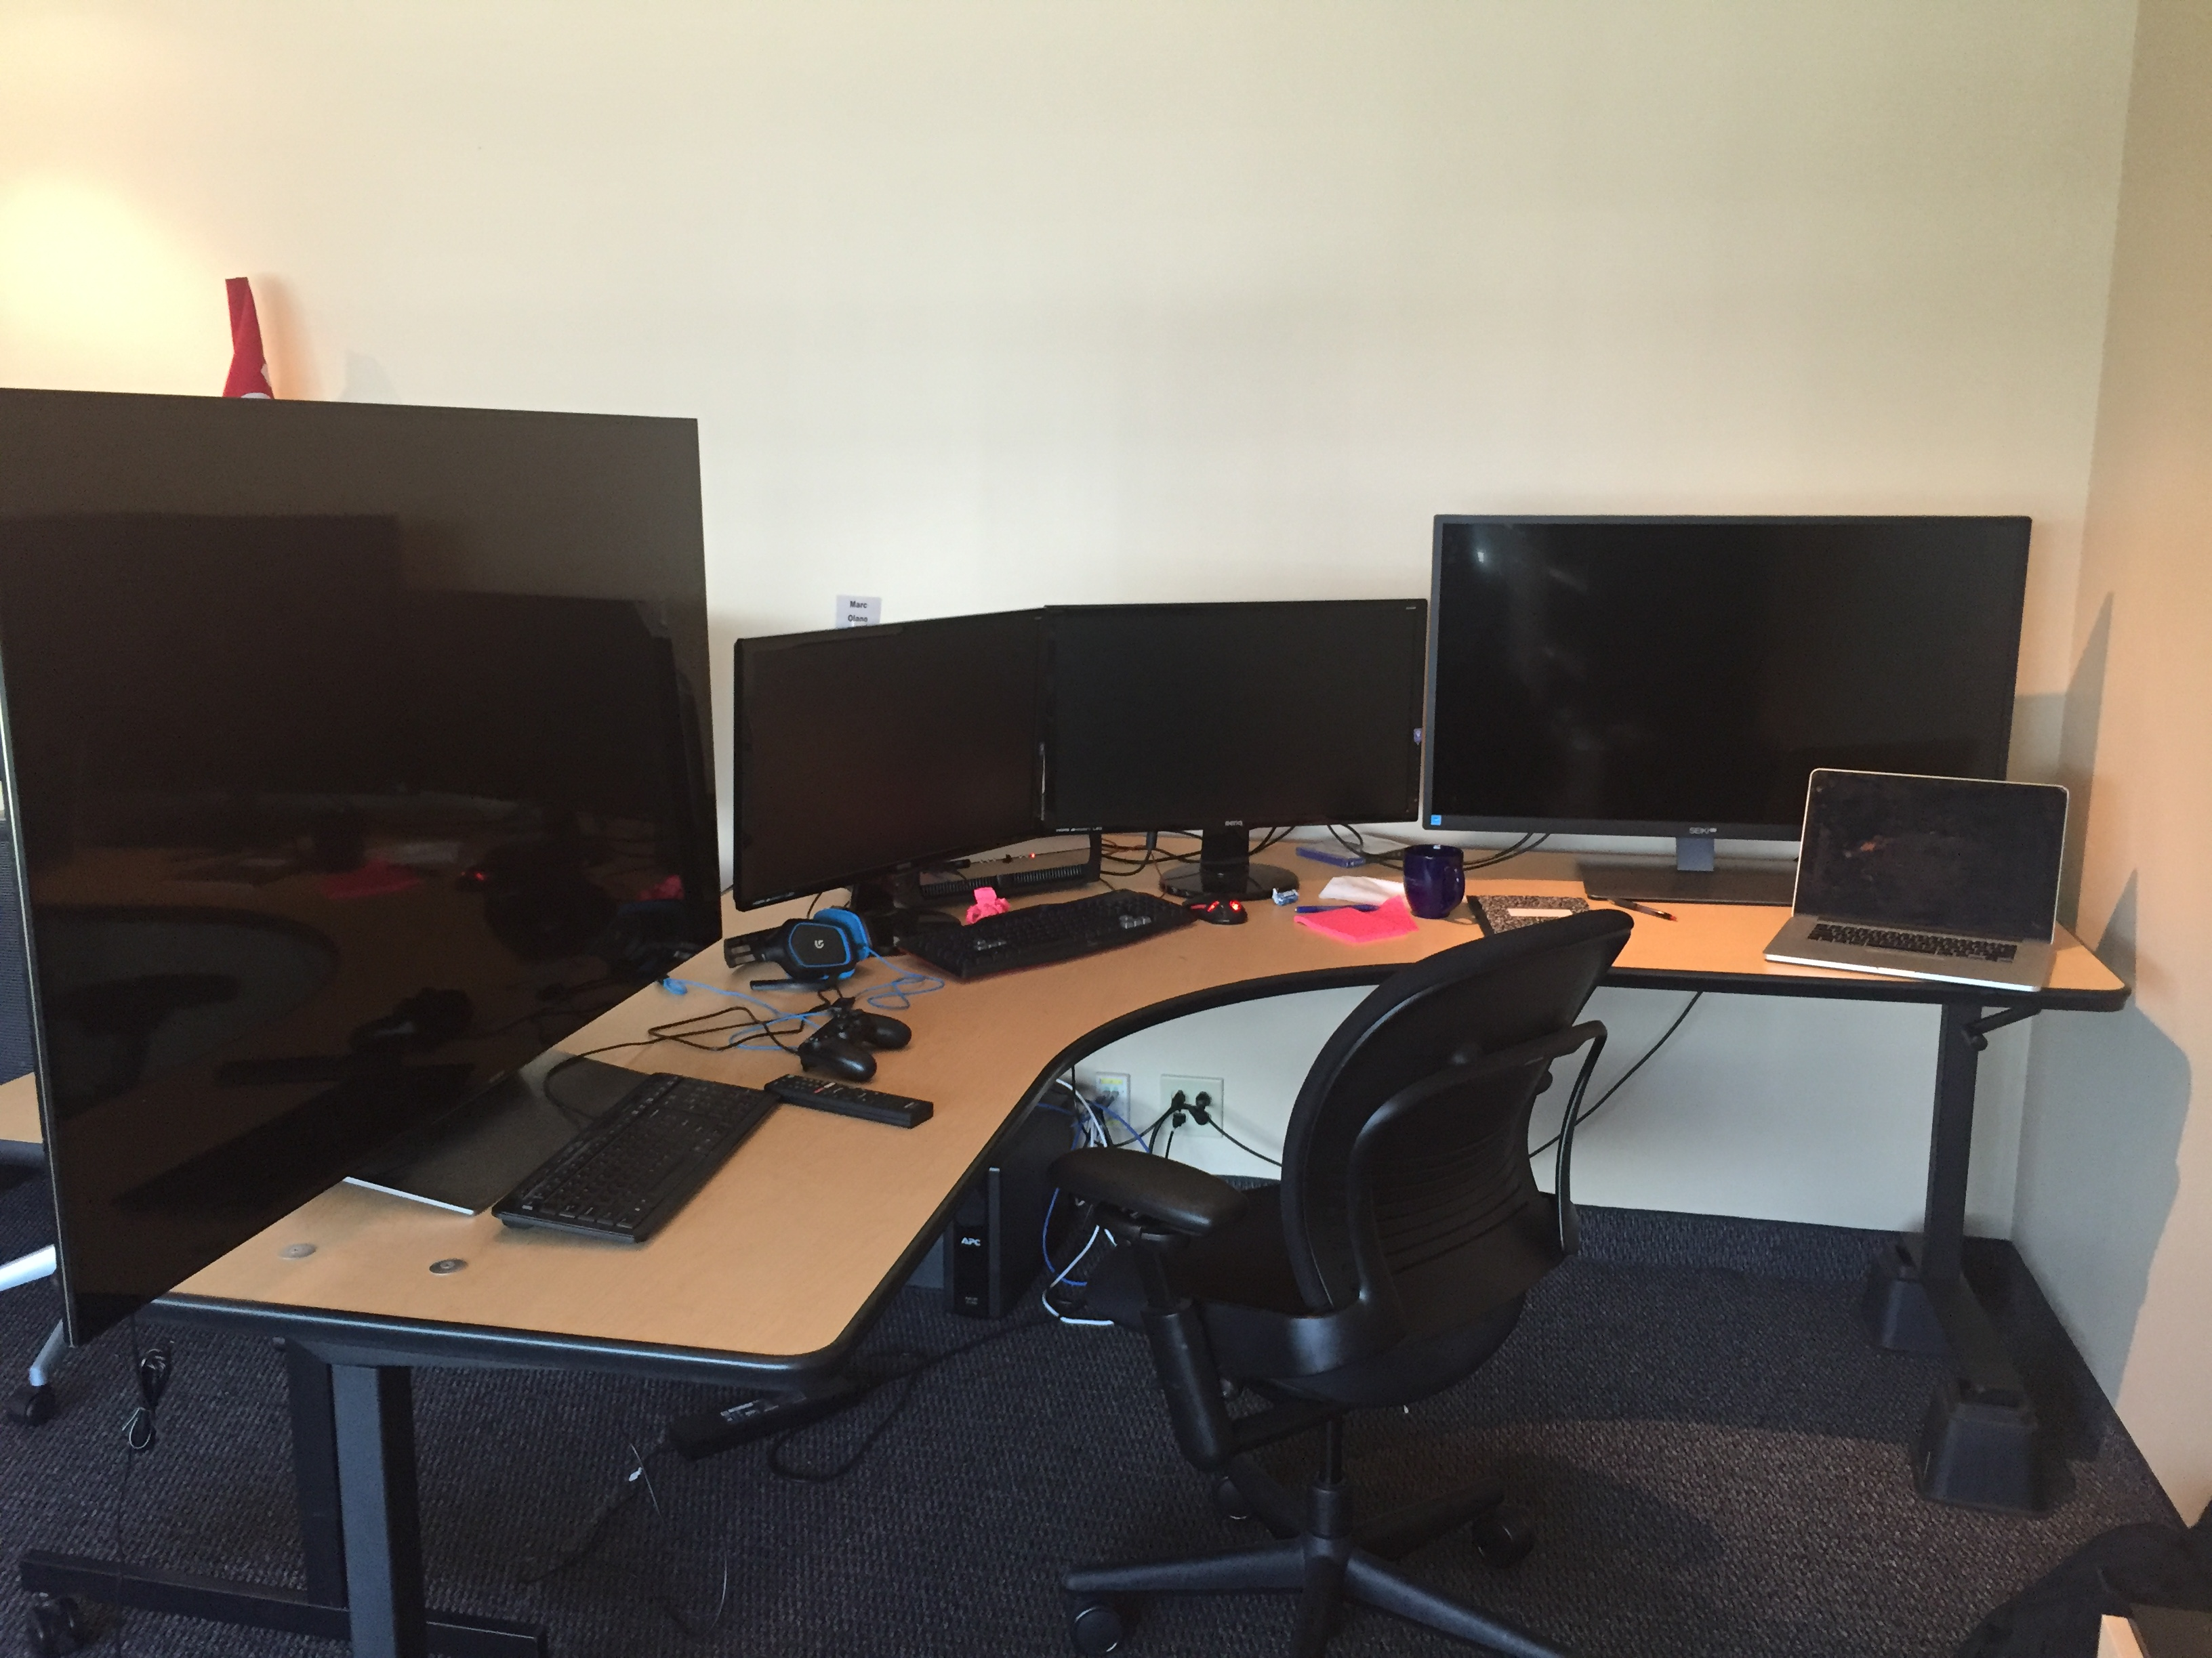
Notepad
You’ll need paper or a text editor for notes.
Write down what’s going on: sequence of operations, interesting files and functions, etc. It’s hard to keep everything in your head, especially when first figuring something out. Notes can serve as that storage and as reminders.
Consider writing your notes as a blog post or wiki to your future self.
You can also bookmark locations in your IDE.

Slide 5
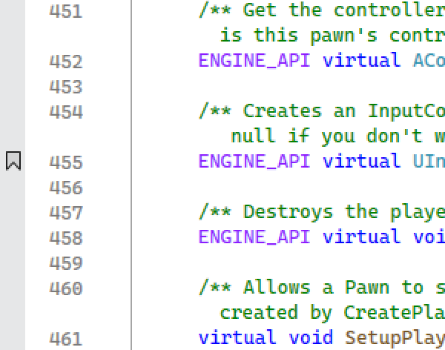
Learn your IDE
Visual Studio:
Set a bookmark with Ctrl-K Ctrl-K.
  Bookmark window: Ctrl-K Ctrl-W. Next/Previous bookmarks Ctrl-K Ctrl-N / Ctrl-K Ctrl-P.
Search for files by name in the Solution Explorer
Jump to a class definition with F12

Slide 6
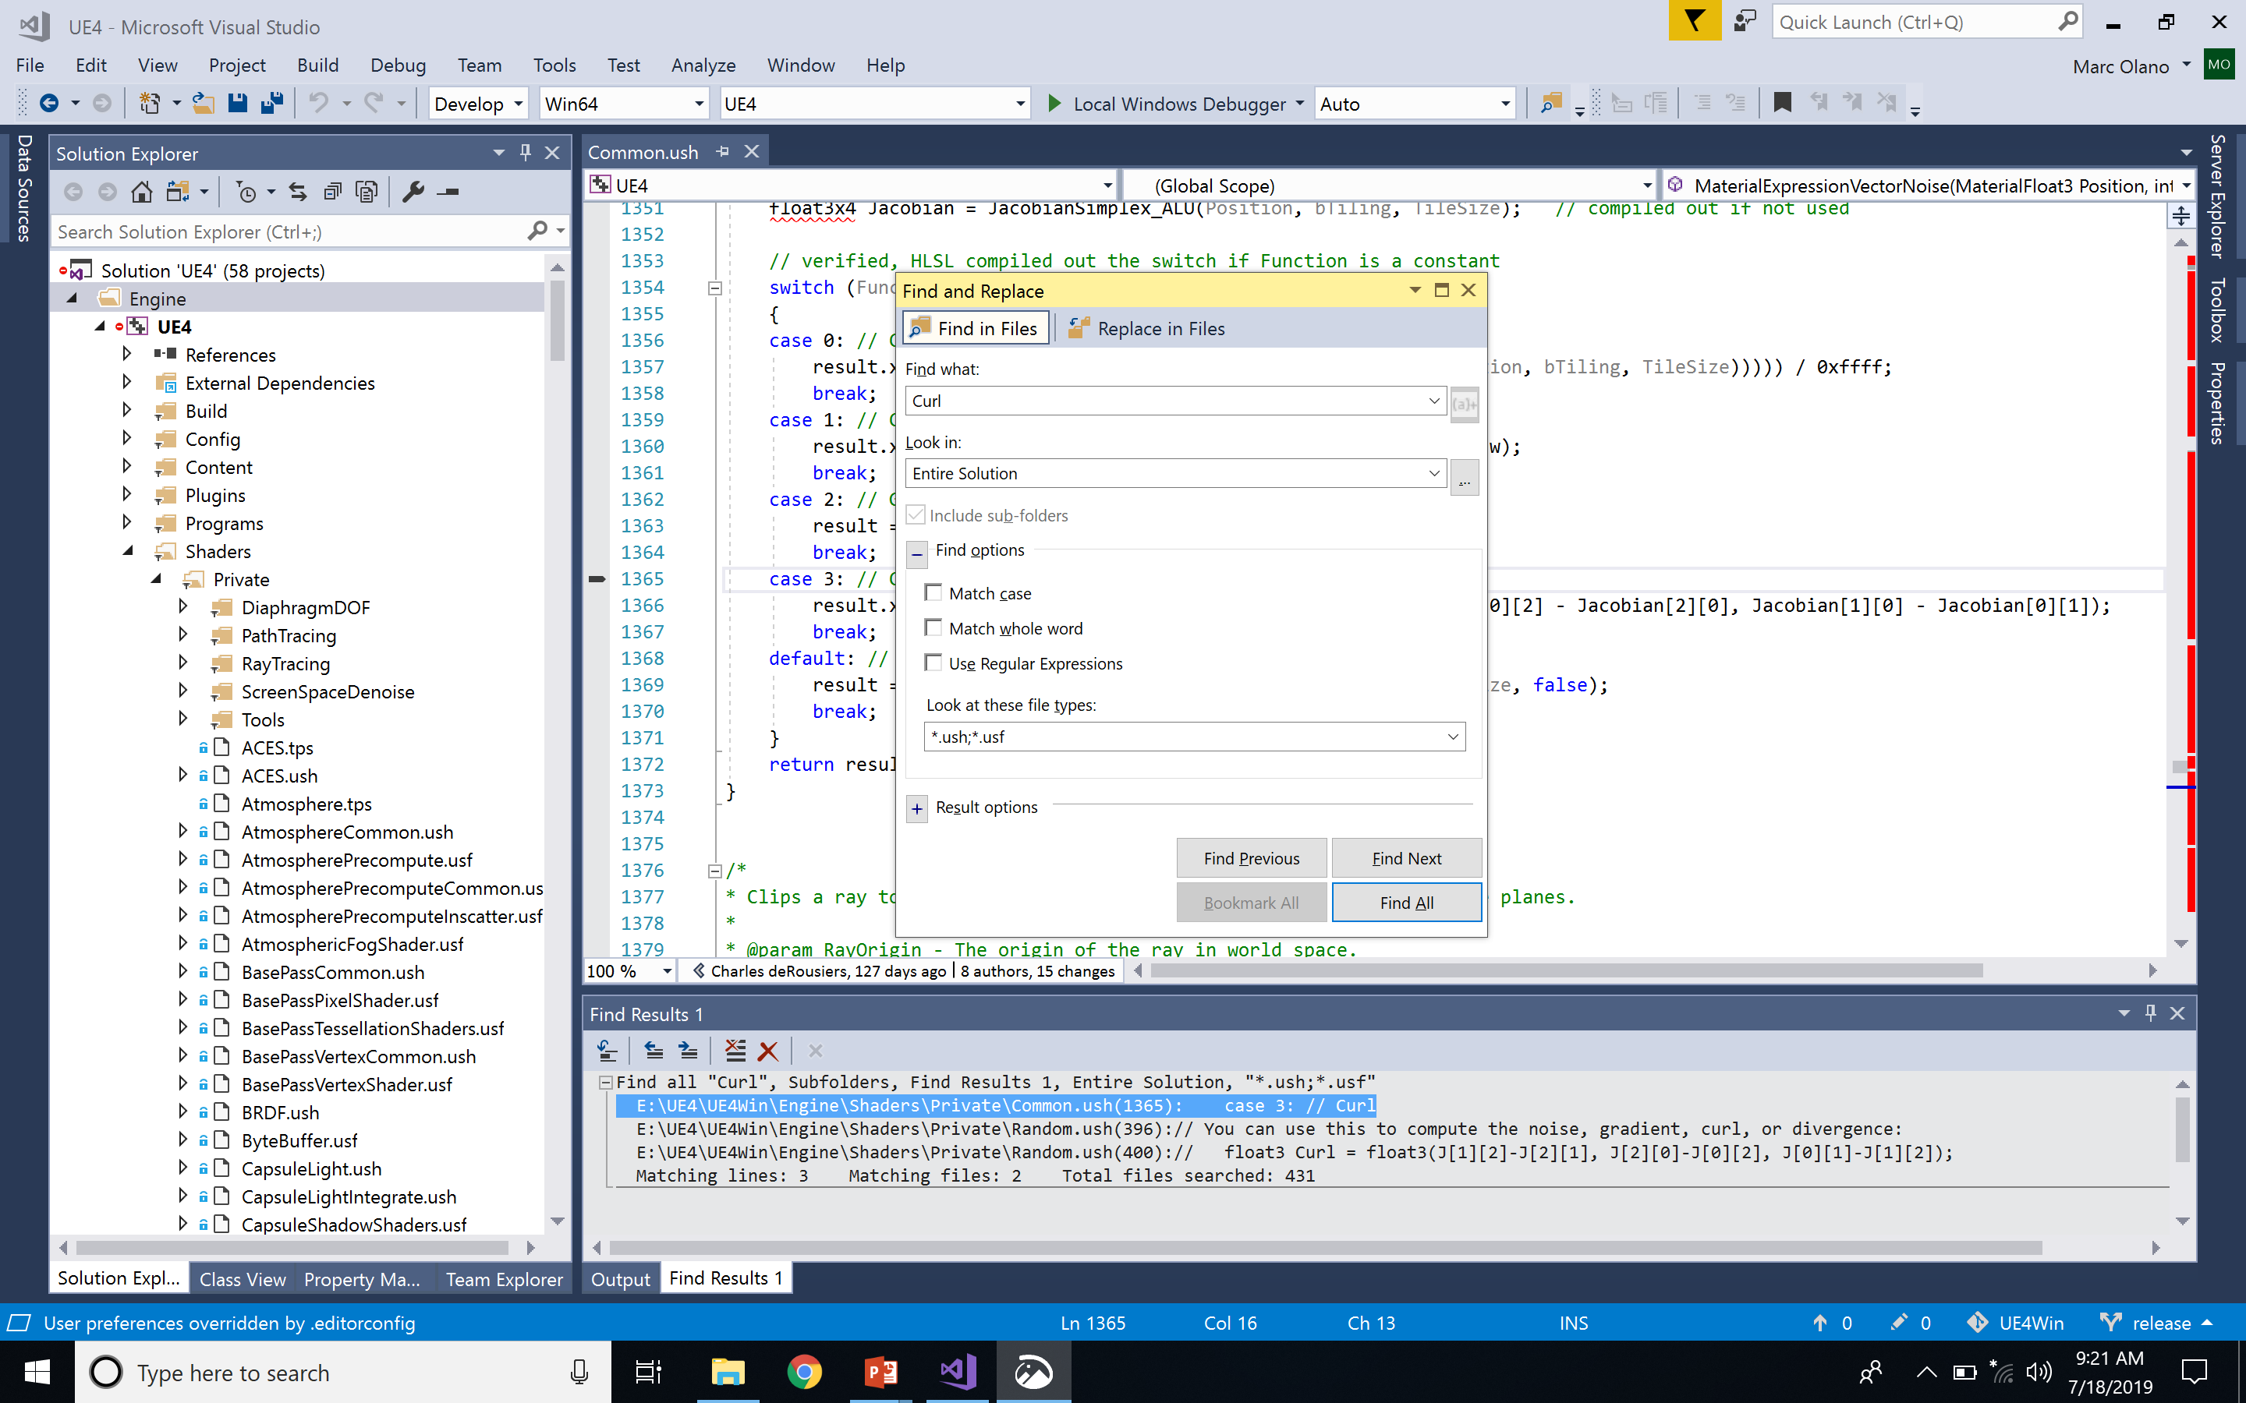
Search Tool
One of the most valuable skills for finding your way around new code is searching through the source files.
In your IDE:
Visual Studio “Find in Files”
(Ctrl-Shift-F)
Xcode search
(magnifying glass tool)
Add-on (e.g., Visual Assist extension / VAX)
External Tool:
git bash: find
ripgrep

Slide 7
Search Strategies
Strategies to get a handful of useful results:
Limit files (single file, project, full solution).
Limit file types (.h, .cpp, .ush, .usf).
Search for exact text of a message.
Consider Regular Expressions
Add context
  Search headers for AActor gets hits in 1700 files.
  Search for “ AActor :” gets one hit

Slide 8
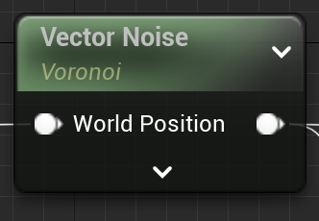
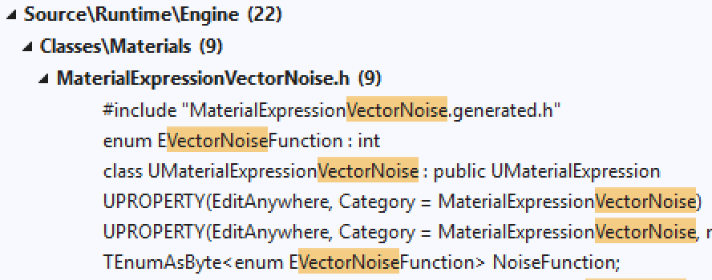
Search for What?
Search for an Editor node name with spaces removed (e.g., “Vector Noise” node will be “VectorNoise” in the code).
Search for the text of a message
Search for words you know to be associated with the algorithm or system you want.

Slide 9
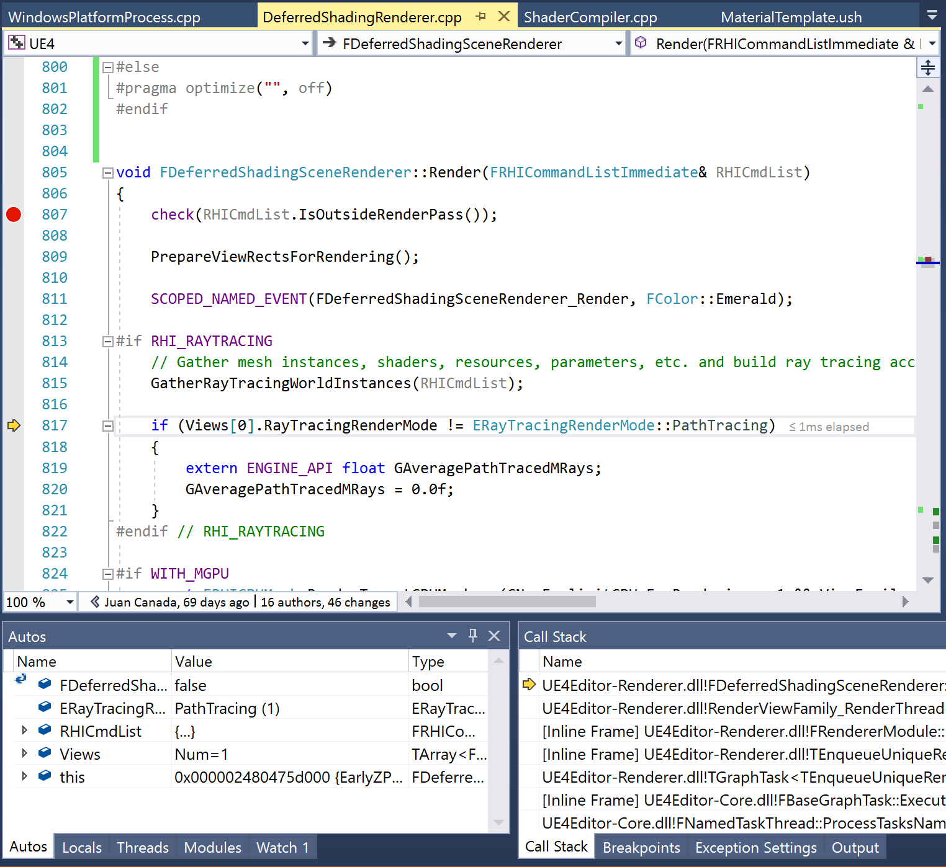
Debugger
A debugger (also known as an integrated development environment, or IDE—Visual Studio or Xcode) is one of the most powerful tools you have for understanding. Try to become an expert at what you can do.
Set a breakpoint. Look at the call stack to see how you got there. Step through the execution to see what happens. Jump ahead by running to your cursor location or until the current function returns.
Watch variables as you step through the code or even change their values to see what happens. Change values and move the execution pointer forward or backward within the current function to see what happens.

Slide 10
Two Possible Goals
Big Picture
Broad understanding of how a large component of the code works
Don’t sweat the details
Local View
Detailed understanding of a small part of the code so that you can make changes
Only worry about who calls you & who you call

Slide 11
Big Picture
Example: Rendering

Slide 12
Big Picture
Get the basic idea of a what the application as a whole or a single system does.
Don’t sweat the details.
It’s good to start with a basic idea of what you expect to see. What algorithms do you expect? What data, inputs, and outputs?

Slide 13
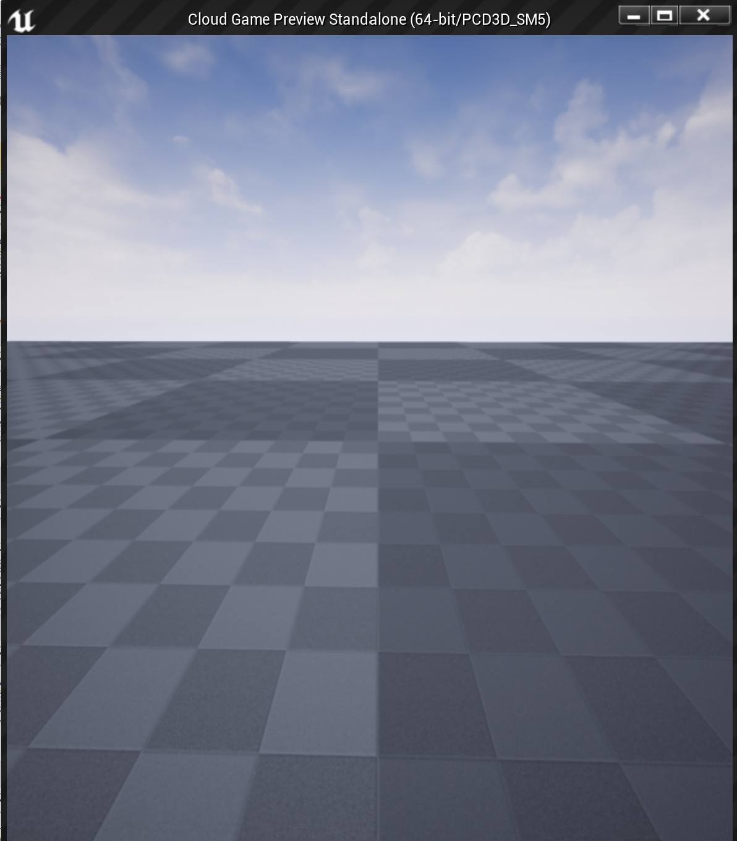
Rendering Algorithms
There are two common strategies for rendering in a game engine: forward shading and deferred shading. The Unreal Engine supports both.
How would you know that? Take a class on real-time graphics. Watch some Game Developers Conference presentations. Read some online blogs. You will need some subject-area knowledge.

Slide 14
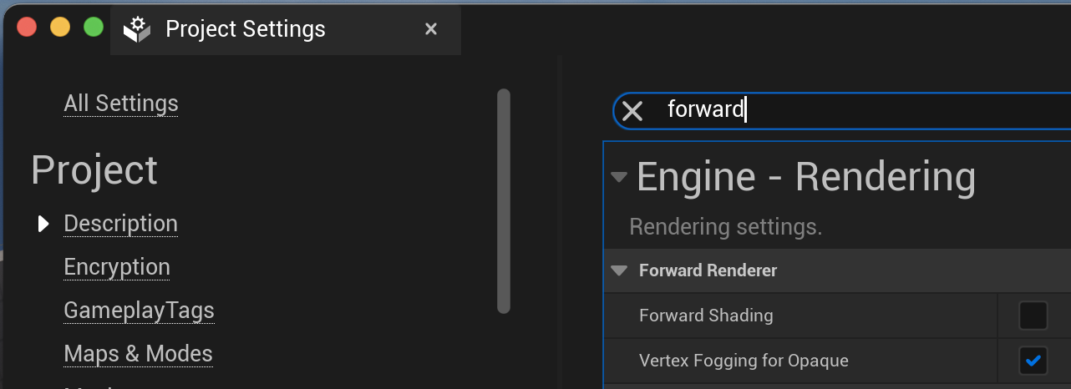
Forward Shading
Forward shading computes per-pixel shading while rendering objects.
It does redundant shading computation for pixels that are overwritten, but gives more per-object control over how the shading is done.
It can support transparency if the objects are sorted from back to front.
There are usually limits on the number and types of lights it can support, mostly because many lights will make the per-object shading functions too complex.

Slide 15
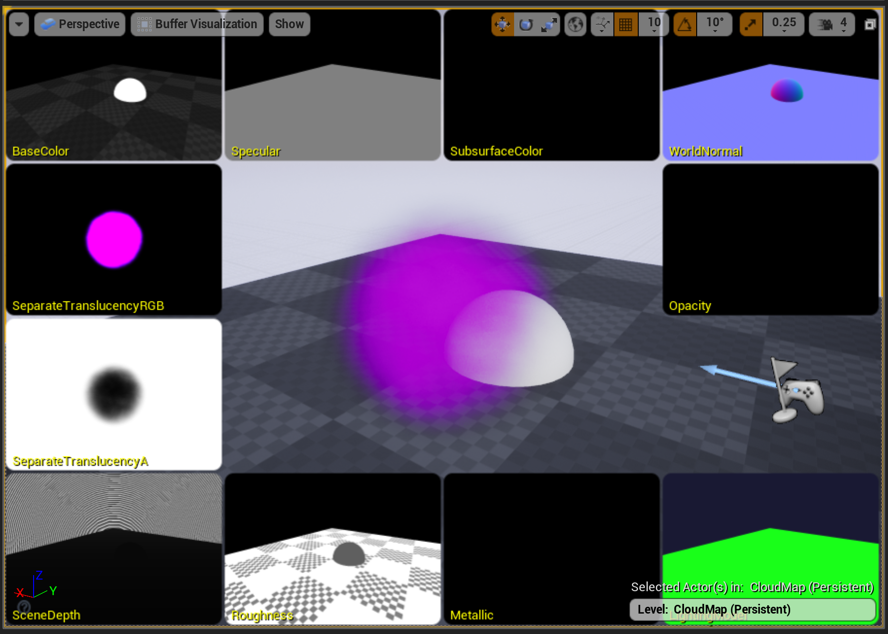
Deferred Shading
In contrast, deferred shading just saves shading parameters per pixel when doing the initial render.
In a later pass, it applies shading and lighting computations per pixel across all of the pixels at once, but these operations only need to run for the objects that were finally visible at each pixel.
The base shading code does need to be similar for all of the objects. This has been made easier by the rise of physically-based shading models in games, which more naturally deal with differing lighting situations with a single shader.
Culling lights by coverage allows tons of lights.
Transparent objects have to be handled in a separate forward shading pass.

Slide 16
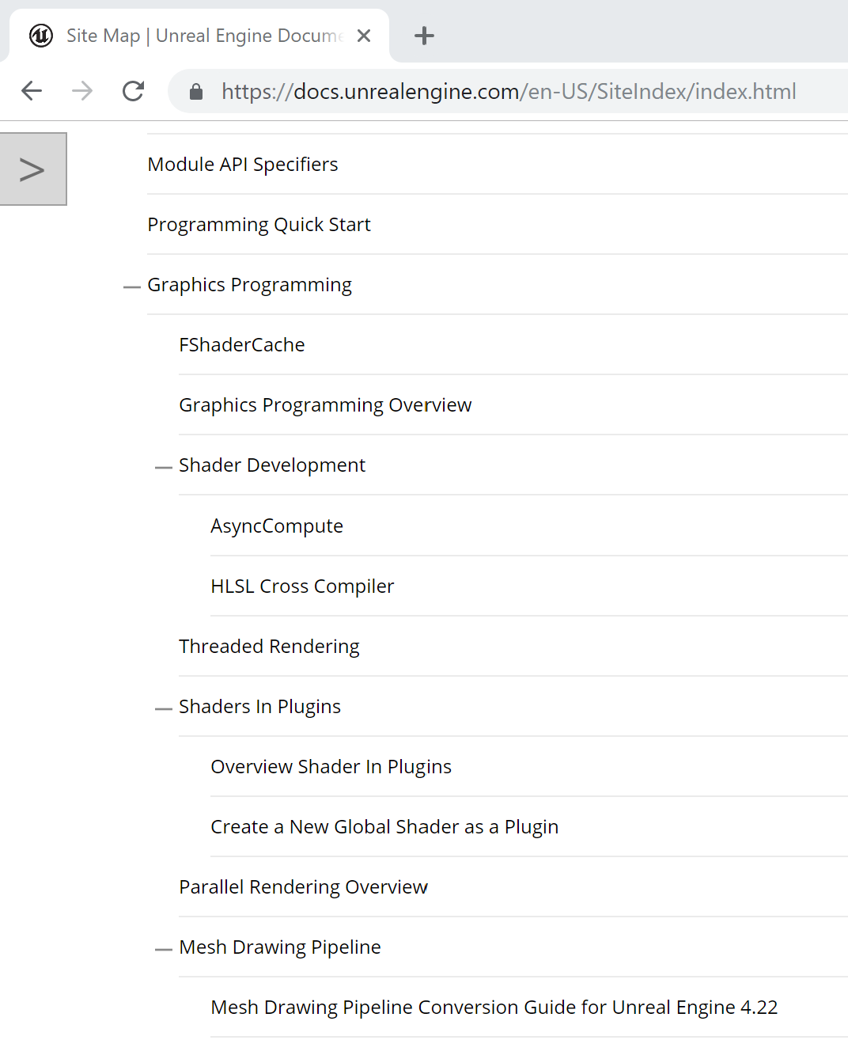
Looking for Documentation
The next step is to see what, if anything, is available to guide your search. For UE rendering, there’s some overview documentation.
For a publicly available engine like UE, you can look for blog posts by others who have taken this journey before you.
Especially at a game studio, you can ask others on the team.

Slide 17
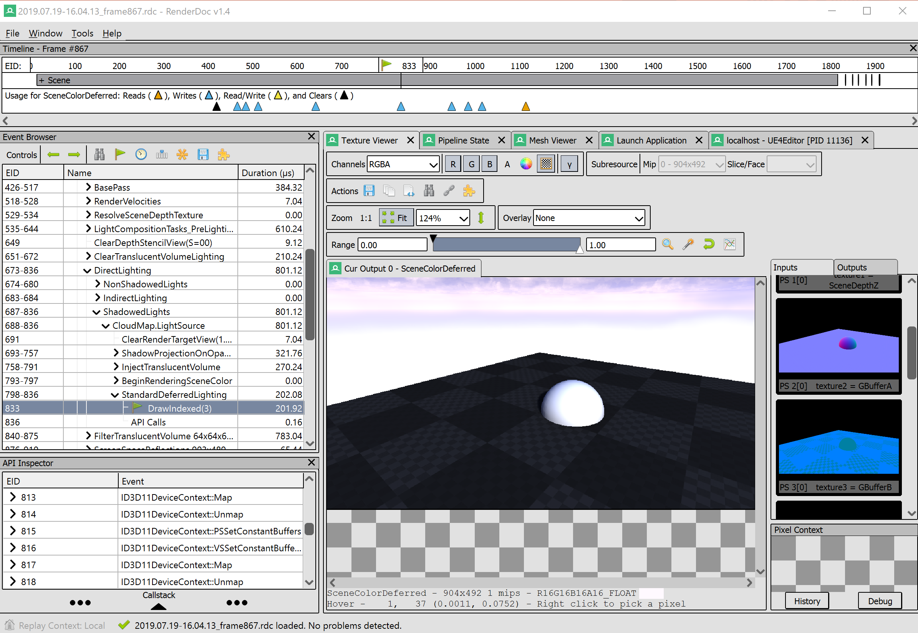
Seeing What It Does
For rendering, RenderDoc and PIX can capture every graphics operation during a frame and let you analyze the effect of each independently. There are several online sites that specialize in doing RenderDoc breakdowns of how different games render, without any need for access to the game code.
In UE, you can open the console
(` key) or Outputs window use the vis console command to look at the results from each of those passes in turn.

Slide 18
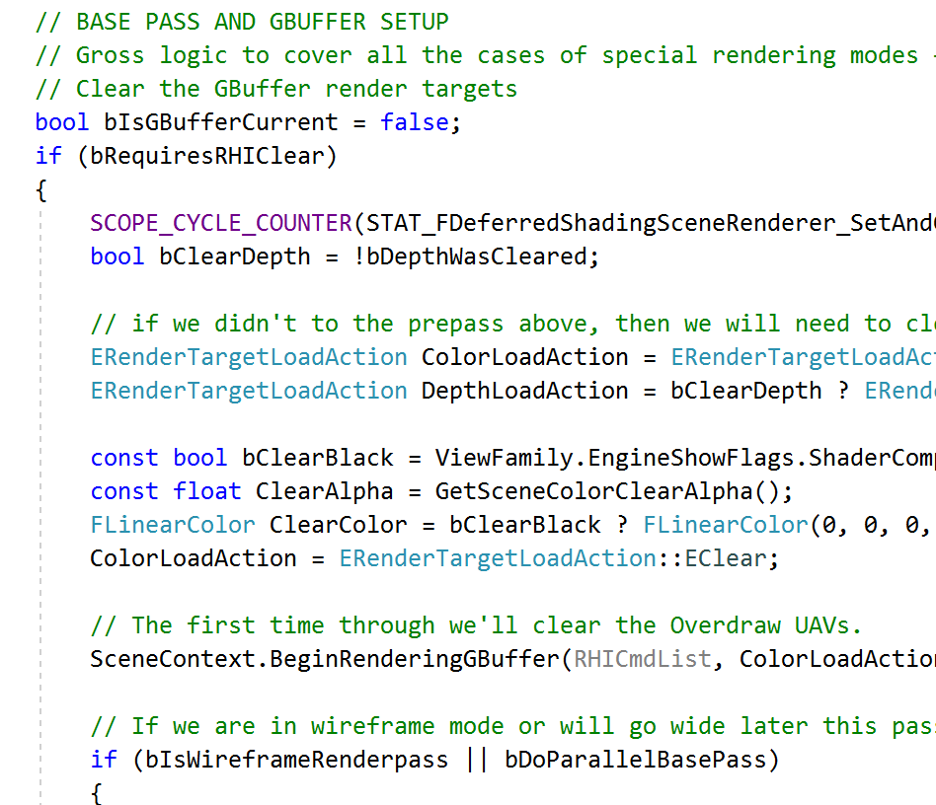
Locating Some Code
Constrain the Level you care about. Find a promising function and set a breakpoint.
Searching just the header files, “ForwardShading” appears in 17 files, “DeferredShading” in 13. If you don’t find any hits on the first thing you search, or find too many, try another search term (e.g. DeferredRendering?)
With only a few hits to check, “DeferredShadingSceneRenderer” sounds promising. Of its member functions, “Render” looks good.
Read through this function to see what operations it performs and in what order.

Slide 19
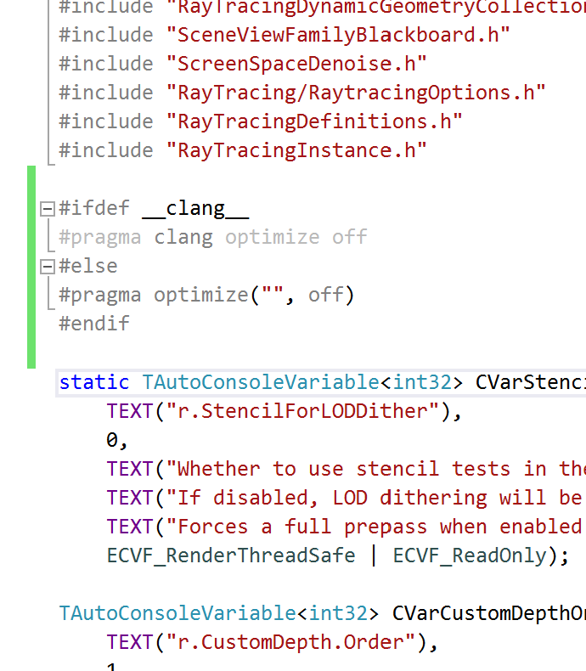
Enabling Debugging
To get a better understanding, you’ll want to step through line-by-line. The Development build of the Editor includes optimization that makes debugging difficult. You can turn it off at the top of a file, and turn it back on again at the bottom:
Visual Studio
  #pragma optimize("", off)
  #pragma optimize("", on)
XCode
  #pragma clang optimize off
  #pragma clang optimize on
Don’t check this in!

Slide 20
Stepping Through the Code
Rebuild with optimization off only in DeferredShadingRenderer.cpp. This should be quick, since it only has to rebuild the one file and repackage the rendering library.
Set a breakpoint in the Render function. Look at the call stack to see where this fits into the other operations. Step through the functions. You can step into some, but mostly for a big-picture view you just want to see what code path is being used.

Slide 21
Local View

Slide 22
Local View
Understand how one thing works, usually to make changes, or to use as a model for creating something similar.
You need to find and understand the local code.
You want to understand who calls it, and with what assumptions.
You want to understand what it calls, and what those things do (but not necessarily how).

Slide 23
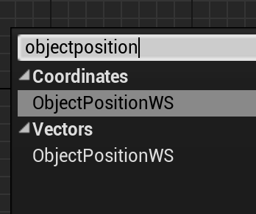
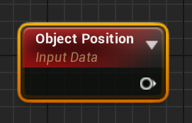
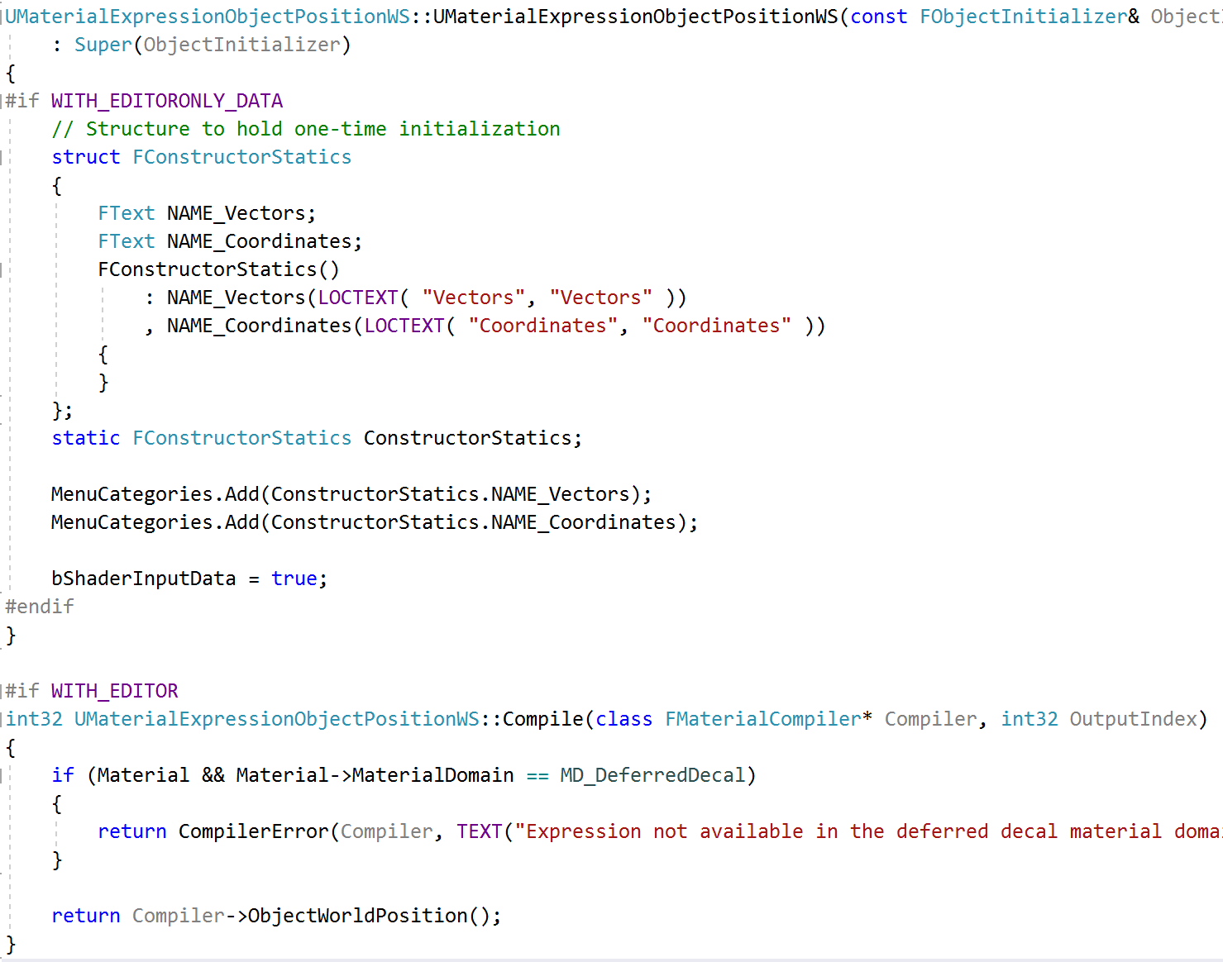
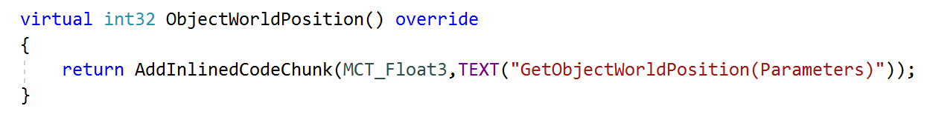
Learning by Example
MaterialExpressions.cpp
Much of this course has used examples to learn about existing code. There are three keys to this method:
Find a relevant example
Build an understanding
Replicate the relevant parts (or replicate everything then trim away the irrelevant parts)
HLSLMaterialTranslator.cpp

Slide 24
Finding Examples
The key first step is to find relevant example code
Search for strings from the Editor user interface or Log
Search in the code for relevant keywords
You are looking for something that is unique enough to have only a few hits in a search, so you can check through them.
If there are too many, try something else.

Slide 25
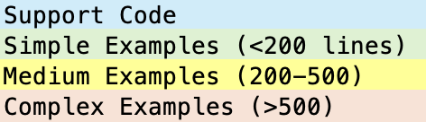
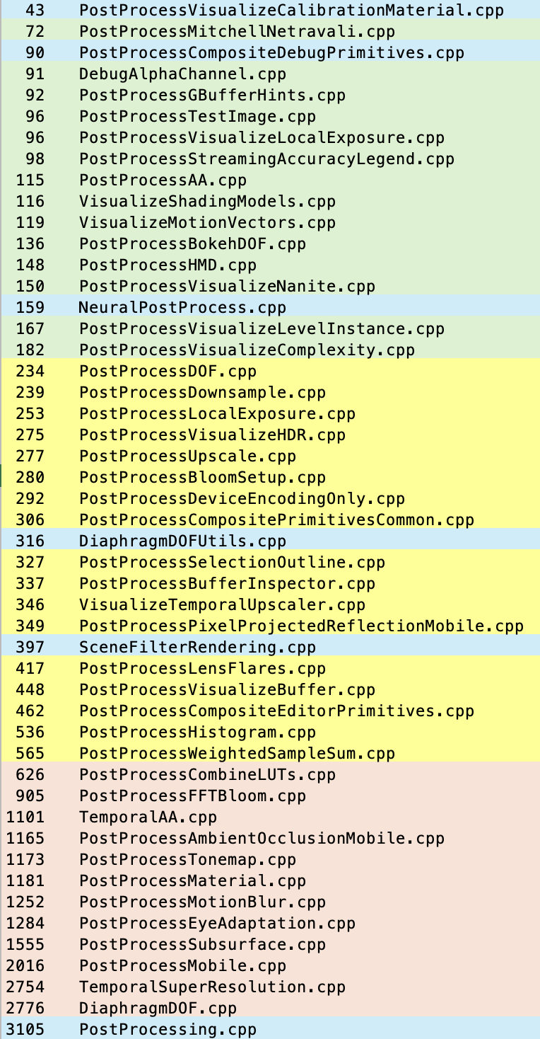
Refining The Example
Lines
File
Once you’ve found the directory or directories containing relevant code, check the other files there to see if another one is a better match.
Also, look at the file sizes: smaller files generally have less extra unnecessary code to wade through.

Slide 26
Building Understanding
Read the code, making notes about what you think it is doing.
Turn off optimization on the files you’ve found, set a breakpoint, and single step in your debugger.
Mostly step over functions, but look at the variables before and after to confirm your understanding of what they do.
Use additional breakpoints or “run to here” to skip over loop iterations.
Conditional breakpoints can be quite slow for many iterations. Sometimes faster to add a conditional & break inside.

Slide 27
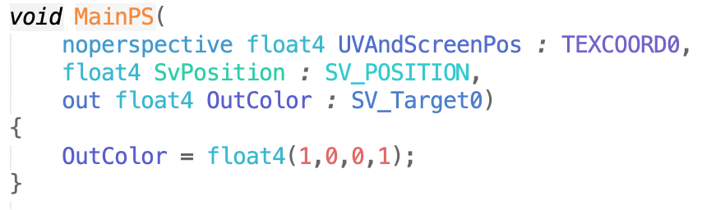
Building from an Example
Make a copy of your example code, changing the names as necessary to get it to compile without conflict.
Get it running with your new code in use (even if it doesn’t do anything new).
Work with the simplest possible test cases to ensure it’s working:
  Get shader code turn the screen a solid color
  Test code that’s working with textures with a simple 2x2 or 4x4 texture.
  Use just 1-2 triangles in geometry code.
Trim out the code you don’t need a bit at a time to make sure it still works.
Add functionality back in.

Slide 28
No Good Examples
New Code
Primary Rendering
Postprocessing
Plugin
Example Project
Often, there is no single good example in the code for what you want to do.
Then you may have to combine multiple sources.

Slide 29



Finding Guides
You may need to find sources inside and outside the engine.
Look at external sources outside of the Unreal Engine. For example, GDC or SIGGRAPH talks, “Gems” books, published papers, developer blogs. These will give an outline of how to accomplish the task, but not how it fits into the Unreal Engine.
Look through the engine code for places that do each part of what you need. These may be in disparate parts of the engine, in plugins, or in example projects. Likely with bits here and there.

Slide 30
Building Slowly
When building from many examples, plan an implementation order that allows you to test continuously along the way. Some of the bits you find may not work together the way you expect or do what you think. Working incrementally is the only way to catch these problems before they become insurmountable.

Slide 31
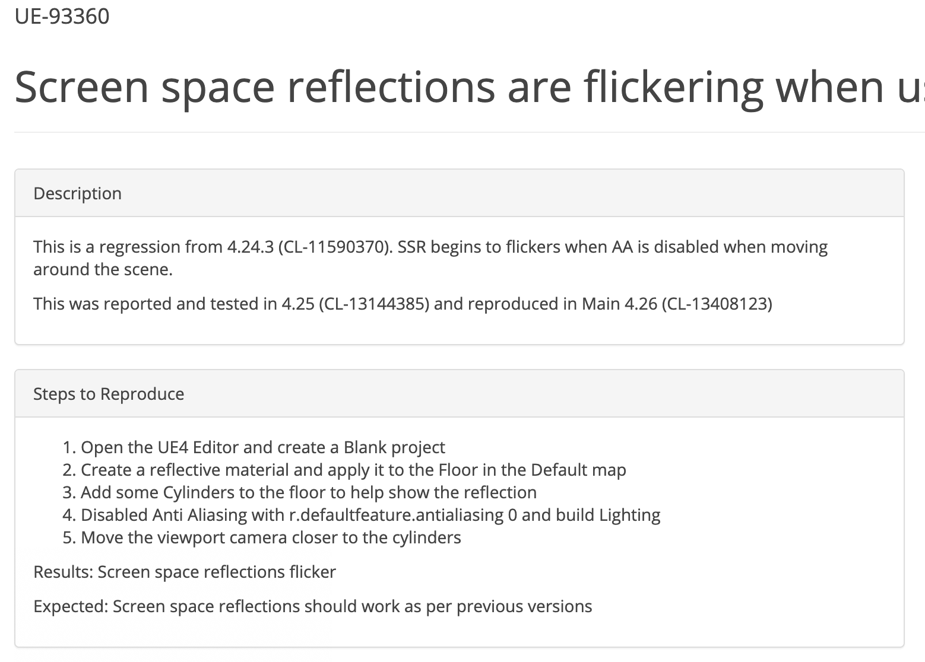
Finding Focus
When you don’t have a specific task, it is hard to figure out where to start to learn about some engine subsystem.
Chasing down an existing bug can provide that focus.
Plus you can submit a pull request to give that work back to the Unreal Engine community!

Slide 32
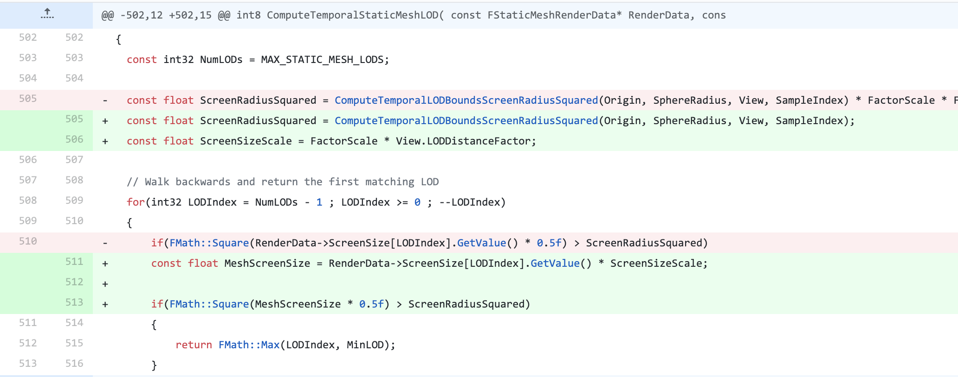
How Bugs Help
A bug gives you a specific goal while digging through unfamiliar code. It also gives you documentation of reproduceable incorrect behavior, and expectation of what it should do if corrected.
Make sure you understand what the code is currently doing and what it should be doing.
Trace through current code and behavior until you understand what is going wrong.
Figure out the right way to fix the problem, not just the easiest band-aid.
Fix the bug, and test to look for any new problems introduced by your fix.

Slide 33
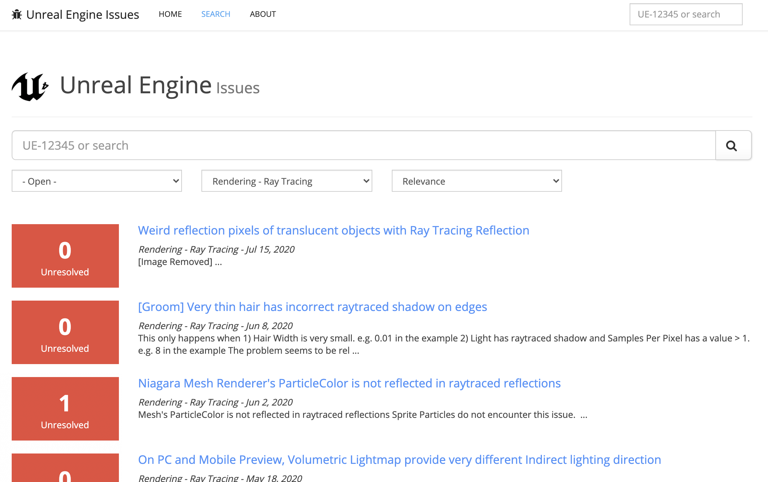
Finding Bugs
Check the bug list at issues.unrealengine.com
Filter to see only open bugs
Filter by component or search to narrow to bugs related to the subsystem you care about.

Slide 34
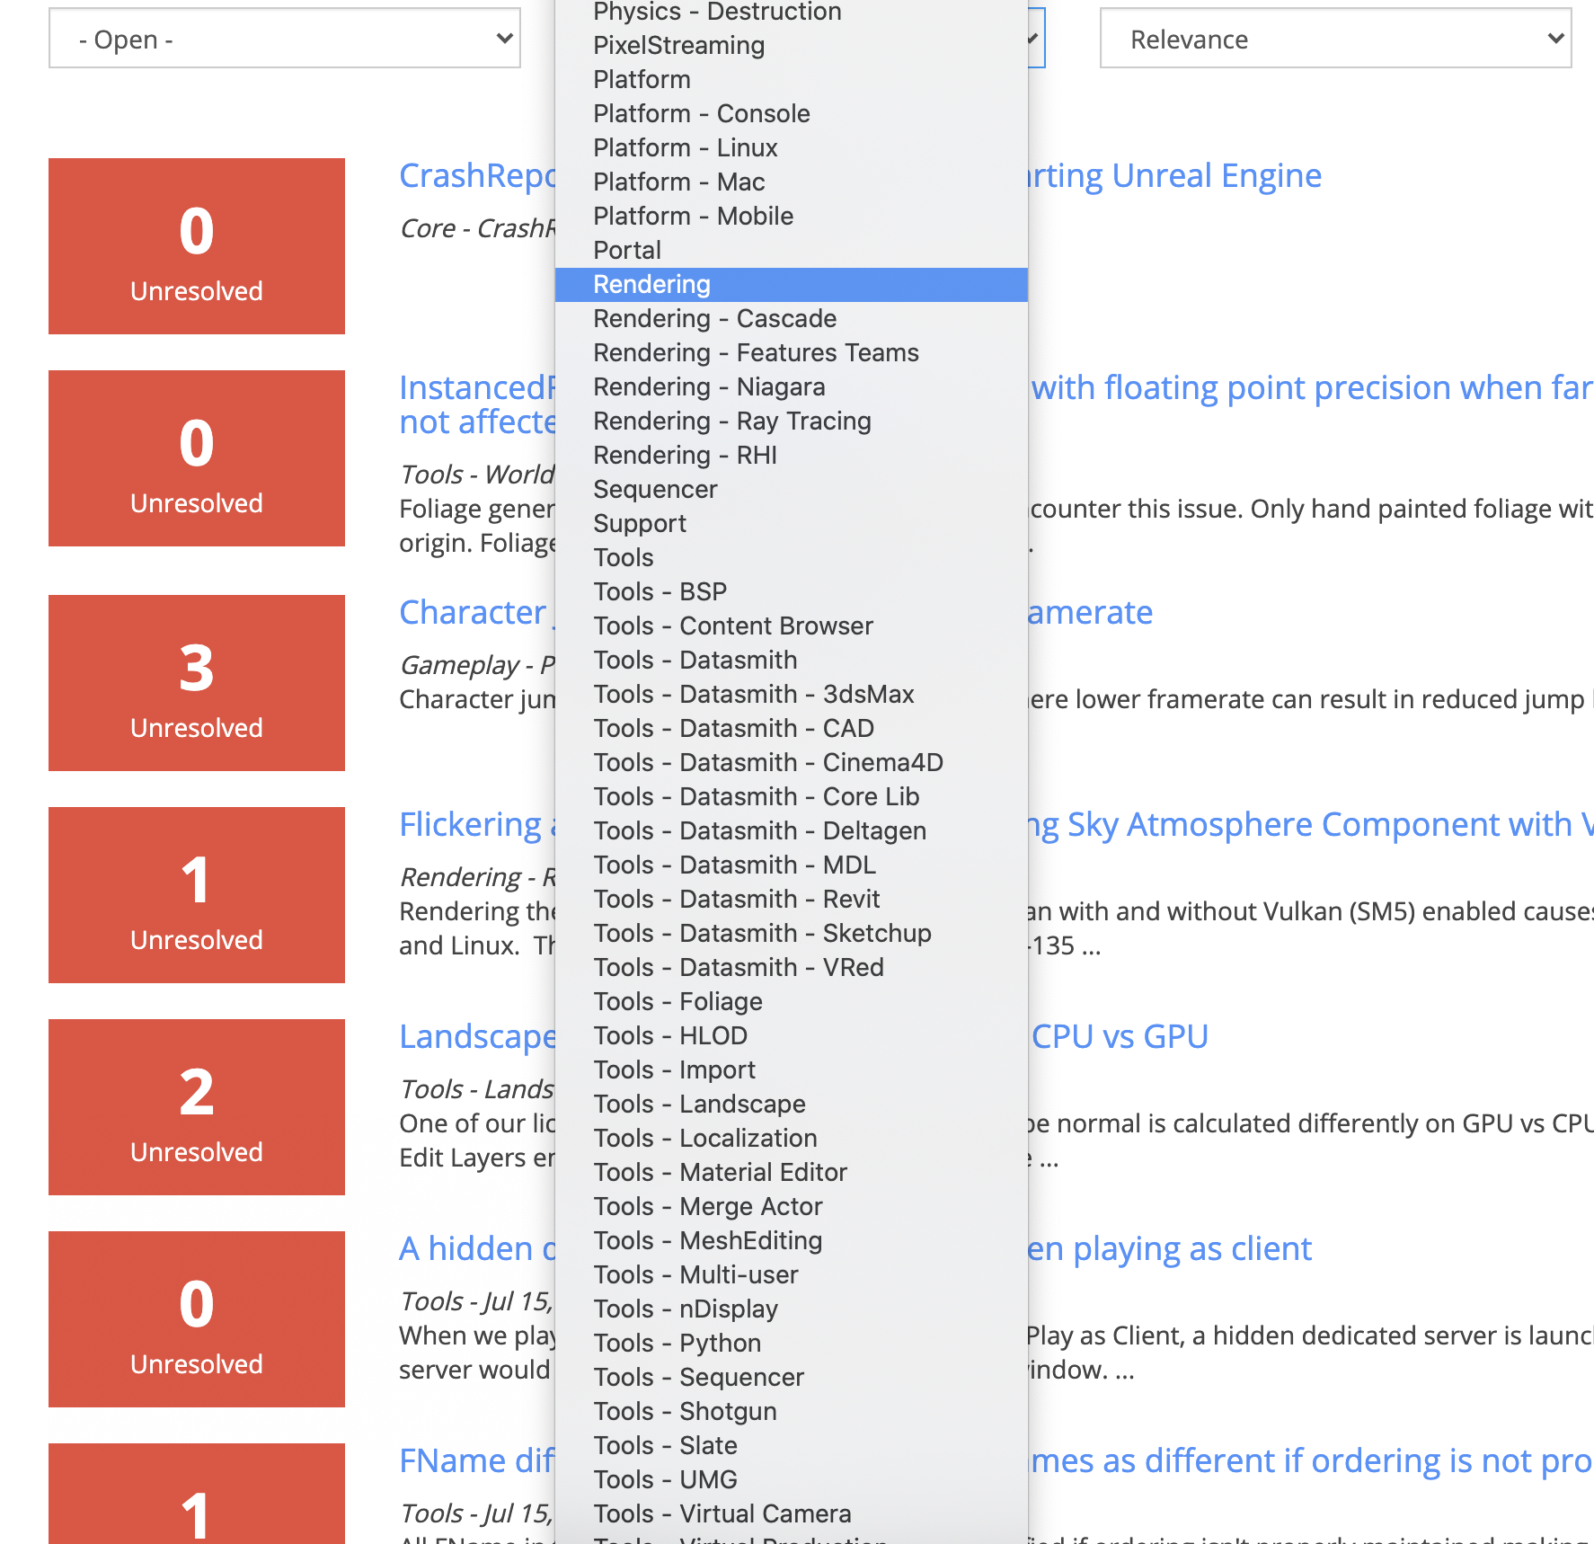
Choosing a Bug
To use a bug to learn about a part of a large codebase, you want a few properties:
Fits the area you want to learn
Localized behavioral problem to be fixed, not a major new feature.
Small in scope. Your primary goal is to use the bug to learn.

Slide 35
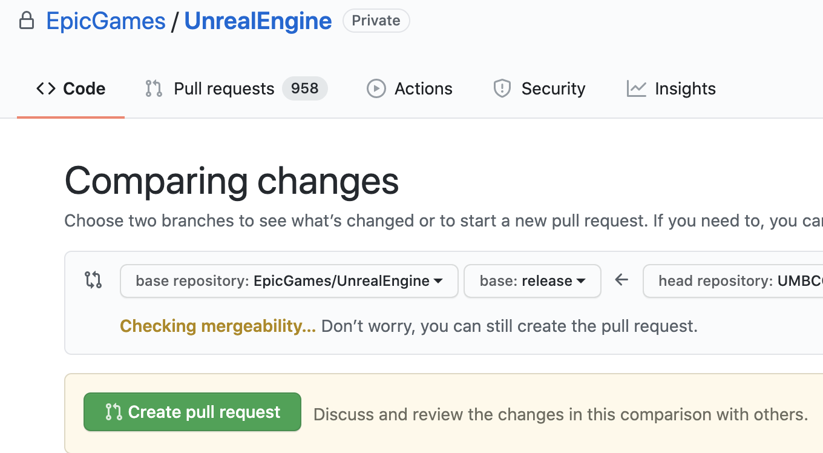
Giving Back
Once you’ve fixed a bug, submit it back as a pull request on github.
Be sure your changes follow Epic’s coding guidelines.
Be sure to reference the bug number (looks like UE-123456).

Slide 36
Summary

Slide 37
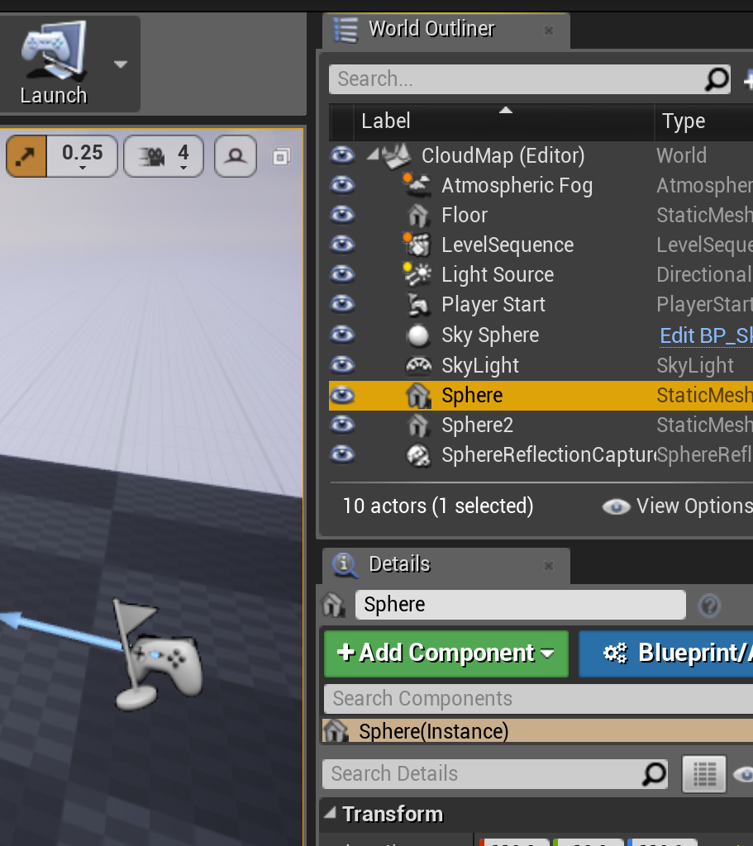
Navigating Code
Learn about the problem domain, and what algorithms might be used.
Look for external resources as a guide. These are helpful, but not necessary.
Search for algorithm names, message text, node names from the Editor, or anything to get a foothold on where to start exploring.
Use your debugger, and take notes as you step through the code to build a local understanding.
Constrain any exploration to one or two layers and one system. You don’t need to understand everything to start making changes.

