Slide 1
Advanced Actor Coding

Slide 2
Delegate Functions

Slide 3
Delegates
I want to know that the player died!
Does anyone care that the player died?
Delegate
Delegates are the Unreal Engine’s method to flexibly assign a function from one class to be called from another when the functions and classes might not be known at compile time. In other systems, these might also be called callback functions.
Class A declares the delegate type (parameters and return value) and creates a delegate variable.
Class B defines a member function that matches and registers it with class A.
Then when class A invokes its delegate, the function in class B is called.
I want to know that the player died!
I want to know that the player died!
I want to know if a file changed, but I don’t know what OS I’ll be running.
I can tell you if a file changed.
Delegate

Slide 4
Simple Delegates
In ILauncherProfile.h, declare a delegate type returning bool with no parameters, to call to see if an asset cook is done.
In FLauncherSimpleProfile, declare a member variable of that type to call later.
The simplest form of delegate can hold one function to call later.
These simple delegates are the only ones that can directly return anything.
There are a variety of Bind functions, depending on the function type (static global function, shared pointer, UObject, etc.).
Find out if a function is bound with IsBound(), execute with Execute() or ExecuteIfBound().
In UUnrealEdEngine, declare a matching function.
In PlayLevel.cpp, register the function.
Call indirectly through the delegate

Slide 5
Dynamic Delegates
Regular delegates need to be set in code every run. A dynamic delegate looks about the same, but can be serialized, so the delegate assignment will be saved.
  Dynamic delegates are slower than regular delegates, so use them only if you need the serialization.
Use:
  Declare delegate type with DECLARE_DYNAMIC_DELEGATE macros (instead of DECLARE_DELEGATE)
  Delegate function should be tagged with UFUNCTION()
  Bind with BindDynamic.

Slide 6
Multicast Delegates
In PrimitiveComponent.h, declare a delegate type to call when an Actor first starts to overlap with a collision volume.
In UPrimitiveComponent, declare a delegate variable.
The basic delegate (and basic dynamic delegate) allows you to bind one function to the delegate and later execute it.
Often multiple Actors want to be able to run code when something happens. Multicast delegates support that.
The declaration of the delegate type is similar, with a DECLARE_MULTICAST_DELEGATE macro (and a DYNAMIC version).
Instead of Bind(), call Add() to add one new function to the list.
Instead of Execute(), call Broadcast() to run any function that has been added.
In AInteractiveFoliageActor (for example), declare a function that matches.
And ask for it to be called when the collision happens.
Then UPrimitiveComponent can broadcast to call all subscribed delegate functions.

Slide 7
Events
UE events are just multicast delegates where only the declaring class can call Broadcast().
With multicast delegates, any class with access to add a function could also invoke a broadcast.
Events allow other classes to add functions to be called, but only the declaring class can do the broadcast.

Slide 8
Blueprint/C++ Inheritance

Slide 9
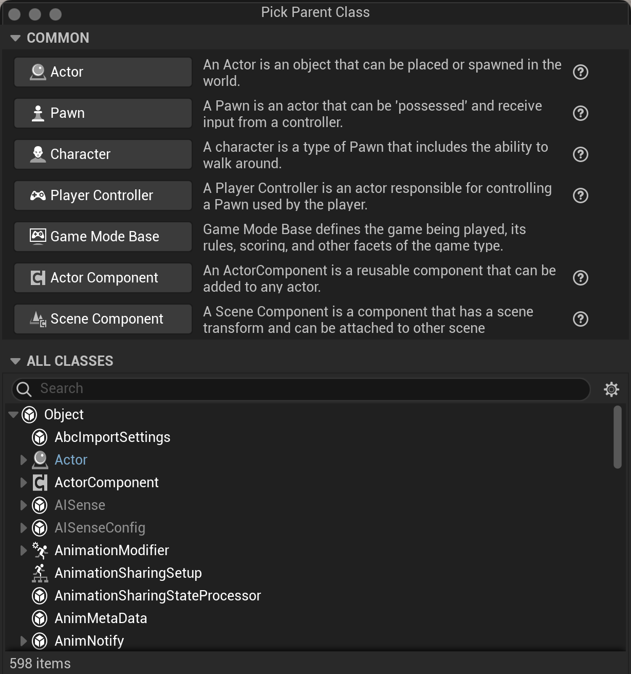
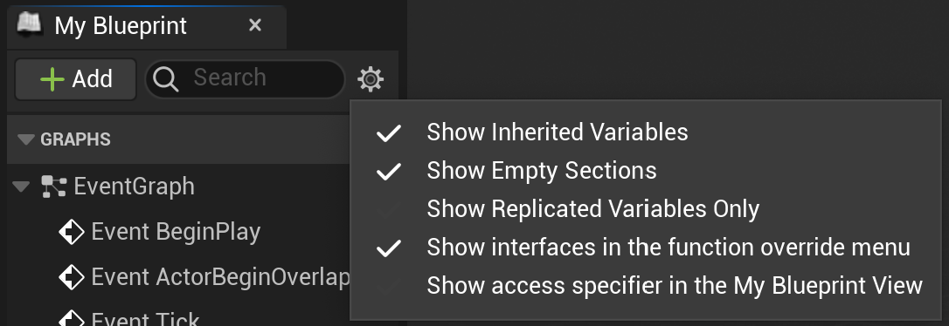
Extending a C++ Class in Blueprint
You can extend any C++ Actor by creating a Blueprint that is derived from it. The new Blueprint object inherits all of the code, variables, and behavior of the original, but can add additional functionality by overriding BeginPlay, Tick, OnConstruction, etc.
Choose “Add New > Blueprint Class”, but rather than choosing one of the standard classes at the top, search for your C++ class in the All Classes list on the bottom.
Any property you want to be accessible in the Blueprint extension should have the BlueprintReadWrite property. In addition, to see the inherited variables, be sure to make them visible in the Blueprint Editor.

Slide 10
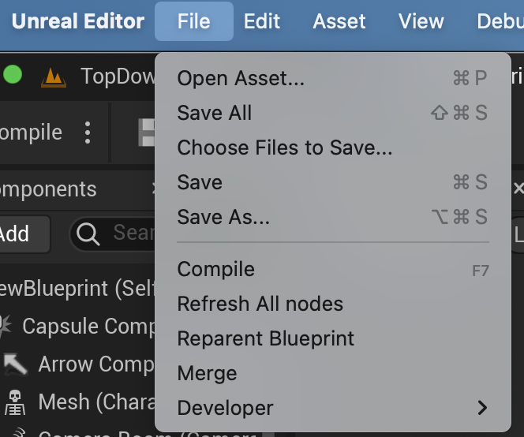
Extending a Blueprint Class in C++
While a Blueprint class can be derived from a C++ class, a C++ class cannot be derived from a Blueprint one.
Instead, create a new C++ class, then reparent the Blueprint class to it (File > Reparent Blueprint). Once you have reparented, you can move logic from the Blueprint class into the C++ parent class.
You can also create new C++ ActorComponents to add to an existing Blueprint class.

Slide 11
Calling Between Blueprint and C++

Slide 12
Mix C++ and Blueprint: Scripting
Why do many projects end up with a mix of C++ and Blueprint?
One of the main reasons Blueprint exists in the first place is to allow nonprogrammers or designers with limited programming experience a way to directly make gameplay changes.
C++ code that is callable from Blueprint can expose functionality to Blueprint that is either not available in the standard Blueprint nodes or is cumbersome to implement there.
Blueprint code that is callable from C++ can allow nonprogrammers on your team to tweak behavior by constructing small Blueprint functions rather than having to build out a full Actor or Component.

Slide 13
Mix C++ and Blueprint: Conversion
Many projects that start out as Blueprint may want to port some of that code to C++ for performance or programmability.
One approach is to replace small sections of Blueprint with local Blueprint nodes that do equivalent work in C++.
Another approach is to convert overall structure first, in which case you may need to call Blueprint parts that have not yet been converted from the C++ code.

Slide 14
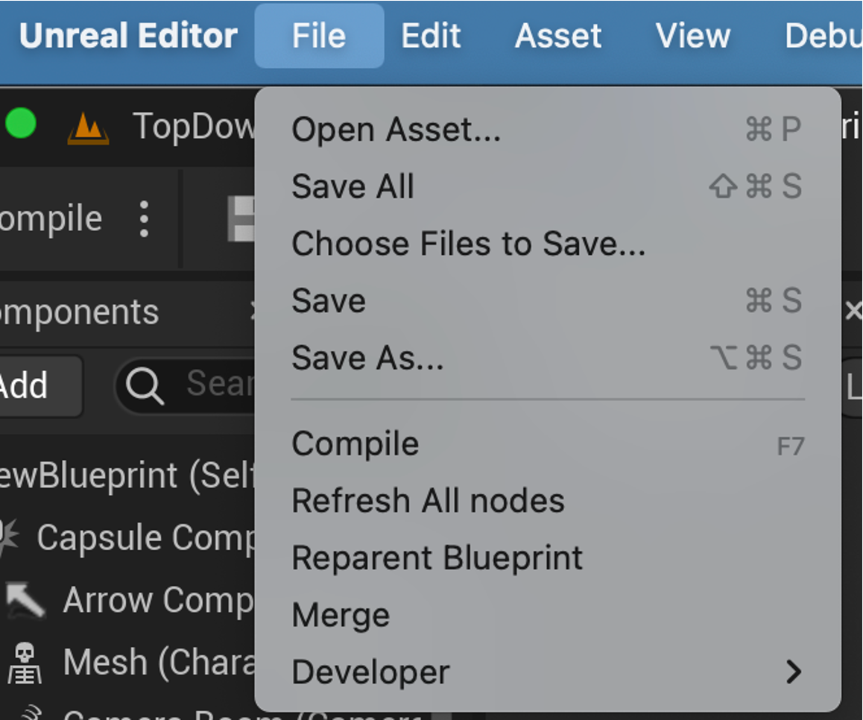
Preparation
No matter what the reason, the first step to a mixed implementation is to have a Blueprint class derived from an underlying C++ class.
  Reparent if the Blueprint is already created.
  If not, create the C++, then make a Blueprint-derived class from it.

Slide 15
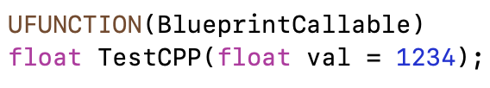
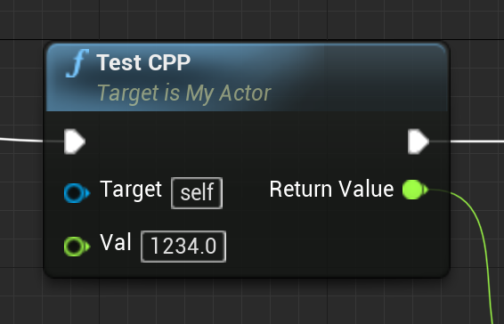

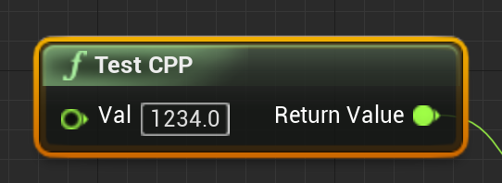
Exposing C++ Functions to Blueprint
To make a new Blueprint node, mark a function in your C++ class as UFUNCTION(BlueprintCallable).
The name will match the function name unless you add meta=(DisplayName=“name”).
The function parameters will appear as input pins. Any with default values in the C++ declaration will have those defaults in Blueprint.
The function output will appear as an output pin.
Add BlueprintPure to the UFUNCTION for pure functions that do not change their Actor state, where the execution order does not matter.

Slide 16

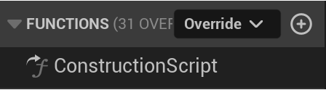
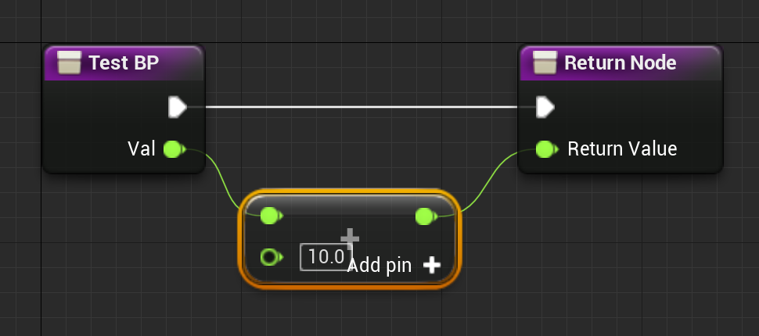
Blueprint Implementable Functions
To call a Blueprint function from C++, create a C++ function that will be overridden in the derived Blueprint.
Create a function prototype in your C++, tagged with UFUNCTION(BlueprintImplementableEvent).
Do not provide an implementation.
In the Functions section of the Blueprint Editor, choose “Override”.
Create a Blueprint implementation.
Call in your C++ code.
A function can be both BlueprintImplementable and BlueprintCallable if you need to be able to call it from both.
It can also be BlueprintPure if it is a pure function without order-dependent side-effects.

Slide 17

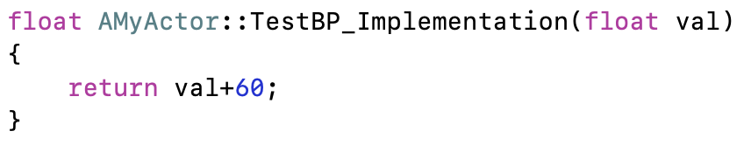
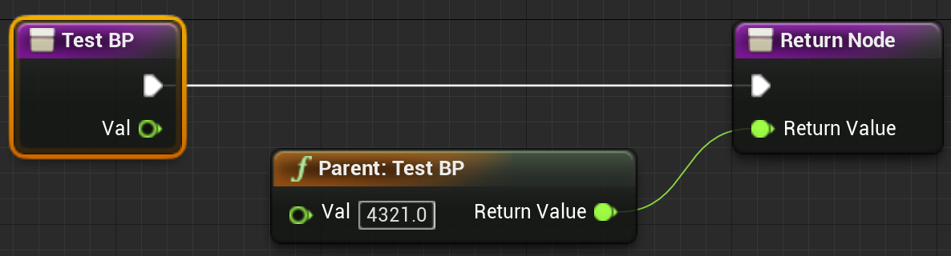
Blueprint Functions with C++ Default
To use a default C++ implementation when the Blueprint one does not exist, use UFUNCTION(BlueprintNativeEvent) instead of BlueprintImplementableEvent.
Create a C++ implementation function with “_Implementation” on the end of the function name. It will use this if a Blueprint version is not provided.

Slide 18
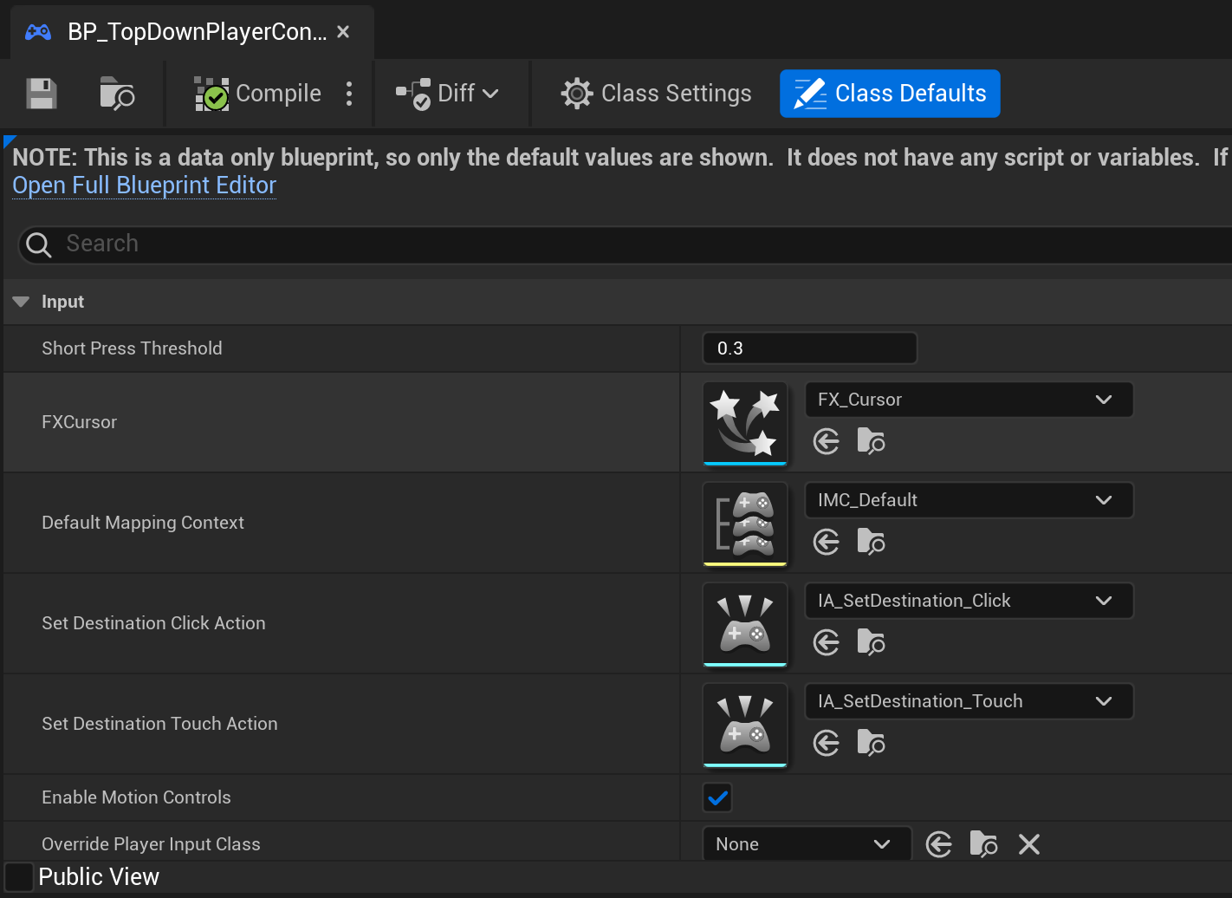
Data-Only Blueprint
Set new defaults for member variables.
Create a derived blueprint, this will open the blueprint editor. Close without adding anything, then reopen.

