Slide 1
Basic Actor Coding

Slide 2
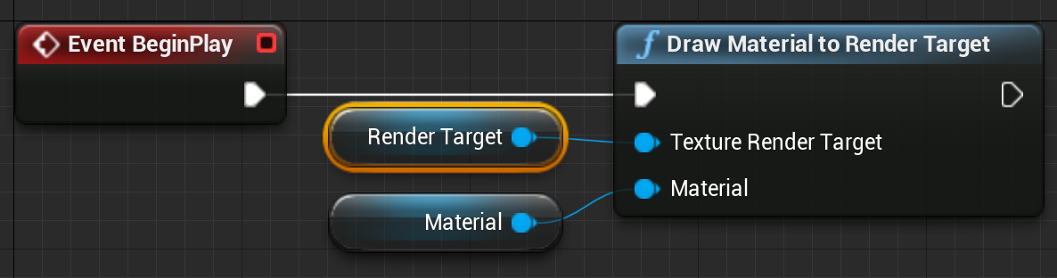
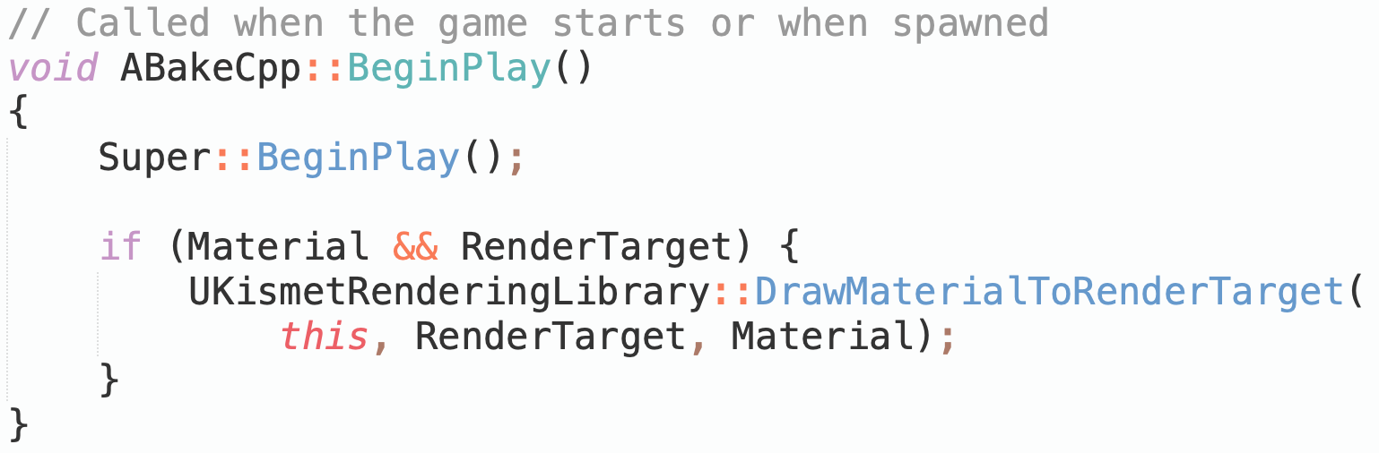
UE5 Actors
A UE5 Actor is any object in the Level. Actors are not used just for characters, but also for every visible scenic element, every light source, every invisible trigger region, and anything else that can have a position in the scene and possibly some attached behavior.
The best-documented way to add that behavior is with the Blueprint visual scripting system.
For more power and control, you can do the same thing in C++. C++ code has access to anything that can be done in Blueprint, plus internal functions and external libraries that are not Blueprint accessible.

Slide 3
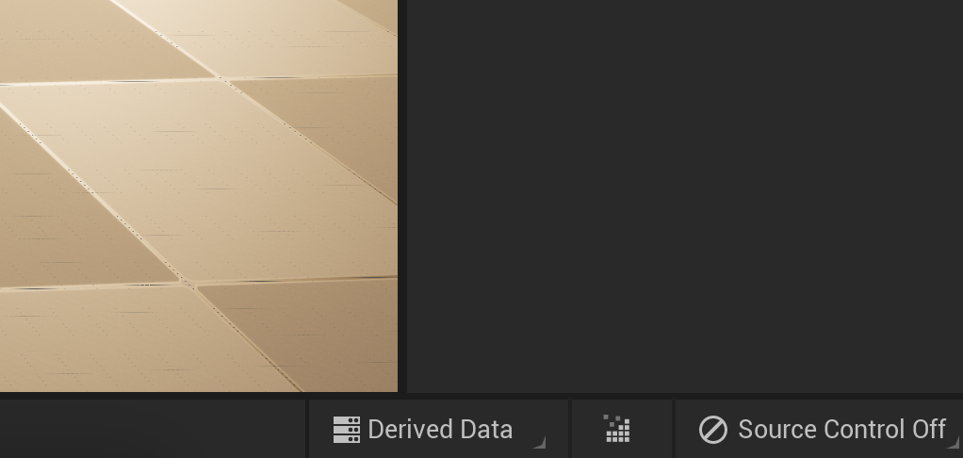
Converting a Blueprint Project to C++
If you start a project using Blueprint and decide later to do some C++, it is possible to switch it over.
  In the Tools menu, create a new C++ class (e.g., a new C++ Actor class for Actor behavior).
  You can identify code projects because they will have a compile button in the toolbar.
  If that does not appear, quit and restart so it will recognize the new files

Slide 4
Recompiling Code
In a C++ project, you can recompile Actor or Component code without having to exit the Editor.
Just press the Compile button at the bottom of the Editor window.
The changed code will be recompiled and reloaded into your running Editor.
To manage the hot reload, UE5 saves the class data with the old class, then loads it with the new.
This can fail if the class member data changes too significantly. For member data changes, you may need to delete the Actor from the scene and recreate it.

Slide 5
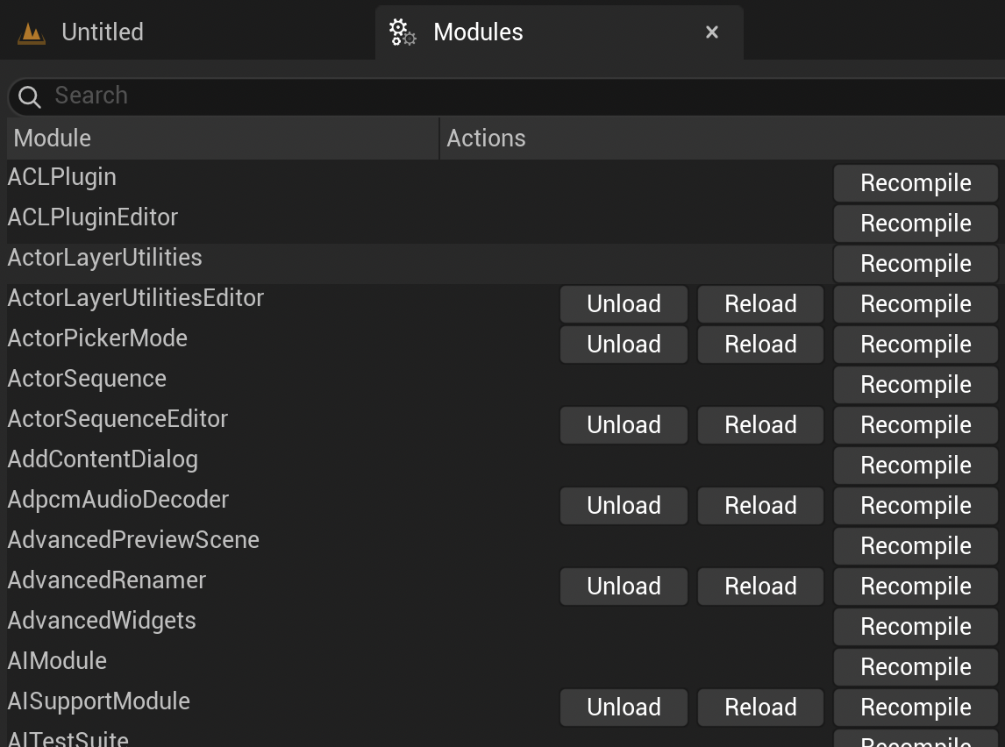
Modules panel
In part to support recompile and hot reloading of code, Unreal splits the code into modules.
The compile button only recompiles the main project module. When working with code in other modules, use the Tools > Debug > Modules panel to recompile.

Slide 6
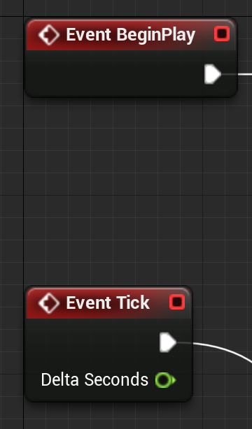
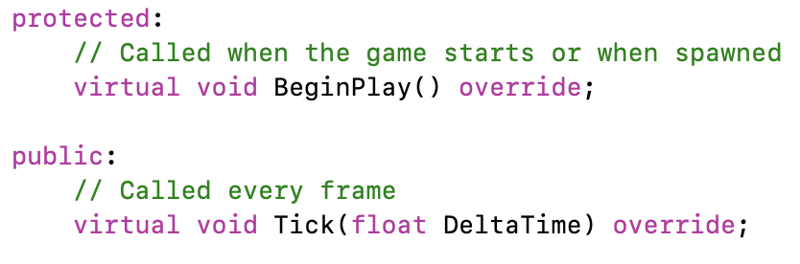
Core Blueprint Events
⇔ C++ Functions
The standard Blueprint Actor has event blocks so you can trigger something to happen on Actor Construction, Begin Play, or every game Tick.
The same options are available in C++ as virtual member functions OnConstruction, BeginPlay, and Tick.
When you create a new Actor class, it automatically creates templates for the BeginPlay and Tick functions, but you can add others. Look at the AActor base class and its parents to see what is available.
Overriding these virtual functions adds behavior for that Actor event.

Slide 7
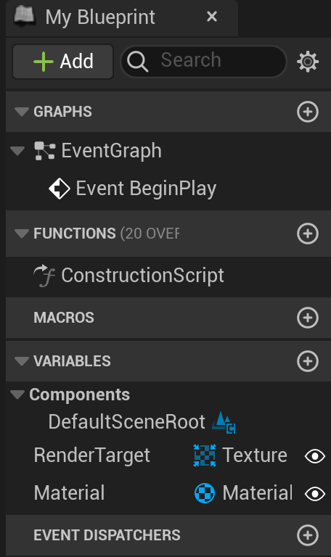
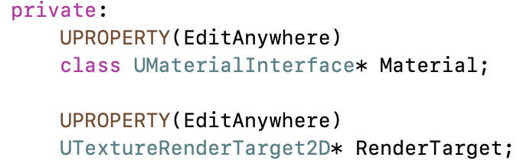
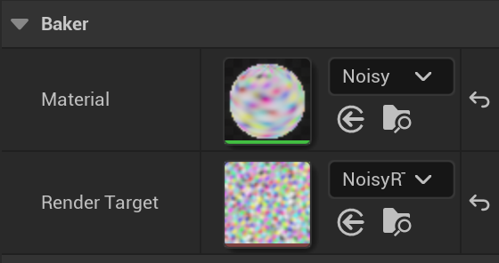
Blueprint Variables
⇔ C++ Member Data
In Blueprint, you can create variables associated with your Actor.
Values for these are saved with the Actor.
These can be set to be either visible in the Actor’s Details window, or internal and hidden.
In C++, any member variable preceded by the UPROPERTY() macro will be saved with the Actor, but hidden.
Variables without UPROPERTY() can hold temporary data, but will not be saved.
A member variable preceded by “UPROPERTY(EditAnywhere)” will be visible and changeable in the Editor Details window.
Default values for variables are set in the class constructor, though be aware that the constructor is not run when restoring from a save.

Slide 8
UPROPERTY Magic
The UPROPERTY macros are parsed by the Unreal build process to generate user interface and serialization (saving and loading) code.
Comments before the UPROPERTY will show up as a pop-up tooltip.
Arguments to UPROPERTY can control many aspects of how it will appear, including changing the displayed name, setting min and max slider bounds, or setting a hard min and max value for the UI (code can still create out-of-range values).
See online documentation for available options.

Slide 9
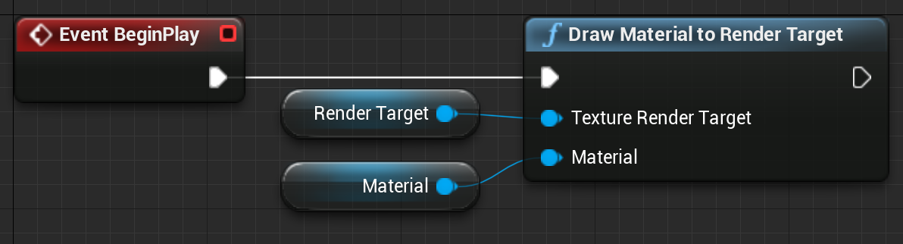
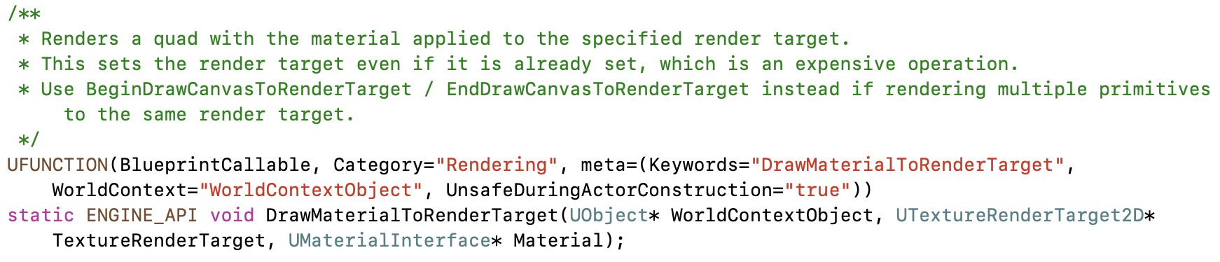
Blueprint Blocks
⇔ C++ Functions
One of the hardest things when getting started programming in an engine like UE5 is knowing what functions already exist and are available for you to use.
Fortunately, every core block in Blueprint is backed by a C++ function. Unless it was specified with a different display name, the function will have the same name as the Blueprint block, with spaces removed.
Search the code .h files for a matching function name. Include that .h at the top of your C++ file for access to the function.

Slide 10
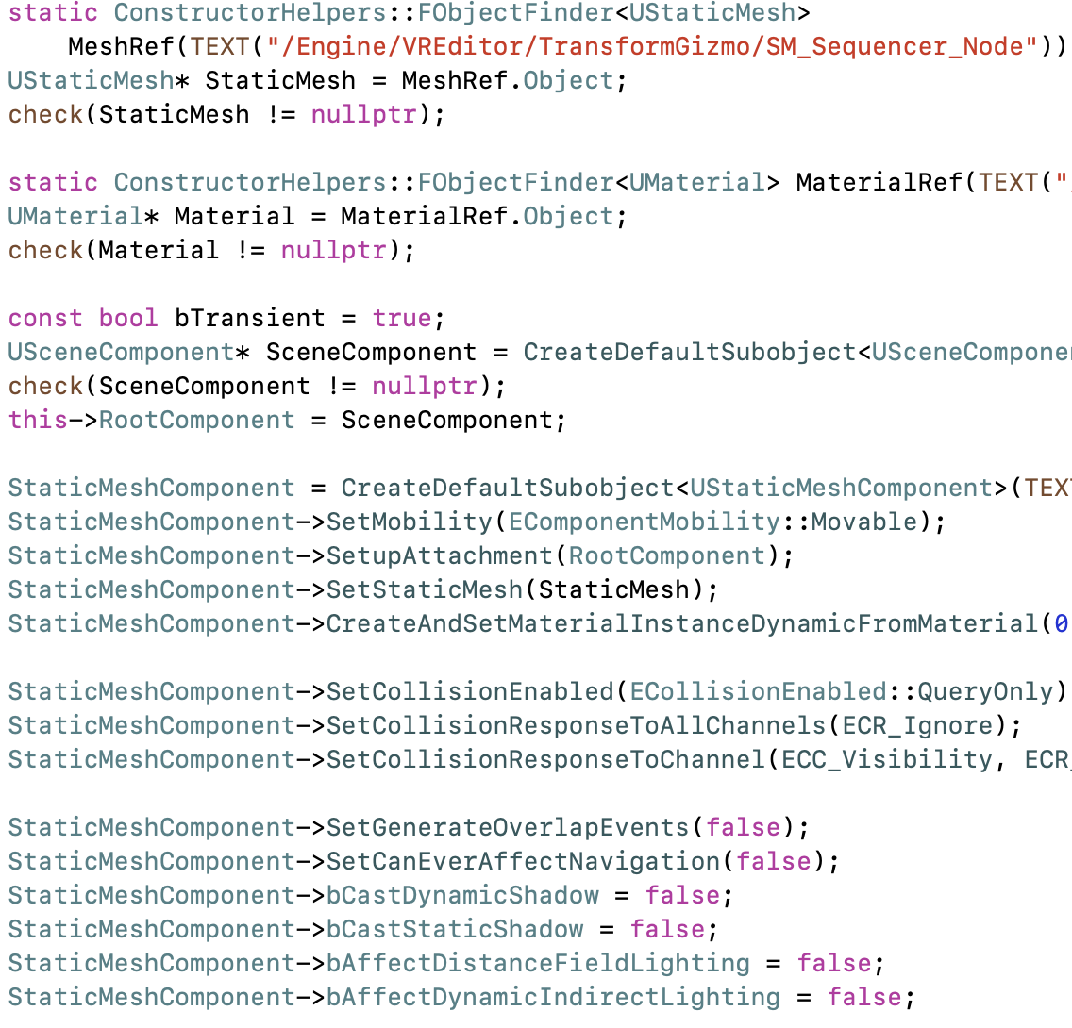
Engine Examples
Many of the things you want to do in Actor code are already done someplace in the engine. If you want to know how to use a particular component, search the engine .cpp files for someplace else where it is used.
If you don’t find an example of the particular component class, examples using its base class or a class derived from it can also prove useful.

Slide 11
Actor Debugging

Slide 12
Running in the IDE
If you have C++ code in the project, it’ll generate a Visual Studio sln or Mac xcworkspace file in the project directory. You can open and run from this file.
If you are running your UE5 from a full engine source build and place the project into the UE5 directory, it’ll also be added to the UE5 Editor’s sln or xcworkspace.
Now you can run and debug your game project within the IDE. This includes C++ Actor code, plugins, or other code.

Slide 13
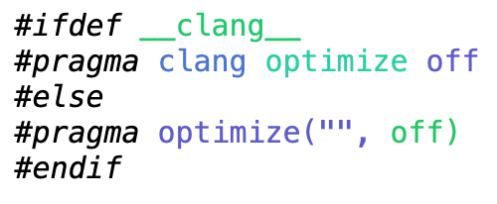
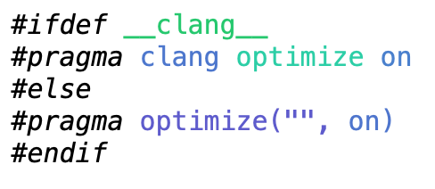
Turning Off Optimization
Compiler optimization can remove variables, rearrange code, and otherwise make debugging difficult. You can turn off optimization in a single .cpp file or around a single function using a pragma.
UE5 combines files together when building for efficiency, so be sure to turn the optimization back on after the code you are debugging.
And don’t forget to remove the pragma blocks when you are done debugging the file!

Slide 14
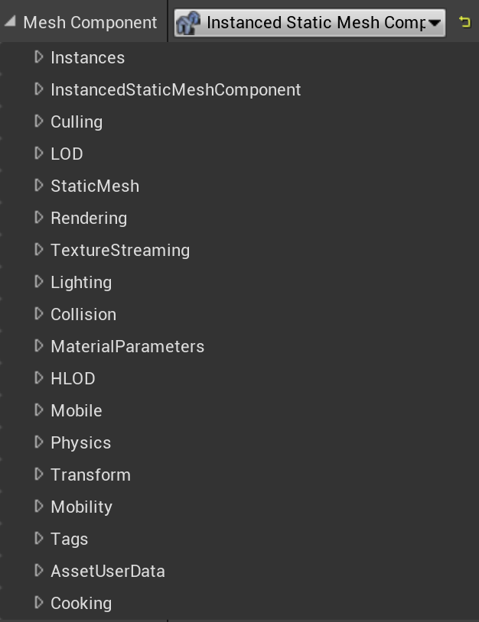
Exposing as a UPROPERTY
Even for data you don’t ultimately want to have in the editor interface for your class, it can be useful to be able to see its values while debugging. Tag the data with “UPROPERTY(EditAnywhere)” or “UPROPERTY(VisibleAnywhere)” to be able to see it in the Details window.
Don’t forget to switch back to “UPROPERTY()” when you’re done!

Slide 15
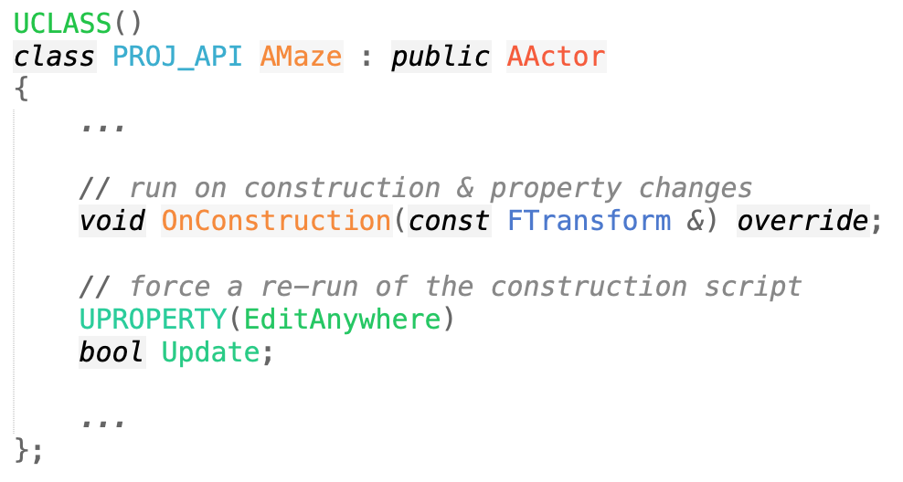
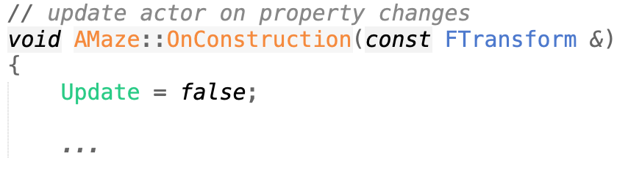
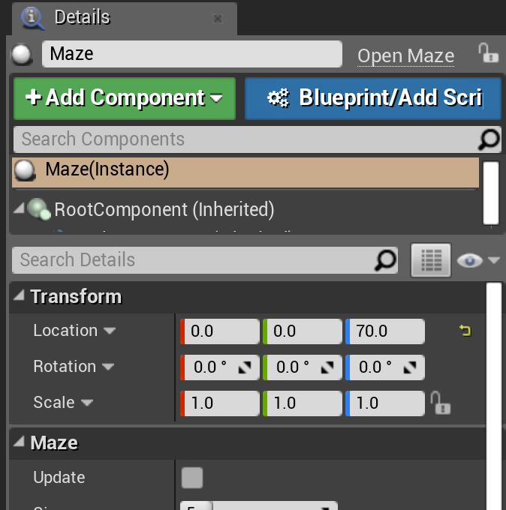
Update Button
Especially when testing an OnConstruction script, it can be handy to have a way to force it to rerun. Since it runs on any change, create a dummy Boolean data member. That will display as a check box, and your OnConstruction function will execute if it changes.
Set it back to false in the OnConstruction function to uncheck it again, ready for the next update.

Slide 16
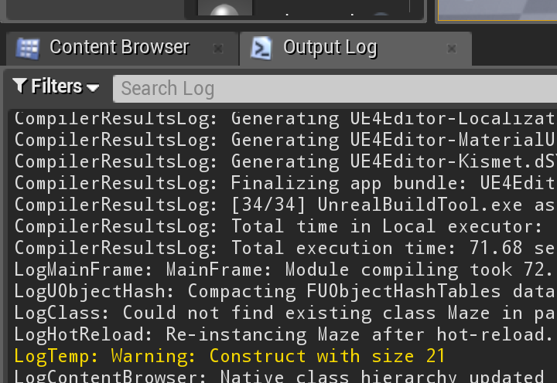
Messages
You can print log messages with UE_LOG().These messages will appear in the Output Log window and in the console output.
For more, see the Unreal Engine wiki.

Slide 17
Blueprint Actor Example

Slide 18
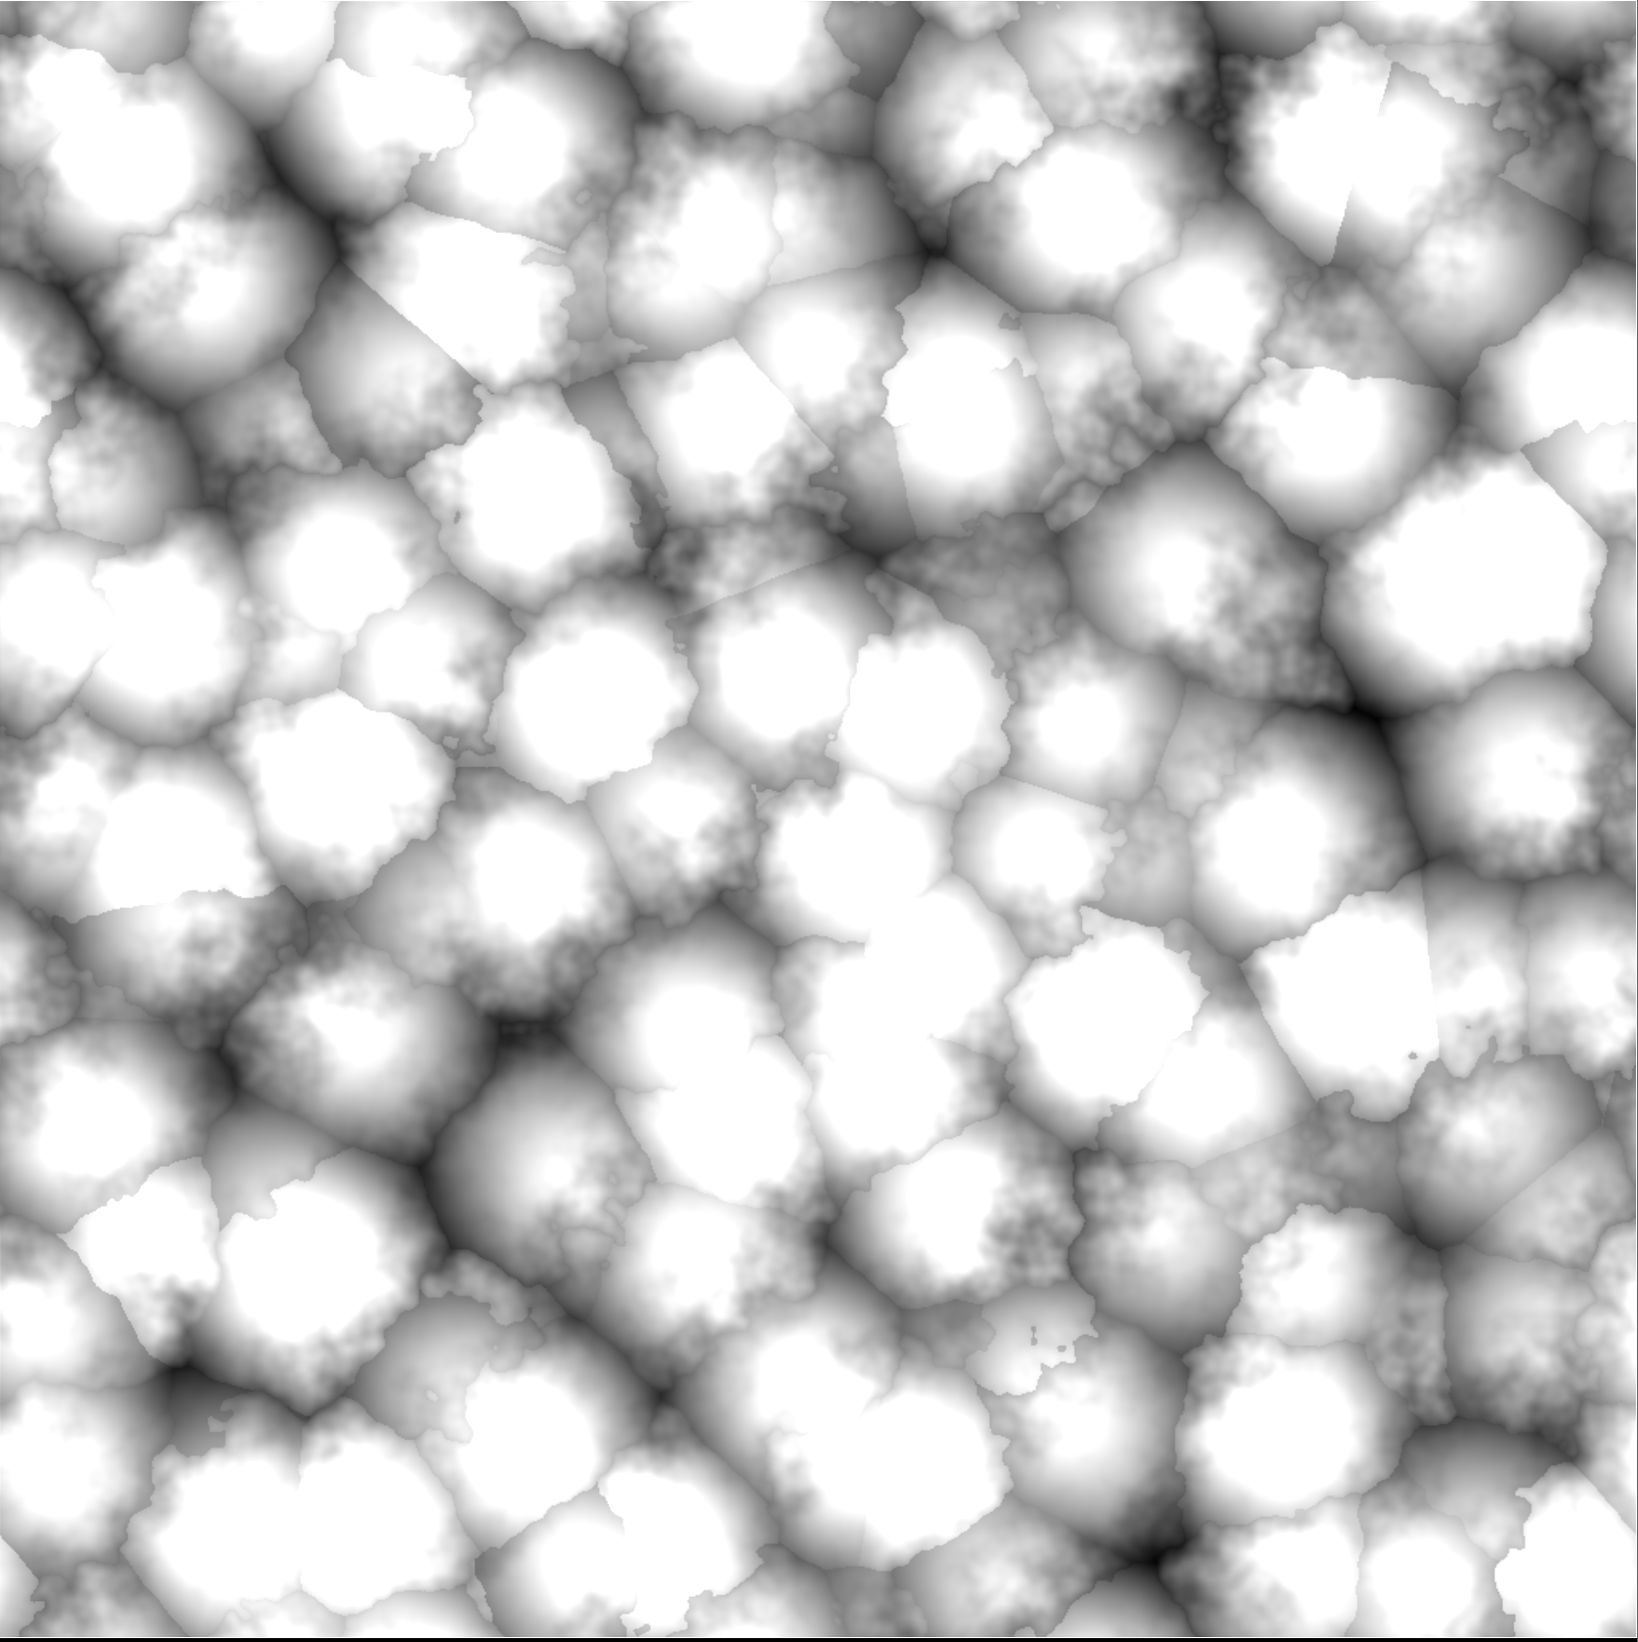

Baking Materials
An expensive Material can take significant runtime. Something like the Noise nodes or a cloud density for ray marching is used again and again in its shader.
It can be more efficient to run it once and store the result into a Texture. This is sometimes called baking the Material into a Texture.
An artist can develop a Material look with expensive operations live in the Editor, where performance does not matter as much, then all or part of the Material can be baked into Textures to be more efficient.
Some expensive lighting computations might be baked during development or at game or level load.

Slide 19
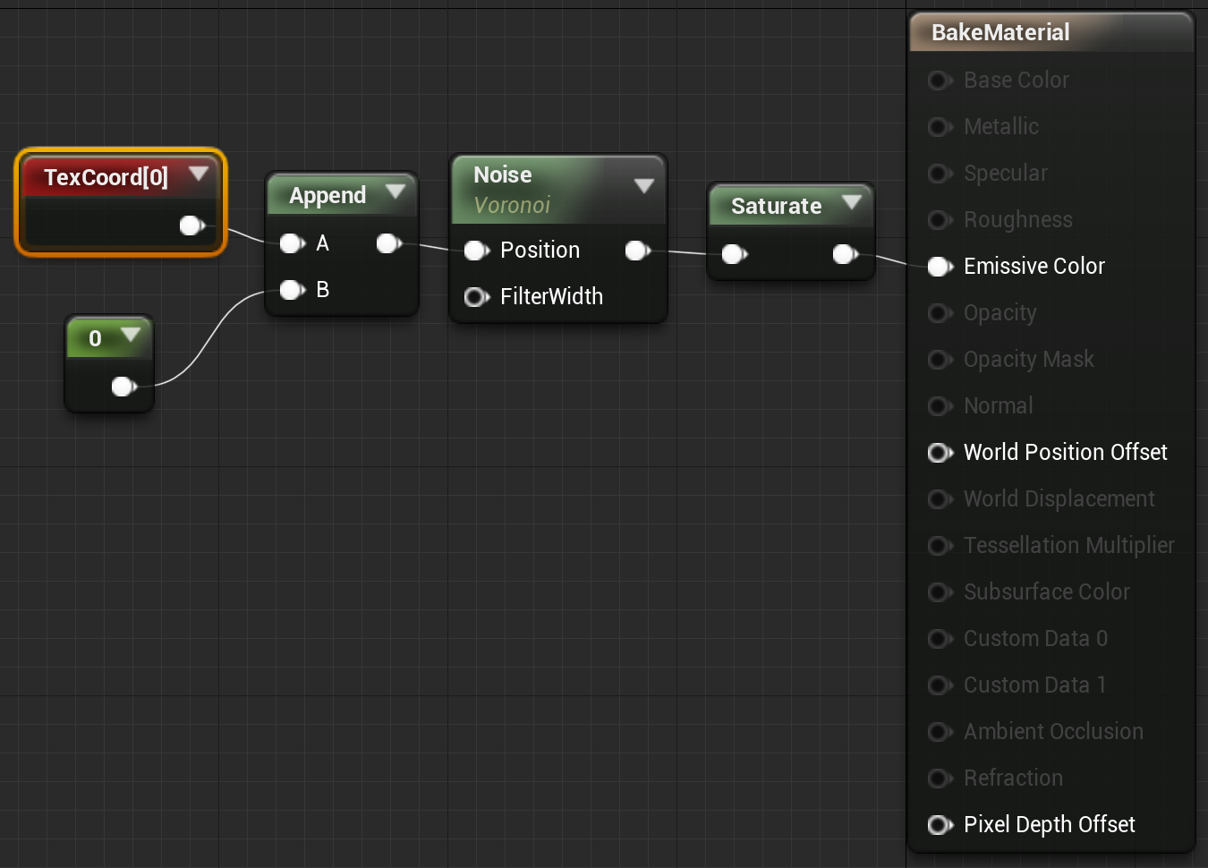
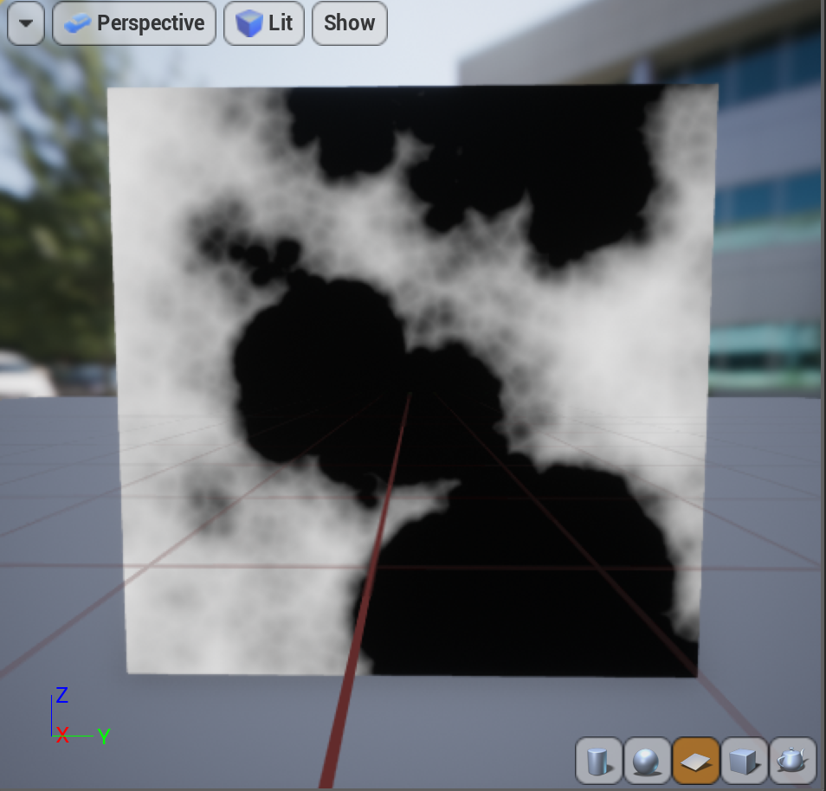
Complex Material
When drawing the Material to a Texture, we won’t have 3D position or lighting.
Create an Unlit Material, using Texture coordinates as input, and preview it on a square.
The example on the right is just using six octaves of the Voronoi noise. Though not that complex a Material expression, it is still too computationally expensive to use directly in most games.

Slide 20
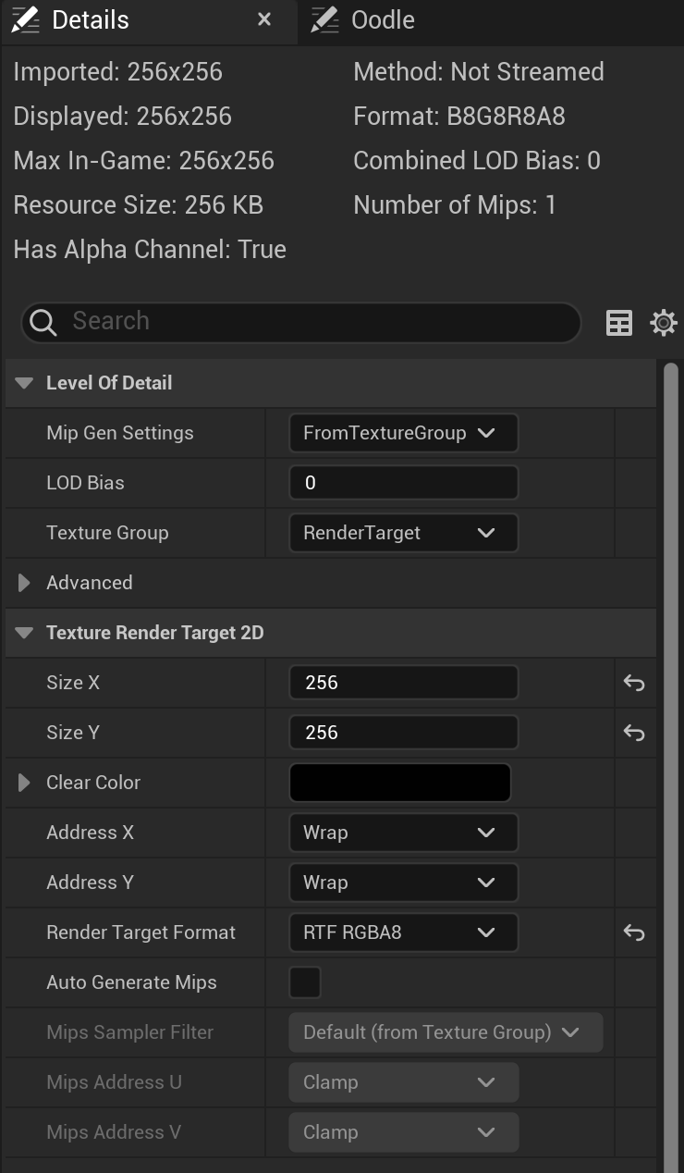
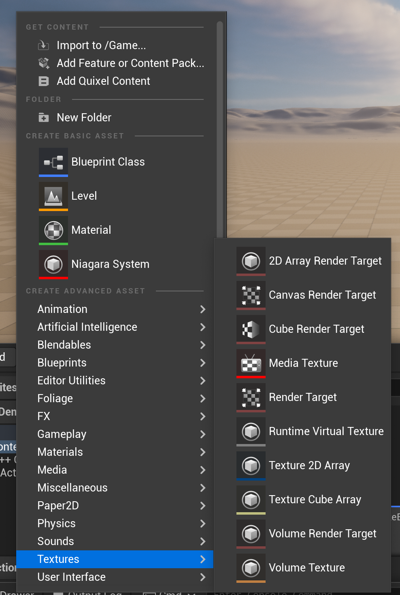
Render Target
To fill a Texture on the GPU, we need a special form of Texture called a Render Target. You can find it in the Materials & Textures section of the Create Advanced Asset menu.
Since we’re generating an actual color rather than other data, change the format to RTF RGBA8, which is 8-bits per channel, holding values between 0 and 1.

Slide 21
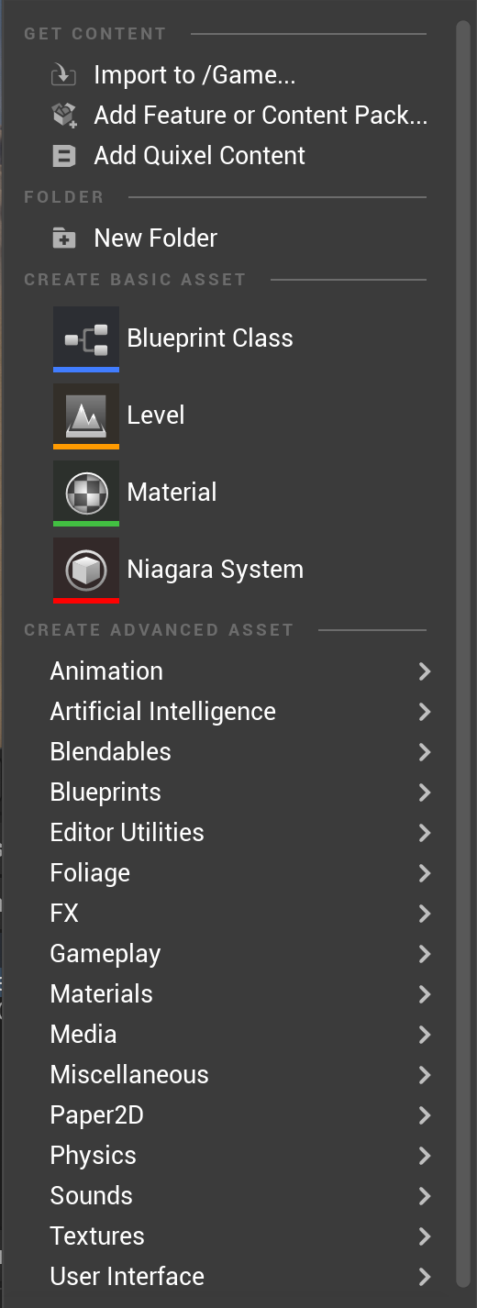
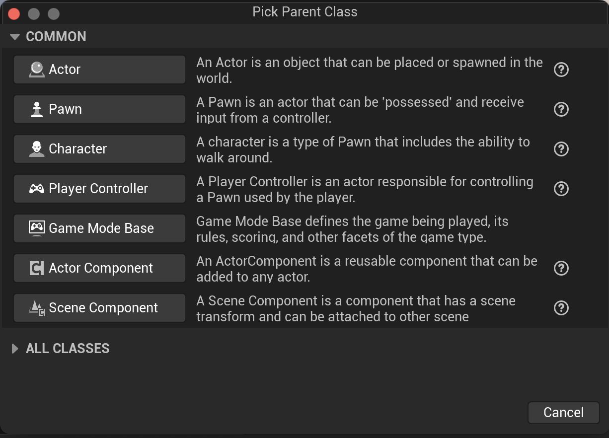
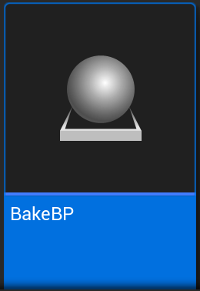
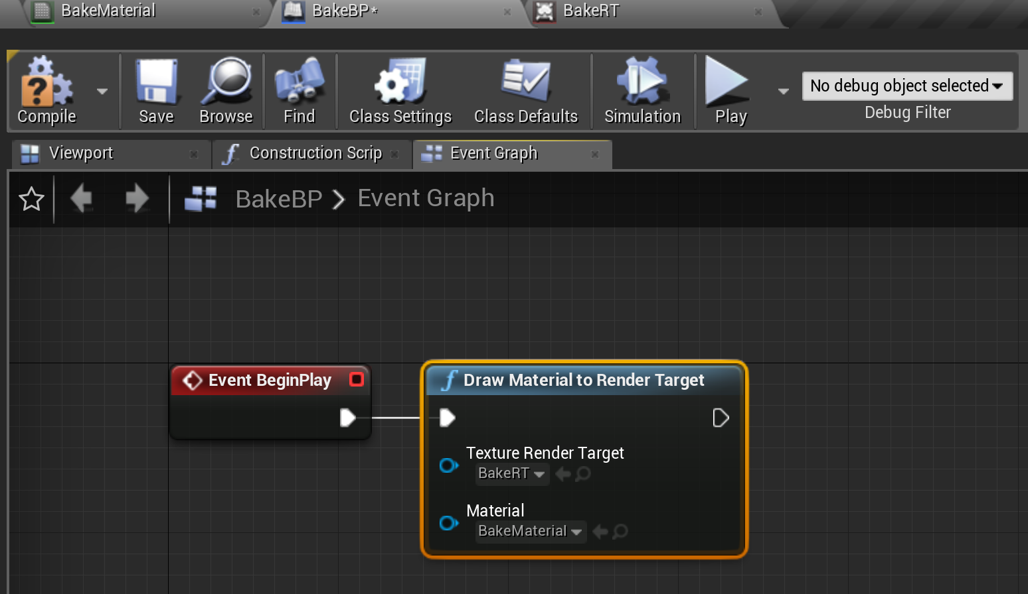
Bake with Blueprint
Create a Blueprint Actor
Drop an instance of this actor into the map.
Open it and switch to Event Graph
Attach a Draw Material to Render Target node to Begin Play
Set the Material and Render Target

Slide 22
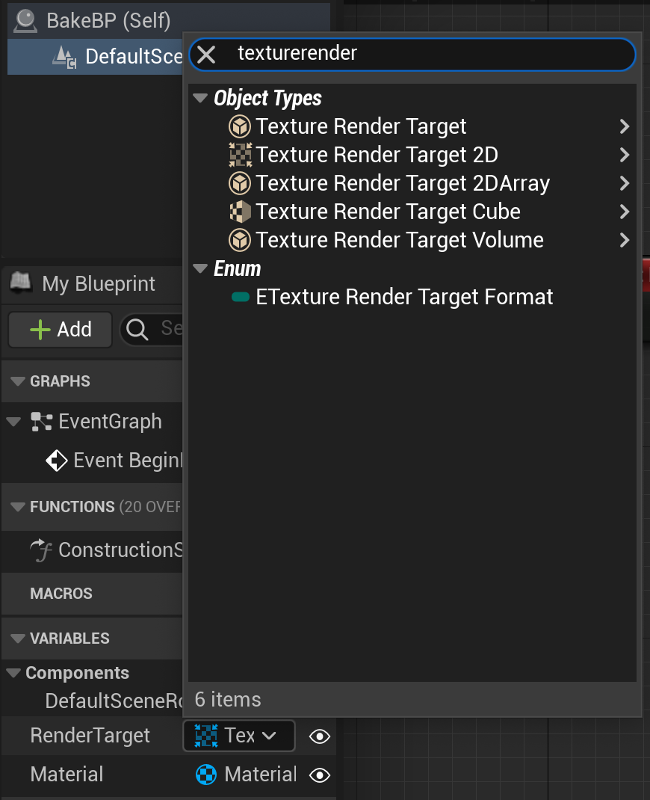
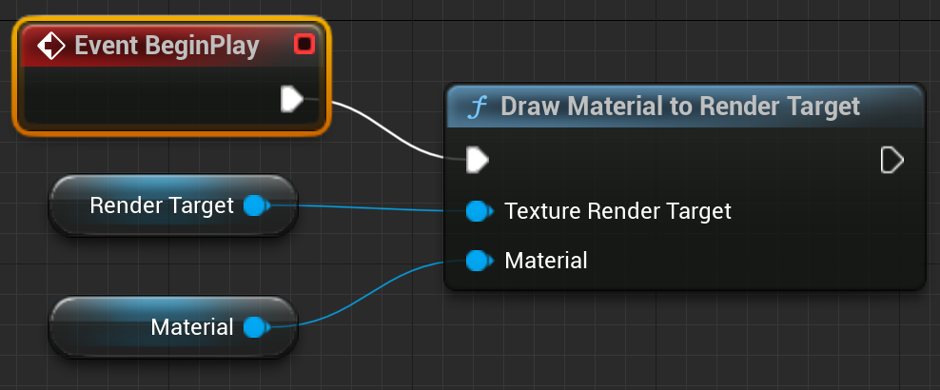
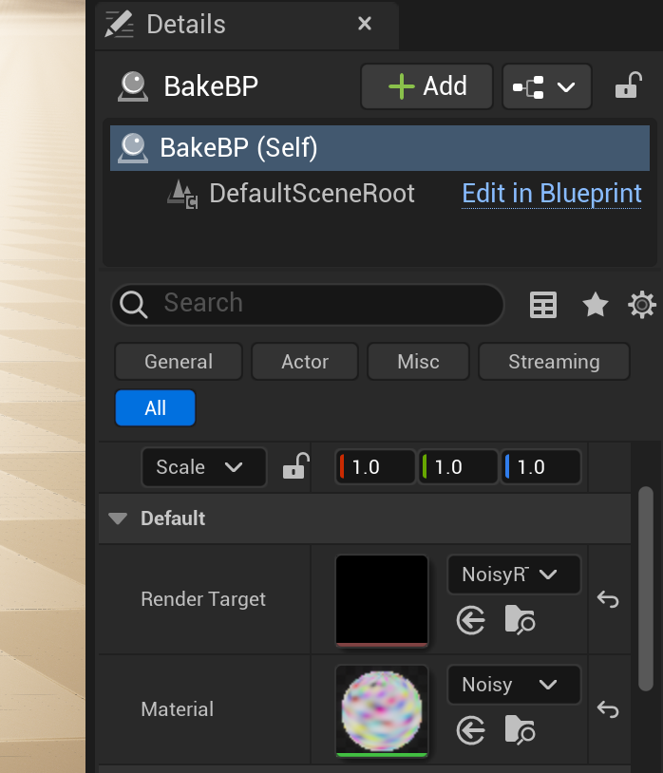
Blueprint Variables
To make the blueprint more flexible, you can add variables for the render target (change the variable type to TextureRenderTarget2D), and material (change the variable type to Material).
Make sure the eye icon next to each variable is open so it will be visible.
Drag the variables into the blueprint to get their values, and hook them up.
Set them in the Details panel of the blueprint actor in the scene.

Slide 23
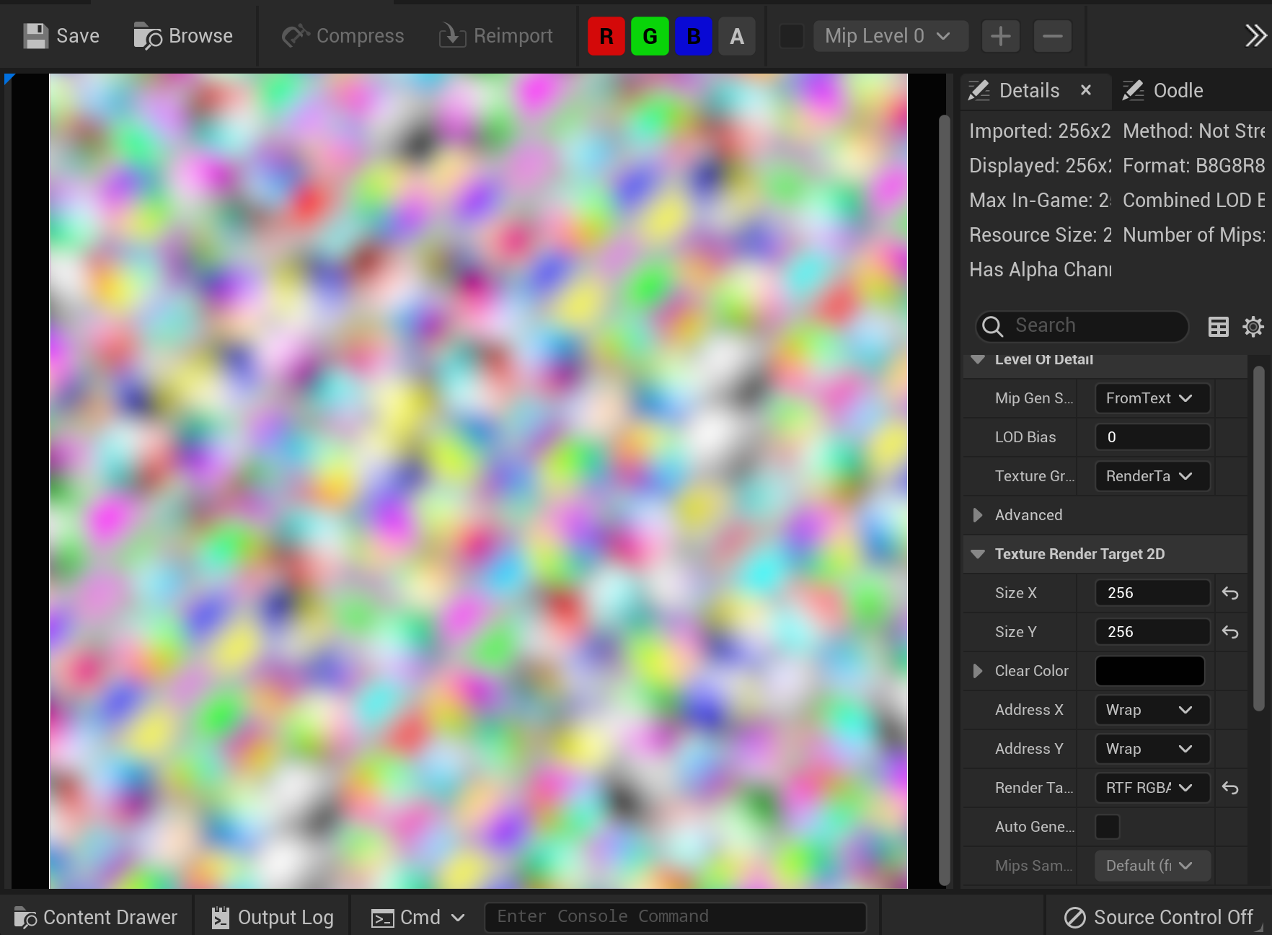
Testing
Hit “Play In Editor”. Once it has started, hit “Escape”.
Open your Render Target, and you should see the baked data filled in.
For 4-channel Textures (RGBA), you’ll need to open the RenderTarget view menu and uncheck “Alpha”, or the Render Target will appear transparent even though the data is there.

Slide 24
C++ Actor Example

Slide 25
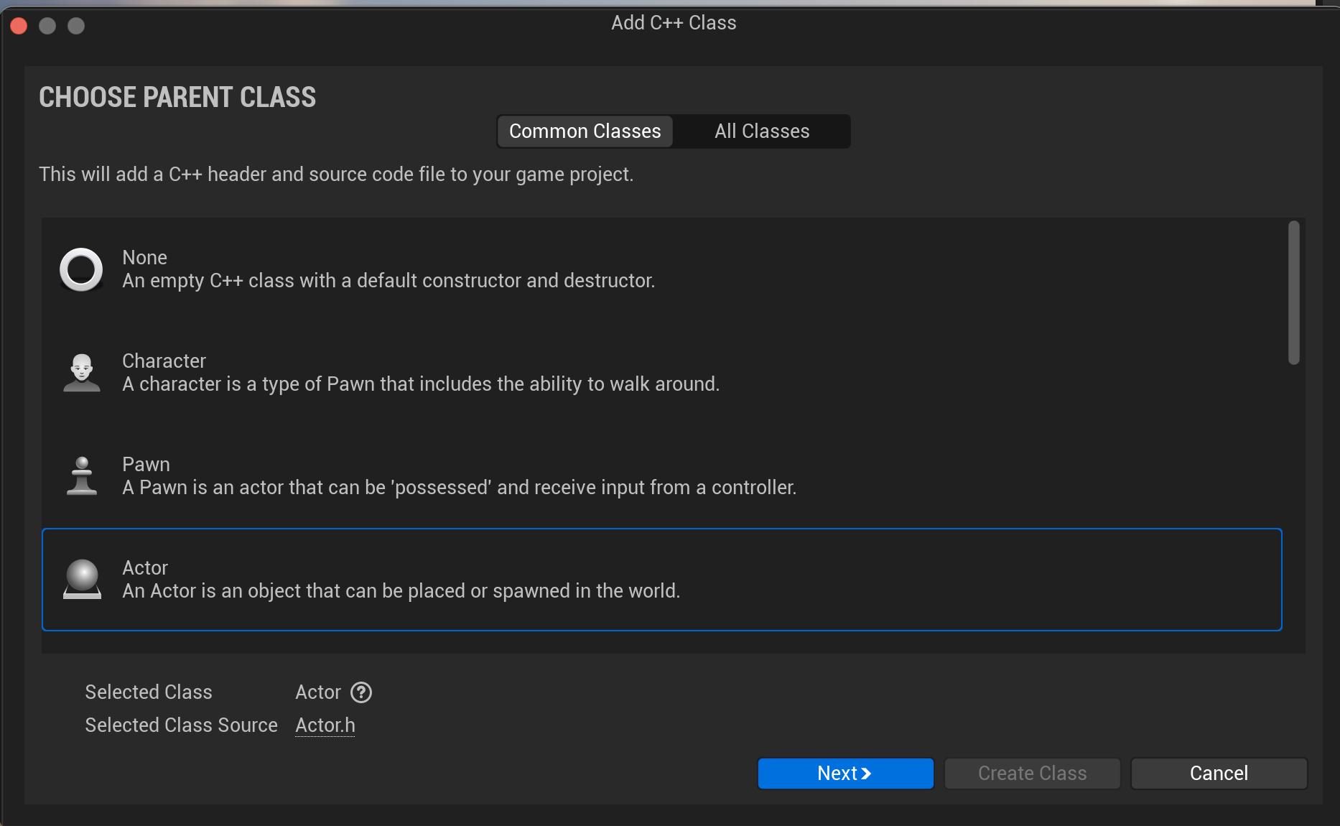
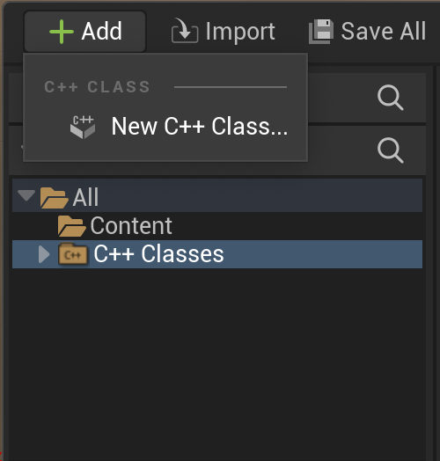
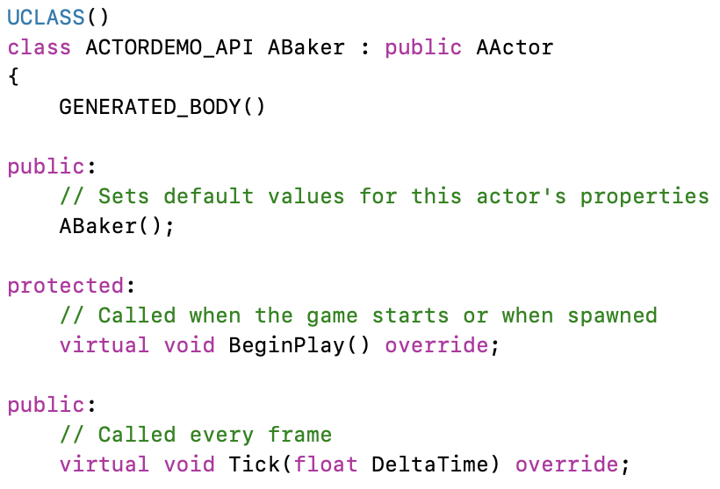
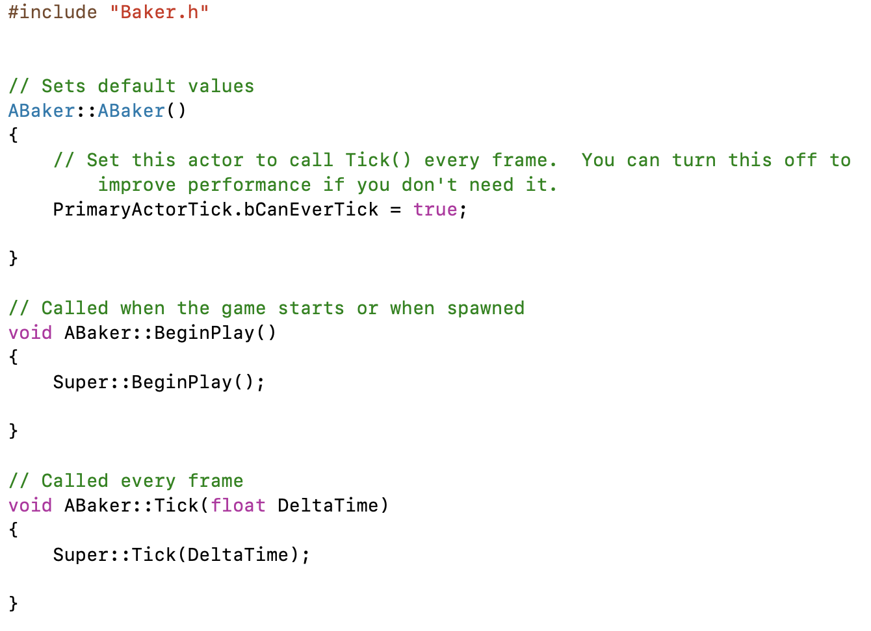
Create C++ Actor
Create a C++ Actor in the C++ Classes folder
The new class files will be created with boilerplate code for BeginPlay and Tick functions.
We don’t need to tick every frame, so can remove the Tick functions.

Slide 26
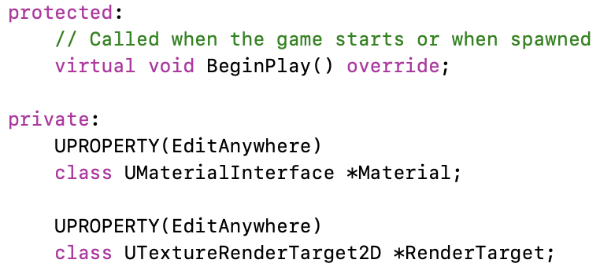
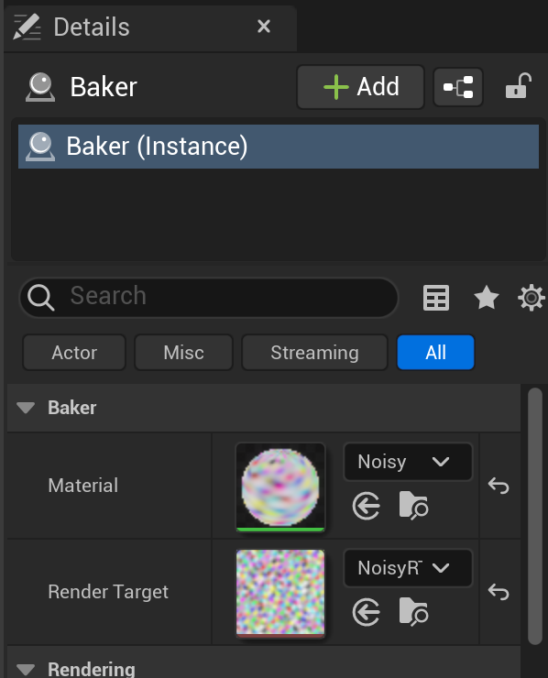
Adding Properties
We can add the RenderTarget and Material as editable RenderProperties to the Actor’s header.
After you compile, and drag the Actor into the scene, the new properties will show up in the Details panel.
You can fill those properties with the Material and render target assets created earlier.

Slide 27
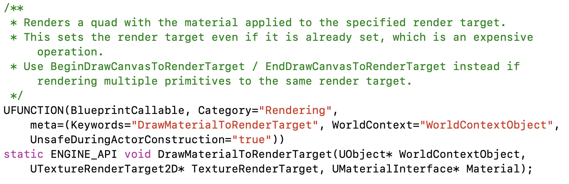
Finding a Function
Knowing a Blueprint function exists to draw a Material to render target, we can search for “DrawMaterialToRenderTarget”. To reduce the number of hits, search in just .h files.
We find it in KismetRenderingLibrary.h.
This needs a WorldContextObject, samples in the code use this.
It also needs a UTextureRenderTarget2D and UMaterialInterface that will have to come from somewhere.

Slide 28
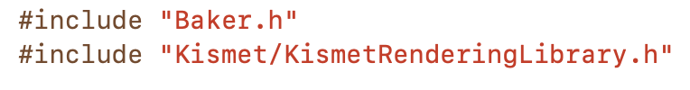
Code Implementation
For the implementation in C++ code, you just need to add the #include to get access to the KismetRenderingLibrary functions and call DrawMaterialToRenderTarget.
It’s good to include a check in case Material or RenderTarget has not been filled in yet.

Slide 29
Extensions

Slide 30
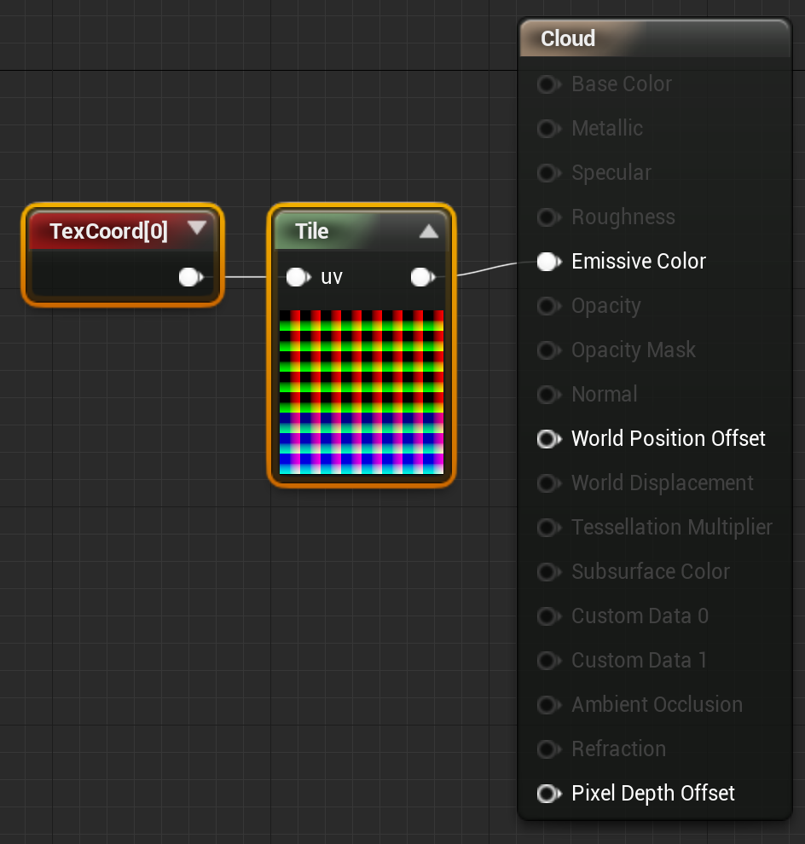
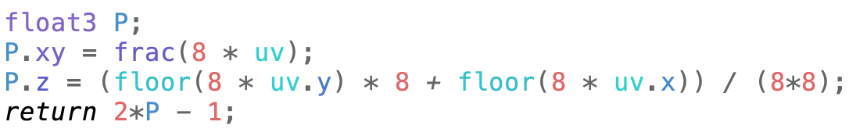
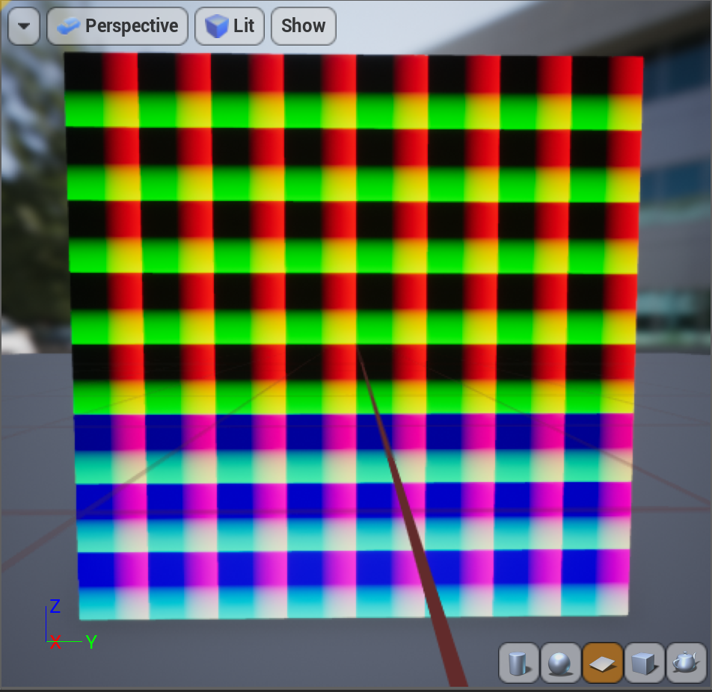
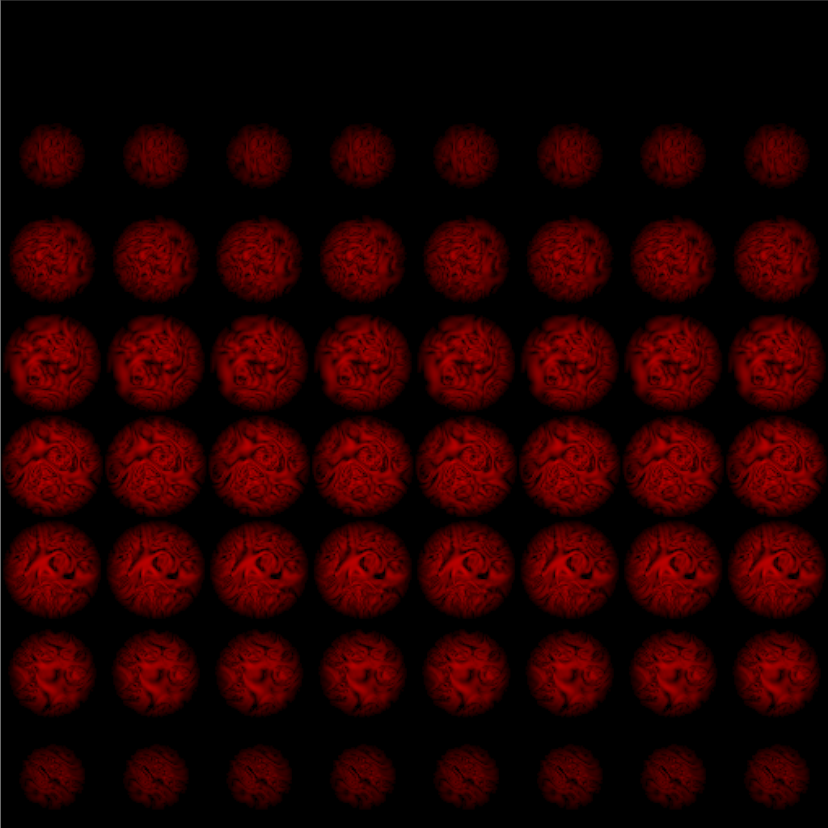
3D Materials
For 3D Materials like cloud density, set up a tiling function to turn Texture coordinates into a stack of 2D tiles.
This simple tiling works for Textures that don’t repeat, allowing 64 tiles, each 64x64 pixels in a 512x512 Texture.
If you need the volume to repeat in x, y, and z, you’d use a slightly more complex tiling function with a little overlap between the right and left sides of each tile, top and bottom, and first tile to last tile.

Slide 31
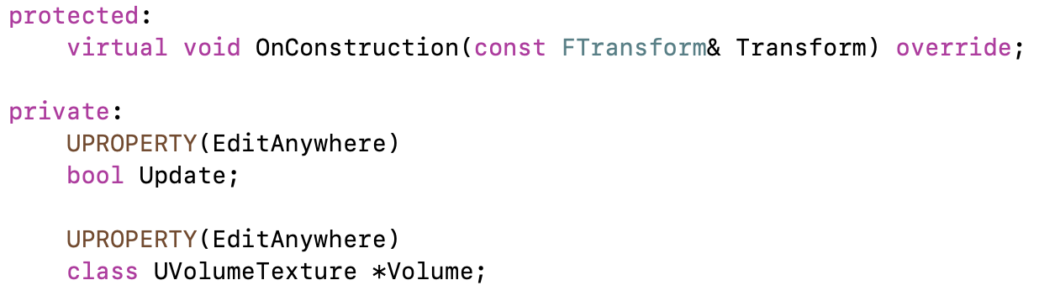
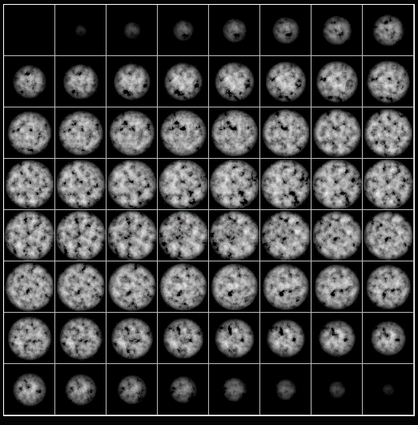

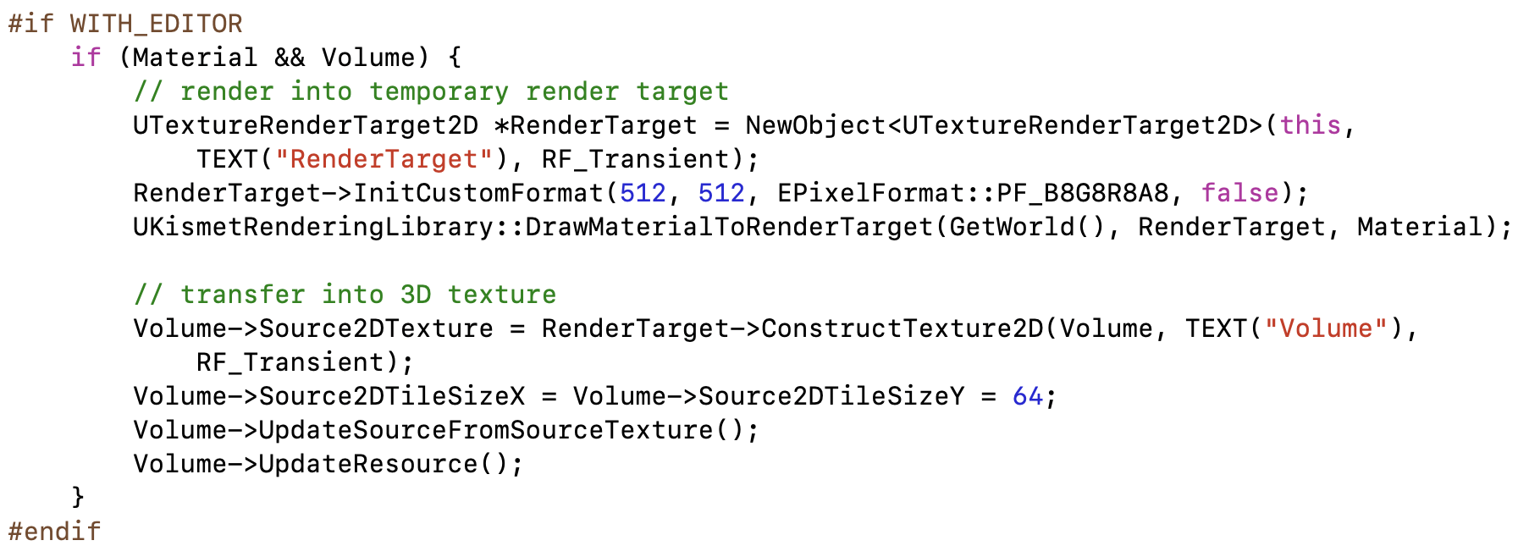
Bake on Demand
Rather than bake on BeginPlay, you could do it on another event (or just in a bake-everything Level), and add code to convert it to a regular serialized Texture after generation.
Just run the bake when something changes, then the Texture is available to use in the real Level.
The version shown on the right uses a temporary render target and 2D Texture to bake into a Volume Texture, something that is not possible in Blueprint.

Slide 32
Live Updates
In contrast to the previous extension to make baking an explicit preprocessing step, you could also use this approach to capture live data in the game to use during shading.
The approach can be used for footprints or tire tracks in snow or mud, foliage motion, velocities to drive smoke motion, damage, . . .

Slide 33
Classes

Slide 34
Class Hierarchy
APawn
UObject
UObjectBaseUtility
AActor
UObjectBase
Character Actor
All Actors in scene
Any Object with serialization and garbage collection
Utility functions for all Objects (and Actors)
Where the garbage collection and serialization are actually implemented
While Blueprint or code examples are a great way to discover functions and classes that are available to Actor code, it is also helpful to browse the class definitions for data you can access, functions you can call, and virtual functions you can override.

Slide 35
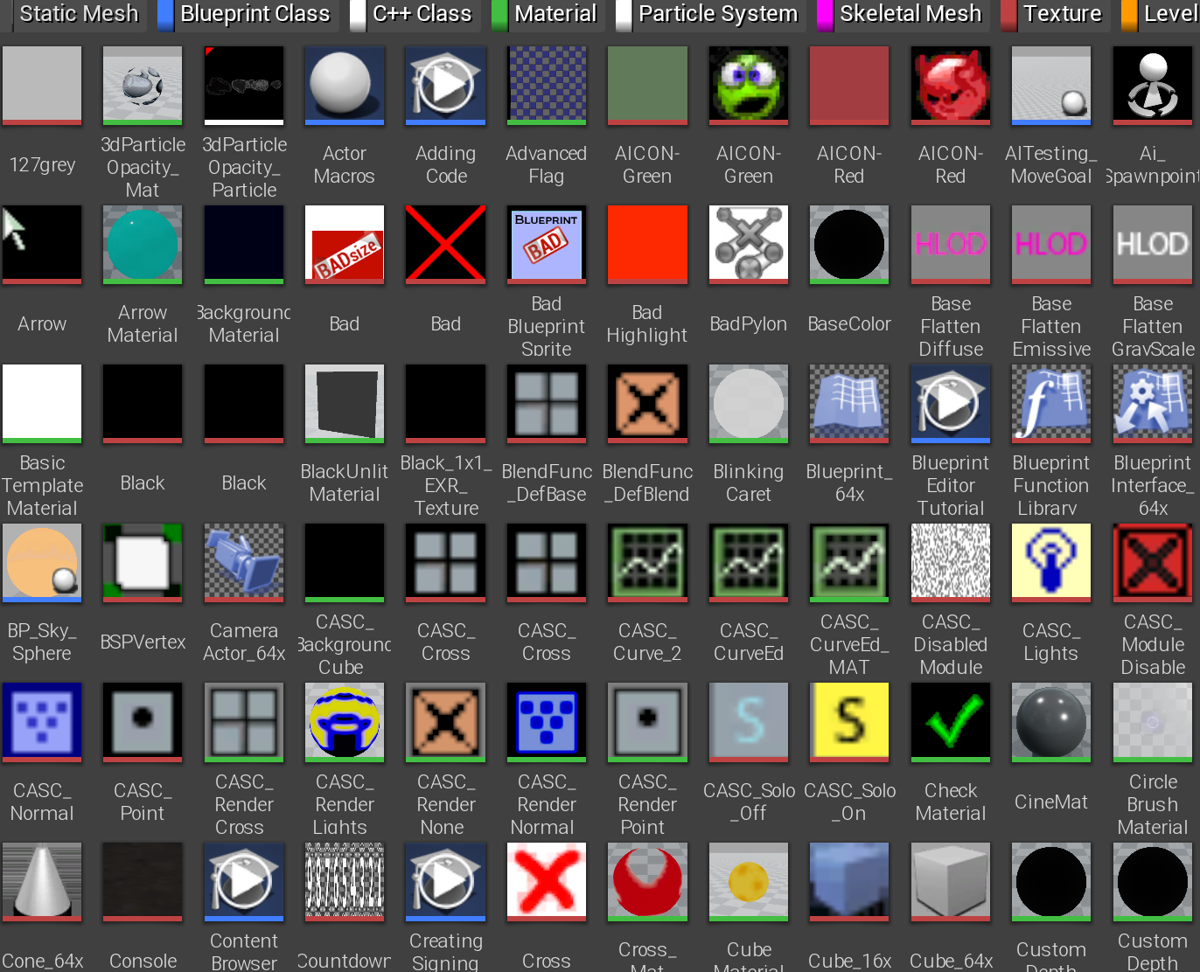
UObject
The base class for all Actors, Components, and Pawns is UObject. Most things derived from UObject have a name starting with “U” to make them easier to identify.
UObjects and classes derived from them support garbage collection and serialization (saving and loading) of all class states. All UObjects have a name, and can be looked up by name.
There are many virtual functions in the UObject base class: to run before or after a save or load, to change serialization from the default (especially for backward compatibility), and many more.

Slide 36
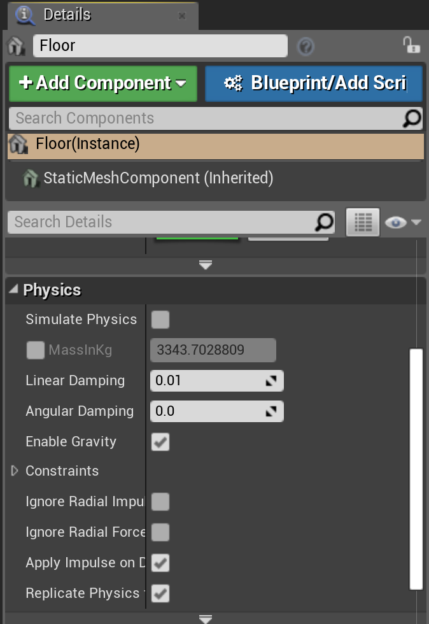
Actor Components
A component is a class that implements common behavior to be shared by many different types of Actors.
You can use components in both Blueprint and C++ Actors to add behavior, and can create new components to be used by both Blueprint and C++ Actors.
Common examples include Scene Components for Actor position, Mesh Components for rendering, Physics and movement components for Actor motion, AI components for behavior, and Networking components for communication.

Slide 37
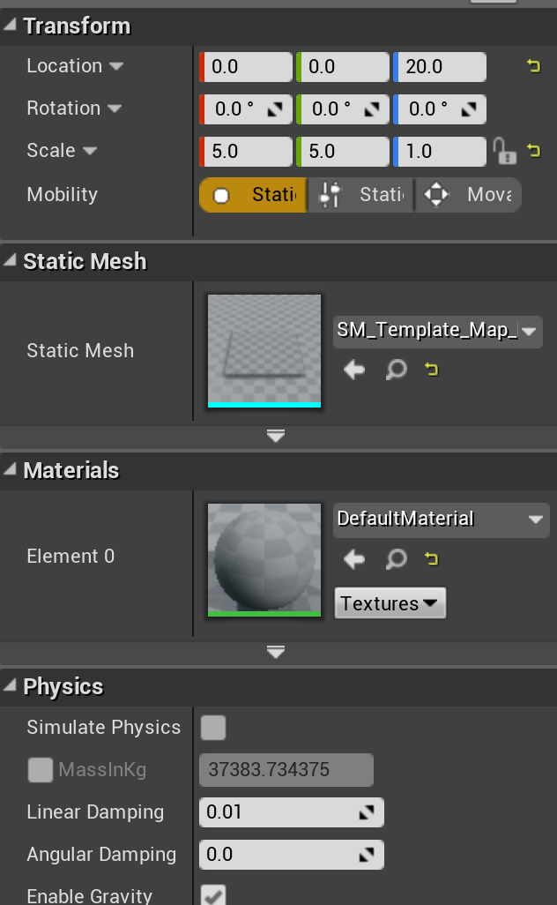
UActorComponent
The base class for all components is derived from UObject, so inherits all its functions and data.
It adds the ability to activate and deactivate the component, and BeginPlay, EndPlay, and TickComponent virtual functions for overriding behavior.
Two key subclasses of UActorComponent are USceneComponent and UPrimitiveComponent.
A Scene Component is used for anything with a position in the scene. Actors often have one Scene Component set as their Root Component to provide the Actor’s position.
A Primitive Component is the base for components that can be drawn or provide a visual representation for an Actor.

Slide 38

AActor
The AActor class is derived from UObject, but the leading character for the AActor class and any derived from it is switched to “A”.
It’s worth browsing through the (3,000-line!) declaration for the AActor class to see what it provides. These include the following:
Virtual functions you can override with new behavior like BeginPlay, Tick, etc.
Network replication functions and data
Child Actors, Child components
Functions and data for handling position, collisions, damage
Don’t forget to set one Scene Component as the Root Component of the Actor to be able to position it.

Slide 39

Pawns
A Pawn is an Actor that can be controlled by either the user or AI. The Pawn class is derived from the Actor class, so inherits all the functionality of the base Actor class.
Pawns are controlled by a Player or AI Controller, and controllers can be swapped without changing the underlying pawn
Why separate Pawn and Controller? Think about a sports game where the user can switch between any player on the field while AI controls the rest.

Slide 40

APawn
The APawn class is derived from AActor and adds virtual functions for controller and AI input.

Slide 41

AController
AController is also derived from AActor.
It is the common base class for APlayerController and AAIController

Slide 42
Summary

Slide 43
To Recap
Make a C++ project, then create a C++ Actor, Pawn, or ActorComponent class.
Add code to the constructor for defaults, OnConstruction for initialization, BeginPlay for start-of-game, and Tick or TickComponent for continuing action during play.
Add a SceneComponent to Actors for positioning, Primitive component(s) for rendering, and other components for other behavior.
Add member variables tagged with “UPROPERTY()” for data that can be set, saved, and loaded in the engine.
Look at Blueprint blocks, engine code examples, and base class declarations to figure out what functions and data are available.

