Slide 1
GPU Hardware
UMBC Graphics for Games

Slide 2
GPU Architecture

Slide 3
CPU vs GPU Goals
CPU
Make one thread go very fast
Avoid pipeline stalls
Complex control
Continue work past stalls
Predict work before the stall
GPU
Make 1000’s of threads running the same program go very fast
Hide stalls
Share hardware
All running the same program
Swap threads to hide stalls
Large, flexible register set
Enough for active and stalled threads

Slide 4
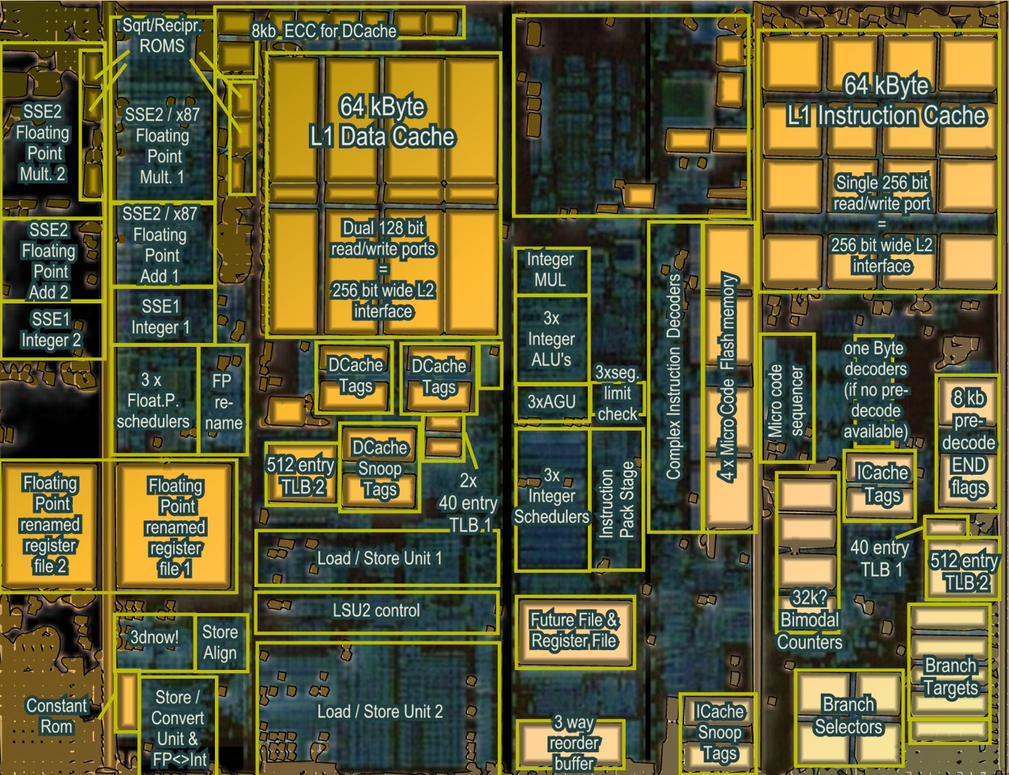
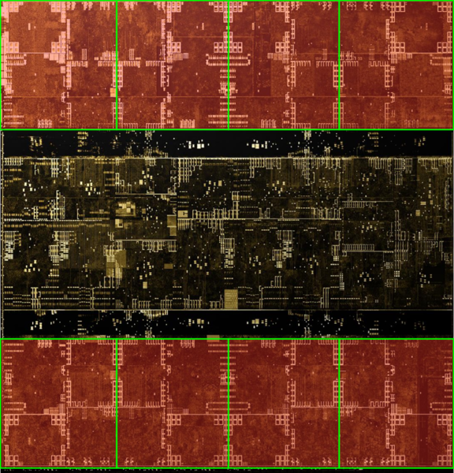
Architecture (MIMD vs SIMD)
Actual computational Units
SIMD (GPU-Like)
MIMD (CPU-Like)
(AMD K10 chip-architect.org)
(NVIDIA Volta / wikichip.org)
Flexibility
Horsepower
Ease of Use

Slide 5
SIMD Branching
if( x ) // mask threads
{
// issue instructions
}
else // invert mask
{
// issue instructions
} // unmask
Threads agree
Threads disagree
or
THEN

Slide 6
SIMD Looping
Active
% Active = Utilization
Inactive
while(x) // update mask
{
// do stuff
}
Everyone runs as long as slowest
This example: 36% utilization (64 blocks useful work / 176 blocks potential work)

Slide 7
GPU Programming Model
Vertex
Vertex Shader
Runs on one vertex at a time
Rasterizer
Collects sets of three vertices
Pixel
Runs on one pixel at a time
Texture/ Buffer/ Cache
Rasterize
Displayed Pixels
Pixel
Z-buffer/ Blend

Slide 8
GPU Processing Model
SIMD for efficiency
Same processors for vertex & pixel
SIMD Batches
Limits on # of vertices & pixels that can run together
Improve Utilization
Limit divergence
Basic scheduling
If batch of pixels, run it
Otherwise run some vertices to make more pixels
Texture/ Buffer/ Cache
Vertex
Displayed Pixels
Pixel
Z-buffer/ Blend
Rasterize

Slide 9
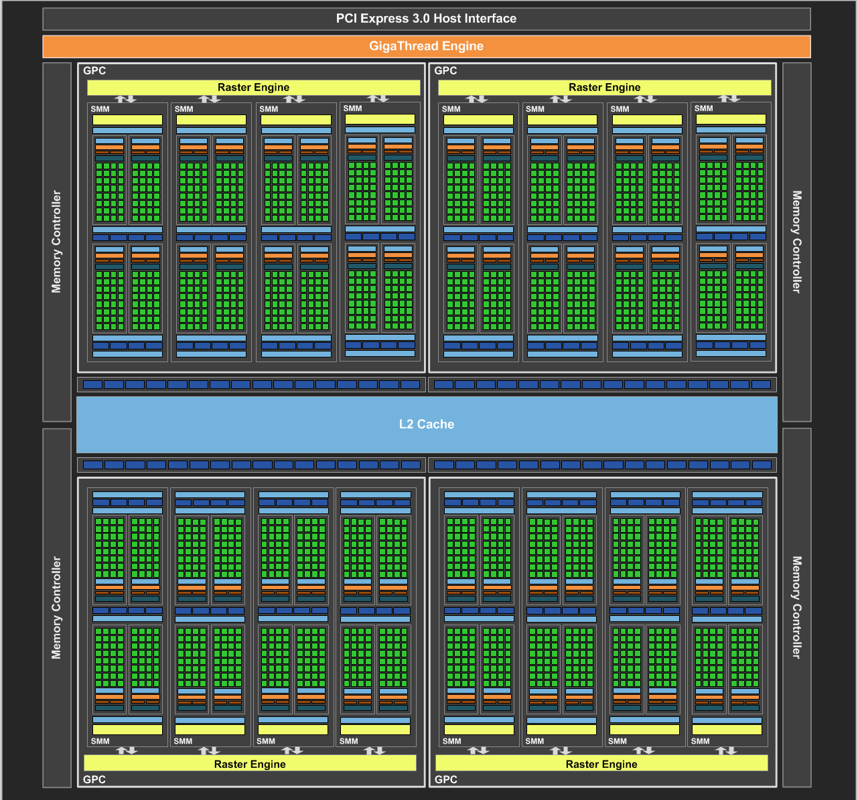
NVIDIA Maxwell
[NVIDIA GeForce GTX 980 Whitepaper, 2014]

Slide 10
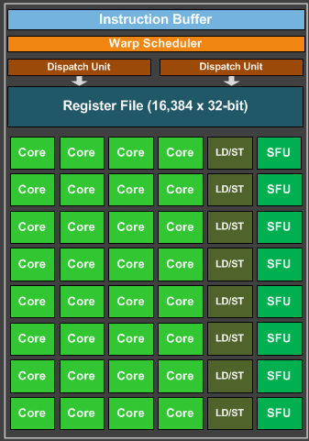
Maxwell SIMD Processing Block
32 Cores
8 Special Function Units (SFU)
Double precision, trig, …
Still issue 1/thread, but run ¼ rate
8 Load/Store
Hide latency by interleaving threads
Wave (AMD) / Warp (NVIDIA)
One set of lanes (AMD) / threads (NVIDIA)
Want at least 4-8 interleaved
% of max = Occupancy

Slide 11
GPU Registers
Scalar General Purpose Register (SGPR)
Same value for all threads
AMD term — Pixar’s RenderMan (& GLSL) called these uniform
Vector General Purpose Registers (VGPR)
Different value in every thread
AMD term — Pixar & GLSL called these varying
# wavefronts usually limited by VGPR

Slide 12
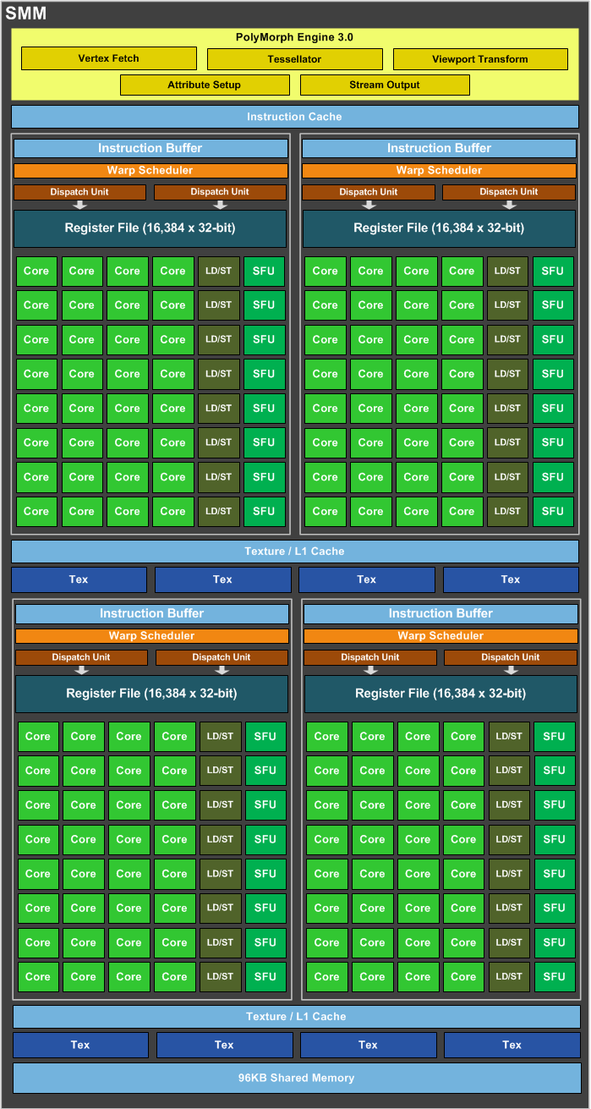
Maxwell Streaming Multiprocessor (SMM)
4 SIMD blocks (128 total cores)
Share L1 Caches
Between-core shared memory
Communication through this memory is fast
Share tessellation HW
Hardware support for tessellation shaders

Slide 13
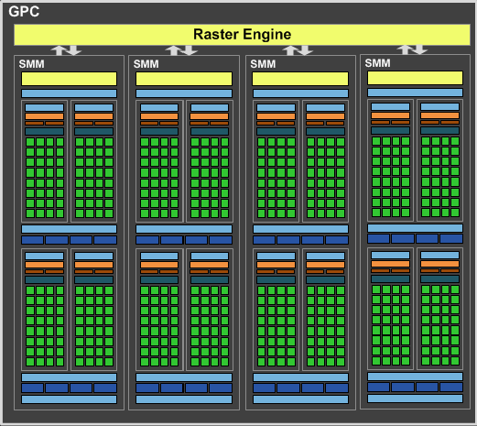
Maxwell Graphics Processing Cluster (GPC)
4 SMM (512 total cores)
Share rasterizer

Slide 14
Full NVIDIA Maxwell
4 GPC (2048 total cores)
Share L2
Share dispatch
Decides which threads to launch and when

Slide 15
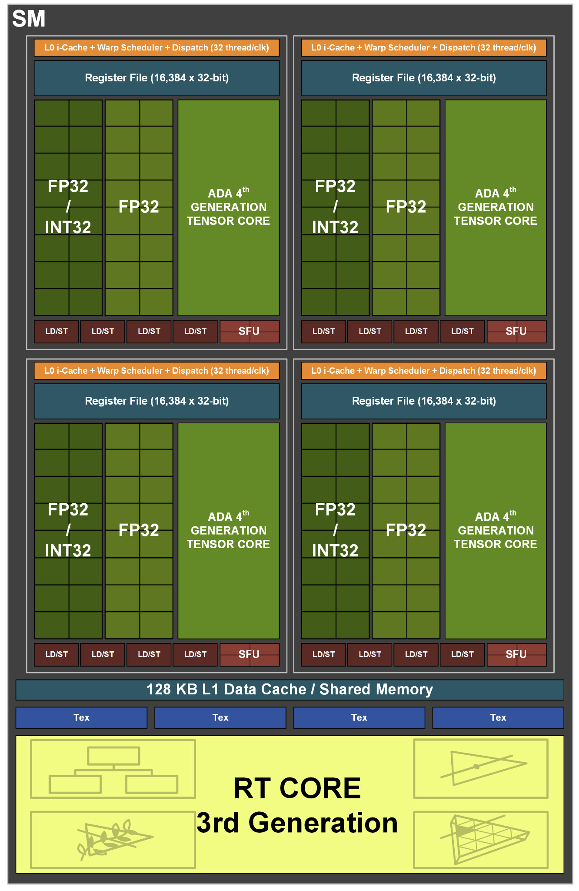
Things in newer GPUs
MMMMMOOOORRRRREEEE CORES
NVIDIA Ada: up to 18,432 cores
Tensor cores = bunch of 4/8/16-bit multiply-add/matrix multiply cores
Targeting AI applications, but general purpose
Hardware support for new shader types
Mesh shaders
Ray tracing hardware at SM level
Adjust balance of float, int, and memory units
[NVIDIA Ada GPU Architecture, 2022]

Slide 16
Care and Feeding of a GPU

Slide 17
Graphics System Architecture
Your Code
Engine
Display
GPU
GPU
GPU(s)
API / Driver
Produce
Consume
Current Frame
(Buffering Commands)
Previous Frame(s)
(Submitted, Pending Execution)

Slide 18
Parallel Submission
Any thread can build Command Lists & submit to GPU when ready
A Command List includes all necessary state, can execute in any order
Command list execution will overlap on GPU
Tell GPU about resource dependencies (Barriers / Transitions)
Enforces partial ordering of command list execution

Slide 19
Resource Transitions
What kind of memory operations does this buffer need to support?
(CPU/GPU) (read/write) (once/many times)
CPU write once, GPU read once; GPU write once, GPU read many times; …
Source/Target stage for the transition
When is it ready? When will it be used?
What use should it be optimized for?
CPU staging, Texture, Render Target, Depth Buffer, Vertex Buffer, Index Buffer, Graphics read/write unordered access view (UAV), Compute buffer, …
Explicitly transition between these
E.g. between render target write in command list A and texture read in command list B

Slide 20
Setting up a Command List
What do I write?
Render Targets, UAVs
Transition/barrier to make sure anyone else reading or writing them is done
What do I read?
Transition if just written or in a different format
What shader(s) am I using?
What shader parameter blocks?
Given by Descriptors & Root Signature

Slide 21
Setting up a Graphics Command List
Begin Pass / End Pass
Primarily necessary for batching on mobile
Rendering Graphics Pipeline State Object (PSO)
Primitive Type: triangle list, fan, strip, quad, points, …
Rasterizer State: Solid/wire frame, two sided / CW side / CCW side, MSAA
Depth/Stencil State: Comparison (<, ≤,=,≠, ≥, >), update?
Blend State:
Transparent layer with opacity 𝛼: 𝛼 * new + (1 - 𝛼) * old
Generalize to (a * new ^{<op>} b * old) for limited selection of a, b, and ^{<op>}

Slide 22
GPU Performance Tips

Slide 23
Communication
Reading results derails the CPU → GPU train…..
Buffer to read answer 2-3 frames later
Significant data will still be slow (e.g. read entire frame buffer)
CPU-GPU communication should be one way
If you must read, do it a few frames later…
Timing, occlusion queries

Slide 24
API & Driver
Merge shader/texture/constant sets
Traverse engine data structures to generate render list; sort render list; traverse list to issue draw command lists
Minimize Draw calls
One instanced draw is much more efficient than many static draws
Minimize CPU → GPU traffic
Use static vertex / index buffers if you can
Copy from CPU to GPU once, then leave there
Use dynamic buffers if you must
With discarding locks: region being updated / region in queue / region being rendered

Slide 25
Dependencies
Be aware of dependencies between command lists
Can cause poor utilization
Use a tool like PIX to identify
Example: transparent objects
Render & blend directly into deferred shading result buffer?
Can’t start until prior pass is done
Render into separate transparent buffer, then composite?
Extra mem, but overlap drawing
Opportunities to overlap & improve utilization can allow “free” work.

Slide 26
Shaders
No unnecessary work!
Precompute constant expressions
Divide by constant → Multiply by reciprocal
x*(1./3.) vs. x/3.
Not always the same in float math, compiler is not allowed to make that optimization
Minimize fetches
Prefer compute (generally)
If ALU/TEX < 4+, ALU is under-utilized
4 = LD/ST to core ratio on Maxwell, worse on newer GPUs
Worse if incoherent accesses, not in cache
If combining static textures, bake it all down…

Slide 27
Shader Occupancy
Know what’s limiting you
Memory bandwidth limited, compute limited, local/shared memory capacity limited, VGPR limited, …
Use perf tools, or try 1x1 texture (guaranteed to be in cache), dummy shaders, etc. to help identify what the bottleneck is for your shader
Limit VGPR usage by specializing shaders
In UE, #ifdefs in shaders, compiles versions with different #define choices
But… exponential growth in number of shader variants to compile
Limit VGPR usage with computation that’s constant across the warp
Can re-merge with cross-wave primitives

Slide 28
Shaders
Careful with flow control
Avoid divergence
Flatten small branches (map to conditional move / predicated instructions)
Prefer simple control structure
Specialize shader (though can lead to 1000’s of shaders)
Double-check the compiler
Shader compilers are getting better…
Look over artists’ shoulders
Material editors give them lots of rope….

Slide 29
Vertices
Cull invisible geometry
Coarse-grained (few thousand triangles) is enough
“Heavy” Geometry load is ~20MTris and rising
Epic released Paragon assets when game was cancelled: characters ~75k triangles
Minimize vertex data
E.g. (position, normal, texture coordinate); (position, normal); (position); …
Or index into separate UAV buffers for each vertex component used
Optimize index buffer
Vertices executed in a full wave with duplicates removed & only run once.
0,1,2, 1,2,3, 2,3,4 ➞ 0,1,2,3,4

Slide 30
Pixels
Small triangles hurt performance
GPU always renders 2x2 pixel blocks (for texture filtering)
Renders extra “fake” pixels to fill block → Waste at triangle edges
UE5 Nanite does compute shader rendering of small primitives to avoid this
Do work per vertex
There are usually less of those (see small triangles)

Slide 31
Pixels
HW is very good at Z culling
Early Z, Hierarchical Z
If possible, submit geometry front to back
“Z Priming” is commonplace (UE5 does this)
Render with simple shader to z-buffer
Then render with real shader
Helps a ton for complex forward shaders, but useful even for G-buffer

Slide 32
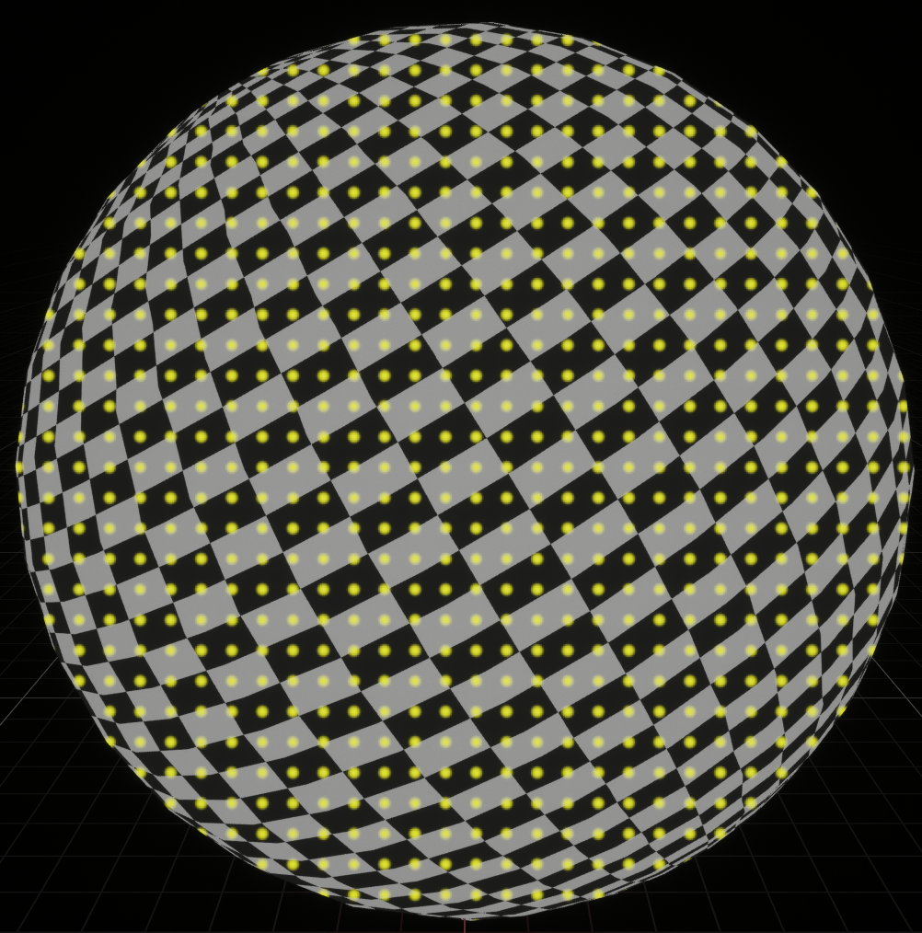
Textures
Respect the texture cache
Adjacent pixels should touch same or adjacent texels
Use mipmap if you can, adjacent in high mip level is cache miss in lowest level
Use the smallest possible texture format
Per texel sizes: DXT5 4b / RGBA8 4B / RGBA16F 8B / RGBA32F 16B
Avoid incoherent texture reads
Commonly from texture used as data table

Slide 33
Frame Buffer
Turn off what you don’t need
Alpha blending
Color/Z writes
Minimize redundant passes
Multiple lights/textures in one pass
As long as it doesn’t kill your occupancy
Use the smallest possible pixel format
8-bit components for 0-1, 1/255 ≈ 0.004 between values
16-bit float when range (±65,504) & precision is good enough
Consider clip/discard in transparent regions
Throws out pixels instead of blending them, does not require sorting

Slide 34
Overall
Learn as much as possible about GPU internals
Use that to guide your optimization decisions
Benchmark, don’t assume
Complex interrelationships can surprise you
Build a good A/B test timing framework
UE has abtest console command: do console command A, time a bit, do B, time a bit, …
Do at least big-picture optimizations early
“Premature optimization is the root of all evil” — Knuth

