Slide 1
Transformations
CMSC 435/634

Slide 2
General Transformations

Slide 3
Transformation
Webster: The operation of changing one configuration or expression into another in accordance with a mathematical rule

Slide 4
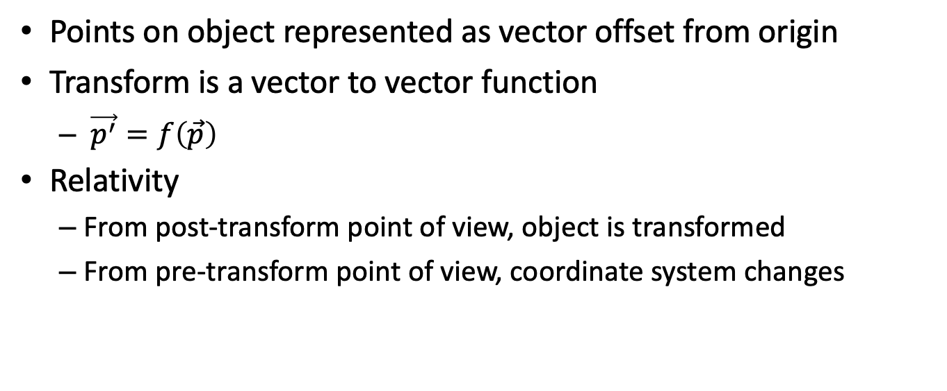
Using Transformation
Points on object represented as vector offset from origin
Transform is a vector to vector function
$\vec{p^{′}}=f\left(\vec{p}\right)$
Relativity
From post-transform point of view, object is transformed
From pre-transform point of view, coordinate system changes

Slide 5

Composing Transforms
Order matters
$R(T(\vec{p}))≠T(R(\vec{p}))$

Slide 6
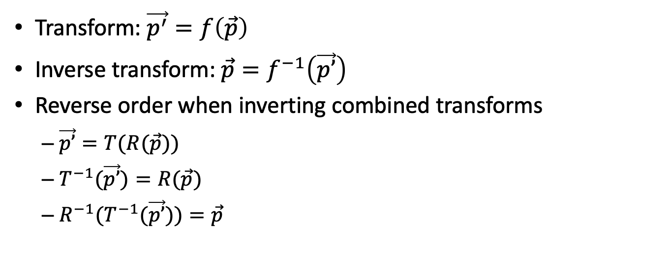
Inverting Transforms
Transform: $\vec{p^{′}}=f\left(\vec{p}\right)$
Inverse transform: $\vec{p}=f^{−1}\left(\vec{p’}\right)$
Reverse order when inverting combined transforms
$\vec{p’}=T(R(\vec{p}))$
$T^{−1}(\vec{p’})=R(\vec{p})$
$R^{−1}{(T}^{−1}(\vec{p’}))=\vec{p}$

Slide 7
Common Transforms

Slide 8
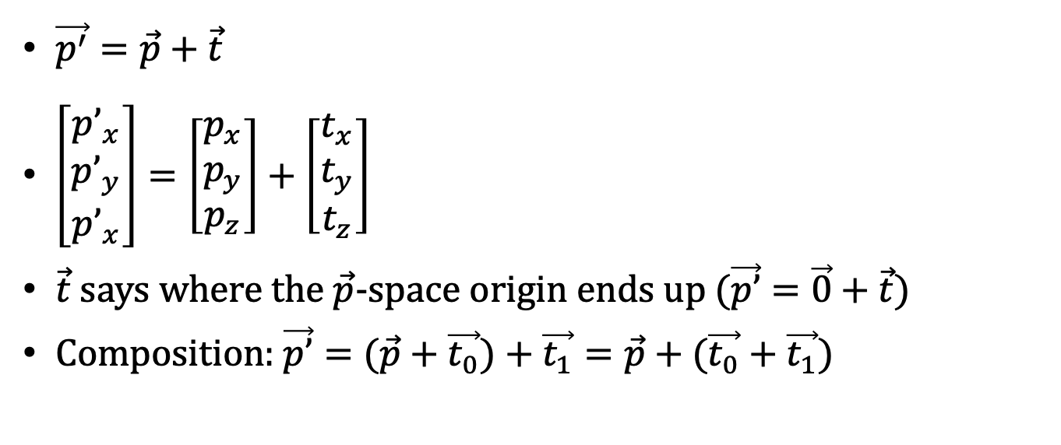
Translation
$\vec{p^{′}}=\vec{p}+\vec{t}$
$\left[\begin{matrix}p’_{x} \\ p’_{y} \\ p’_{x}\end{matrix}\right]=\left[\begin{matrix}p_{x} \\ p_{y} \\ p_{z}\end{matrix}\right]+\left[\begin{matrix}t_{x} \\ t_{y} \\ t_{z}\end{matrix}\right]$
$\vec{t}$ says where the $\vec{p}$-space origin ends up ($\vec{p’}=\vec{0}+\vec{t}$)
Composition: $\vec{p’}=(\vec{p}+\vec{t_{0}})+\vec{t_{1}}=\vec{p}+(\vec{t_{0}}+\vec{t_{1}}$)

Slide 9
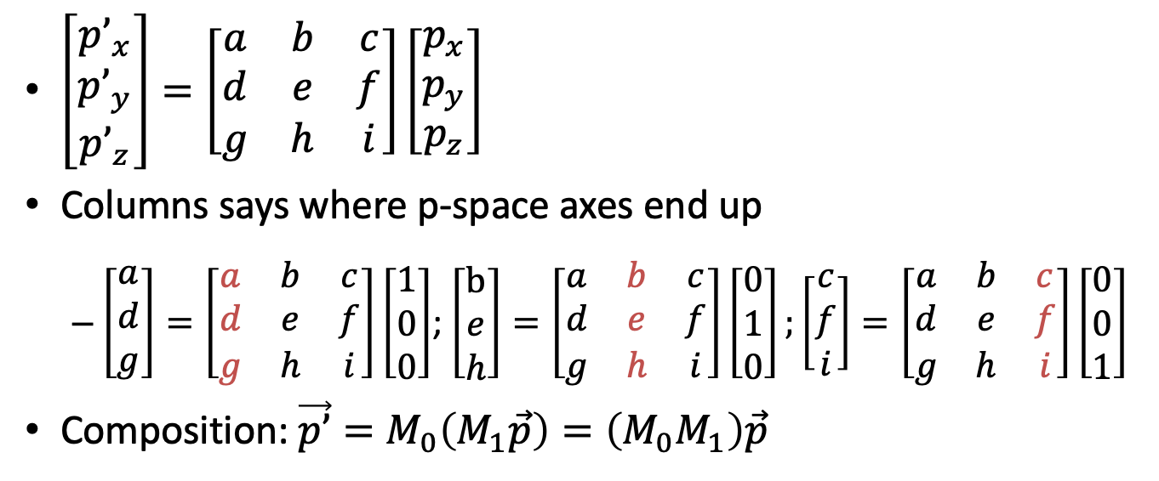
Linear Transforms
$\left[\begin{matrix}p’_{x} \\ p’_{y} \\ p’_{z}\end{matrix}\right]=\left[\begin{matrix}a & b & c \\ d & e & f \\ g & h & i\end{matrix}\right]\left[\begin{matrix}p_{x} \\ p_{y} \\ p_{z}\end{matrix}\right]$
Columns says where p-space axes end up
$\left[\begin{matrix}a \\ d \\ g\end{matrix}\right]=\left[\begin{matrix}a & b & c \\ d & e & f \\ g & h & i\end{matrix}\right]\left[\begin{matrix}1 \\ 0 \\ 0\end{matrix}\right]$; $\left[\begin{matrix}b \\ e \\ h\end{matrix}\right]=\left[\begin{matrix}a & b & c \\ d & e & f \\ g & h & i\end{matrix}\right]\left[\begin{matrix}0 \\ 1 \\ 0\end{matrix}\right];\left[\begin{matrix}c \\ f \\ i\end{matrix}\right]=\left[\begin{matrix}a & b & c \\ d & e & f \\ g & h & i\end{matrix}\right]\left[\begin{matrix}0 \\ 0 \\ 1\end{matrix}\right]$
Composition: $\vec{p’}=M_{0}\left(M_{1}\vec{p}\right)=\left(M_{0}M_{1}\right)\vec{p}$

Slide 10
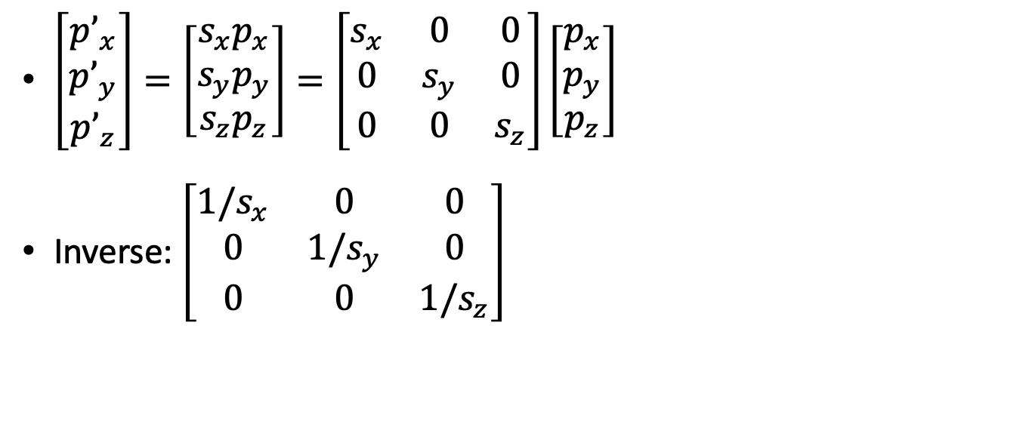
Common Linear Transform: Scaling
$\left[\begin{matrix}p’_{x} \\ p’_{y} \\ p’_{z}\end{matrix}\right]=\left[\begin{matrix}s_{x}p_{x} \\ s_{y}p_{y} \\ s_{z}p_{z}\end{matrix}\right]=\left[\begin{matrix}s_{x} & 0 & 0 \\ 0 & s_{y} & 0 \\ 0 & 0 & s_{z}\end{matrix}\right]\left[\begin{matrix}p_{x} \\ p_{y} \\ p_{z}\end{matrix}\right]$
Inverse: $\left[\begin{matrix}1/s_{x} & 0 & 0 \\ 0 & 1/s_{y} & 0 \\ 0 & 0 & 1/s_{z}\end{matrix}\right]$

Slide 11

Common Linear Transform: Reflection
Negative Scaling
$\left[\begin{matrix}p’_{x} \\ p’_{y} \\ p’_{z}\end{matrix}\right]=\left[\begin{matrix}−p_{x} \\ p_{y} \\ p_{z}\end{matrix}\right]=\left[\begin{matrix}−1 & 0 & 0 \\ 0 & 1 & 0 \\ 0 & 0 & 1\end{matrix}\right]\left[\begin{matrix}p_{x} \\ p_{y} \\ p_{z}\end{matrix}\right]$

Slide 12

Common Linear Transform: Rotation
Rotate around Z axis:
$\vec{p’}=\left[\begin{matrix}\cos{θ} & −\sin{θ} & 0 \\ \sin{θ} & \cos{θ} & 0 \\ 0 & 0 & 1\end{matrix}\right]\vec{p}$
Orthogonal matrix
so $M^{−1}=M^{T}$
All rotations are orthogonal
Axes remain unit-lengths
Axes remain perpendicular

Slide 13
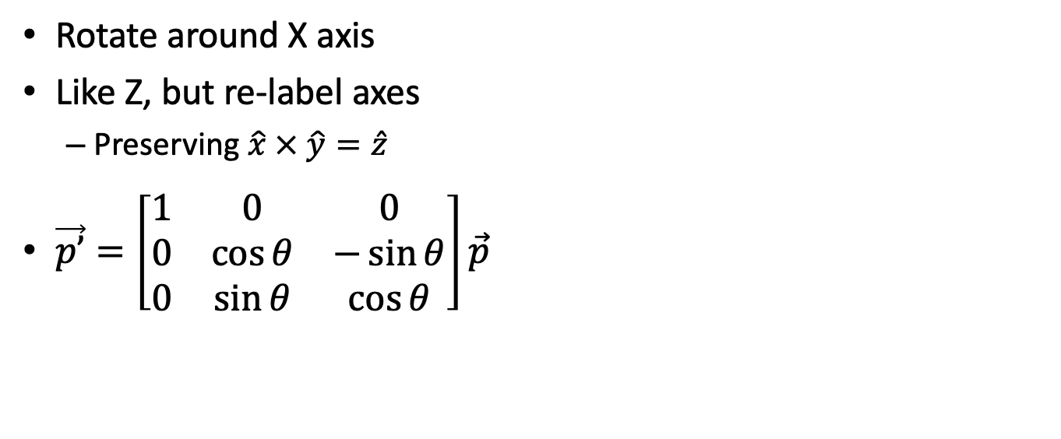
Common Linear Transform: Rotation
Rotate around X axis
Like Z, but re-label axes
Preserving $\hat{x} × \hat{y}=\hat{z}$
$\vec{p’}=\left[\begin{matrix}1 & 0 & 0 \\ 0 & \cos{θ} & −\sin{θ} \\ 0 & \sin{θ} & \cos{θ}\end{matrix}\right]\vec{p}$

Slide 14
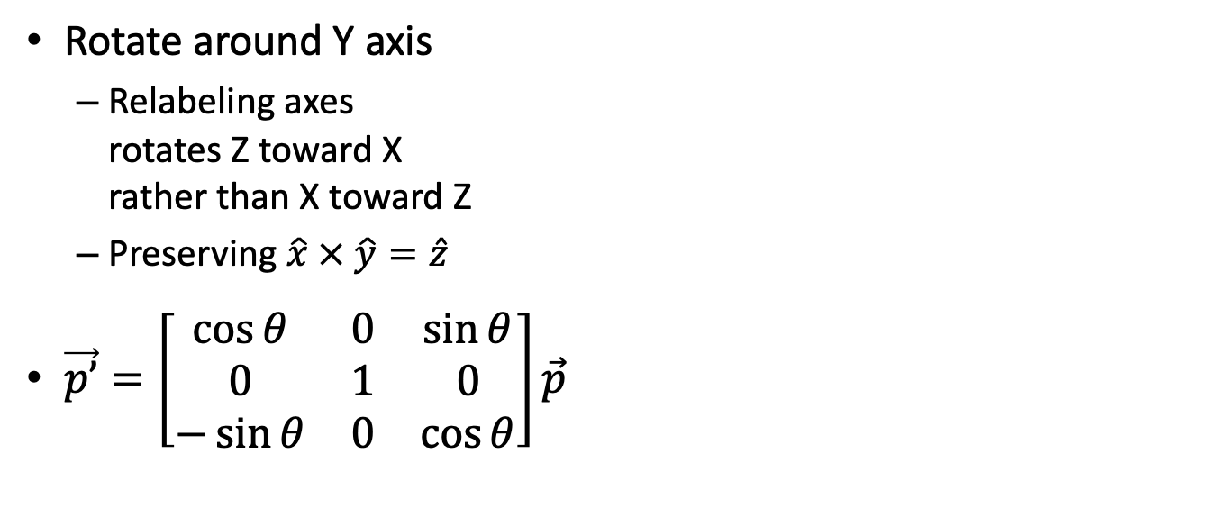
Common Linear Transform: Rotation
Rotate around Y axis
Relabeling axes rotates Z toward X rather than X toward Z
Preserving $\hat{x} × \hat{y}=\hat{z}$
$\vec{p’}=\left[\begin{matrix}\cos{θ} & 0 & \sin{θ} \\ 0 & 1 & 0 \\ −\sin{θ} & 0 & \cos{θ}\end{matrix}\right]\vec{p}$

Slide 15
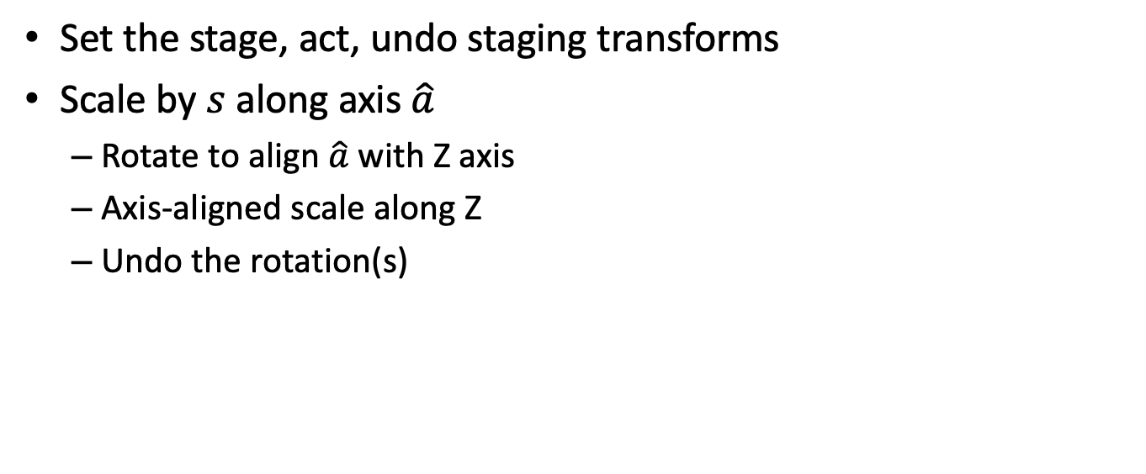
Designing Linear Compositions
Set the stage, act, undo staging transforms
Scale by $s$ along axis $\hat{a}$
Rotate to align $\hat{a}$ with Z axis
Axis-aligned scale along Z
Undo the rotation(s)

Slide 16

Rotate around X into X-Z Plane
$\vec{a_{yz}}=\left(0,a_{y},a_{z}\right)=$ projection of $\hat{a}$ onto Y-Z: plane
Length $\left|\vec{a_{yz}}\right|=d=\sqrt{a_{y}^{2}+a_{z}^{2}}$
So $\cos{α}=a_{z}/d$, $\sin{α}=a_{y}/d$
$R_{X}=\left[\begin{matrix}1 & 0 & 0 \\ 0 & a_{z}/d & −a_{y}/d \\ 0 & a_{y}/d & a_{z}/d\end{matrix}\right]$
Result $\hat{a’}=\left(a_{x},0,d\right)$

Slide 17
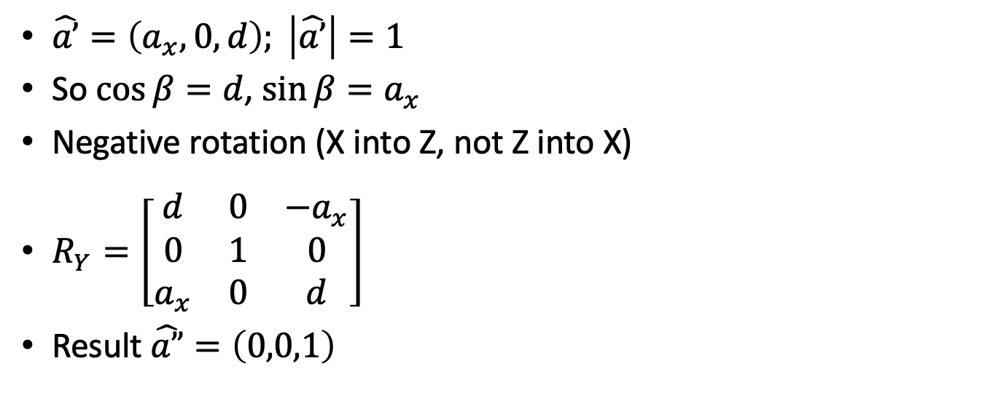
Rotate around Y onto Z Axis
$\hat{a’}=\left(a_{x},0,d\right); \left|\hat{a’}\right|=1$
So $\cos{β}=d$, $\sin{β}=a_{x}$
Negative rotation (X into Z, not Z into X)
$R_{Y}=\left[\begin{matrix}d & 0 & −a_{x} \\ 0 & 1 & 0 \\ a_{x} & 0 & d\end{matrix}\right]$
Result $\hat{a”}=\left(0,0,1\right)$

Slide 18
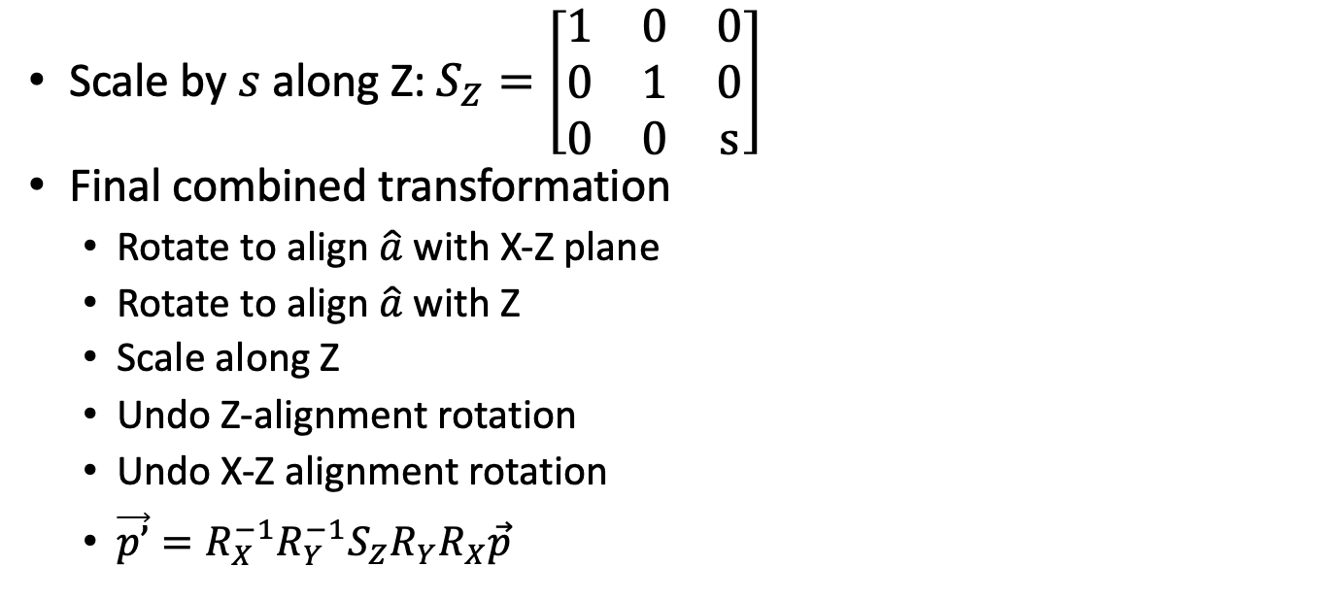
Scale along Z
Scale by $s$ along Z: $S_{Z}=\left[\begin{matrix}1 & 0 & 0 \\ 0 & 1 & 0 \\ 0 & 0 & s\end{matrix}\right]$
Final combined transformation
Rotate to align $\hat{a}$ with X-Z plane
Rotate to align $\hat{a}$ with Z
Scale along Z
Undo Z-alignment rotation
Undo X-Z alignment rotation
$\vec{p’}=R_{X}^{−1}R_{Y}^{−1}S_{Z}R_{Y}R_{X}\vec{p}$

Slide 19
Affine Transforms

Slide 20

Linear & Translation
Affine transforms include both linear and translation
Rigid-body transforms: where and what orientation
Composition?
$A\left(B \vec{p}+\vec{t_{0}}\right)+\vec{t_{1}}=A B \vec{p}+A \vec{t_{0}}+\vec{t_{1}}$
Yuck!

Slide 21
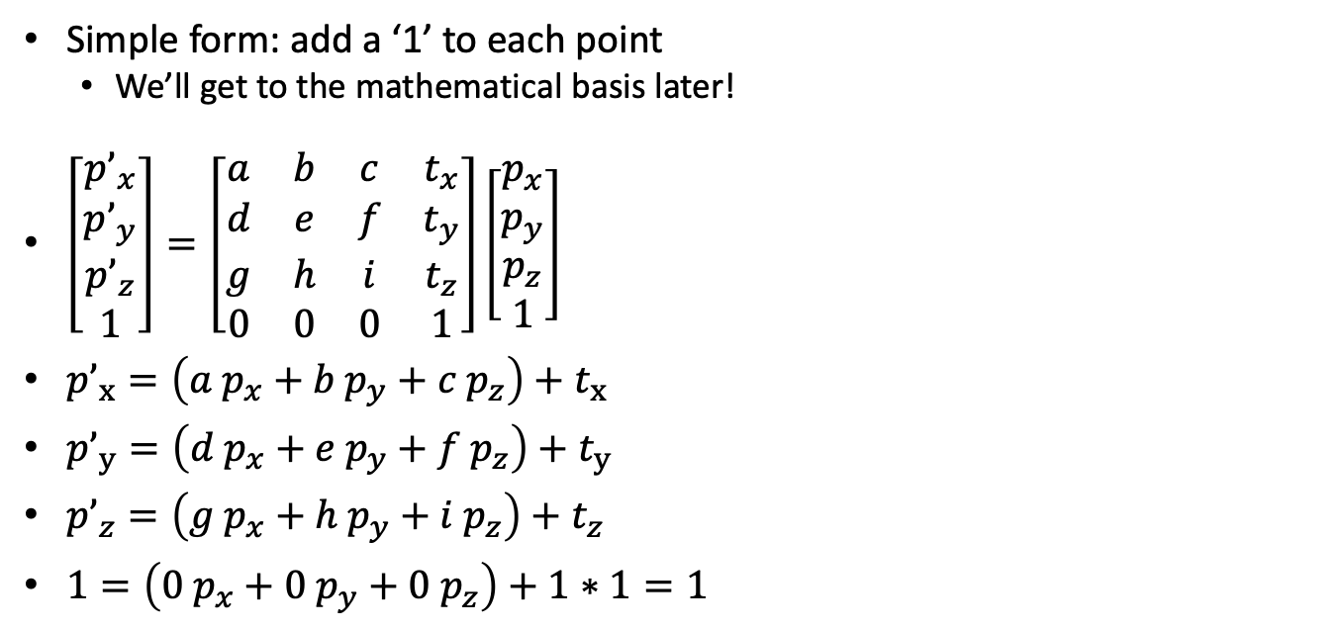
Homogeneous Coordinates
Simple form: add a ‘1’ to each point
We’ll get to the mathematical basis later!
$\left[\begin{matrix}p’_{x} \\ p’_{y} \\ p’_{z} \\ 1\end{matrix}\right]=\left[\begin{matrix}a & b & c & t_{x} \\ d & e & f & t_{y} \\ g & h & i & t_{z} \\ 0 & 0 & 0 & 1\end{matrix}\right]\left[\begin{matrix}p_{x} \\ p_{y} \\ p_{z} \\ 1\end{matrix}\right]$
$p’_{x}=\left(a{ p}_{x}+b p_{y}+c p_{z}\right)+t_{x}$
$p’_{y}=\left(d{ p}_{x}+e{ p}_{y}+f p_{z}\right)+t_{y}$
$p’_{z}=\left(g{ p}_{x}+h p_{y}+i{ p}_{z}\right)+t_{z}$
$1=\left(0 p_{x}+0 p_{y}+0{ p}_{z}\right)+1∗1=1$

Slide 22
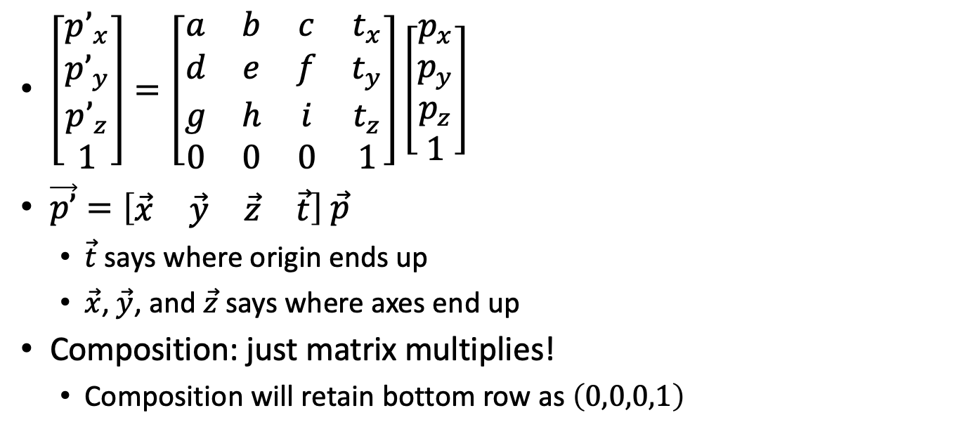
Homogeneous Transforms
$\left[\begin{matrix}p’_{x} \\ p’_{y} \\ p’_{z} \\ 1\end{matrix}\right]=\left[\begin{matrix}a & b & c & t_{x} \\ d & e & f & t_{y} \\ g & h & i & t_{z} \\ 0 & 0 & 0 & 1\end{matrix}\right]\left[\begin{matrix}p_{x} \\ p_{y} \\ p_{z} \\ 1\end{matrix}\right]$
$\vec{p’}=\left[\begin{matrix}\vec{x} & \vec{y} & \vec{z} & \vec{t}\end{matrix}\right] \vec{p}$
$\vec{t}$ says where origin ends up
$\vec{x}$, $\vec{y}$, and $\vec{z}$ says where axes end up
Composition: just matrix multiplies!
Composition will retain bottom row as $\left(0,0,0,1\right)$

Slide 23
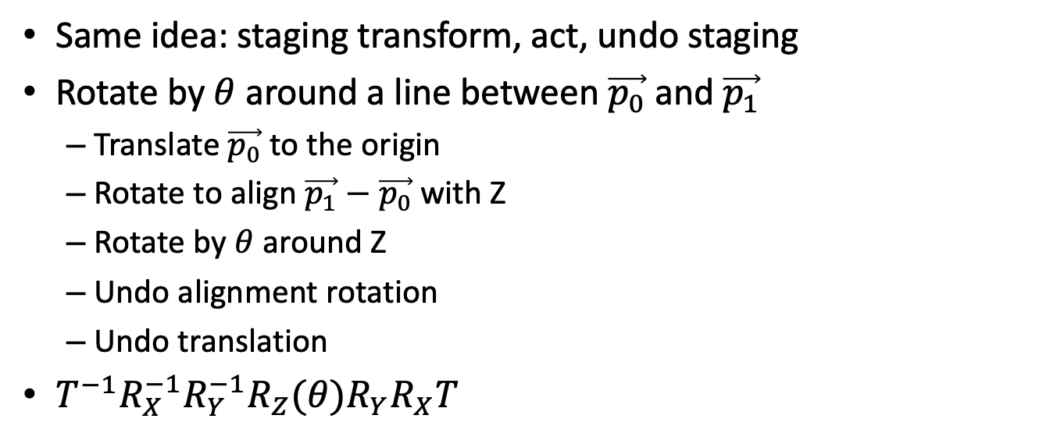
Designing Affine Transforms
Same idea: staging transform, act, undo staging
Rotate by $θ$ around a line between $\vec{p_{0}}$ and $\vec{p_{1}}$
Translate $\vec{p_{0}}$ to the origin
Rotate to align $\vec{p_{1}}−\vec{p_{0}}$ with Z
Rotate by $θ$ around Z
Undo alignment rotation
Undo translation
$T^{−1}R_{X}^{−1}R_{Y}^{−1}R_{Z}(θ)R_{Y}R_{X}T$

Slide 24
Vectors and Normals

Slide 25
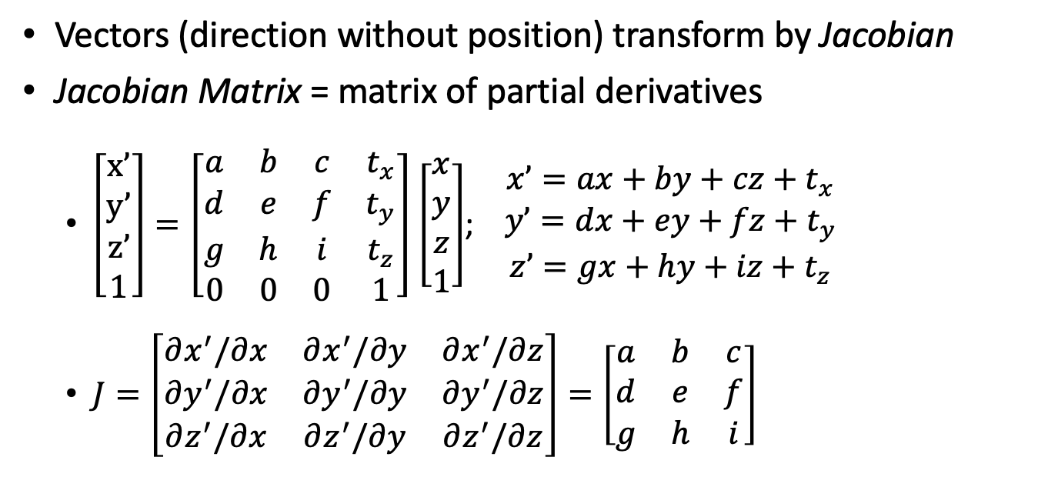
Transforming Vectors
Vectors (direction without position) transform by Jacobian
Jacobian Matrix = matrix of partial derivatives
$\left[\begin{matrix}x’ \\ y’ \\ z’ \\ 1\end{matrix}\right]=\left[\begin{matrix}a & b & c & t_{x} \\ d & e & f & t_{y} \\ g & h & i & t_{z} \\ 0 & 0 & 0 & 1\end{matrix}\right]$ $\left[\begin{matrix}x \\ y \\ z \\ 1\end{matrix}\right]$; $\begin{matrix}x’=ax+by+cz+t_{x} \\ y’=dx+ey+fz+t_{y} \\ z’=gx+hy+iz+t_{z}\end{matrix}$
$J=\left[\begin{matrix}∂x^{′}/∂x & ∂x^{′}/∂y & ∂x^{′}/∂z \\ ∂y^{′}/∂x & ∂y^{′}/∂y & ∂y^{′}/∂z \\ ∂z^{′}/∂x & ∂z^{′}/∂y & ∂z^{′}/∂z\end{matrix}\right]=\left[\begin{matrix}a & b & c \\ d & e & f \\ g & h & i\end{matrix}\right]$

Slide 26
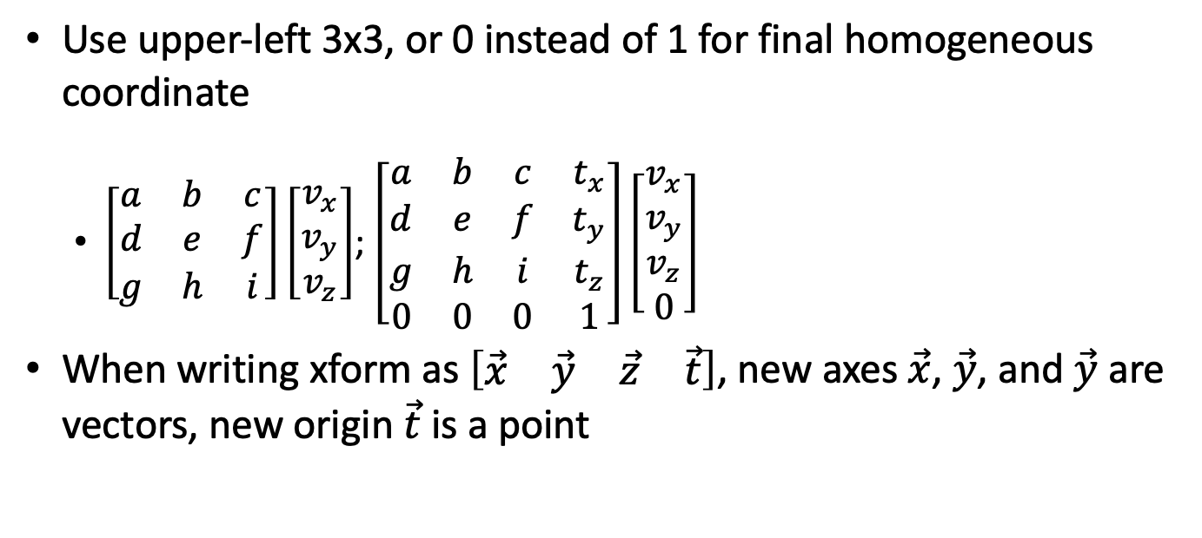
Transforming Vectors
Use upper-left 3x3, or 0 instead of 1 for final homogeneous coordinate
$\left[\begin{matrix}a & b & c \\ d & e & f \\ g & h & i\end{matrix}\right]\left[\begin{matrix}v_{x} \\ v_{y} \\ v_{z}\end{matrix}\right]$; $\left[\begin{matrix}a & b & c & t_{x} \\ d & e & f & t_{y} \\ g & h & i & t_{z} \\ 0 & 0 & 0 & 1\end{matrix}\right]\left[\begin{matrix}v_{x} \\ v_{y} \\ v_{z} \\ 0\end{matrix}\right]$
When writing xform as $\left[\begin{matrix}\vec{x} & \vec{y} & \vec{z} & \vec{t}\end{matrix}\right]$, new axes $\vec{x}$, $\vec{y}$, and $\vec{y}$ are vectors, new origin $\vec{t}$ is a point

Slide 27
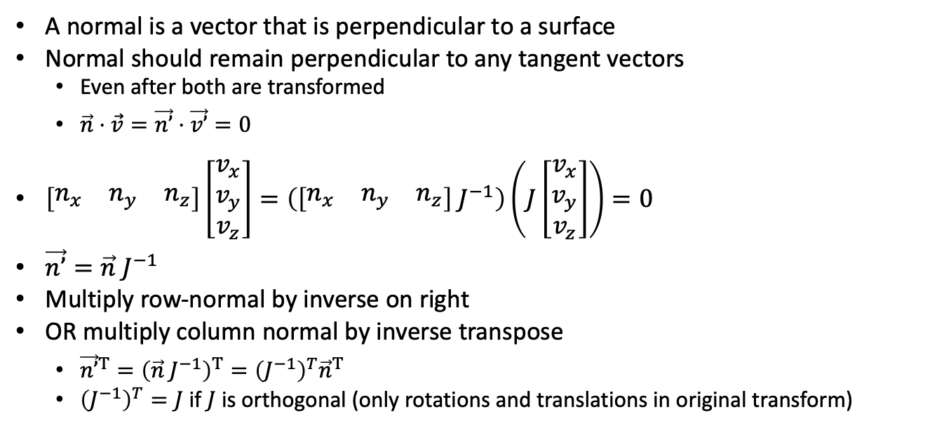
Transforming Normals
A normal is a vector that is perpendicular to a surface
Normal should remain perpendicular to any tangent vectors
Even after both are transformed
$\vec{n}⋅\vec{v}=\vec{n’}⋅\vec{v’}=0$
$\left[\begin{matrix}n_{x} & n_{y} & n_{z}\end{matrix}\right]\left[\begin{matrix}v_{x} \\ v_{y} \\ v_{z}\end{matrix}\right]=\left(\left[\begin{matrix}n_{x} & n_{y} & n_{z}\end{matrix}\right] J^{−1}\right)\left(J\left[\begin{matrix}v_{x} \\ v_{y} \\ v_{z}\end{matrix}\right]\right)=0$
$\vec{n’}=\vec{n} J^{−1}$
Multiply row-normal by inverse on right
OR multiply column normal by inverse transpose
${\vec{n’}}^{T}={\left(\vec{n} J^{−1}\right)}^{T}={\left(J^{−1}\right)}^{T}{\vec{n}}^{T}$
${\left(J^{−1}\right)}^{T}=J$ if $J$ is orthogonal (only rotations and translations in original transform)

Slide 28
Spaces

Slide 29
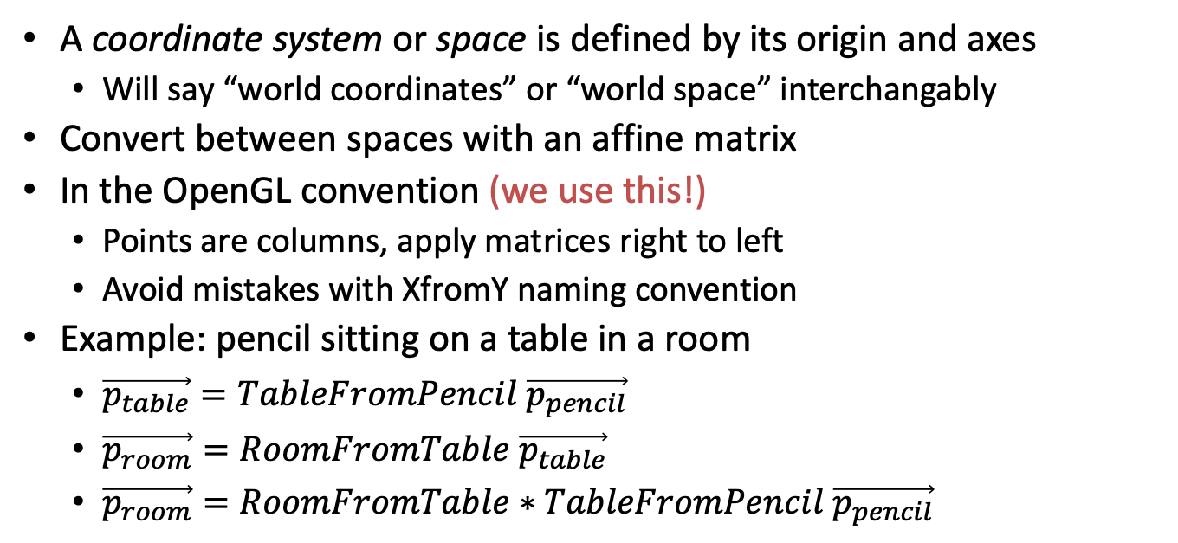
Coordinate System / Space
A coordinate system or space is defined by its origin and axes
Will say “world coordinates” or “world space” interchangably
Convert between spaces with an affine matrix
In the OpenGL convention (we use this!)
Points are columns, apply matrices right to left
Avoid mistakes with XfromY naming convention
Example: pencil sitting on a table in a room
$\vec{p_{table}}=TableFromPencil \vec{p_{pencil}}$
$\vec{p_{room}}=RoomFromTable \vec{p_{table}}$
$\vec{p_{room}}=RoomFromTable∗TableFromPencil \vec{p_{pencil}}$

Slide 30
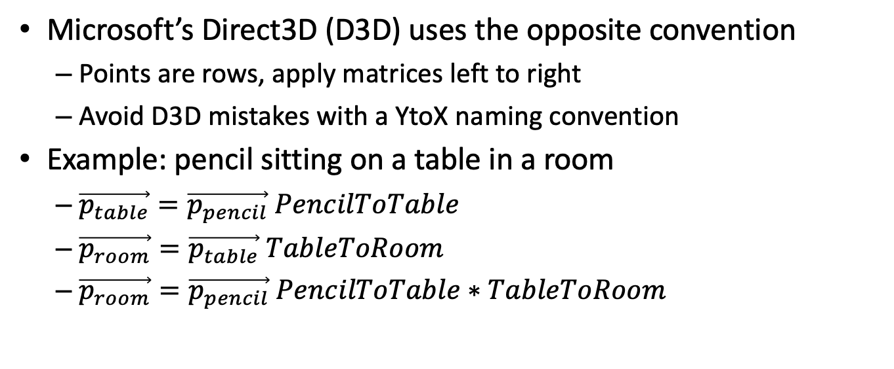
DirectX / Direct3D
Microsoft’s Direct3D (D3D) uses the opposite convention
Points are rows, apply matrices left to right
Avoid D3D mistakes with a YtoX naming convention
Example: pencil sitting on a table in a room
$\vec{p_{table}}=\vec{p_{pencil}} PencilToTable$
$\vec{p_{room}}=\vec{p_{table}} TableToRoom$
$\vec{p_{room}}=\vec{p_{pencil}} PencilToTable∗TableToRoom$

Slide 31
Nesting Transforms
Room
Desk
Desk
Board
Student
Book
Notebook
Student
Eraser

Slide 32
Matrix Stack
Remember transform, return to it later
Push a copy / modify the copy / pop
Keep matrix & inverse at each step
Code | Stack
Start (world space) | Identity
Draw in World space | Identity
Transform(WorldFromRoom) | WfR
Draw in Room space | WfR
Push | WfR WfR
Transform(RoomFromDesk) | WfD WfR
Draw in Desk space | WfD WfR
Pop | WfR
Push | WfR WfR
Transform(RoomFromBoard) | WfB WfR
Draw in Board space | WfB WfR

Slide 33
Common Spaces
Device / Screen space
Translate to window position or scale to fit screen
Raster / Pixel / Viewport space
0,0 to x-resolution,y-resolution
Normalized Device Coordinates (NDC)
Visible portion of scene from (–1,–1,–1) – (1,1,1) or (–1,–1,0) – (1,1,1)
View / Camera / Eye space
Eye/camera at (0,0,0), looking down Z or –Z axis
World space
Common coordinates, easy to transform everything to here
Object / Model space
Logical coordinates for modeling, may have several internal levels
Tangent space
Used for lighting: origin at point on surface, X,Y in tangent directions, Z in normal direction

Slide 34
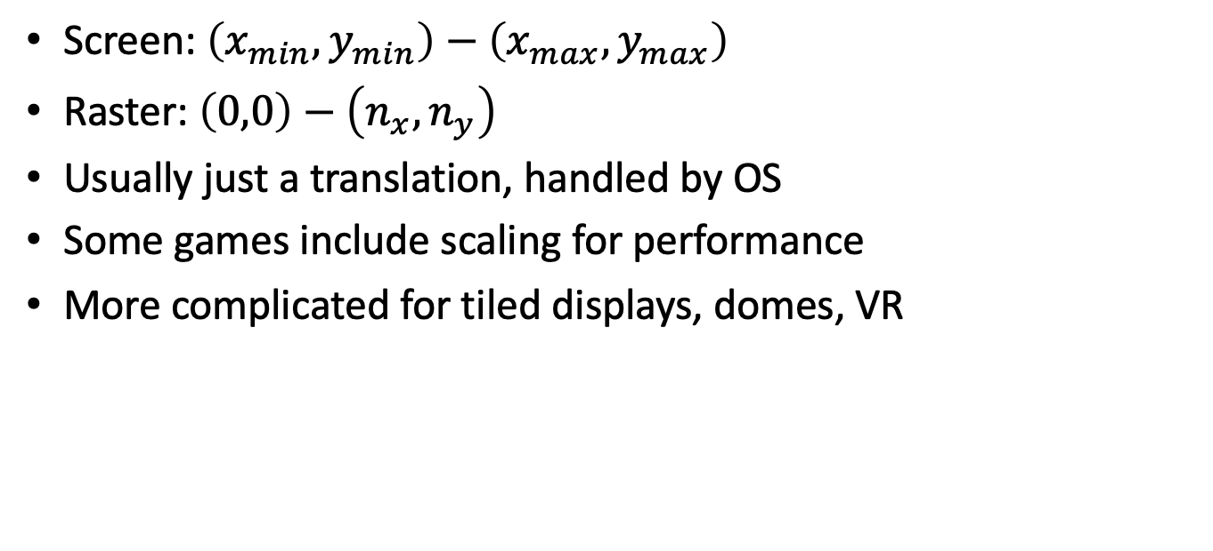
ScreenFromRaster
Screen: $\left(x_{min},y_{min}\right)−\left(x_{max},y_{max}\right)$
Raster: $\left(0,0\right)−\left(n_{x},n_{y}\right)$
Usually just a translation, handled by OS
Some games include scaling for performance
More complicated for tiled displays, domes, VR

Slide 35
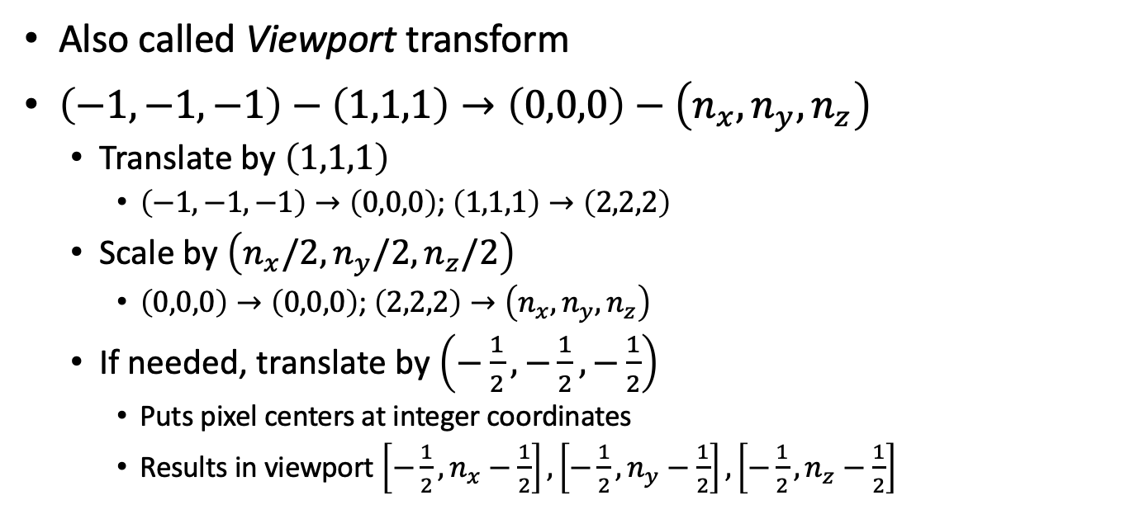
RasterFromNDC
Also called Viewport transform
$\left(−1,−1,−1\right)−\left(1,1,1\right)→\left(0,0,0\right)−\left(n_{x},n_{y},n_{z}\right)$
Translate by $\left(1,1,1\right)$
$\left(−1,−1,−1\right)→\left(0,0,0\right)$; $\left(1,1,1\right)→\left(2,2,2\right)$
Scale by $\left(n_{x}/2,n_{y}/2,n_{z}/2\right)$
$\left(0,0,0\right)→\left(0,0,0\right)$; $\left(2,2,2\right)→\left(n_{x},n_{y},n_{z}\right)$
If needed, translate by $\left(−\frac{1}{2},−\frac{1}{2},−\frac{1}{2}\right)$
Puts pixel centers at integer coordinates
Results in viewport $\left[−\frac{1}{2},n_{x}−\frac{1}{2}\right],\left[−\frac{1}{2},n_{y}−\frac{1}{2}\right],\left[−\frac{1}{2},n_{z}−\frac{1}{2}\right]$

Slide 36
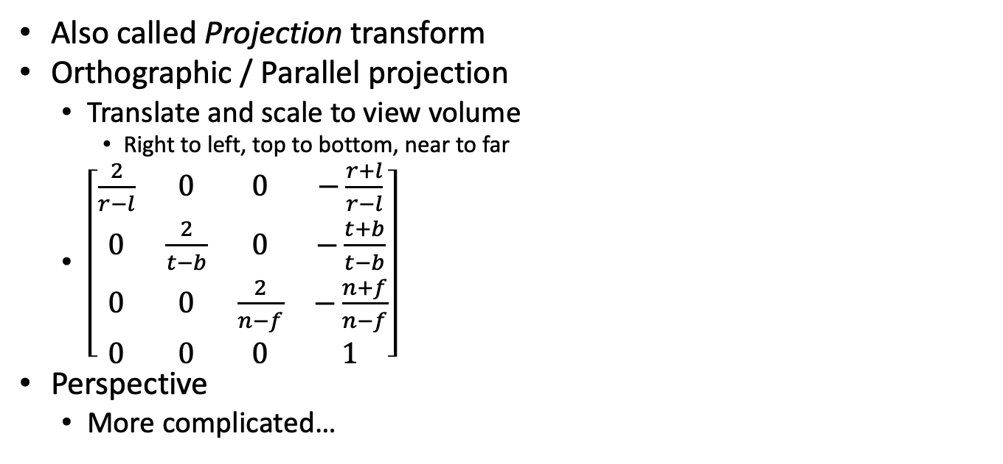
NDCFromView
Also called Projection transform
Orthographic / Parallel projection
Translate and scale to view volume
Right to left, top to bottom, near to far
$\left[\begin{matrix}\frac{2}{r−l} & 0 & 0 & −\frac{r+l}{r−l} \\ 0 & \frac{2}{t−b} & 0 & −\frac{t+b}{t−b} \\ 0 & 0 & \frac{2}{n−f} & −\frac{n+f}{n−f} \\ 0 & 0 & 0 & 1\end{matrix}\right]$
Perspective
More complicated…

Slide 37
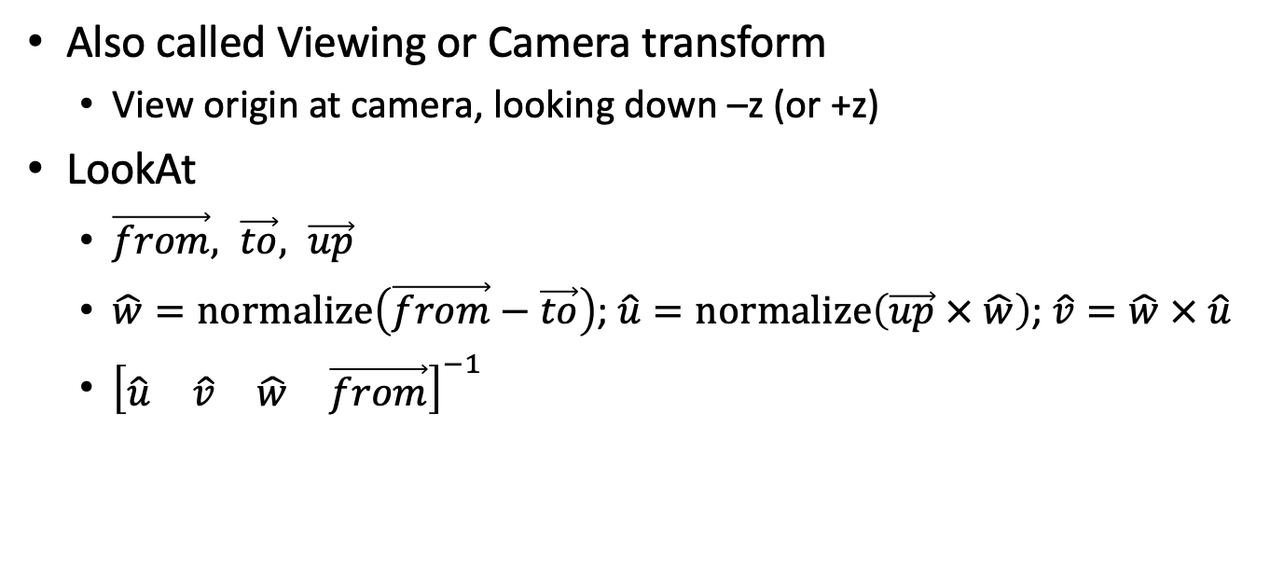
ViewFromWorld
Also called Viewing or Camera transform
View origin at camera, looking down –z (or +z)
LookAt
$\vec{from}, \vec{to}, \vec{up}$
$\hat{w}=normalize\left(\vec{from}−\vec{to}\right)$; $\hat{u}=normalize\left(\vec{up} × \hat{w}\right)$; $\hat{v}=\hat{w} × \hat{u}$
${\left[\begin{matrix}\hat{u} & \hat{v} & \hat{w} & \vec{from}\end{matrix}\right]}^{−1}$

Slide 38
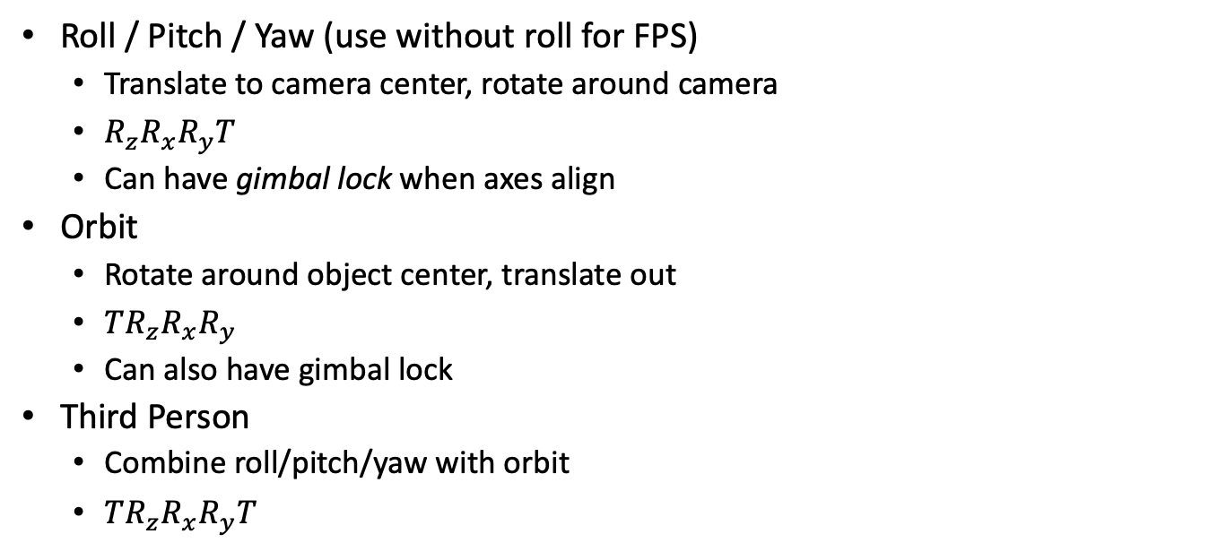
ViewFromWorld
Roll / Pitch / Yaw (use without roll for FPS)
Translate to camera center, rotate around camera
$R_{z}R_{x}R_{y}T$
Can have gimbal lock when axes align
Orbit
Rotate around object center, translate out
$TR_{z}R_{x}R_{y}$
Can also have gimbal lock
Third Person
Combine roll/pitch/yaw with orbit
$TR_{z}R_{x}R_{y}T$

Slide 39
WorldFromModel / ViewFromModel
WorldFromModel
Consistent space for all objects and lights
ViewFromModel
World can by any common space, might as well use view space
Serves just as well for a single view
Complications for stereo or multiple viewers
Old OpenGL used to have a MODELVIEW transform built in!
Ray tracing implicitly does RasterFromWorld

Slide 40
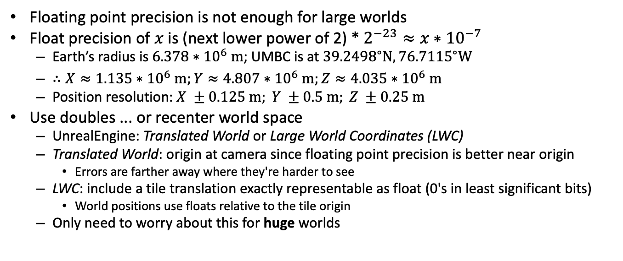
World Coordinate Precision
Floating point precision is not enough for large worlds
Float precision of $x$ is (next lower power of 2) * $2^{−23}≈x∗{10}^{−7}$
Earth’s radius is $6.378∗{10}^{6} m$; UMBC is at ${39.2498}^{∘}N,{76.7115}^{∘}W$
$∴X≈1.135∗{10}^{6} m;Y≈4.807∗{10}^{6} m;Z≈4.035∗{10}^{6} m$
Position resolution: $X ±0.125 m; Y ±0.5 m; Z ±0.25 m$
Use doubles ... or recenter world space
UnrealEngine: Translated World or Large World Coordinates (LWC)
Translated World: origin at camera since floating point precision is better near origin
Errors are farther away where they're harder to see
LWC: include a tile translation exactly representable as float (0's in least significant bits)
World positions use floats relative to the tile origin
Only need to worry about this for huge worlds

Slide 41
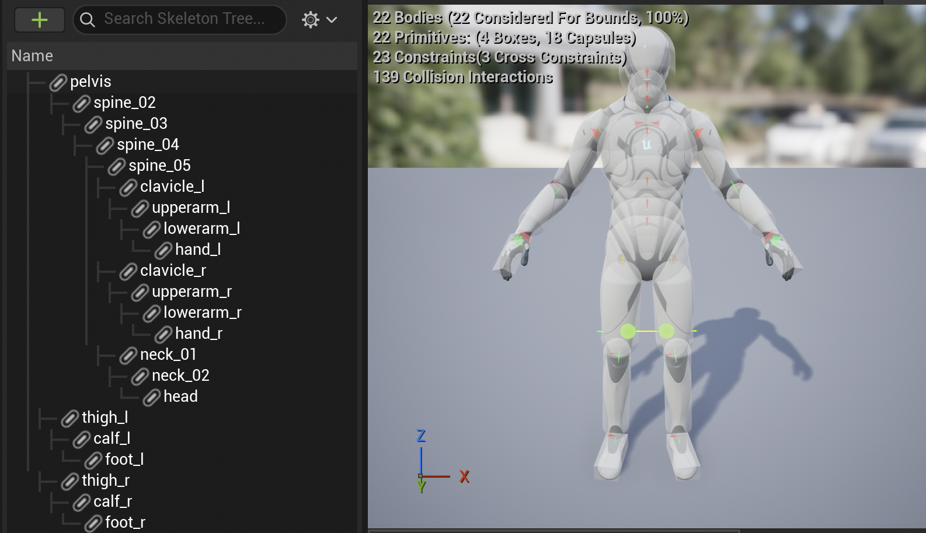
Nesting within Model-space

Slide 42
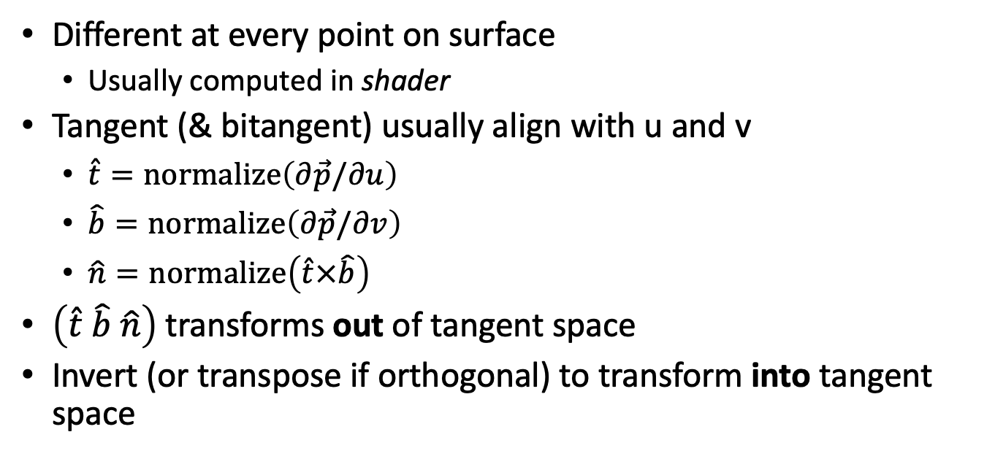
Tangent Space
Different at every point on surface
Usually computed in shader
Tangent (& bitangent) usually align with u and v
$\hat{t}=normalize\left(∂\vec{p}/∂u\right)$
$\hat{b}=normalize\left(∂\vec{p}/∂v\right)$
$\hat{n}=normalize\left(\hat{t}×\hat{b}\right)$
$\left(\hat{t} \hat{b} \hat{n}\right)$ transforms out of tangent space
Invert (or transpose if orthogonal) to transform into tangent space

Slide 43
Perspective

Slide 44
Perspective View Frustum
Orthographic view is a rectangular volume
Perspective is a truncated pyramid or frustum

Slide 45

Perspective Transform
Ray tracing
Given screen point $\left(s_{x},s_{y}\right)$, parameterize all points $\vec{p}$
Perspective transform
Given point $\vec{p}$, find $\left(s_{x},s_{y}\right)$
Use similar triangles
$s_{y}/d=p_{y}/p_{z}$
So $s_{y}=d p_{y}/p_{z}$

Slide 46
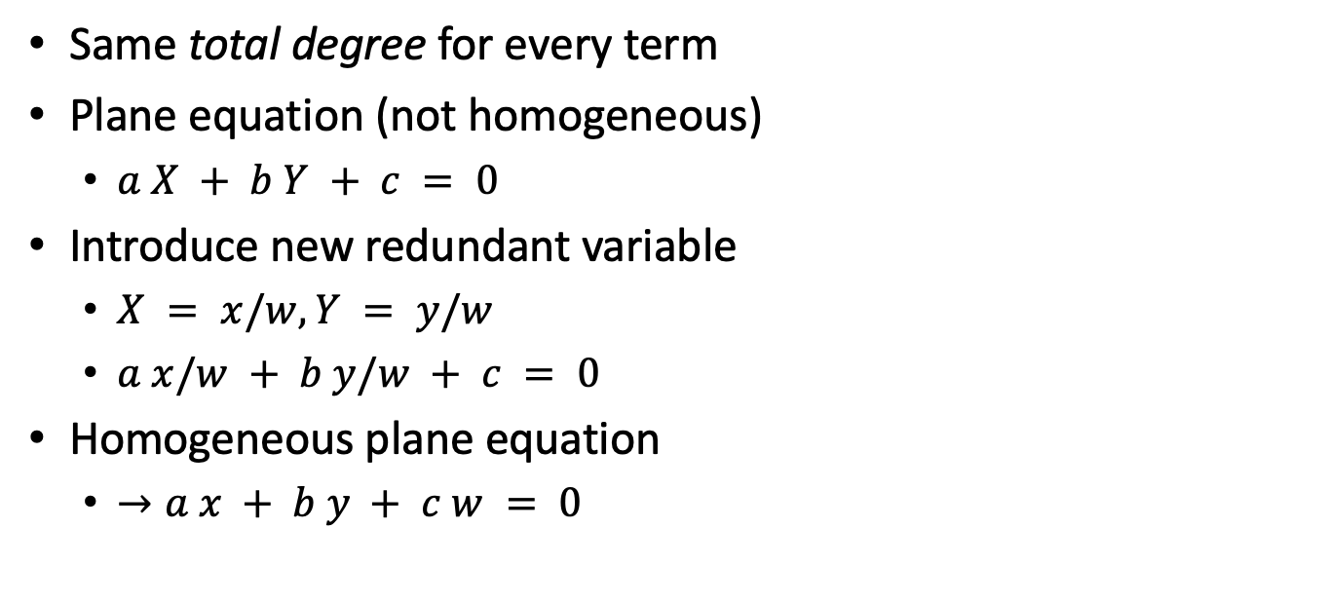
Homogeneous Equations
Same total degree for every term
Plane equation (not homogeneous)
$a X + b Y + c = 0$
Introduce new redundant variable
$X = x/w, Y = y/w$
$a x/w + b y/w + c = 0$
Homogeneous plane equation
$→a x + b y + c w = 0$

Slide 47
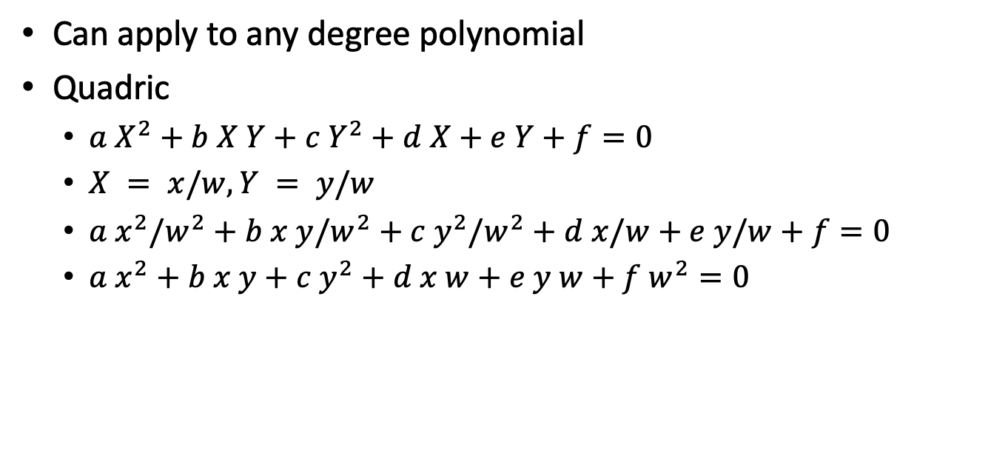
Homogeneous Equations TMI
Can apply to any degree polynomial
Quadric
$a X^{2}+b X Y+c Y^{2}+d X+e Y+f=0$
$X = x/w, Y = y/w$
$a x^{2}/w^{2}+b x y/w^{2}+c y^{2}/w^{2}+d x/w+e y/w+f=0$
$a x^{2}+b x y+c y^{2}+d x w+e y w+f w^{2}=0$

Slide 48
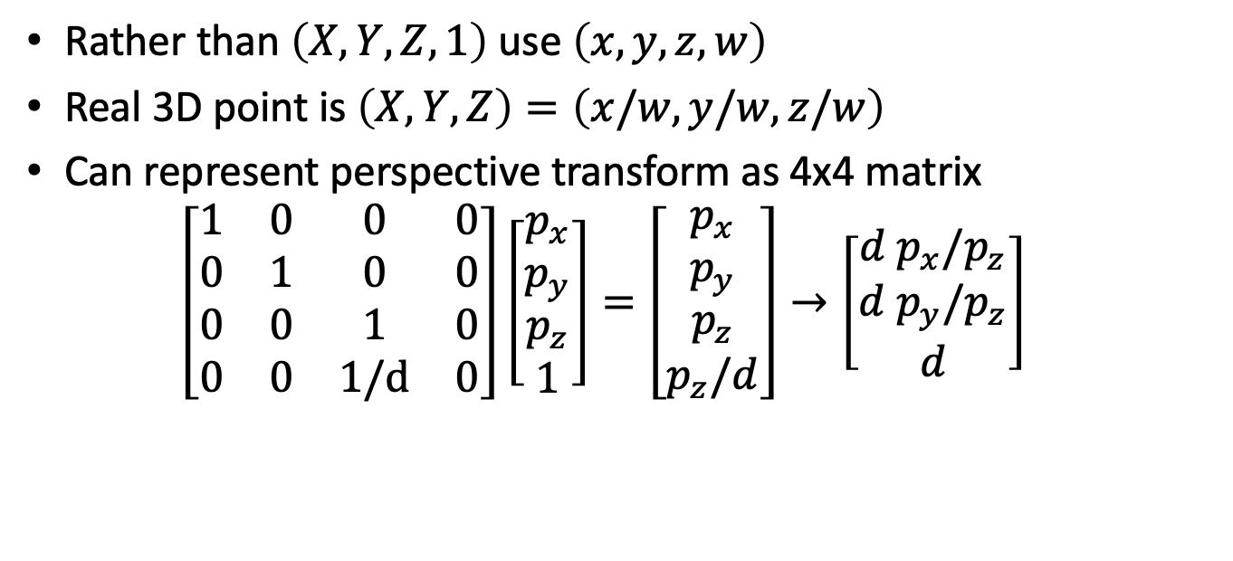
Homogeneous Coordinates Revisited
Rather than $\left(X,Y,Z,1\right)$ use $\left(x,y,z,w\right)$
Real 3D point is $\left(X,Y,Z\right)=\left(x/w,y/w,z/w\right)$
Can represent perspective transform as 4x4 matrix $\left[\begin{matrix}1 & 0 & 0 & 0 \\ 0 & 1 & 0 & 0 \\ 0 & 0 & 1 & 0 \\ 0 & 0 & 1/d & 0\end{matrix}\right]\left[\begin{matrix}p_{x} \\ p_{y} \\ p_{z} \\ 1\end{matrix}\right]=\left[\begin{matrix}p_{x} \\ p_{y} \\ p_{z} \\ p_{z}/d\end{matrix}\right]→\left[\begin{matrix}{d p}_{x}/p_{z} \\ d p_{y}/p_{z} \\ d\end{matrix}\right]$

Slide 49
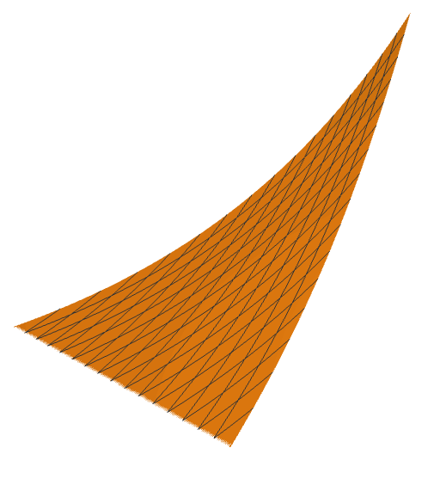
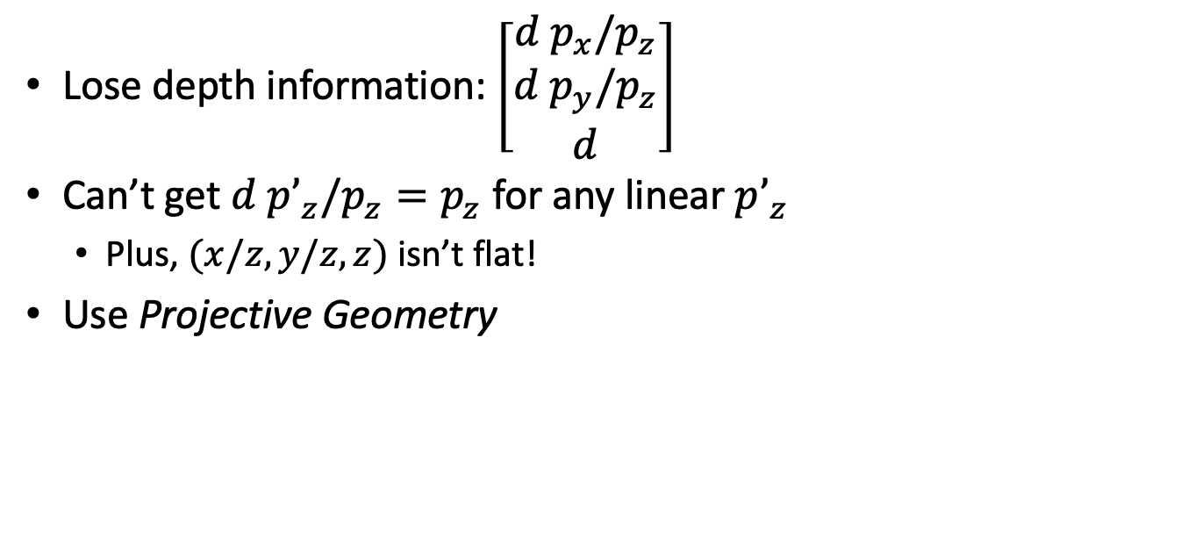
Homogeneous Depth
Lose depth information: $\left[\begin{matrix}{d p}_{x}/p_{z} \\ d p_{y}/p_{z} \\ d\end{matrix}\right]$
Can’t get $d p’_{z}/p_{z}=p_{z}$ for any linear $p’_{z}$
Plus, $(x/z, y/z, z)$ isn’t flat!
Use Projective Geometry

Slide 50
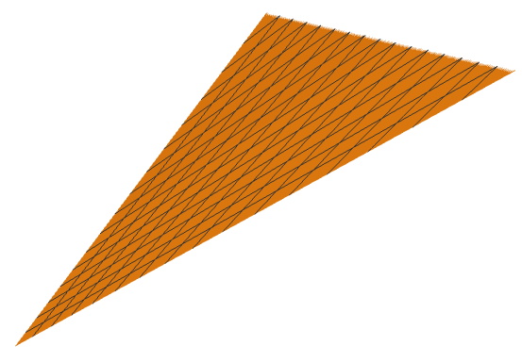
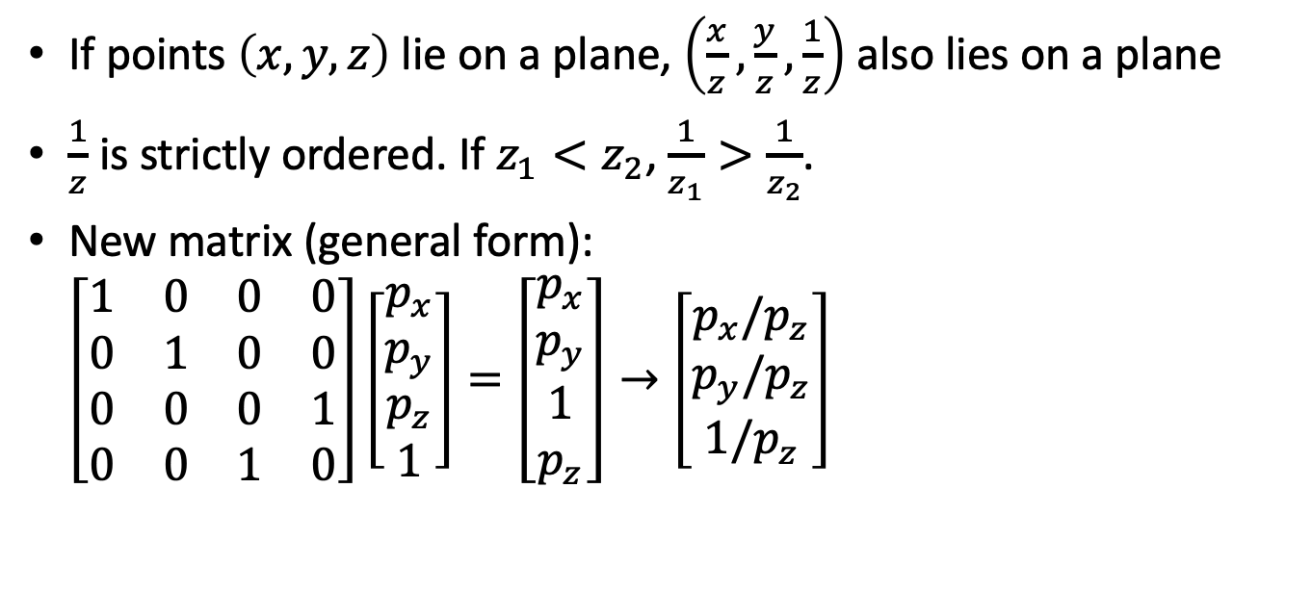
Projective Geometry
If points $\left(x,y,z\right)$ lie on a plane, $\left(\frac{x}{z},\frac{y}{z},\frac{1}{z}\right)$ also lies on a plane
$\frac{1}{z}$ is strictly ordered. If $z_{1}<z_{2}$, $\frac{1}{z_{1}}>\frac{1}{z_{2}}$.
New matrix (general form): $\left[\begin{matrix}1 & 0 & 0 & 0 \\ 0 & 1 & 0 & 0 \\ 0 & 0 & 0 & 1 \\ 0 & 0 & 1 & 0\end{matrix}\right]\left[\begin{matrix}p_{x} \\ p_{y} \\ p_{z} \\ 1\end{matrix}\right]=\left[\begin{matrix}p_{x} \\ p_{y} \\ 1 \\ p_{z}\end{matrix}\right]→\left[\begin{matrix}p_{x}/p_{z} \\ p_{y}/p_{z} \\ 1/p_{z}\end{matrix}\right]$

Slide 51
Getting Fancy with Perspective Matrices
Tune transform output by composing matrices or solving
Field of view = X/Y scale
Near/far range = Z scale and translate

Slide 52
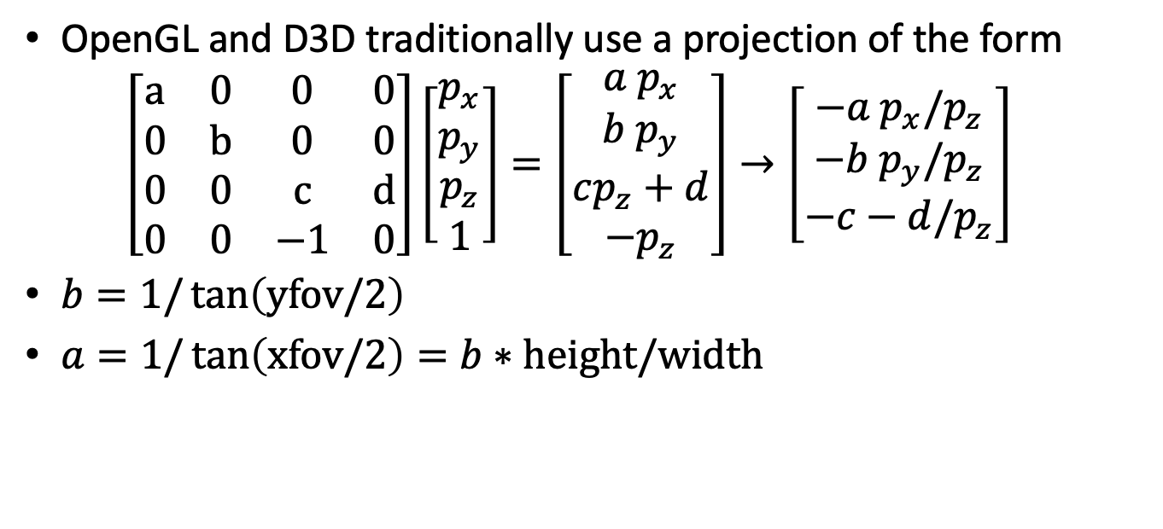
Getting Fancy with Perspective Matrices
OpenGL and D3D traditionally use a projection of the form $\left[\begin{matrix}a & 0 & 0 & 0 \\ 0 & b & 0 & 0 \\ 0 & 0 & c & d \\ 0 & 0 & −1 & 0\end{matrix}\right]\left[\begin{matrix}p_{x} \\ p_{y} \\ p_{z} \\ 1\end{matrix}\right]=\left[\begin{matrix}{a p}_{x} \\ {b p}_{y} \\ cp_{z}+d \\ −p_{z}\end{matrix}\right]→\left[\begin{matrix}{−a p}_{x}/p_{z} \\ −b p_{y}/p_{z} \\ −c−d/p_{z}\end{matrix}\right]$
$b=1/\tan\left(yfov/2\right)$
$a=1/\tan\left(xfov/2\right)=b∗height/width$

Slide 53
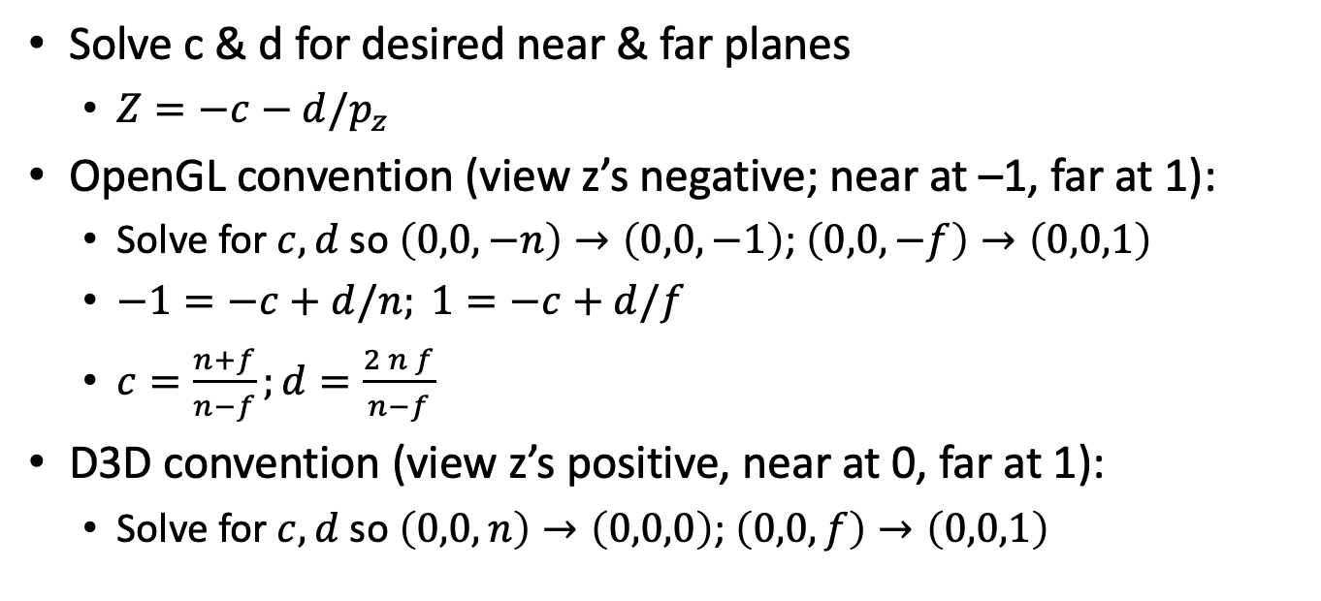
Getting Fancy with Perspective Matrices
Solve c & d for desired near & far planes
$Z=−c−d/p_{z}$
OpenGL convention (view z’s negative; near at –1, far at 1):
Solve for $c,d$ so $\left(0,0,−n\right)→\left(0,0,−1\right)$; $\left(0,0,−f\right)→\left(0,0,1\right)$
$−1=−c+d/n; 1=−c+d/f$
$c=\frac{n+f}{n−f};d=\frac{2 n f}{n−f}$
D3D convention (view z’s positive, near at 0, far at 1):
Solve for $c,d$ so $\left(0,0,n\right)→\left(0,0,0\right)$; $\left(0,0,f\right)→\left(0,0,1\right)$

