Slide 1
Graphics Pipeline Visibility
CMSC 435/634

Slide 2
Graphics Pipeline
Object-order approach to rendering
Vertex Processing
Transformations
Vertex components of shading
Clipping
Find the visible parts of primitives
Rasterization
Break primitives into fragments/pixels
Fragment Processing
Fragment components of shading
Visibility & Blending
Which do we see, how do they combine?

Slide 3
Back Faces

Slide 4
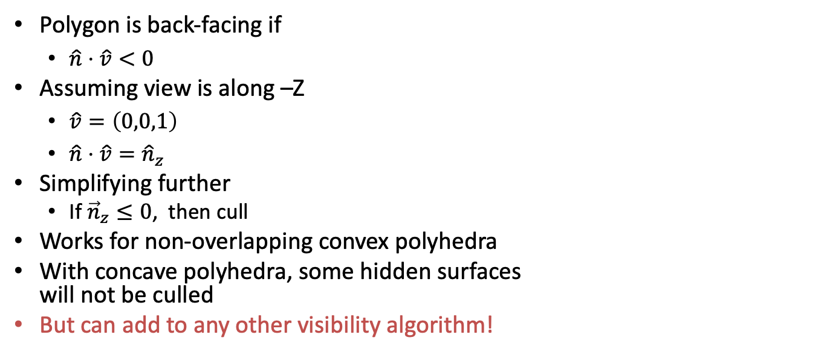
Back-face Culling
Polygon is back-facing if
$\hat{n}⋅\hat{v}<0$
Assuming view is along –Z
$\hat{v}=\left(0,0,1\right)$
$\hat{n}⋅\hat{v}={\hat{n}}_{z}$
Simplifying further
If ${\vec{n}}_{z}≤0$, then cull
Works for non-overlapping convex polyhedra
With concave polyhedra, some hidden surfaces will not be culled
But can add to any other visibility algorithm!

Slide 5
Painter’s Algorithm

Slide 6
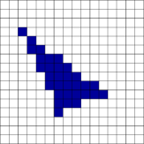
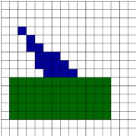
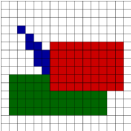
Painter’s Algorithm
First polygon:
(6,3,10), (11, 5,10), (2,2,10)
Second polygon:
(1,2,8), (12,2,8), (12,6,8), (1,6,8)
Third polygon:
(6,5,5), (14,5,5), (14,10,5),( 6,10,5)

Slide 7
Painter’s Algorithm
Given
List of polygons
Array of colors: color[x,y]
Algorithm
Sort polygons on minimum z
For each polygon P in sorted list
For each pixel (x,y,z) in P
color[x,y] = color(P,x,y)

Slide 8

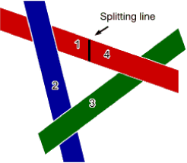
Painter’s Algorithm: Cycles
Which to scan first?
Split along line, then scan 1,2,3,4 (or split another polygon and scan accordingly)
Moral: Painter’s algorithm is fast and easy … except for detecting and splitting cycles and other ambiguities

Slide 9
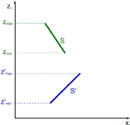
Depth-sort: Overlapping Surfaces
Assume you have sorted by maximum Z
Then if Zmin > Z’max, the surfaces do not overlap each other (minimax test)
Correct order of overlapping surfaces may be ambiguous. Check it.

Slide 10
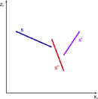
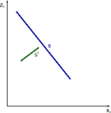
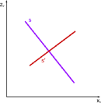
Depth-sort: Overlapping Surfaces
No problem: paint S, then S’
Problem: painting in either order gives incorrect result
Problem? Naïve order S S’ S”; correct order S’ S” S

Slide 11
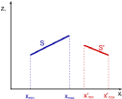

Depth-sort: Order Ambiguity
1. Bounding rectangles in xy plane do not overlap
Check overlap in x
x’min > xmax or xmin > x’max → no overlap
Check overlap in y
y’min > ymax or ymin > y’max → no overlap
2. Surface S is completely behind S’ relative to viewing direction.
Substitute all vertices of S into plane equation for S’
if all are “inside” (< 0), no ambiguity

Slide 12
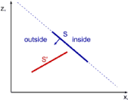
Depth-sort: Order Ambiguity
3. Surface S’ is completely in front S relative to viewing direction.
Substitute all vertices of S’ into plane equation for S
if all are “outside” (>0), no ambiguity

Slide 13
BSP Visibility

Slide 14
Binary Space Partitioning

Slide 15
Building a BSP Tree
Use polygon 3 as root, split on its plane
Polygon 5 split into 5a and 5b

Slide 16
Building a BSP Tree
Split left subtree at polygon 2

Slide 17
Building a BSP Tree
Split right subtree at polygon 4

Slide 18
Building a BSP Tree
Alternate tree if splits are made at 5, 4, 3, 1

Slide 19
BSP Tree: Building the Tree
BSPTree MakeBSP ( Polygon list )
if ( list is empty )
return null
else {
root = some polygon ; remove it from the list
backlist = frontlist = null
for ( each remaining polygon in the list )
if ( p in front of root )
addToList ( p, frontlist )
else if ( p in back of root )
addToList ( p, backlist )
else
splitPolygon (p,root,frontpart,backpart)
addToList ( frontpart, frontlist )
addToList ( backpart, backlist )
return (combineTree(MakeBSP(frontlist),
root,
MakeBSP(backlist)))

Slide 20
BSP Tree: Displaying the Tree
DisplayBSP ( tree )
if ( tree not empty )
if ( viewer in front of root )
DisplayBSP ( tree -> back )
DisplayPolygon ( tree -> root )
DisplayBSP ( tree -> front )
else
DisplayBSP ( tree -> front )
DisplayPolygon ( tree -> root )
DisplayBSP ( tree -> back )

Slide 21
BSP Tree Display
Built BSP tree structure

Slide 22
BSP Tree Display
C in front of 3 (order back/front)
draw 4/5b branch
C in back of 4 (order front/back)
nothing in front of 4
draw 4
draw 5b
draw 3
draw 1/2/5a branch
C in back of 2 (order front/back)
draw 5a
draw 2
draw 1

Slide 23
Z-buffer

Slide 24
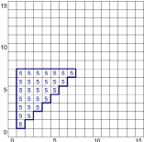
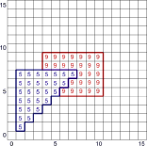
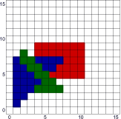
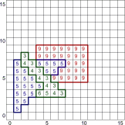
Z-Buffer
First polygon
(1, 1, 5), (7, 7, 5), (1, 7, 5)
scan it in with depth
Second polygon
(3, 5, 9), (10, 5, 9), (10, 9, 9), (3, 9, 9)
Third polygon
(2, 6, 3), (2, 3, 8), (7, 3, 3)

Slide 25
Z-Buffer Algorithm
Originally by Cook, Carpenter, Catmull
Given
List of Polygons
Array of depths: zbuffer[x,y] initialized to ∞
Array of colors: color[x,y]
Algorithm
For each Polygon P
For each pixel (x,y,z) in P
If z < zbuffer[x,y]
zbuffer[x,y] = z
color[x,y] = color(P,x,y)

Slide 26
Z-Buffer Characteristics
Good
Easy to implement
Requires no sorting of surfaces
Easy to put in hardware
Bad
Requires lots of memory (about 8MB for 1920x1080 * 4 bytes per Z)
Can alias badly (only one sample per pixel)
Cannot handle transparent surfaces

Slide 27
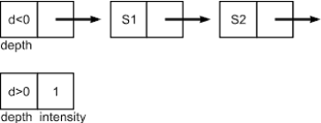
A-Buffer Method
Basically z-buffer with additional memory to consider contribution of multiple surfaces to a pixel
Need to store
Opacity / Area covered
Depth
Surface ID
Rendering parameters
Pointer to next

Slide 28
K-Buffer
Fixed-sized buffer / fixed number of layers per pixel
Insert-sort by depth as you render layers into each pixel
Heuristic to blend anything that gets pushed into the final bin
S0
S1
S2
rest

Slide 29
Classifying Visibility Algorithms

Slide 30
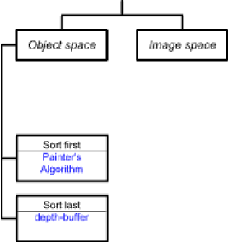
Taxonomy of Visibility Algorithms
Ivan Sutherland — A Characterization of Ten Hidden Surface Algorithms, 1974
Basic design choices
Space for operations
Object
Image
Object space
Loop over objects
Decide the visibility of each
Timing of object sort
Sort-first
Sort-last

Slide 31
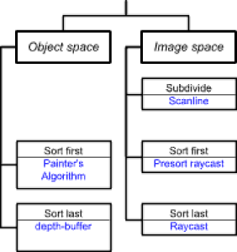
Taxonomy of Visibility Algorithms
Image space
Loop over pixels
Decide what’s visible at each
Timing of sort at pixel
Sort first
Sort last
Subdivide to simplify

Slide 32
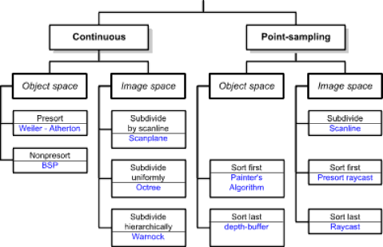
Taxonomy — Remaining Algorithms
Another dimension
Point-sampling
Continuous

