Slide 1
Texture Mapping
CMSC 435/634
UMBC
*With lots of borrowing from the usual victims…

Slide 2
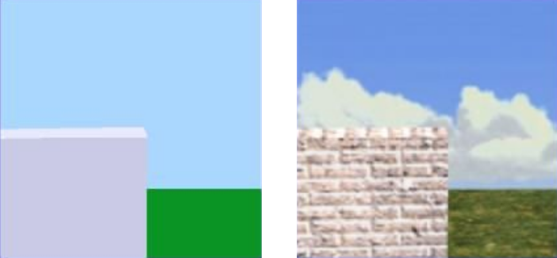
Motivation
Flat and Boring
“Textured”

Slide 3
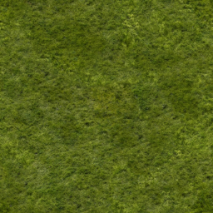
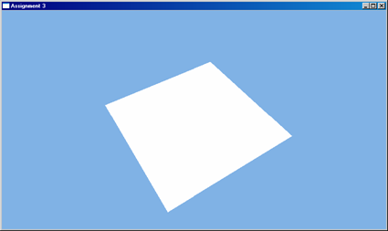
Texture Mapping
“Texture”
Boring Geometry
Texture → An image that’s mapped onto something
Texel → Texture pixel

Slide 4
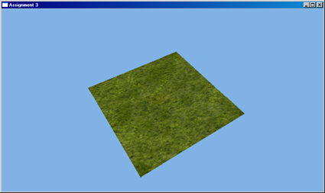
Texture Mapping
Interesting Geometry

Slide 5
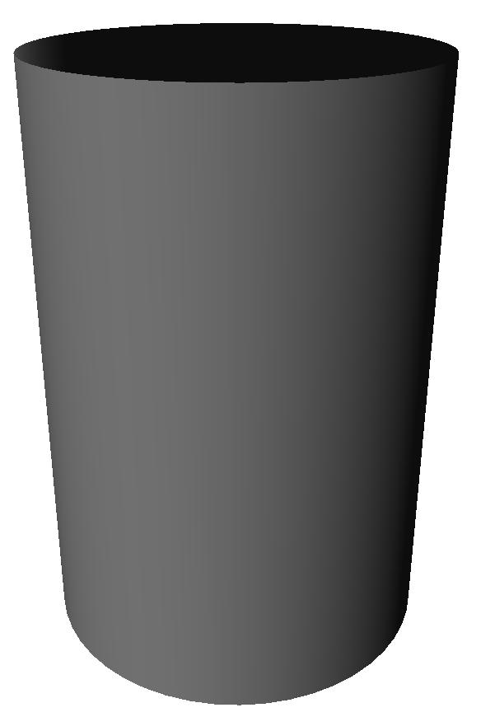
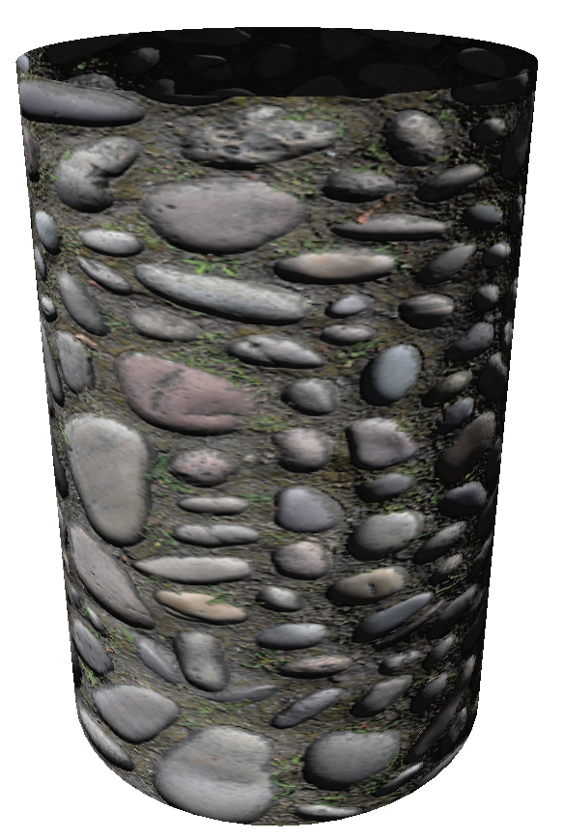
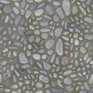

Texture Mapping
Mapping
Function
2D Texture Coordinate
Texture Image
Final Image
3D Coordinate

Slide 6

Texture Coordinates
u
Normalized 2D space
  0-1 on each axis
Letters vary:
  u,v are most common
  GL/RMan specs like s,t
Typically periodic
  For s (or t) > 1, get another copy of texture
D3D
v
Texture Coordinates as RGB
t
OGL
s

Slide 7
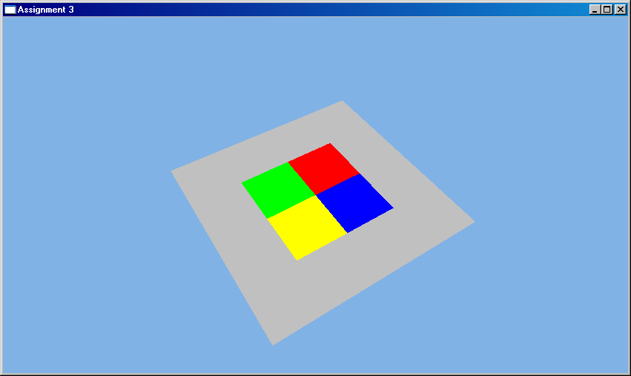
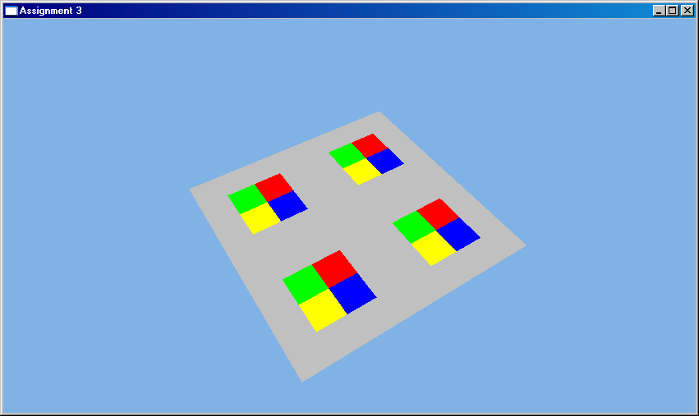
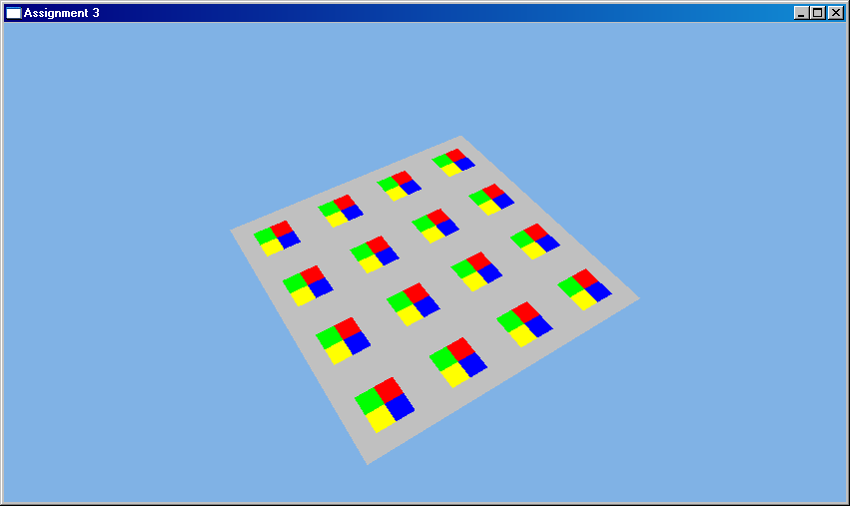
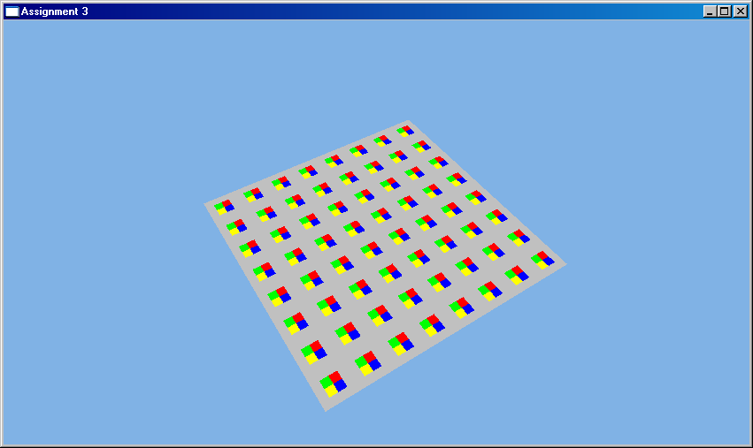
Texture Tiling
0,0
0,0
0,1
0,2
1,0
2,0
Scale UV Coordinates ➔ Alter texture frequency
0,0
0,0
0,4
0,8
4,0
8,0

Slide 8
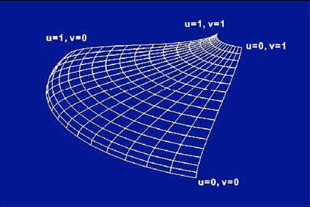
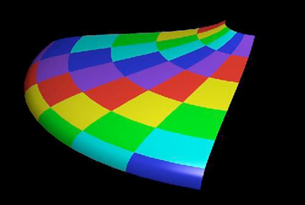
Mapping onto Parametric Shapes
Use scaled surface parameters for texture u,v
Notes:
8

Slide 9
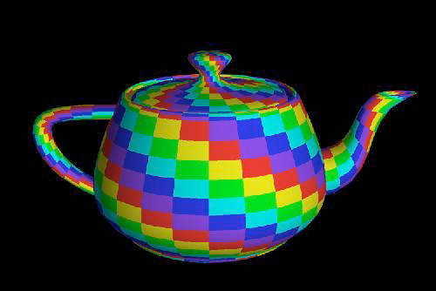
Mapping onto Parametric Patches
Notes:
9

Slide 10
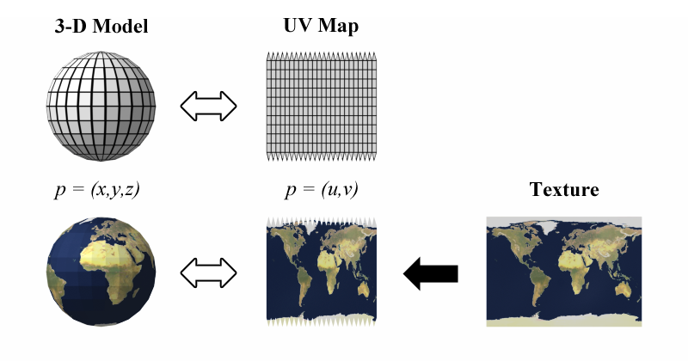
Mapping onto Polygons
Explicit per-vertex coordinates…
Wikipedia

Slide 11
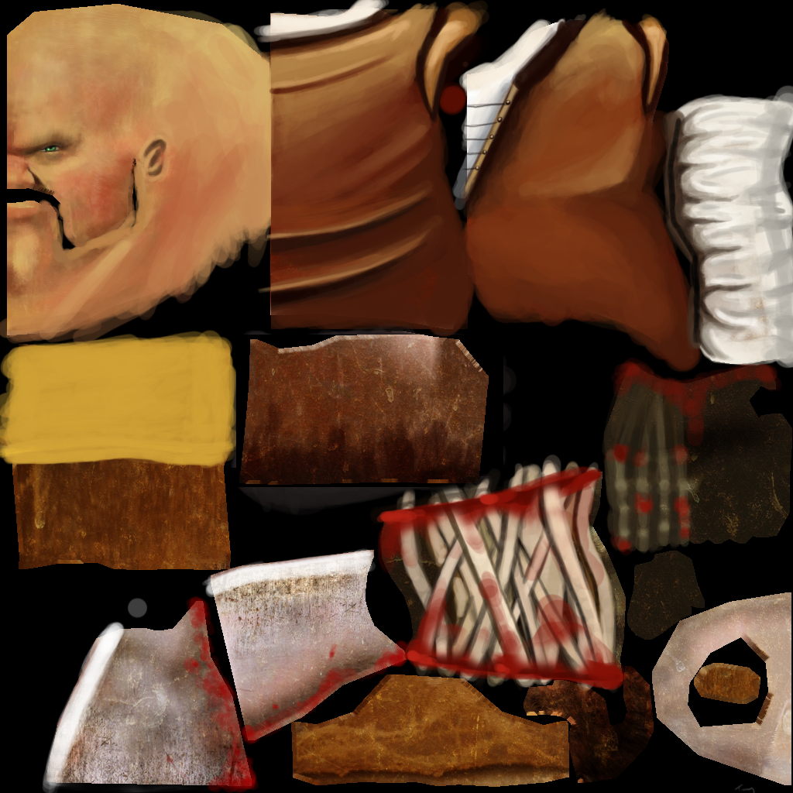
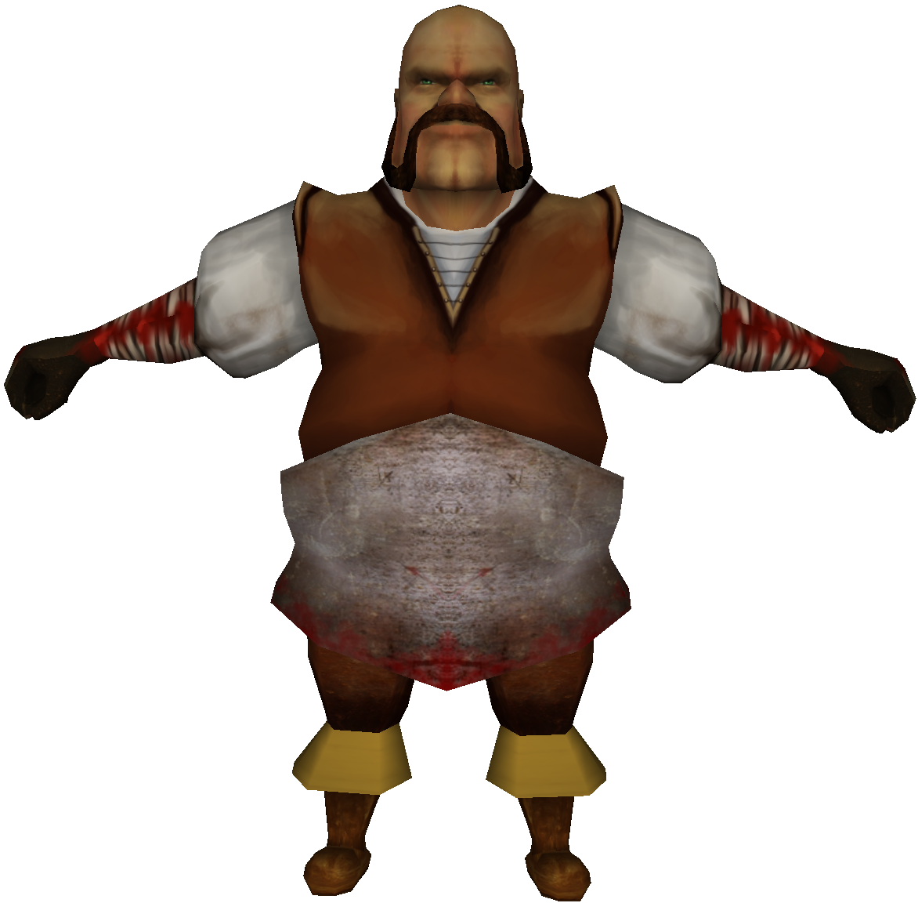
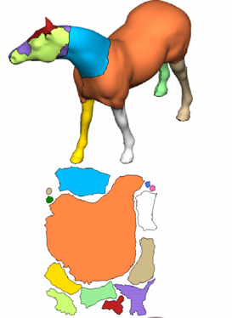
Texture Atlas
Properties of good UV layout:
  Minimizes stretch
  Maximize packing efficiency
  Easy for artist to paint
  Or tightly packed for automatic generation
Zhou et al.

Slide 12
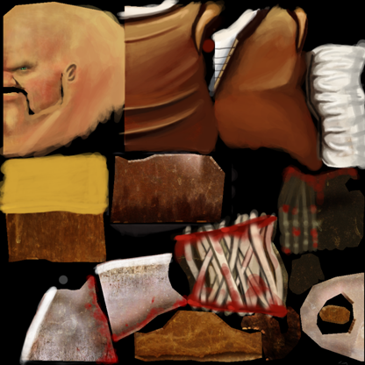
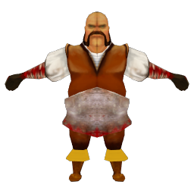
Texture Atlas
Not always a 1:1 mapping

Slide 13
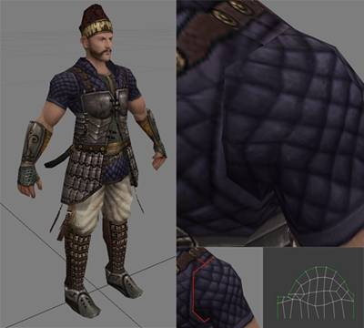
Texture Seams
Discontinuity at UV chart boundaries
Solutions:
  Fix them:
    Copy/Blend texels across boundary
  Hide them
    Armpits, ankles, backs of heads, under clothing
Peter Kojesta (Gamasutra)

Slide 14
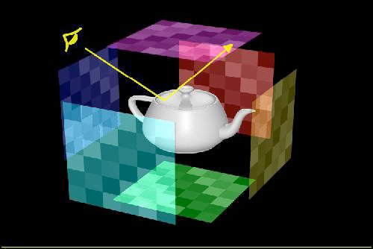
Environment Mapping
Surround scene with maps simulating surrounding detail
Notes:
14

Slide 15
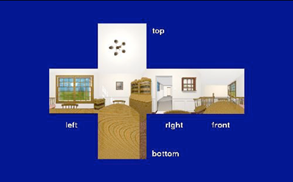
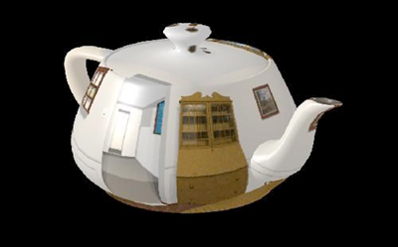
Distant Reflection
Look up reflection direction in reflection or environment map
Notes:
15

Slide 16
Cubic Environment Maps
Pick a face based on largest component
(+x, –x, +y, –y, +z, –z)
Project onto the face
  90° FOV = just divide
Use resulting coordinates for 2D lookup

Slide 17
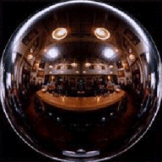
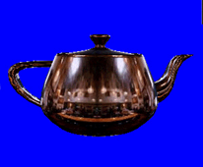
Spherical Environment Maps
Photograph of shiny sphere
  Lookup based on x/y coordinates of H vector
DirectX Documentation

Slide 18
Texture All the Things
Texture/Albedo map (Catmull 74)
Reflection Map (Blinn and Newell 76)
Bump/Normal Map (Blinn 78 / Cohen 98)
Gloss Map (Blinn 78)
Transparency Map (Gardner 85)
Diffuse Reflectance (Miller and Hoffman 84)
  Light Maps
Shadows, displacements, etc (Cook 84)
Tangent map (Kajiya 85)
  Hair / fur, other directional effects

Slide 19
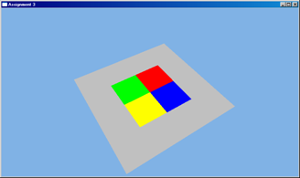
Texture Sampling
Point Sampling
  Map UV coordinate onto texel grid, grab corresponding texel
    i = floor(u*width)
    j = floor(v*height)
  Just like in 1995

Slide 20
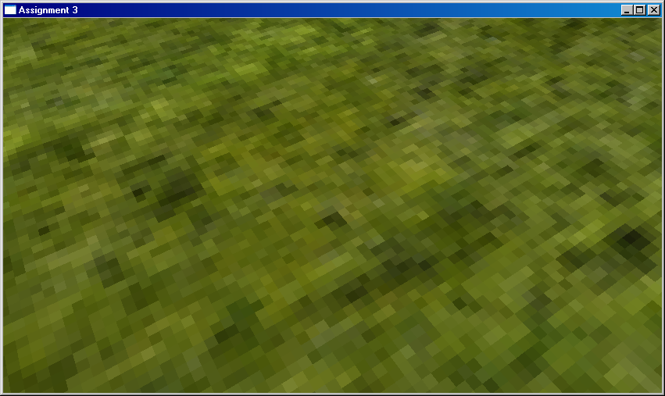
Point Sampling
Point sampling under magnification

Slide 21
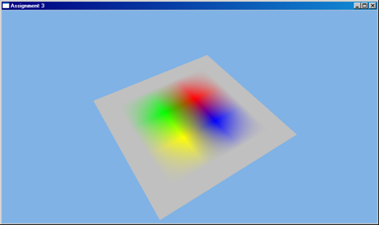
Filtered Sampling
Bilinear Filtering
  Linear in u, linear in v
  Interpolate texels in 2x2 neighborhood
    Top-left texel:
      floor(u*(width-1)), floor(v*(height-1))
    Weight by fractional coordinates

Slide 22
Point Sampling
Point sampling under magnification

Slide 23

Linear Sampling
Linear sampling under magnification

Slide 24
3D Textures
Array of 2D slices
3D Coordinates (u,v,w)
Bilinear tap in each slice using u,v
Linear blend using w
  Trilinear = 3 dimensions of linear blend

Slide 25
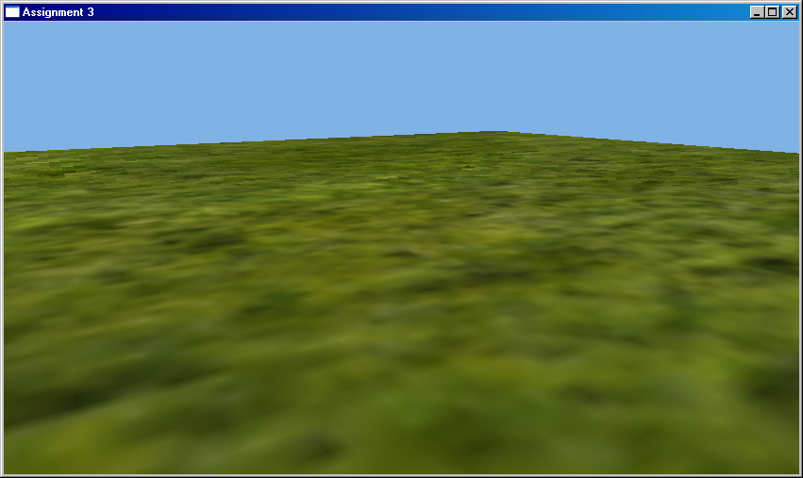
Minification
Aliasing!
Pixels:Texels < 1: Minification
Pixels:Texels ≈ 1
Pixels:Texels > 1: Magnification

Slide 26
Minification Filtering
Anti-aliasing problem
Projected pixel footprint
Texels
Pixels
Texel grid
Large jumps between pixels. Texture is undersampled…

Slide 27
Minification Filtering
One solution:
  Average lots of samples
Problems:
- Expensive
- Guessing the right sampling rate
- Performance death spiral for heavy minification

Slide 28
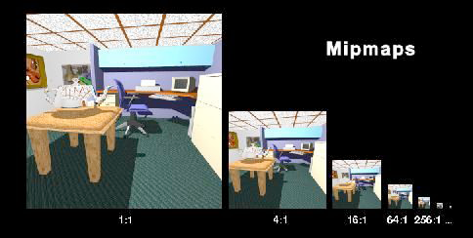
Mip-Mapping
Prefiltering:
  Precalculate chain of filtered images
    Each level is ½ previous resolution
From Latin: "multum in parvo" (much in little)

Slide 29
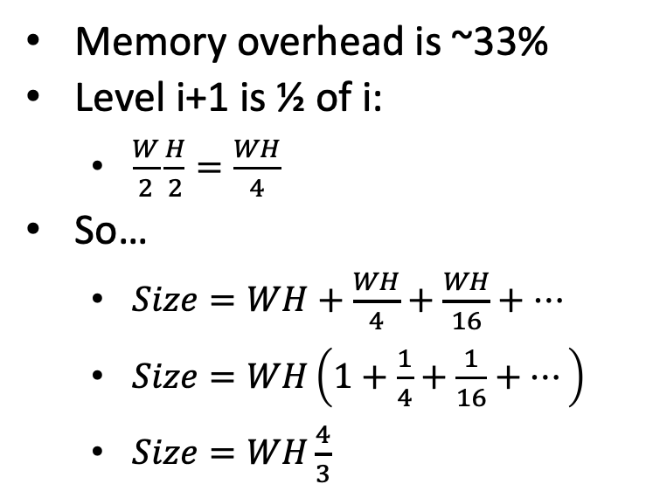
Mip-Mapping
Memory overhead is ~33%
Level i+1 is ½ of i:
  $\frac{W}{2}\frac{H}{2}=\frac{WH}{4}$
So…
  $Size=WH+\frac{WH}{4}+\frac{WH}{16}+…$
  $Size=WH\left(1+\frac{1}{4}+\frac{1}{16}+…\right)$
  $Size=WH\frac{4}{3}$
Geometric series

Slide 30
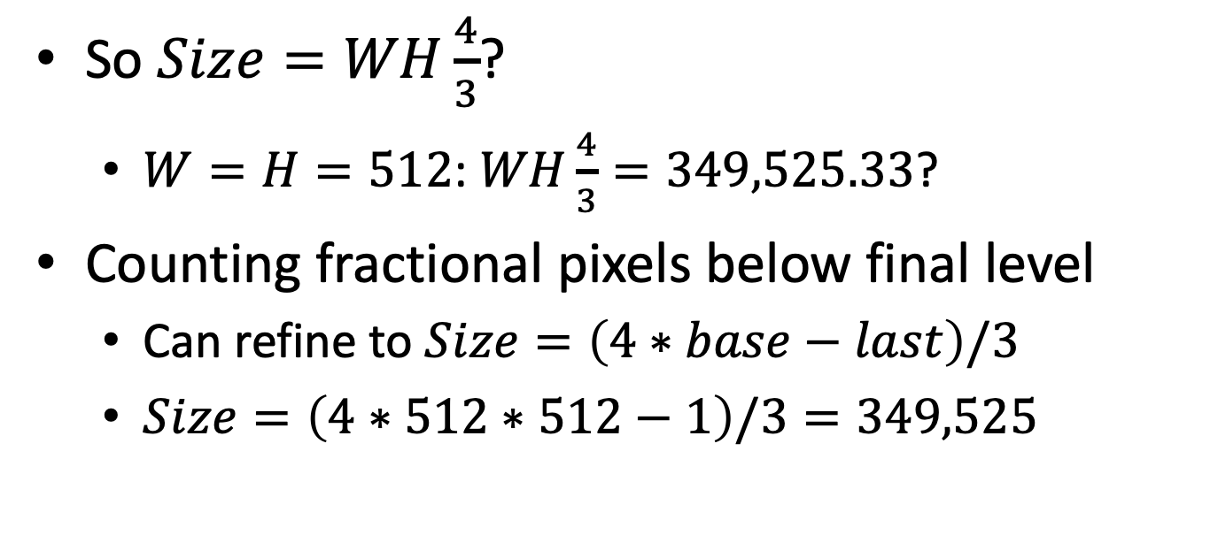
Refining Size Computation
So $Size=WH\frac{4}{3}$?
  $W=H=512$: $WH\frac{4}{3}=349,525.33$?
Counting fractional pixels below final level
  Can refine to $Size=\left(4∗base−last\right)/3$
  $Size=\left(4∗512∗512−1\right)/3=349,525$

Slide 31
Mip-Mapping
Derive footprint using UV derivatives in screenspace
  du/dx = difference between u in adjacent x pixels
du/dy, dv/dy
du/dx, dv/dx

Slide 32
Mip-Mapping
Approximate footprint with a square
  W = Width of square in texels
Find mip level matching footprint size
w

Slide 33
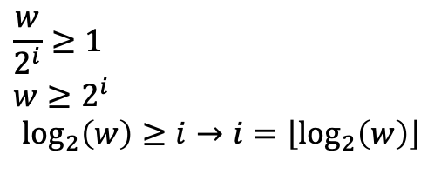
Mip-Mapping
Width of square in texels
$$\frac{w}{2^{i}}≥1$$
$$w≥2^{i}$$
$$\log_{2}\left(w\right)≥i→i=\left\lfloor \log_{2}\left(w\right)\right\rfloor$$
Finest level that won’t alias
Base texels per i^{th} level texel
Aliasing
“Just Right”
Magnification
0
Level of detail
…

Slide 34

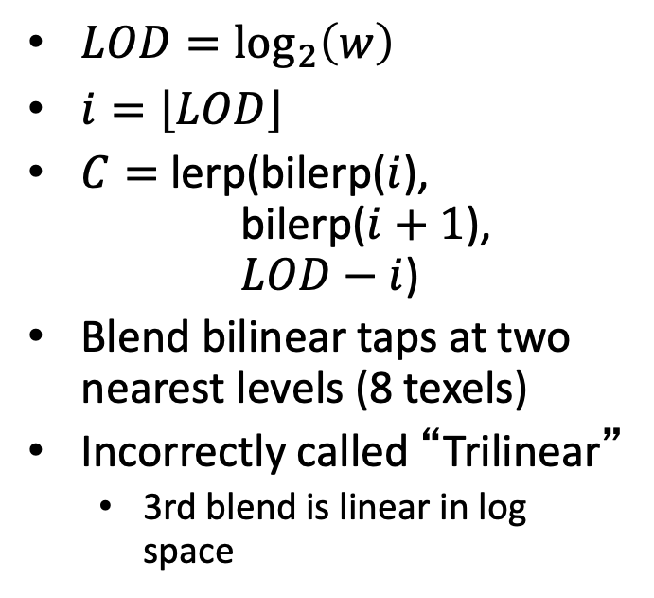
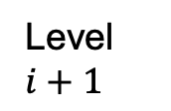
Mip-Mapping
$LOD=\log_{2}\left(w\right)$
$i=\left\lfloor LOD\right\rfloor$
$C=$ lerp(bilerp($i$),
bilerp($i+1$),
$LOD−i$)
Blend bilinear taps at two nearest levels (8 texels)
Incorrectly called “Trilinear”
  3rd blend is linear in log space
Level $i$
Increasing footprint size
Level $i+1$

Slide 35
Without

Slide 36
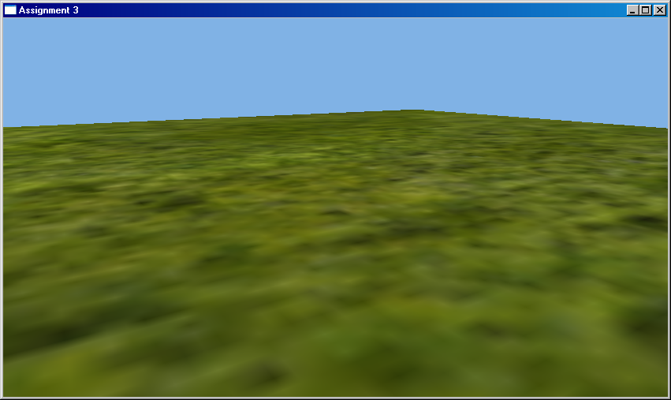
With

Slide 37
Getting Derivatives
Rasterizer: 2x2 Quads + Differencing
Missing pixels are extrapolated…
Each 2x2 quad is self-contained
This is a collosal pain in the collective necks of hardware architects

Slide 38
Getting Derivatives
Raytracer
  Intersect “differential” rays with tangent plane
  Track derivatives during secondary bounces

Slide 39
Mip-Mapping
Advantages:
  Cheap approximation to super-sampling
  Ensures 1:1 pixel/texel ratio
  May actually be FASTER than bilinear
    Big steps in texture space unlikely to be in cache
    Small steps in MIP not just in cache, but likely to be reused between pixels

Slide 40
Mip-Mapping
Disadvantages:
  Needs derivatives
    Complicates renderer
  33% Memory overhead
  Needs some preprocessing

Slide 41
Anisotropic Filtering
Mipmapping is isotropic
  Same in all directions
At oblique angles, footprint is NOT isotropic
  Result: Too much blur

Slide 42
Anisotropic Filtering
Elliptical Weighted Average (EWA)
  Circular Gaussian at pixel
  Projects to elliptical Gaussian on texture
“Gold Standard”
  Lots of samples according to that distribution

Slide 43
Anisotropic Filtering
Hardware Solution:
  Compute major and minor axis of ellipse
  Minor axis picks level
  Multiple filter taps along major axis
Hardware may limit
  e.g. 8:1 anisotropic filtering
  Fatten sample width to cover past limit
    e.g. max(minor, major/8)
4x Anisotropic

Slide 44
No mipmapping

Slide 45
Trilinear

Slide 46

4x Anisotropic

Slide 47
Texture Performance
Mostly memory bandwidth limited
Use cache
  Best when access is coherent between pixels
  Cache in 4x4 blocks instead of 16x1 lines
  Use MIP maps (improves chance of cache hits)
Small data
  Don’t use RGBA when one or two channels will work
  Use 8-bit channels or 16-bit float instead of 32-bit
    32-bit float: sign, 8-bit exponent, 23-bit mantissa
    16-bit float: sign, 5-bit exponent, 10-bit mantissa
Compression
  Cheaper to fetch smaller data then decompress than to fetch full-sized

Slide 48
Texture Compression
Lossless vs Lossy
  Lossless: Get out exact bits you put in
  Lossy: Some error is OK if it is not perceptable
Variable vs Fixed/Constant Bit Rate
  VBR: Large single-color areas can compress more than complex changing areas
  FBR: Cannot easily randomly index into VBR, constant bit rate loses some compression to get random access

Slide 49
Lossless
Run Length Encoding (RLE)
  Pixel value & count
Dictionary (strings of bytes)
  Substring seen before: use dictionary index
  Update dictionary
Entropy coding (symbols with probability)
  Higher probability = fewer bits
  Lower probability = more bits
  Huffman, Arithmetic, Range, ANS

Slide 50
Arithmetic Coding
Bit stream interpreted as a fraction 0.xxxxxx

Slide 51
Arithmetic Coding
Read a 0 bit, know number is 0..½ (0.0xxx)

Slide 52
Arithmetic Coding
All possible #s below cutoff, next bit must be 0
  Rescale active range from 0..cutoff to 0..1

Slide 53
Arithmetic Coding
All possible #s still below cutoff
  Output another 0 bit & rescale to 0..1 again

Slide 54
Arithmetic Coding
All possible #s still below cutoff
  Output another 0 bit & rescale to 0..1 again

Slide 55
Arithmetic Coding
Active range spans cutoff, read another bit (1)
  Bottom of range moves up to 0.5 (0.1xxx)

Slide 56
Arithmetic Coding
Active range still spans cutoff, read another bit
  Bottom of range moves up to 0.75 (0.11xxx)

Slide 57
Arithmetic Coding
Active range still spans cutoff, read another bit
  Bottom of range moves up to 0.875 (0.111xxx)

Slide 58
Arithmetic Coding
Active range entirely above cutoff, output 1
  Rescale cutoff..1 to 0..1

Slide 59
Arithmetic Coding
Example output 3 likely bits from 1 bit read
Had to read 3 bits to output 1 unlikely bit
Can change
or adapt
probability

Slide 60
Entropy Coding IRL
Encoder can only use info decoder will know
Huffman
  Build binary tree (each branch=1 bit)
  Fast, but doesn’t share bits between symbols
Arithmetic/Range
  Can change or adapt probabilities as you go
  Adapt to use machine-word sized window on input
ANS
  Fast (esp. table-based tANS)
  Encodes backwards, so adaptive probabilities harder

Slide 61
Transformation
Improve both entropy & lossy coding
Luminance / Chrominance
  Humans are more sensitive to luminance
Encode difference from a prediction
Fourier transform
…

Slide 62
JPEG Compression
Lossy VBR w/ 8x8 blocks
Convert to luminance/chrominance
  Full res luminance, half-res chrominance
Quantize in frequency space then entropy
  Different # bits for low and high frequencies
  Too much leads to ringing at hard edges

Slide 63
JPEG 2000
Didn’t catch on, but some cool ideas
Color transform (YUV or YC_{r}C_{b})
Split image into tiles
Wavelet transform (MIP-like pyramid of prediction & differences)
Encode blocks one bit-plane at a time (same bit for all pixels in block)
  Rate-distortion ordering (most important first)
  Stop at any time for lossy, all of them for lossless
Three probability models for entropy-coding bits
  Bits so far for pixel & neighbors all still 0 (likely 0 bit)
  Bits so far for pixel = 0, but at least one neighbor ≠ 0 (likely 1 bit)
  The bits we have for this pixel are already ≠ 0 (about equal prob of 0/1 bit)

Slide 64
Block Compression (BC1/DXT1)
Lossy FBR w/ 64 bits per 4x4 block
Encode two representative colors (32 bits)
  16 bits each: 5 red, 6 green, 5 blue
Color of each pixel with 2 bits (32 bits)
  A>B: Color A; (⅔ A + ⅓ B); (⅓ A + ⅔ B); B
  A≤B: Black/Transparent; A; (½ A + ½ B); B

Slide 65
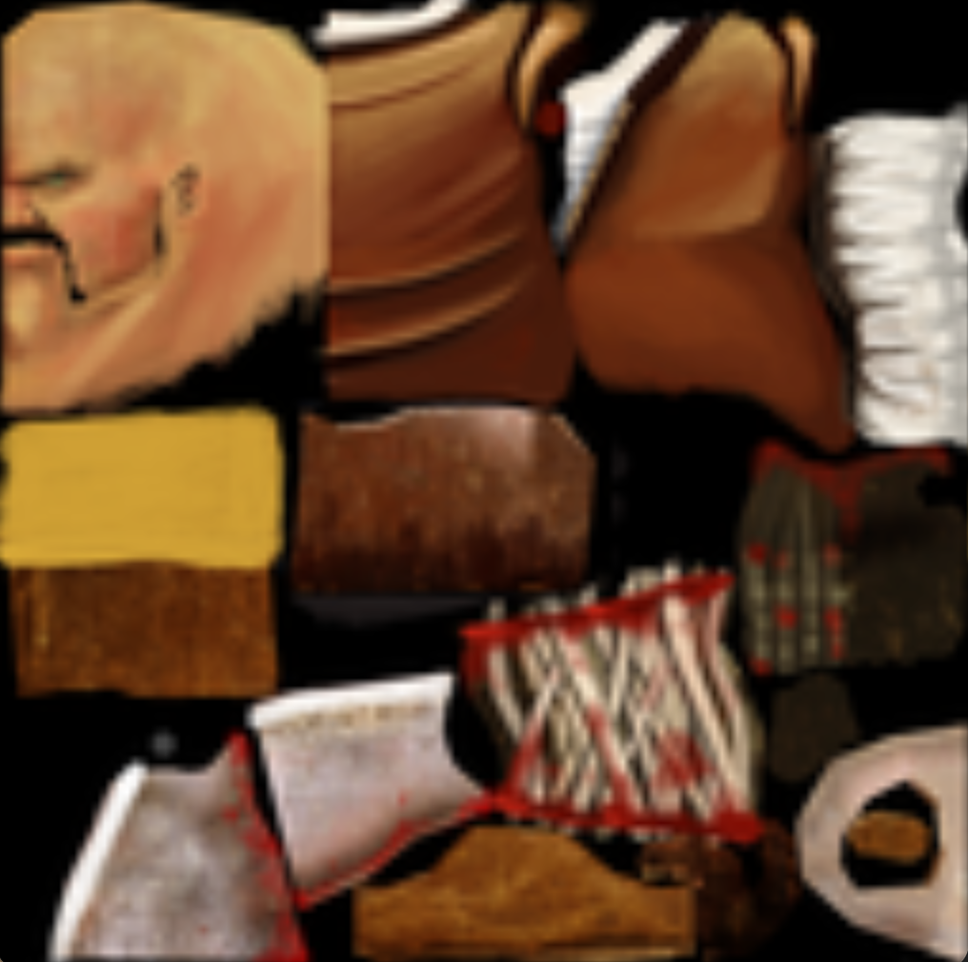
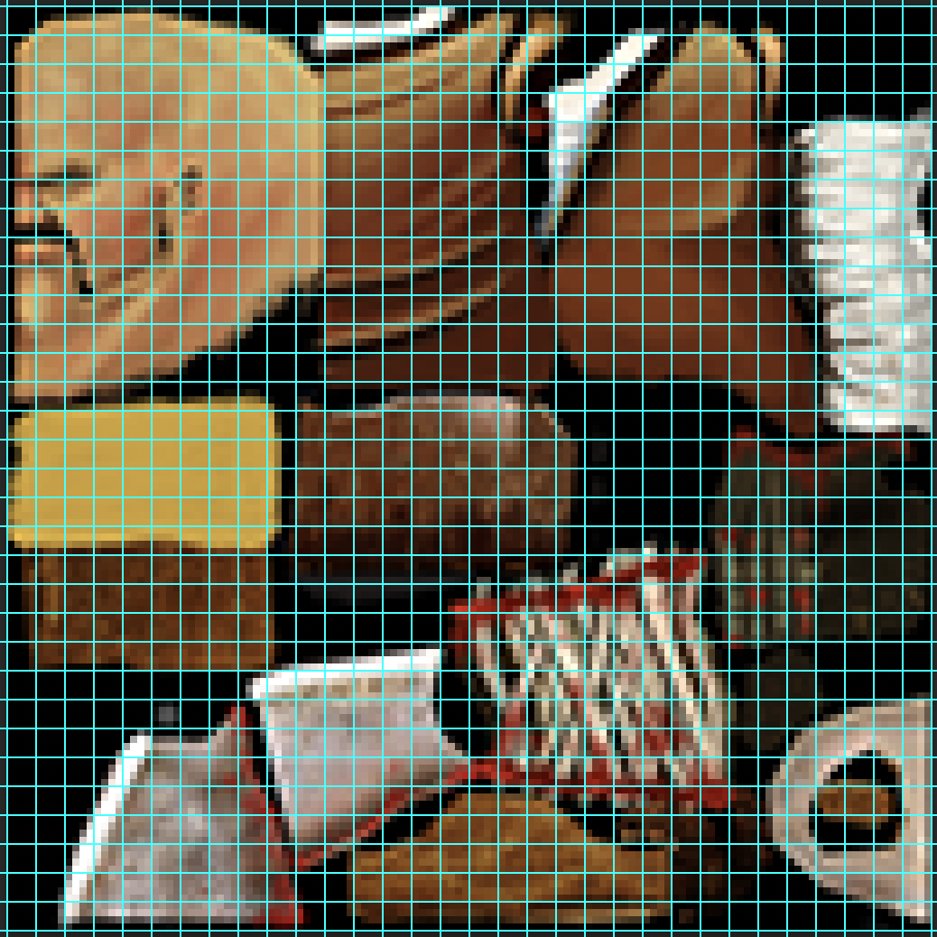


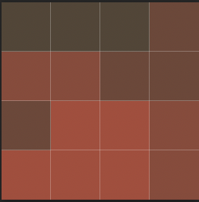
Block Compression
Source Image
Representative
Colors
Quantized
Single 4x4
Block
Palette
Compressed
Block
Result

Slide 66
Normals (BC5/RG)
Lossy FBR w/ 128 bits per 4x4 block
Two independent 64-bit channels.
For each
  Encode two representative values (16 bits)
  Value of each pixel with 3 bits (48 bits)
    A>B: Interpolate A to B in 8 steps
    A≤B: 0, 1; Interpolate A to B in 6 steps

