Slide 1
Shading
CMSC 435/634

Slide 2
Shaders
Customize rendering with code
  Simple programs
  Domain-specific language
  Separates customization from core rendering code or hardware
Similar idea (& motivation) as game engine scripting

Slide 3
History (non-real-time)
Testbed [Whitted and Weimer 1981]
  Ray tracer outputs appearance parameters per pixel
  Separate program computes color
Shade Trees [Cook 1984]
  Simple expressions, came up with shader name
Image Synthesizer [Perlin 1985]
  Add loops, ifs, functions; also Perlin Noise
RenderMan [Hanrahan and Lawson 1990]
  Pixar’s renderer, popularized in film production rendering

Slide 4
RenderMan
Displacement
Surface
Light
Volume
Imager

Slide 5
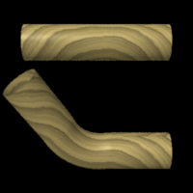
Displacement
Given
  Position
  Normal
Compute
  Position
  Normal
Displacement
Surface
Light
Volume
Imager

Slide 6
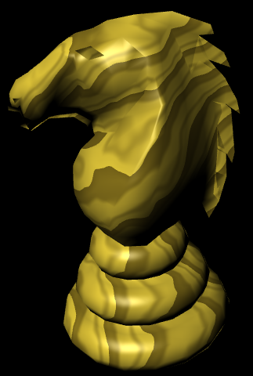
Surface color
Given
  Position
Compute
  Color
  Opacity
Displacement
Surface
Light
Volume
Imager

Slide 7
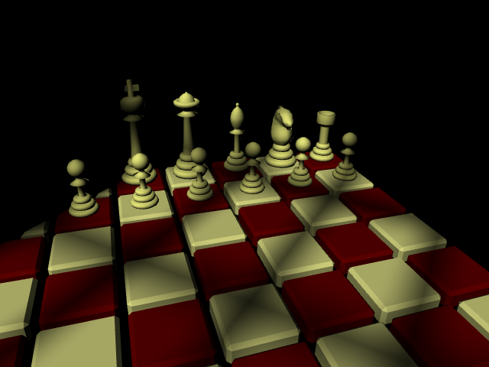
Lighting
Given
  Surface Position
Compute
  Light Direction
  Light Color
Displacement
Surface
Light
Volume
Imager

Slide 8
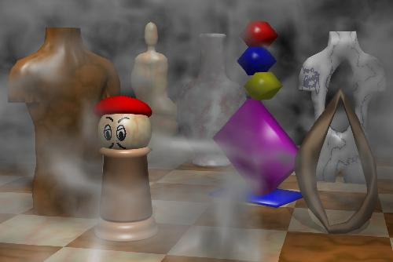
Volume Effects
Given
  Position
  Color
Compute
  New Color
Displacement
Surface
Light
Volume
Imager

Slide 9
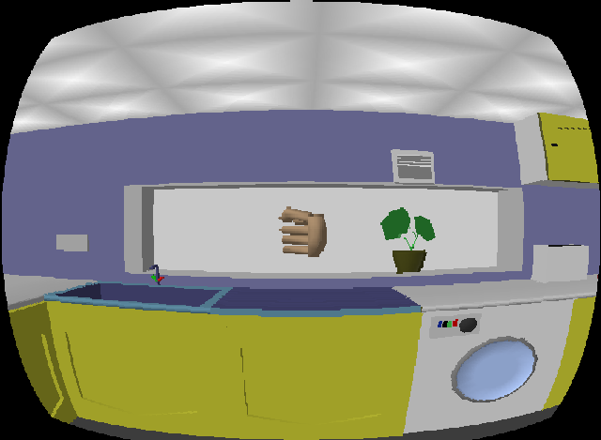
Image Effects
Given
  Pixel Color
Compute
  Pixel Color
Displacement
Surface
Light
Volume
Imager

Slide 10
RenderMan vs. GPU
RenderMan
  Developed from General CPU code
  Seconds to hours per frame
  “Unlimited” computation, texture, memory, …
GPU
  Developed from fixed-function hardware
  Tens of frames per second
  Limited computation, texture, memory, …

Slide 11
Non-real time vs. Real-time
RenderMan
GPU
Application
Application
Displacement
Texture/
Buffer
Vertex
Light
Surface
Volume
Fragment
Imager
Displayed
Pixels
Displayed
Pixels

Slide 12
History (real-time)
Custom HW [Olano and Lastra 1998]
Multi-pass standard HW [Peercy, Olano, Airey and Ungar 2000]
Register combiners [NVIDIA 2000]
Vertex programs [Lindholm et al. 2001]
Compiling to mixed HW [Proudfoot et al. 2001]
Fragment programs
Standardized languages
Other shading stages / Compute / Ray Tracing

Slide 13
GLSL / HLSL
Vertex & Fragment/Pixel
  Other stages added later
C-like, if/while/for
Structs & arrays
Float + small vector and matrix
  vec2, vec3, vec4, mat2, mat3, mat4
  Swizzle & mask (a.xyz = b.xxw)

Slide 14
GLSL / HLSL
Common math & shading functions
  Trigonometric, exponential, min, max, abs, …
  length, distance, normalize, dot, cross
  mix(a, b, t)
  clamp(t, a, b)
  step(a, t), smoothstep(a, b, t)
  reflect, refract

Slide 15
Shader Debugging
Hot reloading
  Make changes without changing viewpoint
External debugging tools
  PIX, Nsight, RenderDoc
Render as color
  Map intermediate values to 0-1
  Interpret results

Slide 16
Handy Color Mappings
color = vec3(-sign(x), sign(x), abs(x))
  Maps –1…0…1 to magenta...red / black / green…cyan
value = x / (1 + abs(x))
  Maps –∞…0…∞ into -1…0…1
c = 2 * x – vec3(0,1,2); color = 1 – c*c
  Maps 0…1 into rainbow

Slide 17
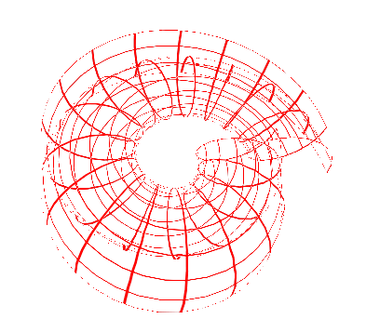
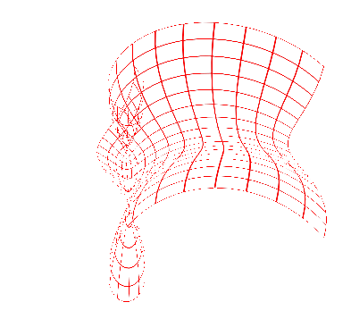
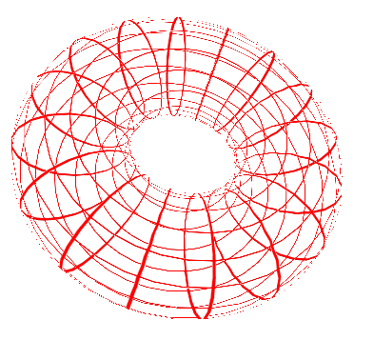
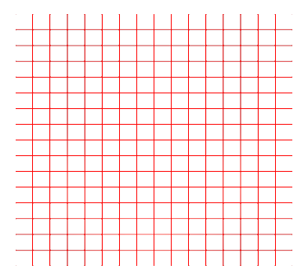
Vertex Demo:
Blend Positions

Slide 18
Shading Methods
Repeating Patterns
  mod, sin
  Divide and floor / fract
Shapes
  Implicit form: is this pixel inside
Color maps
Bombing
Blend layers: lerp(layer0, layer1, blend)
Noise or computed patterns

Slide 19
Bombing
Divide space into cells
Compute random position in each cell
Check if pixel is inside shape (incl. adjacent cells)

Slide 20
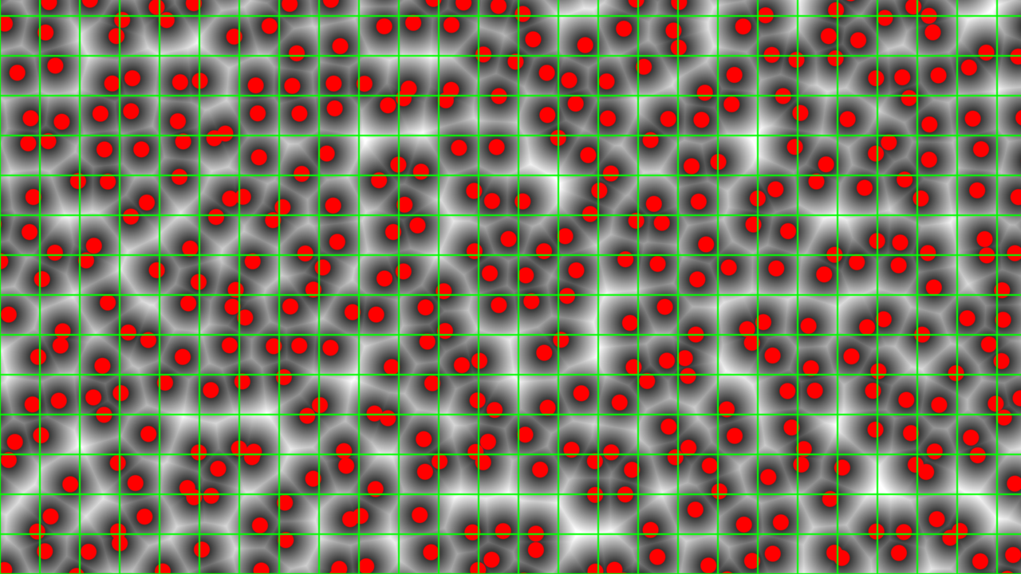
Layers
Blending
  Fade effects in and out with mix and smoothstep
  Pixel-width elements using fwidth or dFdx and dFdy
shadertoy.com/view/MsGcDV

Slide 21
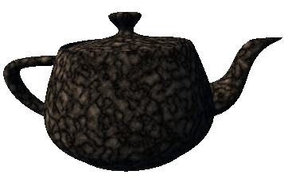
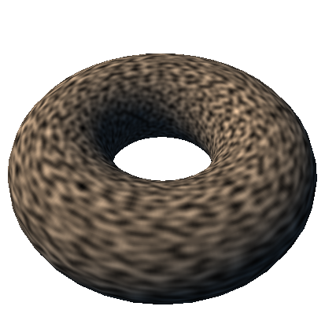
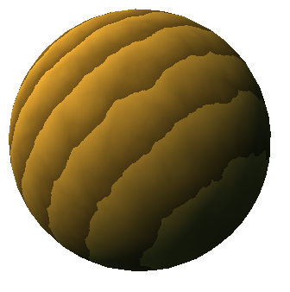
Noise
Controlled, repeatable randomness
  Still spotty GPU implementation (22 years later!)
  Can use texture or compute

Slide 22
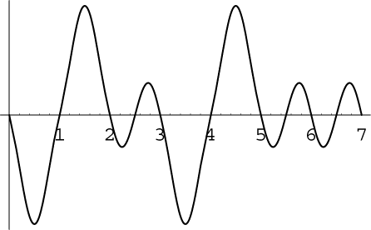
Noise Characteristics
Repeatable
Locally continuous but distant points uncorrelated
Values
  RenderMan [0,1], average 0.5
  Perlin’s [-1,1], average 0
1/2 – 1 cycle per unit
Versions for 1D-4D input/output

Slide 23



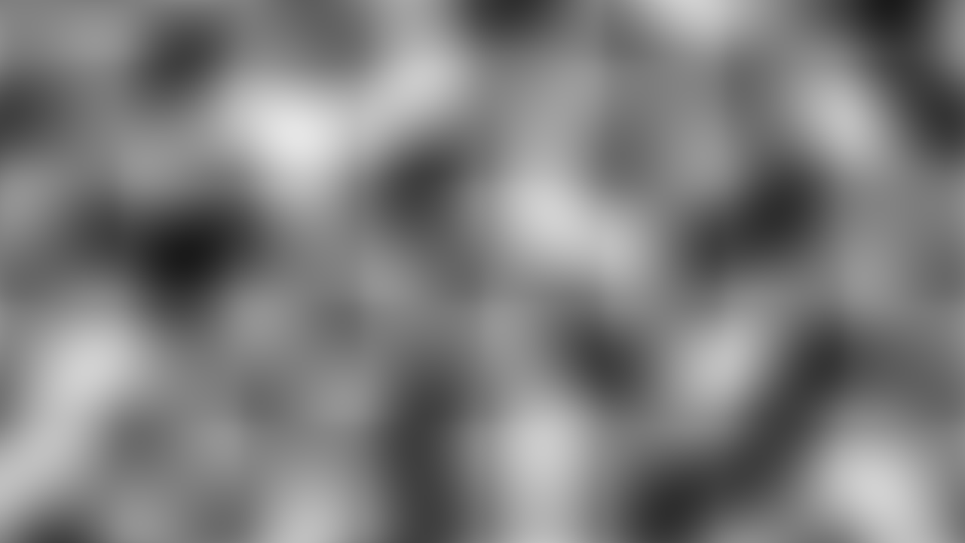
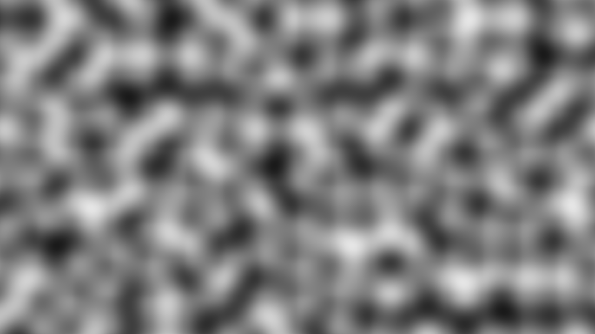
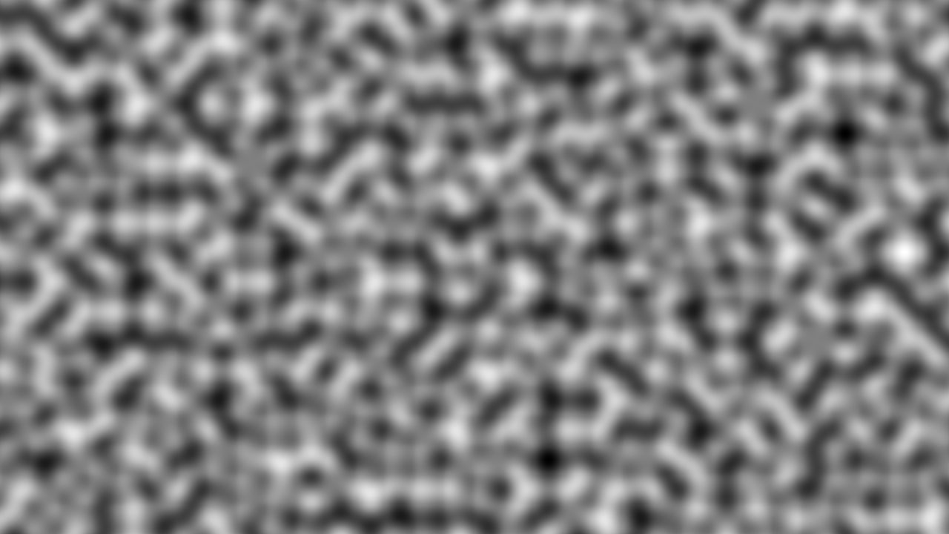
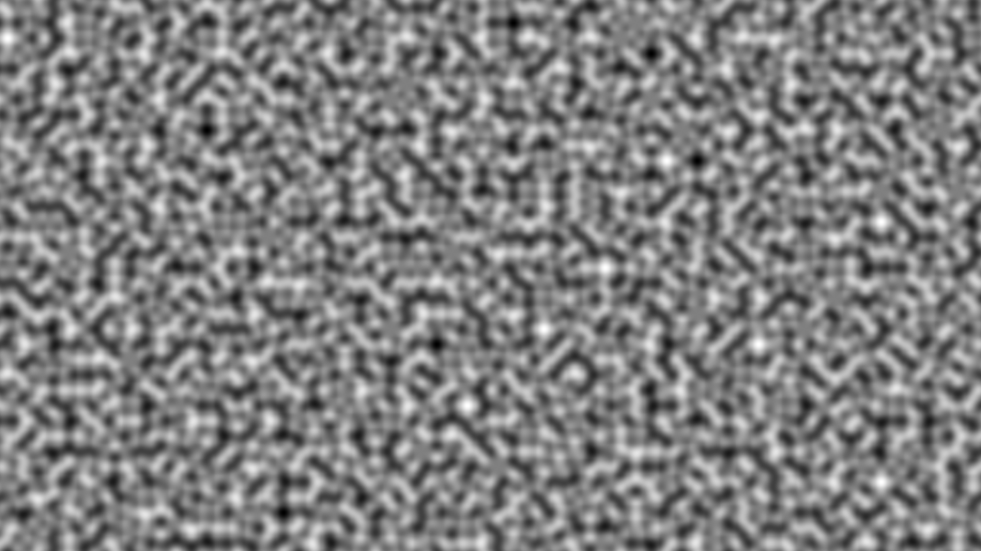

Noise Scale
float n = noise(scale * p) * 0.5 + 0.5;
scale = 1
scale = 2
scale = 4
scale = 8
scale = 16
scale = 32
scale = 64
scale = 128

Slide 24
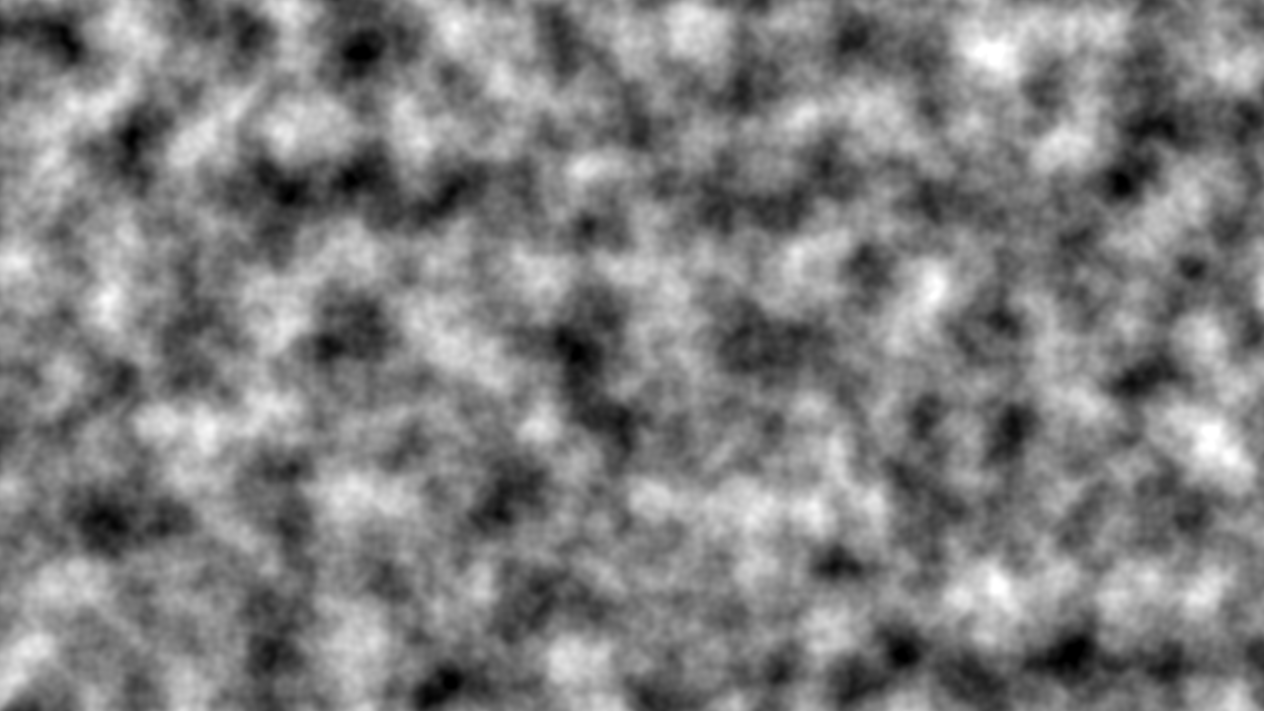
Fractional Brownian Motion (fBm)
float n = 0
for(f=1; f <= M; f*=2)
n += noise(f*P) / f;
n = n * 0.5 + 0.5;

Slide 25
Turbulence
Absolute value introduces creases
float n = 0;
for(f=0; f <= M; f *= 2)
n += abs(noise(f*P)) / f;

Slide 26
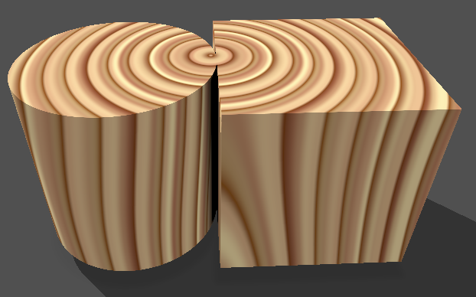

Perturbed patterns
Adjust position, radius, etc. with noise
shadertoy.com/view/NsyGWh

Slide 27
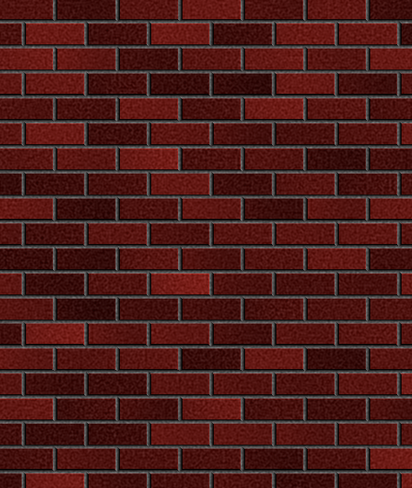
Brick Demo
mortar
brick
gap
height
width
gap
shadertoy.com/view/XXyGD3

