Slide 1
Ray Tracing
CMSC 435/634

Slide 2
Light Sources

Slide 3
Direct Illumination
Technically could trace all possible photon directions
If you hit something emitting light, add it in
If you hit a regular object, continue tracing photon bounces
Need a ton of photon paths per pixel
Simplify to sum over fixed light sources
Rather than sample photon directions randomly, always trace at least one photon path back toward each light.
Makes sure not to miss the important (light ⇢ surface ⇢ eye) paths.

Slide 4
Shadows
What if there is an object between the surface and light?

Slide 5
Ray Traced Shadows
Trace a ray
Start = point on surface
End = light source
t=0 at Surface, t=d at Light
“Bias” (𝜖 < t < d) to avoid surface acne
Test
𝜖 < t < d = shadow
No intersection or t ≥ d = use this light

Slide 6
Lambert’s Law
Intensity of reflected light is related to surface orientation
I
I
0.7*I
I

Slide 7
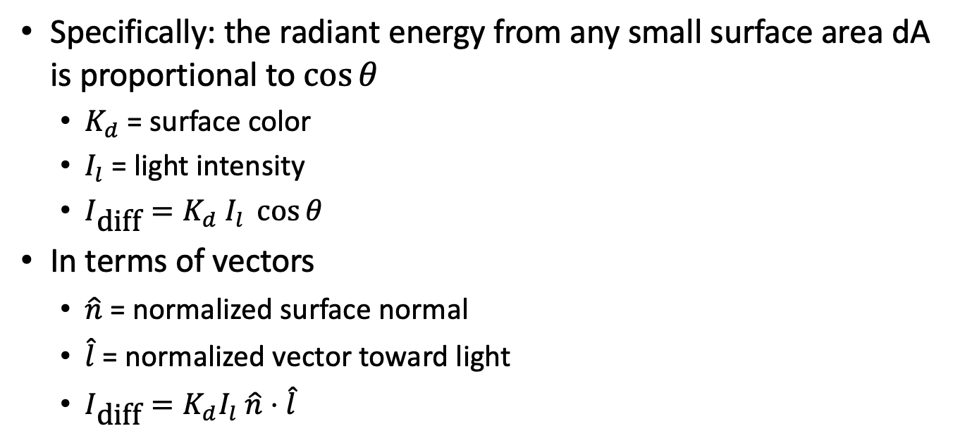
Lambert’s Law (AKA Diffuse Reflectance)
Specifically: the radiant energy from any small surface area dA is proportional to $\cos{θ}$
$K_{d}$ = surface color
$I_{l}$ = light intensity
$I_{\text{diff}}=K_{d} I_{l} \cos{θ}$
In terms of vectors
$\hat{n}$ = normalized surface normal
$\hat{l}$ = normalized vector toward light
$I_{\text{diff}}=K_{d}I_{l} \hat{n}⋅\hat{l}$

Slide 8
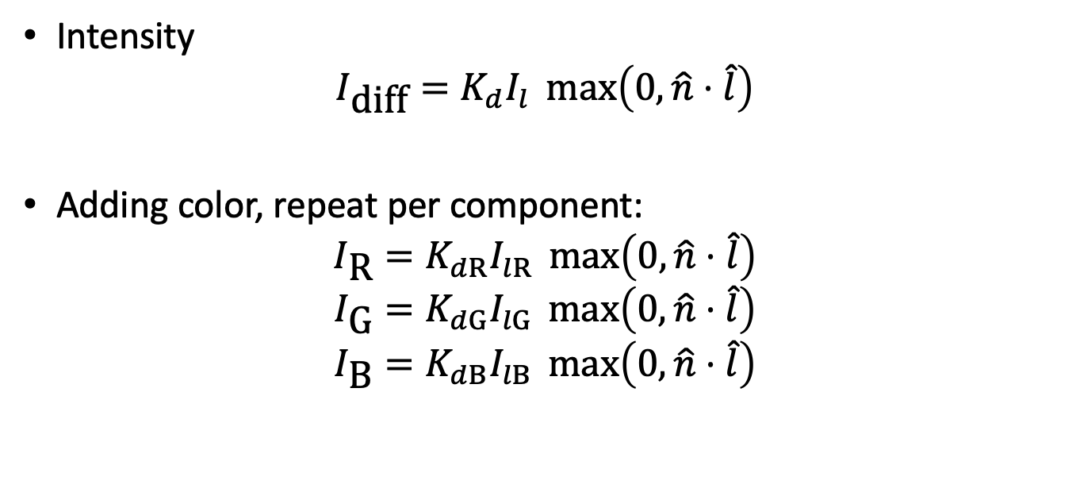
Color
Surface diffuse color aka albedo
Light intensity
Lambertian reflectance
Intensity
$$I_{\text{diff}}=K_{d}I_{l} \max\left(0,\hat{n}⋅\hat{l}\right)$$
Adding color, repeat per component:
$$I_{\text{R}}=K_{dR}I_{lR} \max\left(0,\hat{n}⋅\hat{l}\right)$$
$$I_{\text{G}}=K_{dG}I_{lG} \max\left(0,\hat{n}⋅\hat{l}\right)$$
$$I_{\text{B}}=K_{dB}I_{lB} \max\left(0,\hat{n}⋅\hat{l}\right)$$
Ignore lights below surface

Slide 9
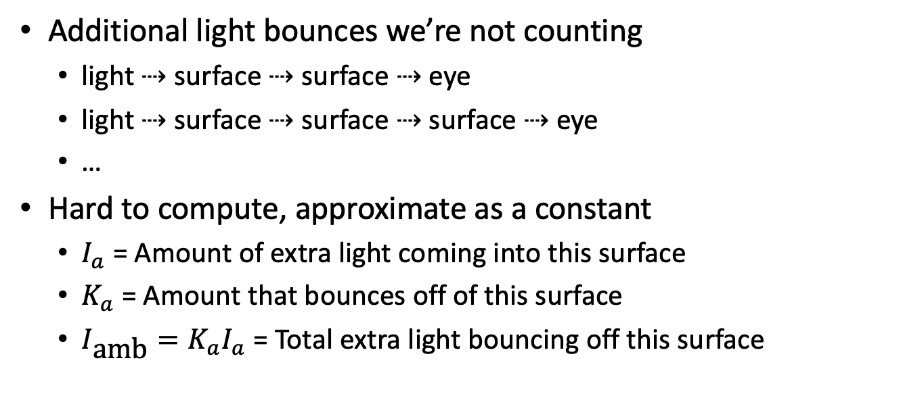
Ambient Light
Additional light bounces we’re not counting
light ⇢ surface ⇢ surface ⇢ eye
light ⇢ surface ⇢ surface ⇢ surface ⇢ eye
…
Hard to compute, approximate as a constant
$I_{a}$ = Amount of extra light coming into this surface
$K_{a}$ = Amount that bounces off of this surface
$I_{\text{amb}}=K_{a}I_{a}$ = Total extra light bouncing off this surface

Slide 10
Reflections

Slide 11
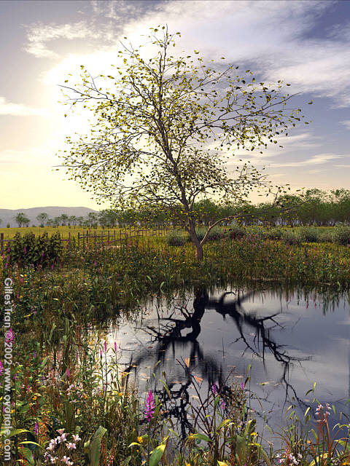
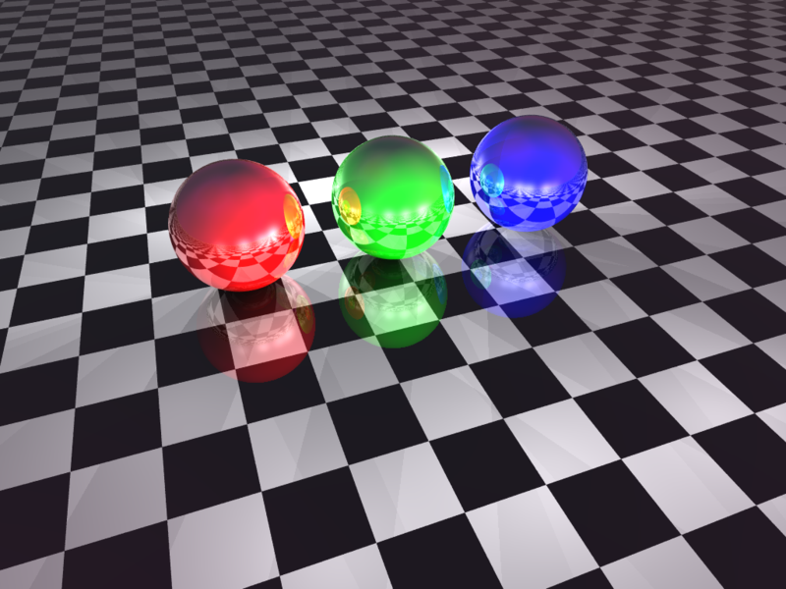
Mirror Reflection
Spheres - Martin K. B.

Slide 12
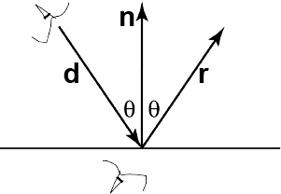
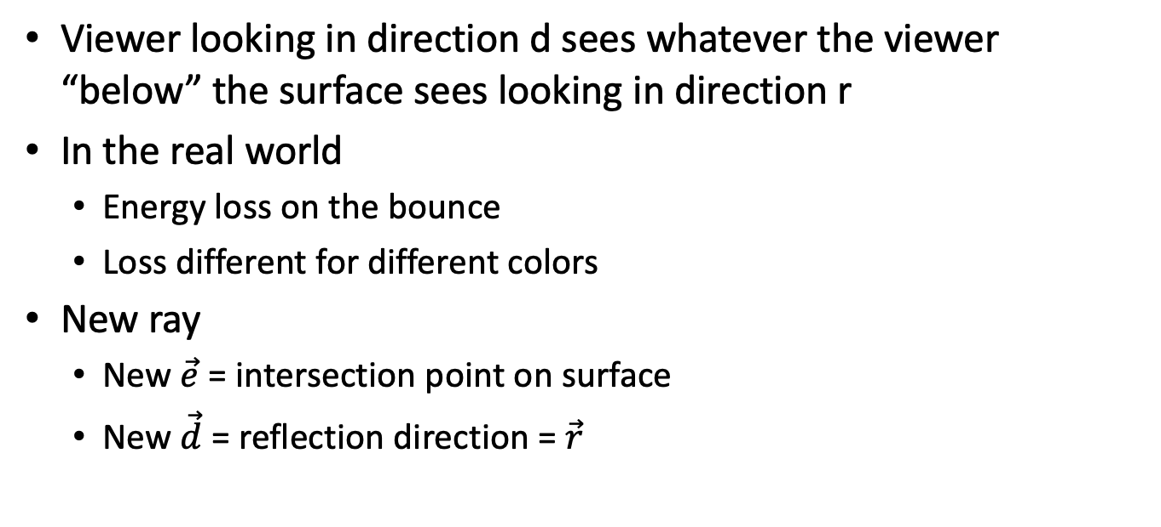
Ray Tracing Reflection
Viewer looking in direction d sees whatever the viewer “below” the surface sees looking in direction r
In the real world
Energy loss on the bounce
Loss different for different colors
New ray
New $\vec{e}$ = intersection point on surface
New $\vec{d}$ = reflection direction = $\vec{r}$

Slide 13
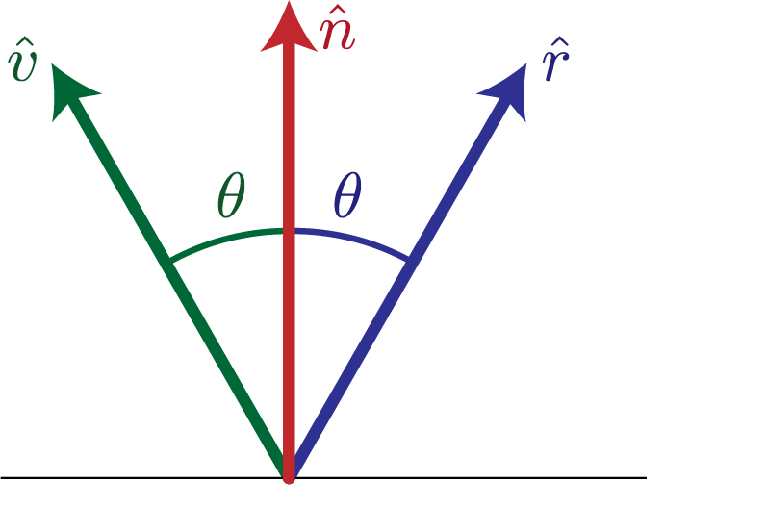
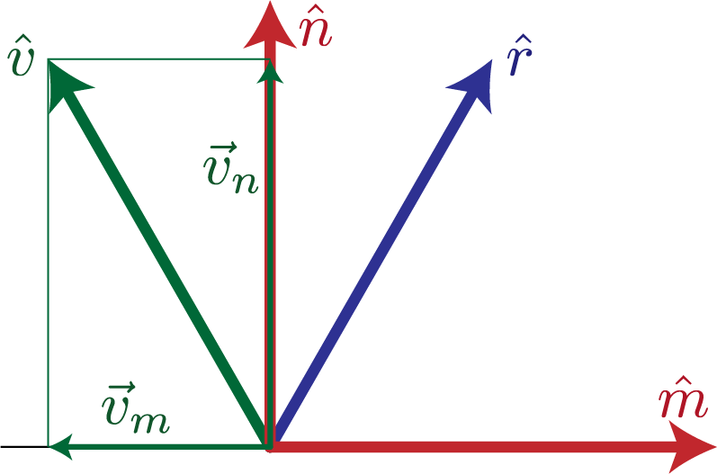
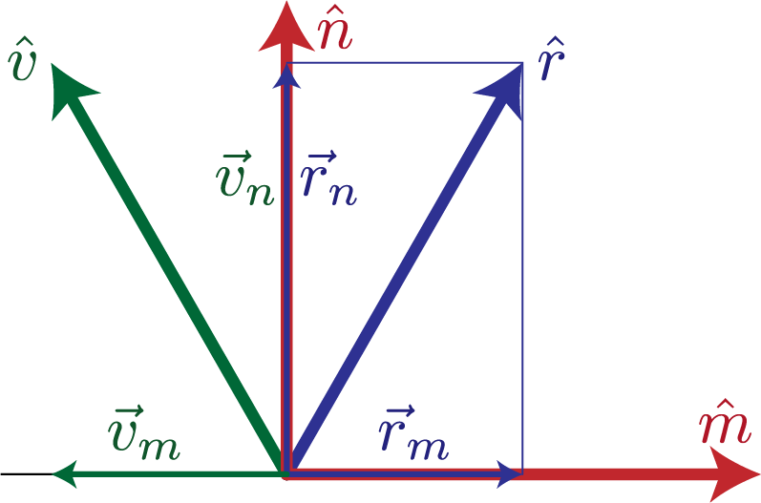
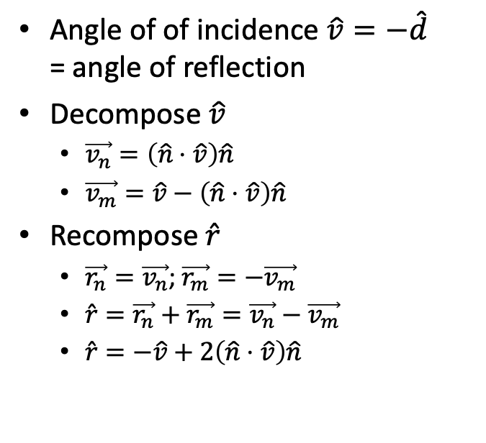
Calculating Reflection Vector
Angle of of incidence $\hat{v}=−\hat{d}$ = angle of reflection
Decompose $\hat{v}$
$\vec{v_{n}}=\left(\hat{n}⋅\hat{v}\right)\hat{n}$
$\vec{v_{m}}=\hat{v}−\left(\hat{n}⋅\hat{v}\right)\hat{n}$
Recompose $\hat{r}$
$\vec{r_{n}}=\vec{v_{n}}$; $\vec{r_{m}}=−\vec{v_{m}}$
$\hat{r}=\vec{r_{n}}+\vec{r_{m}}=\vec{v_{n}}−\vec{v_{m}}$
$\hat{r}=−\hat{v}+2\left(\hat{n}⋅\hat{v}\right)\hat{n}$

Slide 14
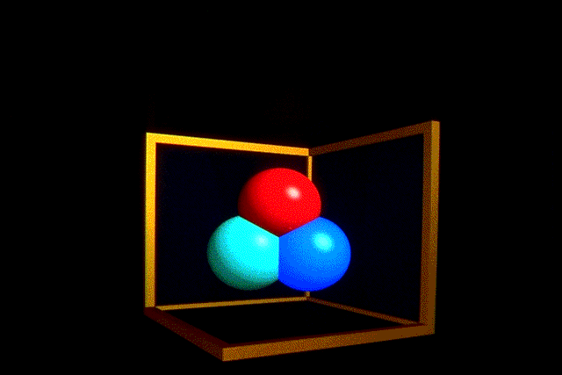
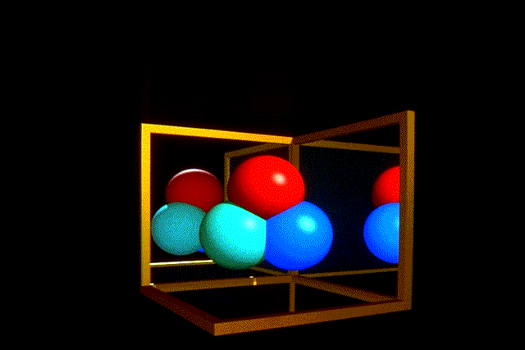
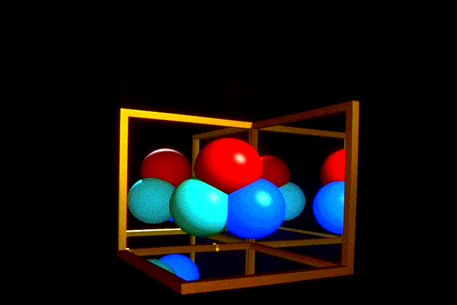
Ray Traced Reflection
Avoid infinite recursion
Stop after n bounces
Stop when contribution to pixel gets too small
Random probability to kill photon path
First two are biased in the presence of bright light sources

Slide 15
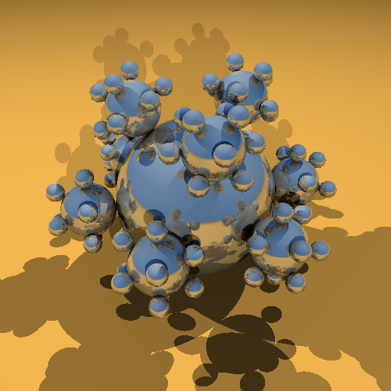
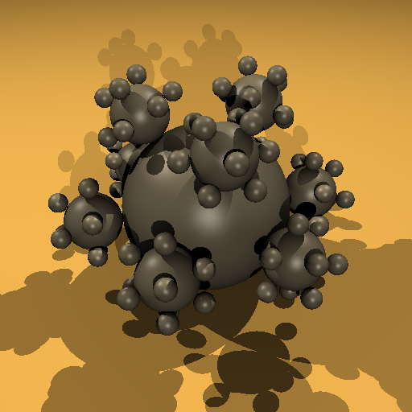
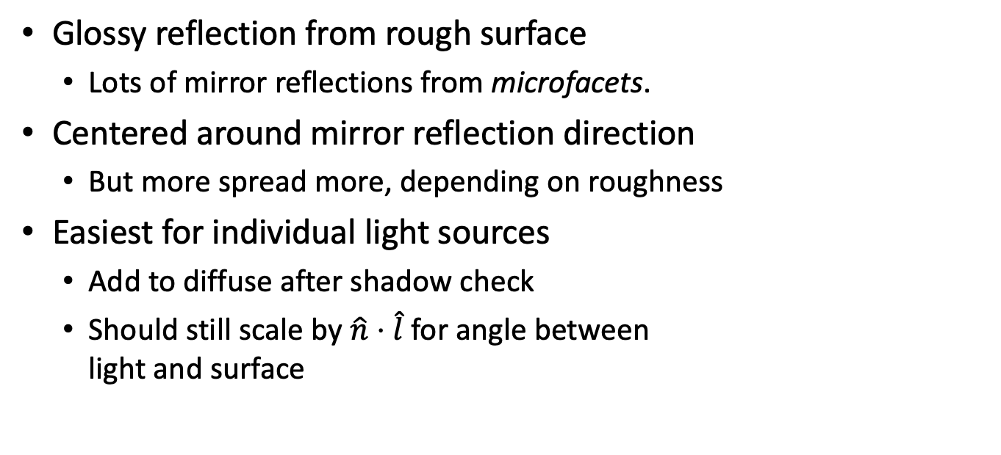
Specular Reflection
Mirror
Glossy reflection from rough surface
Lots of mirror reflections from microfacets.
Centered around mirror reflection direction
But more spread more, depending on roughness
Easiest for individual light sources
Add to diffuse after shadow check
Should still scale by $\hat{n}⋅\hat{l}$ for angle between light and surface
Specular

Slide 16
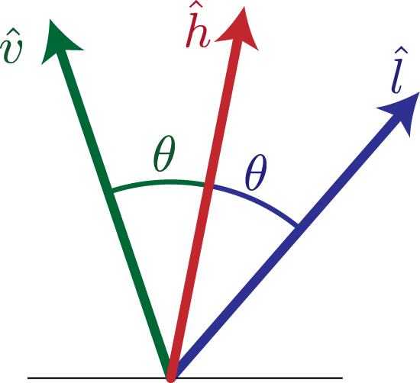
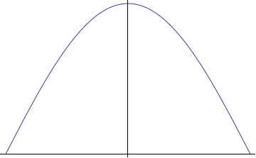
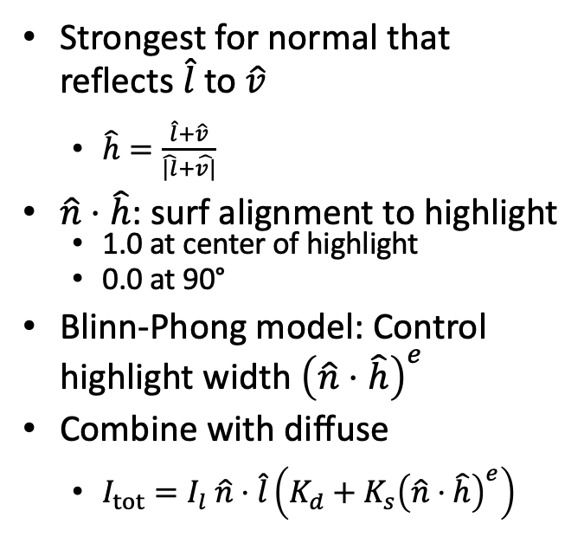
H vector
Strongest for normal that reflects $\hat{l}$ to $\hat{v}$
$\hat{h}=\frac{\hat{l}+\hat{v}}{\hat{|l}+\hat{v|}}$
$\hat{n}⋅\hat{h}$: surf alignment to highlight
1.0 at center of highlight
0.0 at 90°
Blinn-Phong model: Control highlight width ${\left(\hat{n}⋅\hat{h}\right)}^{e}$
Combine with diffuse
$I_{tot}=I_{l} \hat{n}⋅\hat{l}\left(K_{d}+K_{s}{\left(\hat{n}⋅\hat{h}\right)}^{e}\right)$

Slide 17
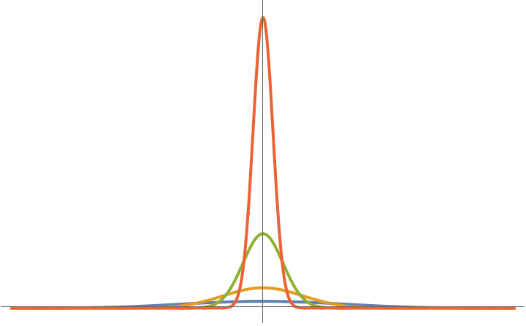

Specular Normalization
Energy Conservation: Highlight intensity scales with width
Really updating eyeball model to modern understanding
Phong: ${\left\langle \vec{r}⋅\vec{l}\right\rangle }^{e}$
Blinn-Phong: ${\left\langle \hat{n}⋅\hat{h}\right\rangle }^{e}$
Normalized Blinn-Phong ${\left\langle \hat{n}⋅\hat{h}\right\rangle }^{e} \frac{e+2}{8}$

Slide 18
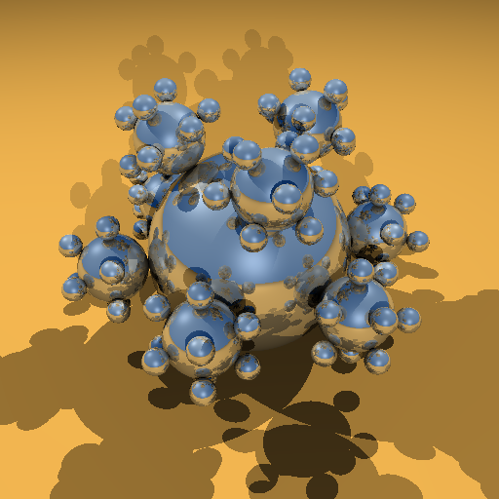

Combined Specular & Mirror
Many surfaces have both

Slide 19
Refraction

Slide 20
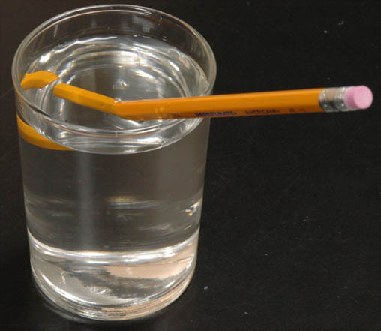
Refraction

Slide 21
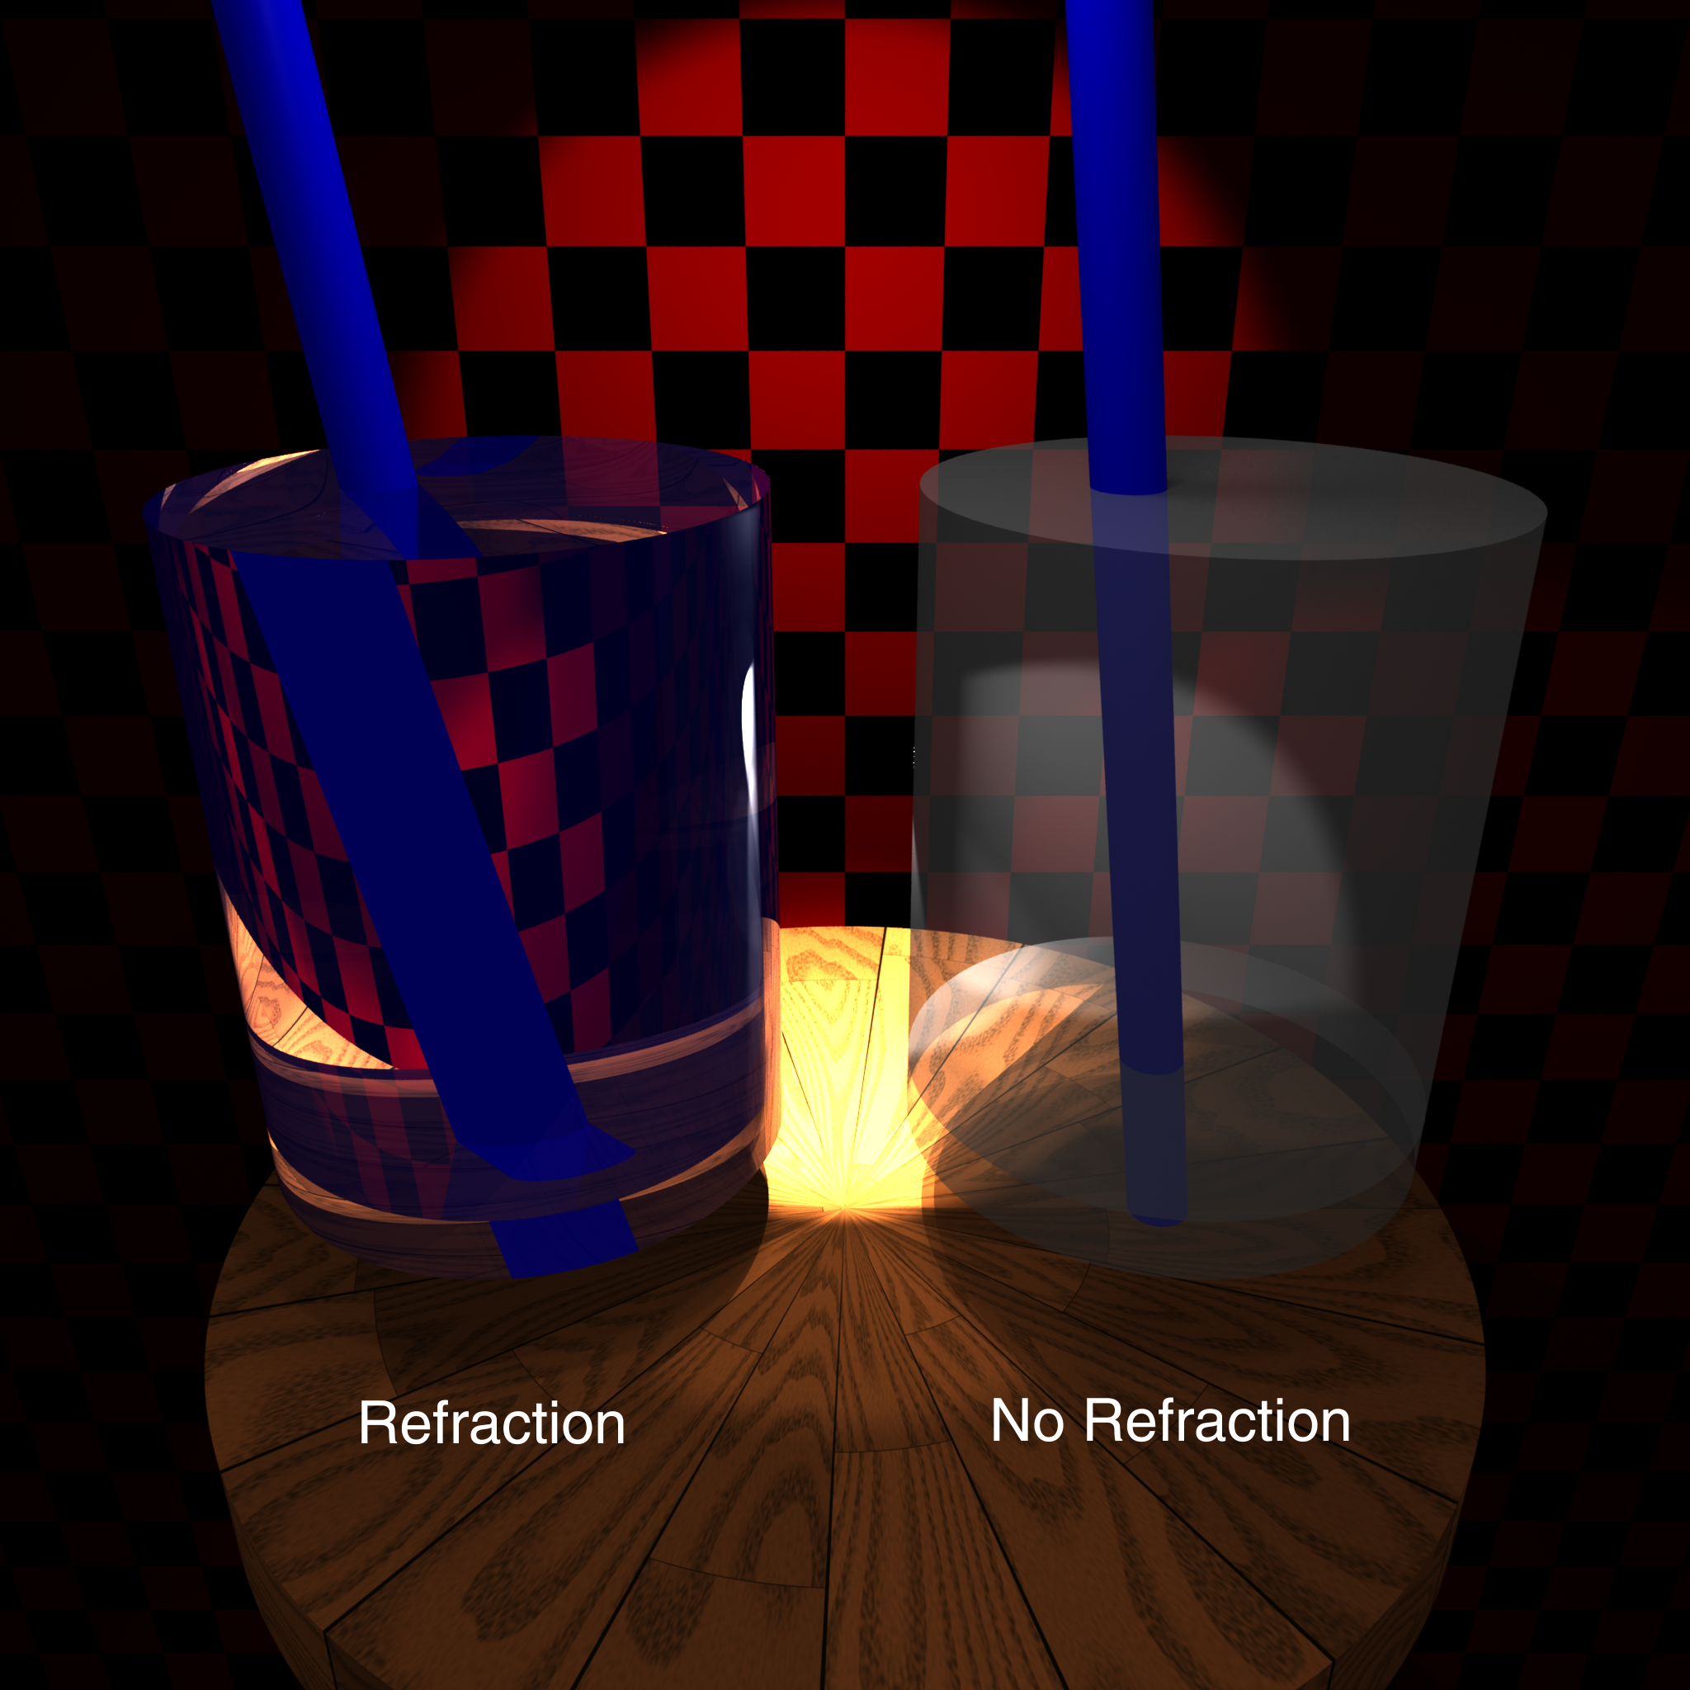

Slide 22
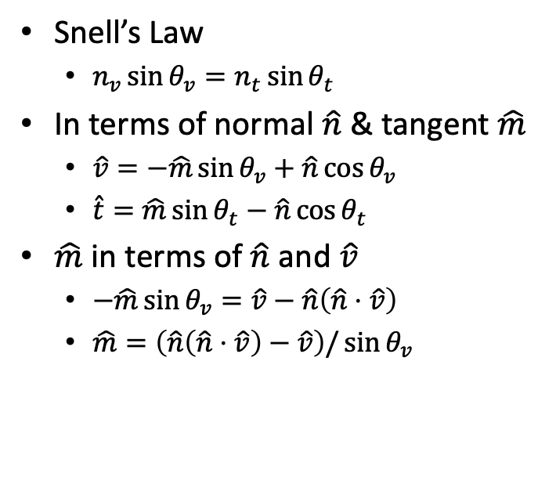
Calculating Refraction Vector
Snell’s Law
$n_{v}\sin{θ_{v}}=n_{t}\sin{θ_{t}}$
In terms of normal $\hat{n}$ & tangent $\hat{m}$
$\hat{v}=−\hat{m}\sin{θ_{v}}+\hat{n}\cos{θ_{v}}$
$\hat{t}=\hat{m}\sin{θ_{t}}−\hat{n}\cos{θ_{t}}$
$\hat{m}$ in terms of $\hat{n}$ and $\hat{v}$
$−\hat{m}\sin{θ_{v}}=\hat{v}−\hat{n}\left(\hat{n}⋅\hat{v}\right)$
$\hat{m}=\left(\hat{n}\left(\hat{n}⋅\hat{v}\right)−\hat{v}\right)/\sin{θ_{v}}$

Slide 23
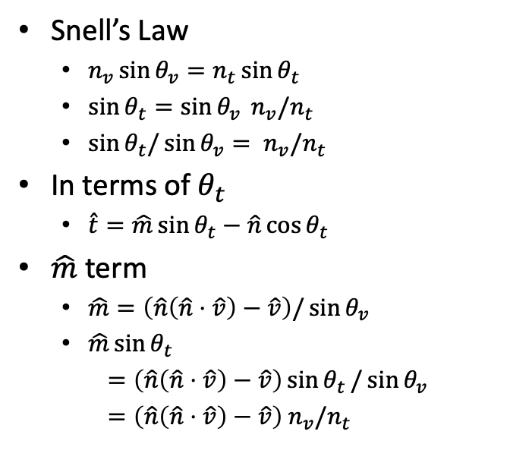
Calculating Refraction Vector
Snell’s Law
$n_{v}\sin{θ_{v}}=n_{t}\sin{θ_{t}}$
$\sin{θ_{t}}=\sin{θ_{v}} n_{v}/n_{t}$
$\sin{θ_{t}/\sin{θ_{v}}}= n_{v}/n_{t}$
In terms of $θ_{t}$
$\hat{t}=\hat{m}\sin{θ_{t}}−\hat{n}\cos{θ_{t}}$
$\hat{m}$ term
$\hat{m}=\left(\hat{n}\left(\hat{n}⋅\hat{v}\right)−\hat{v}\right)/\sin{θ_{v}}$
$\hat{m}\sin{θ_{t}}$
$=\left(\hat{n}\left(\hat{n}⋅\hat{v}\right)−\hat{v}\right)\sin{θ_{t}}/\sin{θ_{v}}$
$=\left(\hat{n}\left(\hat{n}⋅\hat{v}\right)−\hat{v}\right) n_{v}/n_{t}$

Slide 24
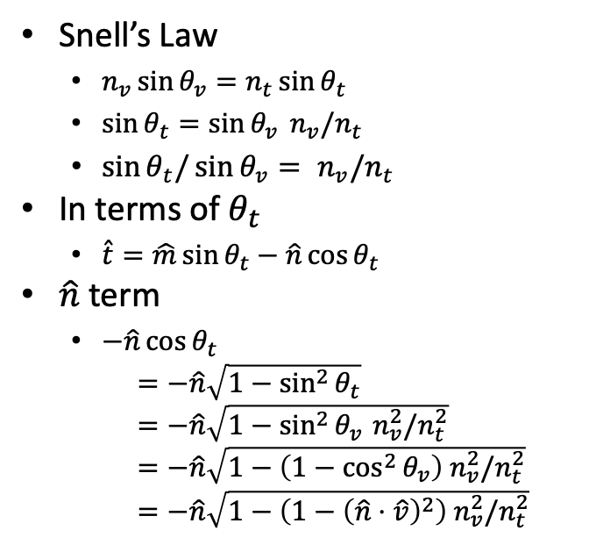
Calculating Refraction Vector
Snell’s Law
$n_{v}\sin{θ_{v}}=n_{t}\sin{θ_{t}}$
$\sin{θ_{t}}=\sin{θ_{v}} n_{v}/n_{t}$
$\sin{θ_{t}/\sin{θ_{v}}}= n_{v}/n_{t}$
In terms of $θ_{t}$
$\hat{t}=\hat{m}\sin{θ_{t}}−\hat{n}\cos{θ_{t}}$
$\hat{n}$ term
$−\hat{n}\cos{θ_{t}}$
$=−\hat{n}\sqrt{1−\sin^{2}{θ_{t}}}$
$=−\hat{n}\sqrt{1−\sin^{2}{θ_{v}} n_{v}^{2}/n_{t}^{2}}$
$=−\hat{n}\sqrt{1−\left(1−\cos^{2}{θ_{v}}\right) n_{v}^{2}/n_{t}^{2}}$
$=−\hat{n}\sqrt{1−\left(1−{\left(\hat{n}⋅\hat{v}\right)}^{2}\right) n_{v}^{2}/n_{t}^{2}}$

Slide 25
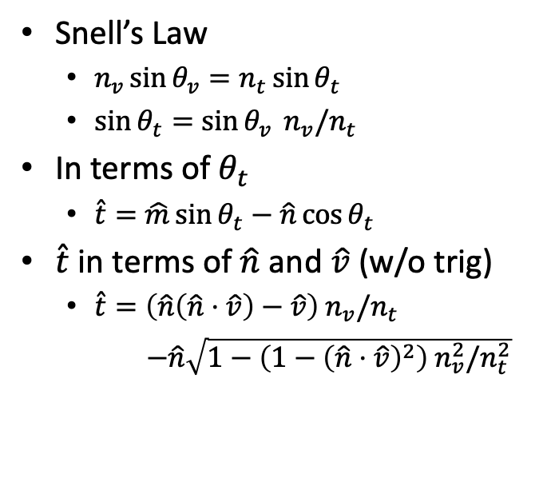
Calculating Refraction Vector
Snell’s Law
$n_{v}\sin{θ_{v}}=n_{t}\sin{θ_{t}}$
$\sin{θ_{t}}=\sin{θ_{v}} n_{v}/n_{t}$
In terms of $θ_{t}$
$\hat{t}=\hat{m}\sin{θ_{t}}−\hat{n}\cos{θ_{t}}$
$\hat{t}$ in terms of $\hat{n}$ and $\hat{v}$ (w/o trig)
$\hat{t}=\left(\hat{n}\left(\hat{n}⋅\hat{v}\right)−\hat{v}\right){ n}_{v}/n_{t}$
$−\hat{n}\sqrt{1−\left(1−{\left(\hat{n}⋅\hat{v}\right)}^{2}\right) n_{v}^{2}/n_{t}^{2}}$

Slide 26
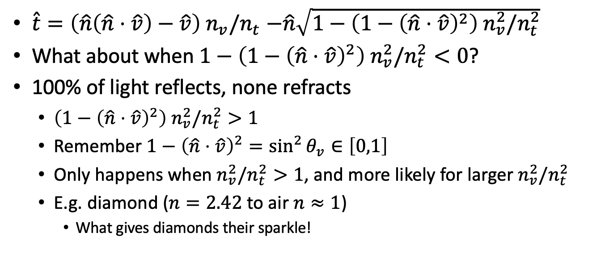
Total Internal Reflection
$\hat{t}=\left(\hat{n}\left(\hat{n}⋅\hat{v}\right)−\hat{v}\right){ n}_{v}/n_{t}$ $−\hat{n}\sqrt{1−\left(1−{\left(\hat{n}⋅\hat{v}\right)}^{2}\right) n_{v}^{2}/n_{t}^{2}}$
What about when $1−\left(1−{\left(\hat{n}⋅\hat{v}\right)}^{2}\right) n_{v}^{2}/n_{t}^{2}<0$?
100% of light reflects, none refracts
$\left(1−{\left(\hat{n}⋅\hat{v}\right)}^{2}\right) n_{v}^{2}/n_{t}^{2}>1$
Remember $1−{\left(\hat{n}⋅\hat{v}\right)}^{2}=\sin^{2}{θ_{v}}∈\left[0,1\right]$
Only happens when $n_{v}^{2}/n_{t}^{2}>1$, and more likely for larger $n_{v}^{2}/n_{t}^{2}$
E.g. diamond ($n=2.42$ to air $n≈1$)
What gives diamonds their sparkle!

Slide 27
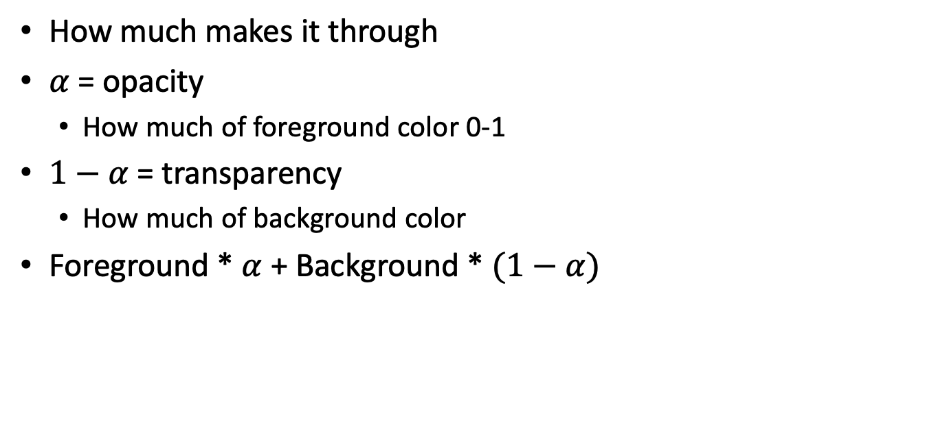
Alpha Blending
How much makes it through
$α$ = opacity
How much of foreground color 0-1
$1−α$ = transparency
How much of background color
Foreground * $α$ + Background * $(1−α)$

Slide 28
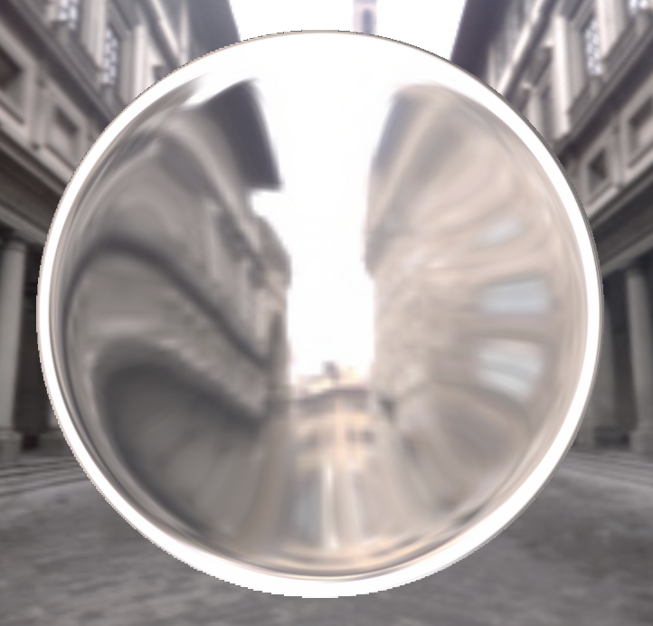
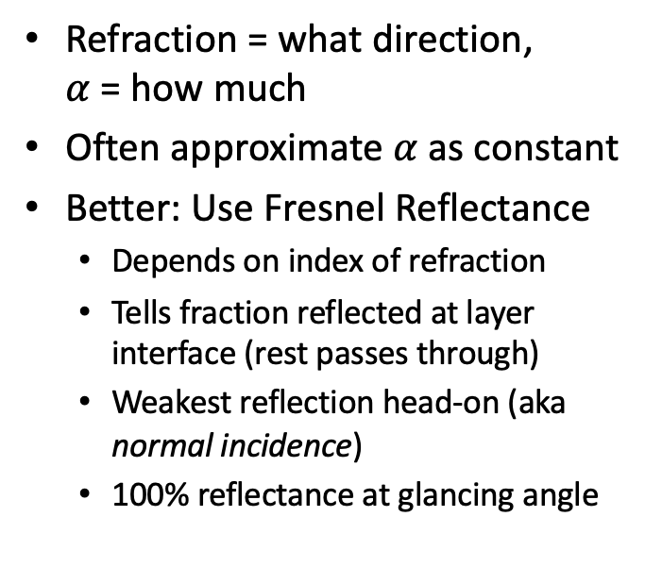
Refraction and Alpha
Refraction = what direction, $α$ = how much
Often approximate $α$as constant
Better: Use Fresnel Reflectance
Depends on index of refraction
Tells fraction reflected at layer interface (rest passes through)
Weakest reflection head-on (aka normal incidence)
100% reflectance at glancing angle

Slide 29
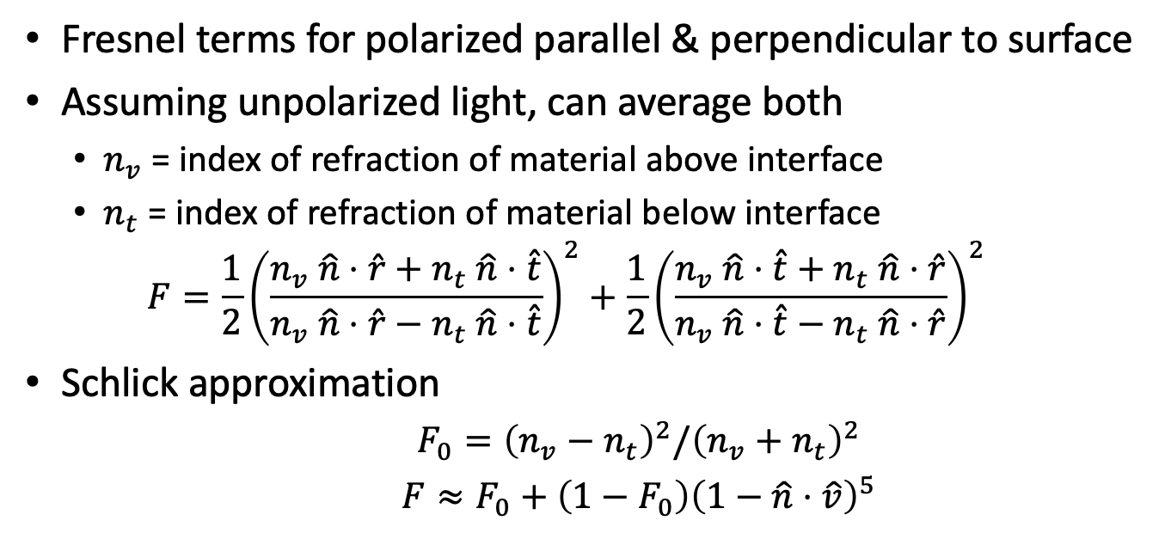
Refraction and Alpha
Fresnel terms for polarized parallel & perpendicular to surface
Assuming unpolarized light, can average both
$n_{v}$ = index of refraction of material above interface
$n_{t}$ = index of refraction of material below interface
$$F=\frac{1}{2}{\left(\frac{n_{v} \hat{n}⋅\hat{r}+n_{t} \hat{n}⋅\hat{t}}{n_{v} \hat{n}⋅\hat{r}−n_{t} \hat{n}⋅\hat{t}}\right)}^{2}+\frac{1}{2}{\left(\frac{n_{v} \hat{n}⋅\hat{t}+n_{t} \hat{n}⋅\hat{r}}{n_{v} \hat{n}⋅\hat{t}−n_{t} \hat{n}⋅\hat{r}}\right)}^{2}$$
Schlick approximation
$F_{0}={\left(n_{v}−n_{t}\right)}^{2}/{\left(n_{v}+n_{t}\right)}^{2}$
$F≈F_{0}+\left(1−F_{0}\right){\left(1−\hat{n}⋅\hat{v}\right)}^{5}$

Slide 30

Layered Surface Models
For physically plausible materials, it’s important that no surface can put out more energy than it takes in.
One way to ensure this is to model the surface as layers, with an alpha-blend between them.
Clear outer mirror reflection layer
Blend with Fresnel($\hat{n}⋅\hat{v}$)
Specular layer
Blend with Fresnel($\hat{h}⋅\hat{v}$)
Diffuse layer
Blend with Fresnel($\hat{n}⋅\hat{v}$)
Refraction
Specular reflections off
clear/diffuse layer
interface
Diffuse inner layer
Refraction through
back of diffuse layer
Mirror reflections off air/clear outer layer
interface

Slide 31
Photon Paths

Slide 32
Ray Casting vs Ray Tracing
Ray Casting asks the question: “Where did the photons that hit this pixel come from?” and finds the first object along that ray.
Ray Tracing and Path Tracing extend the question to additional bounces: “But where did they come before that?” continuing until you find a photon path back to a light source or “emitter” (i.e. glowing object).
Many photons follow the same (or similar) paths. Track the percentages of photons following each path and combine with a weighted sum.

Slide 33
Taking Multiple Photons per Pixel
Quite a few effects can be achieved by averaging the contribution of multiple photon rays per pixel
Antialiasing
Depth of field
Motion blur
Glossy reflection
Secondary bounces (path tracing)

Slide 34
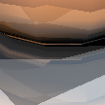



Ray Traced Antialiasing
Only sampling center of each pixel leads to jagged aliasing
Jitter position within pixel on image plane
Average over several random rays per pixel

Slide 35
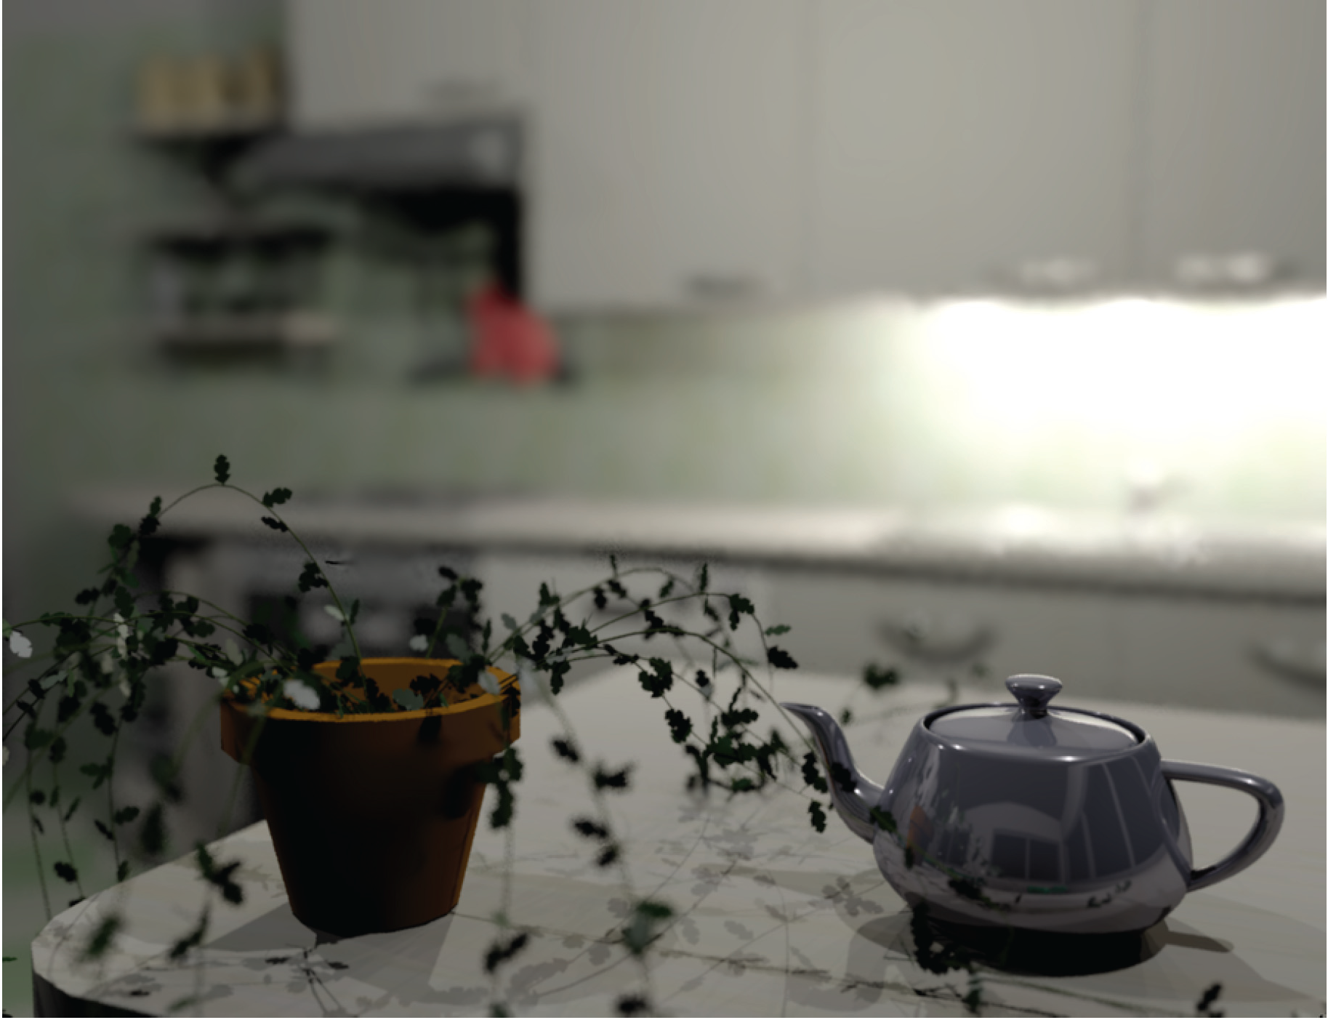
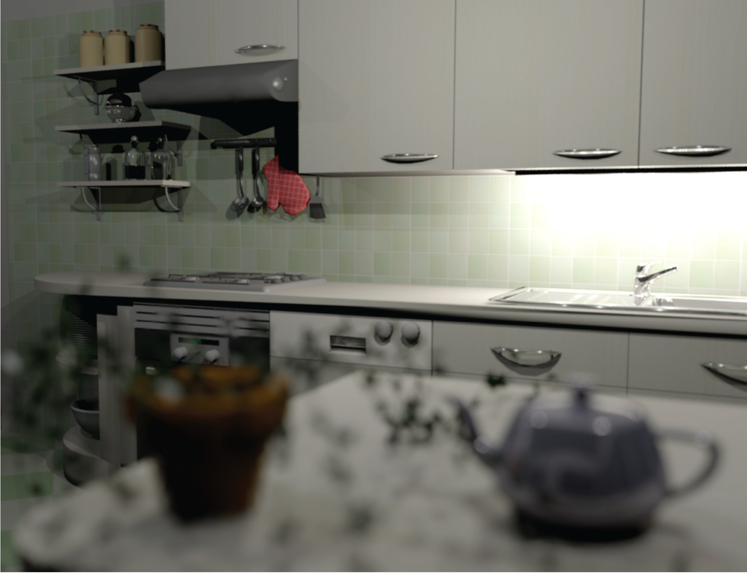
Depth of Field
Soler et al., Fourier Depth of Field, ACM TOG v28n2, April 2009

Slide 36
Physical Pinhole Lens

Slide 37
Lens with Depth of Field
Focal Plane

Slide 38
Our Lens Model
Image Plane

Slide 39
Lens Model with Depth of Field
Image & Focal Plane

Slide 40
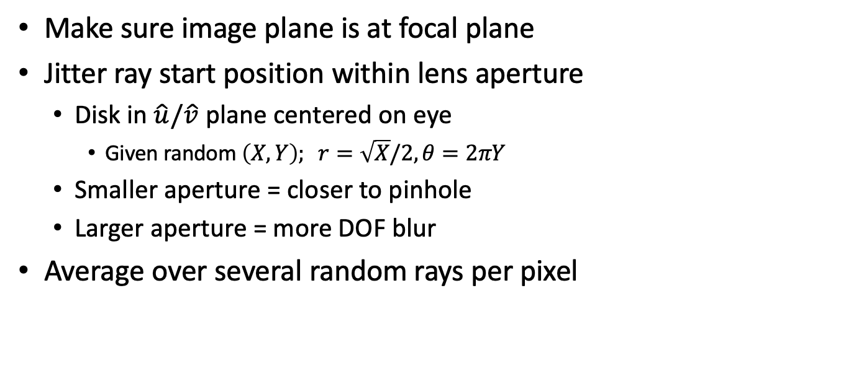
Ray Traced DOF
Make sure image plane is at focal plane
Jitter ray start position within lens aperture
Disk in $\hat{u}/\hat{v}$ plane centered on eye
Given random $\left(X,Y\right); r=\sqrt{X}/2,θ=2πY$
Smaller aperture = closer to pinhole
Larger aperture = more DOF blur
Average over several random rays per pixel

Slide 41
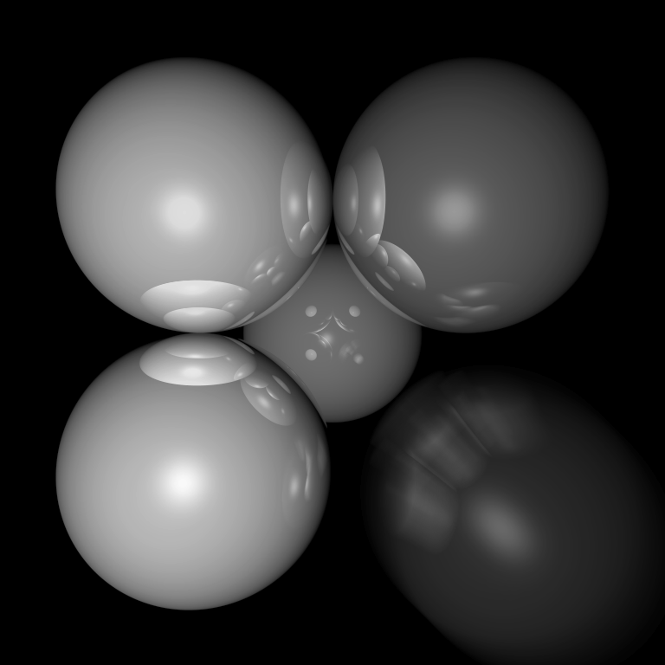
Motion Blur
Things move while the shutter is open
Track object motion
Jitter ray start time within frame

Slide 42
Combining Effects
For each ray, choose a random (point in time, start point, screen location, etc.)
Lots of extra details on reducing the resulting noise
Non-uniform choice of rays (importance sampling)
Smart sample selection (quasi-random, blue noise, adaptive)
Combination and reuse of samples (denoising)
For more, look up Monte-Carlo rendering

Slide 43
Summary

Slide 44
Full Ray Tracing (single sample version)
e = eye position
foreach pixel
s = pixel screen position
pixel color = trace(e, s-e)

Slide 45
Full Ray Tracing (multiple sample version)
e = eye position
foreach pixel
pixel color = (0,0,0)
s = pixel screen position
foreach sample
s’ = jittered screen position
e’ = jittered eye position
pixel color += trace(e’, s’-e’)
pixel color /= number of samples

Slide 46
Full Ray Tracing (trace – non-Fresnel version)
Recursion depth, contribution, or probability
trace(e, d)
if (ray termination) return;
find first object
P,N,S = position, normal, surface parameters
color = S.ambient
foreach light
L = normalize(light.position – P)
if N•L > 0 and probe(P, L, length(light.position – P)) I = light.intensity * N•L
color += S.diffuse * I
if N•H > 0
color += S.specular * I * N•H^{S.specpow}
color += S.reflect * trace(P, reflection direction)
color += S.refract * trace(P, refraction direction)
Direct illumination
Reflection & refraction rays

Slide 47
Full Ray Tracing (shadow probe)
probe(e, d, distance)
foreach object
if 𝜖 < object.intersection(e,d) < distance
return false; // early exit from object loop
return true;
False if shadow
True if not shadowed

Slide 48
Ray Tracing Characteristics
Good
Simple to implement
Minimal memory required
Easy to extend
Bad
Aliasing
Computationally intensive
Intersections expensive (75-90% of rendering time)
Lots of rays

