Slide 1
Ray Casting
CMSC 435/634

Slide 2
Follow the Photons

Slide 3
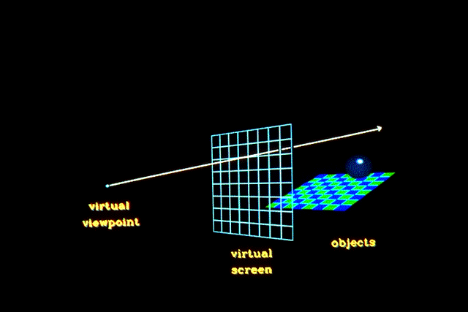
Ray Casting
Given
Scene
Viewpoint
Image Plane
Cast ray from viewpoint through pixels into scene
If a photon made it to the viewer through this pixel, where did it come from?

Slide 4
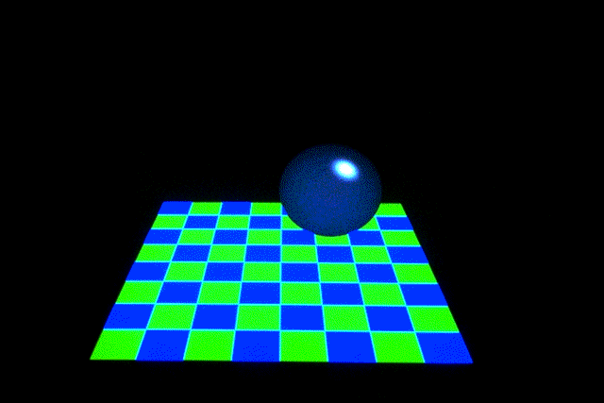
View

Slide 5
Ray Tracing
Ray cast = first hit
Ray trace = additional primary bounces
Path trace = additional less-common bounces

Slide 6
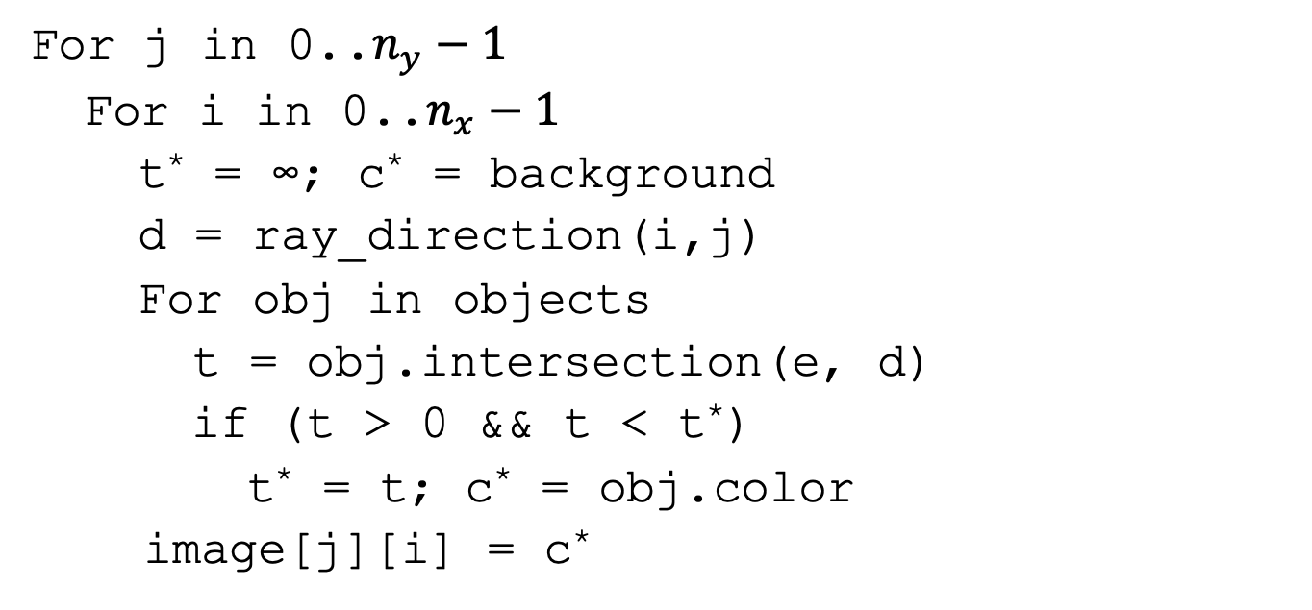
Ray Casting Algorithm Summary
For j in 0..$n_{y}−1$
For i in 0..$n_{x}−1$
t* = ∞; c* = background
d = ray_direction(i,j)
For obj in objects
t = obj.intersection(e, d)
if (t > 0 && t < t*)
t* = t; c* = obj.color
image[j][i] = c*
For every image pixel
Start with background color
Figure out ray direction
Check ray against all obj
If it’s in front of the viewer
And closest so far, switch
Assign as pixel color

Slide 7
Ray/Object Intersections

Slide 8
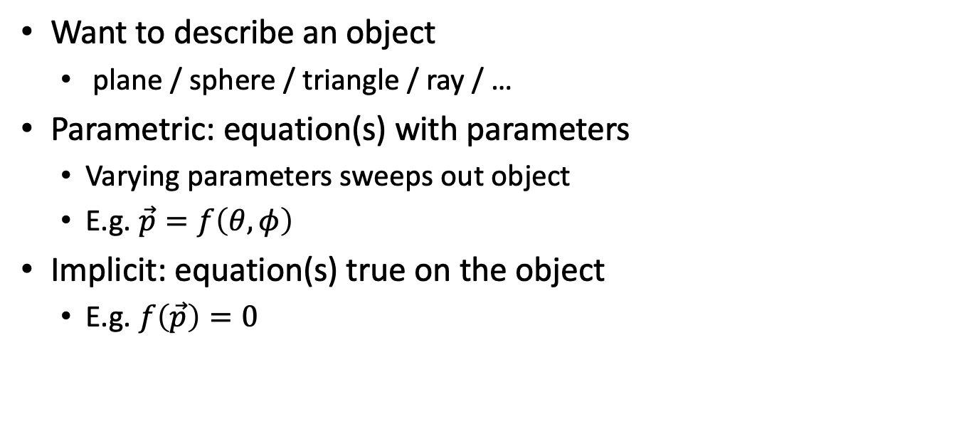
Parametric and Implicit Forms
Want to describe an object
plane / sphere / triangle / ray / …
Parametric: equation(s) with parameters
Varying parameters sweeps out object
E.g. $\vec{p}=f\left(θ,φ\right)$
Implicit: equation(s) true on the object
E.g. $f\left(\vec{p}\right)=0$

Slide 9
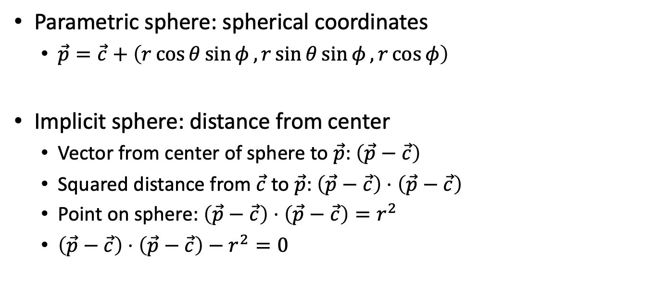
Parametric vs. Implicit Sphere
Parametric sphere: spherical coordinates
$\vec{p}=\vec{c}+\left(r\cos{θ}\sin{φ},r\sin{θ}\sin{φ},r\cos{φ}\right)$
Implicit sphere: distance from center
Vector from center of sphere to $\vec{p}$: $\left(\vec{p}−\vec{c}\right)$
Squared distance from $\vec{c}$ to $\vec{p}$: $\left(\vec{p}−\vec{c}\right)⋅\left(\vec{p}−\vec{c}\right)$
Point on sphere: $\left(\vec{p}−\vec{c}\right)⋅\left(\vec{p}−\vec{c}\right)=r^{2}$
$\left(\vec{p}−\vec{c}\right)⋅\left(\vec{p}−\vec{c}\right)−r^{2}=0$

Slide 10

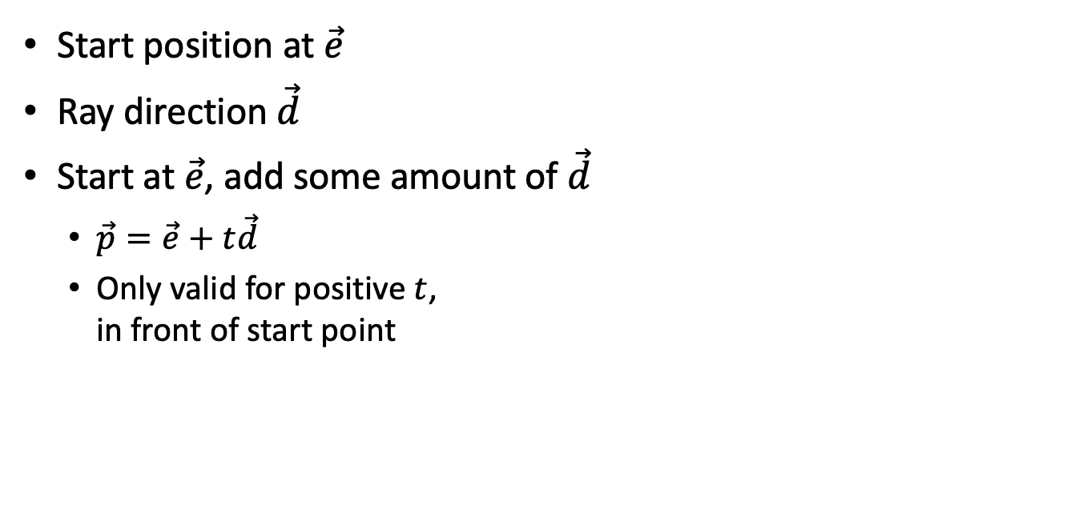


Parametric Ray
Start position at $\vec{e}$
Ray direction $\vec{d}$
Start at $\vec{e}$, add some amount of $\vec{d}$
$\vec{p}=\vec{e}+t\vec{d}$
Only valid for positive $t$, in front of start point
$$\vec{p}$$
$$\vec{d}$$
$$\vec{e}$$

Slide 11
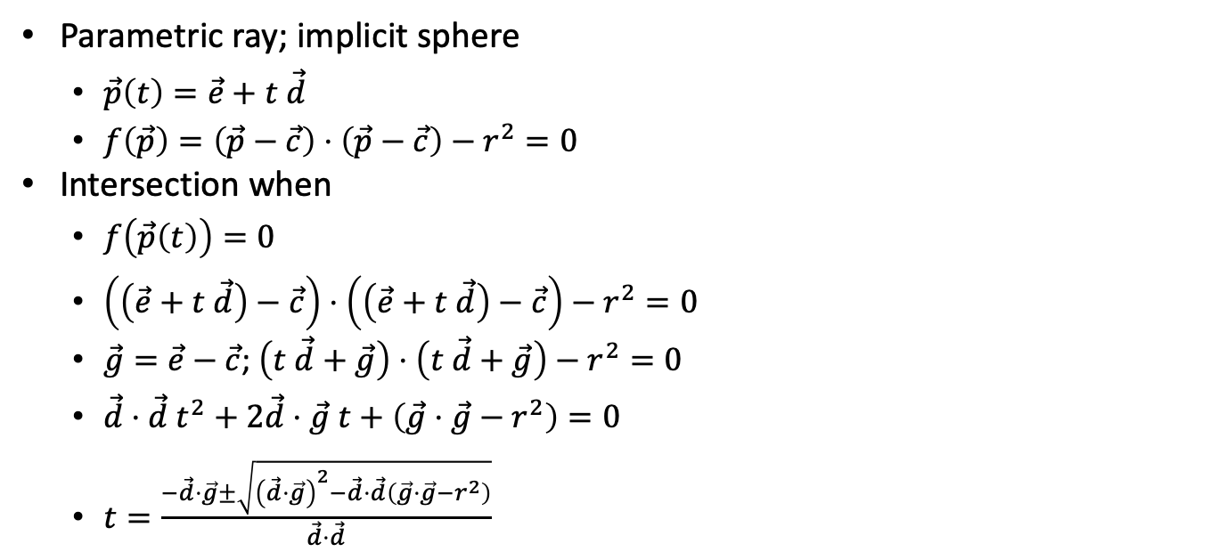
Ray-Sphere Intersection
Parametric ray; implicit sphere
$\vec{p}\left(t\right)=\vec{e}+t \vec{d}$
$f\left(\vec{p}\right)=\left(\vec{p}−\vec{c}\right)⋅\left(\vec{p}−\vec{c}\right)−r^{2}=0$
Intersection when
$f\left(\vec{p}\left(t\right)\right)=0$
$\left(\left(\vec{e}+t \vec{d}\right)−\vec{c}\right)⋅\left(\left(\vec{e}+t \vec{d}\right)−\vec{c}\right)−r^{2}=0$
$\vec{g}=\vec{e}−\vec{c}$; $\left(t \vec{d}+\vec{g}\right)⋅\left(t \vec{d}+\vec{g}\right)−r^{2}=0$
$\vec{d}⋅\vec{d} t^{2}+2\vec{d}⋅\vec{g} t+\left(\vec{g}⋅\vec{g}−r^{2}\right)=0$
$t=\frac{−\vec{d}⋅\vec{g}±\sqrt{{\left(\vec{d}⋅\vec{g}\right)}^{2}−\vec{d}⋅\vec{d}\left(\vec{g}⋅\vec{g}−r^{2}\right)}}{\vec{d}⋅\vec{d}}$

Slide 12
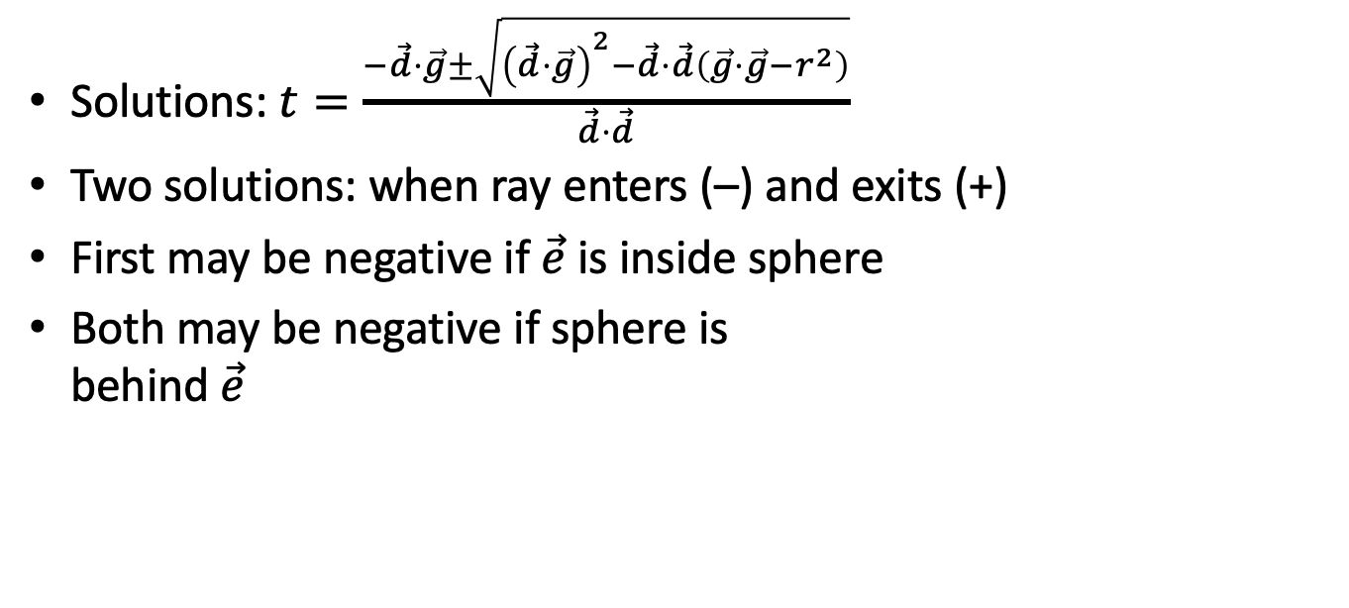
Understanding Ray-Sphere Intersection
Solutions: $t=\frac{−\vec{d}⋅\vec{g}±\sqrt{{\left(\vec{d}⋅\vec{g}\right)}^{2}−\vec{d}⋅\vec{d}\left(\vec{g}⋅\vec{g}−r^{2}\right)}}{\vec{d}⋅\vec{d}}$
Two solutions: when ray enters (–) and exits (+)
First may be negative if $\vec{e}$ is inside sphere
Both may be negative if sphere is behind $\vec{e}$
$$\vec{d}$$
$$\vec{e}$$

Slide 13
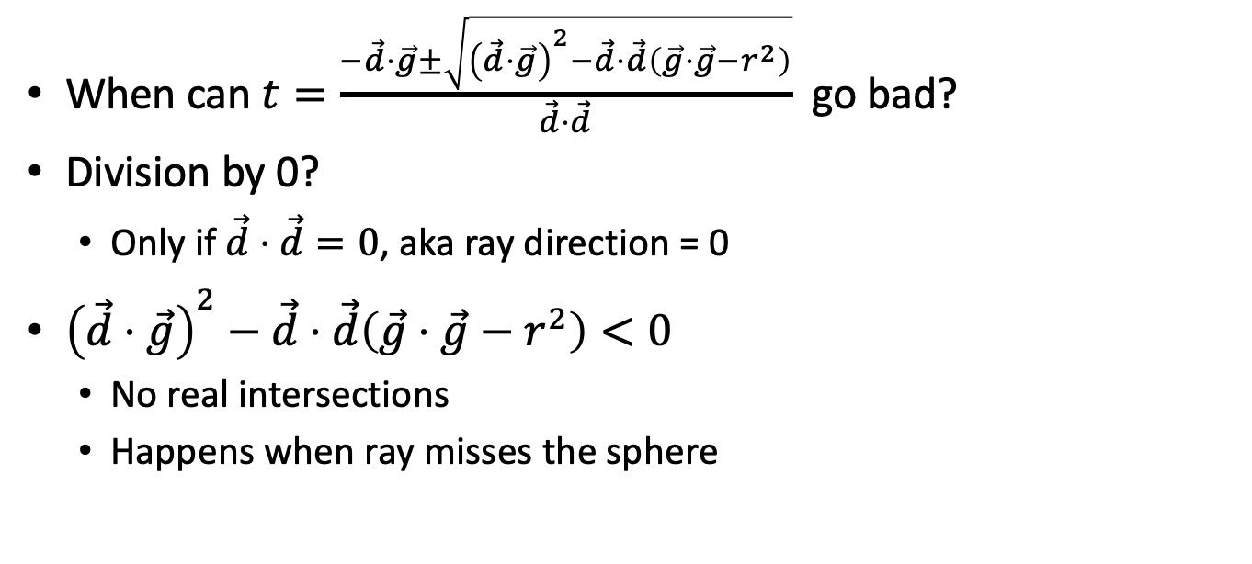
Ray-Sphere Problems
When can $t=\frac{−\vec{d}⋅\vec{g}±\sqrt{{\left(\vec{d}⋅\vec{g}\right)}^{2}−\vec{d}⋅\vec{d}\left(\vec{g}⋅\vec{g}−r^{2}\right)}}{\vec{d}⋅\vec{d}}$ go bad?
Division by 0?
Only if $\vec{d}⋅\vec{d}=0$, aka ray direction = 0
${\left(\vec{d}⋅\vec{g}\right)}^{2}−\vec{d}⋅\vec{d}\left(\vec{g}⋅\vec{g}−r^{2}\right)<0$
No real intersections
Happens when ray misses the sphere
$$\vec{d}$$
$$\vec{e}$$

Slide 14
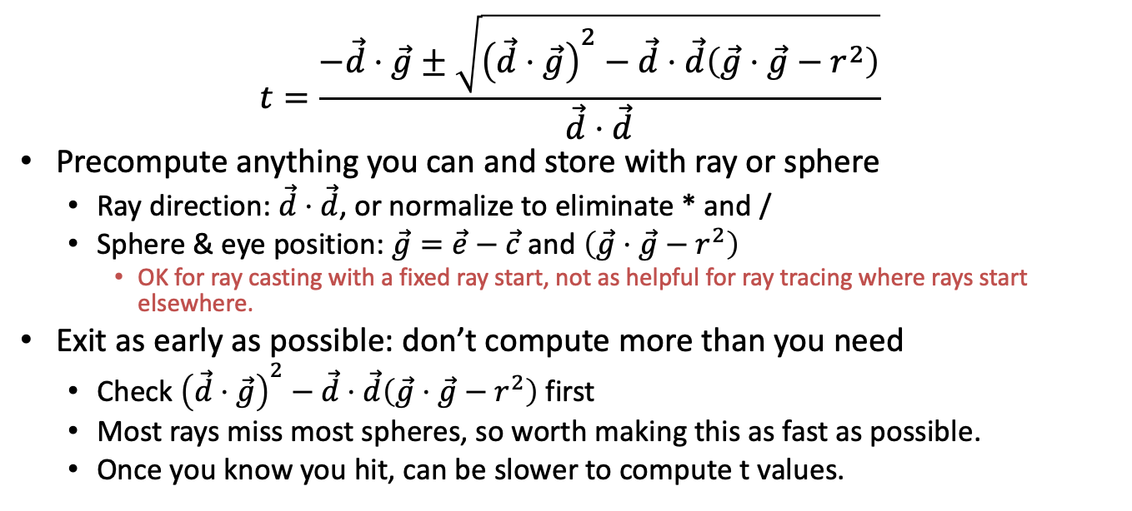
Optimizing Ray-Sphere Intersection
$$t=\frac{−\vec{d}⋅\vec{g}±\sqrt{{\left(\vec{d}⋅\vec{g}\right)}^{2}−\vec{d}⋅\vec{d}\left(\vec{g}⋅\vec{g}−r^{2}\right)}}{\vec{d}⋅\vec{d}}$$
Precompute anything you can and store with ray or sphere
Ray direction: $\vec{d}⋅\vec{d}$, or normalize to eliminate * and /
Sphere & eye position: $\vec{g}=\vec{e}−\vec{c}$ and $\left(\vec{g}⋅\vec{g}−r^{2}\right)$
OK for ray casting with a fixed ray start, not as helpful for ray tracing where rays start elsewhere.
Exit as early as possible: don’t compute more than you need
Check ${\left(\vec{d}⋅\vec{g}\right)}^{2}−\vec{d}⋅\vec{d}\left(\vec{g}⋅\vec{g}−r^{2}\right)$ first
Most rays miss most spheres, so worth making this as fast as possible.
Once you know you hit, can be slower to compute t values.

Slide 15
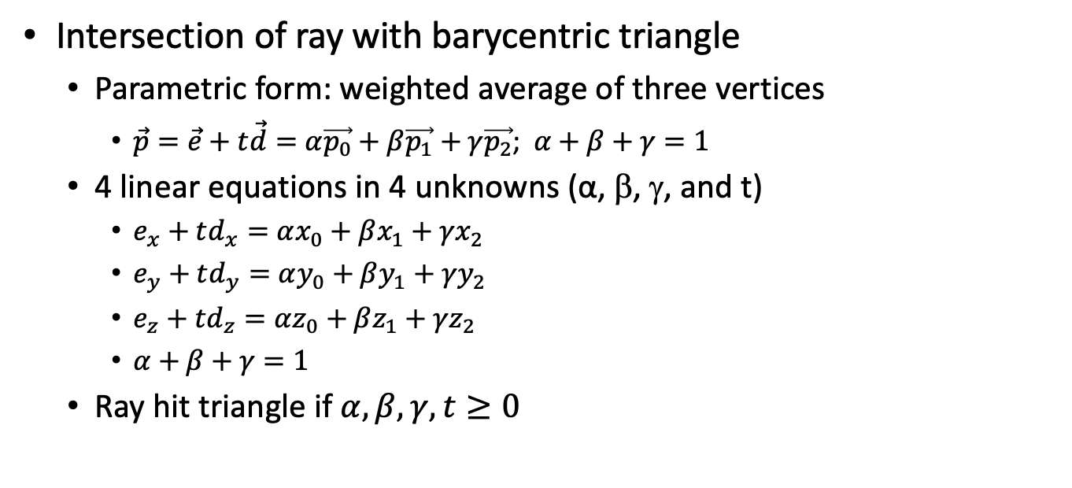
Ray-Triangle Intersection
Intersection of ray with barycentric triangle
Parametric form: weighted average of three vertices
$\vec{p}=\vec{e}+t\vec{d}=α\vec{p_{0}}+β\vec{p_{1}}+γ\vec{p_{2}}$; $α+β+γ=1$
4 linear equations in 4 unknowns (α, β, γ, and t)
$e_{x}+td_{x}=αx_{0}+βx_{1}+γx_{2}$
$e_{y}+td_{y}=αy_{0}+βy_{1}+γy_{2}$
$e_{z}+td_{z}=αz_{0}+βz_{1}+γz_{2}$
$α+β+γ=1$
Ray hit triangle if $α,β,γ,t≥0$

Slide 16
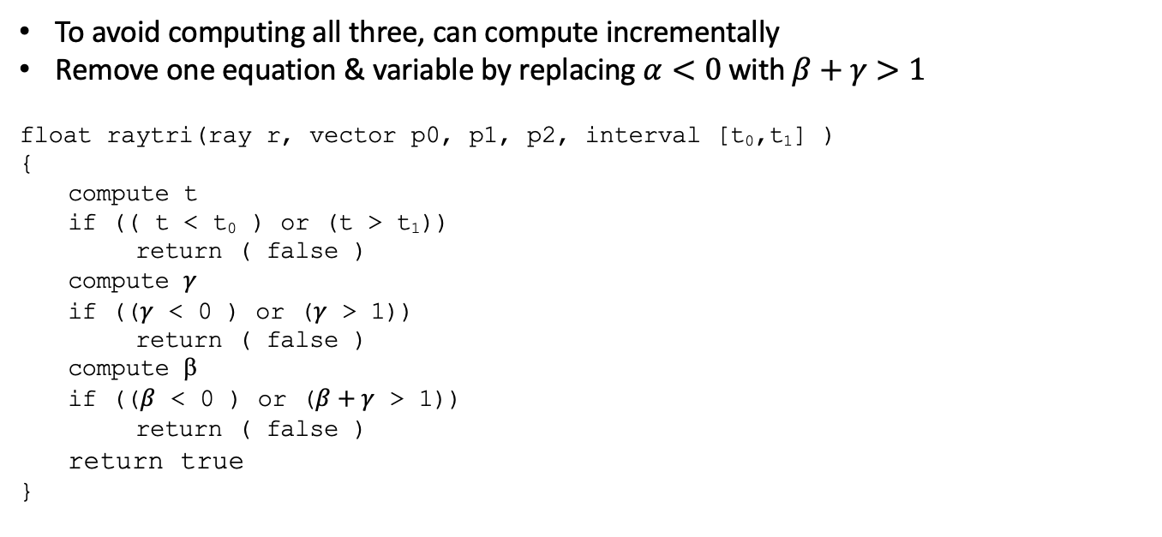
Optimizing Ray-Triangle Intersection
To avoid computing all three, can compute incrementally
Remove one equation & variable by replacing $α<0$with $β+γ>1$
float raytri(ray r, vector p0, p1, p2, interval [t₀,t₁] )
{
compute t
if (( t < t₀ ) or (t > t₁))
return ( false )
compute $γ$
if (($γ$ < 0 ) or ($γ$ > 1))
return ( false )
compute β
if (($β$ < 0 ) or ($β+γ$ > 1))
return ( false )
return true
}

Slide 17
Point in Polygon?
Is P in concave polygon?
Triangulate
General ray/polygon algorithm

Slide 18
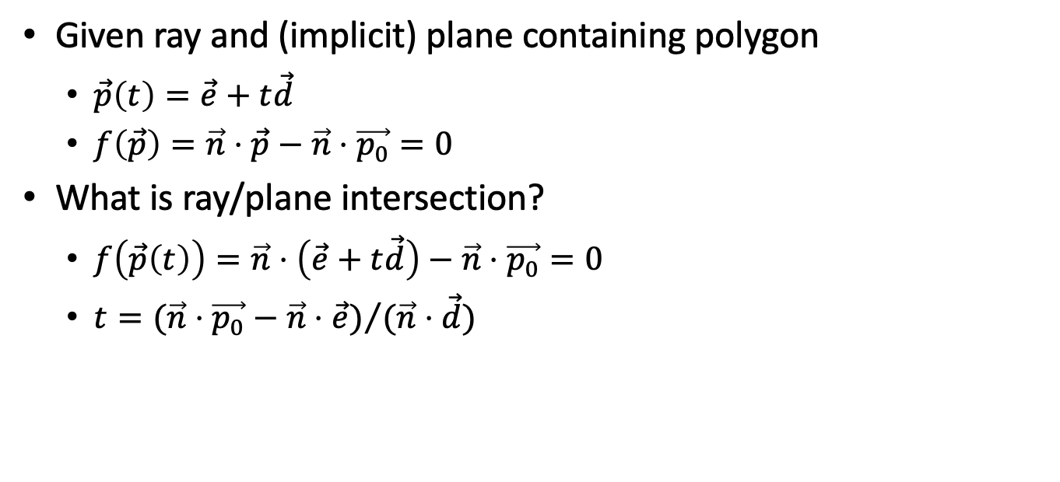
Ray-Polygon Intersection (General Case)
Given ray and (implicit) plane containing polygon
$\vec{p}\left(t\right)=\vec{e}+t\vec{d}$
$f\left(\vec{p}\right)=\vec{n}⋅\vec{p}−\vec{n}⋅\vec{p_{0}}=0$
What is ray/plane intersection?
$f\left(\vec{p}\left(t\right)\right)=\vec{n}⋅\left(\vec{e}+t\vec{d}\right)−\vec{n}⋅\vec{p_{0}}=0$
$t={(\vec{n}⋅\vec{p_{0}}−\vec{n}⋅\vec{e})}/{(\vec{n}⋅\vec{d})}$

Slide 19
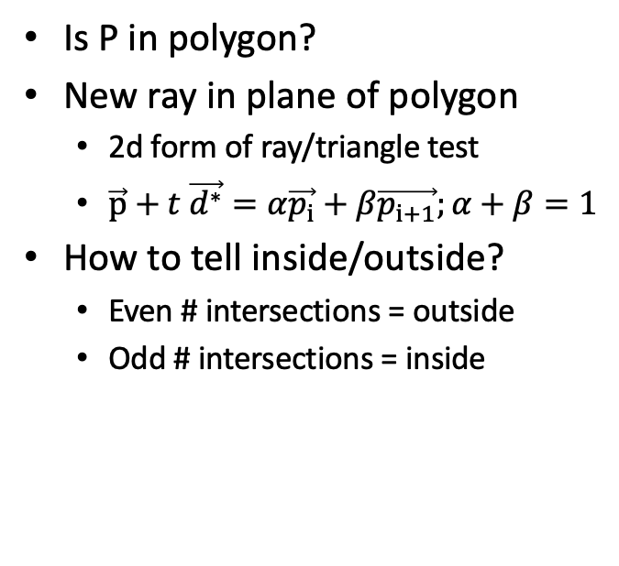
Point in Polygon?
Is P in polygon?
New ray in plane of polygon
2d form of ray/triangle test
$\vec{p}+t \vec{d^{∗}}=α\vec{p_{i}}+β\vec{p_{i+1}};α+β=1$
How to tell inside/outside?
Even # intersections = outside
Odd # intersections = inside

Slide 20
Other algorithm choices?
Option 1: Odd # of crossings
Center of star is not in polygon
Option 2: Winding rule
Vertices given counter-clockwise
+1 if edge crosses ray L-R “entering”
–1 if edge crosses ray R-L “exiting”
Inside for non-zero winding number
Center of star is in polygon
Option 3: Disallow these polygons

Slide 21
Finding Ray Directions

Slide 22
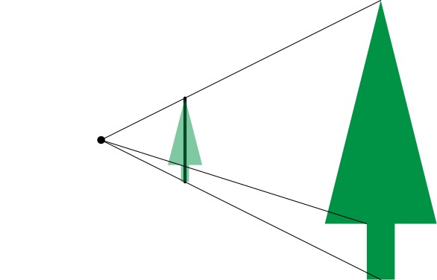
Lens Model

Slide 23
Lens Model
Image scales with distance
Ray direction don’t change
Image plane distance does not matter to the math!
Later: depth of field
Crisp focal plane
Blurry closer/farther
Handy to put image plane at focal plane

Slide 24
Field of View

Slide 25
Field of View

Slide 26
Field of View

Slide 27
Symmetric Window

Slide 28

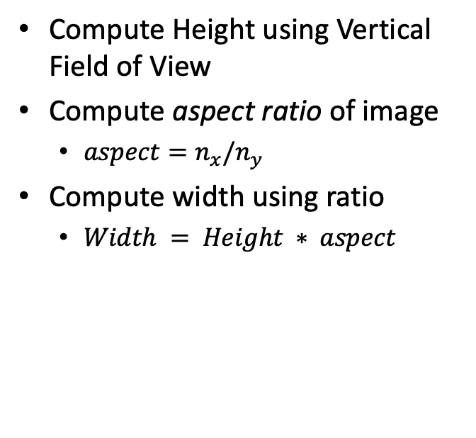

Rectangular Windows
$$n_{x}$$
Compute Height using Vertical Field of View
Compute aspect ratio of image
$aspect=n_{x}/n_{y}$
Compute width using ratio
$Width = Height ∗ aspect$
$$n_{y}$$

Slide 29
Off-center Projection
Used for display walls, image tiling, and VR
d is perpendicular distance to screen
Still need right triangles for trig

Slide 30
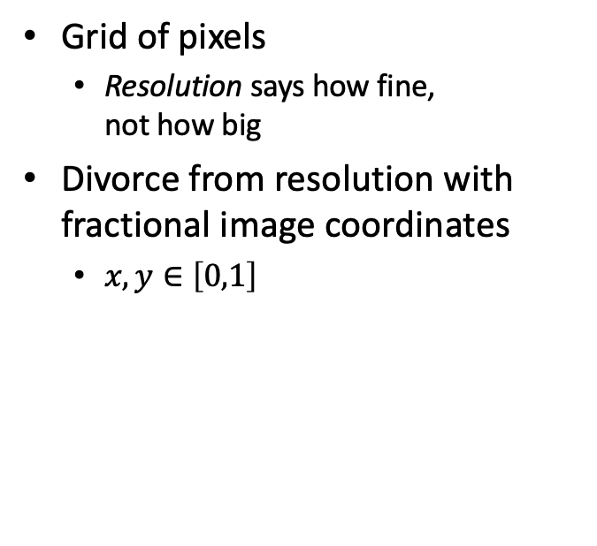
Images
Grid of pixels
Resolution says how fine, not how big
Divorce from resolution with fractional image coordinates
$x,y∈\left[0,1\right]$
1 x 1
2 x 2
3 x 3
4 x 4

Slide 31
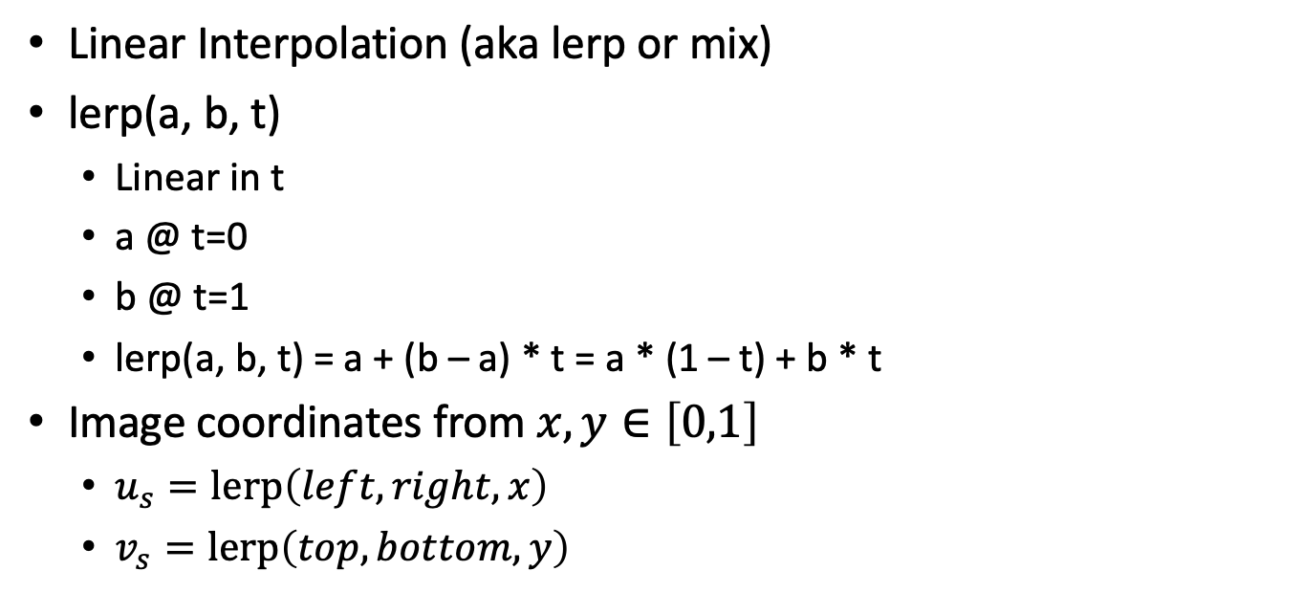
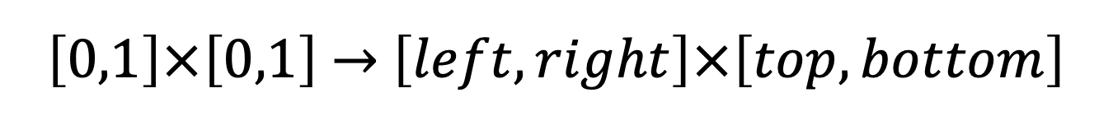
$\left[0,1\right]×\left[0,1\right]$ $→$ $\left[left,right\right]×\left[top,bottom\right]$
Linear Interpolation (aka lerp or mix)
lerp(a, b, t)
Linear in t
a @ t=0
b @ t=1
lerp(a, b, t) = a + (b – a) * t = a * (1 – t) + b * t
Image coordinates from $x,y∈\left[0,1\right]$
$u_{s}=\text{lerp}\left(left,right,x\right)$
$v_{s}=\text{lerp}\left(top,bottom,y\right)$

Slide 32
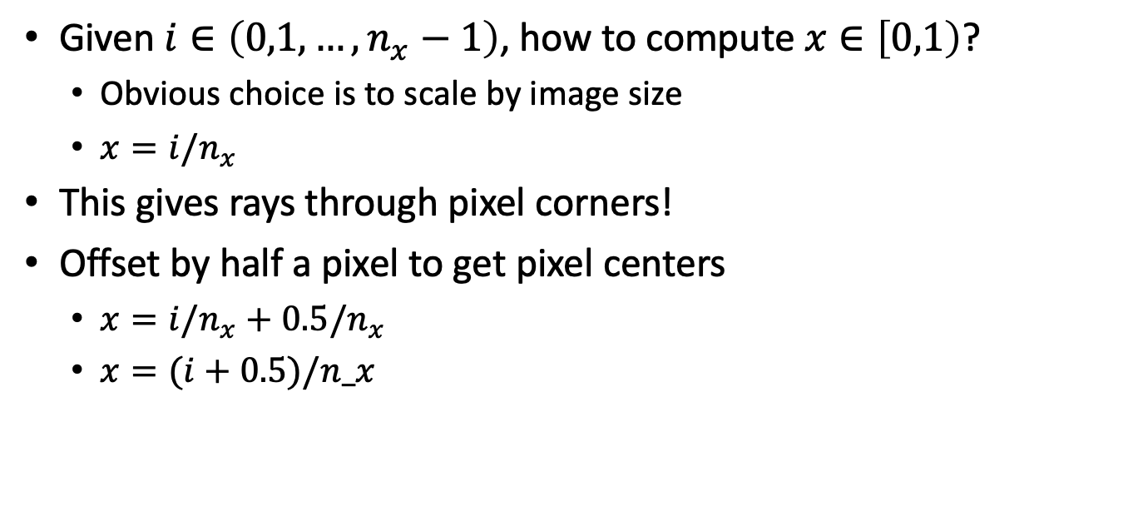
Pixel Centers
Given $i∈\left(0,1,…,n_{x}−1\right)$, how to compute $x∈\left[0,1\right)$?
Obvious choice is to scale by image size
$x=i/n_{x}$
This gives rays through pixel corners!
Offset by half a pixel to get pixel centers
$x=i/n_{x}+0.5/n_{x}$
$x=(i+0.5)/n_x$

Slide 33

Camera Specification
Given eye point $\vec{e}$ or from
Given a point in the scene at the center of the view, at
Given a vector pointing vertically, up
Not necessarily aligned with the image
from
up
at

Slide 34
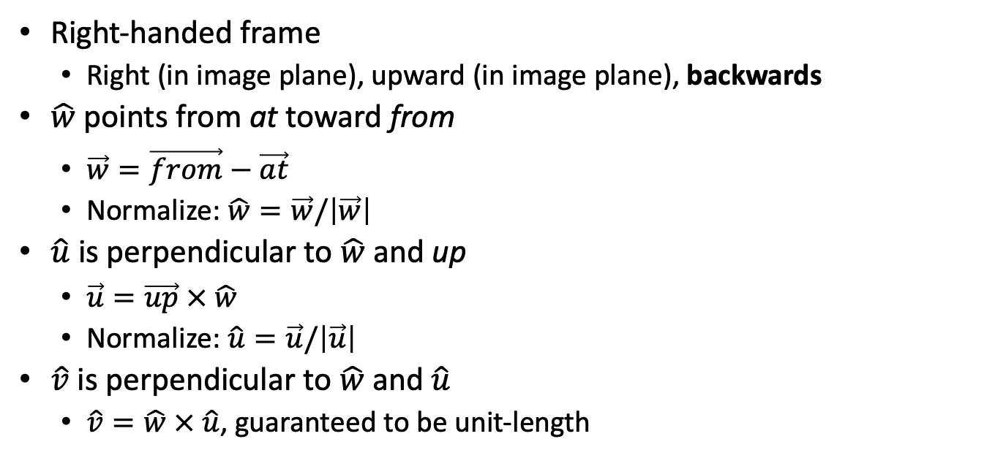

Computing Camera Frame $\left(\hat{u},\hat{v},\hat{w}\right)$
Right-handed frame
Right (in image plane), upward (in image plane), backwards
$\hat{w}$ points from at toward from
$\vec{w}=\vec{from}−\vec{at}$
Normalize: $\hat{w}=\vec{w}/\left|\vec{w}\right|$
$\hat{u}$ is perpendicular to $\hat{w}$ and up
$\vec{u}=\vec{up} × \hat{w}$
Normalize: $\hat{u}=\vec{u}/\left|\vec{u}\right|$
$\hat{v}$ is perpendicular to $\hat{w}$ and $\hat{u}$
$\hat{v}=\hat{w} × \hat{u}$, guaranteed to be unit-length

Slide 35
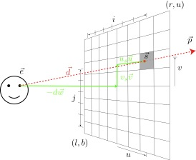
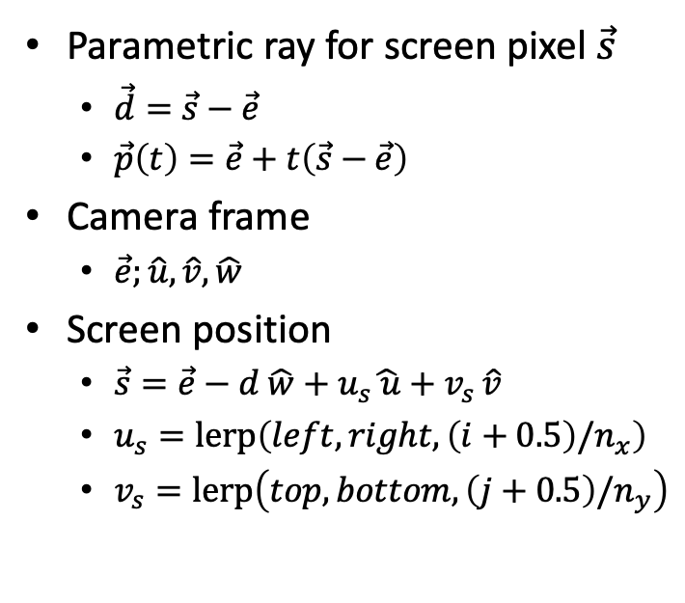
Computing Viewing Rays
Parametric ray for screen pixel $\vec{s}$
$\vec{d}=\vec{s}−\vec{e}$
$\vec{p}\left(t\right)=\vec{e}+t\left(\vec{s}−\vec{e}\right)$
Camera frame
$\vec{e};\hat{u},\hat{v},\hat{w}$
Screen position
$\vec{s}=\vec{e}−d \hat{w}+u_{s}\hat{ u}+v_{s }\hat{v}$
$u_{s}=\text{lerp}\left(left,right,\left(i+0.5\right)/n_{x}\right)$
$v_{s}=\text{lerp}\left(top,bottom,\left(j+0.5\right)/n_{y}\right)$

Slide 36
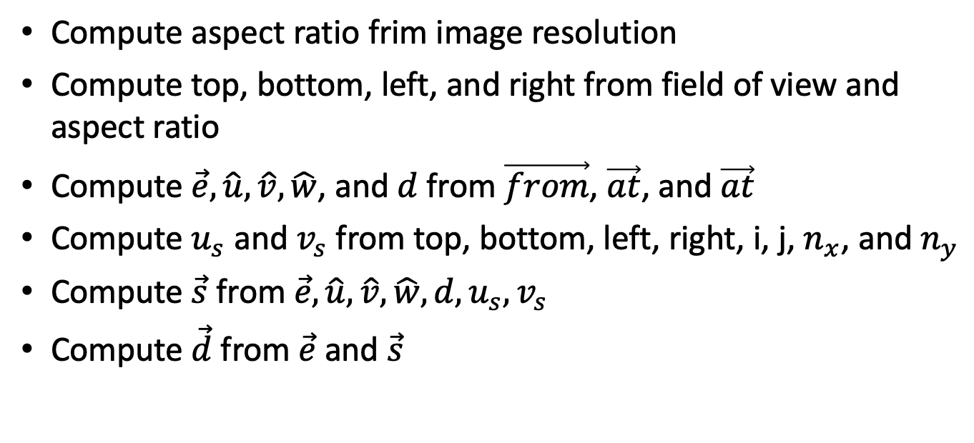
Computing Viewing Rays
Compute aspect ratio frim image resolution
Compute top, bottom, left, and right from field of view and aspect ratio
Compute $\vec{e},\hat{u},\hat{v}, \hat{w}$, and $d$ from $\vec{from}$, $\vec{at}$, and $\vec{at}$
Compute $u_{s}$ and $v_{s}$ from top, bottom, left, right, i, j, $n_{x}$, and $n_{y}$
Compute $\vec{s}$ from $\vec{e},\hat{u},\hat{v}, \hat{w},d,u_{s},v_{s}$
Compute $\vec{d}$ from $\vec{e}$ and $\vec{s}$

Slide 37





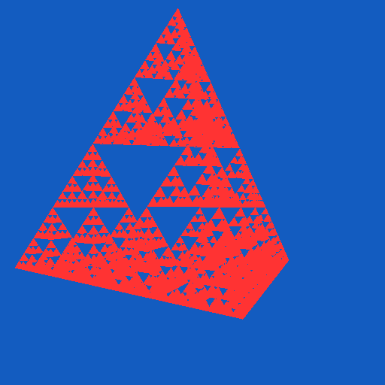
Ray Casting Results
balls3-color
2 tri, 820 sph
balls
2 tri, 7381 sph
mount
8192 tri, 4 sph
gears2
1169 poly
gears
9345 poly
tetra
4096 tri
tetra
4096 tri

