Slide 1
Graphics Pipeline
Rasterization
CMSC 435/634

Slide 2
Overview

Slide 3
Drawing Terms
Primitive
  Basic shape, drawn directly
  Compare to building from simpler shapes
Rasterization or Scan Conversion
  Find pixels for a primitive
  Usually for algorithms that generate pixels one primitive at a time
  Compare to ray tracing: all primitives for one pixel
Fragment (really only used by OpenGL)
  Per-pixel data that may affect the final pixel color
  Some fragments might be hidden by closer ones for that pixel
  Some fragments might be blended with others by transparency or antialiasing

Slide 4
Graphics Pipeline
Object-order approach to rendering
Vertex Processing
Transformations
Vertex components of shading
Clipping
Find the visible parts of primitives
Rasterization
Break primitives into fragments/pixels
Fragment Processing
Fragment components of shading
Visibility & Blending
Which do we see, how do they combine?

Slide 5
Line Rasterization

Slide 6
Line Drawing
Given endpoints of line, which pixels to draw?

Slide 7
Line Drawing
Given endpoints of line, which pixels to draw?

Slide 8
Line Drawing
Given endpoints of line, which pixels to draw?
Assume 1 pixel per x,
y going up
  Flip and mirror to other cases
  At each x have a choice of 2 pixels
Look at midpoint between candidate pixels
?
?
?
?
?
?
?
?

Slide 9
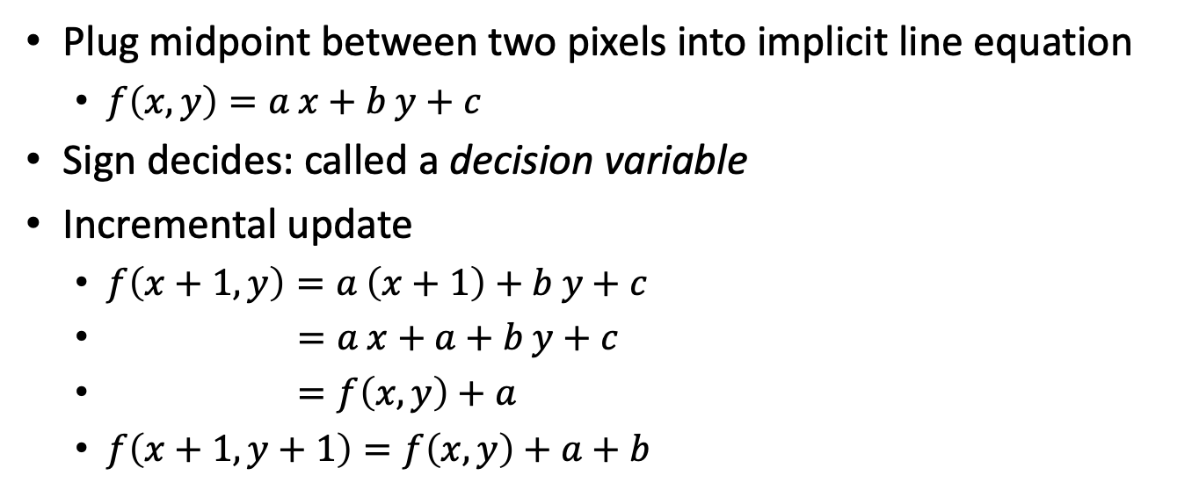
Line Drawing
Plug midpoint between two pixels into implicit line equation
  $f\left(x,y\right)=a x+b y+c$
Sign decides: called a decision variable
Incremental update
  $f\left(x+1,y\right)=a \left(x+1\right)+b y+c$
  $=a x+a+b y+c$
  $=f\left(x,y\right)+a$
  $f\left(x+1,y+1\right)=f\left(x,y\right)+a+b$

Slide 10
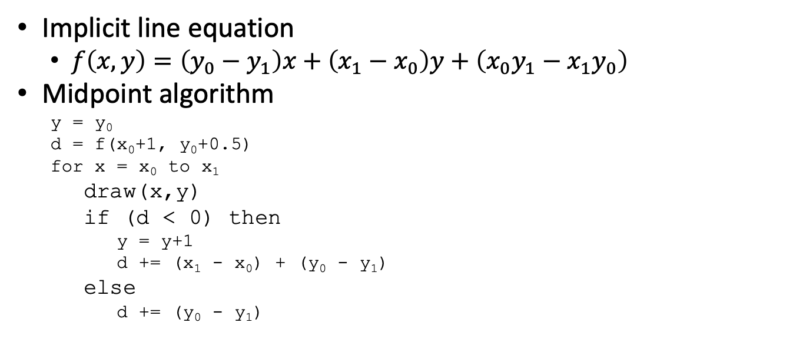
Line Drawing
Implicit line equation
  $f\left(x,y\right)=\left(y_{0}−y_{1}\right)x+\left(x_{1}−x_{0}\right)y+\left(x_{0}y_{1}−x_{1}y_{0}\right)$
Midpoint algorithm
  y = y₀
  d = f(x₀+1, y₀+0.5)
  for x = x₀ to x₁
    draw(x,y)
    if (d < 0) then
      y = y+1
      d += (x₁ - x₀) + (y₀ - y₁)
    else
      d += (y₀ - y₁)

Slide 11
Polygon Rasterization

Slide 12
Polygon Rasterization
Problem
  How to generate filled polygons (by determining which pixel positions are inside the polygon)
  Conversion from continuous to discrete domain
Concepts
  Spatial coherence
  Span coherence
  Edge coherence

Slide 13
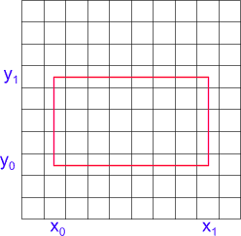
Scanning Rectangles
for ( y from y₀ to y₁ )
for ( x from x₀ to x₁ )
Write Pixel (x, y)

Slide 14
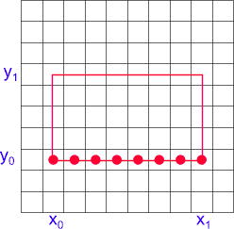
Scanning Rectangles (2)
for ( y from y₀ to y₁ )
for ( x from x₀ to x₁ )
Write Pixel (x, y)

Slide 15
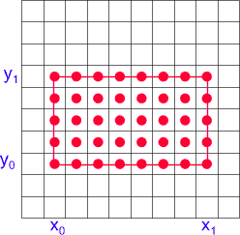
Scanning Rectangles (3)
for ( y from y₀ to y₁ )
for ( x from x₀ to x₁ )
Write Pixel (x, y)

Slide 16
Triangle Rasterization
Barycentric coordinates are decision variables

Slide 17
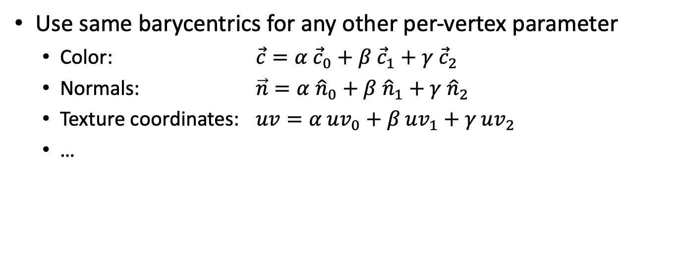
Interpolation
Use same barycentrics for any other per-vertex parameter
  Color: $\vec{c}=α {\vec{c}}_{0}+β {\vec{c}}_{1}+γ{ \vec{c}}_{2}$
  Normals: $\vec{n}=α {\hat{n}}_{0}+β{ \hat{n}}_{1}+γ{ \hat{n}}_{2}$
  Texture coordinates: $uv=α uv_{0}+β uv_{1}+γ uv_{2}$
  …

Slide 18
Barycentric Triangle Rasterization
For all y in y_{min} to y_{max} do
  For all x in x_{min} to x_{max} do
    Compute (α, β, γ) for (x,y)
    If (α ≥ 0 and β ≥ 0 and γ ≥ 0) then
      c = α c₀ + β c₁ + γ c₂
      Draw pixel(x,y) with color c

Slide 19
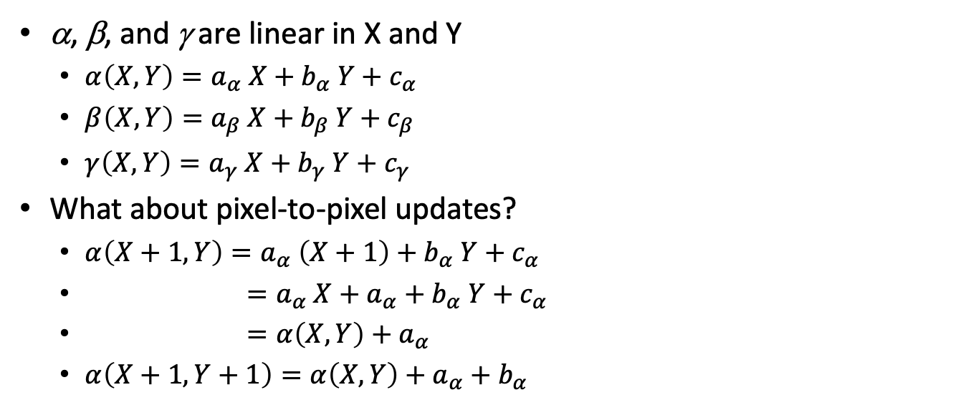
Incremental Computation
α, β, and γ are linear in X and Y
  $α\left(X,Y\right)=a_{α} X+b_{α} Y+c_{α}$
  $β\left(X,Y\right)=a_{β} X+b_{β} Y+c_{β}$
  $γ\left(X,Y\right)=a_{γ} X+b_{γ} Y+c_{γ}$
What about pixel-to-pixel updates?
  $α\left(X+1,Y\right)=a_{α} \left(X+1\right)+b_{α} Y+c_{α}$
  $=a_{α} X+a_{α}+b_{α} Y+c_{α}$
  $=α\left(X,Y\right)+a_{α}$
  $α\left(X+1,Y+1\right)=α\left(X,Y\right)+a_{α}+b_{α}$

Slide 20
Incremental Rasterization
(α_{row}, β_{row}, γ_{row}) = Compute (α, β, γ) for (x_{min},y_{min})
For all y in y_{min} to y_{max} do
  (α, β, γ) = (α_{row}, β_{row}, γ_{row})
  (α_{row}, β_{row}, γ_{row}) += (b_{α}, b_{β}, b_{γ})
  For all x in x_{min} to x_{max} do
    If (α ≥ 0 and β ≥ 0 and γ ≥ 0) then
      c = α c₀ + β c₁ + γ c₂
      Draw pixel(x,y) with color c
    (α, β, γ) += (a_{α}, a_{β}, a_{γ})

