Slide 1
Light & Displays
CMSC 435/634

Slide 2
Light & Color

Slide 3
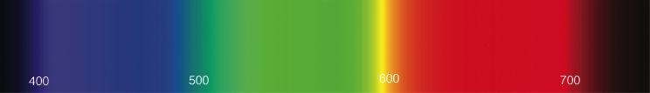
Light
Electromagnetic wave
E & M ⟂ to each other & direction of travel
Photon wavelength λ, frequency f = c/λ Photon energy q = h f = h c/λ (in J)
Visibile λ ≈ 380 nm (blue) to 720 nm (red)
c = speed of light, h = Planck’s constant
Spectral energy Q = J/nm

Slide 4
Light
Infinite-dimensional function vector space
spectrum(λ)
Dimensions = wavelength
Shine two lights on something adds energies
Vector/Vector addition
Scale light energy, scales the intensity
Scalar/Vector multiplication

Slide 5
Radiometric Units
Term | Symbol | Units
Spectral Energy | Q | J
Spectral Power | Φ = dQ/dt | W = J/s
Irradiance | E = dΦ/dA | W/m²
Radiant Intensity | I = dΦ/dω | W/sr
Radiance | L = d²Φ/(dω dA) | W/(sr m²)
/nm dropped by graphics convention

Slide 6
Radiant Energy (Q)
Total energy (Joules)
Over all time, directions, area, …

Slide 7
Radiant Flux (Φ)
Φ = dQ/dt in Watts = J/s
Radiant energy per unit time
This is the one you probably want
Unless you are measuring total energy absorbed
E.g. by a plant over hours of daylight
Not the same as light bulb Watts
Power in vs. power out

Slide 8
Radiant Intensity (I)
I = dΦ/dω in W/sr
Radiant Flux emitted/received per unit solid angle
Light from a point in a small cone of directions
Same units for incoming and outgoing light

Slide 9
Radiosity (B)
B = dΦ/dA in W/m²
All light leaving a patch of surface
Emitted or reflected
All directions at each point
Measured per unit area

Slide 10
Irradiance (E)
E = dΦ/dA in W/m²
All light entering a patch of surface
All directions at each point
Measured per unit area

Slide 11
Radiance (L)
L = d²Φ/(dω dA) in W/(sr m²)
Light entering patch of surface from a small range of directions
Per unit area
Per unit solid angle
Compare to Irradiance (over all directions)

Slide 12
Spectral Graphs
A = Incandescent light
D = Daylight (50=horizon, 65=noon)
F = Fluorescent light

Slide 13
Physiology
Rods
active at low light levels (scotopic vision)
only one wavelength sensitivity function
Cones
active at normal light levels
three types: sensitivity functions with different peaks

Slide 14
Color Perception

Slide 15
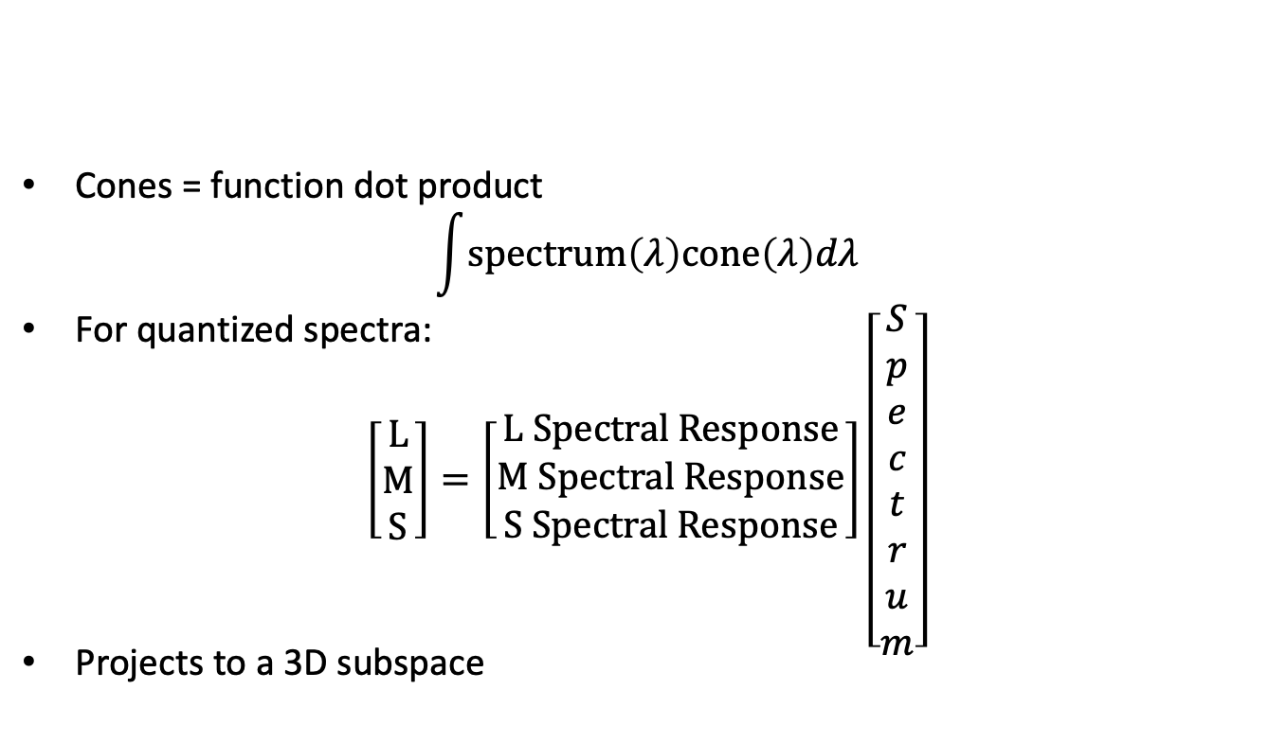
Color Perception
Cones = function dot product
$$\int{\text{spectrum}\left(λ\right)\text{cone}\left(λ\right)dλ}$$
For quantized spectra:
$\left[\begin{matrix}L \\ M \\ S\end{matrix}\right]=\left[\begin{matrix}L Spectral Response \\ M Spectral Response \\ S Spectral Response\end{matrix}\right]\left[\begin{matrix}S \\ p \\ e \\ c \\ t \\ r \\ u \\ m\end{matrix}\right]$
Projects to a 3D subspace

Slide 16
Metamers
Different spectrum, looks the same
Same 3D projection

Slide 17
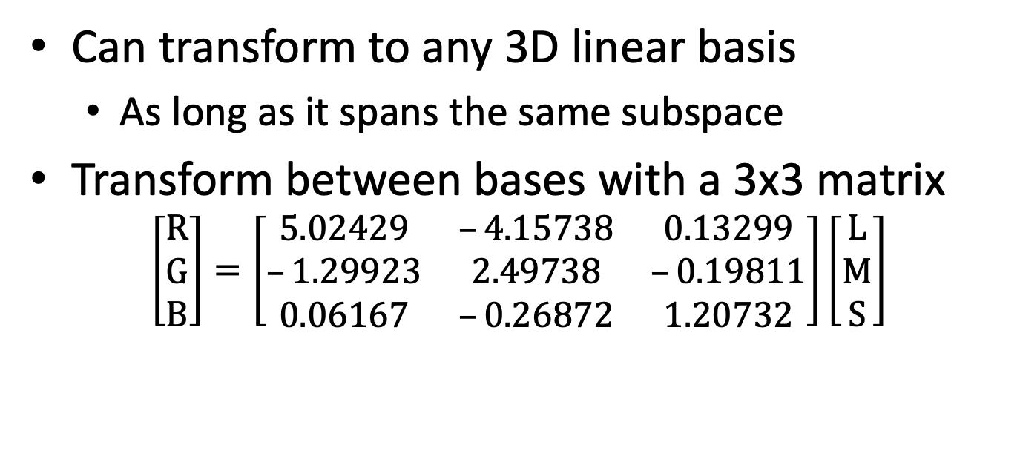
Color Basis
Can transform to any 3D linear basis
As long as it spans the same subspace
Transform between bases with a 3x3 matrix
$$\left[\begin{matrix}R \\ G \\ B\end{matrix}\right]=\left[\begin{matrix}5.02429 & –4.15738 & 0.13299 \\ –1.29923 & 2.49738 & –0.19811 \\ 0.06167 & –0.26872 & 1.20732\end{matrix}\right]\left[\begin{matrix}L \\ M \\ S\end{matrix}\right]$$

Slide 18
Linear Bases
Additive (light)
Tristimulus (LMS cone response)
CIE XYZ (from color matching experiments)
RGB (red/green/blue; different for each device)
Yuv, YC_{r}C_{b}, … (intensity/2 chroma)
Subtractive (pigment)
CMY = 1 - RGB (cyan/magenta/yellow)
grade school Blue, Red, Yellow
CMYK (cyan/magenta/yellow/black)
Hard to reliably get pure black in ink by mixing CMY

Slide 19
Chromaticity
Normalize x = X / (X+Y+Z); y = Y / (X+Y+Z)

Slide 20
RGB Gamut
Gamut = representable colors

Slide 21
Subtractive
Start at white, remove R, G, or B

Slide 22

White Points & Color Temperature
Color of radiating black body at given temperature (°K)
Color of a black body that temperature, not necessarily the temperature of the light

Slide 23
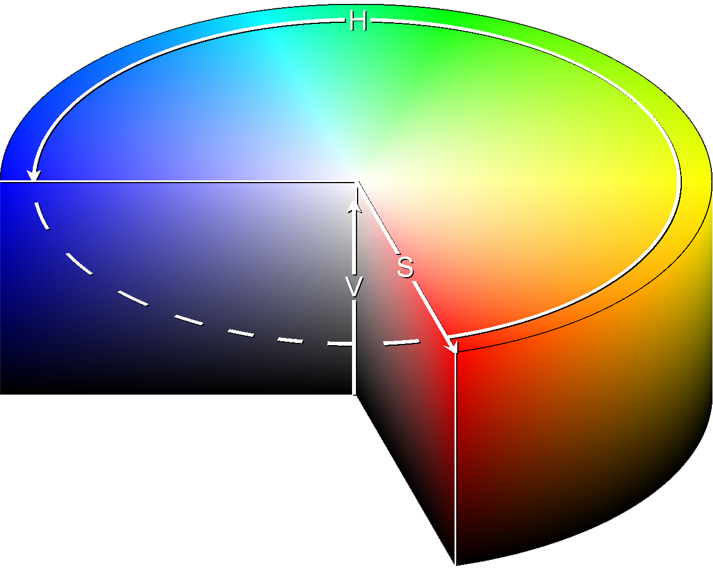
Nonlinear Color Spaces
HSV: Cylindrical Coordinates
Hue = angle
Saturation = distance from central axis
Value = distance along axis
Related HLS
Hue/Lightness/Saturation

Slide 24
Perception

Slide 25
Nonlinear Perception
Linear colors don’t look uniformly different
Nonlinear Luminance
Gamma (sRGB), L*uv
Nonlinear Luminance & Color
L*u*v*, L*a*b*
Can measure color distances

Slide 26
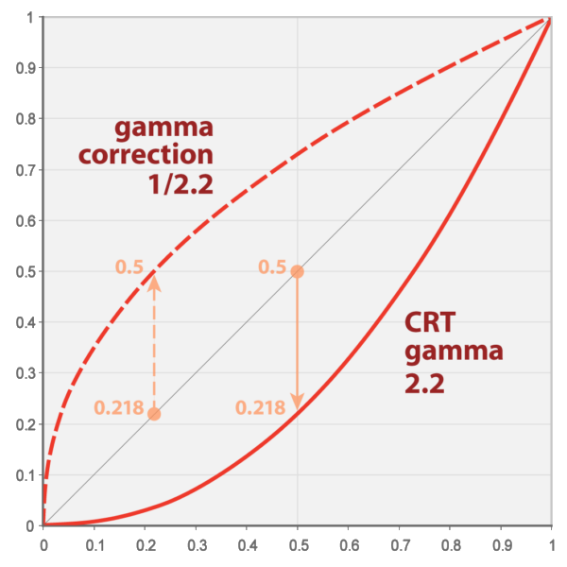
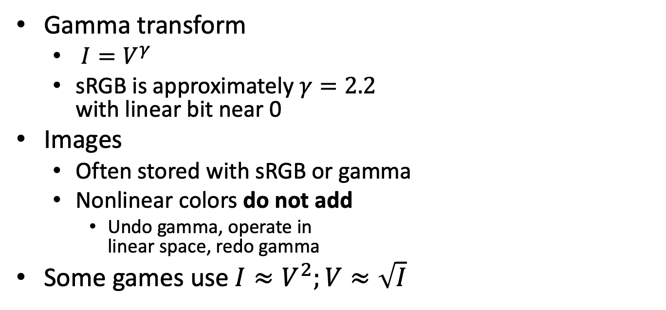
Gamma
Gamma transform
$I=V^{γ}$
sRGB is approximately $γ=2.2$ with linear bit near 0
Images
Often stored with sRGB or gamma
Nonlinear colors do not add
Undo gamma, operate in linear space, redo gamma
Some games use $I≈V^{2};V≈\sqrt{I}$

Slide 27
Photometric Units
Visual intensity
Term | Symbol | Units
Luminous Energy | Q | talbot
Lumens | Φ = dQ/dt | lm = talbot/s
Illuminance (lux) | E = dΦ/dA | lx = lm/m²
Candelas | I = dΦ/dω | cd = lm/sr
Luminance (nit) | L = d²Φ/(dω dA) | nt = cd/m²

Slide 28
Dynamic Range
Real world: High Dynamic range (HDR)
Outside, moonlight 0.0014 nt
Outside, sunrise 25 nt
Outside, overcast 700 nt
Outside, sunlight 5,000 nt
Sky 7,000 nt
Light blub 130,000 nt
Sun 1,600,000,000 nt
Displays: Low Dynamic Range (LDR)
Typically about 1 nt to 250 nt

Slide 29
Tone Mapping
HDR ∈ [0,∞); LDR ∈ [0,1] or [0,255]
Convert HDR to LDR
Nonlinear tone mapping curve
Adapt to overall intensity
Time-dependent adaptation

