Slide 1
Graphics Pipeline Clipping
CMSC 435/634

Slide 2
Graphics Pipeline
Object-order approach to rendering
Vertex Processing
Transformations
Vertex components of shading
Clipping
Find the visible parts of primitives
Rasterization
Break primitives into fragments/pixels
Fragment Processing
Fragment components of shading
Visibility & Blending
Which do we see, how do they combine?

Slide 3
Why Clip?
Window sides
Draw less
Some rasterization algorithms need everything on screen
Near
Draw less
Don’t divide by 0
Don’t divide by negative z
Far
Draw less
Constrain Z range (avoid overflow)

Slide 4
Clipping & Culling
Cull: decide not to draw an object at all
Clip: slice to keep just the visible parts
Trivial Reject: Easy to decide entirely off screen
Trivial Accept: Easy to decide entirely on screen

Slide 5
Line Clipping

Slide 6
Clipping Lines
Lines intersecting a rectangular clip region are always clipped into a single line segment
Clip against one window edge at a time
F
D
D’
D’
B
H
B
C
H’
C
H’
E
A
J
A
G’
J’
G’
G
I’
Clip Rectangle
I

Slide 7
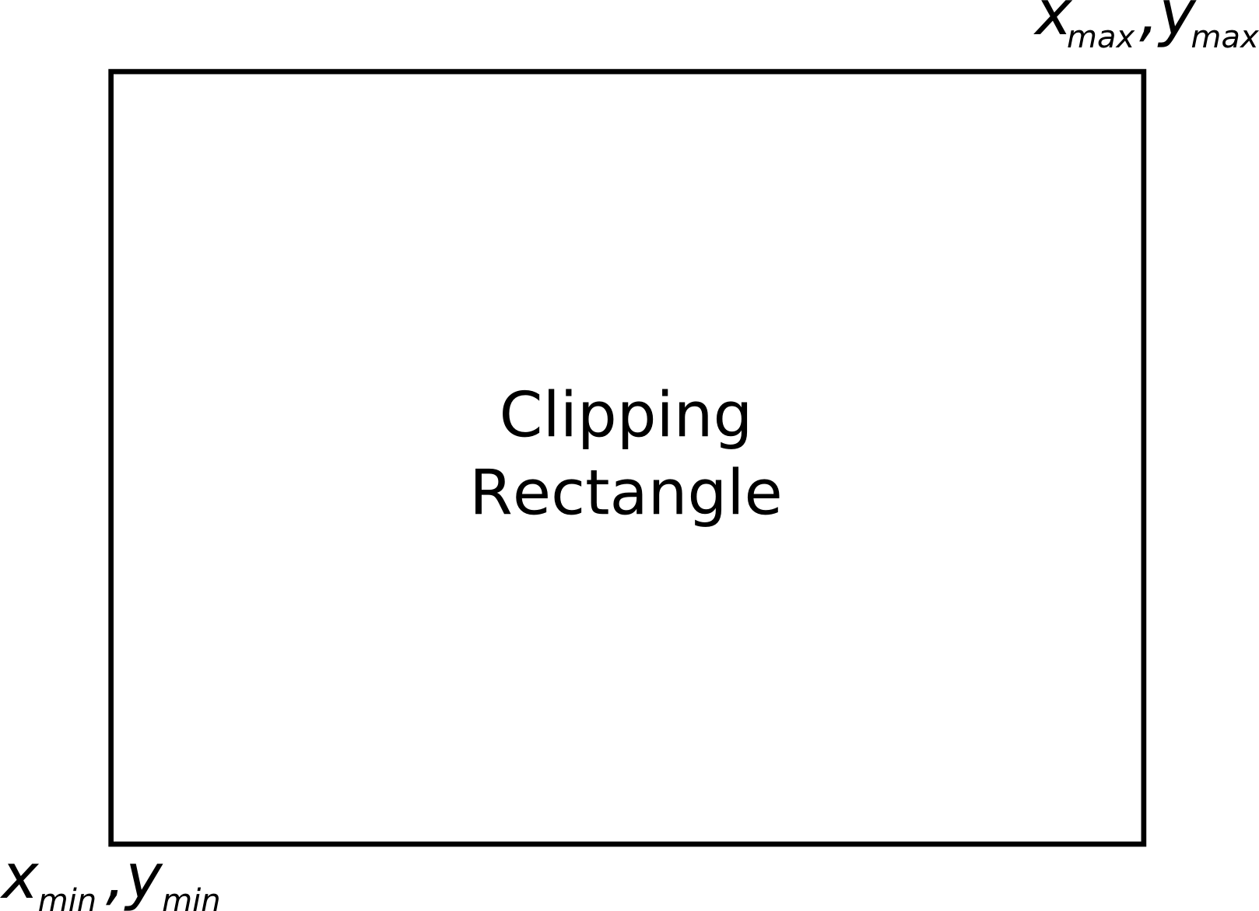

Clipping Endpoints
For a point at (x,y) to be inside the clipping rectangle
$$xmin ≤ x ≤ xmax, ymin ≤ y ≤ ymax$$

Slide 8
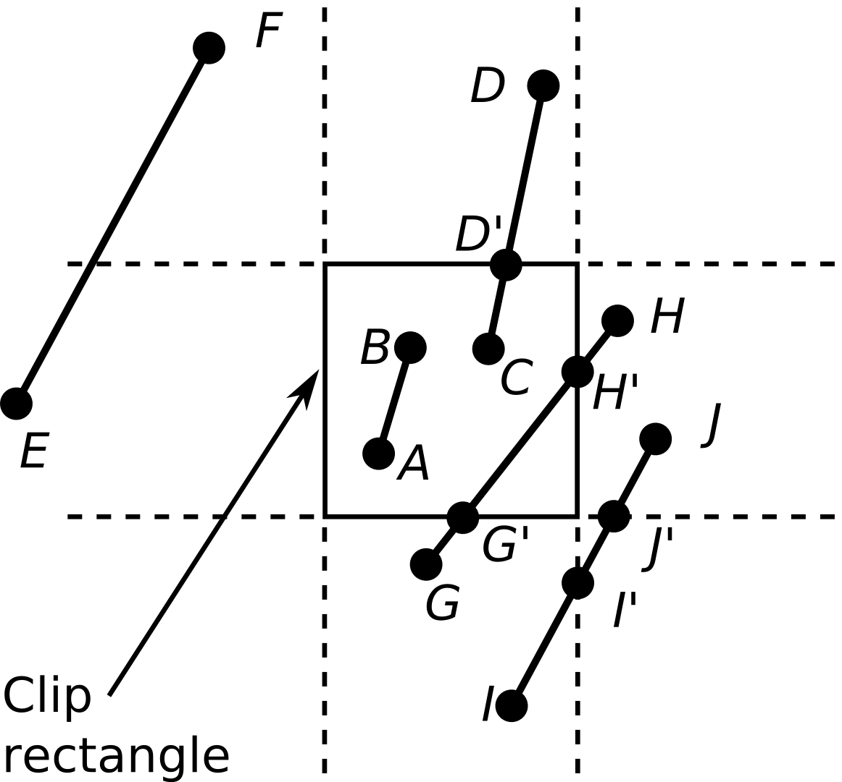
Clipping Conditions
Both endpoints are inside (AB)
One endpoint in, another end outside (CD)
Both outside (EF, GH, IJ)
May or may not be in, further calculations needed

Slide 9
Cohen-Sutherland Line Clipping
First, endpoint pairs are checked for trivial acceptance
If not, region checks are performed in order to trivially reject certain lines
If both x’s or both y’s are < –1 or both are > 1, then it lies outside (EF)

Slide 10
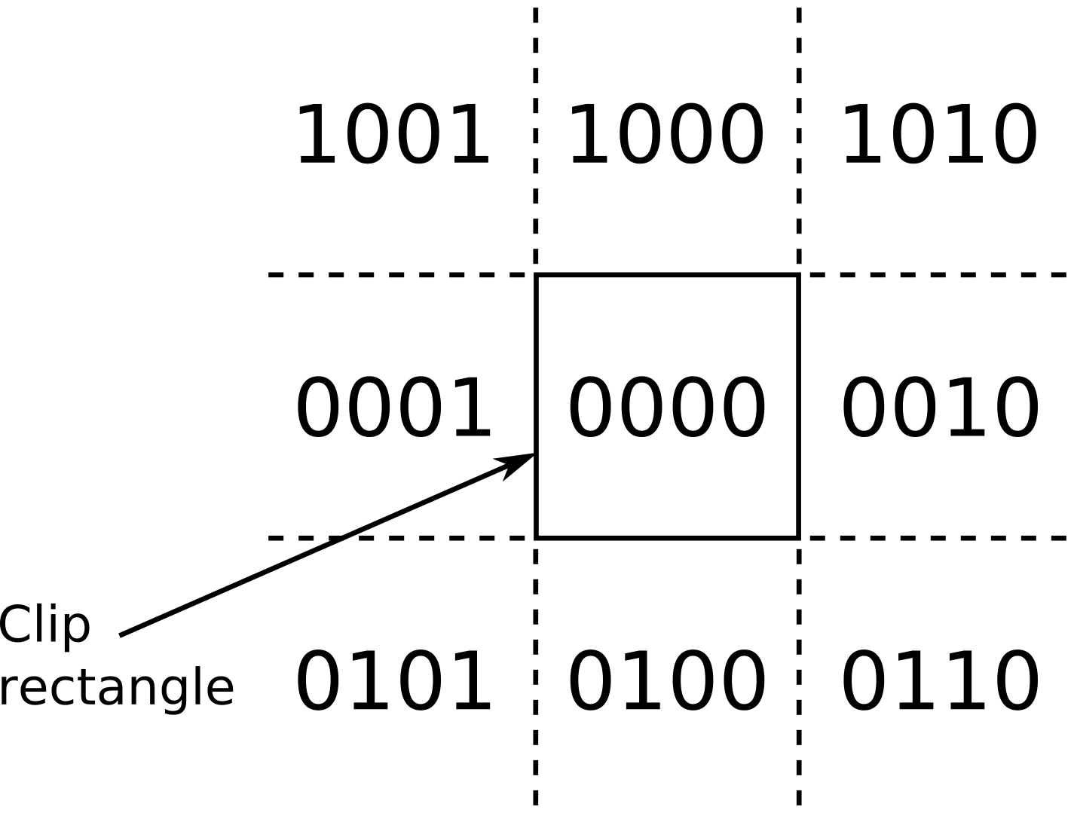
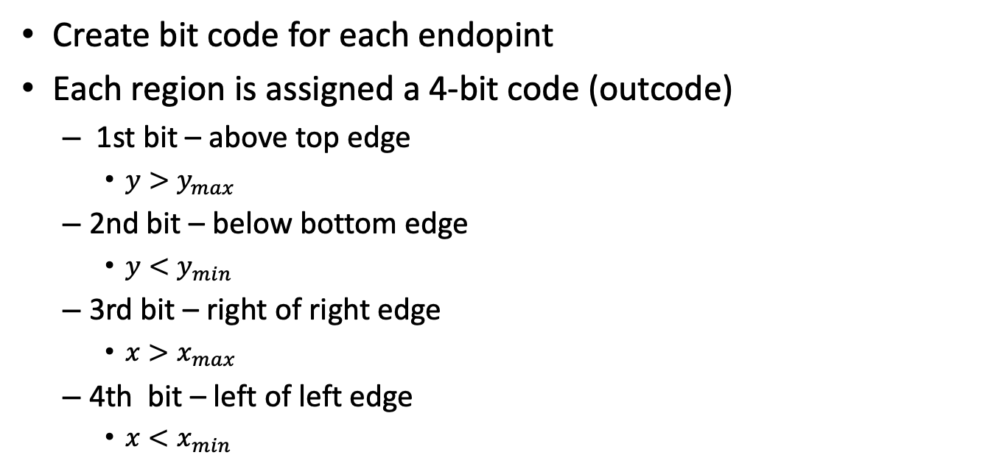
Cohen-Sutherland Line Clipping
Create bit code for each endopint
Each region is assigned a 4-bit code (outcode)
1st bit – above top edge
$y>y_{max}$
2nd bit – below bottom edge
$y<y_{min}$
3rd bit – right of right edge
$x>x_{max}$
4th bit – left of left edge
$x<x_{min}$

Slide 11
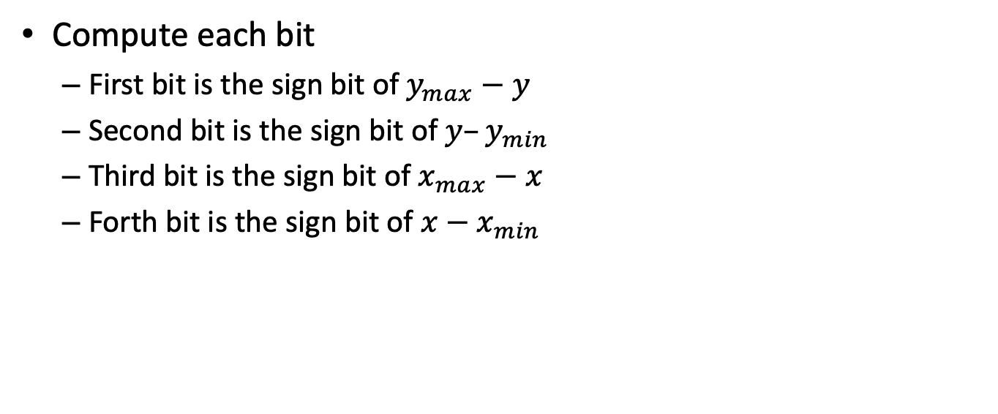
Efficient Computation of Bit-Code
Compute each bit
First bit is the sign bit of $y_{max}−y$
Second bit is the sign bit of $y–y_{min}$
Third bit is the sign bit of $x_{max}−x$
Forth bit is the sign bit of $x−x_{min}$

Slide 12
Bit-Code Trivial Rejects and Accepts
If both bit codes are zero – trivial accept
If endpoints are both outside of same edge, they will share that bit
This can easily be computed as a bitwise and (&) operation – trivial reject if non-zero result
If not, then need to split line at clip edge, discard portion outside, continue testing

Slide 13
Cohen-Sutherland Line Clipping Algorithm
code1 = outcode from endpoint1
code2 = outcode from endpoint2
if (code1 | code2 == 0) then
trivial_accept
else if (code1 & code2 != 0) then
trivial_reject
else
clip against left
clip against right
clip against bottom
clip against top
if (anything remains) then
accept clipped segment

Slide 14
Polygon Clipping

Slide 15
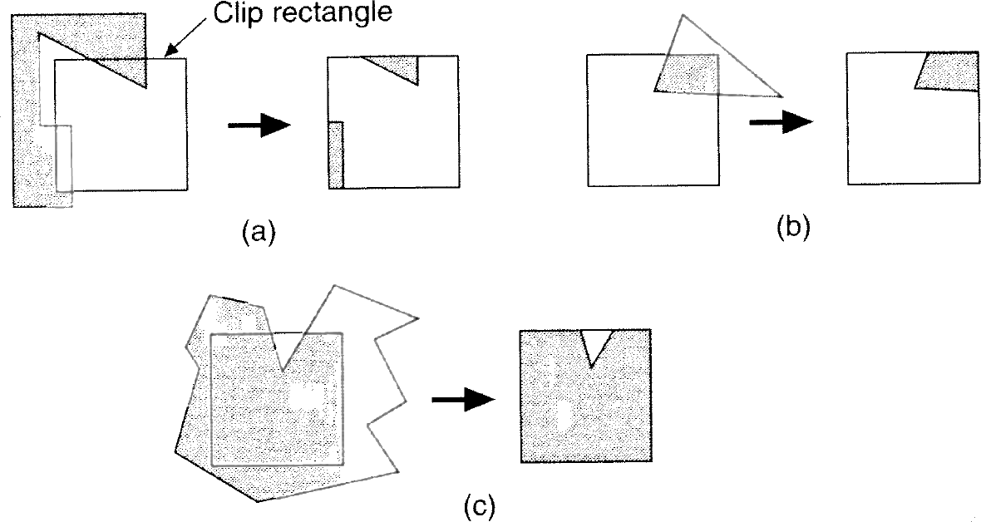
Polygon Clipping
Many cases (new edges, discarded edges)
Multiple polygons may result from a single (concave) polygon

Slide 16
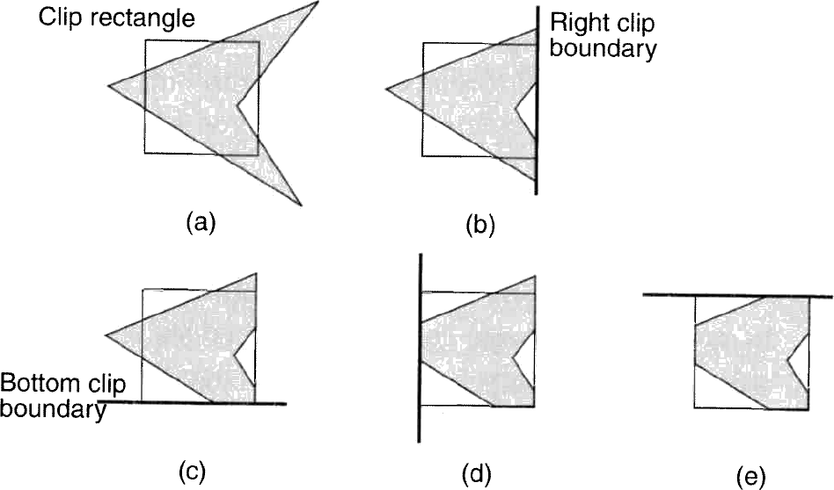
Sutherland-Hodgman Polygon Clipping
Divide and conquer
Simpler problem is to clip polygon against a single infinite edge
Sequence of 4 clips against clipping rectangle

Slide 17
Sutherland-Hodgman Polygon Clipping
Algorithm moves around the polygon from v_{n} to v₁ and then on back to v_{n}
At each step
Check (v_{i} to v_{i+1}) line against the clip edge
Add zero, one, or two vertices to the output

Slide 18
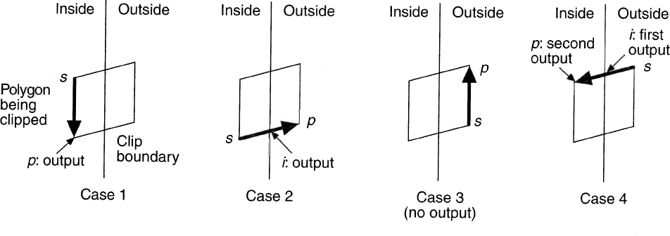
Sutherland-Hodgman Polygon Clipping
At each step, 1 of 4 possible cases arises
1) Edge is completely inside clip boundary, so add vertex p to the output
2) Intersection i is output as vertex because it intersects with boundary
3) Both vertices are outside boundary, so neither is output
4) Intersection i and vertex p both added to output list

Slide 19
Sutherland-Hodgman Algorithm
Sutherland-Hodgman(array)‏
vertex S = array[ length(array) - 1 ]
for ( j = 0 ; j < length(array) ; j++ ) do
vertex P = array[ j ]
if ( P is inside clip plane ) then
if ( S is inside clip plane ) then /* case 1 */
Output( P )
else /* case 4 */
Output( ComputeIntersection( S, P, clip plane ) )‏
Output( P )‏
else if ( S is inside clip plane ) then /* case 2 */
Output( ComputeIntersection( P, S, clip plane ) )‏
else /* case 3 */
do nothing
S = P

Slide 20
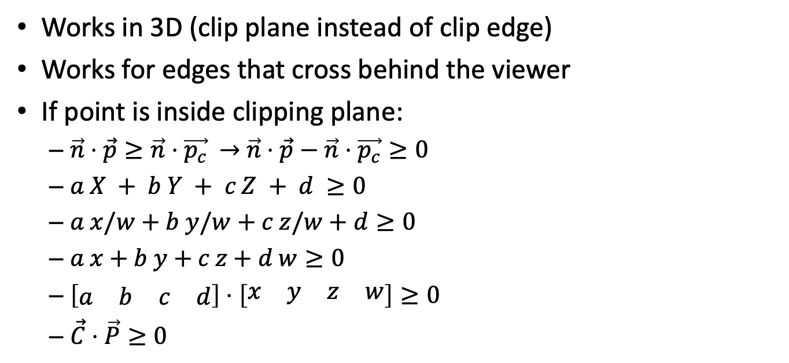
Homogeneous Clipping
Works in 3D (clip plane instead of clip edge)
Works for edges that cross behind the viewer
If point is inside clipping plane:
$\vec{n}⋅\vec{p}≥\vec{n}⋅\vec{p_{c}}$ $→$ $\vec{n}⋅\vec{p}−\vec{n}⋅\vec{p_{c}}≥0$
$a X + b Y + c Z + d ≥0$
$a x/w+b y/w+c z/w+d≥0$
$a x+b y+c z+d w≥0$
$\left[\begin{matrix}a & b & c & d\end{matrix}\right]⋅\left[\begin{matrix}x & y & z & w\end{matrix}\right]≥0$
$\vec{C}⋅\vec{P}≥0$

Slide 21
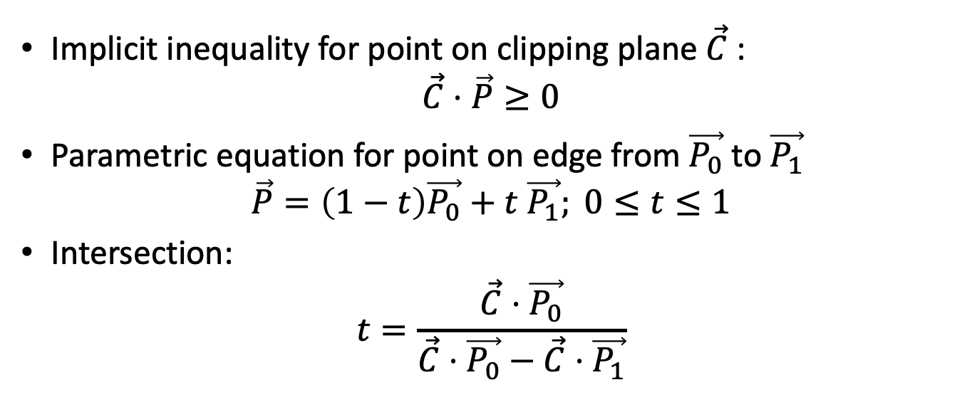
Homogeneous Clipping
Implicit inequality for point on clipping plane $\vec{C}$:
$$\vec{C}⋅\vec{P}≥0$$
Parametric equation for point on edge from $\vec{P_{0}}$ to $\vec{P_{1}}$
$$\vec{P}=\left(1−t\right)\vec{P_{0}}+t \vec{P_{1}}; 0≤t≤1$$
Intersection:
$$t=\frac{\vec{C}⋅\vec{P_{0}}}{\vec{C}⋅\vec{P_{0}}−\vec{C}⋅\vec{P_{1}}}$$

Slide 22
Sutherland-Hodgeman and Triangles
For algorithms that only render triangles
Input and output should be triangles
Result of clipping a triangle can be 0, 1, or 2 new triangles
Max for N planes: N+1 triangles
Clip near, far = up to 3 triangles
Clip 6 frustum planes = up to 7 triangles

Slide 23
“Clipless” Homogeneous Rasterization
Compute barycentrics using homogeneous coordinates
Don’t need to clip to compute valid barycentrics
Extra edge equation / decision variable for each clip edge
Compute t for clip plane at each vertex
Only visible (w>near) pixels will be drawn
Adds computation
Divide by w per pixel instead of per vertex
No clipped pixels drawn, so no division by 0
But avoids branching and extra triangles
Good for hardware

Slide 24

Homogeneous Barycentrics
Each barycentric is
Equal to 1 at one vertex
$α_{0}=1=a_{α} X_{0}+b_{α} Y_{0}+c_{α}$
Equal to 0 at the other two
$α_{1}=0=a_{α} X_{1}+b_{α} Y_{1}+c_{α}$
$α_{2}=0=a_{α} X_{2}+b_{α} Y_{2}+c_{α}$

Slide 25

Homogeneous Barycentrics
Write barycentric formulae in homogeneous form
$α=a_{α} X +b_{α} Y +c_{α}$
$=a_{α} x/w+b_{α} y/w+c_{α}$
$α w=a_{α} x +b_{α} y +c_{α} w$

Slide 26
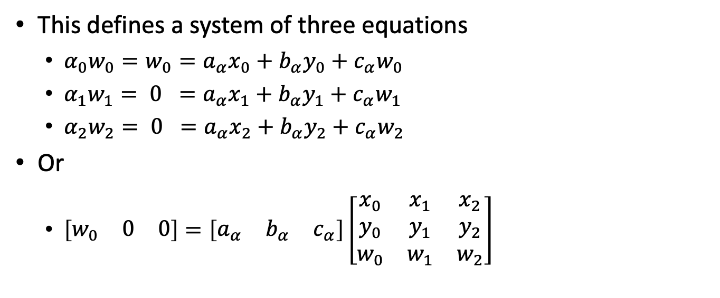
Homogeneous Barycentrics
This defines a system of three equations
$α_{0}w_{0}=w_{0}=a_{α}x_{0}+b_{α}y_{0}+c_{α}w_{0}$
$α_{1}w_{1}= 0 =a_{α}x_{1}+b_{α}y_{1}+c_{α}w_{1}$
$α_{2}w_{2}= 0 =a_{α}x_{2}+b_{α}y_{2}+c_{α}w_{2}$
Or
$\left[\begin{matrix}w_{0} & 0 & 0\end{matrix}\right]=\left[\begin{matrix}a_{α} & b_{α} & c_{α}\end{matrix}\right]\left[\begin{matrix}x_{0} & x_{1} & x_{2} \\ y_{0} & y_{1} & y_{2} \\ w_{0} & w_{1} & w_{2}\end{matrix}\right]$

Slide 27
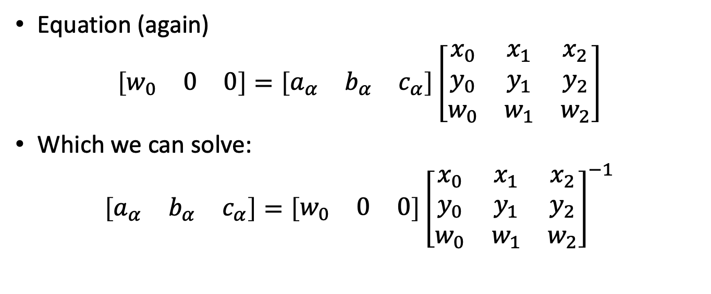
Homogeneous Barycentrics
Equation (again)
$$\left[\begin{matrix}w_{0} & 0 & 0\end{matrix}\right]=\left[\begin{matrix}a_{α} & b_{α} & c_{α}\end{matrix}\right]\left[\begin{matrix}x_{0} & x_{1} & x_{2} \\ y_{0} & y_{1} & y_{2} \\ w_{0} & w_{1} & w_{2}\end{matrix}\right]$$
Which we can solve:
$$\left[\begin{matrix}a_{α} & b_{α} & c_{α}\end{matrix}\right]=\left[\begin{matrix}w_{0} & 0 & 0\end{matrix}\right]{\left[\begin{matrix}x_{0} & x_{1} & x_{2} \\ y_{0} & y_{1} & y_{2} \\ w_{0} & w_{1} & w_{2}\end{matrix}\right]}^{−1}$$

Slide 28
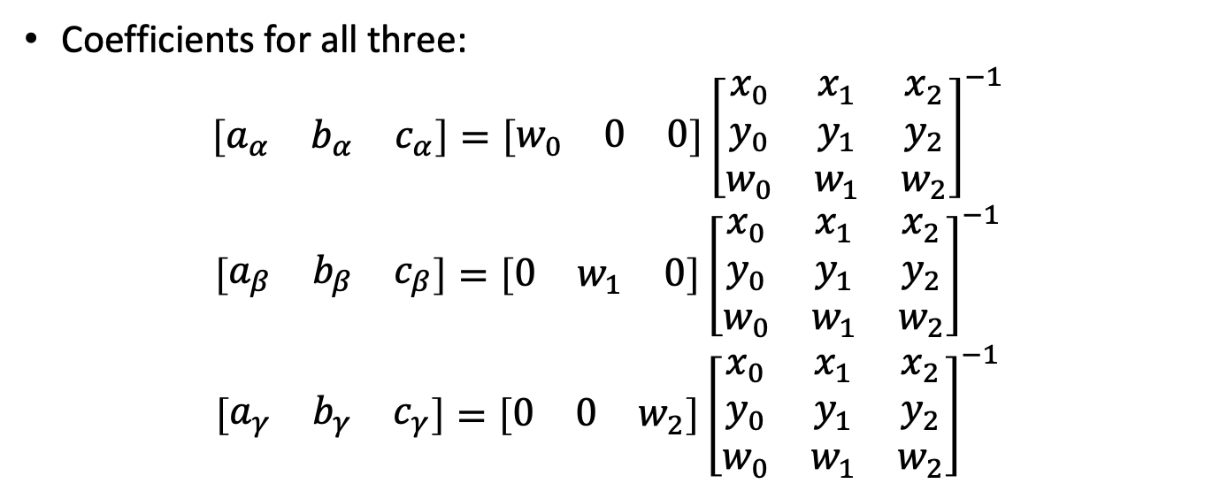
Homogeneous Barycentrics
Coefficients for all three:
$$\left[\begin{matrix}a_{α} & b_{α} & c_{α}\end{matrix}\right]=\left[\begin{matrix}w_{0} & 0 & 0\end{matrix}\right]{\left[\begin{matrix}x_{0} & x_{1} & x_{2} \\ y_{0} & y_{1} & y_{2} \\ w_{0} & w_{1} & w_{2}\end{matrix}\right]}^{−1}$$
$$\left[\begin{matrix}a_{β} & b_{β} & c_{β}\end{matrix}\right]=\left[\begin{matrix}0 & w_{1} & 0\end{matrix}\right]{\left[\begin{matrix}x_{0} & x_{1} & x_{2} \\ y_{0} & y_{1} & y_{2} \\ w_{0} & w_{1} & w_{2}\end{matrix}\right]}^{−1}$$
$$\left[\begin{matrix}a_{γ} & b_{γ} & c_{γ}\end{matrix}\right]=\left[\begin{matrix}0 & 0 & w_{2}\end{matrix}\right]{\left[\begin{matrix}x_{0} & x_{1} & x_{2} \\ y_{0} & y_{1} & y_{2} \\ w_{0} & w_{1} & w_{2}\end{matrix}\right]}^{−1}$$

Slide 29
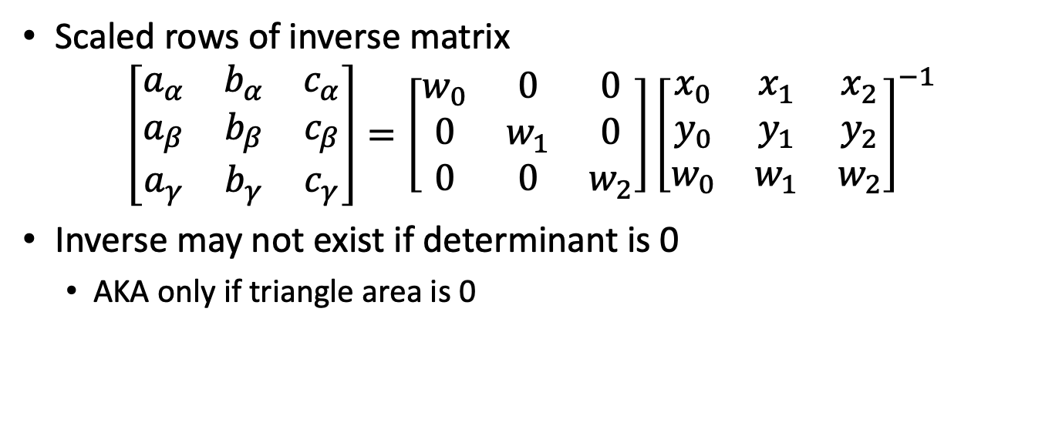
Homogeneous Barycentrics
Scaled rows of inverse matrix
$$\left[\begin{matrix}a_{α} & b_{α} & c_{α} \\ a_{β} & b_{β} & c_{β} \\ a_{γ} & b_{γ} & c_{γ}\end{matrix}\right]=\left[\begin{matrix}w_{0} & 0 & 0 \\ 0 & w_{1} & 0 \\ 0 & 0 & w_{2}\end{matrix}\right]{\left[\begin{matrix}x_{0} & x_{1} & x_{2} \\ y_{0} & y_{1} & y_{2} \\ w_{0} & w_{1} & w_{2}\end{matrix}\right]}^{−1}$$
Inverse may not exist if determinant is 0
AKA only if triangle area is 0

Slide 30
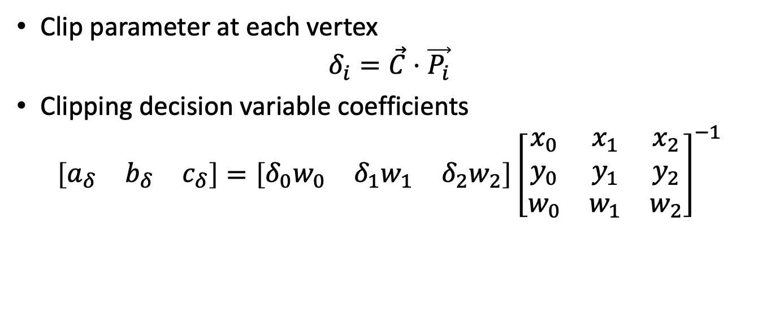
Homogenous Clip Plane
Clip parameter at each vertex
$$δ_{i}=\vec{C}⋅\vec{P_{i}}$$
Clipping decision variable coefficients
$$\left[\begin{matrix}a_{δ} & b_{δ} & c_{δ}\end{matrix}\right]=\left[\begin{matrix}δ_{0}w_{0} & δ_{1}w_{1} & δ_{2}w_{2}\end{matrix}\right]{\left[\begin{matrix}x_{0} & x_{1} & x_{2} \\ y_{0} & y_{1} & y_{2} \\ w_{0} & w_{1} & w_{2}\end{matrix}\right]}^{−1}$$

Slide 31
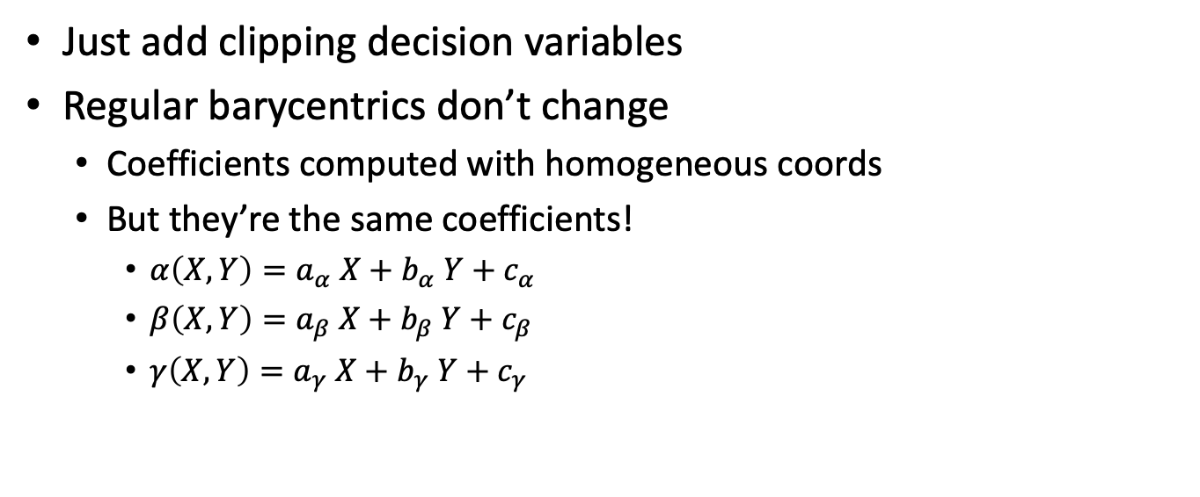
Changes to Rasterization
Just add clipping decision variables
Regular barycentrics don’t change
Coefficients computed with homogeneous coords
But they’re the same coefficients!
$α\left(X,Y\right)=a_{α} X+b_{α} Y+c_{α}$
$β\left(X,Y\right)=a_{β} X+b_{β} Y+c_{β}$
$γ\left(X,Y\right)=a_{γ} X+b_{γ} Y+c_{γ}$

