Slide 1
Triangle Barycentrics
CMSC 435/634

Slide 2
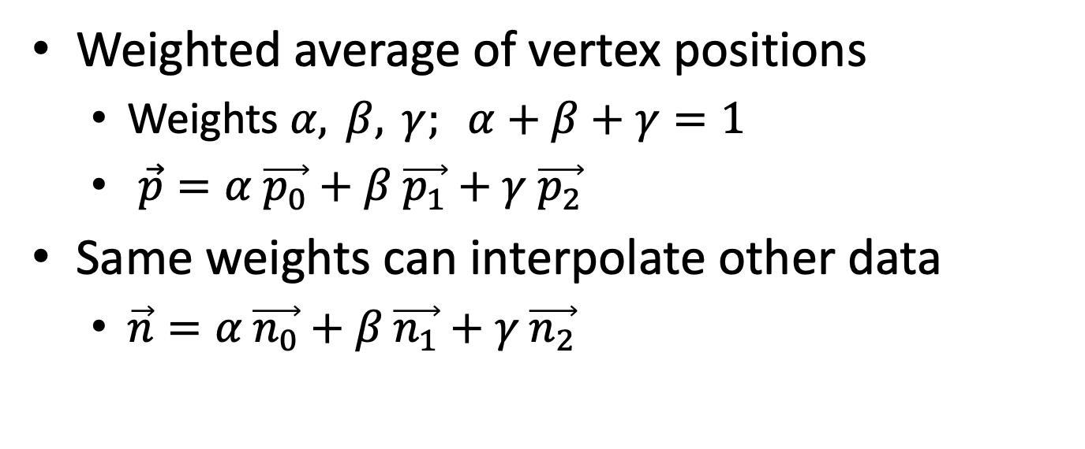
Barycentric Coordinates
Weighted average of vertex positions
  Weights $α, β, γ; α+β+γ=1$
  $\vec{p}=α \vec{p_{0}}+β \vec{p_{1}}+γ \vec{p_{2}}$
Same weights can interpolate other data
  $\vec{n}=α \vec{n_{0}}+β \vec{n_{1}}+γ \vec{n_{2}}$

Slide 3
Barycentric Coordinates
Each coordinate is 1 at its vertex
0 at both other vertices
  and on the line between them

Slide 4

Computing Barycentrics (1)
Ratio of (signed) distance from edge
  $\vec{n}=\left(\vec{p_{2}}−\vec{p_{1}}\right)×\left(\vec{p_{0}}−\vec{p_{1}}\right)$
  $h=\vec{n_{α}}⋅\left(\vec{p_{0}}−\vec{p_{1}}\right)$
  $α=d/h$

Slide 5
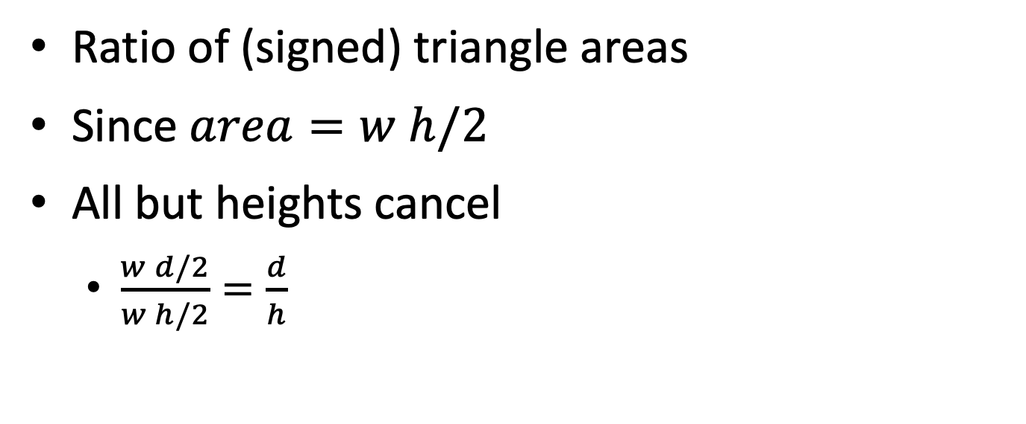
Computing Barycentrics (2)
Ratio of (signed) triangle areas
Since $area=w h/2$
All but heights cancel
  $\frac{w d/2}{w h/2}=\frac{d}{h}$

Slide 6
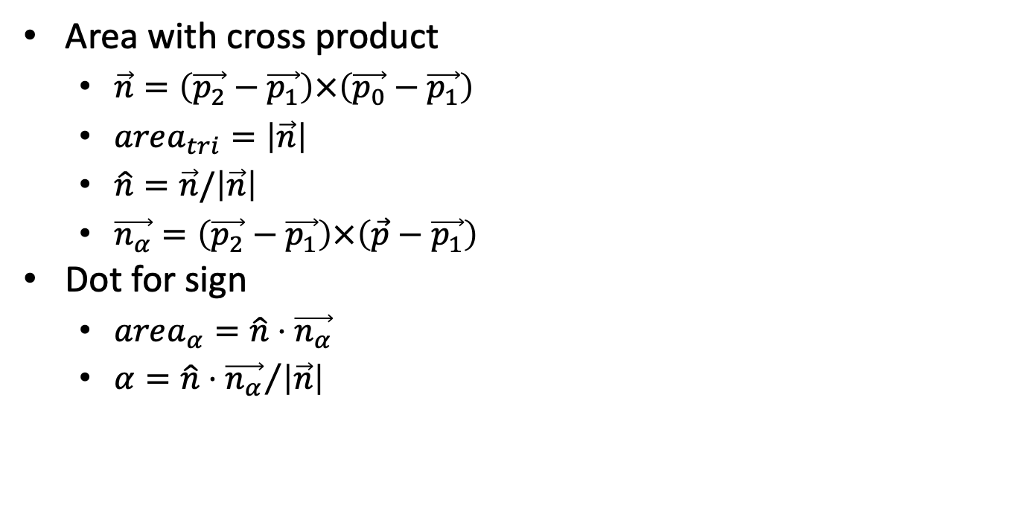
Computing Barycentrics (2a)
Area with cross product
  $\vec{n}=\left(\vec{p_{2}}−\vec{p_{1}}\right)×\left(\vec{p_{0}}−\vec{p_{1}}\right)$
  $area_{tri}=\left|\vec{n}\right|$
  $\hat{n}=\vec{n}/\left|\vec{n}\right|$
  $\vec{n_{α}}=\left(\vec{p_{2}}−\vec{p_{1}}\right)×\left(\vec{p}−\vec{p_{1}}\right)$
Dot for sign
  $area_{α}=\hat{n}⋅\vec{n_{α}}$
  $α={\hat{n}⋅\vec{n_{α}}}/{\left|\vec{n}\right|}$

Slide 7
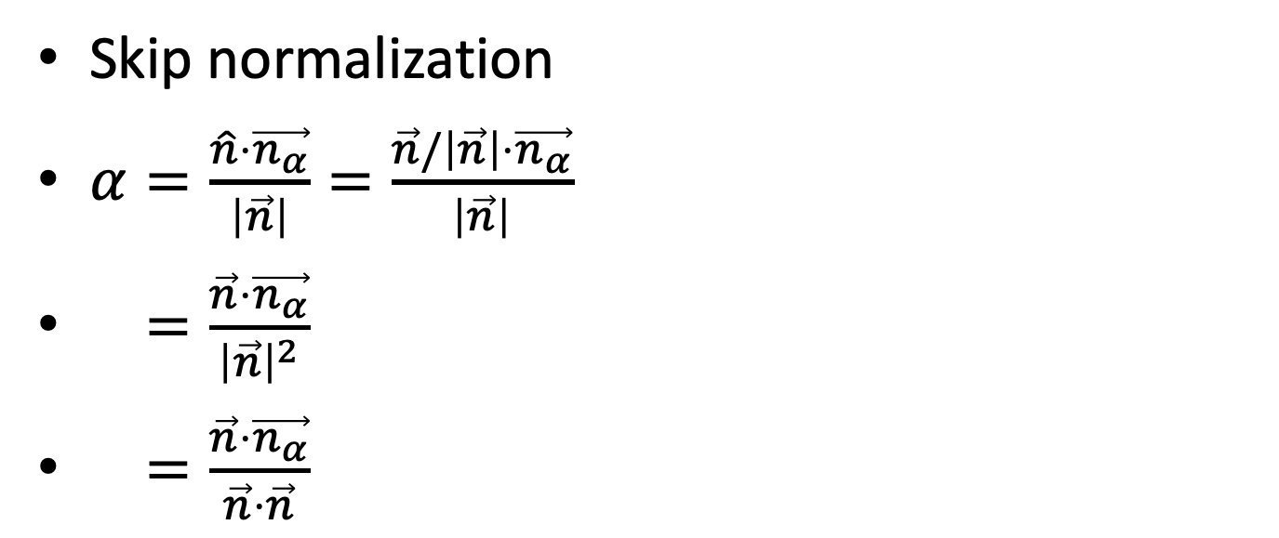
Computing Barycentrics (2b)
Skip normalization
$α=\frac{\hat{n}⋅\vec{n_{α}}}{\left|\vec{n}\right|}=\frac{\vec{n}/\left|\vec{n}\right|⋅\vec{n_{α}}}{\left|\vec{n}\right|}$
$=\frac{\vec{n}⋅\vec{n_{α}}}{{\left|\vec{n}\right|}^{2}}$
$=\frac{\vec{n}⋅\vec{n_{α}}}{\vec{n}⋅\vec{n}}$

Slide 8

Computing Barycentrics (2c)
Area from 2D matrix determinant
  Any non-zero 2D projection
$area_{tri}=\left|\begin{matrix}\left(X_{0}−X_{1}\right) & \left(X_{2}−X_{1}\right) \\ \left(Y_{0}−Y_{1}\right) & \left(Y_{2}−Y_{1}\right)\end{matrix}\right|$
$area_{α}=\left|\begin{matrix}\left(X_{p}−X_{1}\right) & \left(X_{2}−X_{1}\right) \\ \left(Y_{p}−Y_{1}\right) & \left(Y_{2}−Y_{1}\right)\end{matrix}\right|$

Slide 9
Computing Barycentrics (2d)
Area by Green’s Theorem

Slide 10
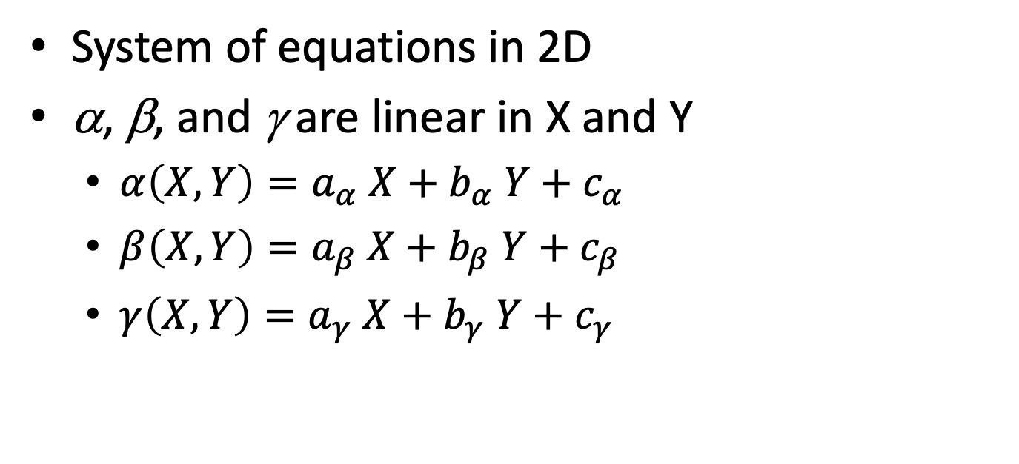
Computing Barycentrics (3)
System of equations in 2D
α, β, and γ are linear in X and Y
  $α\left(X,Y\right)=a_{α} X+b_{α} Y+c_{α}$
  $β\left(X,Y\right)=a_{β} X+b_{β} Y+c_{β}$
  $γ\left(X,Y\right)=a_{γ} X+b_{γ} Y+c_{γ}$

Slide 11
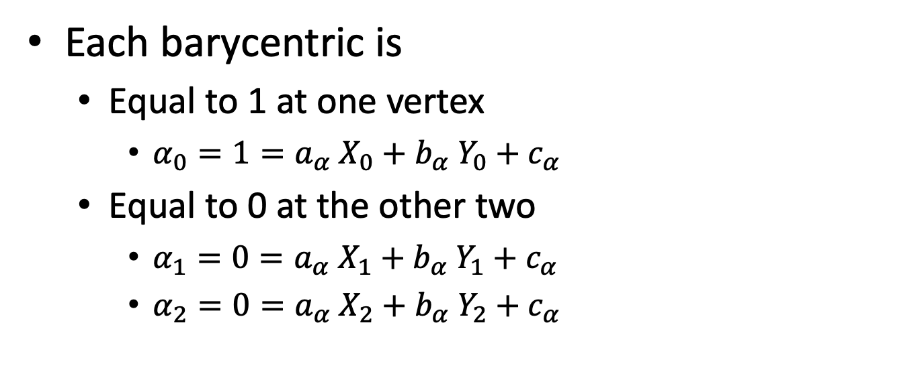
Computing Barycentrics (3)
Each barycentric is
  Equal to 1 at one vertex
    $α_{0}=1=a_{α} X_{0}+b_{α} Y_{0}+c_{α}$
  Equal to 0 at the other two
    $α_{1}=0=a_{α} X_{1}+b_{α} Y_{1}+c_{α}$
    $α_{2}=0=a_{α} X_{2}+b_{α} Y_{2}+c_{α}$

Slide 12
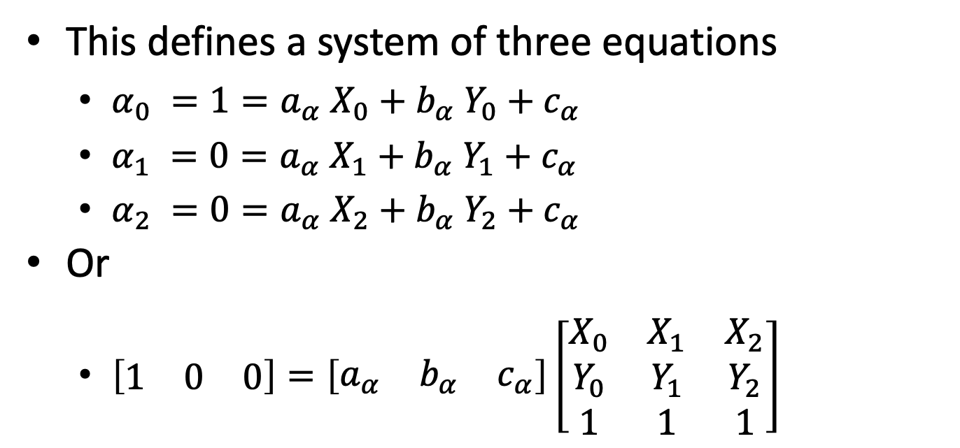
Computing Barycentrics (3)
This defines a system of three equations
  $α_{0} =1=a_{α} X_{0}+b_{α} Y_{0}+c_{α}$
  $α_{1} =0=a_{α} X_{1}+b_{α} Y_{1}+c_{α}$
  $α_{2} =0=a_{α} X_{2}+b_{α} Y_{2}+c_{α}$
Or
  $\left[\begin{matrix}1 & 0 & 0\end{matrix}\right]=\left[\begin{matrix}a_{α} & b_{α} & c_{α}\end{matrix}\right]\left[\begin{matrix}X_{0} & X_{1} & X_{2} \\ Y_{0} & Y_{1} & Y_{2} \\ 1 & 1 & 1\end{matrix}\right]$

Slide 13
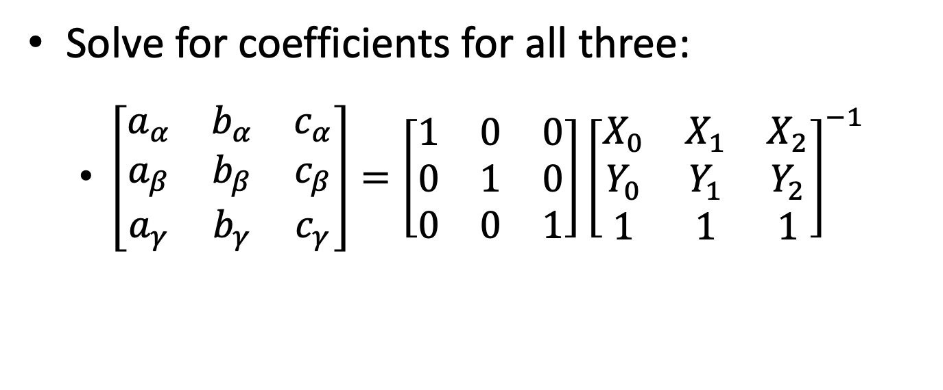
Computing Barycentrics (3)
Solve for coefficients for all three:
  $\left[\begin{matrix}a_{α} & b_{α} & c_{α} \\ a_{β} & b_{β} & c_{β} \\ a_{γ} & b_{γ} & c_{γ}\end{matrix}\right]=\left[\begin{matrix}1 & 0 & 0 \\ 0 & 1 & 0 \\ 0 & 0 & 1\end{matrix}\right]{\left[\begin{matrix}X_{0} & X_{1} & X_{2} \\ Y_{0} & Y_{1} & Y_{2} \\ 1 & 1 & 1\end{matrix}\right]}^{−1}$

Slide 14
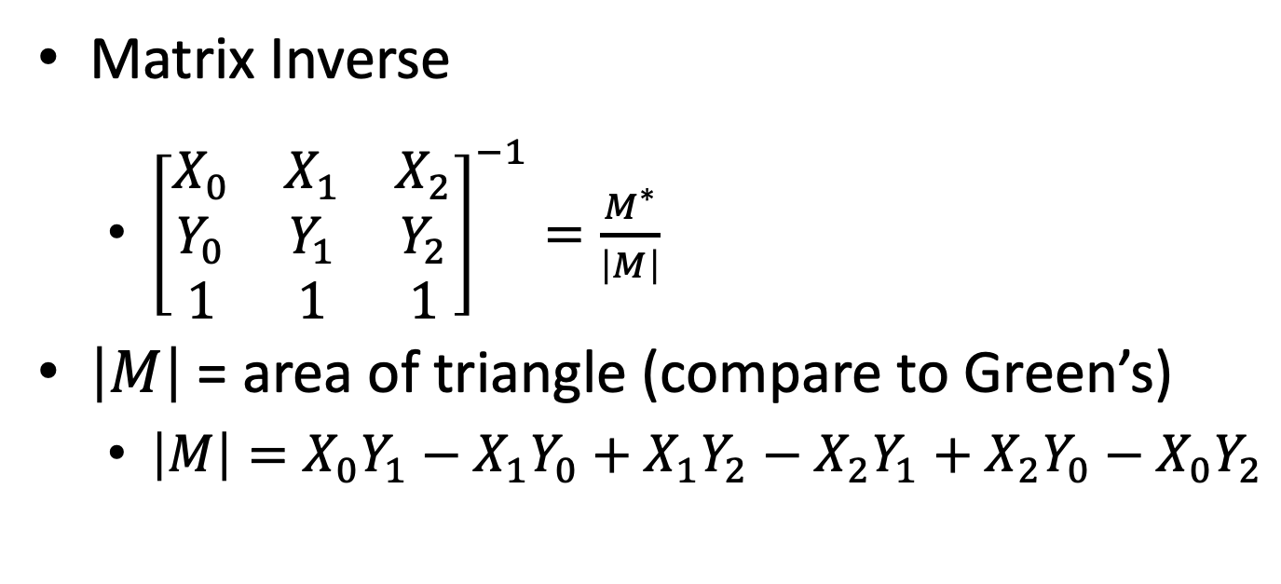
Computing Barycentrics (3)
Matrix Inverse
  ${\left[\begin{matrix}X_{0} & X_{1} & X_{2} \\ Y_{0} & Y_{1} & Y_{2} \\ 1 & 1 & 1\end{matrix}\right]}^{−1}=\frac{M^{∗}}{\left|M\right|}$
$\left|M\right|$ = area of triangle (compare to Green’s)
  $\left|M\right|=X_{0}Y_{1}−X_{1}Y_{0}+X_{1}Y_{2}−X_{2}Y_{1}+X_{2}Y_{0}−X_{0}Y_{2}$

Slide 15
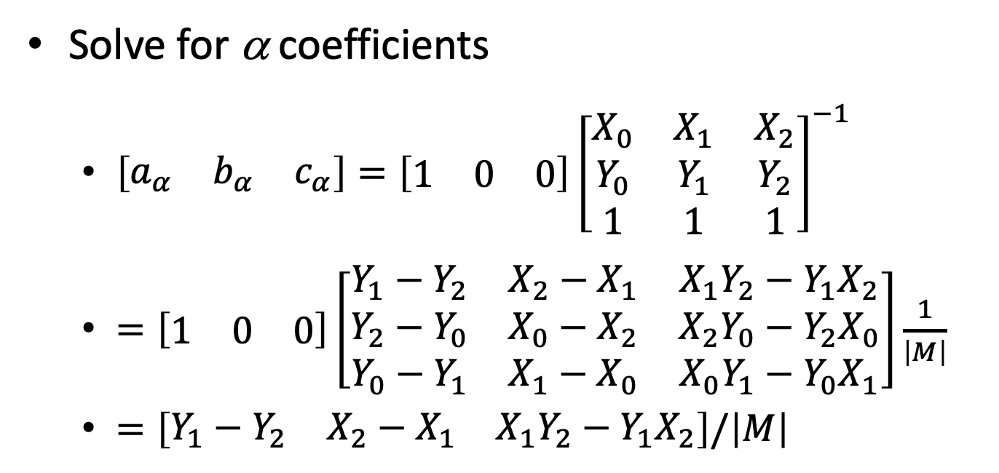
Computing Barycentrics (3)
Solve for α coefficients
  $\left[\begin{matrix}a_{α} & b_{α} & c_{α}\end{matrix}\right]=\left[\begin{matrix}1 & 0 & 0\end{matrix}\right]{\left[\begin{matrix}X_{0} & X_{1} & X_{2} \\ Y_{0} & Y_{1} & Y_{2} \\ 1 & 1 & 1\end{matrix}\right]}^{−1}$
  $=\left[\begin{matrix}1 & 0 & 0\end{matrix}\right]\left[\begin{matrix}Y_{1}−Y_{2} & X_{2}−X_{1} & X_{1}Y_{2}−Y_{1}X_{2} \\ Y_{2}−Y_{0} & X_{0}−X_{2} & X_{2}Y_{0}−Y_{2}X_{0} \\ Y_{0}−Y_{1} & X_{1}−X_{0} & X_{0}Y_{1}−Y_{0}X_{1}\end{matrix}\right]\frac{1}{\left|M\right|}$
  $=\left[\begin{matrix}Y_{1}−Y_{2} & X_{2}−X_{1} & X_{1}Y_{2}−Y_{1}X_{2}\end{matrix}\right]/\left|M\right|$

Slide 16
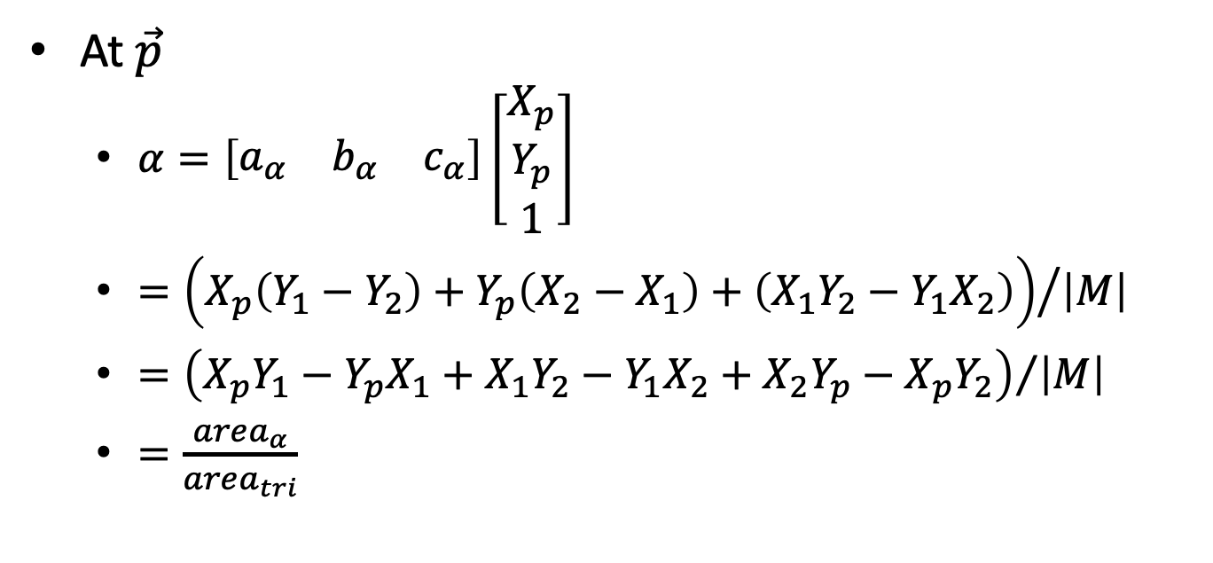
Computing Barycentrics (3)
At $\vec{p}$
  $α=\left[\begin{matrix}a_{α} & b_{α} & c_{α}\end{matrix}\right]\left[\begin{matrix}X_{p} \\ \begin{aligned}Y_{p} \\ 1\end{aligned}\end{matrix}\right]$
  $={\left(X_{p}\left(Y_{1}−Y_{2}\right)+Y_{p}\left(X_{2}−X_{1}\right)+\left(X_{1}Y_{2}−Y_{1}X_{2}\right)\right)}/{\left|M\right|}$
  $={\left(X_{p}Y_{1}−Y_{p}X_{1}+X_{1}Y_{2}−Y_{1}X_{2}+X_{2}Y_{p}−X_{p}Y_{2}\right)}/{\left|M\right|}$
  $=\frac{area_{α}}{area_{tri}}$

Slide 17
Computing Barycentrics
Bottom Line:
  Lots of ways to compute them
  All algebraically equivalent
Use the one that you find easiest

