Slide 1
Animation
CMSC 435/634

Slide 2
Keyframe Animation
From hand drawn animation
Lead animator draws poses at key frames
Inbetweener draws frames between keys
Computer animation
Can have separate keys for different attributes
Position (or even x, y, and z separately)
Rotation (or individual rotation angles)
...
Interpolate between values at key frames

Slide 3
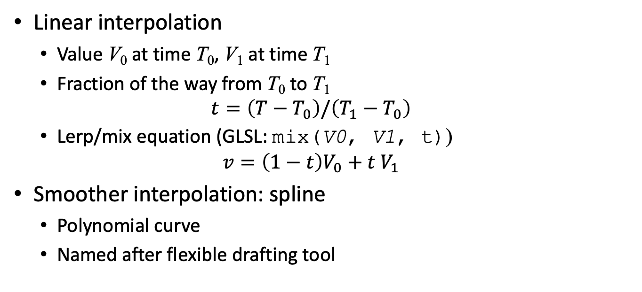
How to Interpolate
Linear interpolation
Value V₀ at time T₀, V₁ at time T₁
Fraction of the way from T₀ to T₁
$$t=\left(T−T_{0}\right)/\left(T_{1}−T_{0}\right)$$
Lerp/mix equation (GLSL: mix(V0, V1, t))
$$v=\left(1−t\right)V_{0}+t V_{1}$$
Smoother interpolation: spline
Polynomial curve
Named after flexible drafting tool

Slide 4
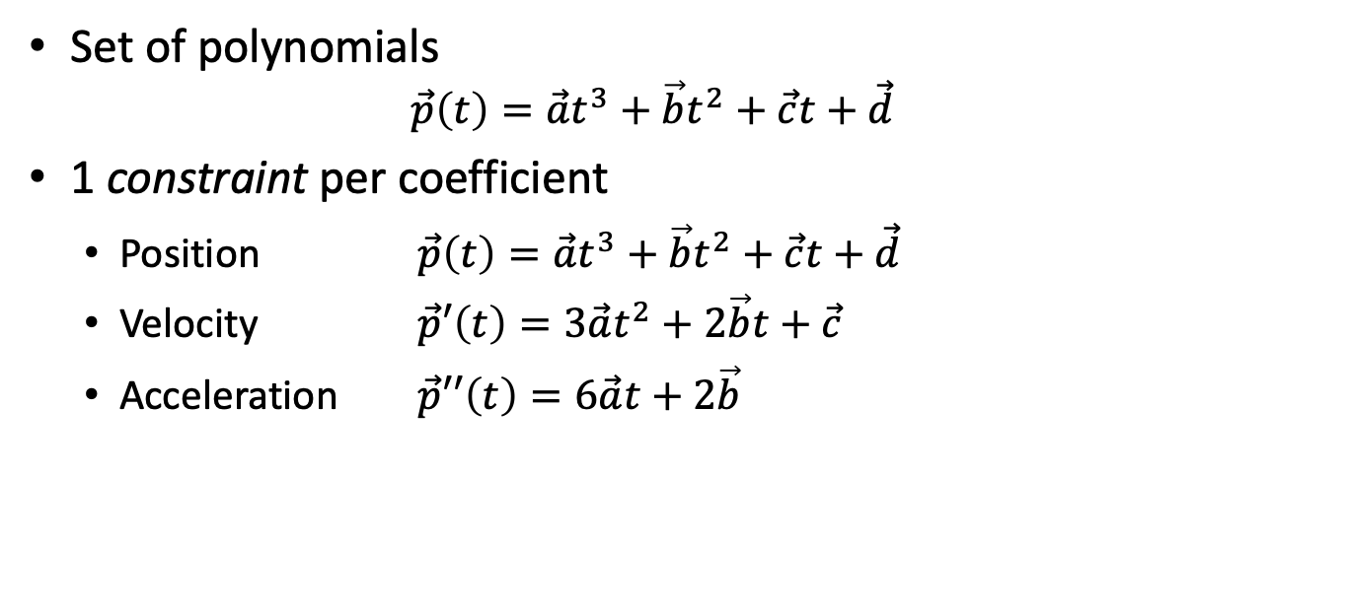
Spline
Set of polynomials
$$\vec{p}\left(t\right)=\vec{a}t^{3}+\vec{b}t^{2}+\vec{c}t+\vec{d}$$
1 constraint per coefficient
Position $\vec{p}\left(t\right)=\vec{a}t^{3}+\vec{b}t^{2}+\vec{c}t+\vec{d}$
Velocity $\vec{p}′\left(t\right)=3\vec{a}t^{2}+2\vec{b}t+\vec{c}$
Acceleration $\vec{p}′′\left(t\right)=6\vec{a}t+2\vec{b}$

Slide 5

Bezier Spline
All constraints from control points:
$\vec{p}\left(0\right)={\vec{p}}_{0}$; $\vec{p}\left(1\right)={\vec{p}}_{3}$
$\vec{p}′\left(0\right)=3\left({\vec{p}}_{1}−{\vec{p}}_{0}\right)$ $\vec{p}′\left(1\right)=3\left({\vec{p}}_{3}−{\vec{p}}_{2}\right)$

Slide 6
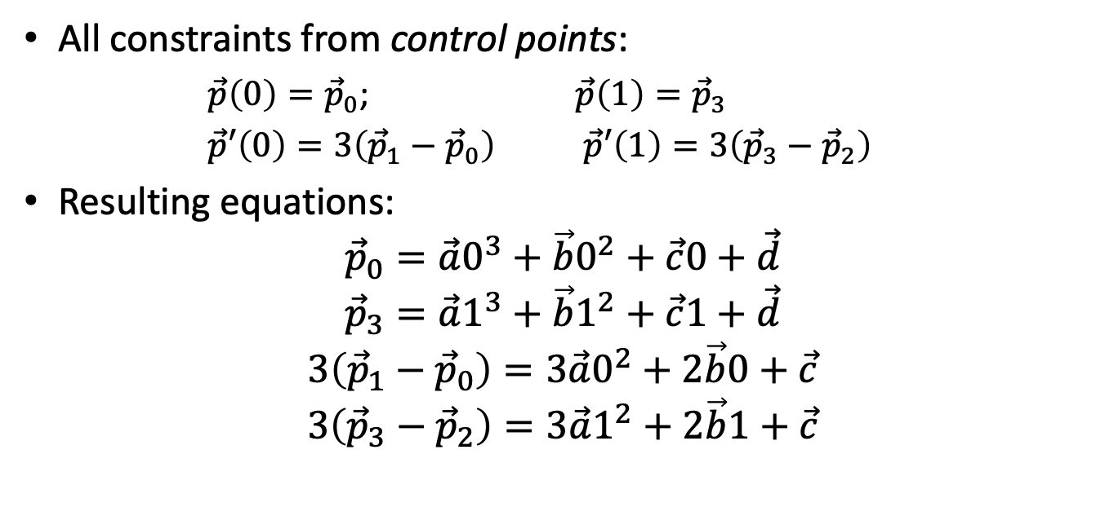
Bezier Spline
All constraints from control points:
$\vec{p}\left(0\right)={\vec{p}}_{0}$; $\vec{p}\left(1\right)={\vec{p}}_{3}$
$\vec{p}′\left(0\right)=3\left({\vec{p}}_{1}−{\vec{p}}_{0}\right)$ $\vec{p}′\left(1\right)=3\left({\vec{p}}_{3}−{\vec{p}}_{2}\right)$
Resulting equations:
$${\vec{p}}_{0}=\vec{a}0^{3}+\vec{b}0^{2}+\vec{c}0+\vec{d}$$
$${\vec{p}}_{3}=\vec{a}1^{3}+\vec{b}1^{2}+\vec{c}1+\vec{d}$$
$$3\left({\vec{p}}_{1}−{\vec{p}}_{0}\right)=3\vec{a}0^{2}+2\vec{b}0+\vec{c}$$
$$3\left({\vec{p}}_{3}−{\vec{p}}_{2}\right)=3\vec{a}1^{2}+2\vec{b}1+\vec{c}$$

Slide 7
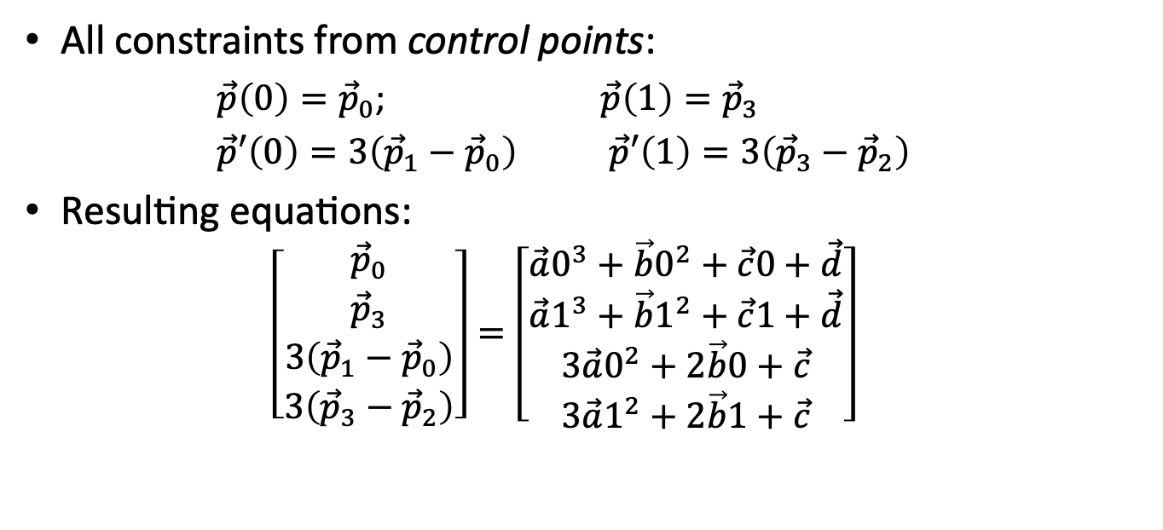
Bezier Spline
All constraints from control points:
$\vec{p}\left(0\right)={\vec{p}}_{0}$; $\vec{p}\left(1\right)={\vec{p}}_{3}$
$\vec{p}′\left(0\right)=3\left({\vec{p}}_{1}−{\vec{p}}_{0}\right)$ $\vec{p}′\left(1\right)=3\left({\vec{p}}_{3}−{\vec{p}}_{2}\right)$
Resulting equations:
$$\left[\begin{matrix}{\vec{p}}_{0} \\ {\vec{p}}_{3} \\ 3\left({\vec{p}}_{1}−{\vec{p}}_{0}\right) \\ 3\left({\vec{p}}_{3}−{\vec{p}}_{2}\right)\end{matrix}\right]=\left[\begin{matrix}\vec{a}0^{3}+\vec{b}0^{2}+\vec{c}0+\vec{d} \\ \vec{a}1^{3}+\vec{b}1^{2}+\vec{c}1+\vec{d} \\ 3\vec{a}0^{2}+2\vec{b}0+\vec{c} \\ 3\vec{a}1^{2}+2\vec{b}1+\vec{c}\end{matrix}\right]$$

Slide 8
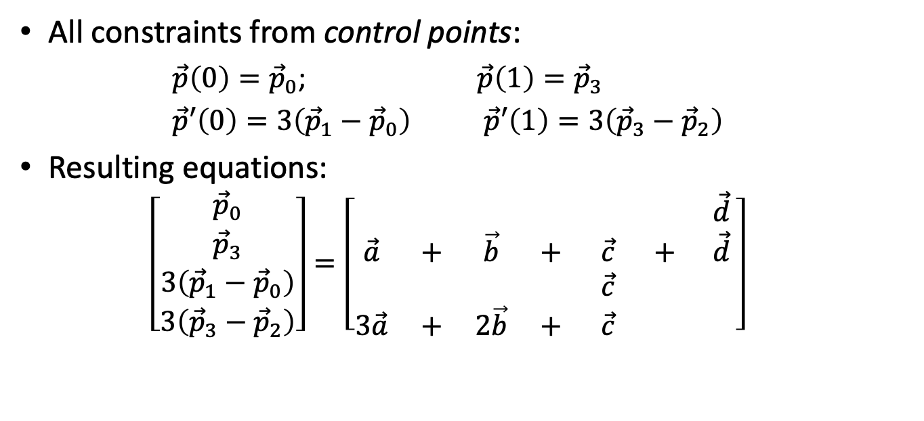
Bezier Spline
All constraints from control points:
$\vec{p}\left(0\right)={\vec{p}}_{0}$; $\vec{p}\left(1\right)={\vec{p}}_{3}$
$\vec{p}′\left(0\right)=3\left({\vec{p}}_{1}−{\vec{p}}_{0}\right)$ $\vec{p}′\left(1\right)=3\left({\vec{p}}_{3}−{\vec{p}}_{2}\right)$
Resulting equations:
$$\left[\begin{matrix}{\vec{p}}_{0} \\ {\vec{p}}_{3} \\ 3\left({\vec{p}}_{1}−{\vec{p}}_{0}\right) \\ 3\left({\vec{p}}_{3}−{\vec{p}}_{2}\right)\end{matrix}\right]=\left[\begin{matrix} & & & & & & \vec{d} \\ \vec{a} & + & \vec{b} & + & \vec{c} & + & \vec{d} \\ & & & & \vec{c} & & \\ 3\vec{a} & + & 2\vec{b} & + & \vec{c} & & \end{matrix}\right]$$

Slide 9
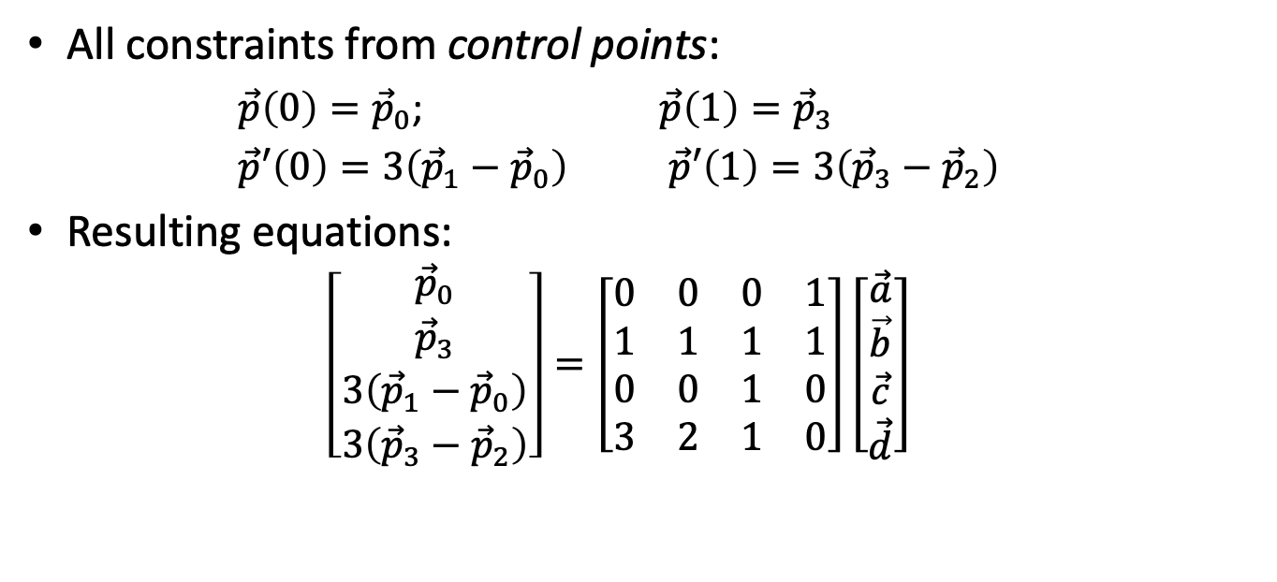
Bezier Spline
All constraints from control points:
$\vec{p}\left(0\right)={\vec{p}}_{0}$; $\vec{p}\left(1\right)={\vec{p}}_{3}$
$\vec{p}′\left(0\right)=3\left({\vec{p}}_{1}−{\vec{p}}_{0}\right)$ $\vec{p}′\left(1\right)=3\left({\vec{p}}_{3}−{\vec{p}}_{2}\right)$
Resulting equations:
$$\left[\begin{matrix}{\vec{p}}_{0} \\ {\vec{p}}_{3} \\ 3\left({\vec{p}}_{1}−{\vec{p}}_{0}\right) \\ 3\left({\vec{p}}_{3}−{\vec{p}}_{2}\right)\end{matrix}\right]=\left[\begin{matrix}0 & 0 & 0 & 1 \\ 1 & 1 & 1 & 1 \\ 0 & 0 & 1 & 0 \\ 3 & 2 & 1 & 0\end{matrix}\right]\left[\begin{matrix}\vec{a} \\ \vec{b} \\ \vec{c} \\ \vec{d}\end{matrix}\right]$$

Slide 10
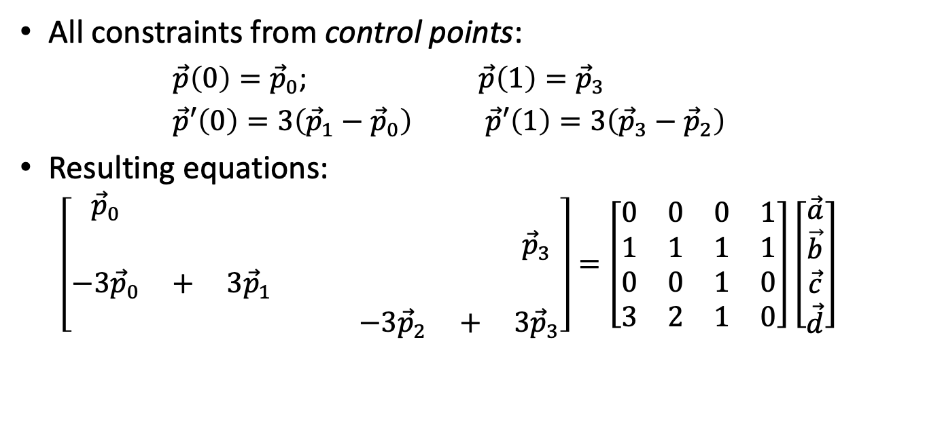
Bezier Spline
All constraints from control points:
$\vec{p}\left(0\right)={\vec{p}}_{0}$; $\vec{p}\left(1\right)={\vec{p}}_{3}$
$\vec{p}′\left(0\right)=3\left({\vec{p}}_{1}−{\vec{p}}_{0}\right)$ $\vec{p}′\left(1\right)=3\left({\vec{p}}_{3}−{\vec{p}}_{2}\right)$
Resulting equations:
$$\left[\begin{matrix}{\vec{p}}_{0} & & & & & & \\ & & & & & & {\vec{p}}_{3} \\ −{3\vec{p}}_{0} & + & 3{\vec{p}}_{1} & & & & \\ & & & & −{3\vec{p}}_{2} & + & 3{\vec{p}}_{3}\end{matrix}\right]=\left[\begin{matrix}0 & 0 & 0 & 1 \\ 1 & 1 & 1 & 1 \\ 0 & 0 & 1 & 0 \\ 3 & 2 & 1 & 0\end{matrix}\right]\left[\begin{matrix}\vec{a} \\ \vec{b} \\ \vec{c} \\ \vec{d}\end{matrix}\right]$$

Slide 11
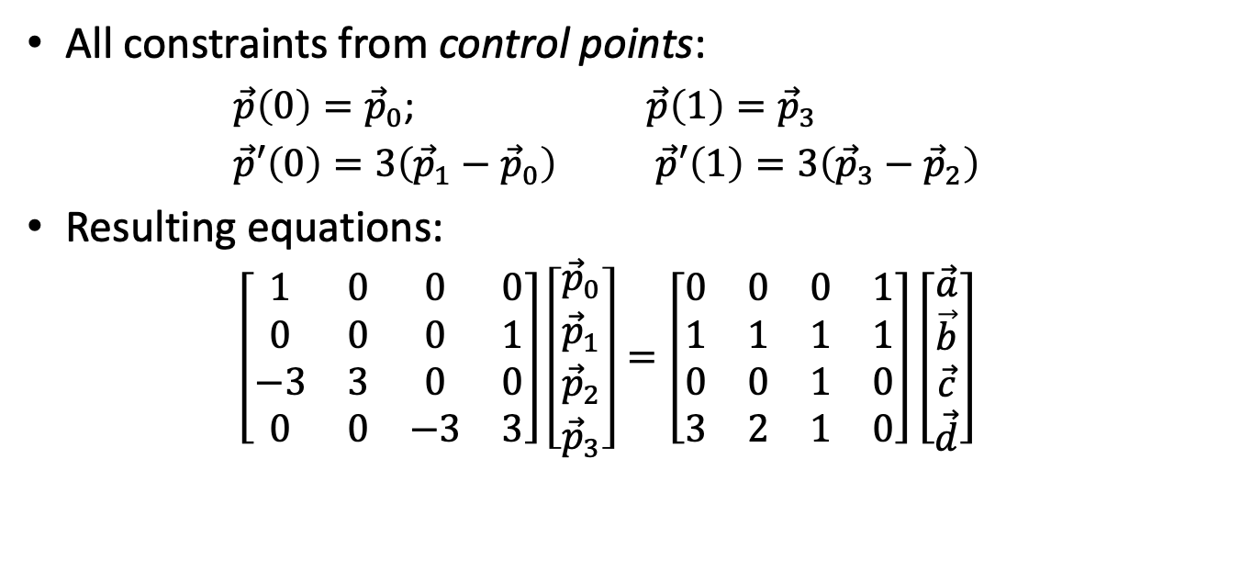
Bezier Spline
All constraints from control points:
$\vec{p}\left(0\right)={\vec{p}}_{0}$; $\vec{p}\left(1\right)={\vec{p}}_{3}$
$\vec{p}′\left(0\right)=3\left({\vec{p}}_{1}−{\vec{p}}_{0}\right)$ $\vec{p}′\left(1\right)=3\left({\vec{p}}_{3}−{\vec{p}}_{2}\right)$
Resulting equations:
$$\left[\begin{matrix}1 & 0 & 0 & 0 \\ 0 & 0 & 0 & 1 \\ −3 & 3 & 0 & 0 \\ 0 & 0 & −3 & 3\end{matrix}\right]\left[\begin{matrix}{\vec{p}}_{0} \\ {\vec{p}}_{1} \\ {\vec{p}}_{2} \\ {\vec{p}}_{3}\end{matrix}\right]=\left[\begin{matrix}0 & 0 & 0 & 1 \\ 1 & 1 & 1 & 1 \\ 0 & 0 & 1 & 0 \\ 3 & 2 & 1 & 0\end{matrix}\right]\left[\begin{matrix}\vec{a} \\ \vec{b} \\ \vec{c} \\ \vec{d}\end{matrix}\right]$$

Slide 12
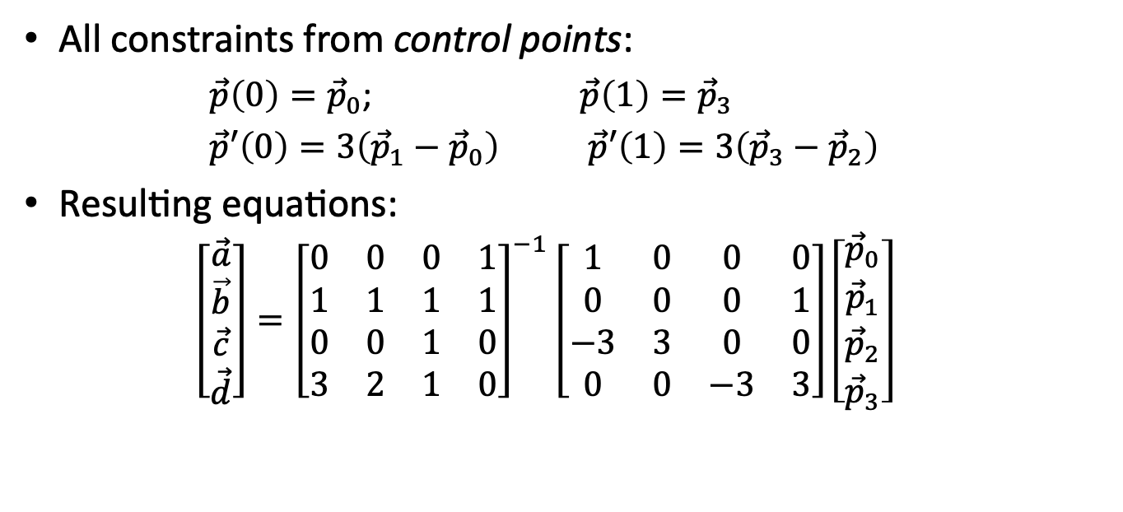
Bezier Spline
All constraints from control points:
$\vec{p}\left(0\right)={\vec{p}}_{0}$; $\vec{p}\left(1\right)={\vec{p}}_{3}$
$\vec{p}′\left(0\right)=3\left({\vec{p}}_{1}−{\vec{p}}_{0}\right)$ $\vec{p}′\left(1\right)=3\left({\vec{p}}_{3}−{\vec{p}}_{2}\right)$
Resulting equations:
$$\left[\begin{matrix}\vec{a} \\ \vec{b} \\ \vec{c} \\ \vec{d}\end{matrix}\right]={\left[\begin{matrix}0 & 0 & 0 & 1 \\ 1 & 1 & 1 & 1 \\ 0 & 0 & 1 & 0 \\ 3 & 2 & 1 & 0\end{matrix}\right]}^{−1}\left[\begin{matrix}1 & 0 & 0 & 0 \\ 0 & 0 & 0 & 1 \\ −3 & 3 & 0 & 0 \\ 0 & 0 & −3 & 3\end{matrix}\right]\left[\begin{matrix}{\vec{p}}_{0} \\ {\vec{p}}_{1} \\ {\vec{p}}_{2} \\ {\vec{p}}_{3}\end{matrix}\right]$$

Slide 13
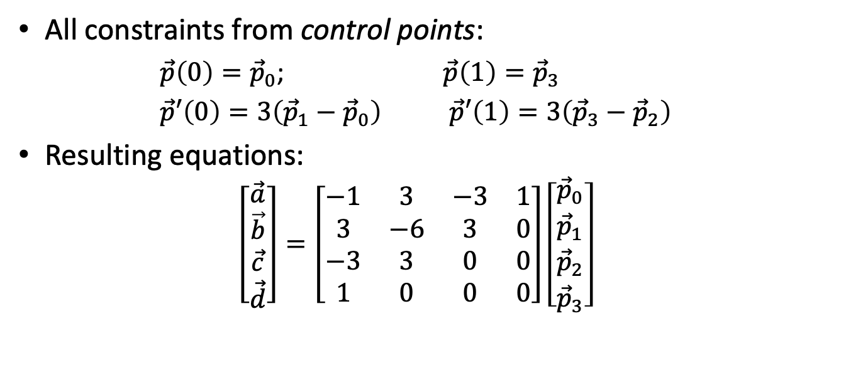
Bezier Spline
All constraints from control points:
$\vec{p}\left(0\right)={\vec{p}}_{0}$; $\vec{p}\left(1\right)={\vec{p}}_{3}$
$\vec{p}′\left(0\right)=3\left({\vec{p}}_{1}−{\vec{p}}_{0}\right)$ $\vec{p}′\left(1\right)=3\left({\vec{p}}_{3}−{\vec{p}}_{2}\right)$
Resulting equations:
$$\left[\begin{matrix}\vec{a} \\ \vec{b} \\ \vec{c} \\ \vec{d}\end{matrix}\right]=\left[\begin{matrix}−1 & 3 & −3 & 1 \\ 3 & −6 & 3 & 0 \\ −3 & 3 & 0 & 0 \\ 1 & 0 & 0 & 0\end{matrix}\right]\left[\begin{matrix}{\vec{p}}_{0} \\ {\vec{p}}_{1} \\ {\vec{p}}_{2} \\ {\vec{p}}_{3}\end{matrix}\right]$$

Slide 14

Bezier Basis Functions
Computing position
$$\vec{p}\left(t\right)=\left[\begin{matrix}t^{3} & t^{2} & t & 1\end{matrix}\right]\left[\begin{matrix}\vec{a} \\ \vec{b} \\ \vec{c} \\ \vec{d}\end{matrix}\right]$$

Slide 15

Bezier Basis Functions
Computing position
$$\vec{p}\left(t\right)=\left[\begin{matrix}t^{3} & t^{2} & t & 1\end{matrix}\right]\left[\begin{matrix}−1 & 3 & −3 & 1 \\ 3 & −6 & 3 & 0 \\ −3 & 3 & 0 & 0 \\ 1 & 0 & 0 & 0\end{matrix}\right]\left[\begin{matrix}{\vec{p}}_{0} \\ {\vec{p}}_{1} \\ {\vec{p}}_{2} \\ {\vec{p}}_{3}\end{matrix}\right]$$

Slide 16
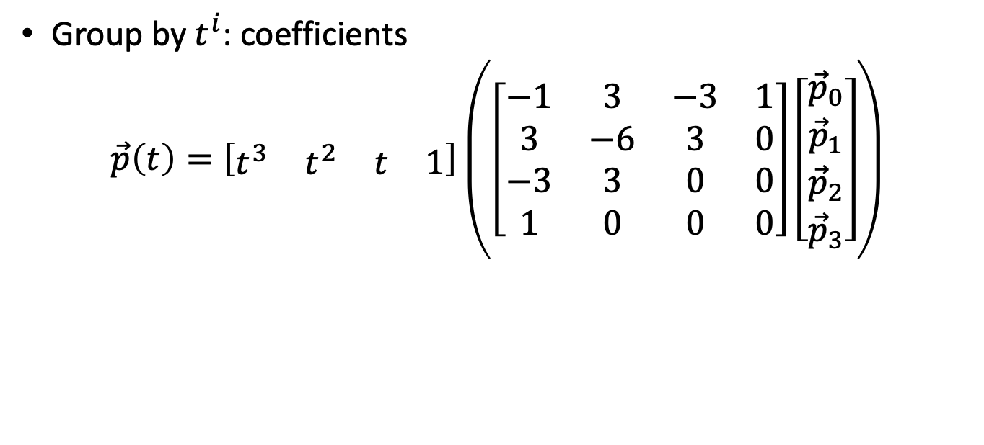
Bezier Basis Functions
Group by $t^{i}$: coefficients
$$\vec{p}\left(t\right)=\left[\begin{matrix}t^{3} & t^{2} & t & 1\end{matrix}\right]\left(\left[\begin{matrix}−1 & 3 & −3 & 1 \\ 3 & −6 & 3 & 0 \\ −3 & 3 & 0 & 0 \\ 1 & 0 & 0 & 0\end{matrix}\right]\left[\begin{matrix}{\vec{p}}_{0} \\ {\vec{p}}_{1} \\ {\vec{p}}_{2} \\ {\vec{p}}_{3}\end{matrix}\right]\right)$$

Slide 17
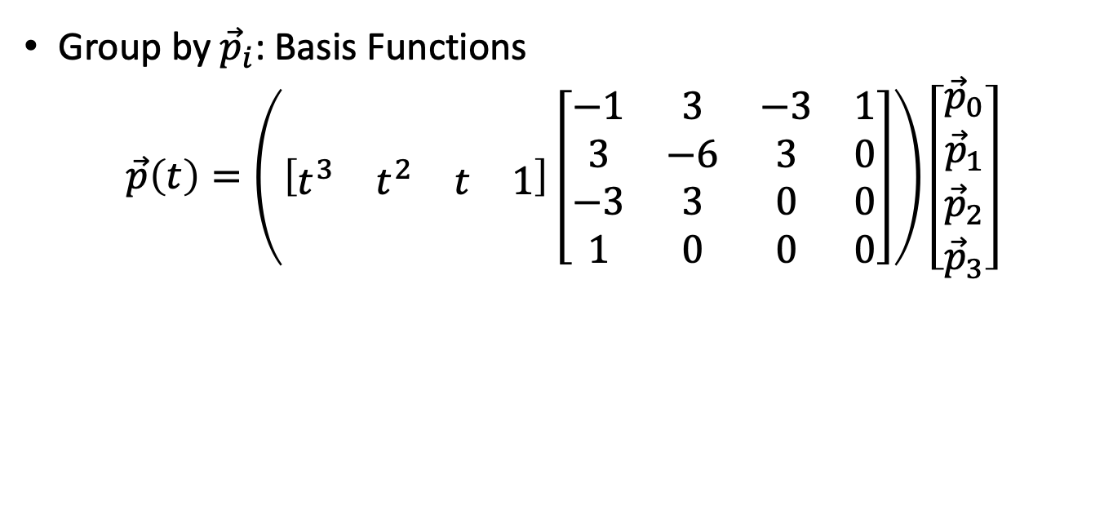
Bezier Basis Functions
Group by ${\vec{p}}_{i}$: Basis Functions
$$\vec{p}\left(t\right)=\left(\left[\begin{matrix}t^{3} & t^{2} & t & 1\end{matrix}\right]\left[\begin{matrix}−1 & 3 & −3 & 1 \\ 3 & −6 & 3 & 0 \\ −3 & 3 & 0 & 0 \\ 1 & 0 & 0 & 0\end{matrix}\right]\right)\left[\begin{matrix}{\vec{p}}_{0} \\ {\vec{p}}_{1} \\ {\vec{p}}_{2} \\ {\vec{p}}_{3}\end{matrix}\right]$$

Slide 18
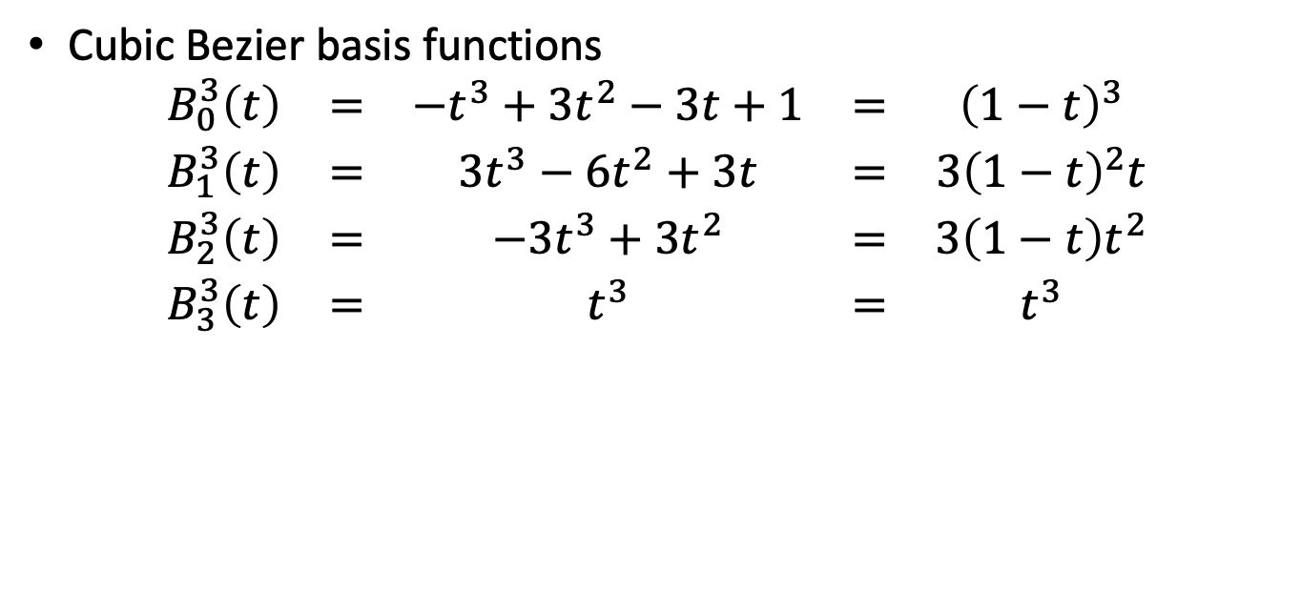
Bezier Basis Functions
Cubic Bezier basis functions
$$\begin{matrix}B_{0}^{3}\left(t\right) & = & −t^{3}+3t^{2}−3t+1 & = & {\left(1−t\right)}^{3} \\ B_{1}^{3}\left(t\right) & = & 3t^{3}−6t^{2}+3t & = & 3{\left(1−t\right)}^{2}t \\ B_{2}^{3}\left(t\right) & = & −3t^{3}+3t^{2} & = & 3\left(1−t\right)t^{2} \\ B_{3}^{3}\left(t\right) & = & t^{3} & = & t^{3}\end{matrix}$$

Slide 19

Catmull-Rom Spline
Constraints
$\vec{p}\left(0\right)={\vec{p}}_{1}$; $\vec{p}\left(1\right)={\vec{p}}_{2}$
$\vec{p}′\left(0\right)=\left({\vec{p}}_{2}−{\vec{p}}_{0}\right)/2$ $\vec{p}′\left(1\right)=\left({\vec{p}}_{3}−{\vec{p}}_{1}\right)/2$

Slide 20
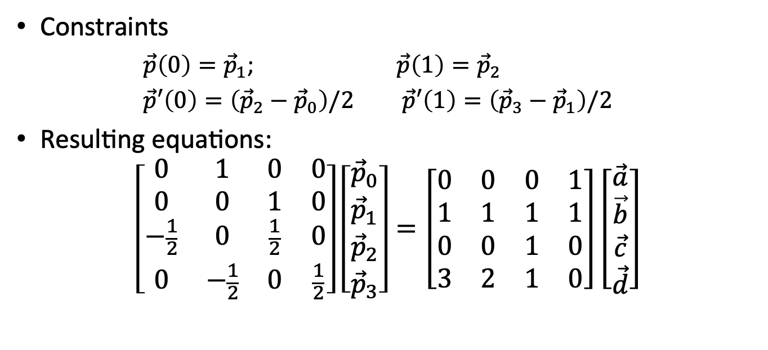
Catmull-Rom Spline
Constraints
$\vec{p}\left(0\right)={\vec{p}}_{1}$; $\vec{p}\left(1\right)={\vec{p}}_{2}$
$\vec{p}′\left(0\right)=\left({\vec{p}}_{2}−{\vec{p}}_{0}\right)/2$ $\vec{p}′\left(1\right)=\left({\vec{p}}_{3}−{\vec{p}}_{1}\right)/2$
Resulting equations:
$$\left[\begin{matrix}0 & 1 & 0 & 0 \\ 0 & 0 & 1 & 0 \\ −\frac{1}{2} & 0 & \frac{1}{2} & 0 \\ 0 & −\frac{1}{2} & 0 & \frac{1}{2}\end{matrix}\right]\left[\begin{matrix}{\vec{p}}_{0} \\ {\vec{p}}_{1} \\ {\vec{p}}_{2} \\ {\vec{p}}_{3}\end{matrix}\right]=\left[\begin{matrix}0 & 0 & 0 & 1 \\ 1 & 1 & 1 & 1 \\ 0 & 0 & 1 & 0 \\ 3 & 2 & 1 & 0\end{matrix}\right]\left[\begin{matrix}\vec{a} \\ \vec{b} \\ \vec{c} \\ \vec{d}\end{matrix}\right]$$

Slide 21
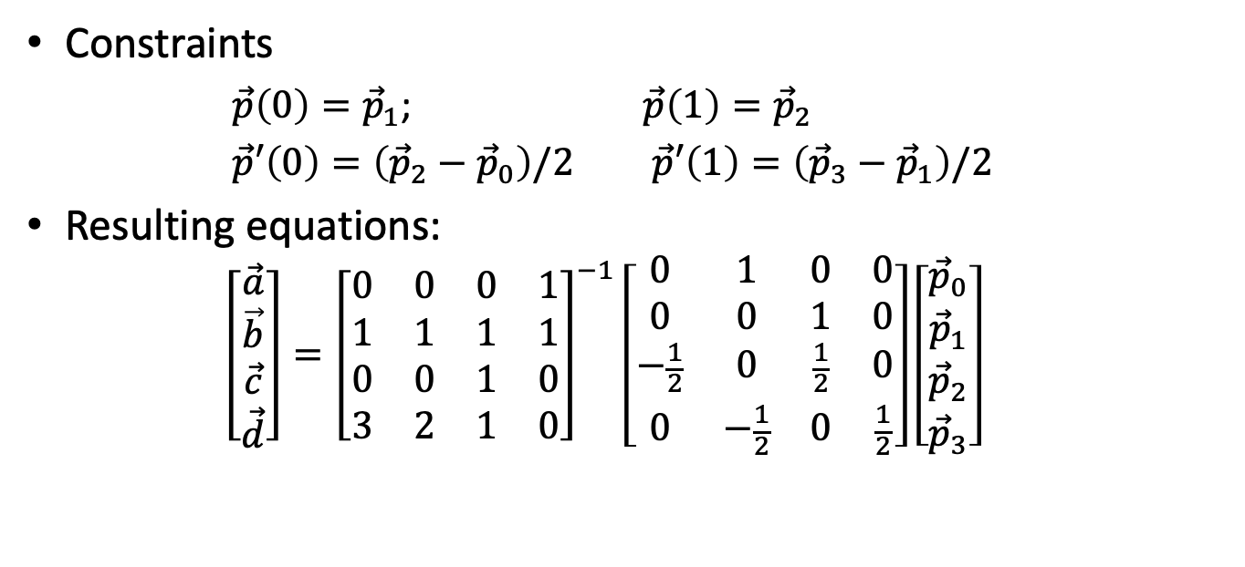
Catmull-Rom Spline
Constraints
$\vec{p}\left(0\right)={\vec{p}}_{1}$; $\vec{p}\left(1\right)={\vec{p}}_{2}$
$\vec{p}′\left(0\right)=\left({\vec{p}}_{2}−{\vec{p}}_{0}\right)/2$ $\vec{p}′\left(1\right)=\left({\vec{p}}_{3}−{\vec{p}}_{1}\right)/2$
Resulting equations:
$$\left[\begin{matrix}\vec{a} \\ \vec{b} \\ \vec{c} \\ \vec{d}\end{matrix}\right]={\left[\begin{matrix}0 & 0 & 0 & 1 \\ 1 & 1 & 1 & 1 \\ 0 & 0 & 1 & 0 \\ 3 & 2 & 1 & 0\end{matrix}\right]}^{−1}\left[\begin{matrix}0 & 1 & 0 & 0 \\ 0 & 0 & 1 & 0 \\ −\frac{1}{2} & 0 & \frac{1}{2} & 0 \\ 0 & −\frac{1}{2} & 0 & \frac{1}{2}\end{matrix}\right]\left[\begin{matrix}{\vec{p}}_{0} \\ {\vec{p}}_{1} \\ {\vec{p}}_{2} \\ {\vec{p}}_{3}\end{matrix}\right]$$

Slide 22
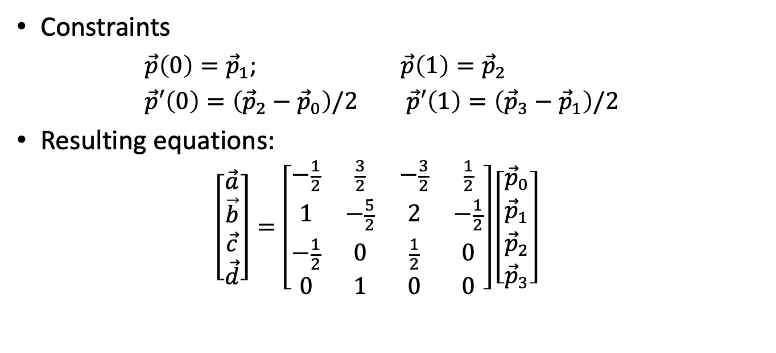
Catmull-Rom Spline
Constraints
$\vec{p}\left(0\right)={\vec{p}}_{1}$; $\vec{p}\left(1\right)={\vec{p}}_{2}$
$\vec{p}′\left(0\right)=\left({\vec{p}}_{2}−{\vec{p}}_{0}\right)/2$ $\vec{p}′\left(1\right)=\left({\vec{p}}_{3}−{\vec{p}}_{1}\right)/2$
Resulting equations:
$$\left[\begin{matrix}\vec{a} \\ \vec{b} \\ \vec{c} \\ \vec{d}\end{matrix}\right]=\left[\begin{matrix}−\frac{1}{2} & \frac{3}{2} & −\frac{3}{2} & \frac{1}{2} \\ 1 & −\frac{5}{2} & 2 & −\frac{1}{2} \\ −\frac{1}{2} & 0 & \frac{1}{2} & 0 \\ 0 & 1 & 0 & 0\end{matrix}\right]\left[\begin{matrix}{\vec{p}}_{0} \\ {\vec{p}}_{1} \\ {\vec{p}}_{2} \\ {\vec{p}}_{3}\end{matrix}\right]$$

Slide 23

Catmull-Rom Basis Functions
$$\begin{matrix}B_{0}\left(t\right) & = & −t^{3}/2+t^{2}−t/2 \\ B_{1}\left(t\right) & = & 3t^{3}/2−5t^{2}/2+1 \\ B_{2}\left(t\right) & = & −3t^{3}/2+2t^{2}+t/2 \\ B_{3}\left(t\right) & = & t^{3}/2−t^{2}/2\end{matrix}$$

Slide 24
Slow In and Out
The spacing of the in between frames to achieve subtlety of timing and movement
Example:
Moving from place to place: start and end slow

Slide 25
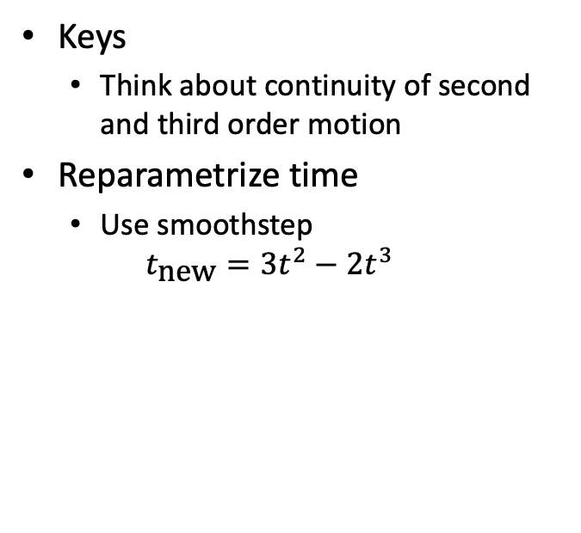
Slow In and Out
Keys
Think about continuity of second and third order motion
Reparametrize time
Use smoothstep
$$t_{\text{new}}=3t^{2}−2t^{3}$$

Slide 26
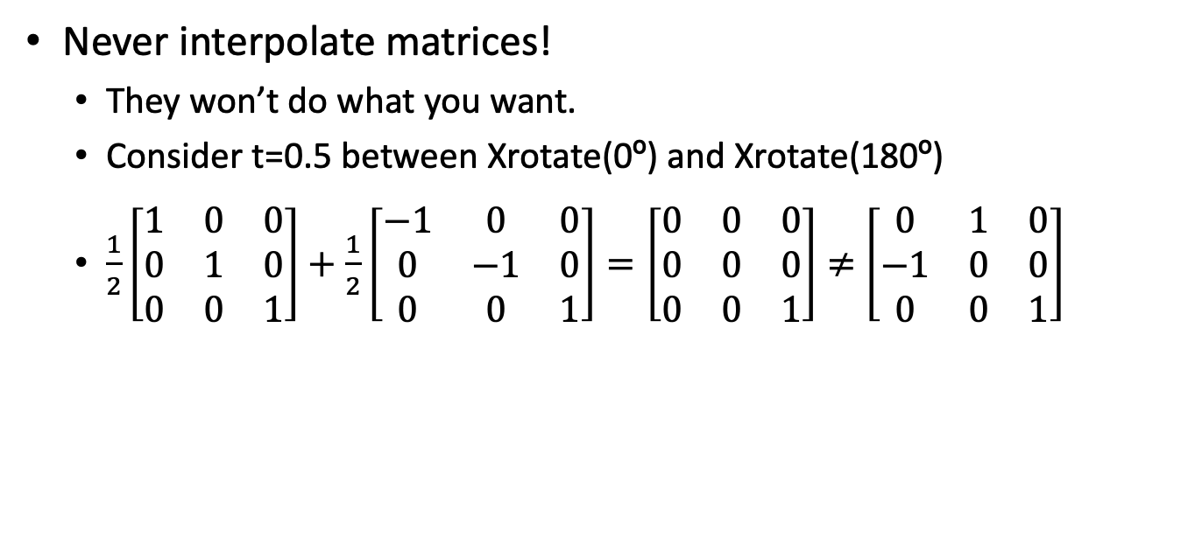
Interpolating Orientation
Never interpolate matrices!
They won’t do what you want.
Consider t=0.5 between Xrotate(0º) and Xrotate(180º)
$\frac{1}{2}\left[\begin{matrix}1 & 0 & 0 \\ 0 & 1 & 0 \\ 0 & 0 & 1\end{matrix}\right]+\frac{1}{2}\left[\begin{matrix}−1 & 0 & 0 \\ 0 & −1 & 0 \\ 0 & 0 & 1\end{matrix}\right]=\left[\begin{matrix}0 & 0 & 0 \\ 0 & 0 & 0 \\ 0 & 0 & 1\end{matrix}\right]≠$ $\left[\begin{matrix}0 & 1 & 0 \\ −1 & 0 & 0 \\ 0 & 0 & 1\end{matrix}\right]$

Slide 27
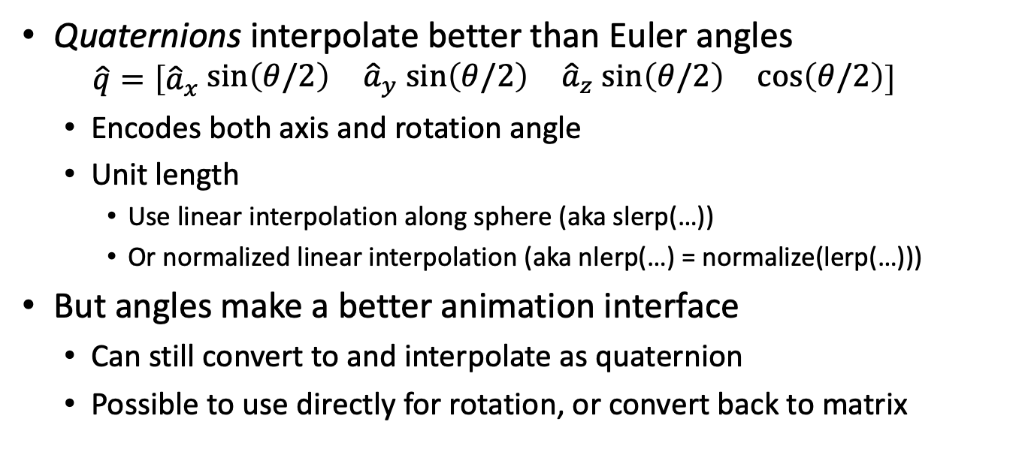
Quaternions
Quaternions interpolate better than Euler angles
$$\hat{q}=\left[{\hat{a}}_{x}\begin{matrix}\sin\left(θ/2\right) & {\hat{a}}_{y} sin\left(θ/2\right) & {\hat{a}}_{z} sin\left(θ/2\right) & \cos\left(θ/2\right)\end{matrix}\right]$$
Encodes both axis and rotation angle
Unit length
Use linear interpolation along sphere (aka slerp(…))
Or normalized linear interpolation (aka nlerp(…) = normalize(lerp(…)))
But angles make a better animation interface
Can still convert to and interpolate as quaternion
Possible to use directly for rotation, or convert back to matrix

Slide 28
Character Animation
Control
Hierarchical model
Forward kinematics
Inverse kinematics
Motion capture
Rendering
Skinning
Blend Shapes
Deformation

Slide 29
Forward Kinematics
Given a set of joint angles, where’s the hand?
(or foot or head or …)
End effector
Just apply nested transforms
We know how to do that!

Slide 30
Inverse Kinematics
Find angles to match end effector position
Few joints: system of equations
Many joints: optimization
Often with constraints
(wrist doesn't bend that way)
And heuristics
Minimal change from prior frame
Load support
Physical data

Slide 31
Motion Capture (mocap)
Track markers on actor
Infer transforms
Often significant artistic cleanup

Slide 32
Skinning
Don’t just jam a rigid arm into a rigid shoulder
Animate skeleton
Just joint rotations and translations for bone length, no geometry
Each vertex in skin
Linear average of one or more joint transforms
E.g. α Shoulder + β Arm
Can retarget same animation to different skins

Slide 33
Blend Shapes
Also called morph targets
Sculpted positions of all vertices in key poses
Vertex counts and connections are the same for all poses
Blend vertex positions between poses
Good when skeletons don’t work well
Most often used for facial animation

Slide 34
Autonomous Objects/Groups
Generally: create complex group behavior by defining relatively simple individual behavior
Common applications:
Flocks, crowds
Particle systems (explosions, effects)
Approach: leverage AI techniques

Slide 35
Physics-based Animation
Generally: simulating the laws of physics to predict motion
Common applications:
Rigid body motion
Fluids, smoke, fog
Cloth, hair
Deformation and fracture

Slide 36
Rigid Body Animation
Locally, forward kinematics influenced by forces
Detect collisions between objects
Spatial data structures to avoid O(N²) object-object testing
Use bounding or proxy shapes instead of full polygonal models
E.g. cylinder or capsule for arm, then apply computed transform to real arm
Small time steps to avoid stability problems
And/or collisions between swept shapes

Slide 37
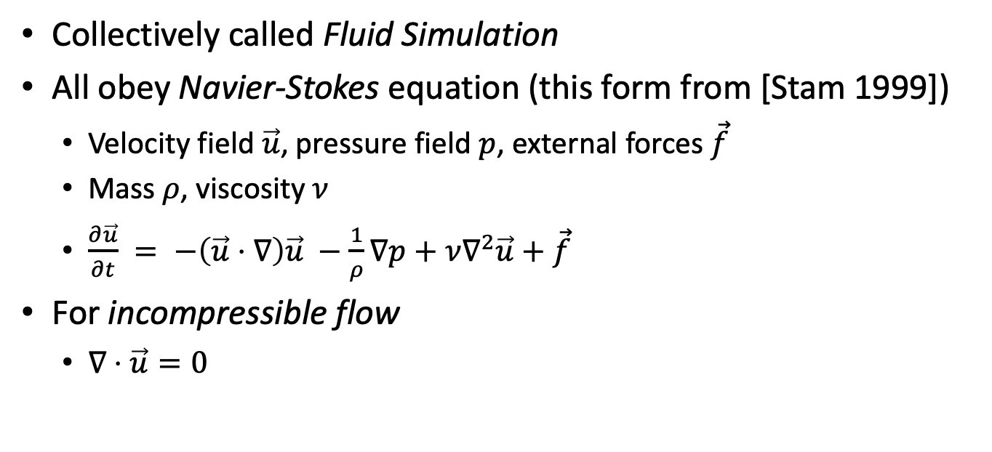
Fog, Smoke & Clouds
Collectively called Fluid Simulation
All obey Navier-Stokes equation (this form from [Stam 1999])
Velocity field $\vec{u}$, pressure field $p$, external forces $\vec{f}$
Mass $ρ$, viscosity $ν$
$\frac{∂\vec{u}}{∂t} = −\left(\vec{u}⋅∇\right)\vec{u} −\frac{1}{ρ}∇p+ν∇^{2}\vec{u}+\vec{f}$
For incompressible flow
$∇⋅\vec{u}=0$
Acceleration
Convection
External Forces
Diffusion
Pressure

Slide 38
Fluid Simulation
Finite Element Method (FEM – Eulerian simulation)
Partition space into grid
Track temperature, pressure, etc. of material in each cell
Move from cell to cell according to physics equations
Enforce physical constraints each step (e.g. divergence free)
Particle Dynamics (Lagrangian simulation)
Particles of fixed amount of material
Move according to physics equations

Slide 39
Cloth and Hair
Network of connected nodes
Connections often modeled as springs
Can express as linear equations between nodes
Collect large sparse matrix
Solve with numeric matrix techniques

Slide 40
Deformation & Fracture
Merging of rigid body and fluid techniques
Elastic deformation: returns to original shape
Plastic deformation: some shape change permanent
Fracture: strong enough forces break object
Often pre-compute post-fracture shapes
Then check strain on fracture boundary

