Slide 1
Graphics Hardware
CMSC 435/634

Slide 2
A Graphics Pipeline
Transform
Vertex
Clip
Triangle
Rasterize
Shade
Fragment
Z-buffer

Slide 3
Computation and Bandwidth
Based on:
• 100 Mtri/sec (1.6M/frame@60Hz)
• 300 Mvert/sec
• 50 bytes vertex data (P,N,T,uv)
• 50 bytes interpolated
• 68 bytes fragment output
• 5x depth complexity
• 16 4-byte textures
• 1024 ops/vert
• 1024 ops/frag
• No caching
• No compression
Vertex
7.2 GB/s
307 GFLOPS
Triangle
14.4 GB/s
2.6 TB/s Texture
106 GB/s Fragment
Fragment
20.5 TFLOPS

Slide 4
Data Parallel
Distribute
Task
Task
Task
Task
Merge

Slide 5
Sort First
Objects
Distribute objects by screen tile
Vertex
Vertex
Vertex
Triangle
Triangle
Triangle
Some pixels
Fragment
Fragment
Fragment
Screen

Slide 6
Sort Middle
Objects
Distribute objects or vertices
Vertex
Vertex
Vertex
Some objects
Merge & Redistribute by screen location
Triangle
Triangle
Triangle
Triangle
Some pixels
Fragment
Fragment
Fragment
Fragment
Screen

Slide 7
Sort Last
Objects
Distribute by object
Vertex
Vertex
Vertex
Full Screen
Some objects
Triangle
Triangle
Triangle
Fragment
Fragment
Fragment
Z-merge
Screen

Slide 8
Screen Subdivision
Tiled
Interleaved

Slide 9
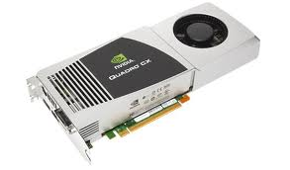
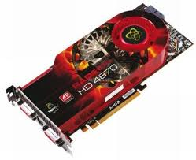
Graphics Processing Unit (GPU)
Sort Middle(ish)
Fixed-Function HW for clip/cull, raster, texturing, Z-test
Programmable stages
Commands in, pixels out

Slide 10
Architecture: Latency
CPU: Make one thread go very fast
Avoid the stalls
  Branch prediction
  Out-of-order execution
  Memory prefetch
  Big caches
GPU: Make 1,000,000 threads go very fast
Hide the stalls
  HW thread scheduler
  Swap threads to hide stalls

Slide 11
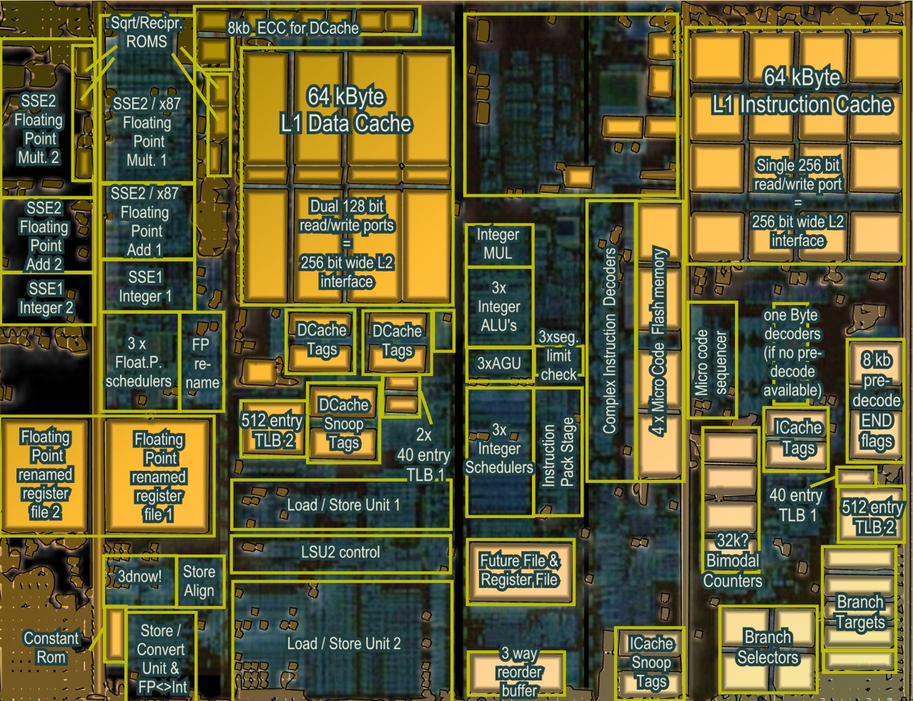
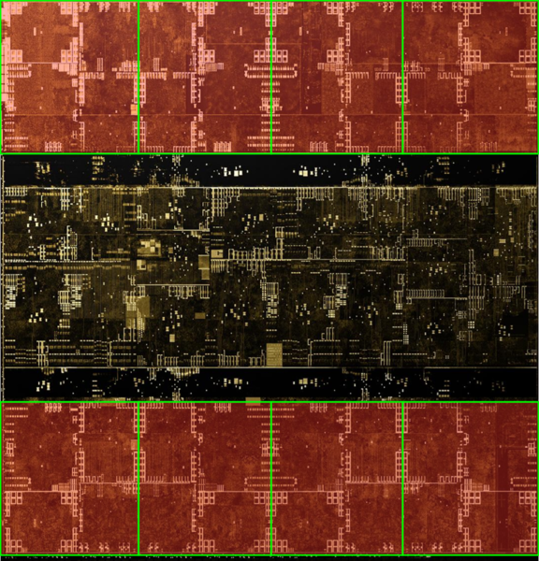
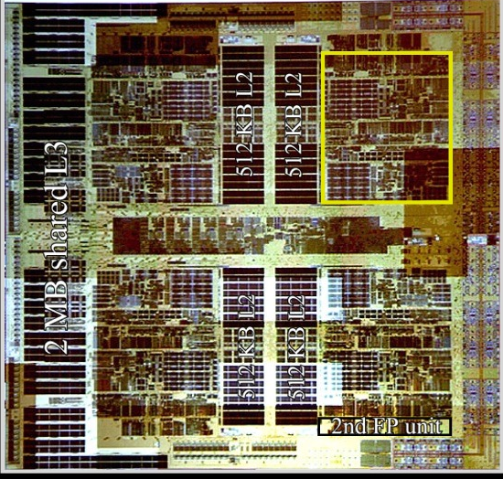
Architecture (MIMD vs SIMD)
Actual computational
Units
SIMD (GPU-Like)
MIMD (CPU-Like)
(AMD K10 chip-architect.org)
(NVIDIA Volta / wikichip.org)
Flexibility
Horsepower
Ease of Use

Slide 12
SIMD Branching
if( x ) // mask threads
{
// issue instructions
}
else // invert mask
{
// issue instructions
} // unmask
Threads agree
Threads disagree
or
THEN

Slide 13
SIMD Looping
while(x) // update mask
{
// do stuff
}
Everyone runs as long as slowest
Active
% Active = Utilization
Inactive
This example: 36% utilization

Slide 14
GPU graphics processing model
CPU
Texture/Buffer
Vertex
Rasterize
Fragment
Z-Buffer
Pixels

Slide 15
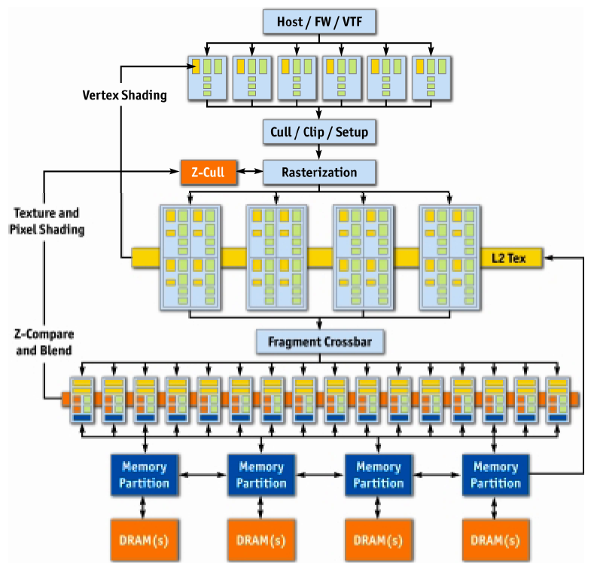
NVIDIA GeForce 6
Vertex
Rasterize
Sort
Fragment
Z-Buffer
Displayed
Pixels
[Kilgaraff and Fernando, GPU Gems 2]

Slide 16
GPU graphics processing model
CPU
Texture/Buffer
Vertex
Rasterize
Fragment
Z-Buffer
Pixels

Slide 17
GPU graphics processing model
CPU
Vertex
Texture/Buffer
Fragment
Rasterize
Displayed
Pixels
Z-Buffer

Slide 18
GPU Processing Model
SIMD for efficiency
  Same processors
  for vertex & pixel
SIMD Batches
  Limits on # of vertices & pixels that can run together
  Improve utilization
  Limit divergence
Basic scheduling
  If batch of pixels, run it
  Otherwise run some vertices to make more

Slide 19
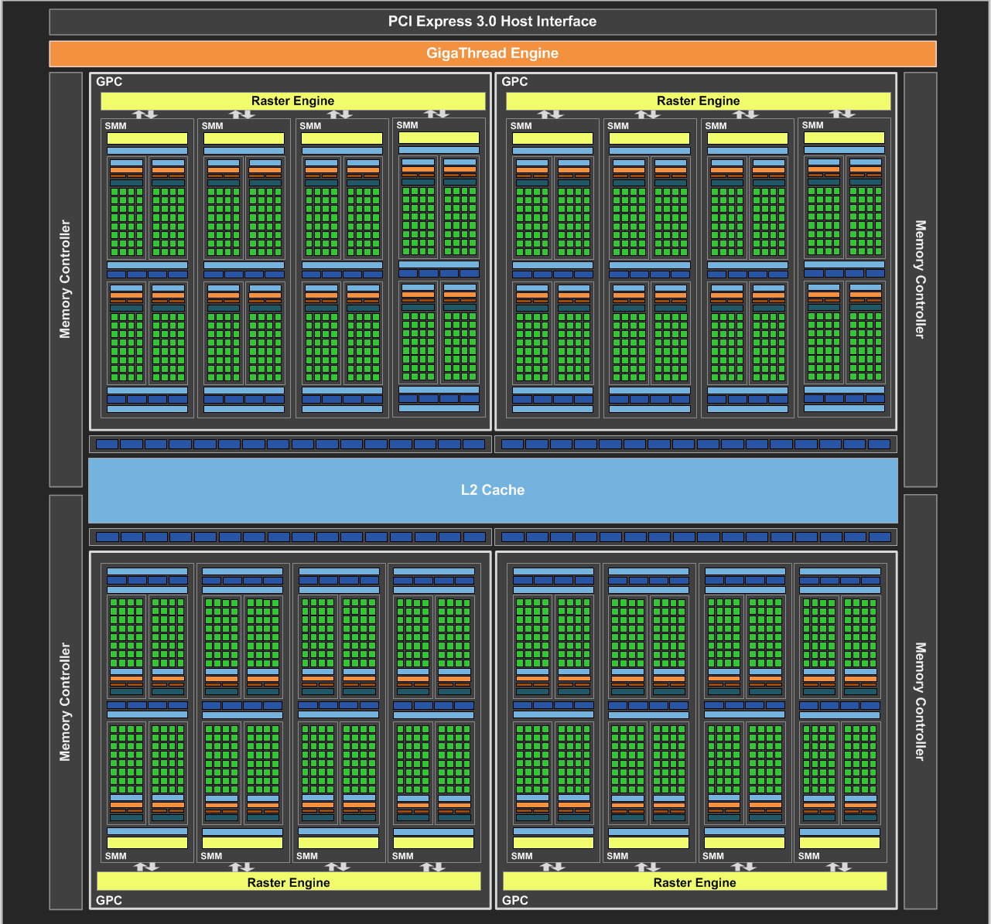
NVIDIA Maxwell
[NVIDIA, NVIDIA GeForce GTX 980 Whitepaper, 2014]

Slide 20
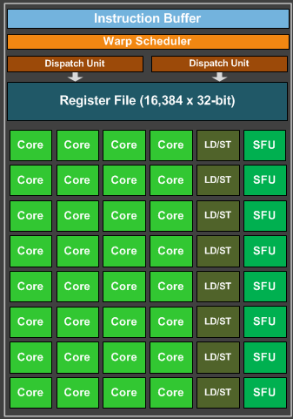
Maxwell SIMD Processing Block
32 Cores
8 Special Function Units (SFU)
  Double precision, trig, …
  Still issue 1/thread, but run ¼ rate
8 Load/Store memory access
  Hide latency by interleaving threads
Wave/Warp (AMD/NVIDIA)
  One set of lanes/threads (AMD/NVIDIA)
  Want at least 4-8 interleaved
  % of max = Occupancy

Slide 21
GPU Registers
Scalar General Purpose Register (SGPR)
  Same value for all threads
  Pixar’s Renderman (& GLSL)
  called these uniform
Vector General Purpose Registers (VGPR)
  Different value in every thread
  Pixar & GLSL called these varying
  # wavefronts usually limited by VGPR

Slide 22
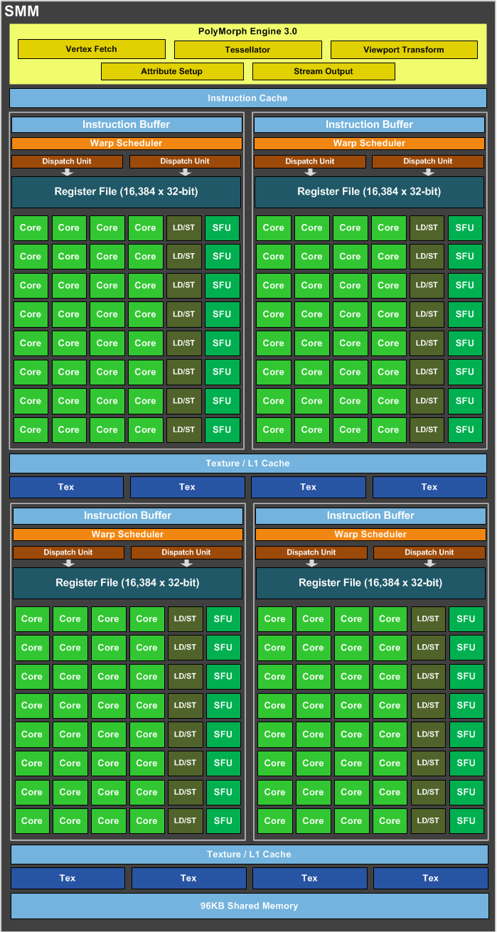
Maxwell Streaming
Multiprocessor (SMM)
4 SIMD blocks (128 total cores)
Share L1 Caches
Between-core shared memory
  Communication through this shared memory
  is fast
Share tessellation HW
  Hardware support for tessellation shaders

Slide 23
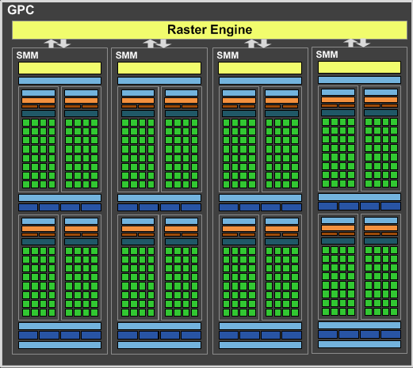
Maxwell Graphics Processing Cluster (GPC)
4 SMM (512 total cores)
Share rasterizer

Slide 24
Full NVIDIA Maxwell
4 GPC (2048 total cores)
Share L2
Share dispatch
  Decides which threads
  to launch and when

Slide 25
What’s new?
NVIDIA Maxwell was 12 years ago

Slide 26
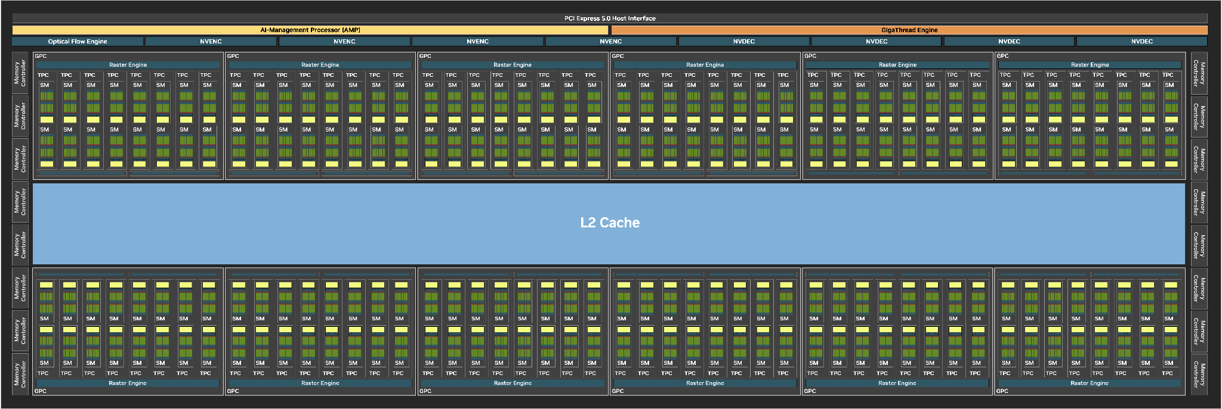
NVIDIA Blackwell
More cores!!!!!
[NVIDIA, NVIDIA RTX Blackwell GPU Architecture, 2025]

Slide 27
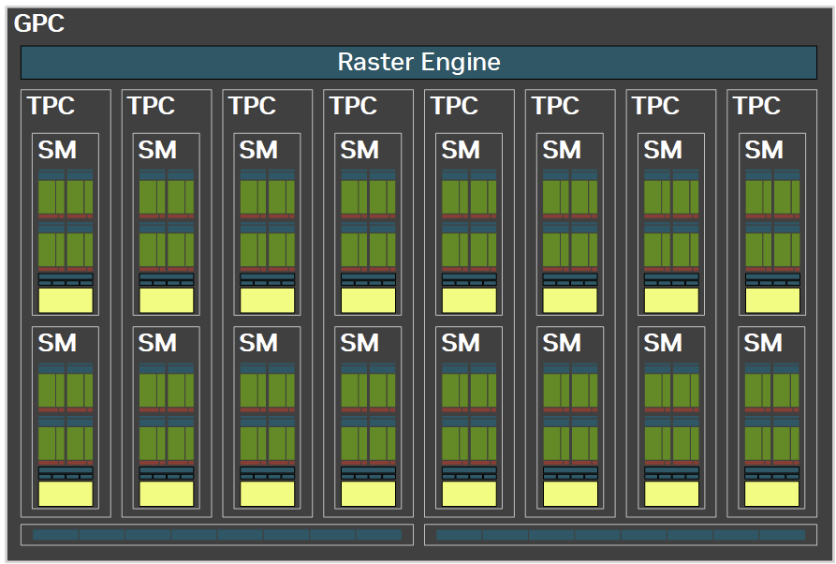
Blackwell GPC

Slide 28
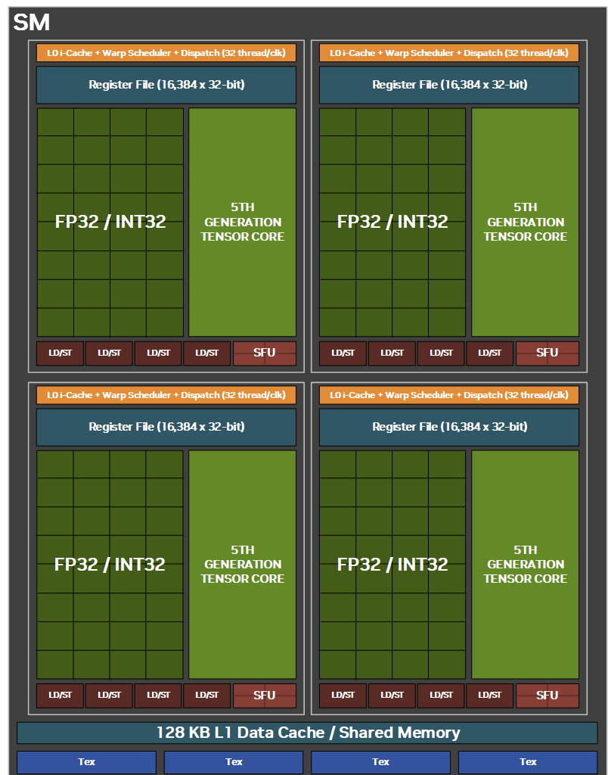
Blackwell SM
Same number of SM registers and cores
Half the memory units
Fewer spec. func. Units
Add hardware for AI
  Matrix multiply, convolution
  FP16, FP6, FP4
Add ray tracing HW
  shared per SM

