Slide 1
Graphics Pipeline
Visibility
CMSC 435/634

Slide 2
Graphics Pipeline
Object-order approach to rendering
Vertex Processing
Transformations
Vertex components of shading
Clipping
Find the visible parts of primitives
Rasterization
Break primitives into fragments/pixels
Fragment Processing
Fragment components of shading
Visibility & Blending
Which do we see, how do they combine?

Slide 3
Visibility
We can convert simple primitives to pixels
Which primitives (or parts of primitives) should be visible?

Slide 4
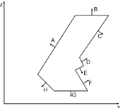
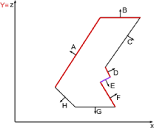
Back-face Culling
Polygon is back-facing if
Assuming view is along –Z
Simplifying further
  If , then cull
Works for non-overlapping convex polyhedra
With concave polyhedra, some hidden surfaces
will not be culled

Slide 5
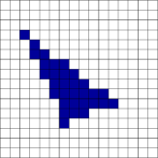
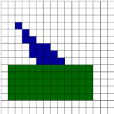
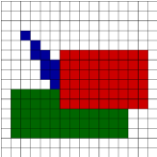
Painter’s Algorithm
First polygon:
  (6,3,10), (11, 5,10), (2,2,10)
Second polygon:
  (1,2,8), (12,2,8), (12,6,8), (1,6,8)
Third polygon:
  (6,5,5), (14,5,5),
  (14,10,5),( 6,10,5)

Slide 6
Painter’s Algorithm
Given
  List of polygons
  Array of colors: color[x,y]
Algorithm
  Sort polygons on minimum z
  For each polygon P in sorted list
  For each pixel (x,y,z) in P
  color[x,y] = color(P,x,y)

Slide 7

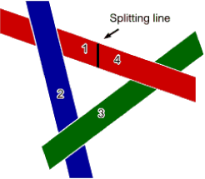
Painter’s Algorithm: Cycles
Which to scan first?
  Split along line, then scan 1,2,3,4 (or split another polygon and scan accordingly)
  Moral: Painter’s algorithm is fast and easy … except for detecting and splitting cycles and other ambiguities

Slide 8
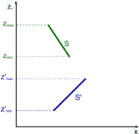
Depth-sort: Overlapping Surfaces
Assume you have sorted by
maximum Z
  Then if Zmin > Z’max, the surfaces do
  not overlap each other (minimax test)
Correct order of overlapping surfaces
may be ambiguous. Check it.

Slide 9
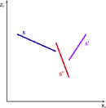
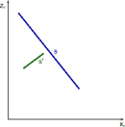
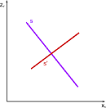
Depth-sort: Overlapping Surfaces
No problem: paint S, then S’
Problem: painting in either order gives incorrect result
Problem? Naïve order S S’ S”; correct order S’ S” S

Slide 10
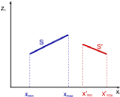

Depth-sort: Order Ambiguity
1. Bounding rectangles in xy plane do not overlap
  Check overlap in x
    x’min > xmax or xmin > x’max → no overlap
  Check overlap in y
    y’min > ymax or ymin > y’max → no overlap
2. Surface S is completely behind S’ relative to
viewing direction.
  Substitute all vertices of S into plane equation for S’
  if all are “inside” (< 0), no ambiguity

Slide 11
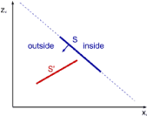
Depth-sort: Order Ambiguity
3. Surface S’ is completely in front S relative to viewing direction.
  Substitute all vertices of S’ into plane equation for S
  if all are “outside” ( >0), no ambiguity

Slide 12
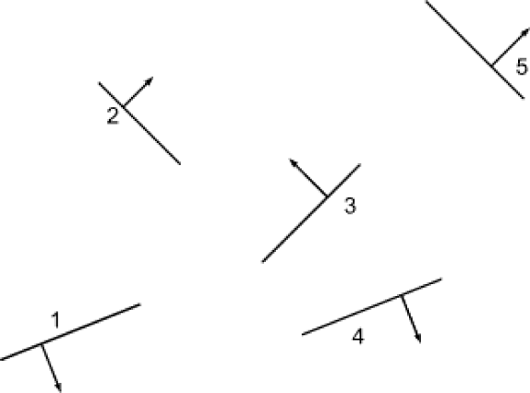
Binary Space Partitioning

Slide 13
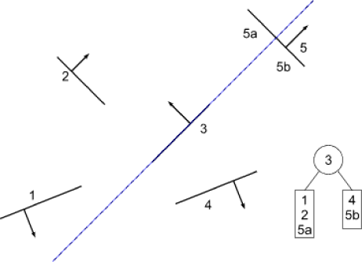
Building a BSP Tree
Use polygon 3 as root, split on its plane
Polygon 5 split into 5a and 5b

Slide 14
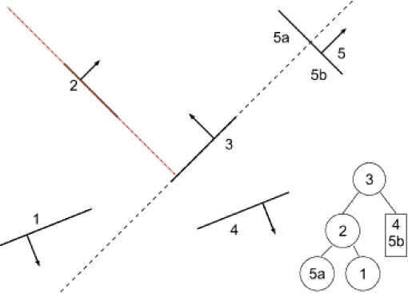
Building a BSP Tree
Split left subtree at polygon 2

Slide 15
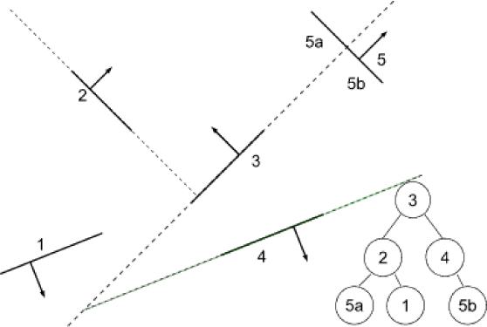
Building a BSP Tree
Split right subtree at polygon 4

Slide 16
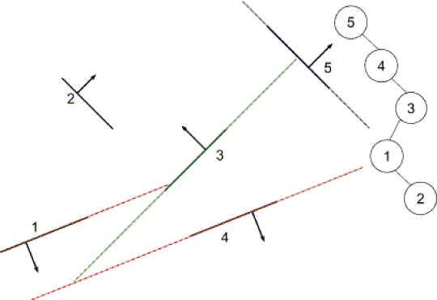
Building a BSP Tree
Alternate tree if splits
are made at 5, 4, 3, 1

Slide 17
BSP Tree: Building the Tree
BSPTree MakeBSP ( Polygon list )
if ( list is empty )
return null
else {
root = some polygon ; remove it from the list
backlist = frontlist = null
for ( each remaining polygon in the list )
if ( p in front of root )
addToList ( p, frontlist )
else if ( p in back of root )
addToList ( p, backlist )
else
splitPolygon (p,root,frontpart,backpart)
addToList ( frontpart, frontlist )
addToList ( backpart, backlist )
return (combineTree(MakeBSP(frontlist),
root,
MakeBSP(backlist)))

Slide 18
BSP Tree: Displaying the Tree
DisplayBSP ( tree )
if ( tree not empty )
if ( viewer in front of root )
DisplayBSP ( tree -> back )
DisplayPolygon ( tree -> root )
DisplayBSP ( tree -> front )
else
DisplayBSP ( tree -> front )
DisplayPolygon ( tree -> root )
DisplayBSP ( tree -> back )

Slide 19
BSP Tree Display
Built BSP tree structure

Slide 20
BSP Tree Display
C in front of 3 (order back/front)
draw 4/5b branch
C in back of 4 (order front/back)
nothing in front of 4
draw 4
draw 5b
draw 3
draw 1/2/5a branch
C in back of 2 (order front/back)
draw 5a
draw 2
draw 1

Slide 21
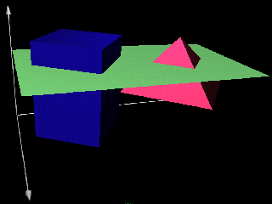
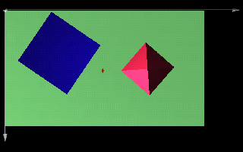
Scanline Algorithm
Simply problem by considering only one scanline at a time
intersection of 3D scene with plane through scanline

Slide 22
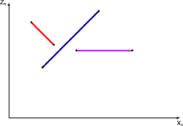
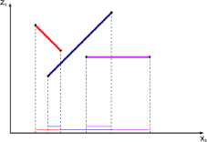
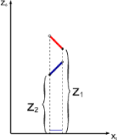
Scanline Algorithm
Consider xz slice
Calculate where visibility can change
Decide visibility in each span

Slide 23
Scanline Algorithm
Sort polygons into sorted surface table (SST) based on first Y
Initialize y and active surface table (AST)
  Y = first nonempty scanline
  AST = SST[y]
Repeat until AST and SST are empty
  Identify spans for this scanline (sorted on x)
  For each span
  determine visible element (based on z)
  fill pixel intensities with values from element
  Update AST
  remove exhausted polygons
  y++
  update x intercepts
  resort AST on x
  add entering polygons
Display Intensity array

Slide 24
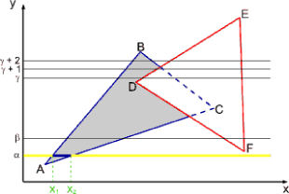
Scanline Visibility Algorithm
Scanline α
  AST: ABC
  Spans
    0 -> x₁
    x₁ -> x₂
    x₂ -> max
background
ABC
background

Slide 25
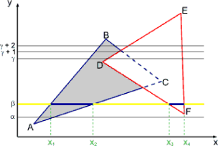
Scanline Visibility Algorithm
Scanline β
  AST: ABC DEF
  Spans
    0 -> x₁
    x₁ -> x₂
    x₂ -> x₃
    x₃ -> x₄
    x₄-> max
background
ABC
background
DEF
background

Slide 26
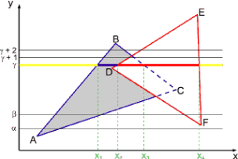
Scanline Visibility Algorithm
Scanline γ
  AST: ABC DEF
  Spans
    0 -> x₁
    x₁ -> x₂
    x₂ -> x₃
    x₃ -> x₄
    x₄-> max
background
ABC
DEF
DEF
background

Slide 27
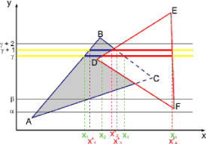
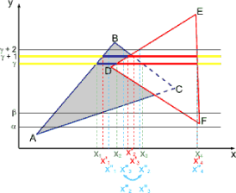
Scanline Visibility Algorithm
Scanline γ + 1
  Spans
    0 -> x₁
    x₁ -> x₂
    x₂ -> x₃
    x₃ -> x₄
    x₄-> max
background
ABC
DEF
DEF
background
Scanline γ + 2
  Spans
    0 -> x₁
    x₁ -> x₂
    x₂ -> x₃
    x₃ -> x₄
    x₄-> max
background
ABC
background
DEF
background

Slide 28
Characteristics of Scanline Algorithm
Good
  Little memory required
  Can generate scanlines as required
  Can antialias within scanline
  Fast
    Simplification of problem simplifies geometry
    Can exploit coherence
Bad
  Fairly complicated to implement
  Difficult to antialias between scanlines

Slide 29
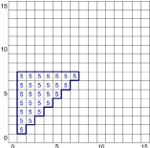
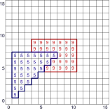
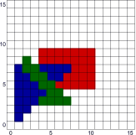
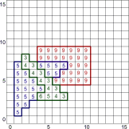
Z-Buffer
First polygon
  (1, 1, 5), (7, 7, 5), (1, 7, 5)
  scan it in with depth
Second polygon
  (3, 5, 9), (10, 5, 9), (10, 9, 9), (3, 9, 9)
Third polygon
  (2, 6, 3), (2, 3, 8),
  (7, 3, 3)

Slide 30
Z-Buffer Algorithm
Originally by Cook, Carpenter, Catmull
Given
  List of Polygons
  Array of depths: zbuffer[x,y] initialized to ∞
  Array of colors: color[x,y]
Algorithm
  For each Polygon P
  For each pixel (x,y,z) in P
  If z < zbuffer[x,y]
  zbuffer[x,y] = z
  color[x,y] = color(P,x,y)

Slide 31
Z-Buffer Characteristics
Good
  Easy to implement
  Requires no sorting of surfaces
  Easy to put in hardware
Bad
  Requires lots of memory (about 8MB for 1920x1080 * 4 bytes per Z)
  Can alias badly (only one sample per pixel)
  Cannot handle transparent surfaces

Slide 32
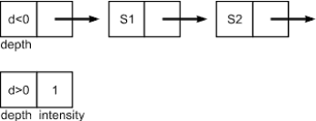
A-Buffer Method
Basically z-buffer with additional memory to consider contribution of multiple surfaces to a pixel
Need to store
  Color (rgb triple)
  Opacity
  Depth
  Percent area covered
  Surface ID
  Misc rendering parameters
  Pointer to next

Slide 33
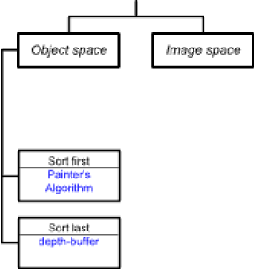
Taxonomy of Visibility Algorithms
Ivan Sutherland — A Characterization of Ten Hidden Surface Algorithms
Basic design choices
  Space for operations
    Object
    Image
  Object space
    Loop over objects
    Decide the visibility of each
  Timing of object sort
    Sort-first
    Sort-last

Slide 34
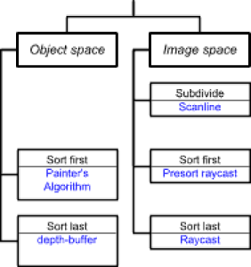
Taxonomy of Visibility Algorithms
Image space
  Loop over pixels
  Decide what’s visible at each
Timing of sort at pixel
  Sort first
  Sort last
  Subdivide to simplify

Slide 35
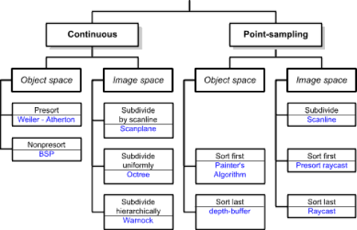
Taxonomy Revisted
Another dimension
  Point-sampling
  Continuous

