Slide 1
Advanced Ray Tracing
CMSC 435/634

Slide 2
Taking Multiple Photons per Pixel
Quite a few effects can be achieved by averaging the contribution of multiple photon rays per pixel
  Antialiasing
  Depth of field
  Motion blur
  Glossy reflection
  Secondary bounces (path tracing)

Slide 3
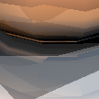



Ray Traced Antialiasing
Only sampling center of each pixel leads to jagged aliasing
Jitter position within pixel on image plane
Average over several random rays per pixel

Slide 4
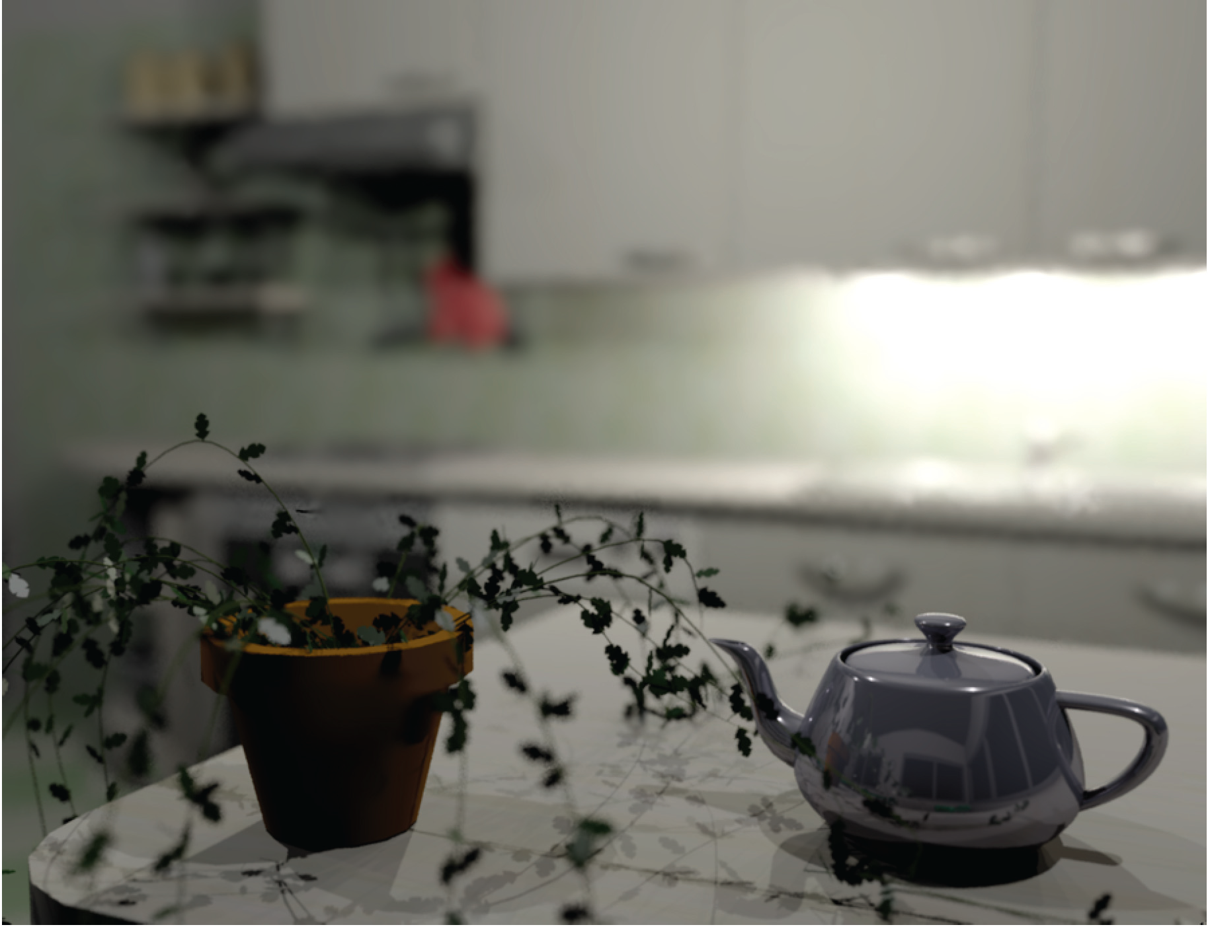
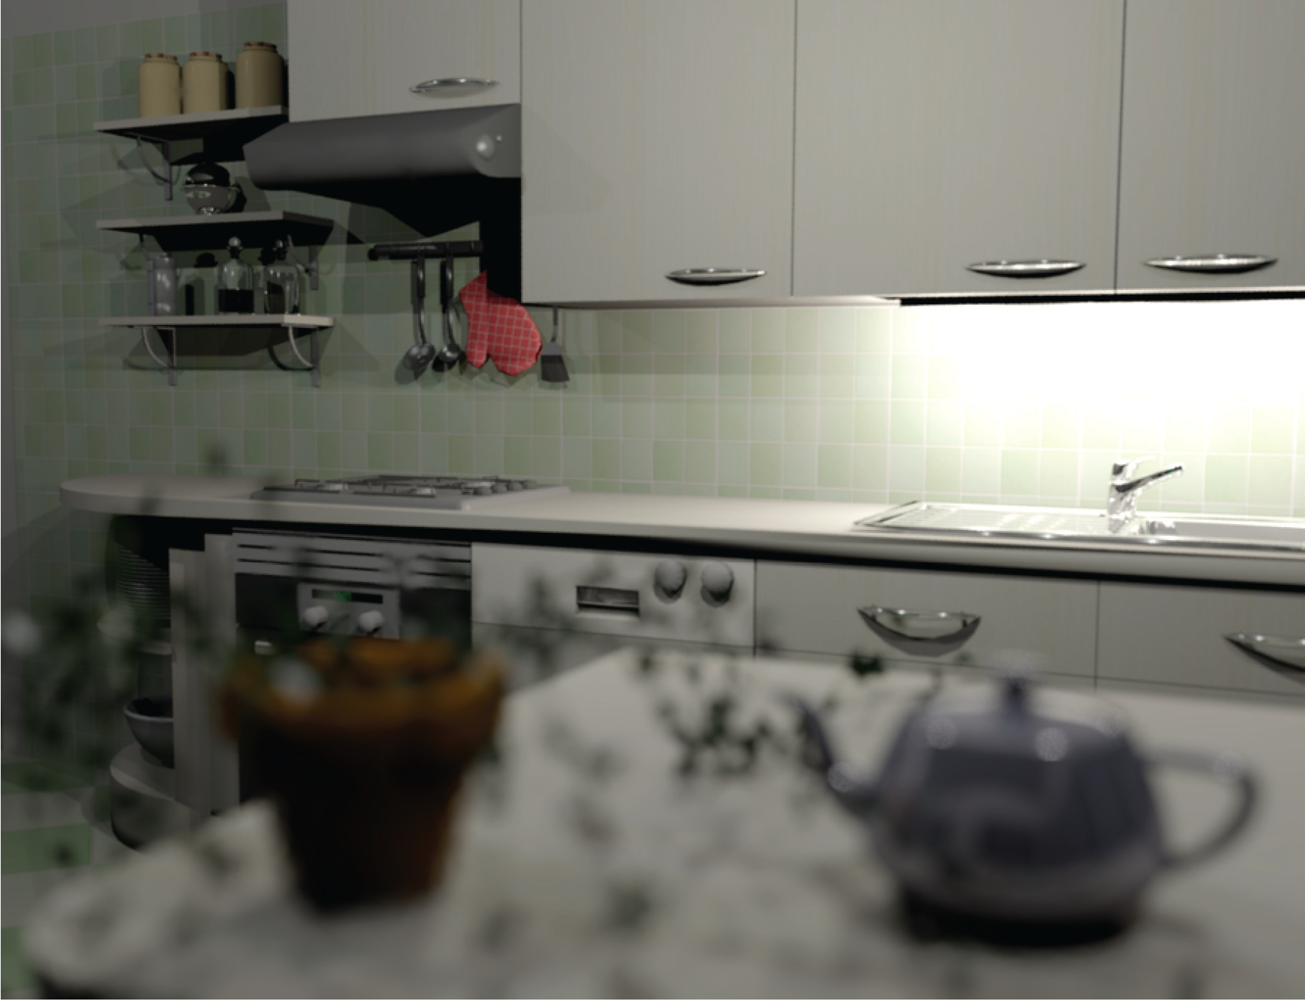
Depth of Field
Soler et al., Fourier Depth of Field, ACM TOG v28n2, April 2009

Slide 5
Pinhole Lens

Slide 6
Real Lens
Focal Plane

Slide 7
Lens Model
Focal Plane

Slide 8
Ray Traced DOF
Make sure image plane is at focal plane
Jitter ray start position within lens aperture
  Disk in plane centered on eye
    Given random
  Smaller aperture = closer to pinhole
  Larger aperture = more DOF blur
Average over several random rays per pixel

Slide 9
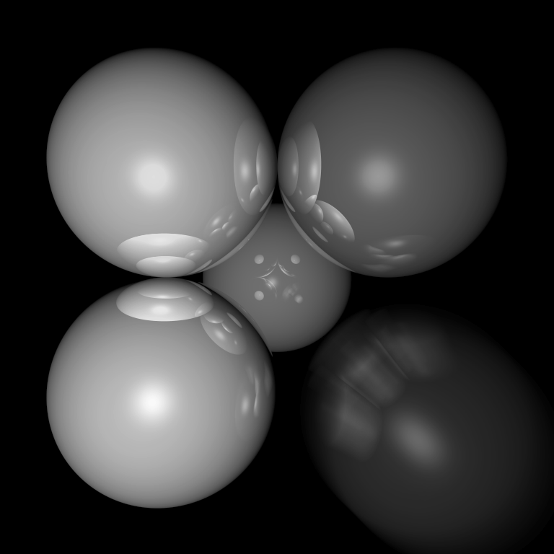
Motion Blur
Things move while the shutter is open
Track object motion
Jitter ray start time within frame

Slide 10
Combining Effects
For each ray, choose a random (point in time, start point, screen location, etc.)
Lots of extra details on reducing the resulting noise
  Non-uniform choice of rays (importance sampling)
  Smart sample selection (quasi-random, blue noise, adaptive)
  Combination and reuse of samples (denoising)
For more, look up Monte-Carlo rendering

Slide 11
Lambert’s Law
Intensity of reflected light is related to surface orientation
I
I
0.7*I
I

Slide 12
Lambert’s Law (AKA Diffuse Reflectance)
Specifically: the radiant energy from any small surface area dA is proportional to cos θ
= normalized surface normal
= normalized vector toward light
= surface color
= light intensity

Slide 13
Light Directions
Technically could trace all possible photon directions
  If you hit something emitting light, add it in
  If you hit a regular object, continue tracing photon bounces
  Need a ton of photon paths per pixel
Simplify to sum over fixed light sources
  Assumption that only one bounce matters (light ⇢ surface ⇢ eye)

Slide 14
Color
Intensity
Adding color:
For any wavelength λ (or use random λ for each ray):

Slide 15
Shadows
What if there is an object between the surface and light?

Slide 16
Ray Traced Shadows
Trace a ray
  Start = point on surface
  End = light source
  t=0 at Surface, t=1 at Light
  “Bias” (𝜖 < t < 1) to avoid surface acne
Test
  𝜖 < t < 1 = shadow
  No intersection or t ≥ 1 = use this light

Slide 17
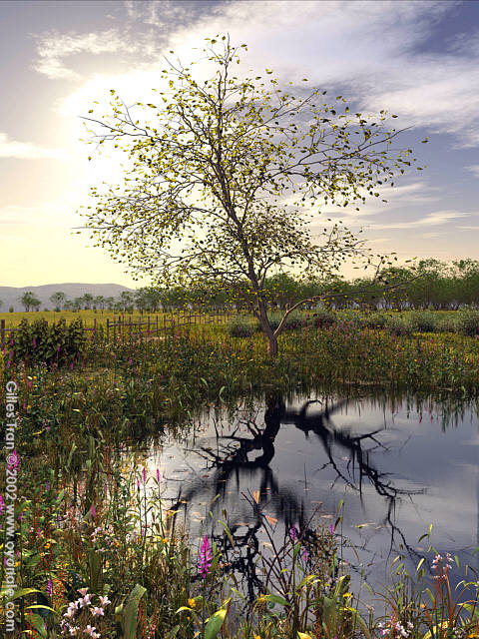
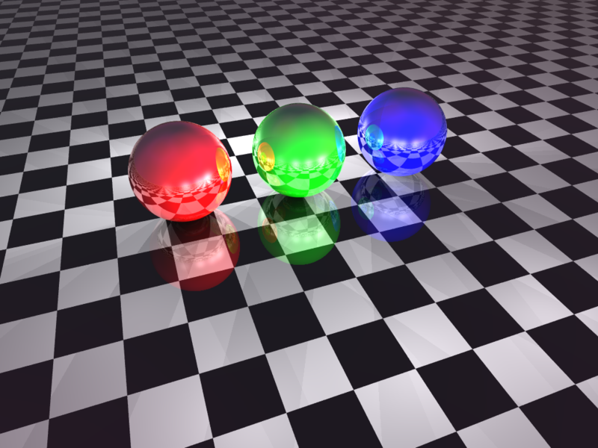
Mirror Reflection

Slide 18
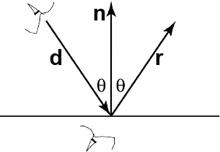
Ray Tracing Reflection
Viewer looking in direction d sees whatever the viewer “below” the surface sees looking in direction r
In the real world
  Energy loss on the bounce
  Loss different for different colors
New ray
  Start on surface, in reflection direction

Slide 19
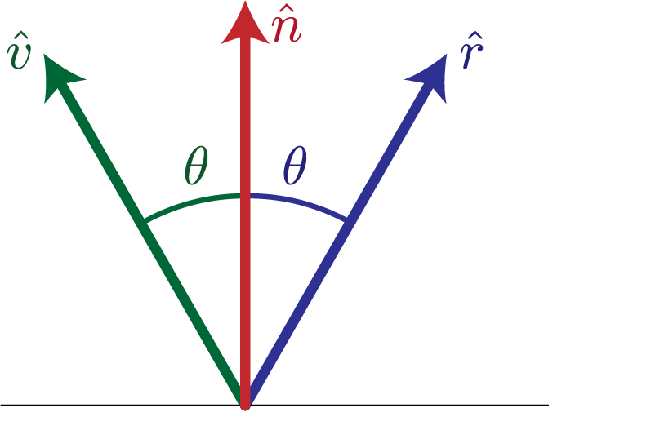
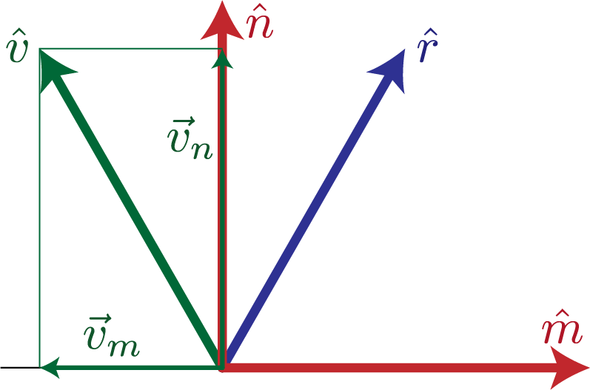
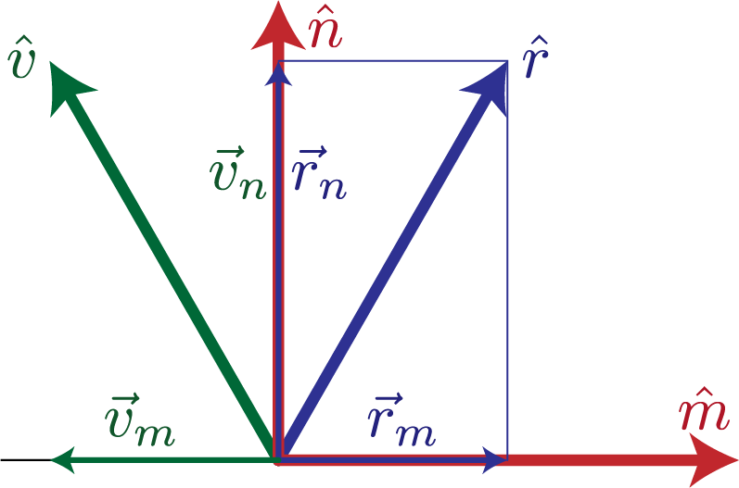
Calculating Reflection Vector
Angle of of incidence
= angle of reflection
Decompose
Recompose

Slide 20
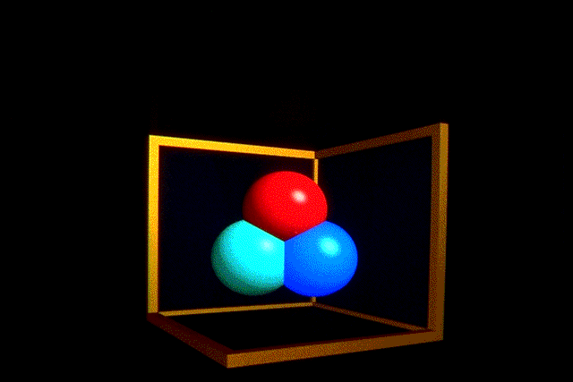
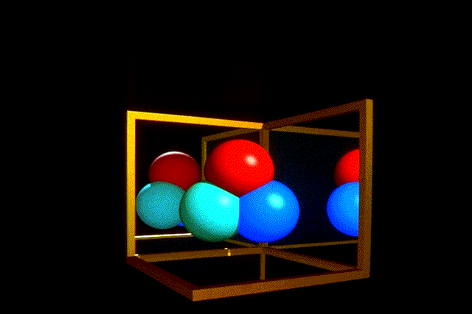
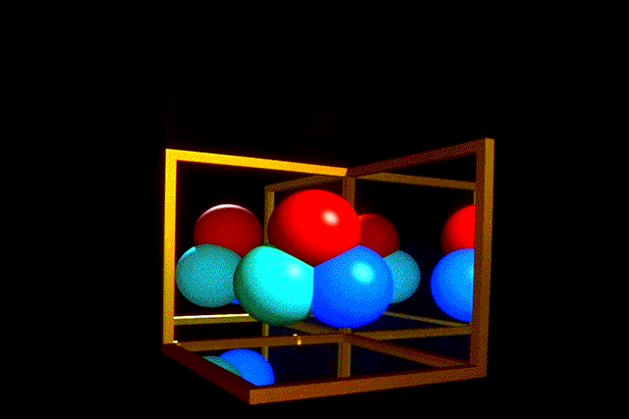
Ray Traced Reflection
Avoid looping forever
  Stop after n bounces
  Stop when contribution to pixel gets too small
  Random probability to kill photon path

Slide 21
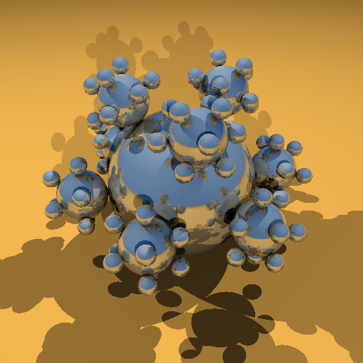
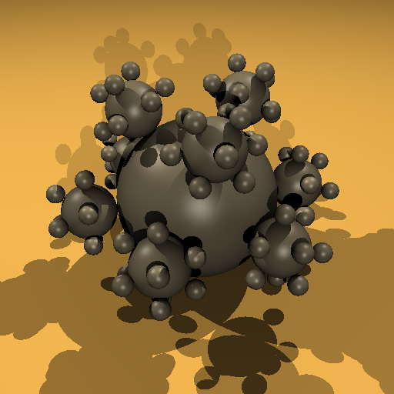
Specular Reflection
Mirror
Glossy reflection from rough surface
Centered around mirror reflection direction
  But more spread more, depending on roughness
Easiest for individual light sources
  Add to diffuse after shadow check
  Should still scale by for angle between light and surface
Specular

Slide 22
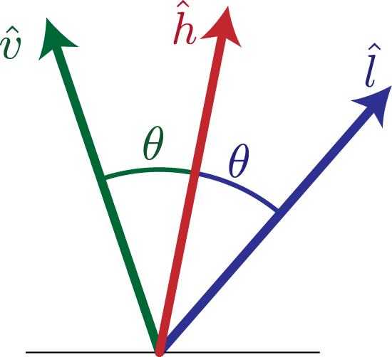
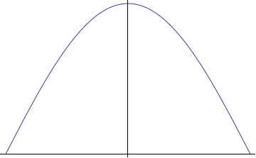
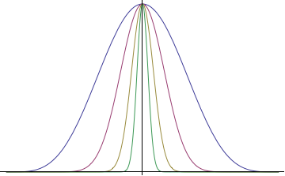
H vector
Strongest for normal that reflects to
  One at center of highlight
  Zero at 90°
Control highlight width
Combine with diffuse

Slide 23
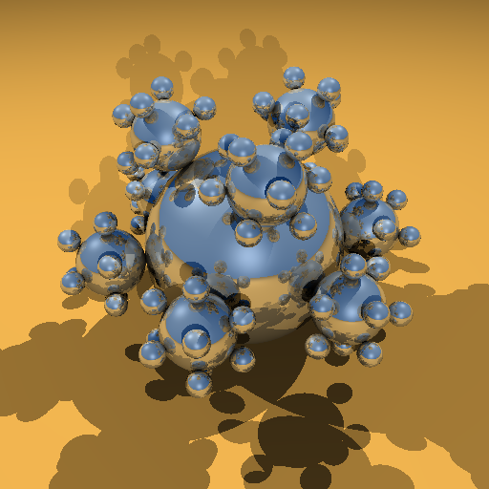

Combined Specular & Mirror
Many surfaces have both

Slide 24
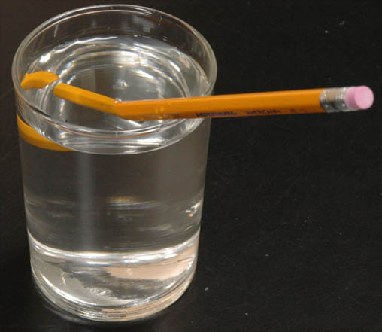
Refraction

Slide 25
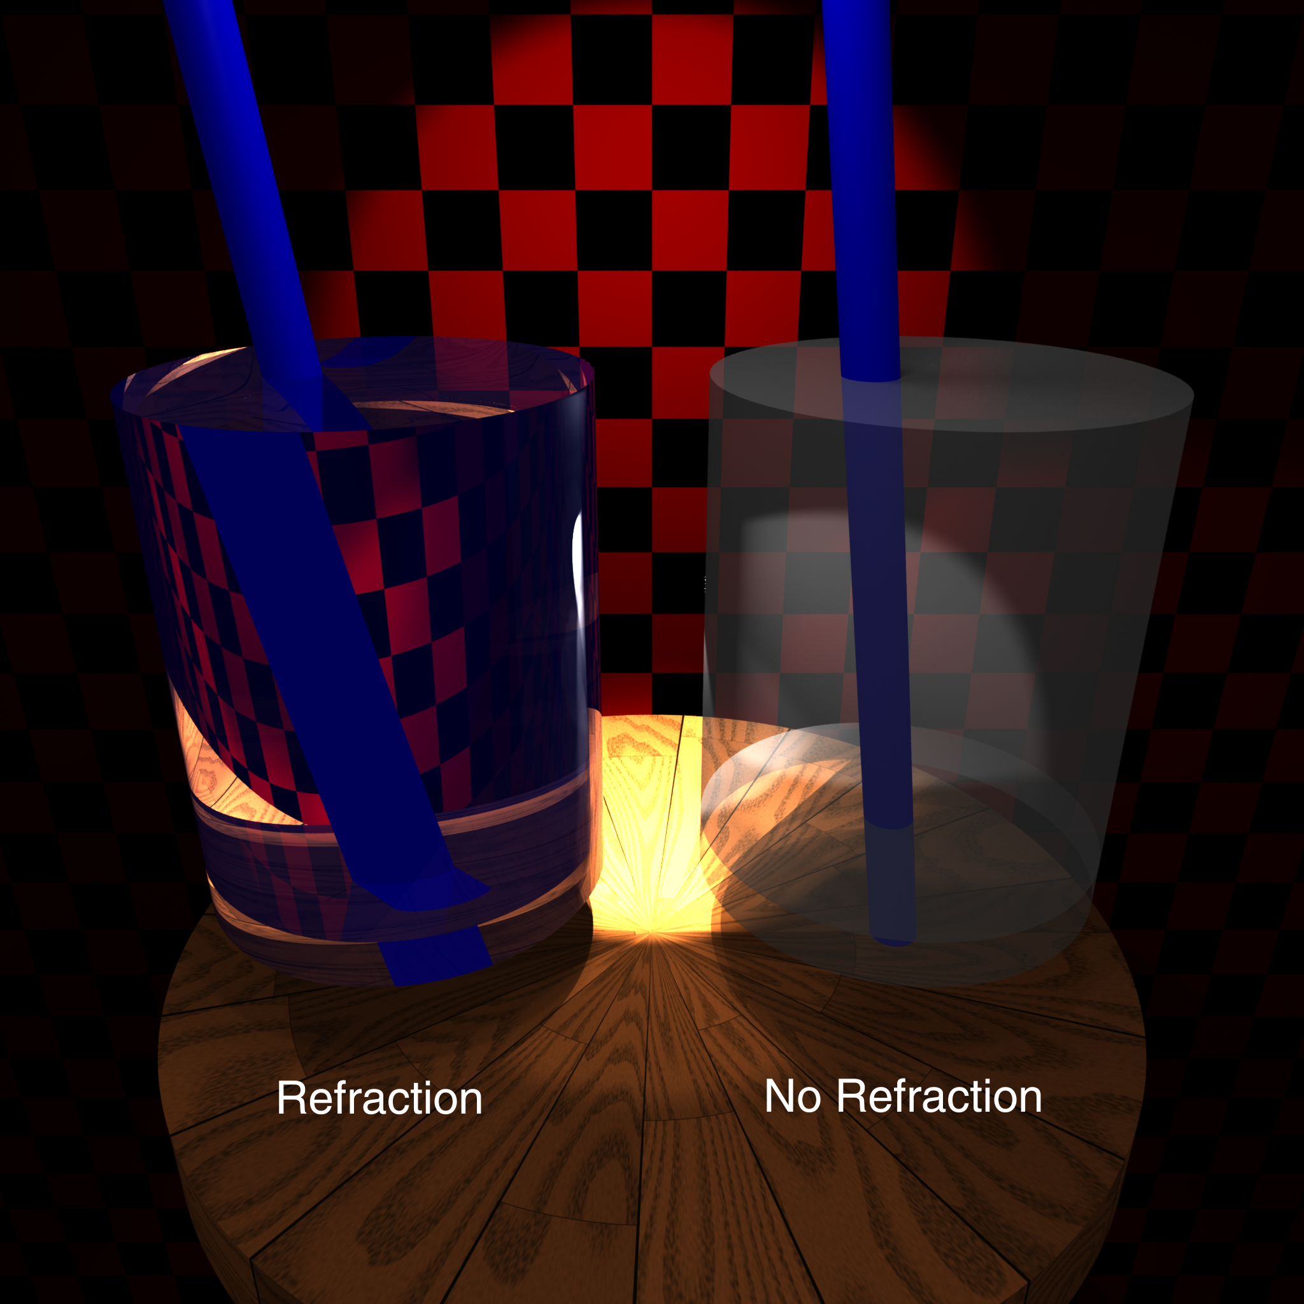

Slide 26
Calculating Refraction Vector
Index of refraction & Snell’s Law
In terms of normal & tangent
in terms of and

Slide 27
Calculating Refraction Vector
Index of refraction & Snell’s Law
In terms of
term

Slide 28
Calculating Refraction Vector
Snell’s Law
In terms of
term

Slide 29
Calculating Refraction Vector
Snell’s Law
In terms of
in terms of and

Slide 30
Alpha Blending
How much makes it through
α = opacity
  How much of foreground color 0-1
1 – α = transparency
  How much of background color
Foreground * α + Background * (1 – α)

Slide 31
Refraction and Alpha
Refraction = what direction
α = how much
  Often approximate as a constant
  Better: Use Fresnel
  Schlick approximation

Slide 32
Ambient Light
Additional light bounces we’re not counting
Approximate them as a constant
  = Amount of extra light coming into this surface
  = Amount that bounces off of this surface
  Total extra light bouncing off this surface

Slide 33
Full Ray Tracing (single sample)
e = eye position
foreach pixel
s = pixel screen position
pixel color = trace(e, s-e)

Slide 34
Full Ray Tracing (multiple samples)
e = eye position
foreach pixel
pixel color = (0,0,0)
s = pixel screen position
foreach sample
s’ = jittered screen position
e’ = jittered eye position
pixel color += trace(e’, s’-e’)
pixel color /= number of samples

Slide 35
Full Ray Tracing (trace)
trace(e, d)
if (ray termination) return;
find first object
P,N,S = position, normal, surface parameters
color = (0,0,0)
foreach light
L = normalize(light.position – P)
if N•L > 0 and probe(P, L, length(light.position – P))
I = light.intensity * N•L
color += S.diffuse * I
if N•H > 0
color += S.specular * I * N•H^{S.specpow}
color += S.reflect * trace(P, reflection direction)
color += S.refract * trace(P, refraction direction)
direct illumination
Reflection & refraction rays, terminate based on recursion/contribution

Slide 36
Full Ray Tracing (shadow probe)
probe(e, d, distance)
foreach object
if 𝜖 < object.intersection(e,d) < distance
return false;
return true;
False if shadow
True if not shadowed

