Slide 1
Color & Light
CMSC 435/634

Slide 2
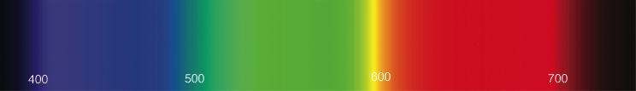
Light
Electromagnetic wave
  E & M perpendicular to each other & direction
Photon wavelength λ, frequency f = c/λ
  Visibile λ ≈ 380 nm (blue) to 720 nm (red)
Photon energy q = h f = h c/λ (in J)
  c = speed of light, h = Planck’s constant
Spectral energy Q = J/nm

Slide 3
Light
Infinite-dimensional function vector space
  spectrum(λ)
  Dimensions = wavelength
Shine two lights on something adds energies
  Vector addition
Scale light energy, scales the intensity
  Vector multiplication

Slide 4
Radiometric Units
Term | Symbol | Units
Spectral Energy | Q | J
Spectral Power | Φ = dQ/dt | W = J/s
Irradiance | E = dΦ/dA | W/m²
Radiant Intensity | I = dΦ/dω | W/sr
Radiance | L = d²Φ/(dω dA) | W/(sr m²)
/nm dropped by graphics convention

Slide 5
Radiant Energy (Q)
Total energy (Joules)
Over all time, directions, area, …

Slide 6
Radiant Flux (Φ)
Φ = dQ/dt in Watts = J/s
Radiant energy per unit time
This is the one you probably want
  Unless you are measuring total energy absorbed
  E.g. by a plant over hours of daylight

Slide 7
Radiant Intensity (I)
I = dΦ/dω in W/sr
Radiant Flux emitted per unit solid angle
  Light from a point in a small cone of directions
Same units for incoming and outgoing light

Slide 8
Radiosity (B)
B = dΦ/dA in W/m²
All light leaving a patch of surface
  Emitted or reflected
  All directions at each point
  Measured per unit area

Slide 9
Irradiance (E)
E = dΦ/dA in W/m²
All light entering a patch of surface
  All directions at each point
  Measured per unit area

Slide 10
Radiance (L)
L = d²Φ/(dω dA) in W/(sr m²)
Light entering patch of surface from a small range of directions
  Per unit area
  Per unit solid angle
Compare to Irradiance
(over all directions)

Slide 11
Spectral Graphs
A = Incandescent light
D = Daylight
(50=horizon,
65=noon)
F = Fluorescent
light

Slide 12
Color Perception

Slide 13
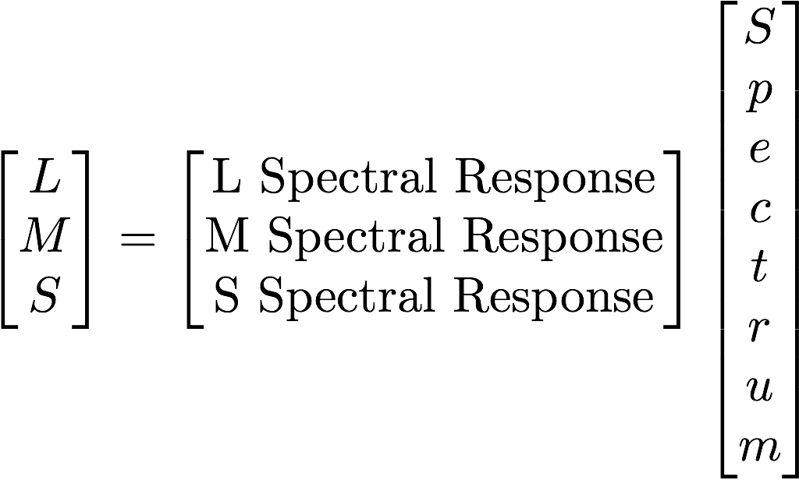
Color Perception
Cones = function dot product
For quantized spectra:
Projects to a 3D subspace

Slide 14
Metamers
Different spectrum, looks the same
Same 3D projection

Slide 15
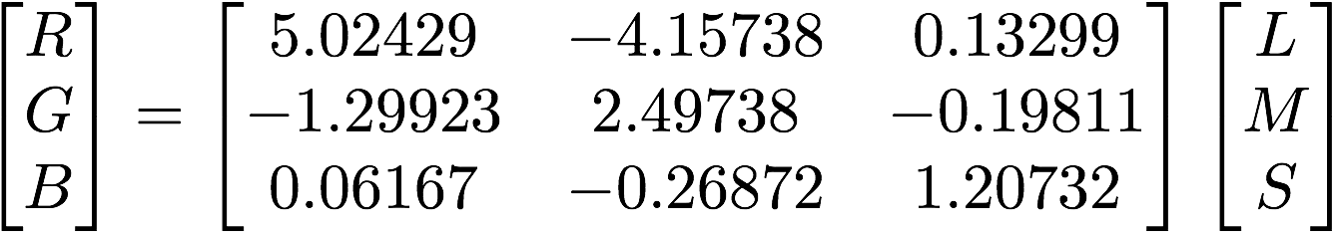
Color Basis
Can transform to any 3D linear basis
  As long as it spans the same subspace
Transform between bases with a 3x3 matrix

Slide 16
Linear Bases
Additive (light)
  Tristimulus (LMS cone response)
  CIE XYZ (from color matching experiments)
  RGB (red/green/blue; different for each device)
  Yuv, YC_{r}C_{b}, … (intensity/2 chroma)
Subtractive (pigment)
  CMY = 1 - RGB (cyan/magenta/yellow)
    grade school Blue, Red, Yellow
  CMYK (cyan/magenta/yellow/black)
    Hard to reliably get pure black in ink by mixing CMY

Slide 17
Chromaticity
Normalize x = X / (X+Y+Z); y = Y / (X+Y+Z)

Slide 18
RGB Gamut
Gamut = representable colors

Slide 19
Subtractive
Start at white, remove R, G, or B

Slide 20

White Points & Color Temperature
Color of radiating black body
Specified in Kelvin degrees

Slide 21
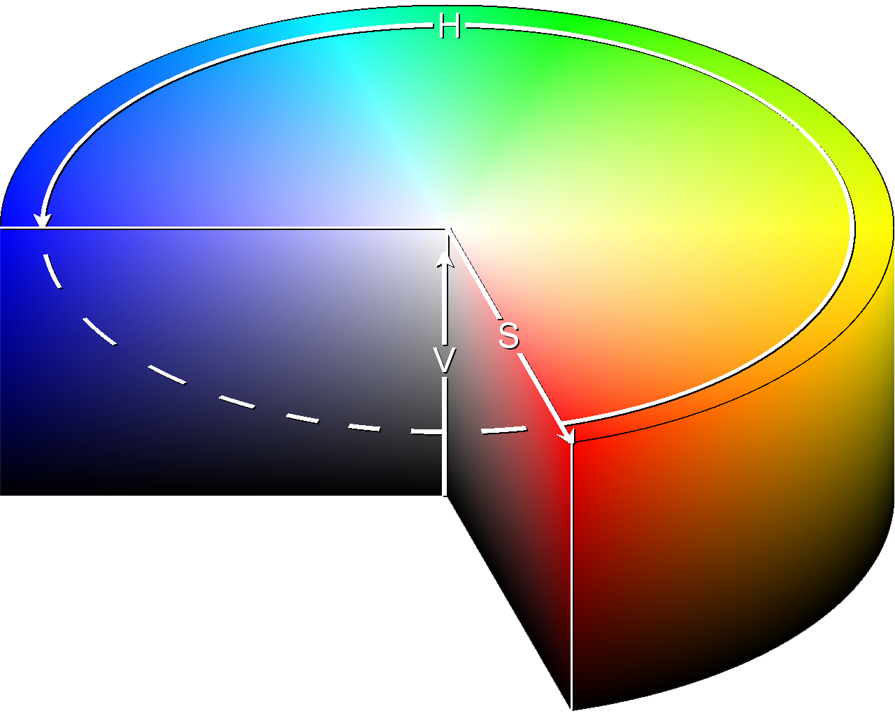
Nonlinear Color Spaces
HSV: Cylindrical Coordinates
  Hue = angle
  Saturation = distance from central axis
  Value = distance along axis

Slide 22
Nonlinear Perception
Linear colors don’t look uniformly different
Nonlinear Luminance
  Gamma (sRGB), L*uv
Nonlinear Luminance & Color
  L*u*v*, L*a*b*
  Can measure color distances
Nonlinear colors do not add

Slide 23
Photometric Units
Visual intensity
Term | Symbol | Units
Luminous Energy | Q | talbot
Lumens | Φ = dQ/dt | lm = talbot/s
Illuminance (lux) | E = dΦ/dA | lx = lm/m²
Candelas | I = dΦ/dω | cd = lm/sr
Luminance (nit) | L = d²Φ/(dω dA) | nt = cd/m²

Slide 24
Dynamic Range
Real world: High Dynamic range (HDR)
  Outside, moonlight 0.0014 nt
  Outside, sunrise 25 nt
  Outside, overcast 700 nt
  Outside, sunlight 5,000 nt
  Sky 7,000 nt
  Light blub 130,000 nt
  Sun 1,600,000,000 nt
Displays: Low Dynamic Range (LDR)
  Typically about 1 nt to 250 nt

Slide 25
Tone Mapping
Convert HDR to LDR
  Nonlinear tone mapping curve
  Adapt to overall intensity
  Time-dependent
  adaptation

Slide 26
Film Exposure
Aperture in f/stop = focal length / diameter
  What matters is aperture area ∝ diameter²
  f/1, f/1.4, f/2, f/2.8 (sqrt 1,2,4,8,…)
  Controls light, but also depth of field
Shutter time t = how long shutter is open
  Controls light, but also motion blur
ISO = sensitivity
  Controls light, but also noise
Exposure Value EV = log₂(f²/t)

Slide 27
Dynamic Range “Stops”
1 stop = double the light
LCD Display: 8-9 stops
Film: 13-15 stops
Eye: 20 stops
Real world, moonlight to sun: 40 stops

