Slide 1
Graphics Hardware
CMSC 435/634

Slide 2
A Graphics Pipeline
Transform
Vertex
Clip
Rasterize
Triangle
Interpolate
Shade
Fragment
Z-buffer

Slide 3
Computation and Bandwidth
Based on:
• 100 Mtri/sec (1.6M/frame@60Hz)
• 300 Mvert/sec
• 50 bytes vertex data (pos,norm,tang,uv)
• 50 bytes interpolated
• 68 bytes fragment output
• 5x depth complexity
• 16 4-byte textures
• 1024 ops/vert
• 1024 ops/frag
• No caching
• No compression
Vertex
7.2 GB/s
307 GFLOPS
Triangle
14.4 GB/s
2.6 TB/s Texture
106 GB/s Fragment
Fragment
20.5 TFLOPS

Slide 4
Data Parallel
Distribute
Task
Task
Task
Task
Merge

Slide 5
Sort First
Objects
Distribute objects by screen tile
Vertex
Vertex
Vertex
Triangle
Triangle
Triangle
Some pixels
Fragment
Fragment
Fragment
Screen

Slide 6
Sort Middle
Objects
Distribute objects or vertices
Vertex
Vertex
Vertex
Some objects
Merge & Redistribute by screen location
Triangle
Triangle
Triangle
Triangle
Some pixels
Fragment
Fragment
Fragment
Fragment
Screen

Slide 7
Screen Subdivision
Tiled
Interleaved

Slide 8
Sort Last
Objects
Distribute by object
Vertex
Vertex
Vertex
Full Screen
Some objects
Triangle
Triangle
Triangle
Fragment
Fragment
Fragment
Z-merge
Screen

Slide 9
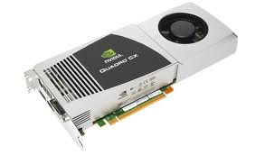
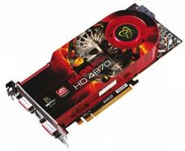
Graphics Processing Unit (GPU)
Sort Middle(ish)
Fixed-Function HW for clip/cull, raster, texturing, Ztest
Programmable stages
Commands in, pixels out

Slide 10
Architecture: Latency
CPU: Make one thread go very fast
Avoid the stalls
Branch prediction
Out-of-order execution
Memory prefetch
Big caches
GPU: Make 1000 threads go very fast
Hide the stalls
HW thread scheduler
Swap threads to hide stalls

Slide 11
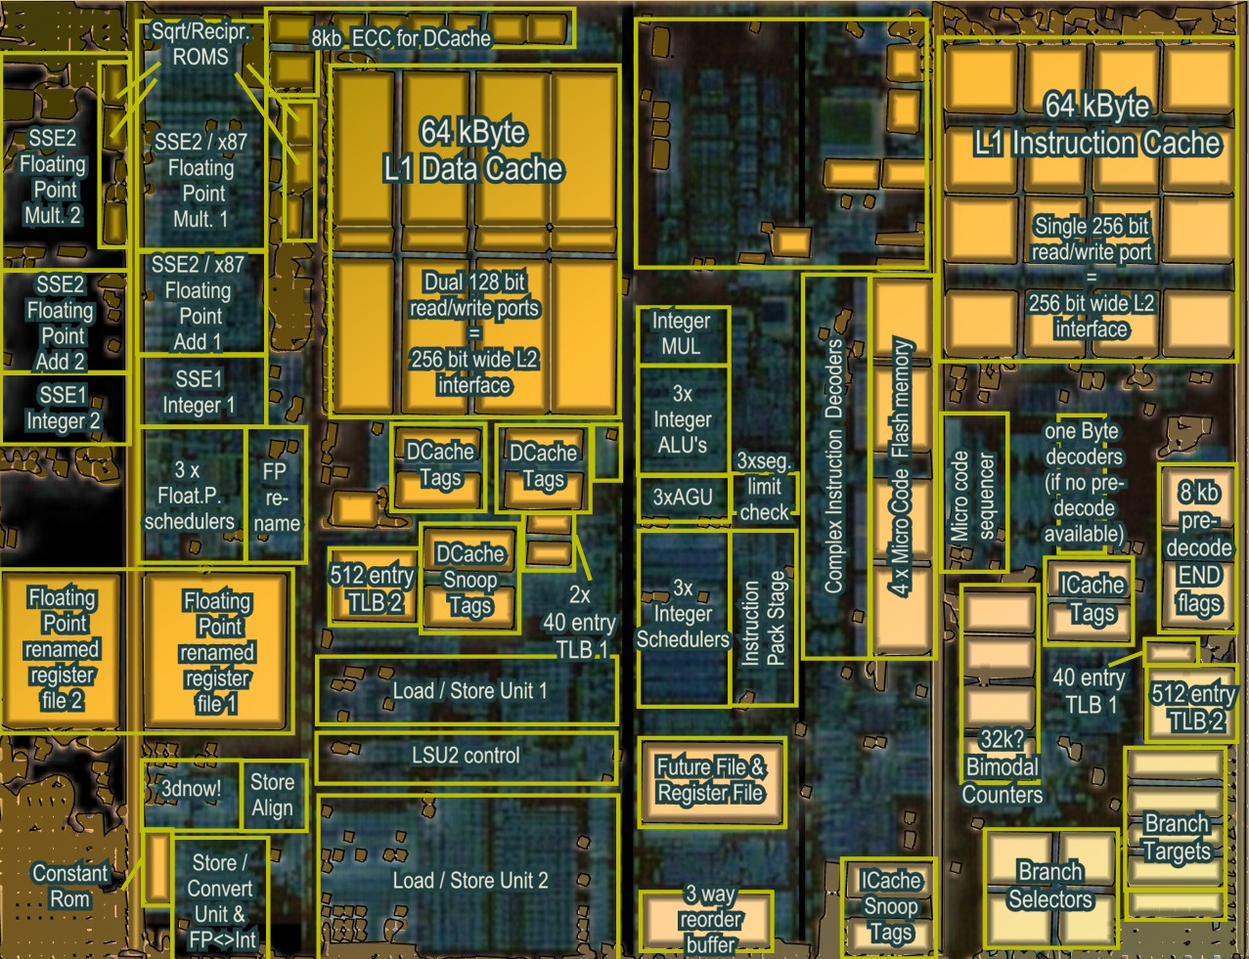
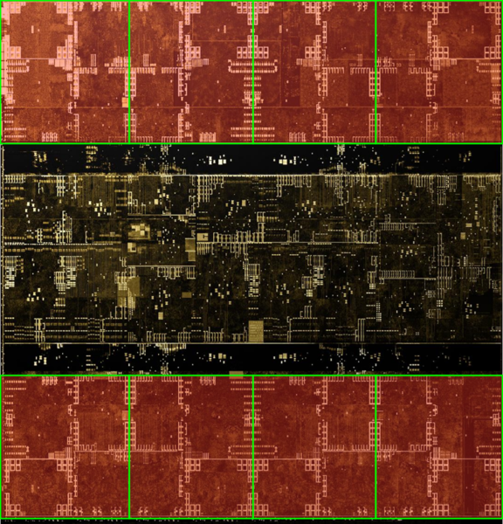
Architecture (MIMD vs SIMD)
Actual computational Units
SIMD (GPU-Like)
MIMD (CPU-Like)
(AMD K10 chip-architect.org)
(NVIDIA Volta / wikichip.org)
Flexibility
Horsepower
Ease of Use

Slide 12
SIMD Branching
if( x ) // mask threads
{
// issue instructions
}
else // invert mask
{
// issue instructions
} // unmask
Threads agree
Threads disagree
or
THEN

Slide 13
SIMD Looping
while(x) // update mask
{
// do stuff
}
Everyone runs as long as slowest
Active
% Active = Utilization
Inactive
This example: 36% utilization

Slide 14
GPU graphics processing model
CPU
Texture/Buffer
Vertex
Rasterize
Fragment
Z-Buffer
Pixels

Slide 15
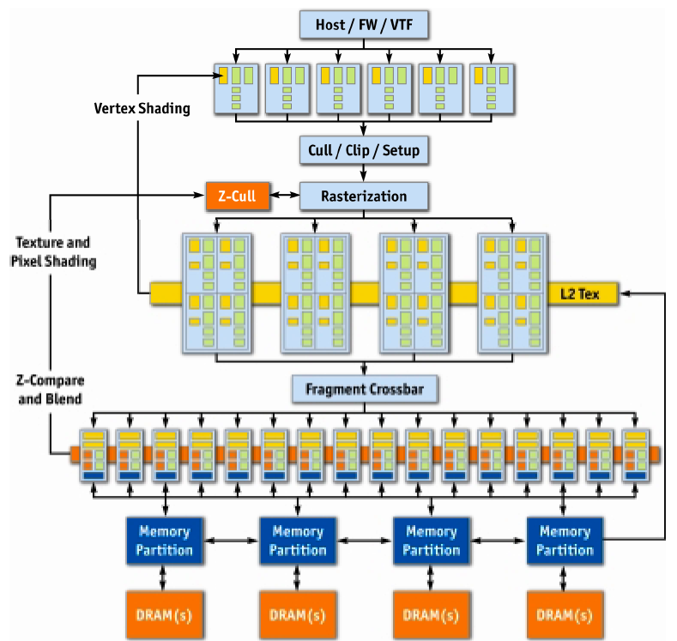
NVIDIA GeForce 6
Vertex
Rasterize
Fragment
Z-Buffer
Displayed
Pixels
[Kilgaraff and Fernando, GPU Gems 2]

Slide 16
GPU graphics processing model
CPU
Texture/Buffer
Vertex
Rasterize
Fragment
Z-Buffer
Pixels

Slide 17
GPU graphics processing model
CPU
Vertex
Texture/Buffer
Fragment
Rasterize
Displayed
Pixels
Z-Buffer

Slide 18
GPU Processing Model
SIMD for efficiency
Same processors for vertex & pixel
SIMD Batches
Limits on # of vertices & pixels that can run together
Improve utilization
Limit divergence
Basic scheduling
If batch of pixels, run it
Otherwise run some vertices to make more

Slide 19
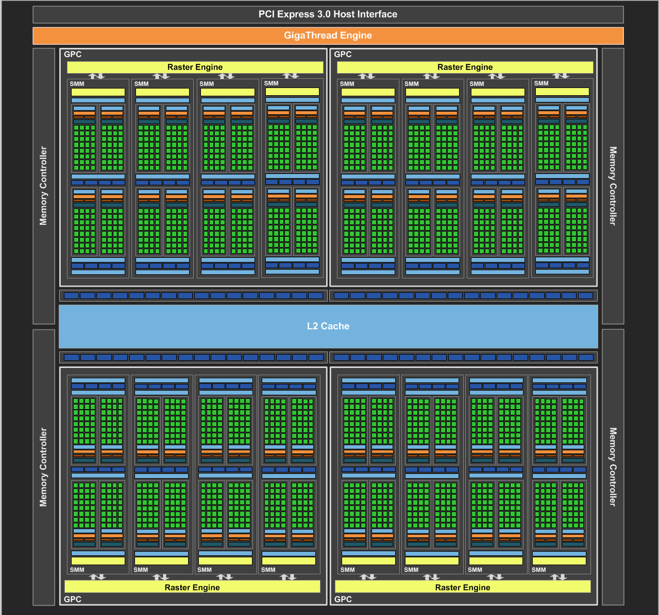
NVIDIA Maxwell
[NVIDIA, NVIDIA GeForce GTX 980 Whitepaper, 2014]

Slide 20
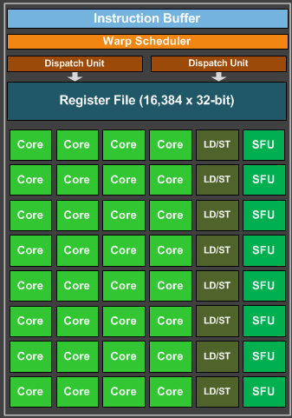
Maxwell SIMD Processing Block
32 Cores
8 Special Function Units (SFU)
Double precision, trig, …
Still issue 1/thread, but run ¼ rate
8 Load/Store memory access
Hide latency by interleaving threads
Wave (AMD) / Warp (NVIDIA)
One set of lanes (AMD) / threads (NVIDIA)
Want at least 4-8 interleaved
% of max = Occupancy

Slide 21
GPU Registers
Scalar General Purpose Register (SGPR)
Same value for all threads
AMD term: Pixar’s Renderman (& GLSL) called these uniform
Vector General Purpose Registers (VGPR)
Different value in every thread
AMD term: Pixar & GLSL called these varying
# wavefronts usually limited by VGPR

Slide 22
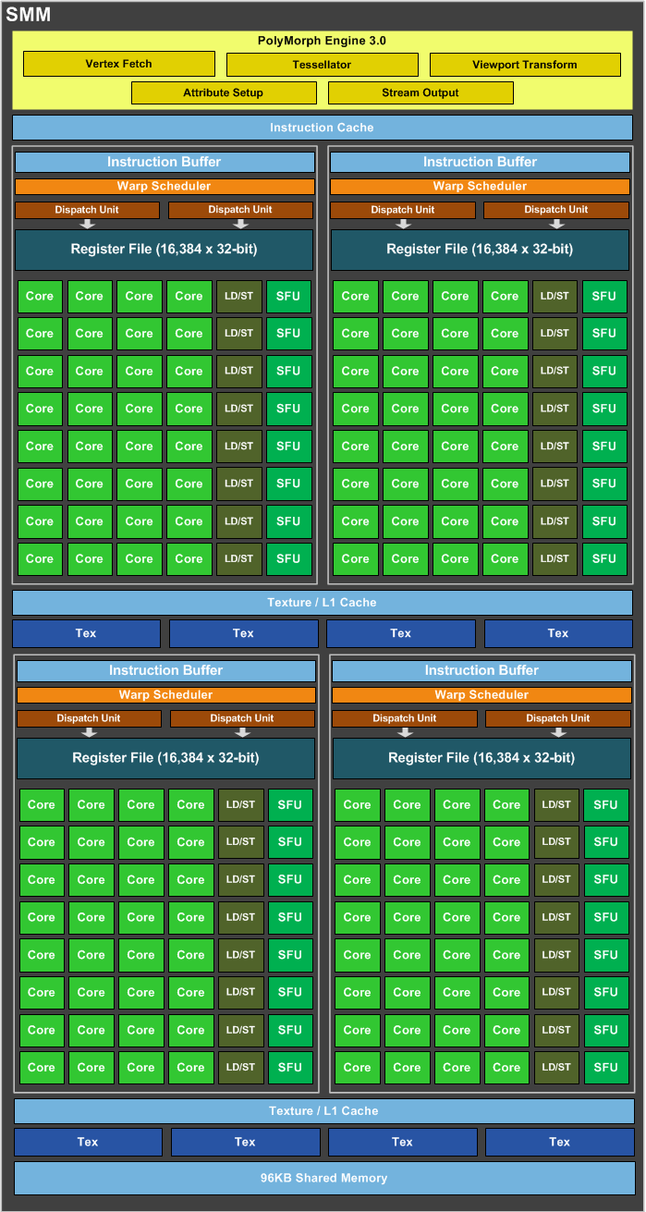
Maxwell Streaming Multiprocessor (SMM)
4 SIMD blocks (128 total cores)
Share L1 Caches
Between-core shared memory
Communication through this shared memory is fast
Share tessellation HW
Hardware support for tessellation shaders

Slide 23
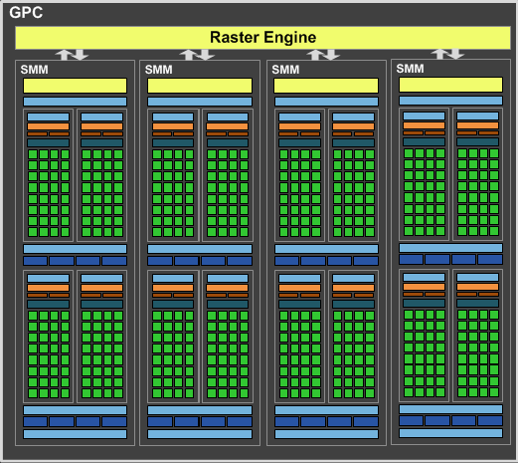
Maxwell Graphics Processing Cluster (GPC)
4 SMM (512 total cores)
Share rasterizer

Slide 24
Full NVIDIA Maxwell
4 GPC (2048 total cores)
Share L2
Share dispatch
Decides which threads to launch and when

Slide 25
NVIDIA Volta
[NVIDIA, NVIDIA TESLA V100 GPU ARCHITECTURE]

