Slide 1
Texture Mapping
CMSC435
UMBC
*With lots of borrowing from the usual victims…

Slide 2
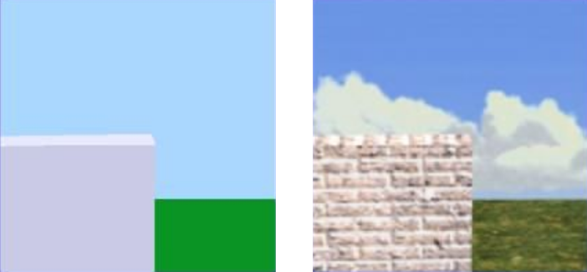
Motivation
Flat and Boring
“Textured”

Slide 3
Texture Mapping
Definition: mapping a function onto a surface; function can be:
  1, 2, or 3D
  sampled (image) or mathematical function

Slide 4

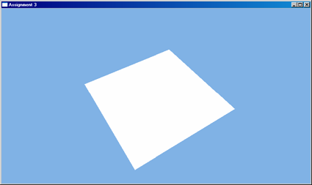
Texture Mapping
“Texture”
Boring Geometry
Texture ➔ An image that’s mapped onto something
Texel ➔ Texture pixel (Also, an island in Denmark…)

Slide 5
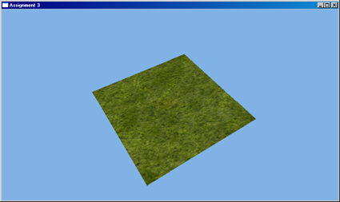
Texture Mapping
Interesting Geometry

Slide 6
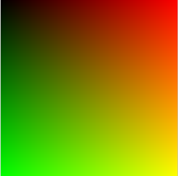
Texture Mapping
Mapping
Function
2D Texture Coordinate
3D Coordinate
Texture Image

Slide 7
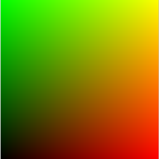
Texture Coordinates
u
Normalized 2D space
  0-1 on each axis
Letters vary:
  U,V are most common
  GL/RMan specs like s,t
Typically periodic
v
D3D
Texture Coordinates as RGB
t
OGL
s

Slide 8
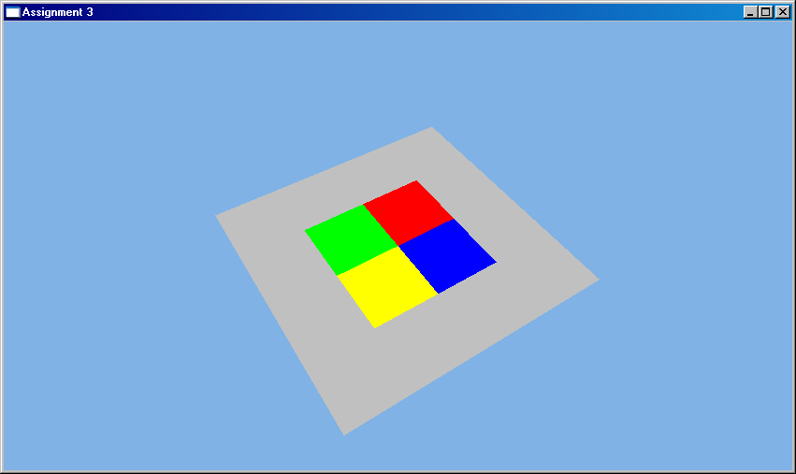
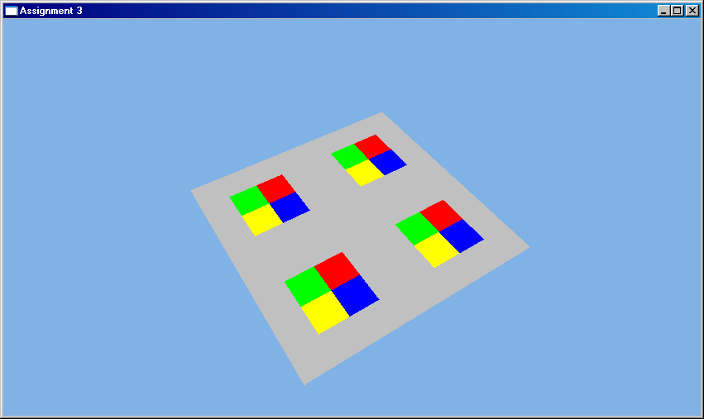
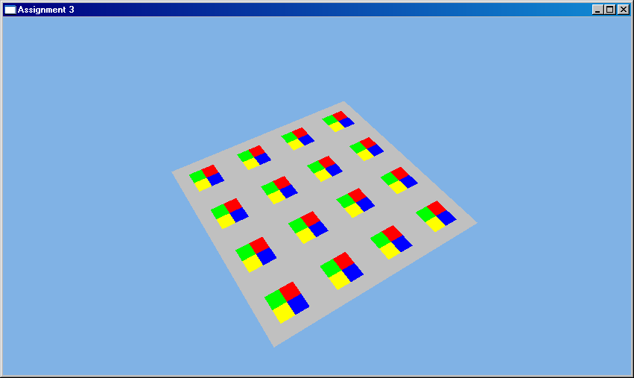
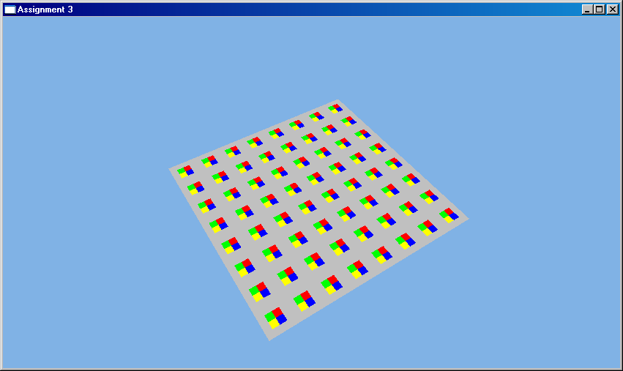
Texture Tiling
0,0
0,0
0,1
0,2
1,0
2,0
Scale UV Coordinates ➔ Alter texture frequency
0,0
0,0
0,4
0,8
4,0
8,0

Slide 9
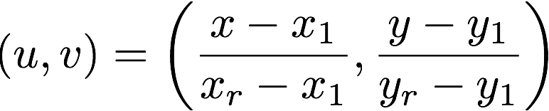
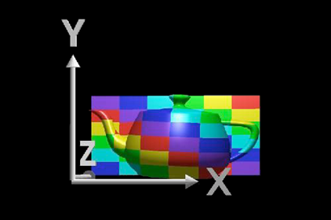
Planar Mapping
For xy aligned plane
Reverse projection
9
Notes:
9

Slide 10
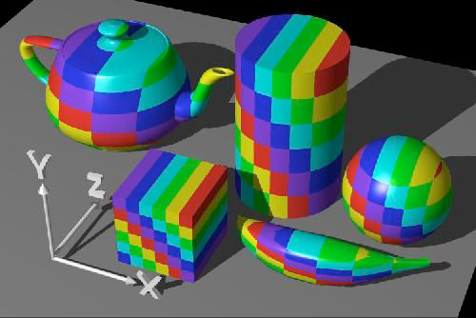
Planar Mapping
10
Notes:
10

Slide 11


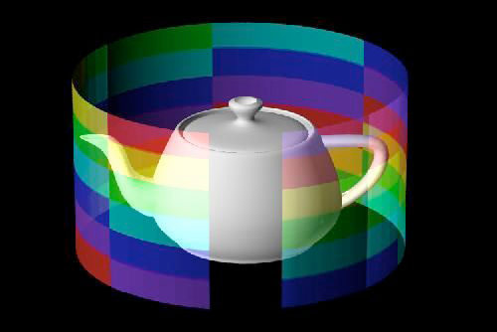
Cylindrical Mapping
For cylinder with point
Texture coordinates
11
Notes:
11

Slide 12
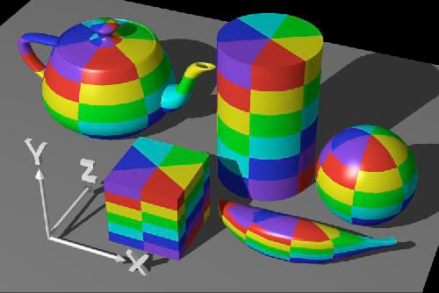
Cylindrical Mapping
12
Notes:
12

Slide 13
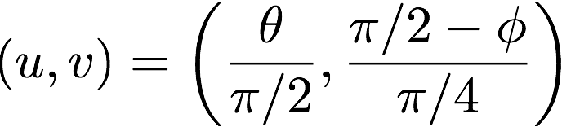
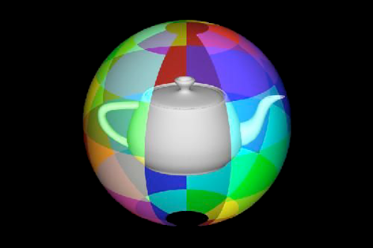
Spherical Mapping
For sphere with point
Texture coordinates
13
Notes:
13

Slide 14
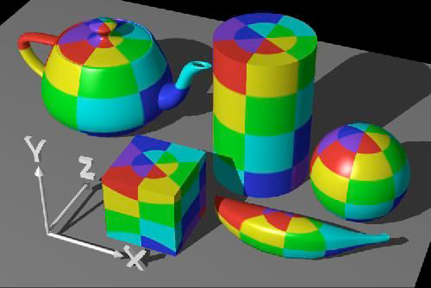
Spherical Mapping
14
Notes:
14

Slide 15
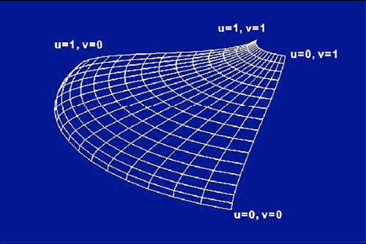
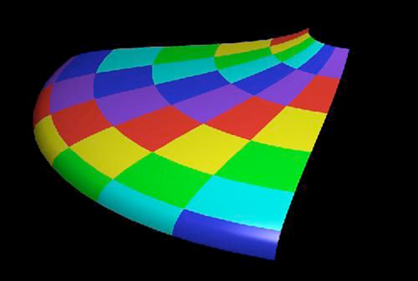
Mapping onto Parametric Patches
Use scaled surface u,v parameters for texture u,v
15
Notes:
15

Slide 16
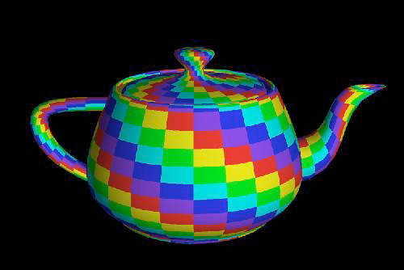
Mapping onto Parametric Patches
16
Notes:
16

Slide 17
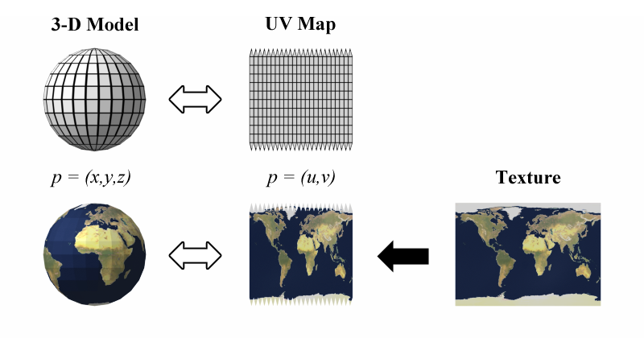
Mapping onto Polygons
Explicit per-vertex coordinates…
Wikipedia

Slide 18
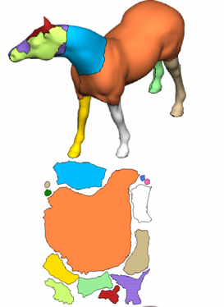
Texture Atlas
Properties of good UV layout:
  Minimizes stretch
  Maximize packing efficiency
  Easy for artist to paint into
    Unlike that one…
  Automatic is possible, but manual often preferred
Zhou et al.

Slide 19
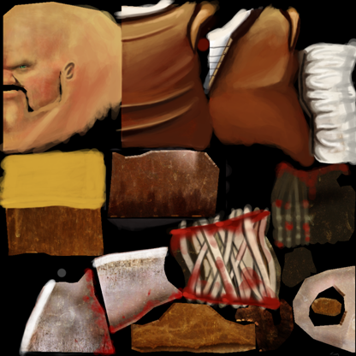
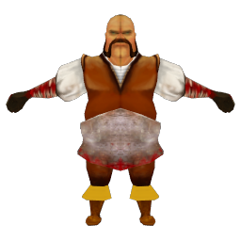
Texture Atlas
Not always a 1:1 mapping

Slide 20
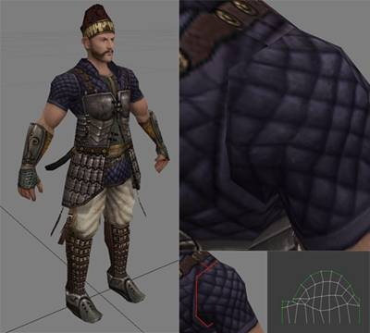
Texture Seams
Discontinuity at UV chart boundaries
Solutions:
  Fix them:
    Copy/Blend texels across boundary
  Hide them
    Armpits, ankles, backs of heads, under clothing
Peter Kojesta (Gamasutra)

Slide 21
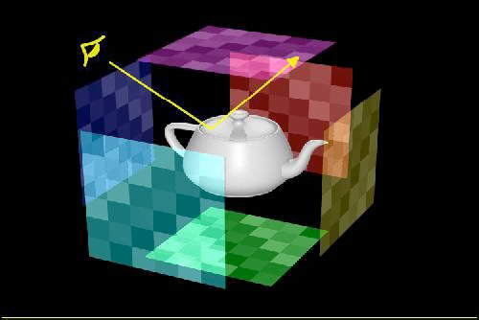
Environment Mapping
Surround scene with maps simulating surrounding detail
21
Notes:
21

Slide 22
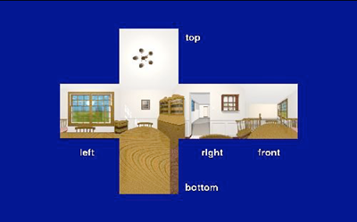
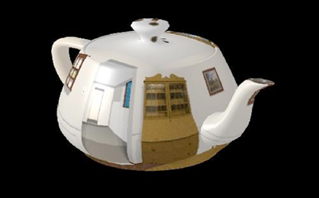
Distant Reflection
Look up reflection direction in reflection or environment map
22
Notes:
22

Slide 23
Cubic Environment Maps
Pick a face based on largest reflection vector component
Project onto the face
  Divide through
Use resulting coordinates for 2D lookup

Slide 24
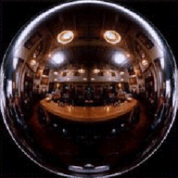
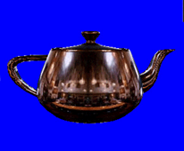
Spherical Environment Maps
Photograph of shiny sphere
  Lookup based on x/y coordinates of normal
DirectX Documentation

Slide 25
Texture All the Things
Texture/Albedo map (Catmull 74)
Reflection Map (Blinn and Newell 76)
Bump/Normal Map (Blinn 78 / Cohen 98)
Gloss Map (Blinn 78)
Transparency Map (Gardner 85)
Diffuse Reflectance (Miller and Hoffman 84)
Shadows, displacements, etc (Cook 84)
Tangent map (Kajiya 85)

Slide 26
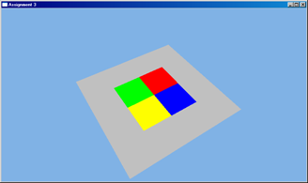
Texture Sampling
Point Sampling
  Map UV coordinate onto texel grid, grab corresponding texel
    i = floor(u*width)
    j = floor(v*height)
  Just like in 1995

Slide 27
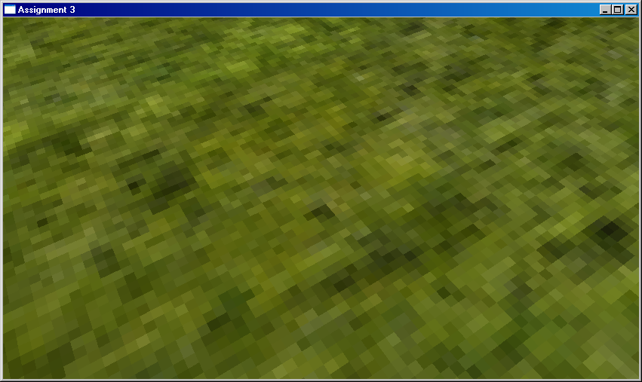
Point Sampling
Point sampling under magnification

Slide 28
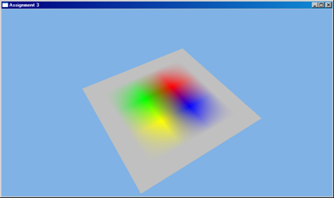
Filtered Sampling
Bilinear Filtering
  Interpolate texels in 2x2 neighborhood
    Top-left texel:
      floor(u*(width-1)), floor(v*(height-1))
    Weight by fractional coordinates

Slide 29
Point Sampling
Point sampling under magnification

Slide 30

Linear Sampling
Linear sampling under magnification

Slide 31
3D Textures
Array of 2D slices
3D Coordinates (u,v,w)
Bilinear tap in each slice using u,v
Blend using w

Slide 32
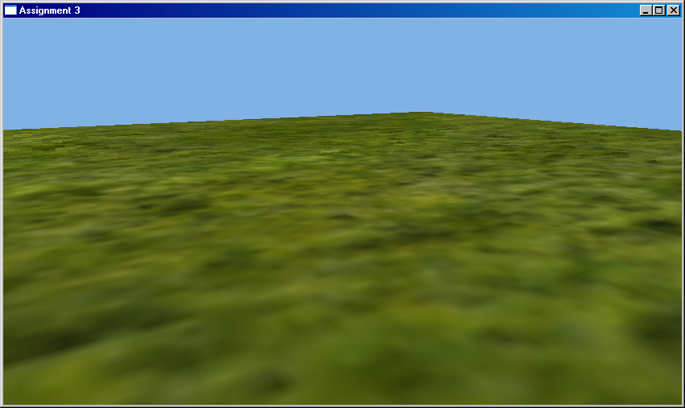
Minification
Aliasing!
Pixels:Texels < 1: Minification
Pixels:Texels ~= 1
Pixels:Texels > 1: Magnification

Slide 33
Minification Filtering
Anti-aliasing problem
Projected pixel footprint
Texel grid
Large jumps between pixels. Texture is undersampled…

Slide 34
Minification Filtering
One solution:
  Average lots of samples
Problems:
- Expensive
- Guessing the right sampling rate
- Performance death spiral for heavy minification

Slide 35
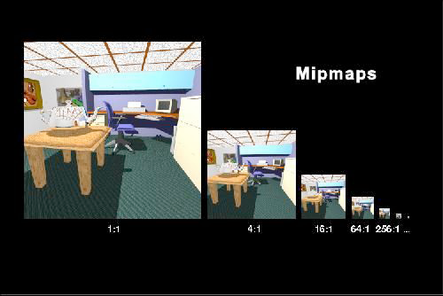
Mip-Mapping
Prefiltering:
  Precalculate chain of filtered images
    Each level is ½ previous resolution
From Latin: "multum in parvo" (much in little)

Slide 36
Mip-Mapping
Memory overhead is 33%
  Level i+1 is ½
  resolution of i:
    W/2*H/2=WH/4
  So…
Geometric series

Slide 37
Mip-Mapping
Derive footprint using UV derivatives in screenspace
du/dy, dv/dy
du/dx, dv/dx

Slide 38
Mip-Mapping
Approximate footprint with a square
  W = Width of square in texels
Find mip level matching footprint size
w

Slide 39
Mip-Mapping
Width of square in texels
Finest level that won’t alias
Base texels per ith level texel
Aliasing
“Just Right”
Magnification
0
Level of detail
…

Slide 40
Mip-Mapping
Level i
Blend bilinear taps at two nearest levels (8 texels accessed)
Sometimes incorrectly called “Trilinear”
Increasing footprint size
Level i+1

Slide 41
Without

Slide 42
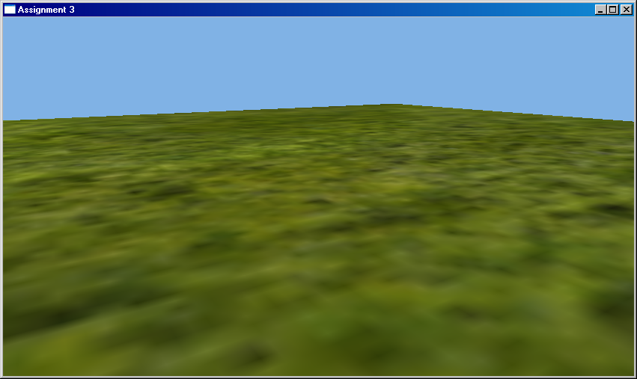
With

Slide 43
Getting Derivatives
Rasterizer: 2x2 Quads + Differencing
Missing pixels are extrapolated…
Each 2x2 quad is self-contained
This is a collosal pain in the collective necks of hardware architects

Slide 44
Getting Derivatives
Raytracer
  Intersect “differential” rays with tangent plane
  Track derivatives during secondary bounces

Slide 45
Mip-Mapping
Advantages:
  Cheap approximation to super-sampling
  Ensures 1:1 pixel/texel ratio
    May actually be FASTER than bilinear
      Avoids cache thrashing

Slide 46
Mip-Mapping
Disadvantages:
  Needs derivatives
    Complicates renderer
  33% Memory overhead
  Needs some preprocessing

Slide 47
Anisotropic Filtering
Mipmapping is isotropic
  Same in all directions
At oblique angles, footprint is NOT isotropic
  Result: Too much blur

Slide 48
Anisotropic Filtering
“Ideal” solution:
  Elliptical Weighted Average (EWA)
  Anisotropic gaussian kernel
  “Gold Standard”

Slide 49
Anisotropic Filtering
Actual Solution:
  Approximate ellipse with rectangle
    Box kernel
  Minor axis picks level
  Multiple filter taps along major axis
4x Anisotropic

Slide 50
No mipmapping

Slide 51
Trilinear

Slide 52

4x Anisotropic

