Slide 1
Ray Tracing Illumination
CMSC 435/634

Slide 2
Basic Illumination Concepts
Terms
  Illumination: calculating light intensity at a point (object space; equation) based loosely on physical laws
  Shading: algorithm for calculating intensities at pixels (image space; algorithm)
Objects
  Light sources: light-emitting
  Other objects: light-reflecting
Light sources
  Point (special case: at infinity)
  Area

Slide 3
Lambert’s Law
Intensity of reflected light related to orientation

Slide 4
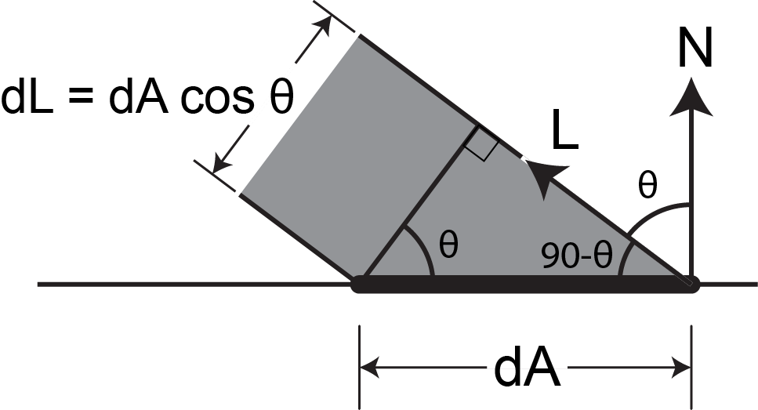
Lambert’s Law
Specifically: the radiant energy from any small surface area dA in any direction θ relative to the surface normal is proportional to cos θ

Slide 5
Ambient Light
Additional light bounces we’re not counting
Approximate them as a constant
  = Amount of extra light coming into this surface
  = Amount that bounces off of this surface
  Total extra light bouncing off this surface

Slide 6
Combined Model
Adding color:
For any wavelength λ:

Slide 7
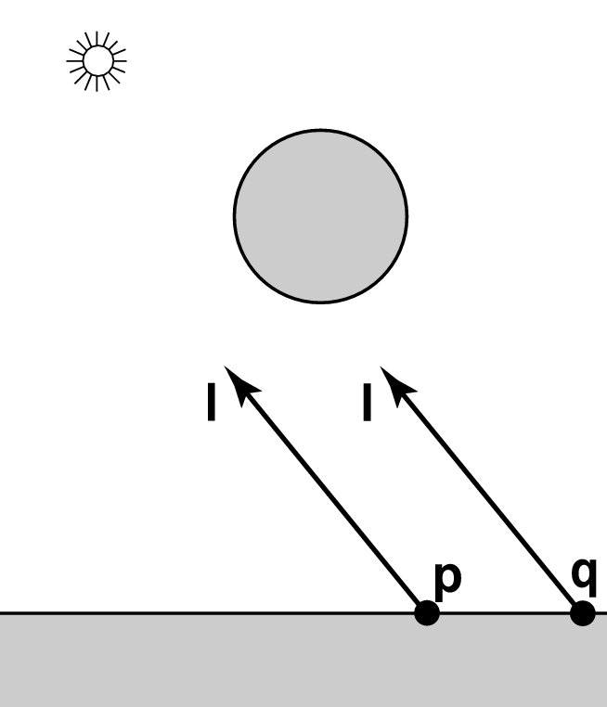
Shadows
What if there is an object between the surface and light?

Slide 8
Ray Traced Shadows
Trace a ray
  Start = point on surface
  End = light source
  t=0 at Suface, t=1 at Light
  “Bias” to avoid surface acne
Test
  Bias ≤ t ≤ 1 = shadow
  t < Bias or t > 1 = use this light

Slide 9

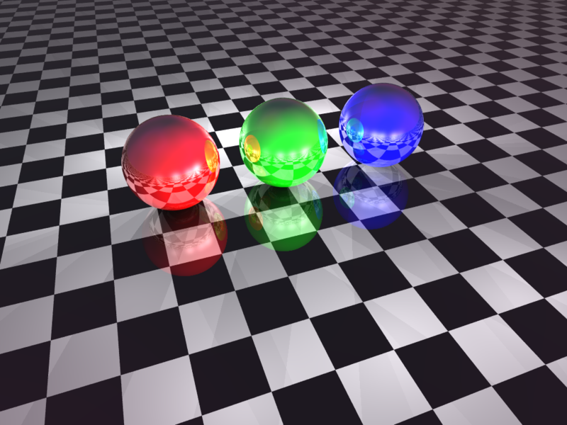
Mirror Reflection

Slide 10
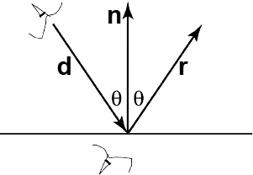
Ray Tracing Reflection
Viewer looking in direction d sees whatever the viewer “below” the surface sees looking in direction r
In the real world
  Energy loss on the bounce
  Loss different for different colors
New ray
  Start on surface, in reflection direction

Slide 11
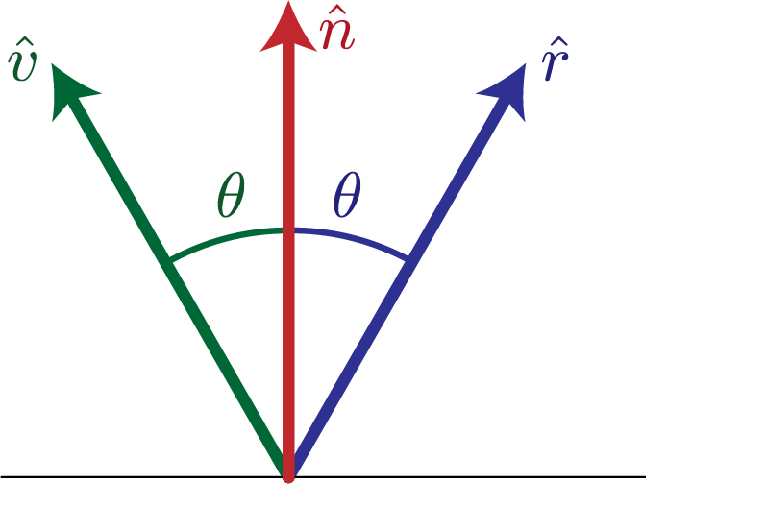
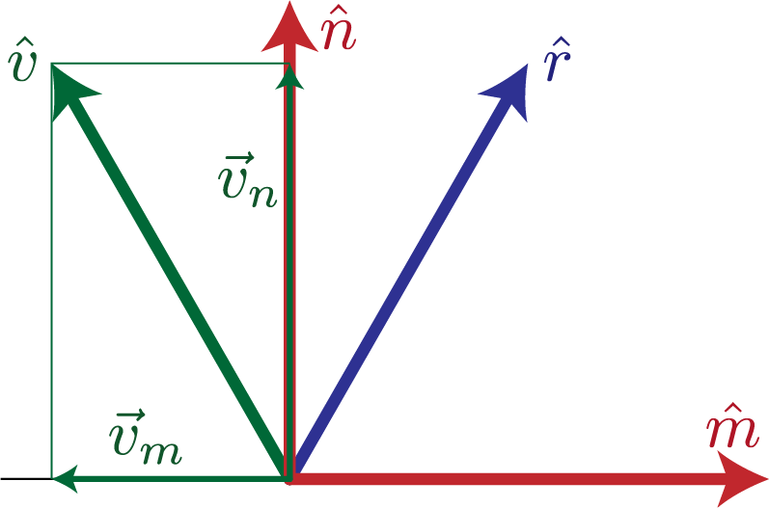
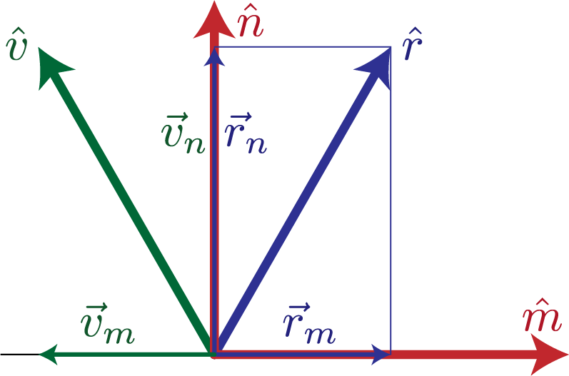
Calculating Reflection Vector
Angle of of incidence
= angle of reflection
Decompose
Recompose

Slide 12
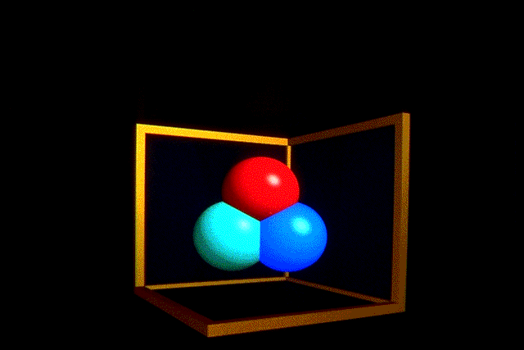
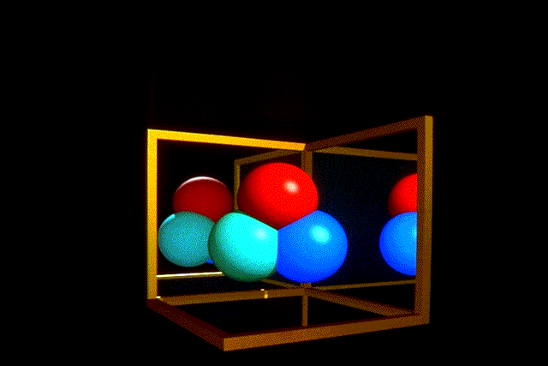
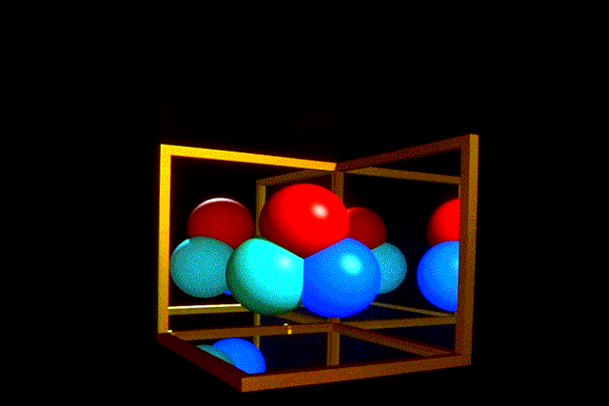
Ray Traced Reflection
Avoid looping forever
  Stop after n bounces
  Stop when contribution to pixel gets too small

Slide 13
Specular Reflection
Shiny reflection from rough surface
Centered around mirror reflection direction
  But more spread more, depending on roughness
Easiest for individual light sources

Slide 14
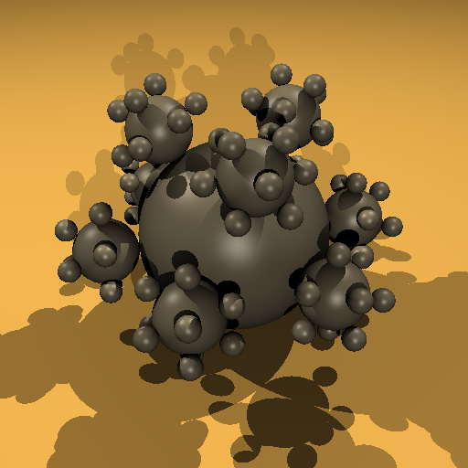
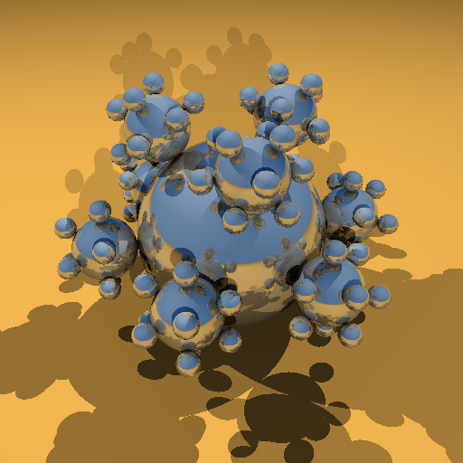
Specular vs. Mirror Reflection

Slide 15
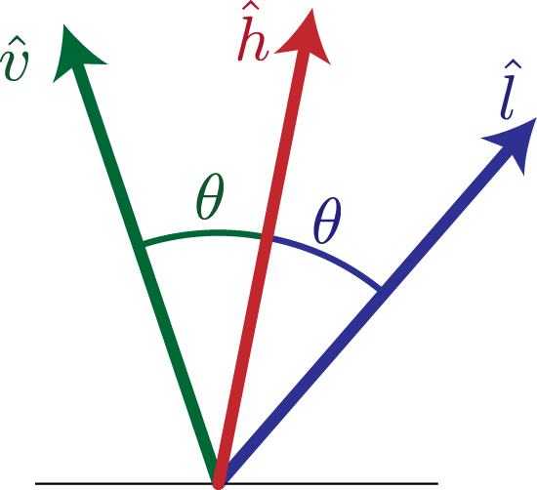
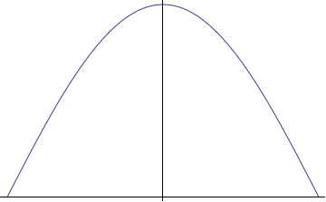
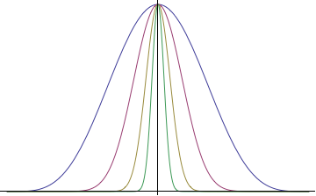
H vector
Strongest for normal that reflects to
  One at center of highlight
  Zero at 90°
Control highlight width

Slide 16
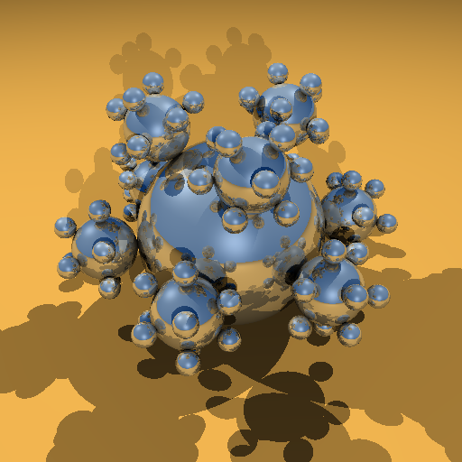

Combined Specular & Mirror
Many surfaces have both

Slide 17
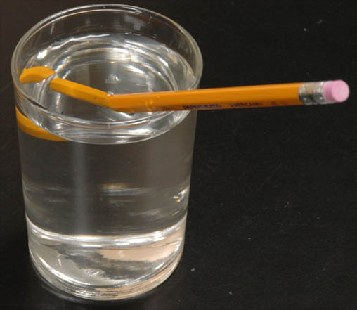
Refraction

Slide 18
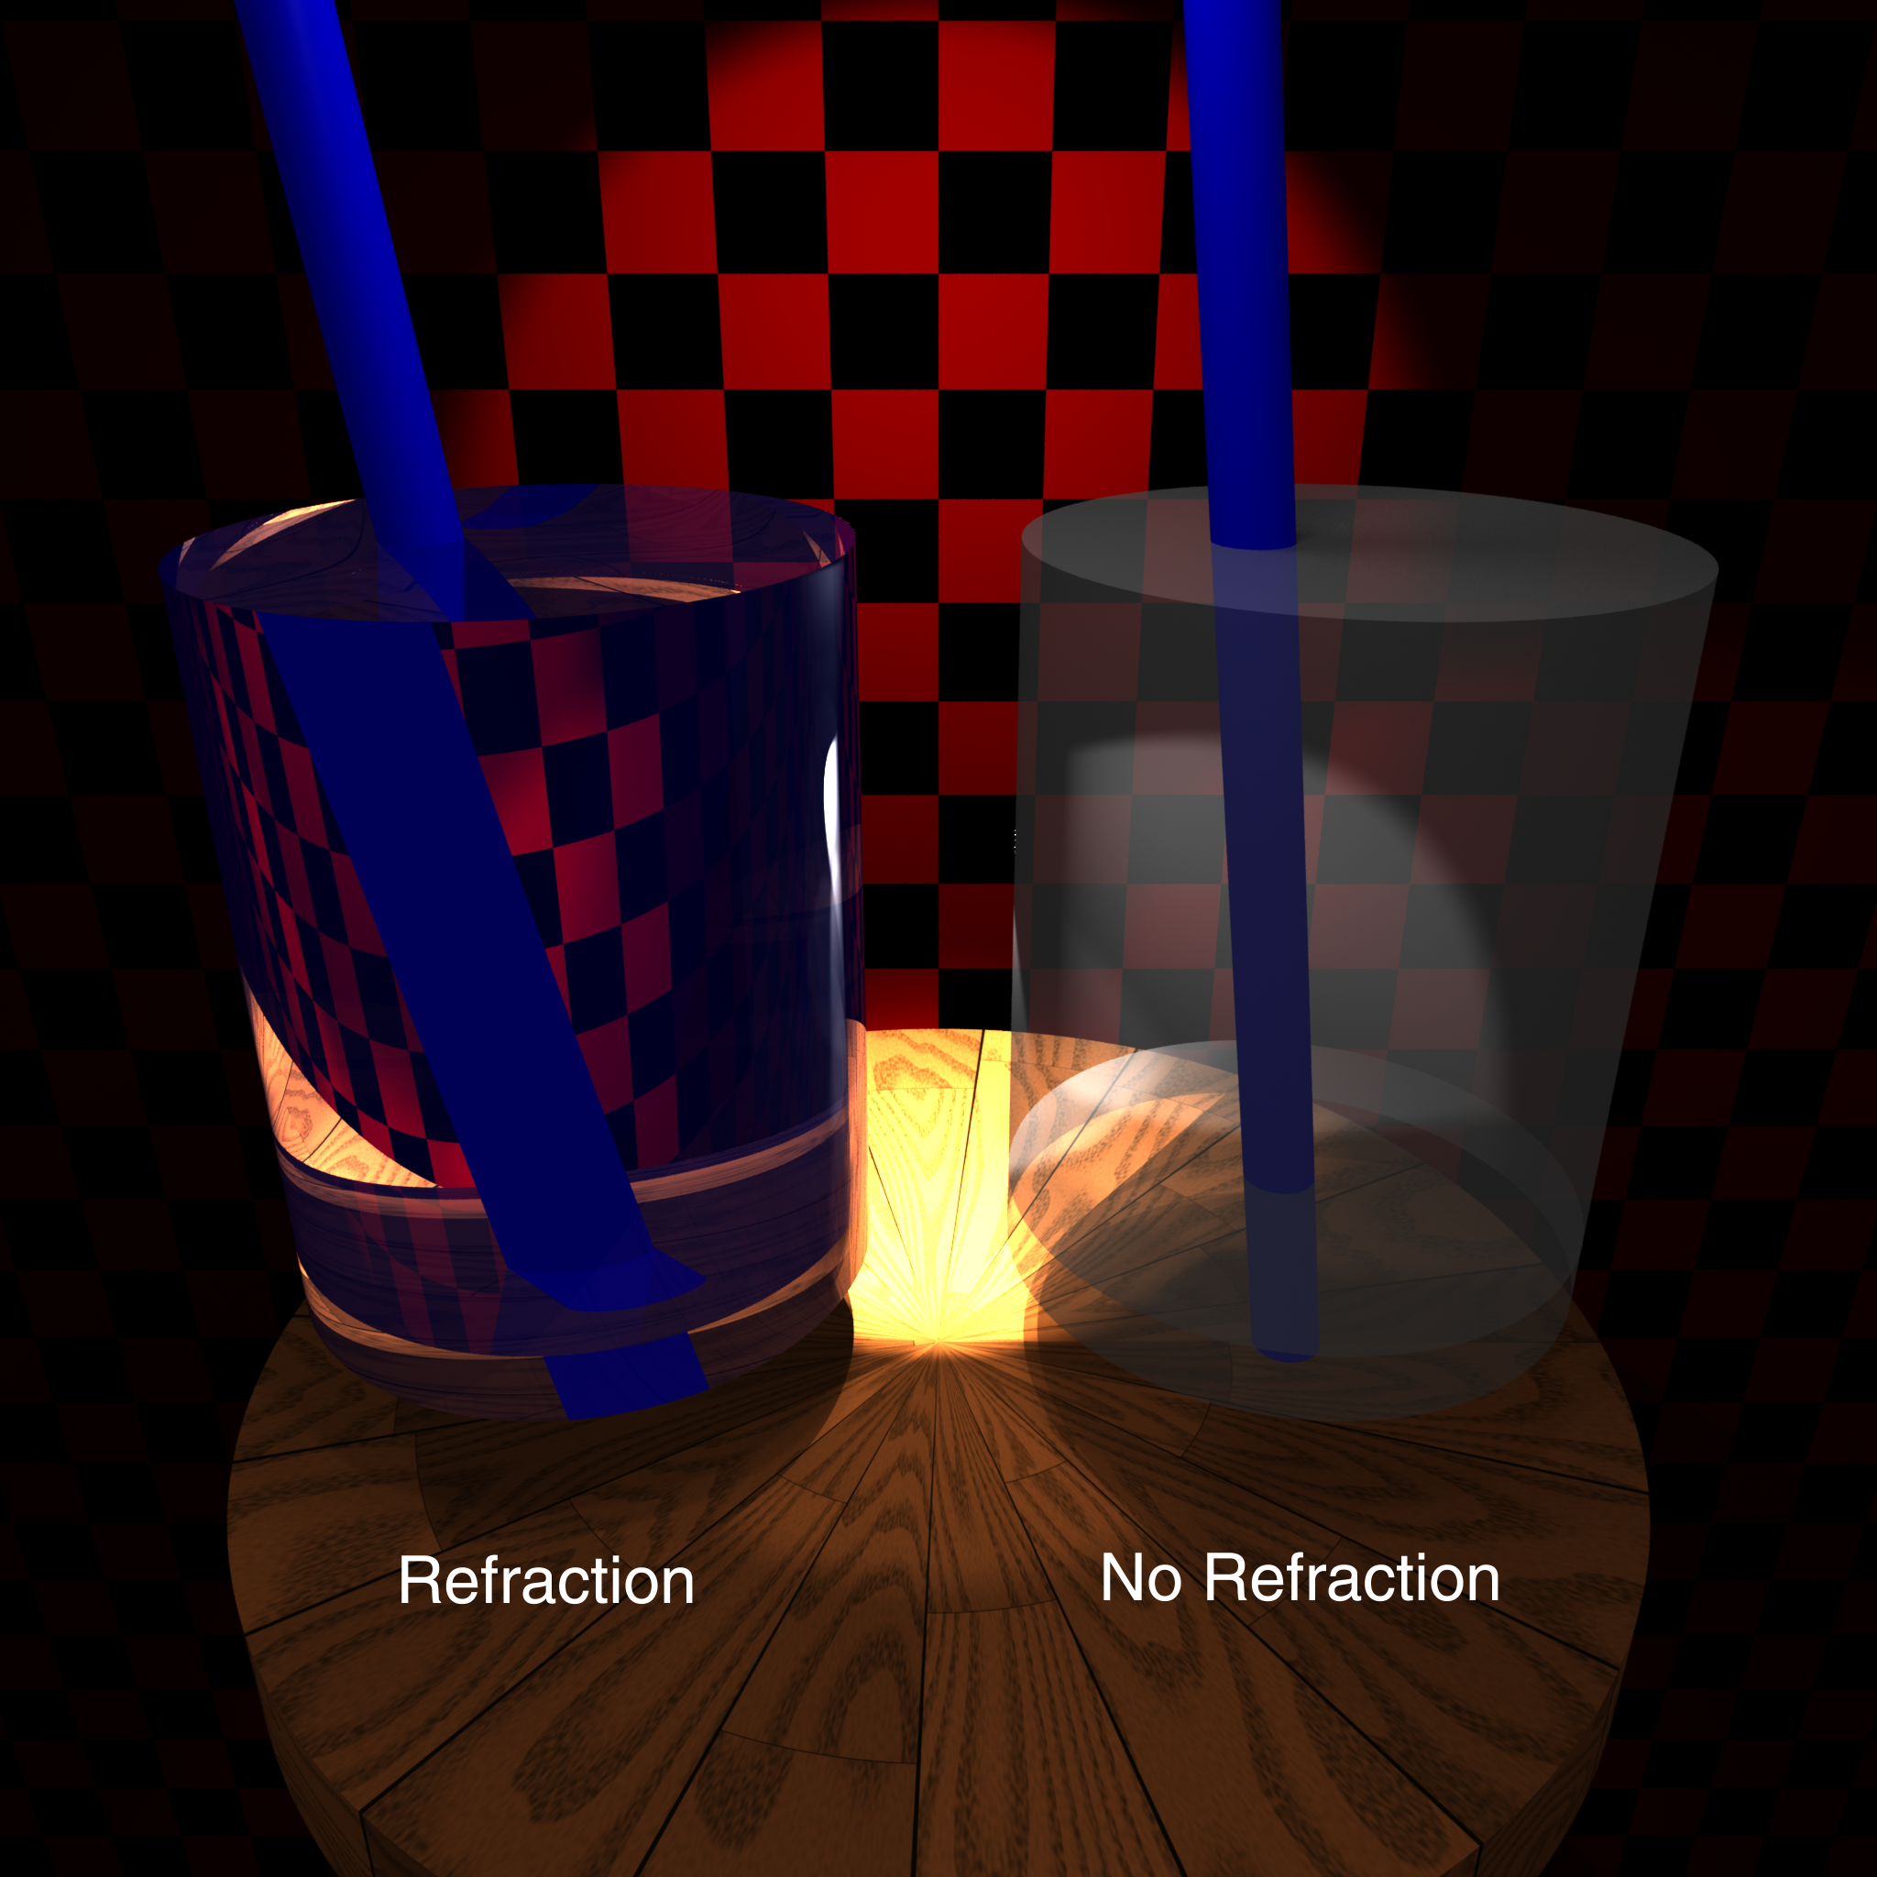

Slide 19
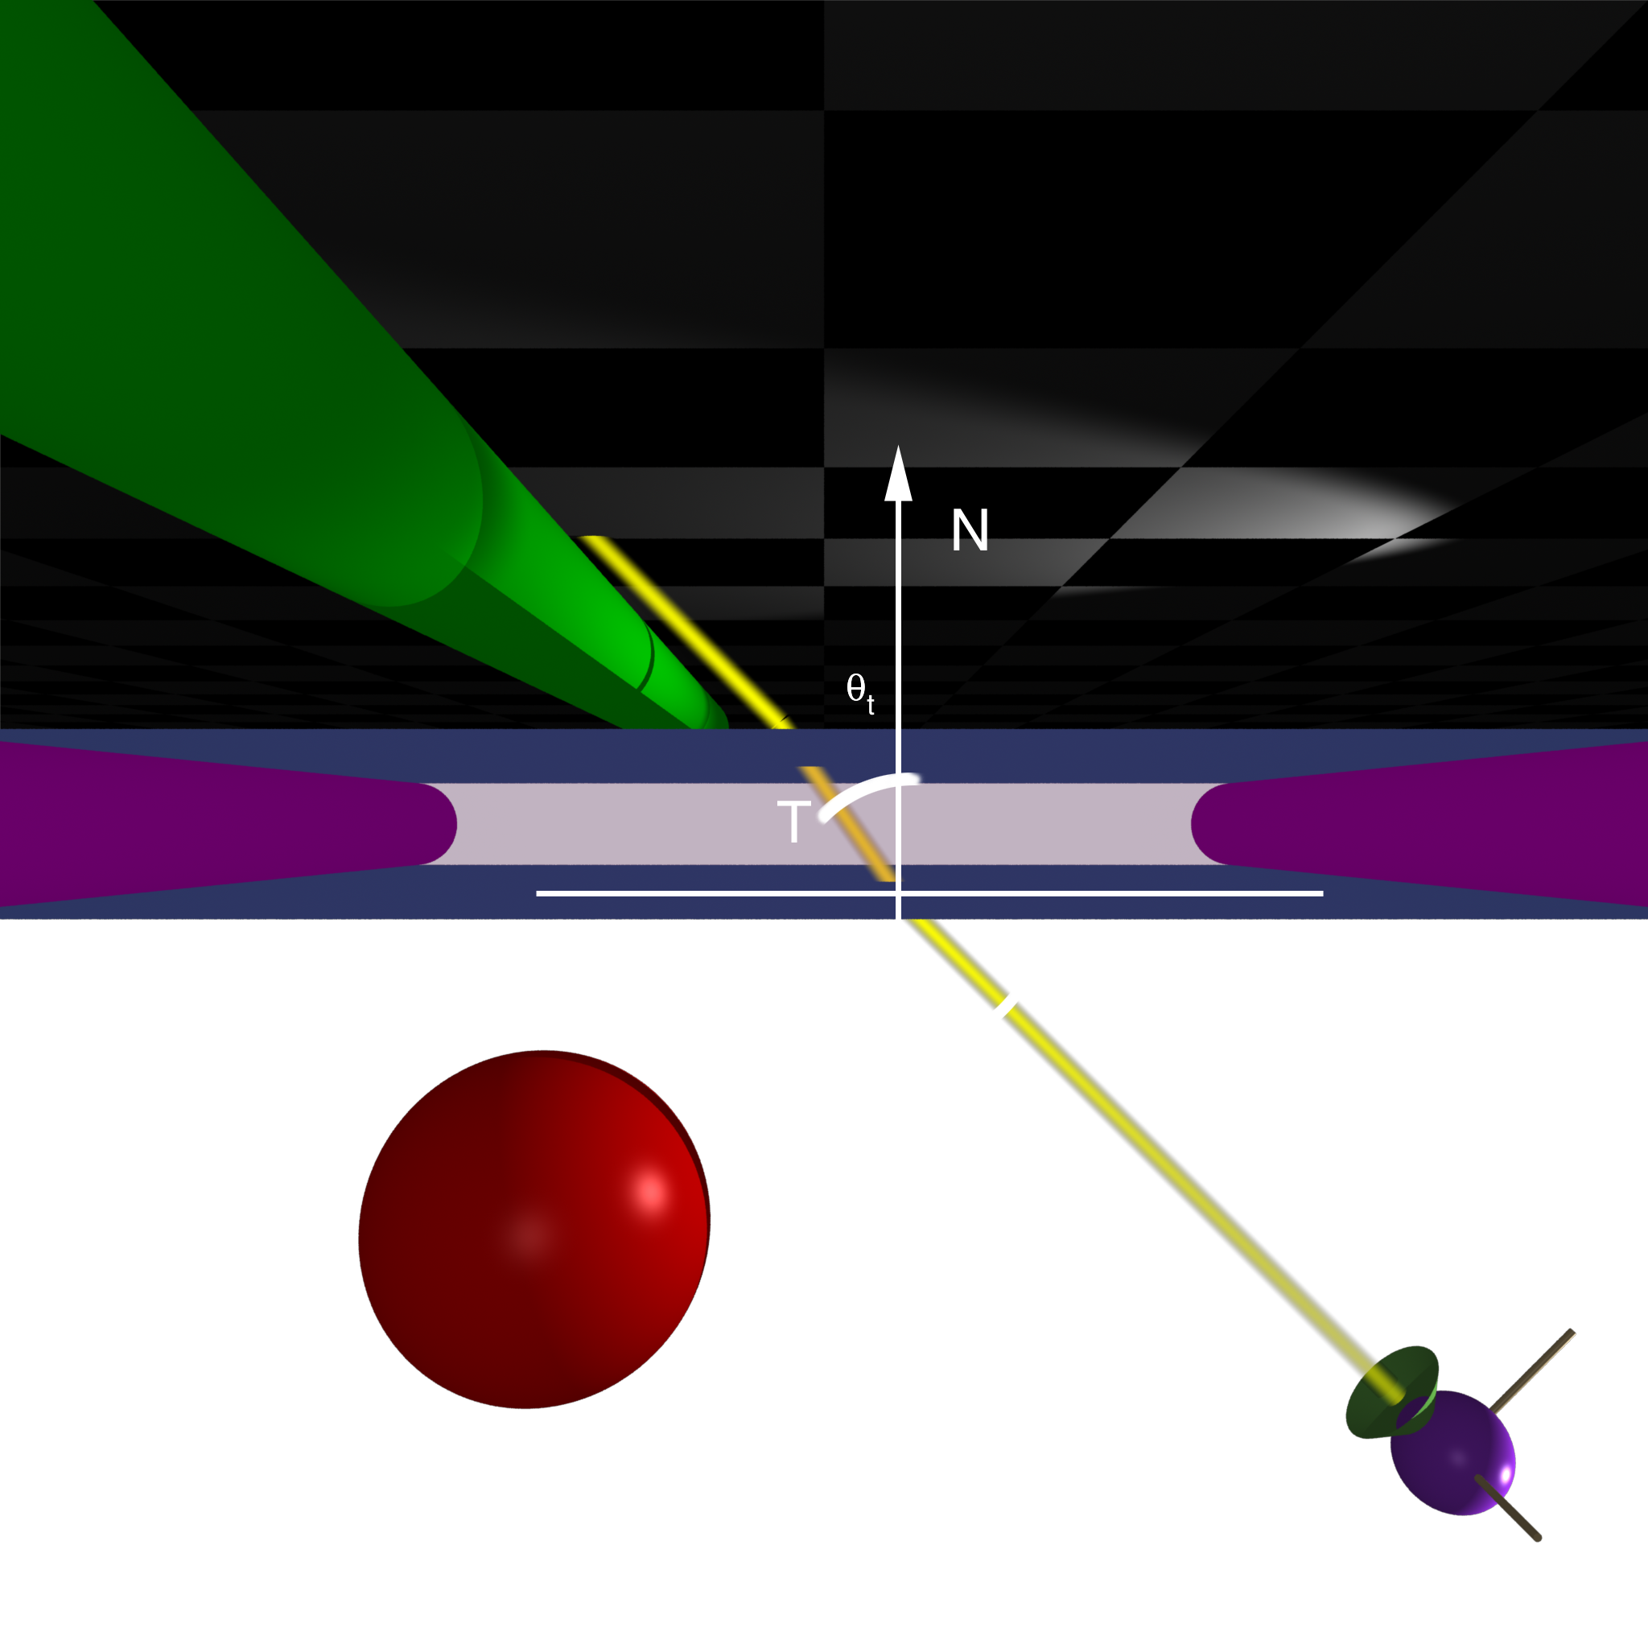
Top

Slide 20
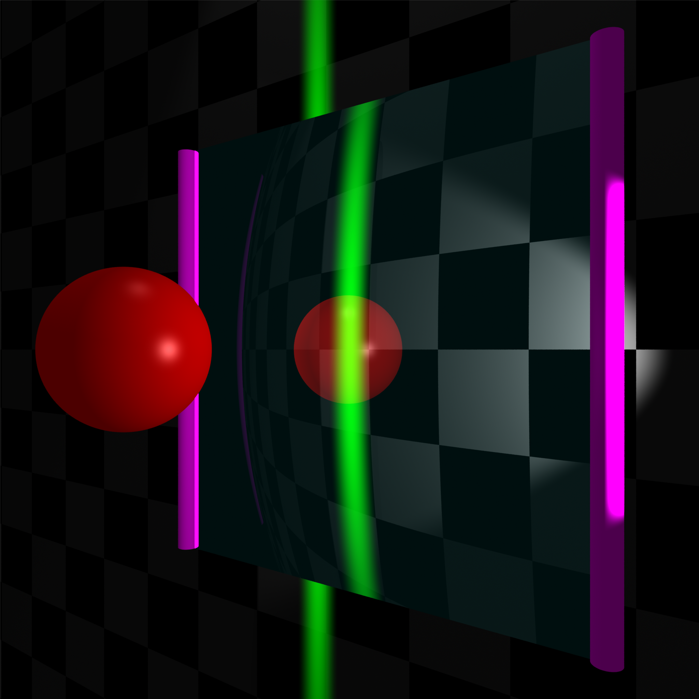
Front

Slide 21
Calculating Refraction Vector
Snell’s Law
In terms of
term

Slide 22
Calculating Refraction Vector
Snell’s Law
In terms of
term

Slide 23
Calculating Refraction Vector
Snell’s Law
In terms of
In terms of and

Slide 24
Alpha Blending
How much makes it through
α = opacity
  How much of foreground color 0-1
1-α = transparency
  How much of background color
Foreground*α + Background*(1-α)

Slide 25
Refraction and Alpha
Refraction = what direction
α = how much
  Often approximate as a constant
  Better: Use Fresnel
  Schlick approximation

Slide 26
Full Ray-Tracing
For each pixel
  Compute ray direction
  Find closest surface
  For each light
    Shoot shadow ray
    If not shadowed, add direct illumination
  Shoot ray in reflection direction
  Shoot ray in refraction direction

Slide 27
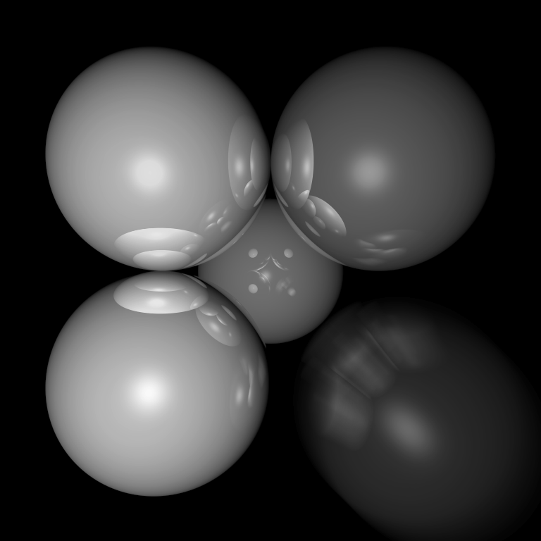
Motion Blur
Things move while the shutter is open

Slide 28
Ray Traced Motion Blur
Include information on object motion
Spread multiple rays per pixel across time

Slide 29
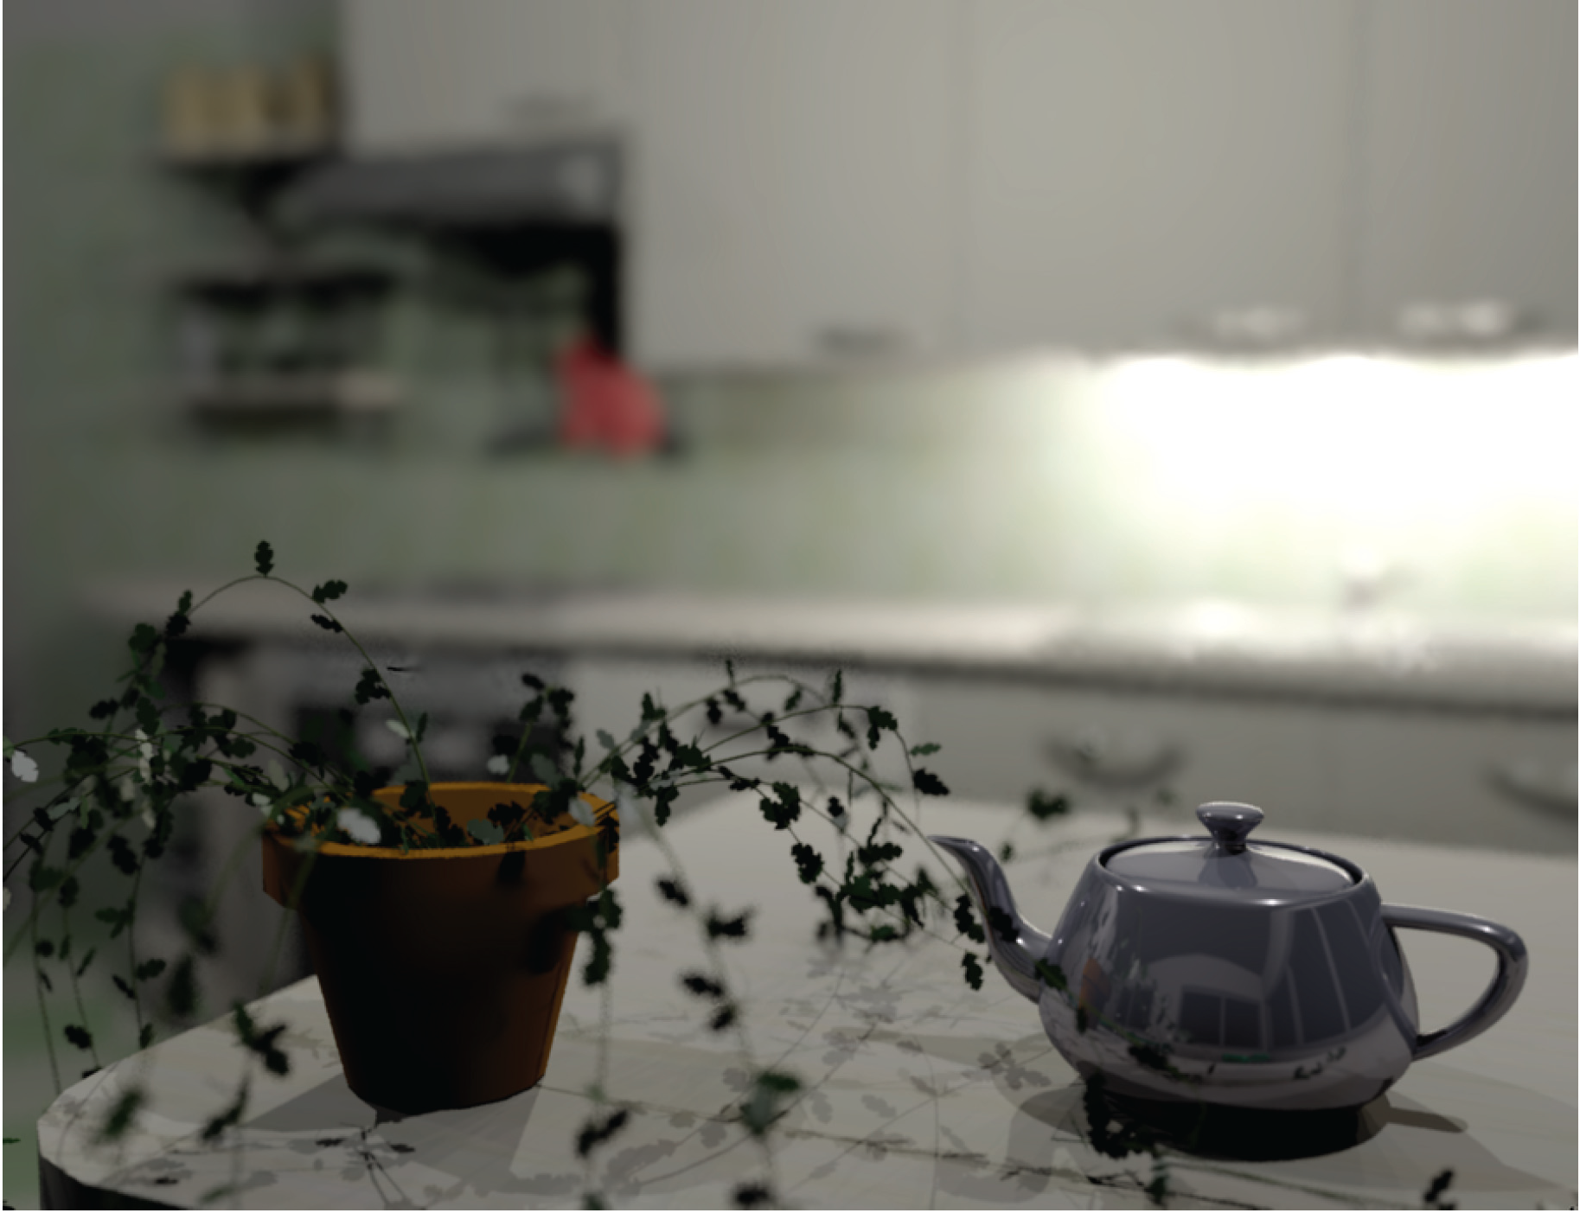
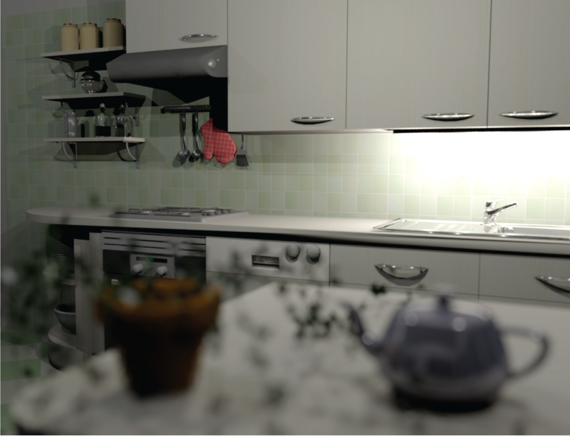
Depth of Field
Soler et al., Fourier Depth of Field, ACM TOG v28n2, April 2009

Slide 30
Pinhole Lens

Slide 31
Lens Model

Slide 32
Real Lens
Focal Plane

Slide 33
Lens Model
Focal Plane

Slide 34
Ray Traced DOF
Make sure image plane is at focal plane
Jitter start position within lens aperture
  Smaller aperture = closer to pinhole
  Larger aperture = more DOF blur

