Slide 1
Graphics Hardware
CMSC 435/634

Slide 2
A Graphics Pipeline
Transform
Shade
Vertex
Clip
Project
Rasterize
Triangle
Interpolate
Texture
Fragment
Z-buffer

Slide 3
Computation and Bandwidth
Based on:
• 100 Mtri/sec (1.6M/frame@60Hz)
• 256 Bytes vertex data
• 128 Bytes interpolated
• 68 Bytes fragment output
• 5x depth complexity
• 16 4-Byte textures
• 223 ops/vert
• 1664 ops/frag
• No caching
• No compression
Vertex
75 GB/s
67 GFLOPS
Triangle
13 GB/s
335 GB/s Texture
45 GB/s Fragment
Fragment
1.1 TFLOPS

Slide 4
Data Parallel
Distribute
Task
Task
Task
Task
Merge

Slide 5
Sort First
Objects
Distribute objects by screen tile
Vertex
Vertex
Vertex
Some pixels
Some objects
Triangle
Triangle
Triangle
Fragment
Fragment
Fragment
Screen

Slide 6
Sort Middle
Objects
Distribute objects or vertices
Vertex
Vertex
Vertex
Some objects
Merge & Redistribute by screen location
Triangle
Triangle
Triangle
Triangle
Some pixels
Some objects
Fragment
Fragment
Fragment
Fragment
Screen

Slide 7
Screen Subdivision
Tiled
Interleaved

Slide 8
Sort Last
Objects
Distribute by object
Vertex
Vertex
Vertex
Full Screen
Some objects
Triangle
Triangle
Triangle
Fragment
Fragment
Fragment
Z-merge
Screen

Slide 9
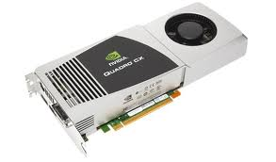
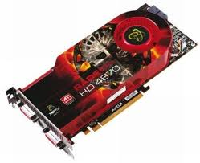
Graphics Processing Unit (GPU)
Sort Middle(ish)
Fixed-Function HW for clip/cull, raster, texturing, Ztest
Programmable stages
Commands in, pixels out

Slide 10
Architecture: Latency
CPU: Make one thread go very fast
Avoid the stalls
  Branch prediction
  Out-of-order execution
  Memory prefetch
  Big caches
GPU: Make 1000 threads go very fast
Hide the stalls
  HW thread scheduler
  Swap threads to hide stalls

Slide 11
Architecture (MIMD vs SIMD)
MIMD(CPU-Like)
SIMD (GPU-Like)
CTRL
ALU
CTRL
ALU
CTRL
ALU
ALU
ALU
ALU
CTRL
ALU
ALU
ALU
ALU
CTRL
ALU
ALU
ALU
ALU
Flexibility
Horsepower
Ease of Use

Slide 12
SIMD Branching
if( x ) // mask threads
// issue instructions
else // invert mask
// issue instructions
// unmask
Threads agree, issue if
Threads agree, issue else
Threads disagree, issue if AND else

Slide 13
SIMD Looping
Useful
Useless
while(x) // update mask
// do stuff
They all run ‘till the last one’s done….

Slide 14
GPU graphics processing model
CPU
Texture/Buffer
Vertex
Geometry
Rasterize
Fragment
Z-Buffer
Displayed
Pixels

Slide 15
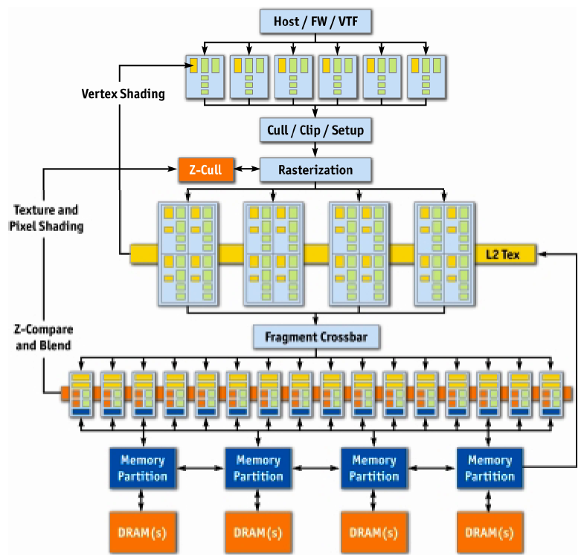
NVIDIA GeForce 6
Vertex
Rasterize
Fragment
Z-Buffer
Displayed
Pixels
[Kilgaraff and Fernando, GPU Gems 2]

Slide 16
GPU graphics processing model
CPU
Texture/Buffer
Vertex
Geometry
Rasterize
Fragment
Z-Buffer
Displayed
Pixels

Slide 17
GPU graphics processing model
CPU
Vertex
Texture/Buffer
Geometry
Fragment
Rasterize
Displayed
Pixels
Z-Buffer

Slide 18
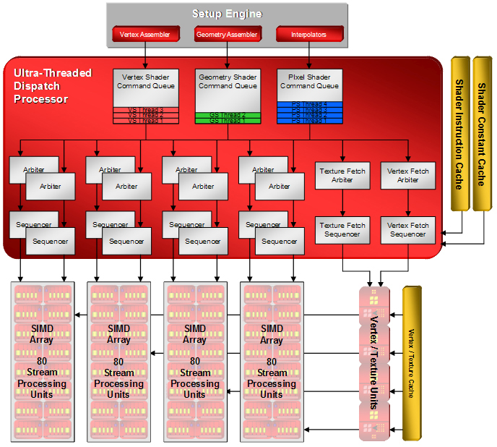
AMD/ATI R600 Dispatch

Slide 19
SIMD Units
2x2 Quads (4 per SIMD)
20 ALU/Quad (5 per thread)
“Wavefront” of 64 Threads, executed over 8 clocks
2 Waves interleaved
Interleaving + multi-cycling hides ALU latency.
Wavefront switching hides memory latency.
GPR Usage determines wavefront count.
General Purpose Registers
4x32bit
(THOUSANDS of them)

Slide 20
AMD/ATI R600
[Tom’s Hardware]

Slide 21
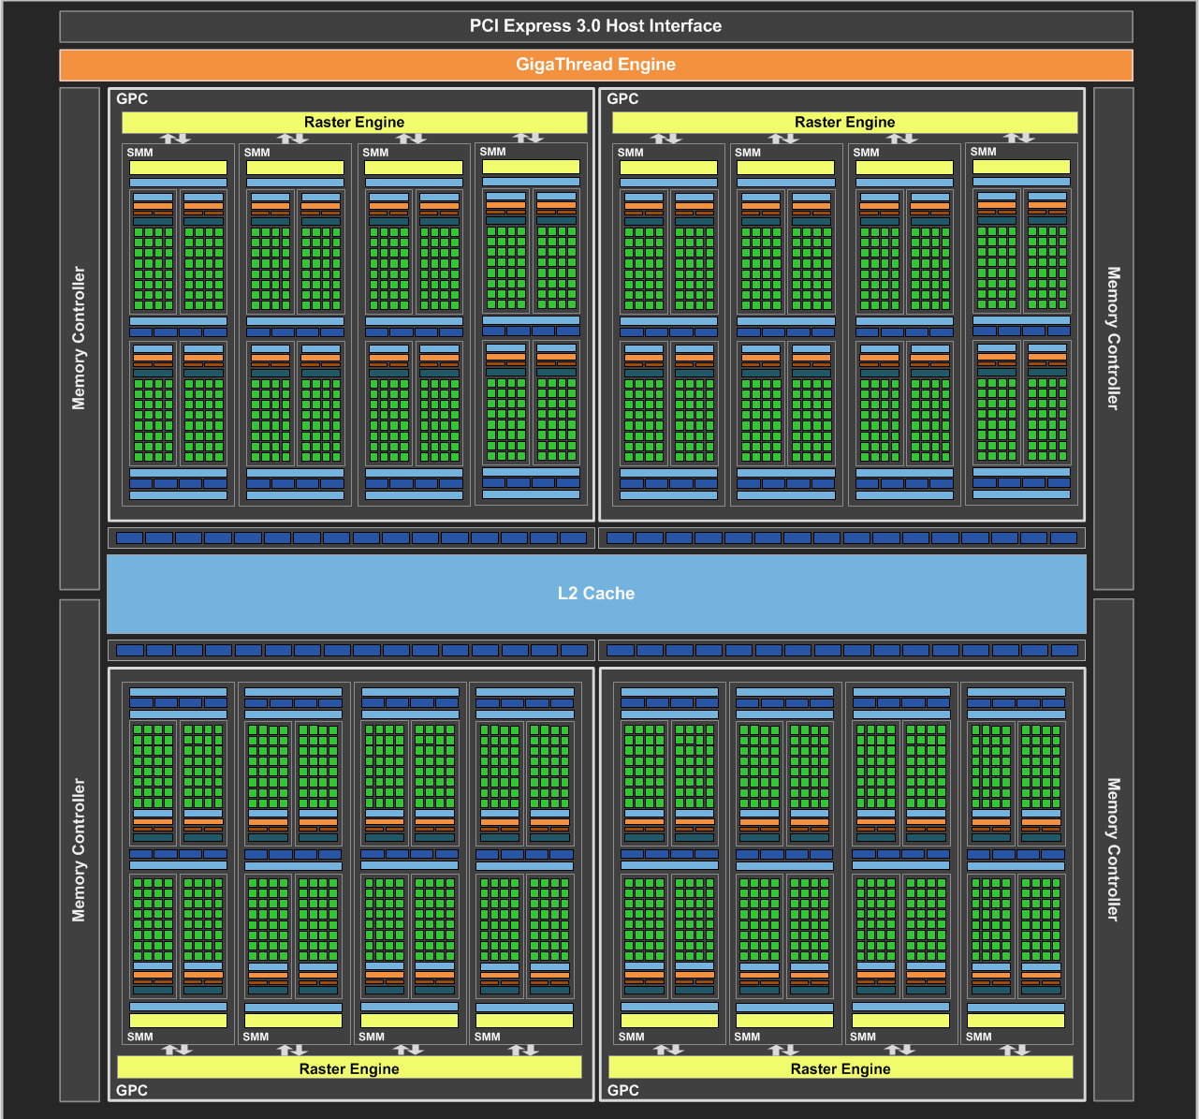
NVIDIA Maxwell
[NVIDIA, NVIDIA GeForce GTX 980 Whitepaper, 2014]

Slide 22
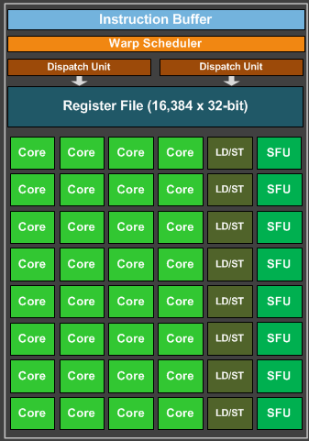
Maxwell SIMD Processing Block
32 Cores
8 Special Function
NVIDIA Terminology:
  Warp = interleaved threads
    Want at least 4-8
  Thread Block
  = Warps*Cores
Flexible Registers
  Trade registers for warps

Slide 23
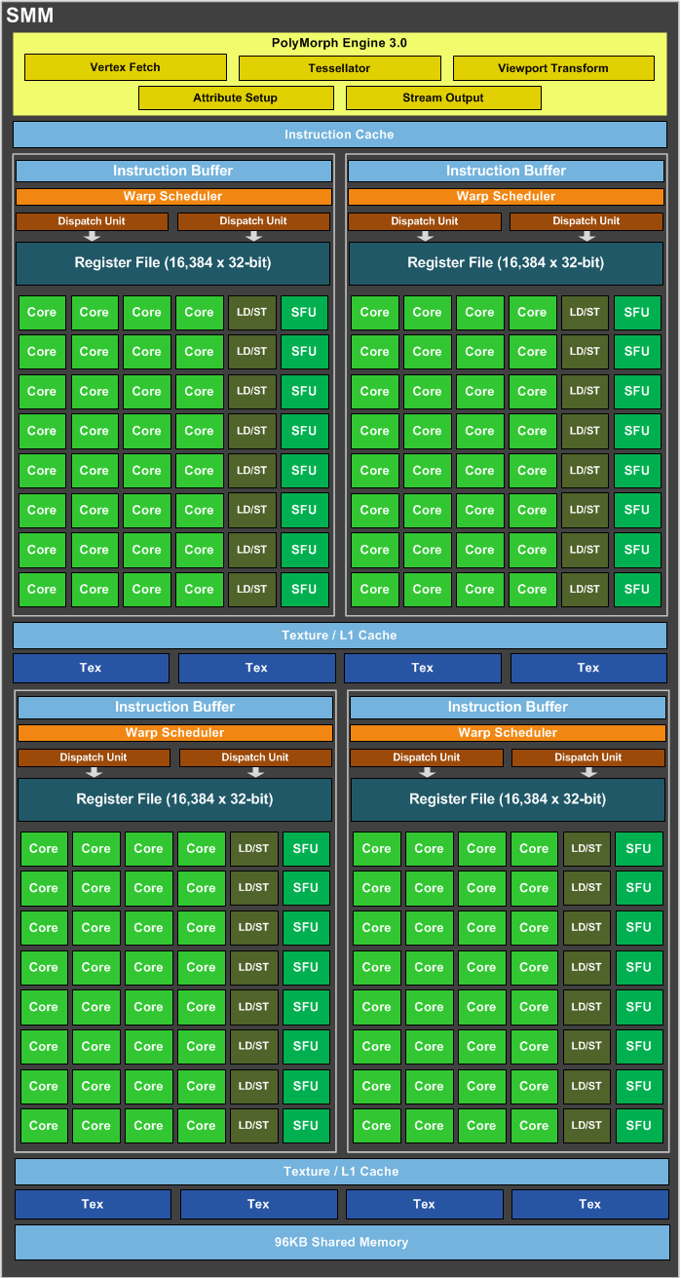
Maxwell Streaming
Multiprocessor (SMM)
4 SIMD blocks
Share L1 Caches
Share memory
Share tessellation HW

Slide 24
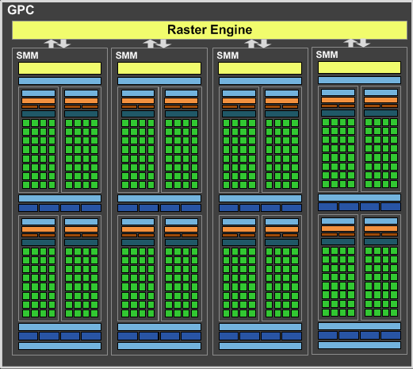
Maxwell Graphics Processing Cluster (GPC)
4 SMM
Share raster

Slide 25
Full NVIDIA Maxwell
4 GPC
Share L2
Share dispatch

Slide 26
NVIDIA Volta
[NVIDIA, NVIDIA TESLA V100 GPU ARCHITECTURE]

Slide 27
Care and Feeding of a GPU

Slide 28
Parallel Submission
OpenGL and DX11 had a 1-CPU thread bottleneck to the GPU
DX12, Vulkan and Metal are designed for multiple CPU cores to simultaneously submit work to a single GPU
Build a Command List, submit to GPU when ready
Command List includes all necessary state, can execute in any order
Tell GPU about resource dependencies (Barriers / Transitions)
  Enforces partial ordering of command list execution

Slide 29
Resource Transitions
What kind of memory operations does this buffer need to support?
  (CPU/GPU) (read/write) (once/many times)
  CPU write once, GPU read once; GPU write once, GPU read many times; …
Source/Target stage for the transition
  When is it ready? When will it be used?
What use should it be optimized for?
  CPU staging, Texture, Render Target, Depth Buffer, Vertex Buffer, Index Buffer,
  Graphics read/write unordered access view (UAV), Compute buffer, …
Explicitly transition between these
  E.g. between render target write in pass A and texture read in pass B

Slide 30
Setting up a Command List
What do I write?
  Render Targets, UAVs
  Transition to make sure anyone reading them is done
What do I read?
  Transition if just written or in a different format
What shader(s) am I using?
What shader parameter blocks?
  Given by Descriptors & Root Signature

Slide 31
Setting up a Graphics Command List
Begin Pass / End Pass
  Primarily necessary for batching on mobile
Rendering Graphics Pipeline State Object (PSO)
  Primitive Type: triangle list, fan, strip, quad, points, …
  Rasterizer State: Solid/wire frame, two sided / CW side / CCW side, MSAA
  Depth/Stencil State: Comparison (<, ≤,=,≠, ≥, >), update?
  Blend State: 𝛼 * new + (1 - 𝛼) * old
    Generalize to (a * new ^{(op)} b * old) for limited selection of a, b, and (op)

Slide 32
GPU Performance Tips

Slide 33
Graphics System Architecture
Your Code
Display
GPU
GPU
GPU(s)
API
Driver
Produce
Consume
Current Frame
(Buffering Commands)
Previous Frame(s)
(Submitted, Pending Execution)

Slide 34
GPU Performance Tips
API and Driver
  Reading Results Derails the train…..
    Occlusion Queries → Death
      When used poorly ….
    Framebuffer reads ➔ DEATH!!!
      Almost always…
  CPU-GPU communication should be one way
    If you must read, do it a few frames later…

Slide 35
GPU Performance Tips
API and Driver
  Minimize shader/texture/constant changes
  Minimize Draw calls
  Minimize CPU→GPU traffic
    glBegin()/glEnd() are EVIL!
    Use static vertex/index buffers if you can
    Use dynamic buffers if you must
      With discarding locks…

Slide 36
GPU Performance Tips
Shaders, Generally
  NO unnecessary work!
    Precompute constant expressions
    Div by constant → Mul by reciprocal
  Minimize fetches
    Prefer compute (generally)
    If ALU/TEX < 4+, ALU is under-utilized
    If combining static textures, bake it all down…

Slide 37
GPU Performance Tips
Shaders, Generally
  Careful with flow control
    Avoid divergence
    Flatten small branches
    Prefer simple control structure
  Double-check the compiler
    Shader compilers are getting better…
  Look over artists’shoulders
    Material editors give them lots of rope….

Slide 38
GPU Performance Tips
Vertex Processing
  Use the right data format
    Cache-optimized index buffer
    Small, 16-byte aligned vertices
  Cull invisible geometry
    Coarse-grained (few thousand triangles) is enough
    “Heavy” Geometry load is ~2MTris and rising

Slide 39
GPU Performance Tips
Pixel Processing
  Small triangles hurt performance
    2x2 pixel quads ➔ Waste at edge pixels
  Respect the texture cache
    Adjacent pixels should touch adjacent texels
    Use the smallest possible texture format
  Avoid dependent texture reads
  Do work per vertex
    There’s usually less of those (see small triangles)

Slide 40
GPU Performance Tips
Pixel Processing
  HW is very good at Z culling
    Early Z, Hierarchical Z
  If possible, submit geometry front to back
  “Z Priming” is commonplace
    Render with simple shader to z-buffer
    Then render with real shader

Slide 41
GPU Performance Tips
Blending/Backend
  Turn off what you don’t need
    Alpha blending
    Color/Z writes
  Minimize redundant passes
    Multiple lights/textures in one pass
  Use the smallest possible pixel format
  Consider clip/discard in transparent regions

