Slide 1
Shading
CMSC 435/634

Slide 2
RenderMan
Displacement
Surface
Light
Volume
Imager

Slide 3

Displacement
Given
  Position
  Normal
Compute
  Position
  Normal
Displacement
Surface
Light
Volume
Imager

Slide 4
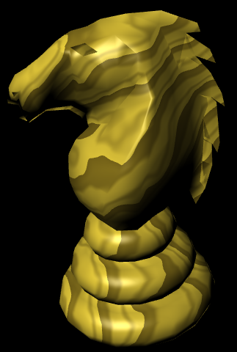
Surface color
Given
  Position
Compute
  Color
  Opacity
Displacement
Surface
Light
Volume
Imager

Slide 5
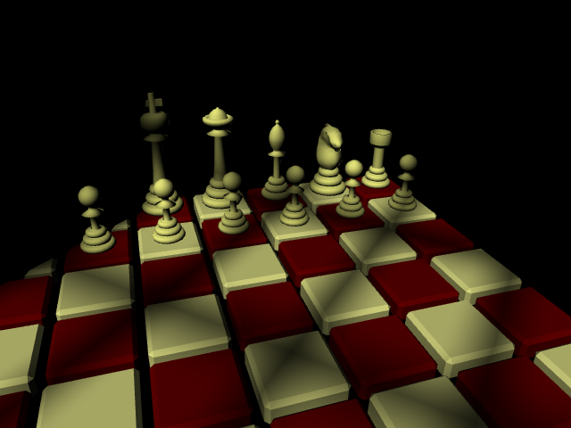
Lighting
Given
  Surface Position
Compute
  Light Direction
  Light Color
Displacement
Surface
Light
Volume
Imager

Slide 6
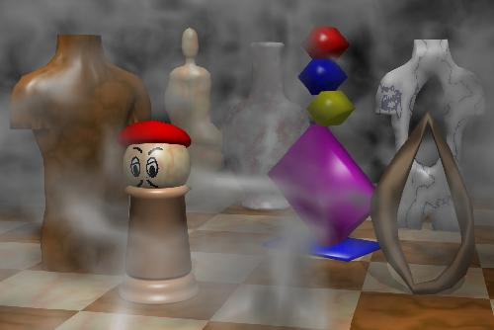
Volume Effects
Given
  Position
  Color
Compute
  New Color
Displacement
Surface
Light
Volume
Imager

Slide 7
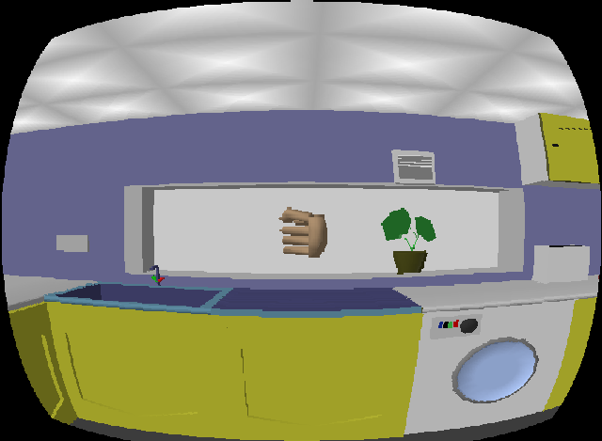
Image Effects
Given
  Pixel Color
Compute
  Pixel Color
Displacement
Surface
Light
Volume
Imager

Slide 8
Non-real time vs. Real-time
RenderMan
GPU
Application
Application
Displacement
Texture/
Buffer
Vertex
Light
Surface
Geometry
Volume
Imager
Fragment
Displayed
Pixels
Displayed
Pixels

Slide 9
RenderMan vs. GPU
RenderMan
  Developed from General CPU code
  Seconds to hours per frame
  1000s of lines
  “Unlimited” computation, texture, memory, …
GPU
  Developed from fixed-function hardware
  Tens of frames per second
  1000s of instructions
  Limited computation, texture, memory, …

Slide 10
History (not real-time)
Testbed [Whitted and Weimer 1981]
Shade Trees [Cook 1984]
Image Synthesizer [Perlin 1985]
RenderMan [Hanrahan and Lawson 1990]

Slide 11
History (real-time)
Custom HW [Olano and Lastra 1998]
Multi-pass standard HW [Peercy, Olano, Airey and Ungar 2000]
Register combiners [NVIDIA 2000]
Vertex programs [Lindholm et al. 2001]
Compiling to mixed HW [Proudfoot et al. 2001]
Fragment programs
Standardized languages
Compute

Slide 12
GLSL / HLSL
Vertex, Geometry & Fragment/Pixel
C-like, if/while/for
Structs & arrays
Float + small vector and matrix
  vec2, vec3, vec4, mat2, mat3, mat4
  Swizzle & mask (a.xyz = b.xxw)

Slide 13
GLSL / HLSL
Common math & shading functions
  Trigonometric, exponential, min, max, abs, …
  length, distance, normalize, dot, cross
  mix(a, b, t)
  clamp(t, a, b)
  step(a, t), smoothstep(a, b, t)
  reflect, refract

Slide 14
Shader Debugging
Render as color
  Map intermediate values to 0-1
  Interpret results
Hot reloading
  Make changes without changing viewpoint
Remap debug values
  vec4(-sign(x), sign(x), abs(x), 1)
  x / (1 + abs(x))
External debugging tools

Slide 15
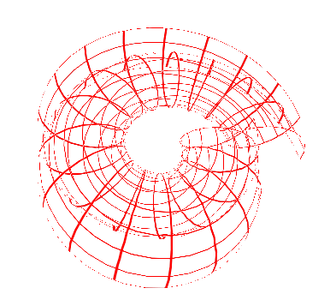
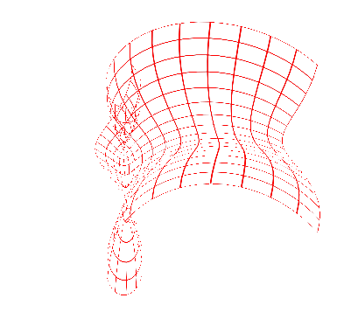
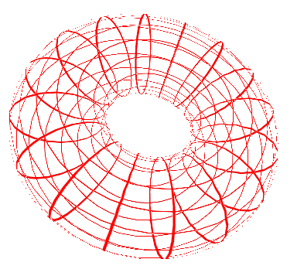
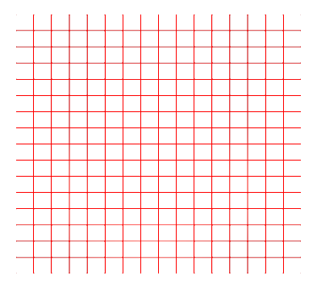
Vertex Demo:
Blend Positions

Slide 16
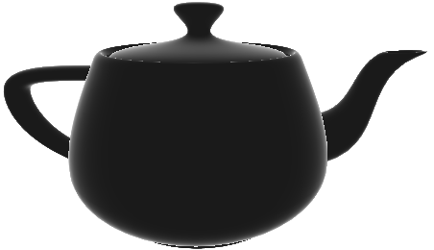
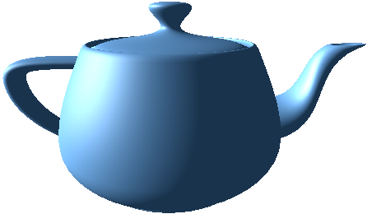
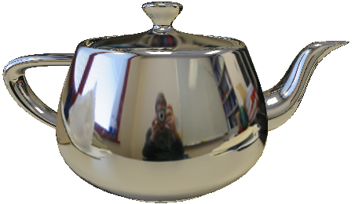

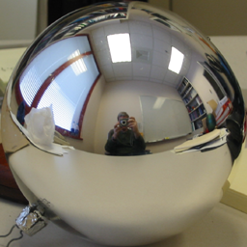
Vertex + Fragment Demo:
Fresnel Environment Map

Slide 17
Shading Methods
Repeating Patterns
  mod, sin
  Divide and floor
Shapes
  Implicit form: is this pixel inside
Color tables
Noise or computed patterns

Slide 18
Brick Demo
mortar
brick
gap
height
width
gap

Slide 19
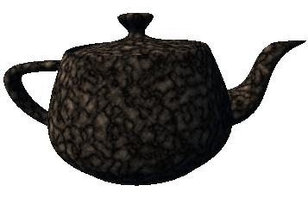
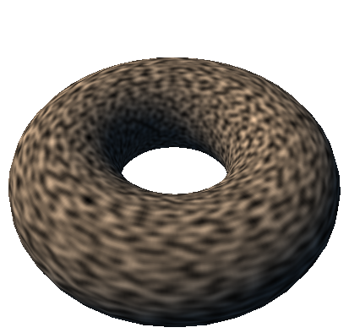
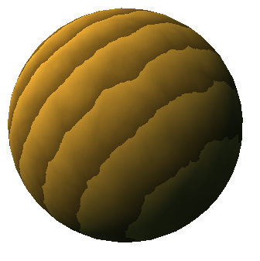
Noise
Controlled, repeatable randomness
  Still spotty GPU implementation
  Can use texture or compute

Slide 20
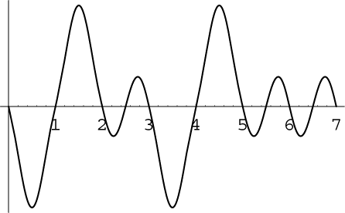
Noise Characteristics
Repeatable
Locally continuous but distant points uncorrolated
Values
  RenderMan [0,1], average 0.5
  Perlin’s [-1,1], average 0
1/2 – 1 cycle per unit
Versions for 1D-4D input

Slide 21
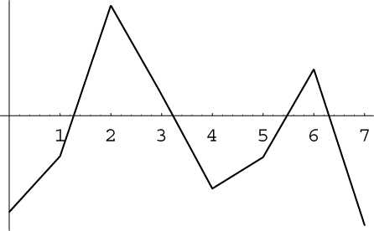
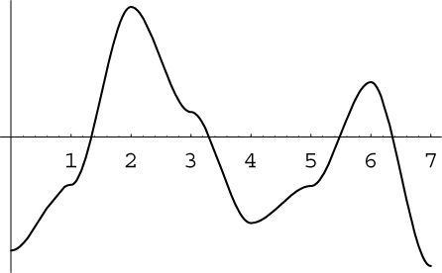
Noise Subtleties
Many noise functions based on a lattice
  Piecewise function between integer coordinates
  Hash of integer coordinates → control points
Interpolating values easy but poor
  Even with higher-order interpolation
Perlin’s noise
  Passes through 0 at each integer
  Hash gives gradient

Slide 22
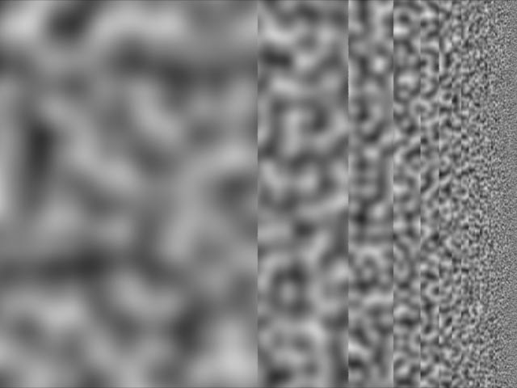
Perlin Noise in RenderMan
Ci = float noise(floor(1/t)*P);
1
2
3
4
5
6
7
8
12
13
9
14
15
16
20

Slide 23
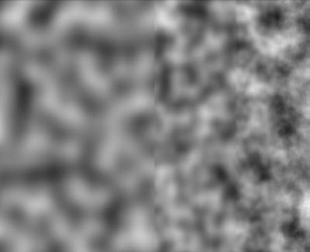
Fractional Brownian Motion (fBm)
// Combine octaves, scaled by 1/f
for(f=1; f<=floor(1/t); f*=2)
Ci += (float noise(f*P)-.5)/f;
Ci += .5;
1
2
3
4
5
6
7
8
12
13
9
14
15
16
20

Slide 24
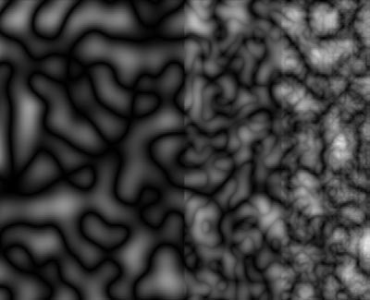
Turbulence
// fBm using abs(noise)
for(f=1; f<=floor(1/t); f*=2)
Ci += abs(float noise(f*P)-.5)/f;
Ci += .5;
1
2
3
4
5
6
7
8
12
13
9
14
15
16
20

Slide 25
Advanced Shading Methods
Perturbed patterns
  Adjust position, radius, etc. with noise
Bombing
  Divide space into cells
  Compute random position in each cell
  Check if pixel is inside shape
Blending
  Fade effects in and out with smoothstep

