Slide 1
Antialiasing
CMSC 435/634

Slide 2
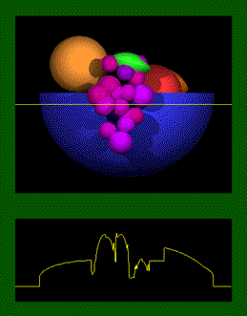
Original Scene
Luminosity

Slide 3
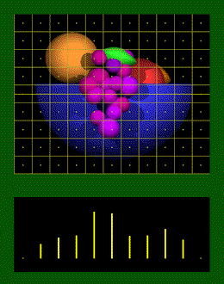
Pixel Sampling
Samples

Slide 4
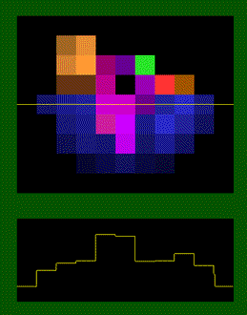
Displayed Image
Luminosity

Slide 5
What went wrong?

Slide 6
Aliasing
Visual artifacts
  Jagged lines and edges
  High frequencies appearing as low
  Small objects missed
  Texture distortions
  Strobing and popping
  Backward movement

Slide 7
Jagged Lines

Slide 8
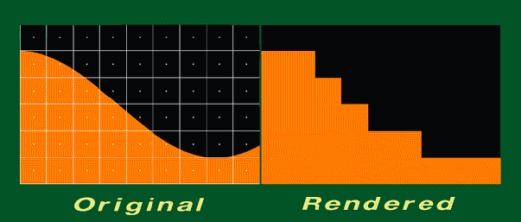
Jagged Edges

Slide 9
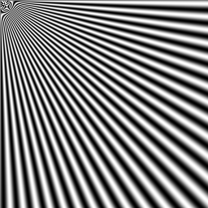
Frequency Aliasing

Slide 10
Missed Detail

Slide 11
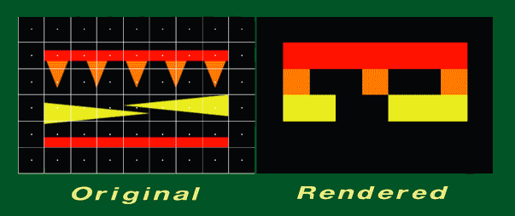
Missed Detail

Slide 12
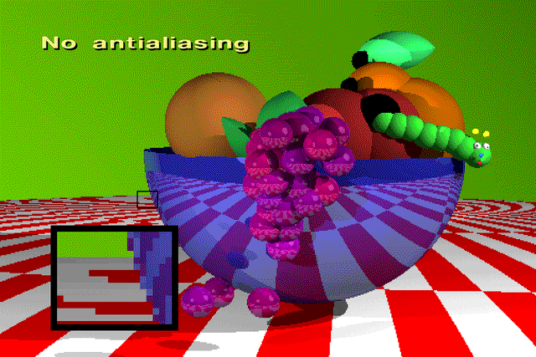

Slide 13
Strobing/Popping

Slide 14
How might you fix aliasing?

Slide 15
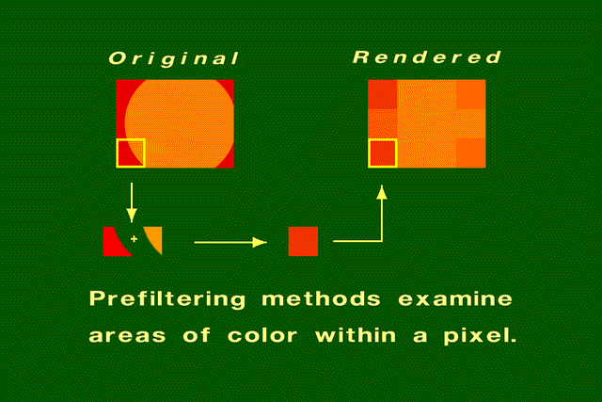

Slide 16


Slide 17
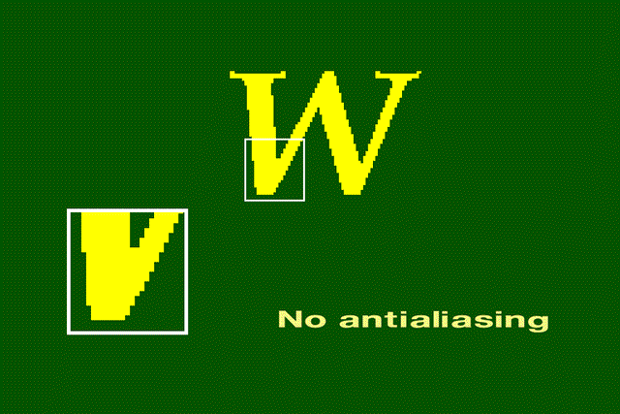

Slide 18
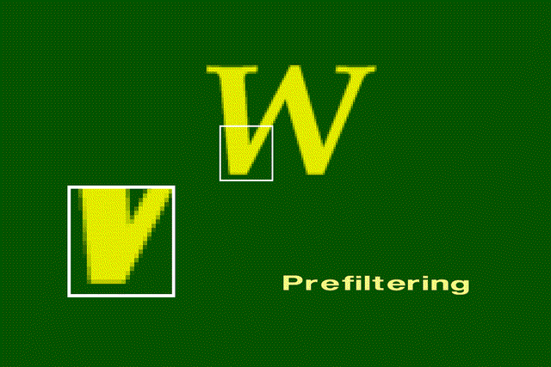

Slide 19
Sampling Theory
Shannon’s sampling theory (1D):
  A band limited signal f(t) with cut off frequency w_{F} may be perfectly reconstructed from its samples f(nT₀) if 2π/T₀ >= 2w_{F}
  w_{F} == Nyquist limit
Alternatively:
  a signal can be reconstructed exactly from samples only if the highest frequency is less than half the sampling rate

Slide 20
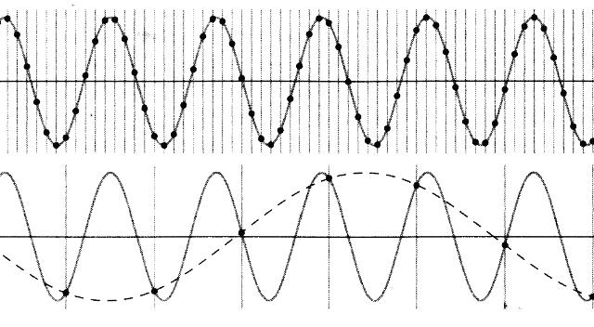
Sampling a Sine Wave

Slide 21
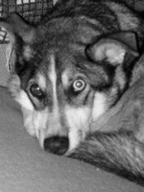
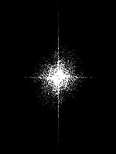
What Will Alias?
Plot based on frequency
  Like audio equalizer
  Fourier transform

Slide 22
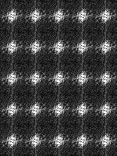
What Will Alias?
Sampling replicates spectrum in a grid
  Aliasing when they overlap

Slide 23
How to Fix It?
Filter
  Blur away high frequency
  Blur is better than aliasing

Slide 24
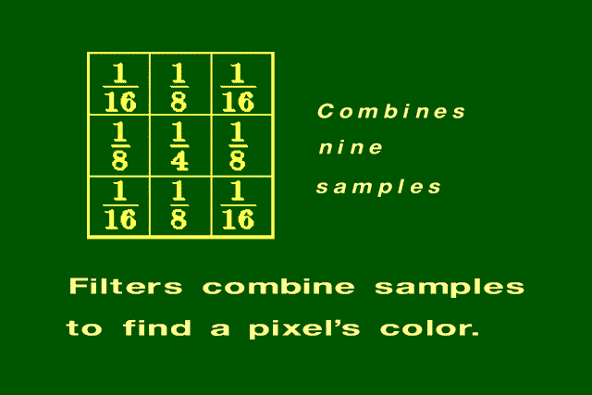
Filters

Slide 25
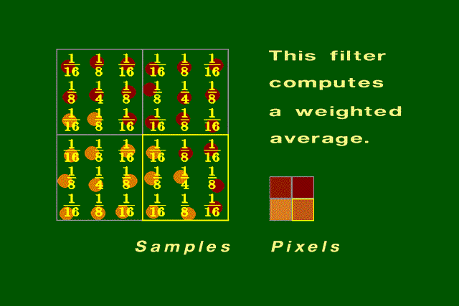
Using a Filter to Compute Pixel Color

Slide 26
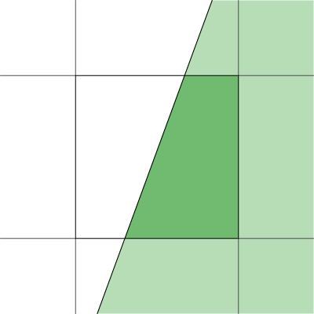
Analytic Area Sampling
Compute “area” of pixel covered
Box in spatial domain
  Nice finite kernel
    easy to compute
  sinc (sin(x)/x) in freq domain
    Plenty of high freq
    Still aliases

Slide 27
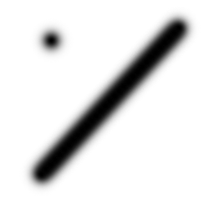
Analytic higher order filtering
Fold better filter into rasterization
  Can make rasterization much harder
  Usually just done for lines
    Draw with filter kernel
    “paintbrush”
Only practical for
finite filters

Slide 28
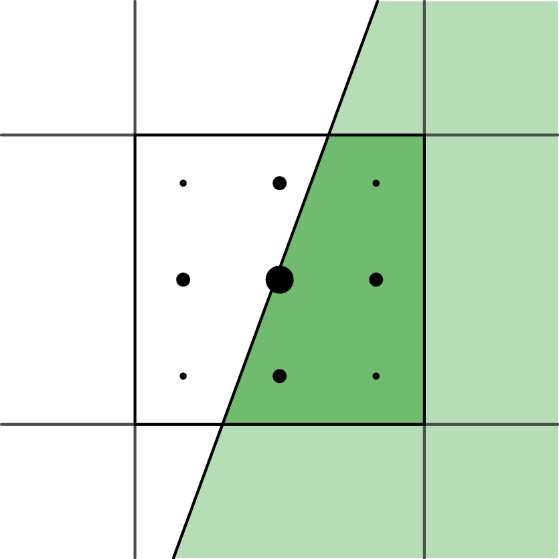
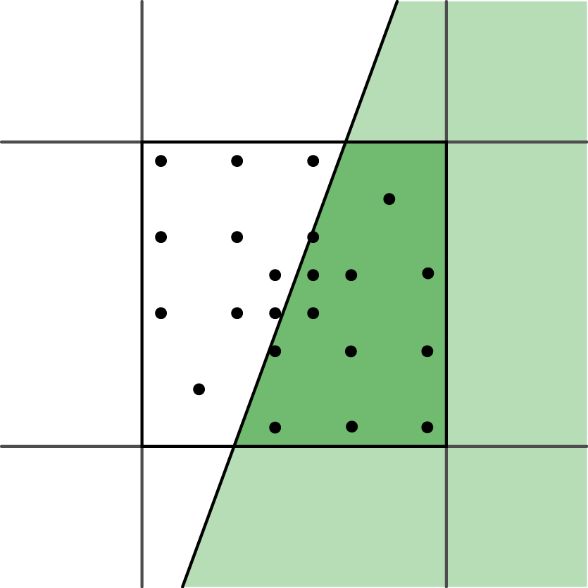
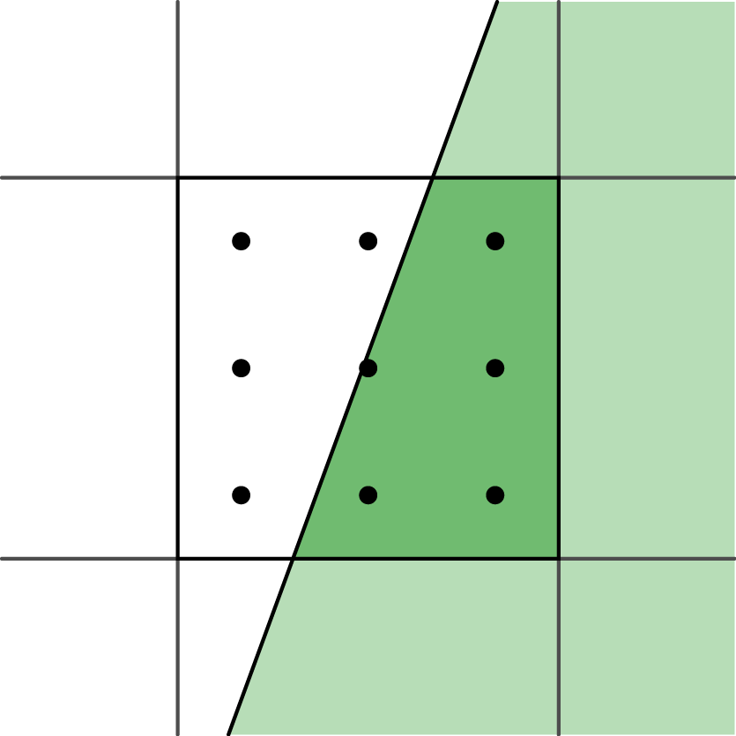
Supersampling
Numeric integration of filter
Grid with equal weight = box filter
Push up Nyquist
frequency
  Edges: ∞ frequency,
  still alias
Other filters:
  Grid with unequal
  weights
  Priority sampling

Slide 29
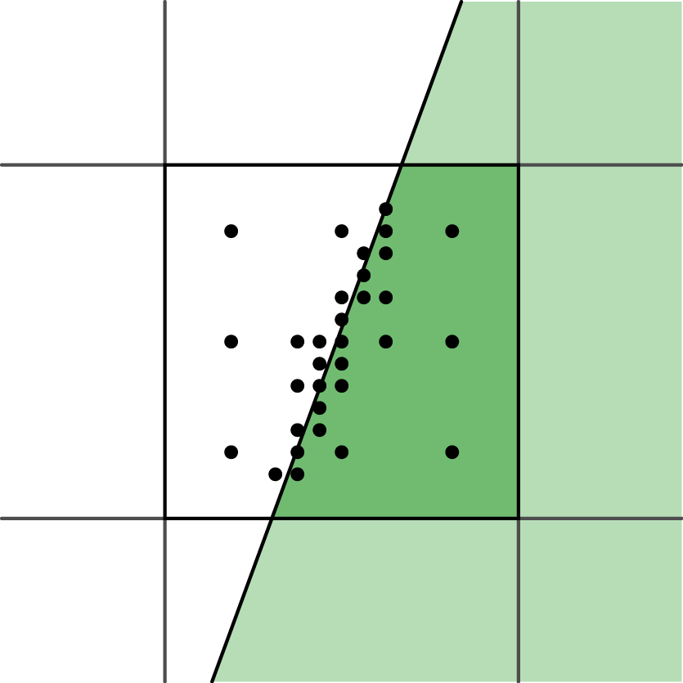
Adaptive sampling
Vary numerical integration step
More samples in
high contrast areas
Easy with ray
tracing, harder for
others
Possible bias

Slide 30
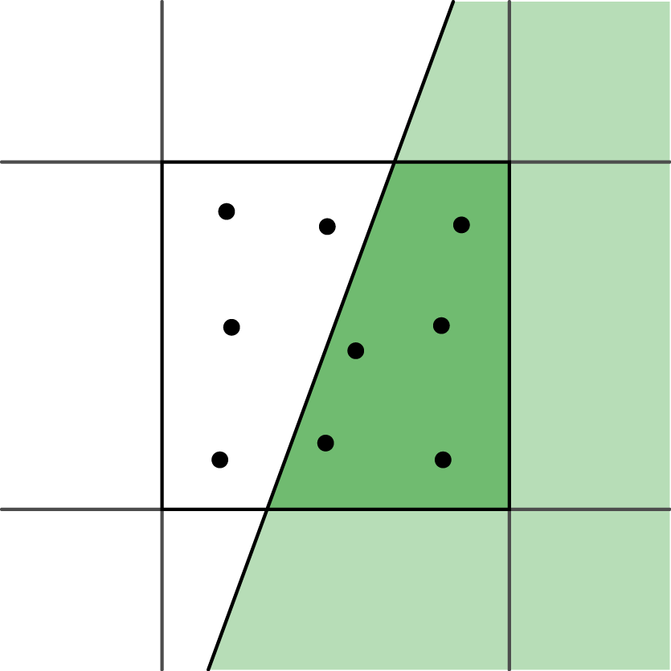
Stochastic sampling
Monte-Carlo integration of filter
Sample distribution
  Poisson disk
  Jittered grid
Aliasing ⇔ Noise

Slide 31
No Antialiasing

Slide 32
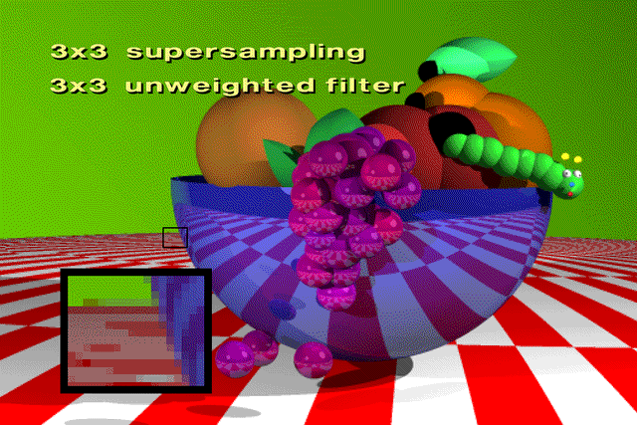
With Antialiasing

Slide 33

With Antialiasing

Slide 34

With Antialiasing

