Slide 1
Shading
CMSC 435/634

Slide 2
RenderMan
Displacement
Surface
Light
Volume
Imager

Slide 3
Displacement
Given
Position
Normal
Compute
Position
Normal
Displacement
Surface
Light
Volume
Imager

Slide 4
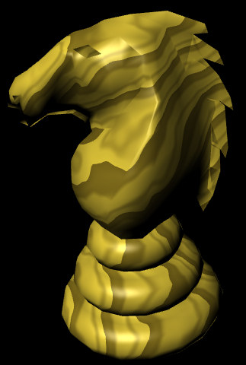
Surface color
Given
Position
Compute
Color
Opacity
Displacement
Surface
Light
Volume
Imager

Slide 5
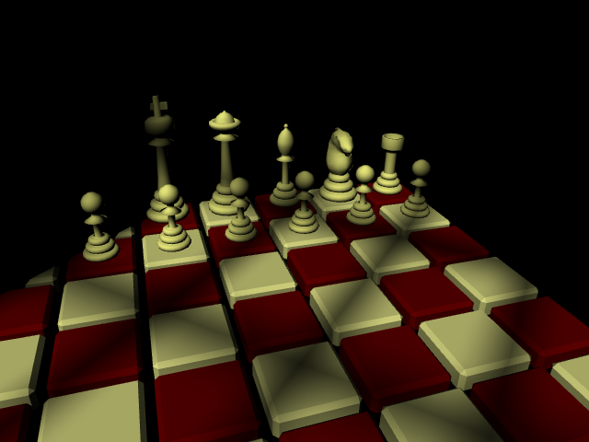
Lighting
Given
Surface Position
Compute
Light Direction
Light Color
Displacement
Surface
Light
Volume
Imager

Slide 6
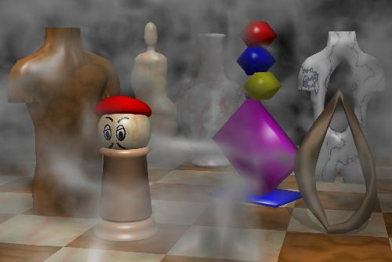
Volume Effects
Given
Position
Color
Compute
New Color
Displacement
Surface
Light
Volume
Imager

Slide 7
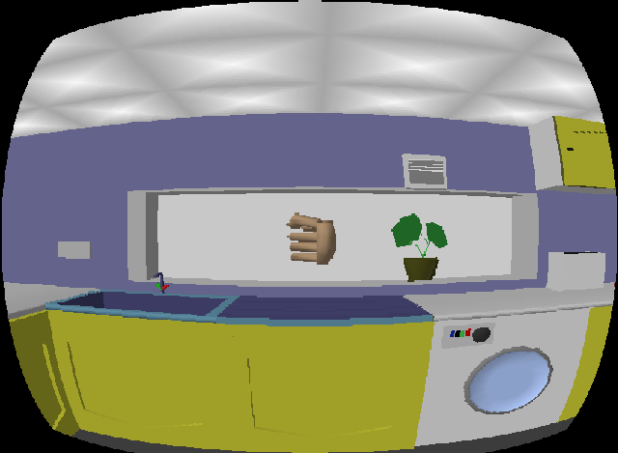
Image Effects
Given
Pixel Color
Compute
Pixel Color
Displacement
Surface
Light
Volume
Imager

Slide 8
Non-real time vs. Real-time
RenderMan
GPU
Application
Application
Displacement
Texture/
Buffer
Vertex
Light
Surface
Geometry
Volume
Imager
Fragment
Displayed
Pixels
Displayed
Pixels

Slide 9
RenderMan vs. GPU
RenderMan
Developed from General CPU code
Seconds to hours per frame
1000s of lines
“Unlimited” computation, texture, memory, …
GPU
Developed from fixed-function hardware
Tens of frames per second
1000s of instructions
Limited computation, texture, memory, …

Slide 10
History (not real-time)
Testbed [Whitted and Weimer 1981]
Shade Trees [Cook 1984]
Image Synthesizer [Perlin 1985]
RenderMan [Hanrahan and Lawson 1990]

Slide 11
History (real-time)
Custom HW [Olano and Lastra 1998]
Multi-pass standard HW [Peercy, Olano, Airey and Ungar 2000]
Register combiners [NVIDIA 2000]
Vertex programs [Lindholm et al. 2001]
Compiling to mixed HW [Proudfoot et al. 2001]
Fragment programs
Standardized languages
Compute

Slide 12
GLSL / HLSL
Vertex, Geometry & Fragment/Pixel
C-like, if/while/for
Structs & arrays
Float + small vector and matrix
vec2, vec3, vec4, mat2, mat3, mat4
Swizzle & mask (a.xyz = b.xxw)

Slide 13
GLSL / HLSL
Common math & shading functions
Trigonometric, exponential, min, max, abs, …
length, distance, normalize, dot, cross
mix(a, b, t)
clamp(t, a, b)
step(a, t), smoothstep(a, b, t)
reflect, refract

Slide 14
Shader Debugging
Render as color
Map intermediate values to 0-1
Interpret results
Hot reloading
Make changes without changing viewpoint
Conditional shading
My favorite: vec4(-sign(x), sign(x), abs(x), 1)
External debugging tools

Slide 15
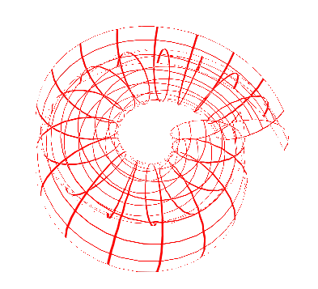
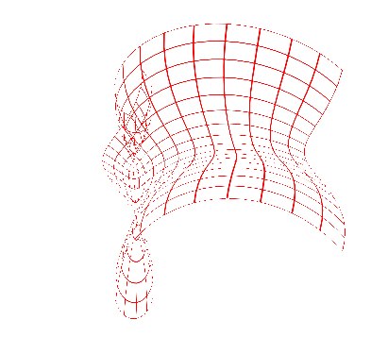
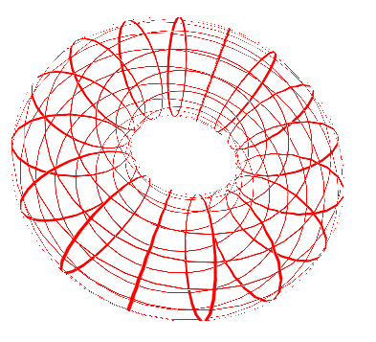
Vertex Demo: Blend Positions

Slide 16
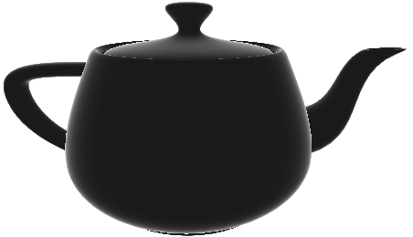
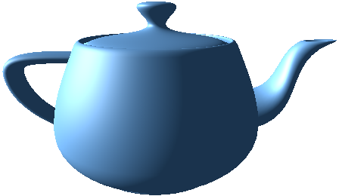
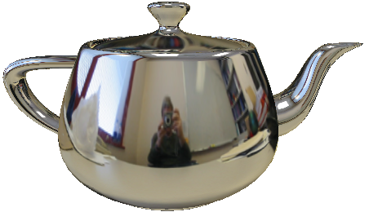
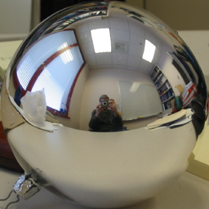
Vertex + Fragment Demo: Fresnel Environment Map

Slide 17
Shading Methods
Repeating Patterns
mod, sin
Divide and floor
Shapes
Implicit form: is this pixel inside
Color tables
Noise or computed patterns

Slide 18
Brick Demo
mortar
brick
gap
height
width
gap

Slide 19
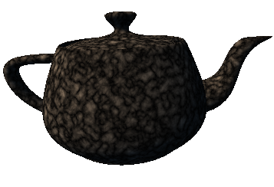
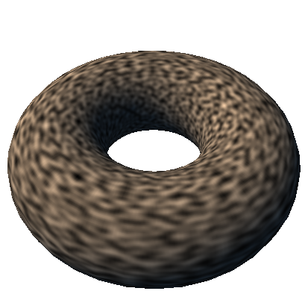
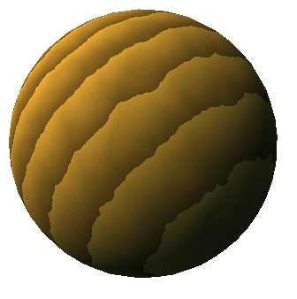
Noise
Controlled, repeatable randomness
Still spotty GPU implementation
Can use texture or compute

Slide 20
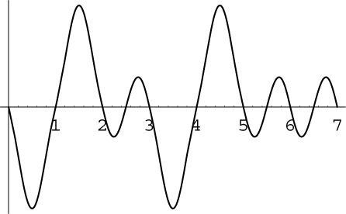
Noise Characteristics
Repeatable
Locally continuous but distant points uncorrolated
values
RenderMan [0,1], average 0.5
Perlin’s [-1,1], average 0
1/2 – 1 cycle per unit
Versions for 1D-4D input

Slide 21
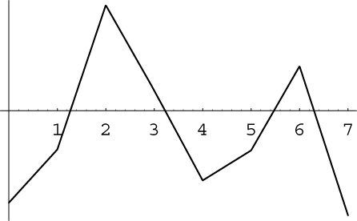
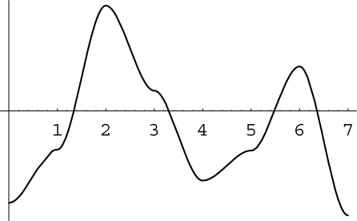
Noise Subtleties
Many noise functions based on a lattice
Piecewise function between integer coordinates
Hash of integer coordinates → control points
Interpolating values easy but poor
Even with higher-order interpolation
Perlin’s noise
Passes through 0 at each integer
Hash gives gradient

Slide 22
Perlin Noise in RenderMan
Ci = float noise(floor(1/t)*P);
1
2
3
4
5
6
7
8
12
13
9
14
15
16
20

Slide 23
Fractional Brownian Motion (fBm)
// Combine octaves, scaled by 1/f
for(f=1; f<=floor(1/t); f*=2)
Ci += (float noise(f*P)-.5)/f;
Ci += .5;
1
2
3
4
5
6
7
8
12
13
9
14
15
16
20

Slide 24
Turbulence
// fBm using abs(noise)
for(f=1; f<=floor(1/t); f*=2)
Ci += abs(float noise(f*P)-.5)/f;
Ci += .5;
1
2
3
4
5
6
7
8
12
13
9
14
15
16
20

Slide 25
Advanced Shading Methods
Perturbed patterns
Adjust position, radius, etc. with noise
Bombing
Divide space into cells
Compute random position in each cell
Check if pixel is inside shape
Blending
Fade effects in and out with smoothstep

