Slide 1
Basic Ray Tracing
CMSC 435/634

Slide 2
Visibility Problem
Rendering: converting a model to an image
Visibility: deciding which objects (or parts) will appear in the image
  Object-order
    OpenGL (later)
  Image-order
    Ray Tracing (now)

Slide 3
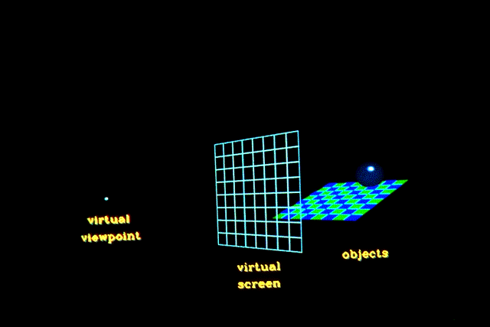
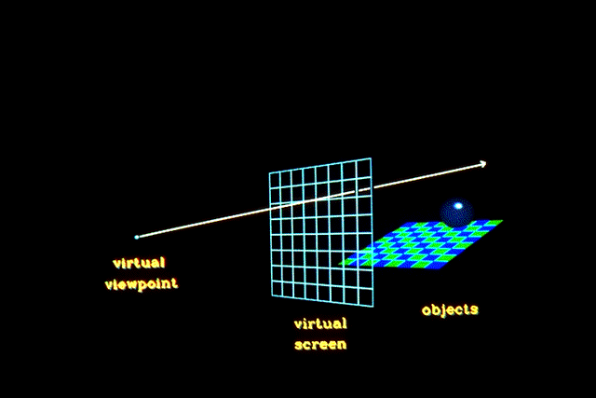
Raytracing
Given
  Scene
  Viewpoint
  Viewplane
Cast ray from viewpoint through pixels into scene

Slide 4
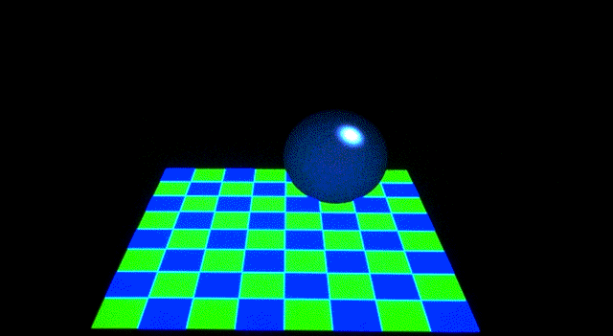
View

Slide 5
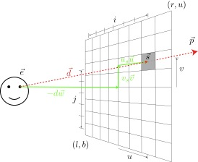
Computing Viewing Rays
Parametric ray
Camera frame
  : eye point
  : basis vectors
  right, up, backward
    Right hand rule!
Screen position

Slide 6
Calculating Intersections
Define ray parametrically:
If is center of projection and
is center of pixel, then
  : points between those locations
  : points behind viewer
  : points beyond view window

Slide 7
Ray-Sphere Intersection
Sphere in vector form
Ray
Intersection when

Slide 8
Ray-Polygon Intersection
Given ray and plane containing polygon
What is ray/plane intersection?
Is intersection point inside polygon?

Slide 9
Ray-Triangle Intersection
Intersection of ray with barycentric triangle
  In triangle if α ≥ 0, β ≥ 0, γ ≥ 0
  To avoid computing all three, can replace α ≥ 0 with β+ γ ≤ 1
boolean raytri (ray r, vector p0, p1, p2, interval [t₀,t₁] )
{
  compute t
  if (( t < t₀ ) or (t > t₁))
return ( false )
  compute γ
  if ((γ < 0 ) or (γ > 1))
return ( false )
  compute β
  if ((β < 0 ) or (β+γ > 1))
return ( false )
return true
}

Slide 10
Point in Polygon?
Is P in polygon?
Cast ray from P to infinity
  1 crossing = inside
  0, 2 crossings = outside

Slide 11
Point in Polygon?
Is P in concave polygon?
Cast ray from P to infinity
  Odd crossings = inside
  Even crossings = outside

Slide 12
What Happens?

Slide 13
Raytracing Characteristics
Good
  Simple to implement
  Minimal memory required
  Easy to extend
Bad
  Aliasing
  Computationally intensive
    Intersections expensive (75-90% of rendering time)
    Lots of rays

Slide 14
Basic Illumination Concepts
Terms
  Illumination: calculating light intensity at a point (object space; equation) based loosely on physical laws
  Shading: algorithm for calculating intensities at pixels (image space; algorithm)
Objects
  Light sources: light-emitting
  Other objects: light-reflecting
Light sources
  Point (special case: at infinity)
  Area

Slide 15
Lambert’s Law
Intensity of reflected light related to orientation

Slide 16
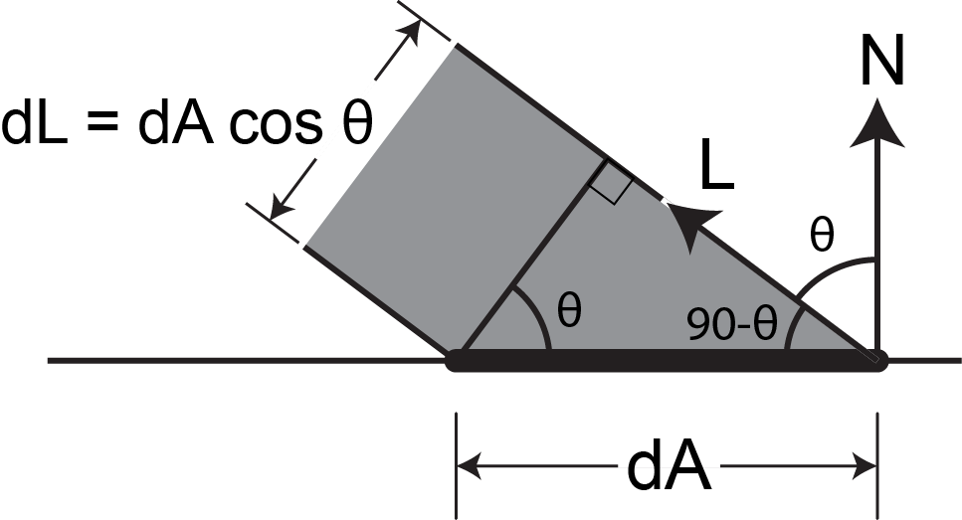
Lambert’s Law
Specifically: the radiant energy from any small surface area dA in any direction θ relative to the surface normal is proportional to cos θ

Slide 17
Ambient Light
Additional light bounces we’re not counting
Approximate them as a constant
  = Amount of extra light coming into this surface
  = Amount that bounces off of this surface
  Total extra light bouncing off this surface

Slide 18
Combined Model
Adding color:
For any wavelength λ:

Slide 19
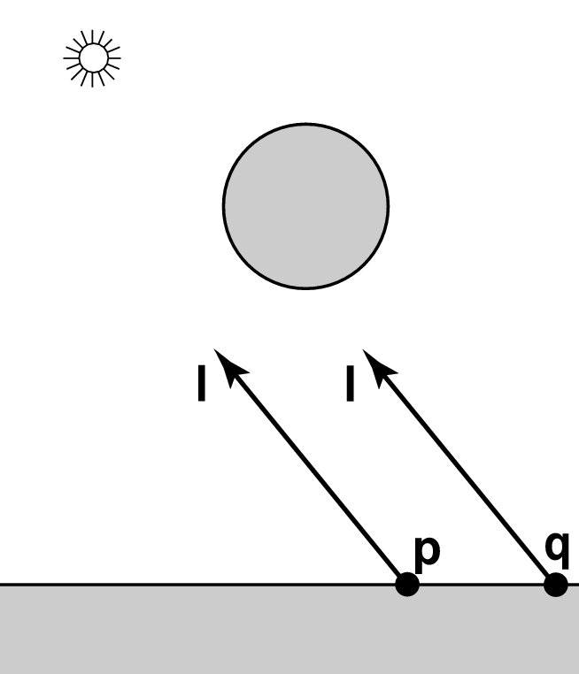
Shadows
What if there is an object between the surface and light?

Slide 20
Ray Traced Shadows
Trace a ray
  Start = point on surface
  End = light source
  t=0 at Suface, t=1 at Light
  “Bias” to avoid surface acne
Test
  Bias ≤ t ≤ 1 = shadow
  t < Bias or t > 1 = use this light

Slide 21

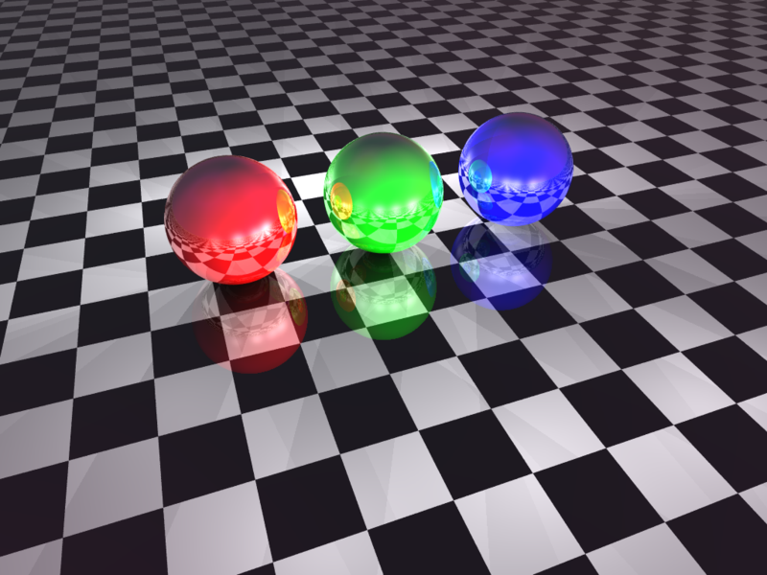
Mirror Reflection

Slide 22
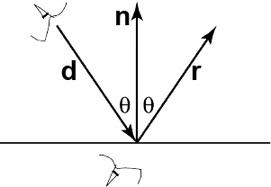
Ray Tracing Reflection
Viewer looking in direction d sees whatever the viewer “below” the surface sees looking in direction r
In the real world
  Energy loss on the bounce
  Loss different for different colors
New ray
  Start on surface, in reflection direction

Slide 23
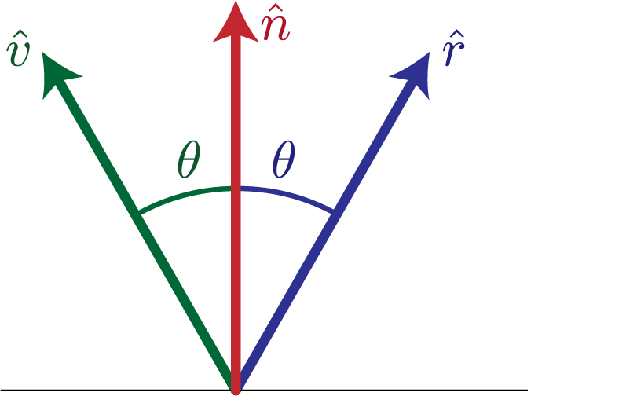
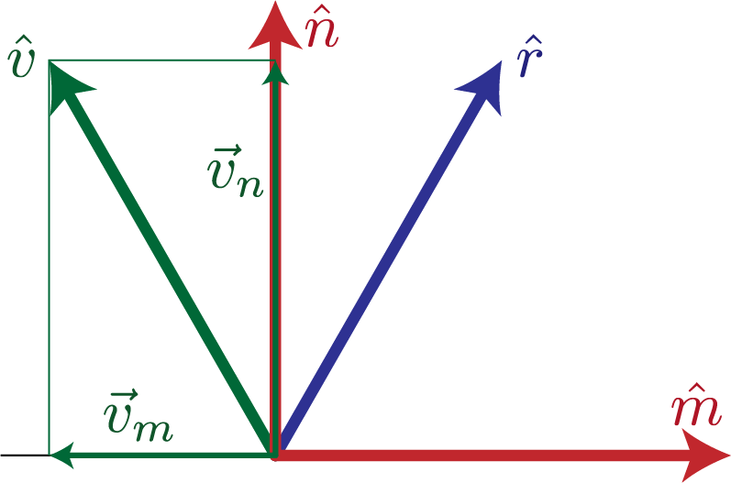
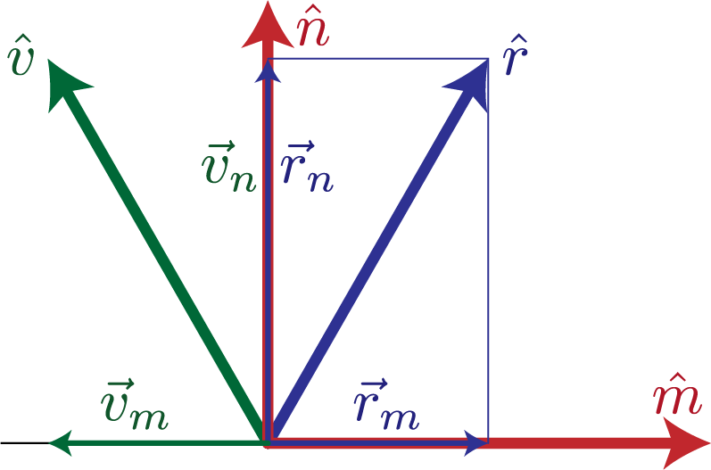
Calculating Reflection Vector
Angle of of incidence
= angle of reflection
Decompose
Recompose

Slide 24
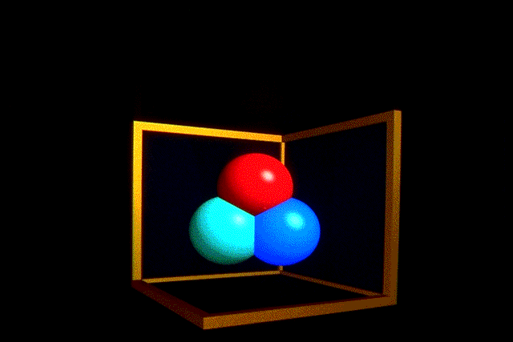
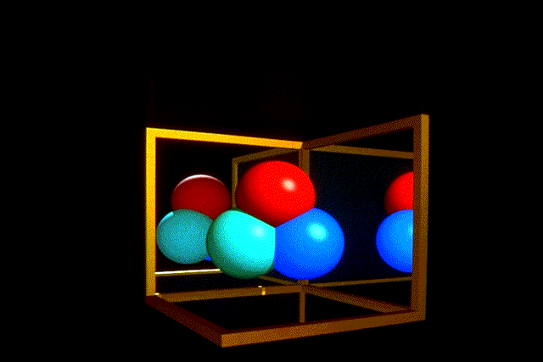
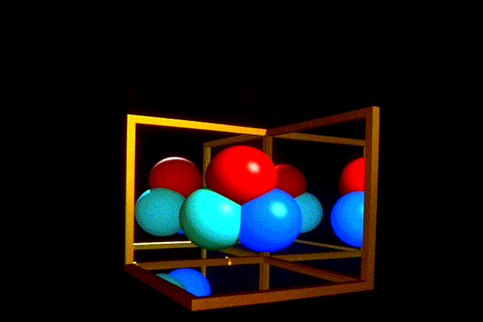
Ray Traced Reflection
Avoid looping forever
  Stop after n bounces
  Stop when contribution to pixel gets too small

Slide 25
Specular Reflection
Shiny reflection from rough surface
Centered around mirror reflection direction
  But more spread more, depending on roughness
Easiest for individual light sources

Slide 26
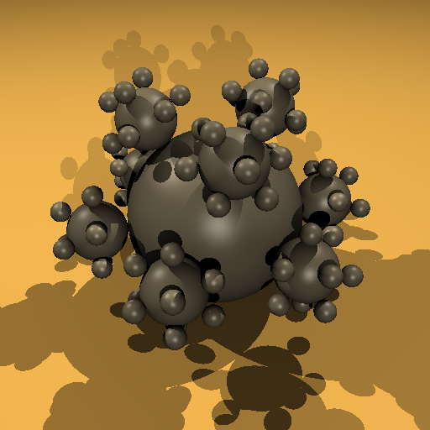
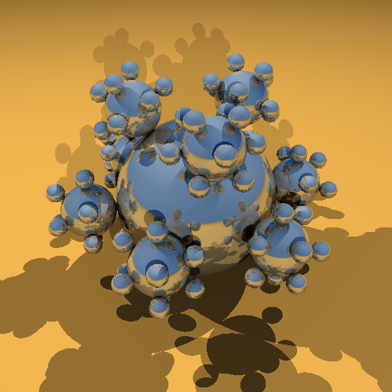
Specular vs. Mirror Reflection

Slide 27
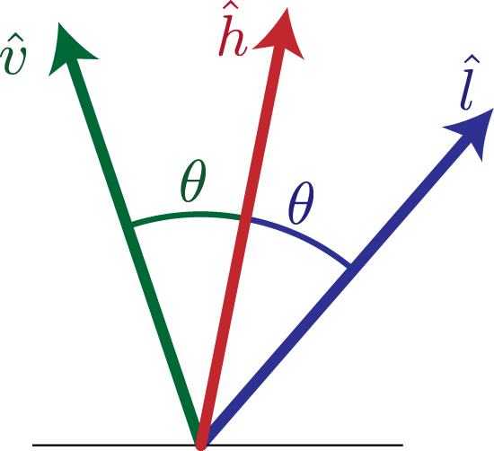
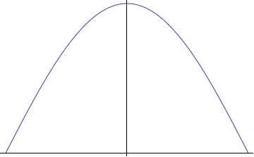
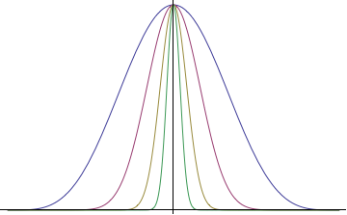
H vector
Strongest for normal that reflects to
  One at center of highlight
  Zero at 90°
Control highlight width

Slide 28
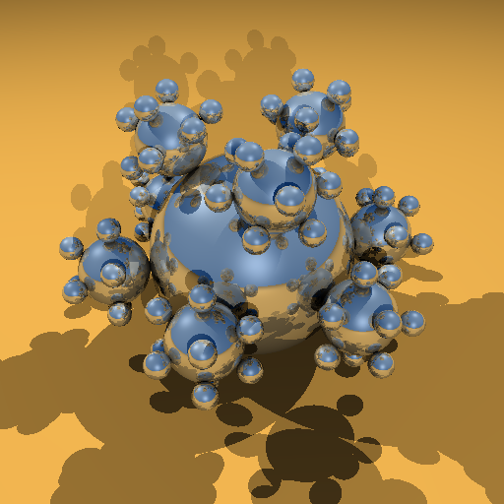

Combined Specular & Mirror
Many surfaces have both

Slide 29
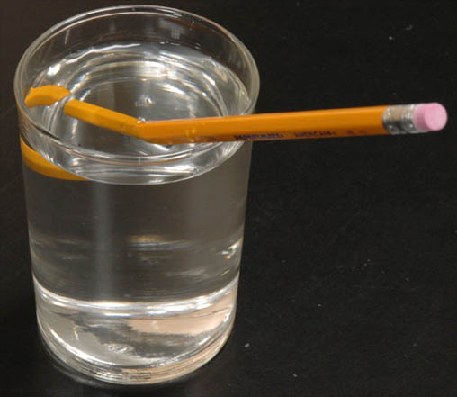
Refraction

Slide 30
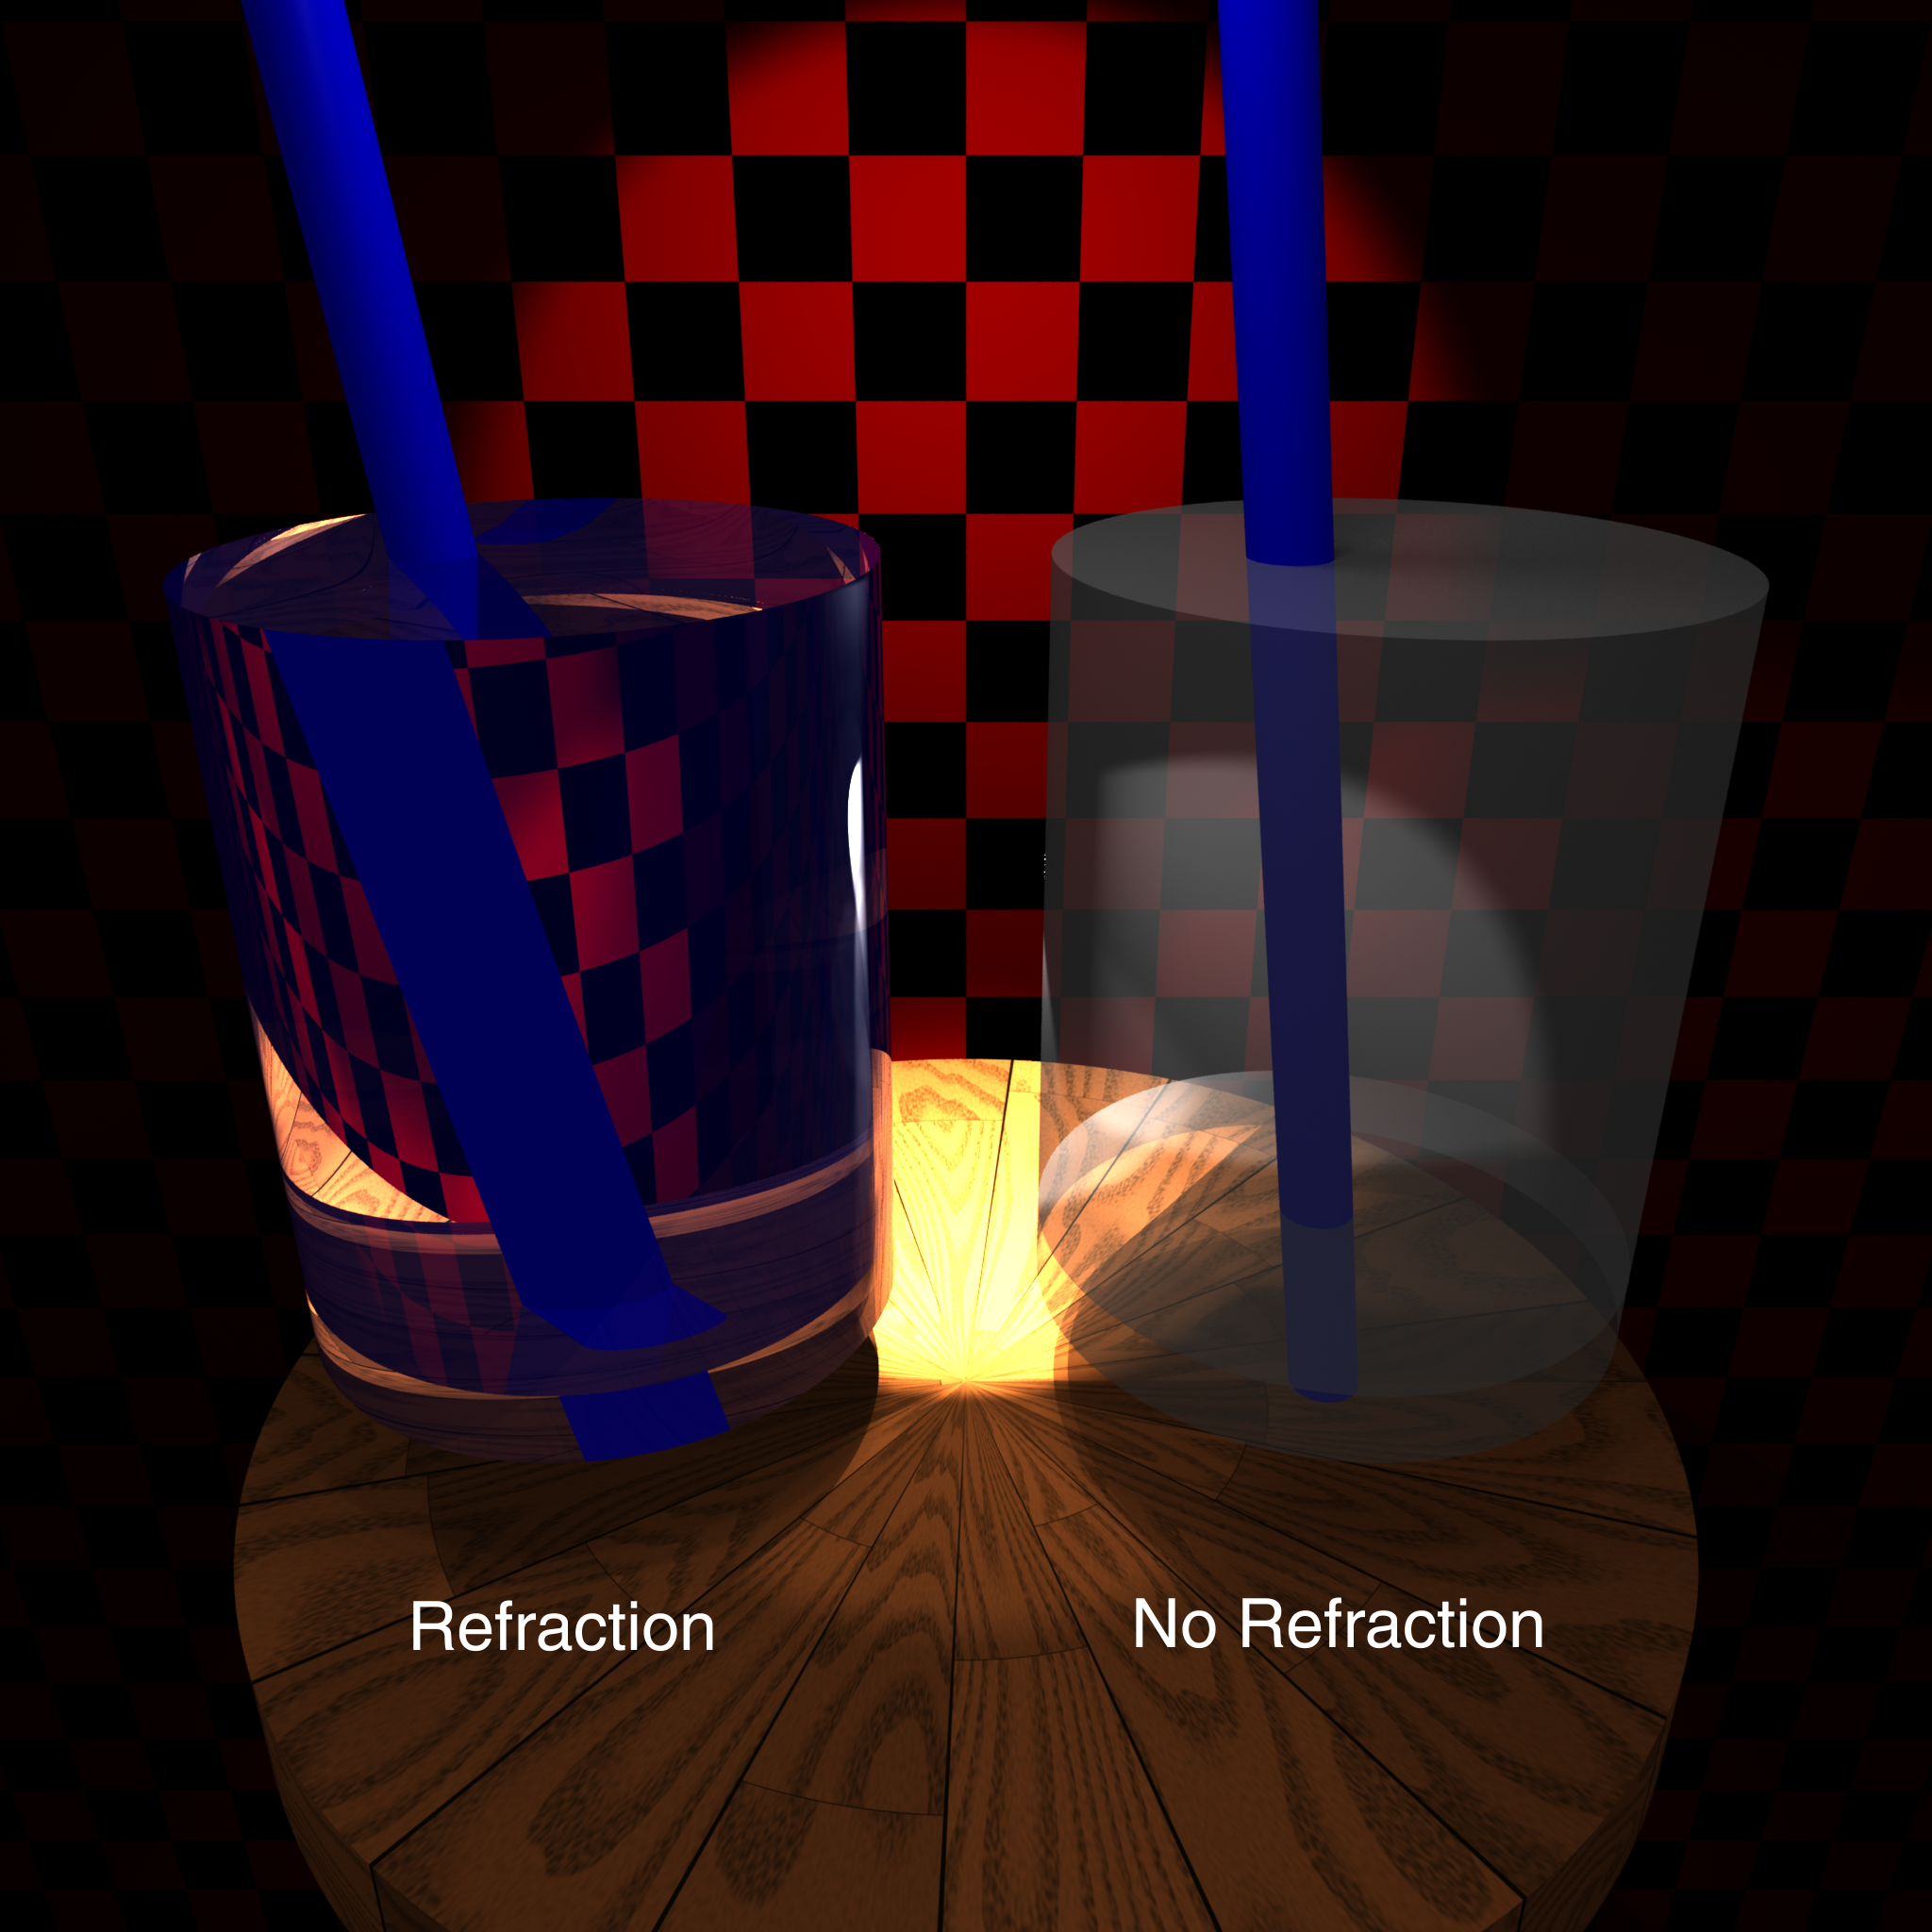

Slide 31
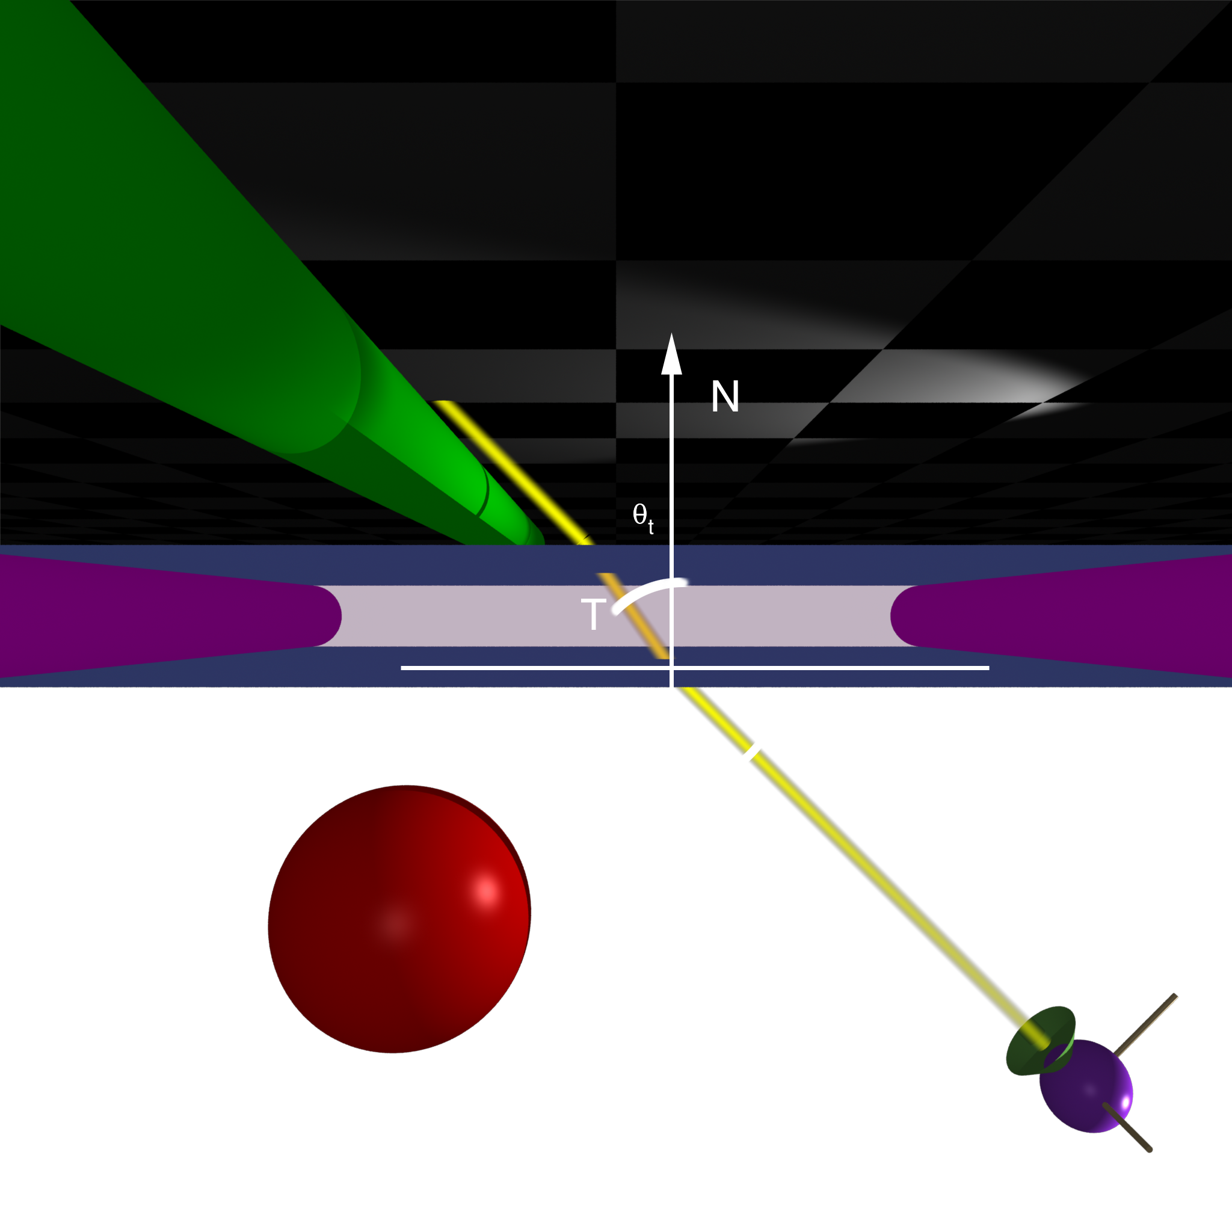
Top

Slide 32
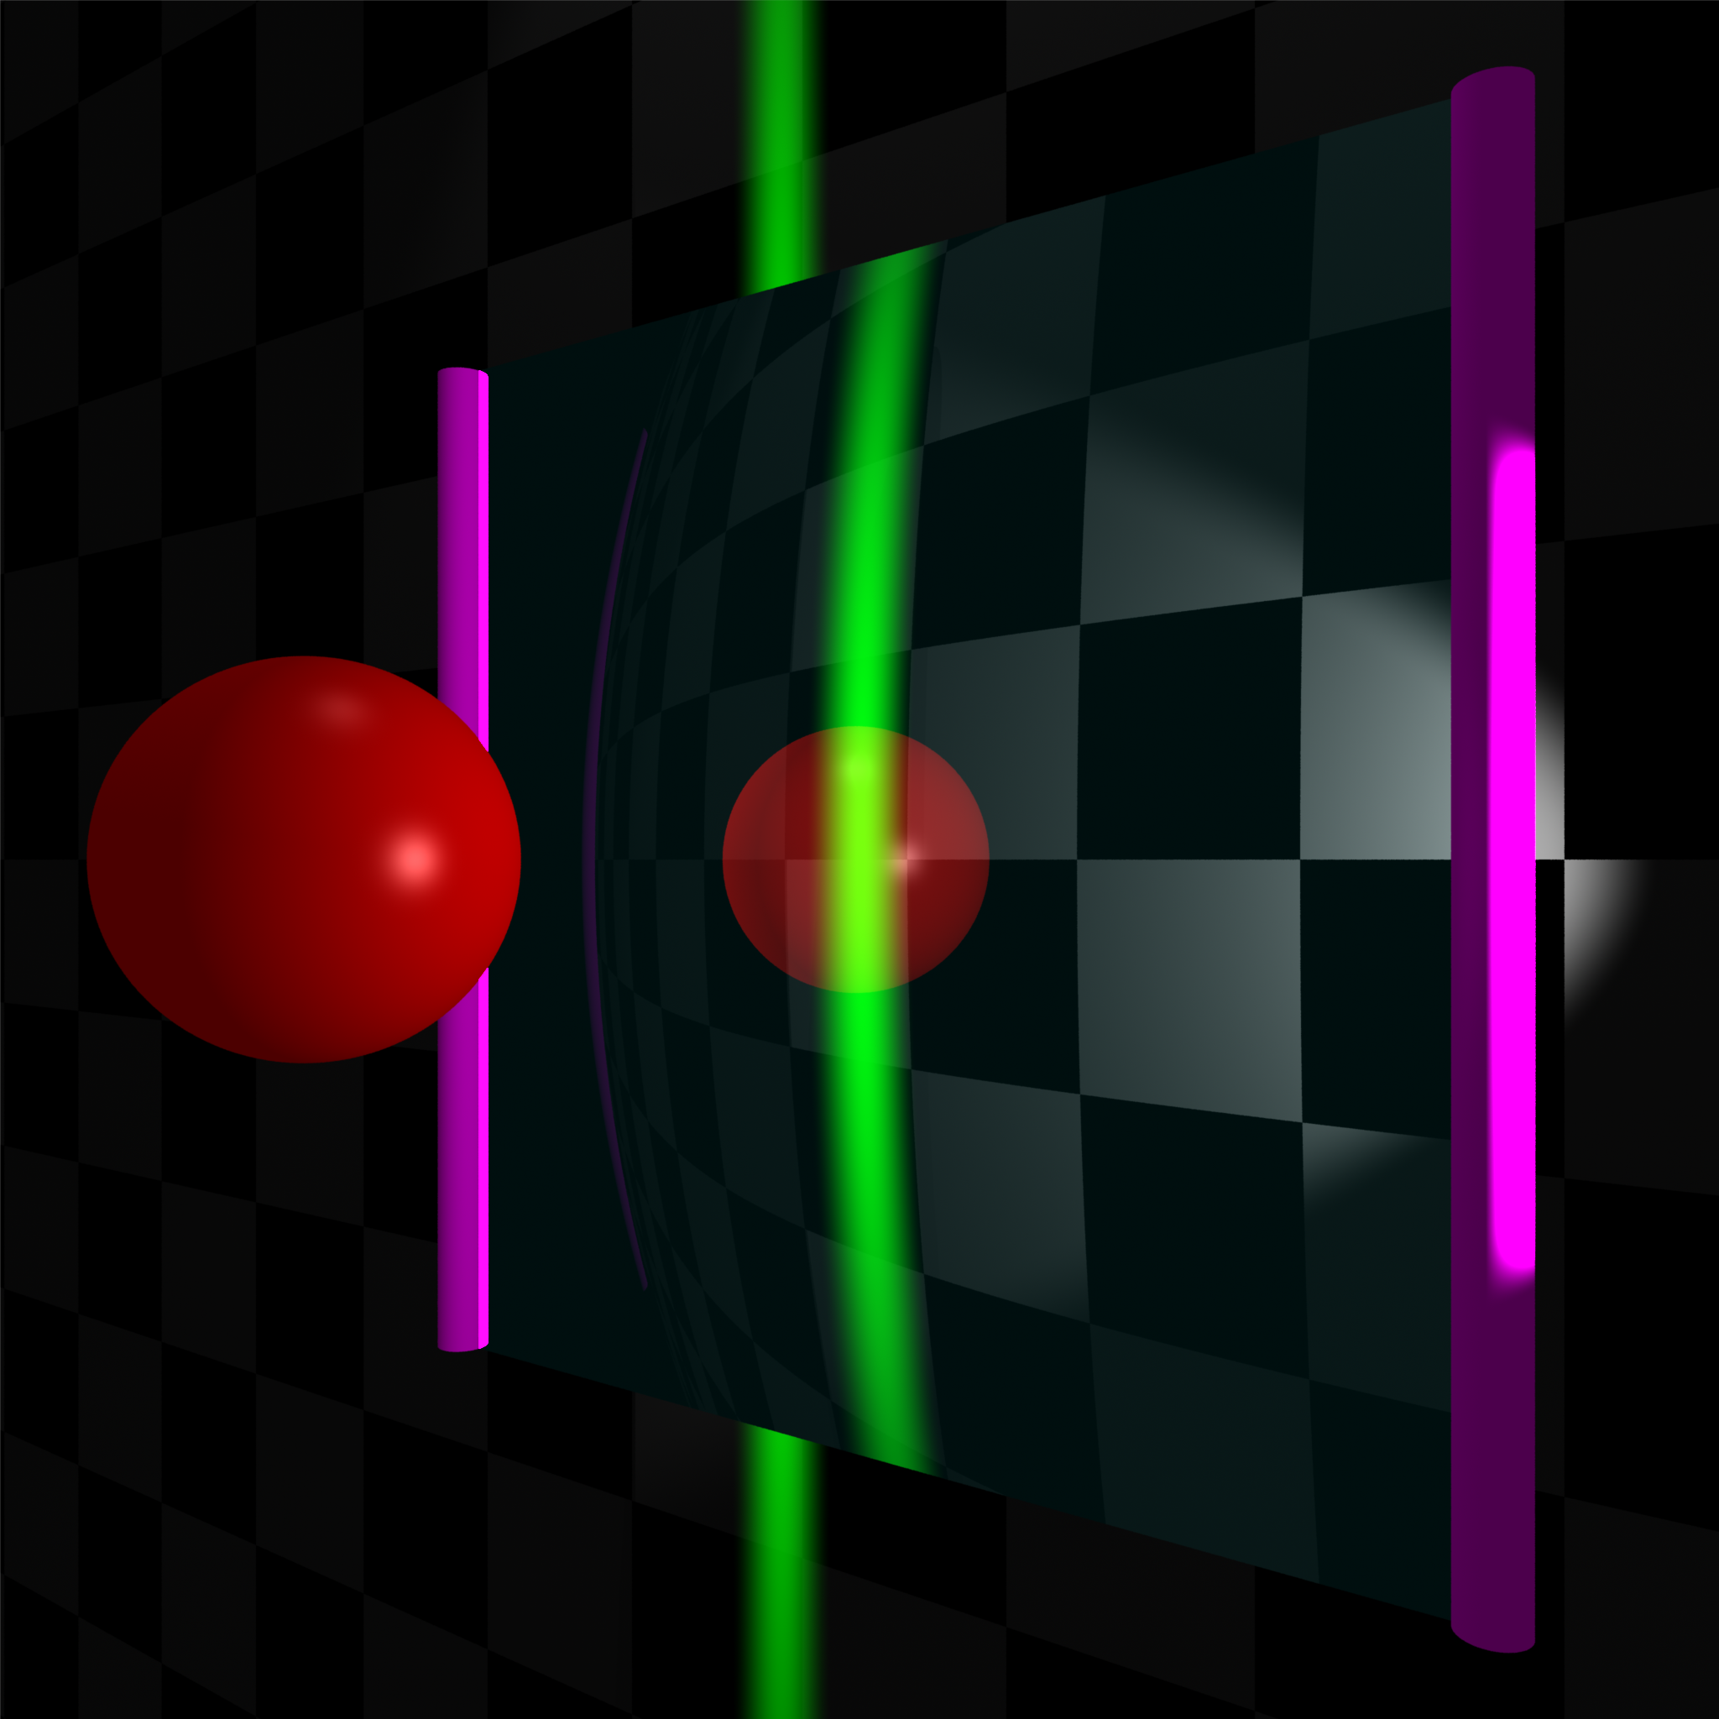
Front

Slide 33
Calculating Refraction Vector
Snell’s Law
In terms of
term

Slide 34
Calculating Refraction Vector
Snell’s Law
In terms of
term

Slide 35
Calculating Refraction Vector
Snell’s Law
In terms of
In terms of and

Slide 36
Alpha Blending
How much makes it through
α = opacity
  How much of foreground color 0-1
1-α = transparency
  How much of background color
Foreground*α + Background*(1-α)

Slide 37
Refraction and Alpha
Refraction = what direction
α = how much
  Often approximate as a constant
  Better: Use Fresnel
  Schlick approximation

Slide 38
Full Ray-Tracing
For each pixel
  Compute ray direction
  Find closest surface
  For each light
    Shoot shadow ray
    If not shadowed, add direct illumination
  Shoot ray in reflection direction
  Shoot ray in refraction direction

Slide 39
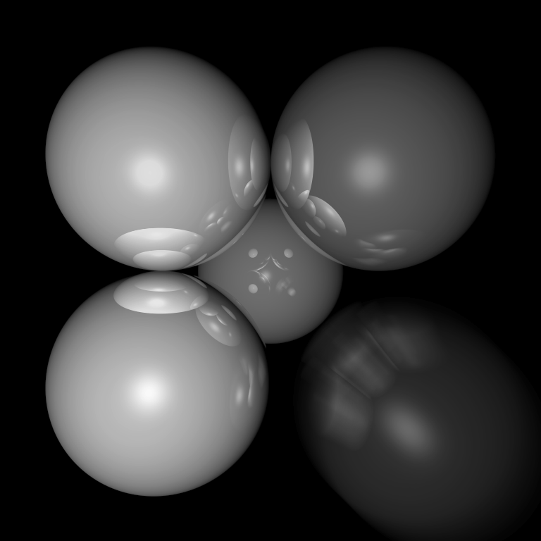
Motion Blur
Things move while the shutter is open

Slide 40
Ray Traced Motion Blur
Include information on object motion
Spread multiple rays per pixel across time

Slide 41
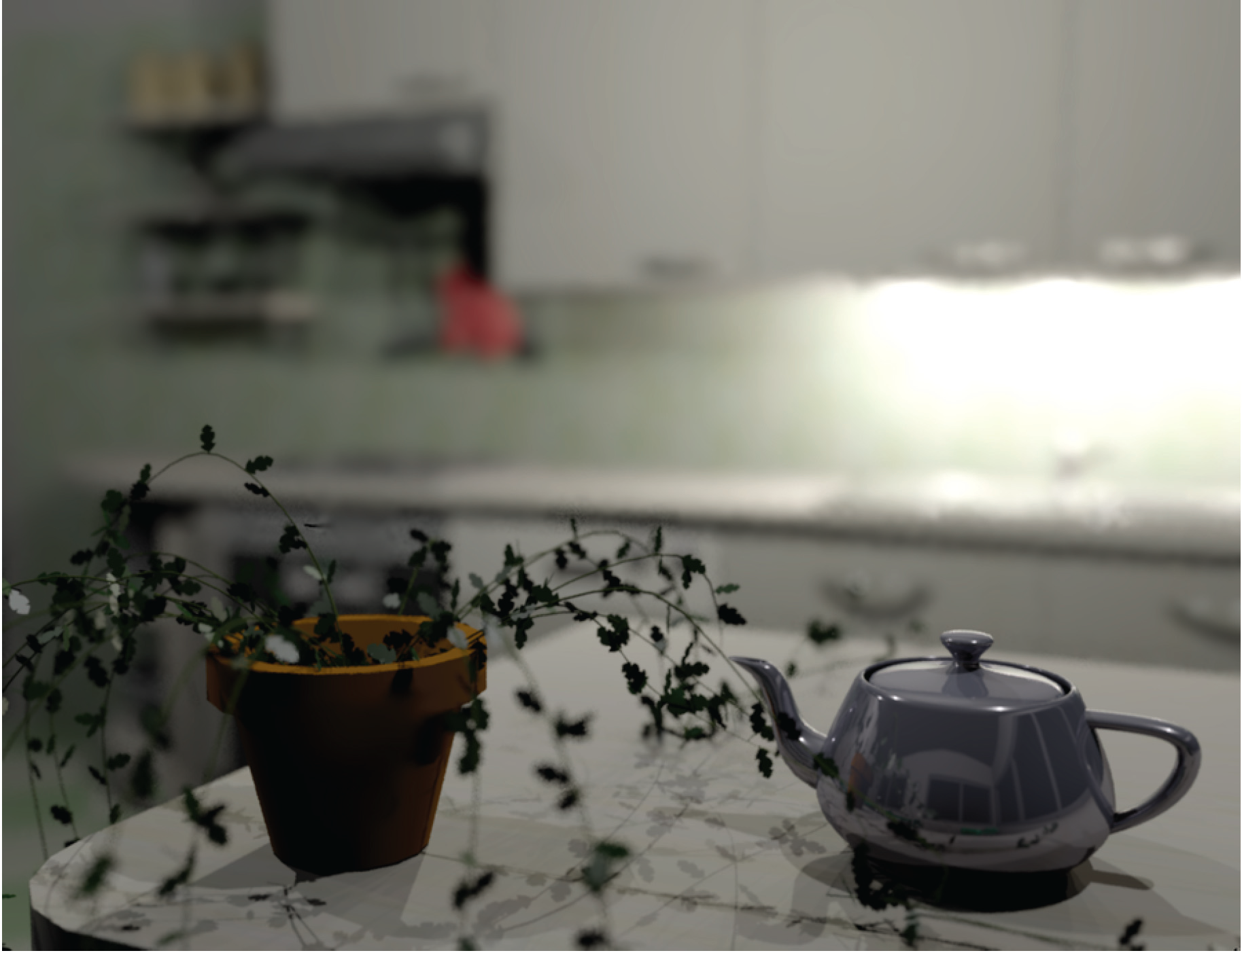
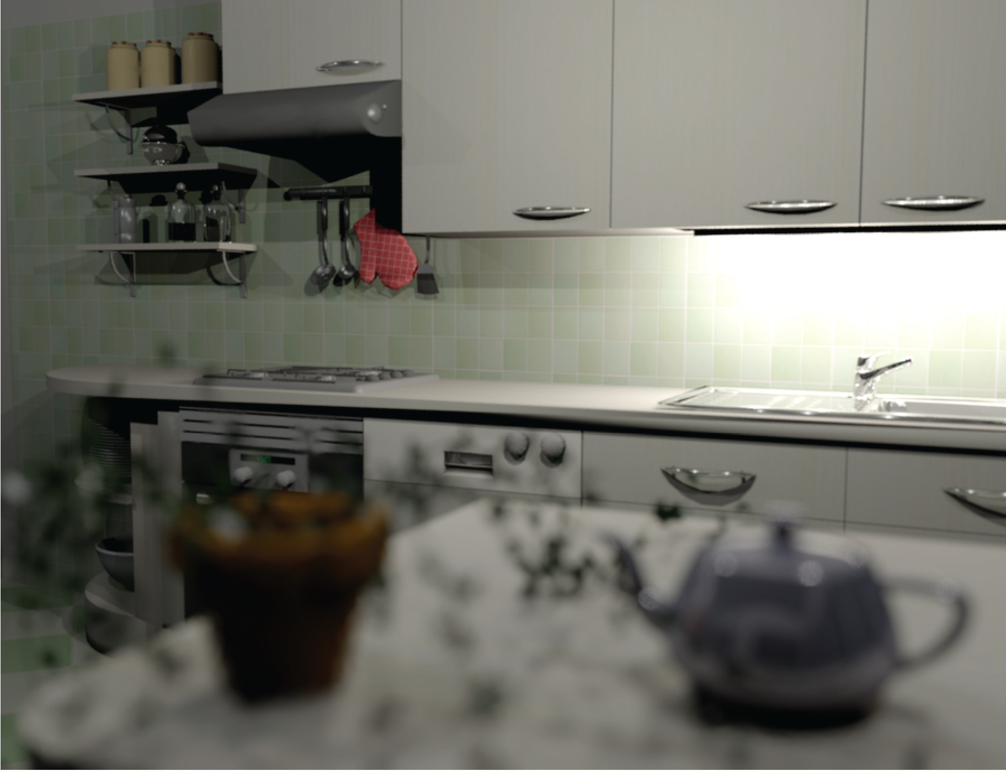
Depth of Field
Soler et al., Fourier Depth of Field, ACM TOG v28n2, April 2009

Slide 42
Pinhole Lens

Slide 43
Lens Model

Slide 44
Real Lens
Focal Plane

Slide 45
Lens Model
Focal Plane

Slide 46
Ray Traced DOF
Move image plane out to focal plane
Jitter start position within lens aperture
  Smaller aperture = closer to pinhole
  Larger aperture = more DOF blur

