Slide 1
Computer Graphics
Overview
CMSC 435/634

Slide 2
Graphics Areas
“Core” graphics areas
  Modeling
  Rendering
  Animation
Other areas which draw on computer graphics
  User Interaction
  Virtual Reality
  Visualization
  Image Processing
  3D Scanning

Slide 3
Graphics Areas – Modeling
Deals with the mathematical specification of shape and appearance
  Definition of surface
  Interpolation rules
  Reflection models

Slide 4
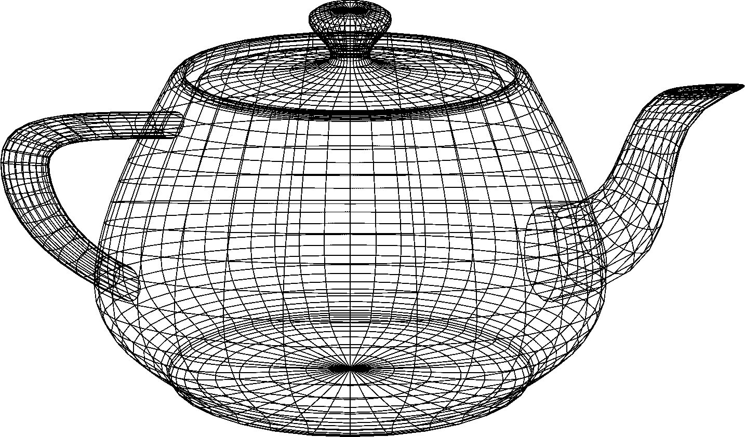
Graphics Areas – Modeling

Slide 5
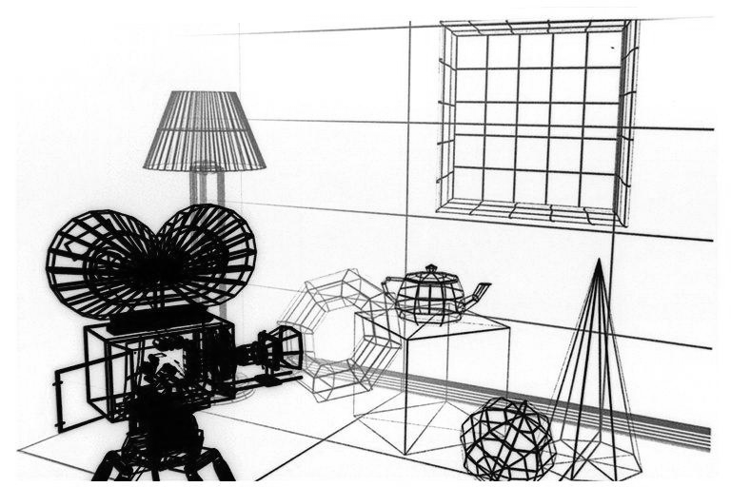
Graphics Area – Modeling

Slide 6
Graphics Areas – Rendering
Term inherited from art – create shaded images from computer models
  Many techniques
  Many styles of rendering

Slide 7
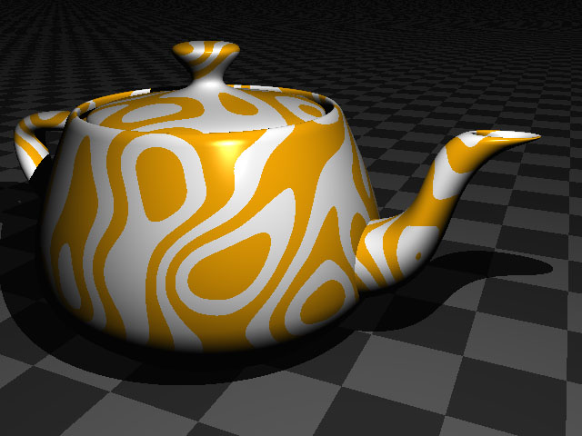
Graphics Areas – Rendering

Slide 8
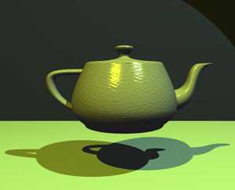
Graphics Areas – Rendering

Slide 9
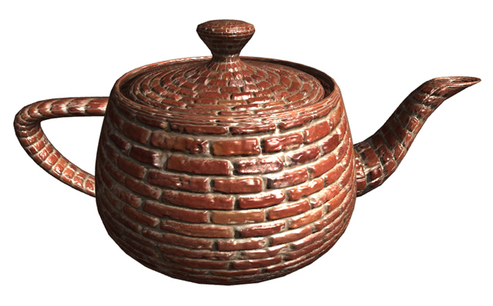
Graphics Areas – Rendering

Slide 10
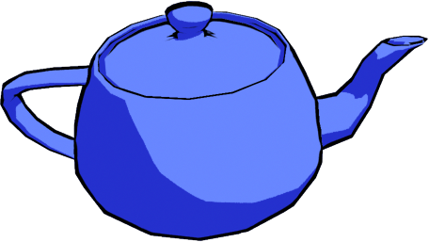
Graphics Areas – Rendering

Slide 11
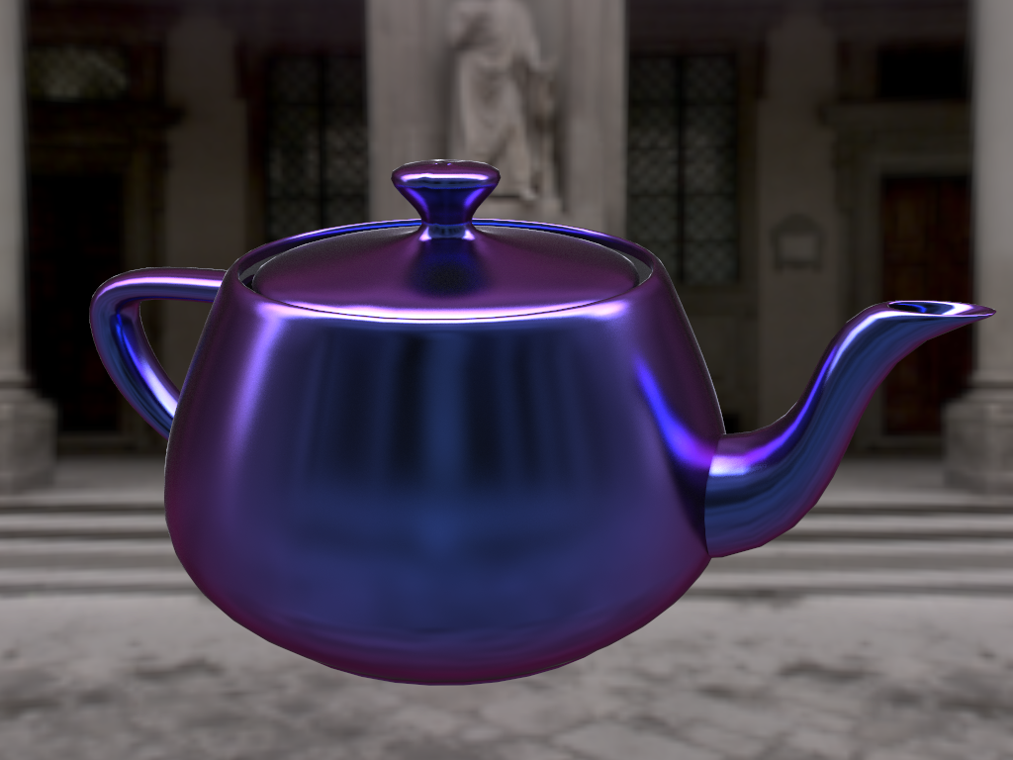
Graphics Areas – Rendering

Slide 12
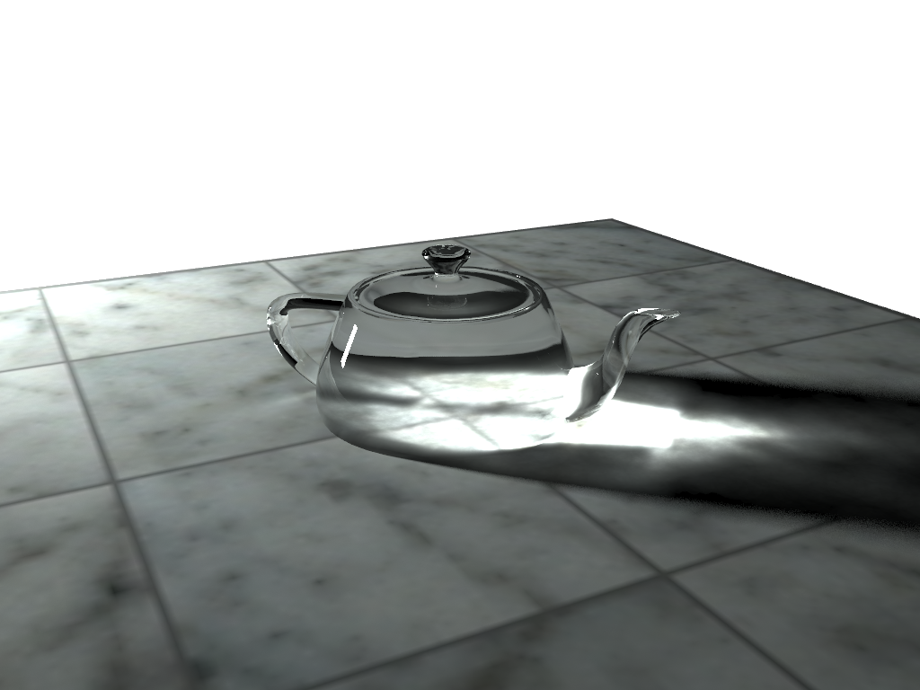
Graphics Areas – Rendering

Slide 13

Graphics Areas – Rendering

Slide 14
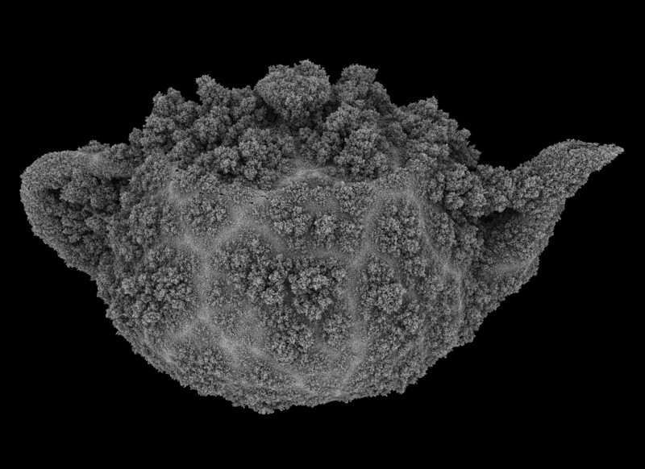
Graphics Areas – Rendering

Slide 15
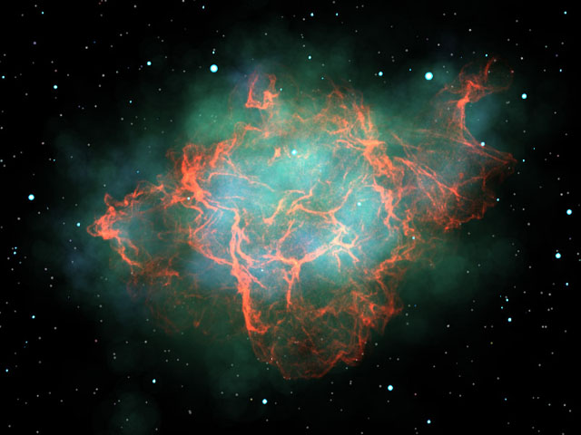
Graphics Areas – Rendering

Slide 16
Graphics Areas – Animation
Creating an illusion of motion through a sequence of images
  Time as a key issue, not normally dealt with in basic modeling and rendering

Slide 17
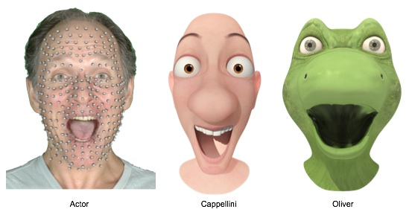
Graphics Areas – Animation
Lucasfilm, The Adventures of André and Wally B.
Disney Research, Content Retargetting Using Parameter Parallel Facial Layers

Slide 18
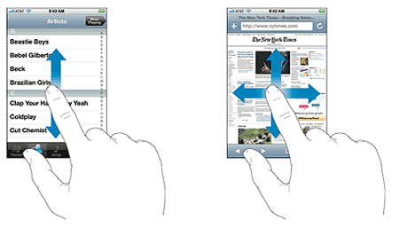
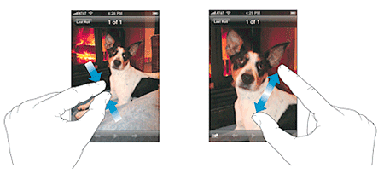
Graphics Areas – User Interaction
Deals with the interface between input devices, the application, and feedback to the user in imagery and other sensory feedback

Slide 19
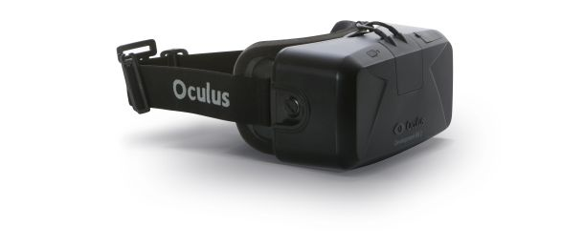
Graphics Areas – Virtual Reality
Immersion of user into a 3D virtual world
  Typically involves stereo graphics
  Response to head motion
  Force feedback

Slide 20
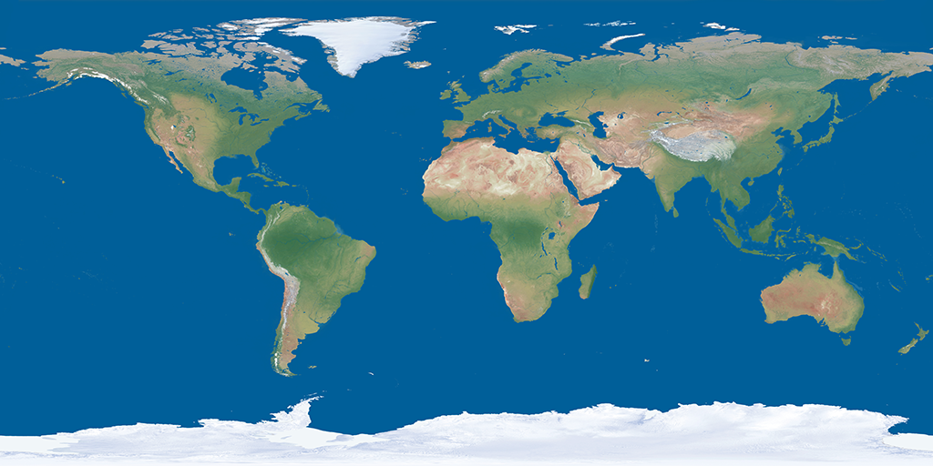
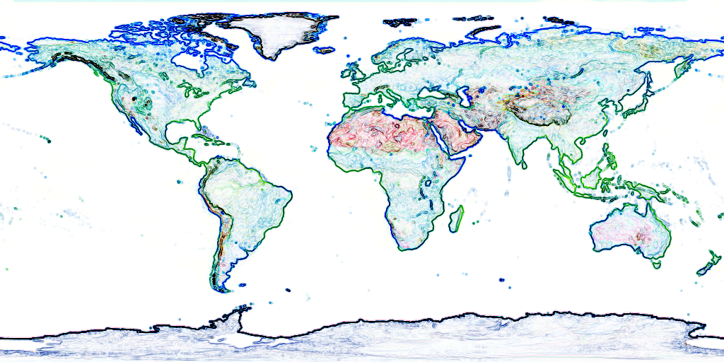
Graphics Areas – Image Processing
Manipulation of 2D images
  Interpolation
  Filters
  Conversion

Slide 21
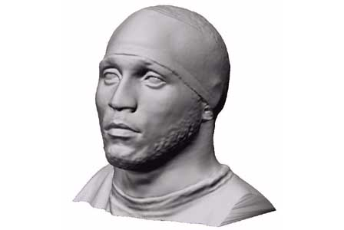
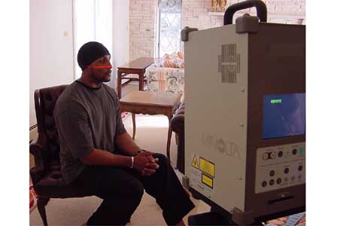
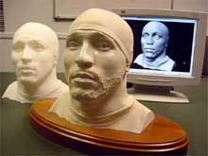
Graphics Areas – 3D Scanning
Uses range-finding technology to create measured 3D models

Slide 22
Major Applications
Video Games
Cartoons
Film Special Effects
CAD/CAM
Simulation
Medical Imaging
Information Visualization

Slide 23
Applications – Video Games
3D modeling
3D scanning
Rendering algorithms
User interaction
Force feedback
Motion capture
Graphics data structures
Etc...

Slide 24
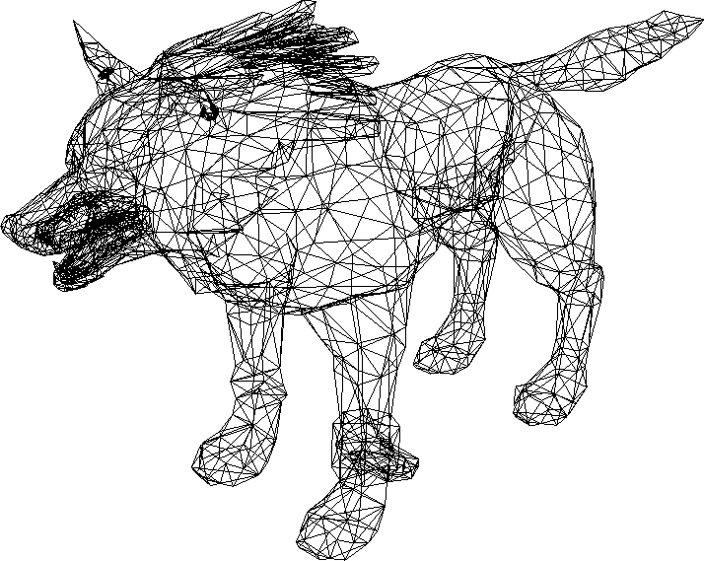
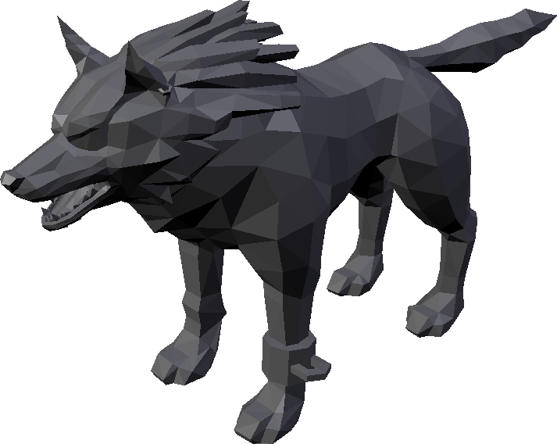
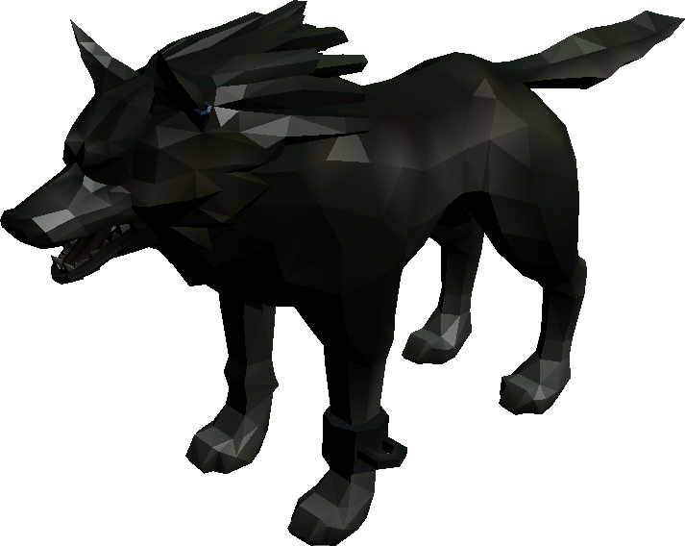
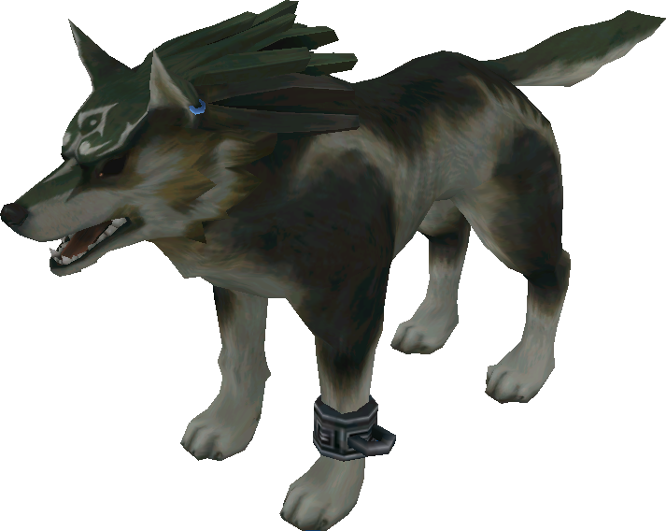
Applications – Video Games

Slide 25
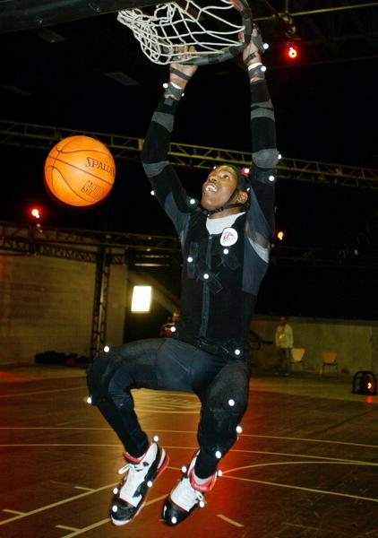
Applications – Video Games

Slide 26
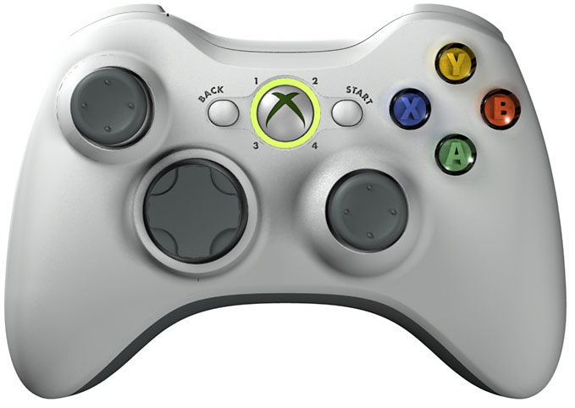
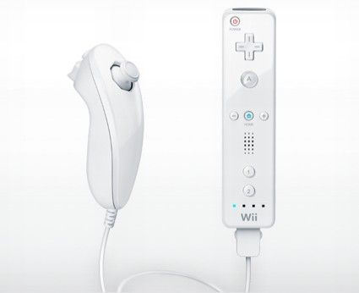
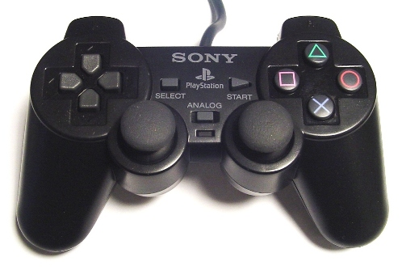
Applications – Video Games

Slide 27

Applications - Cartoons
Often rendered from 3D models
Traditional 2D use backgrounds rendered from 3D models

Slide 28
Applications – Film Special Effects
Almost all graphics technologies
Digital compositing to superimpose filmed foregrounds onto backgrounds
Foregrounds with 3D models

Slide 29
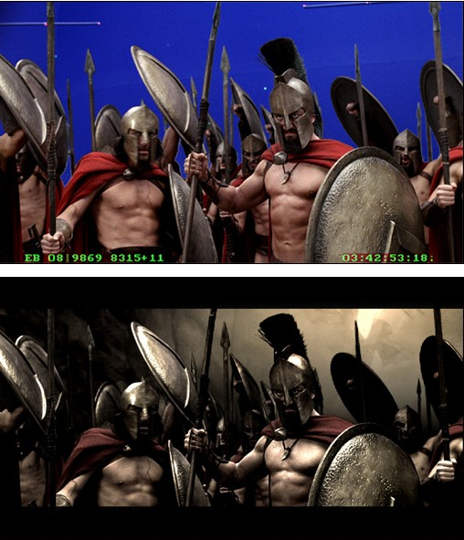
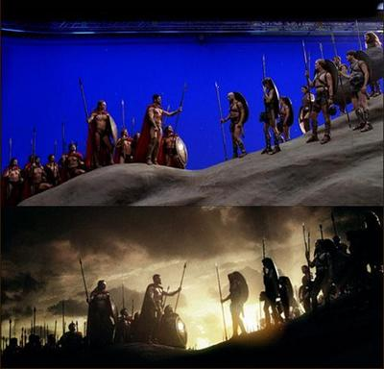
Applications – Film Special Effects

Slide 30
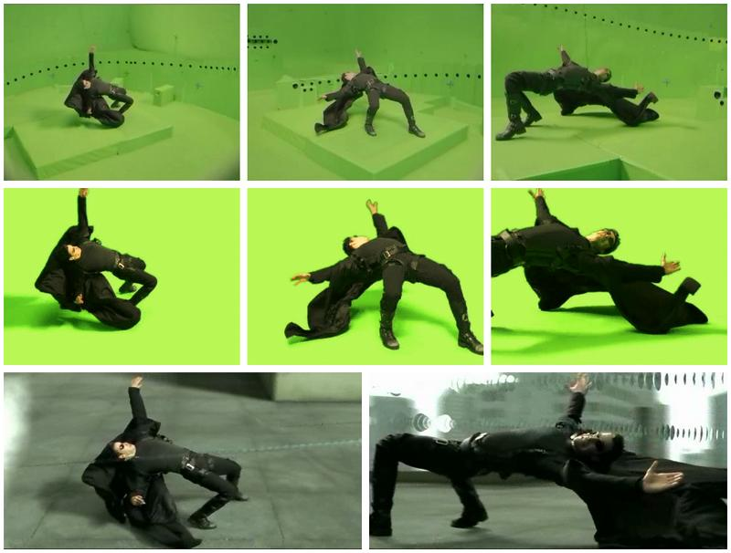
Applications – Film Special Effects

Slide 31
Applications - CAD/CAM
Used to model/design parts which directly guide the manufacturing process
Computer controlled milling devices

Slide 32
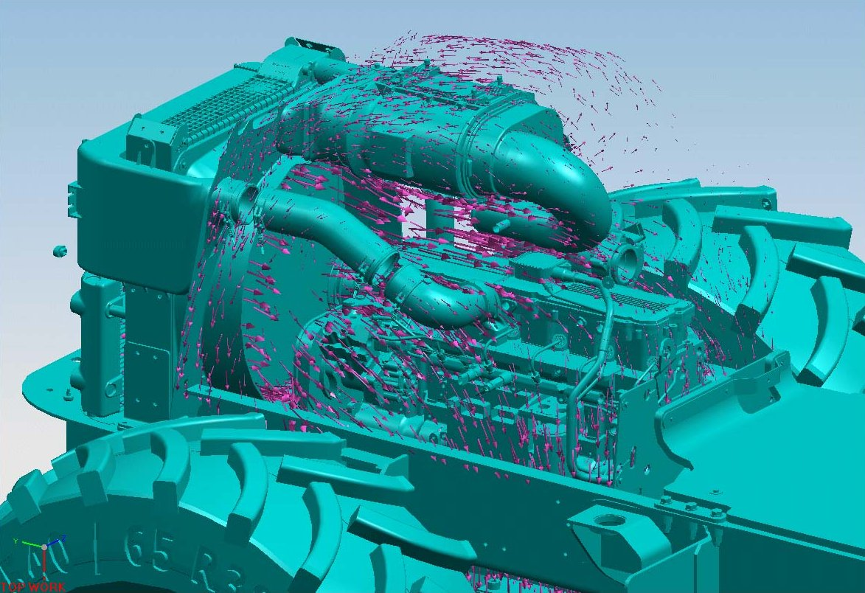
Applications - CAD/CAM

Slide 33
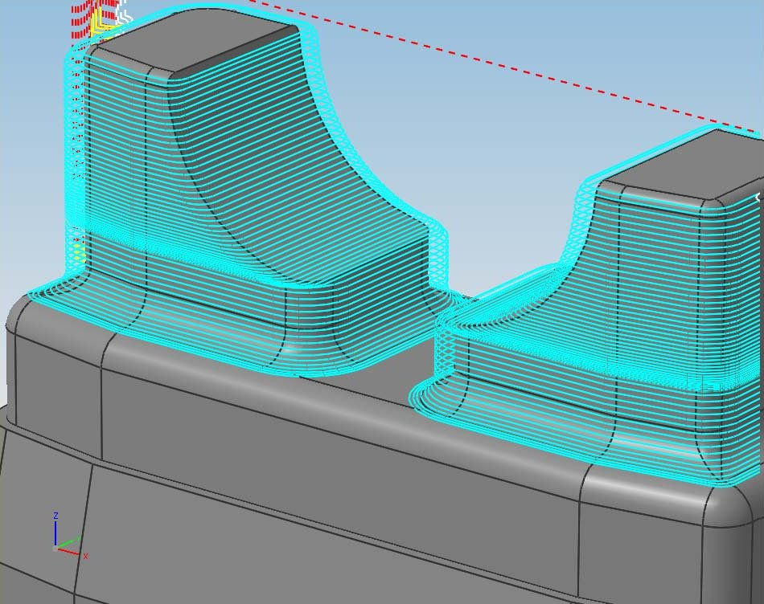
Applications - CAD/CAM

Slide 34
Applications – Simulation
“Serious games”
Flight & driving simulators
Situations which are too dangerous to costly to perform directly

Slide 35
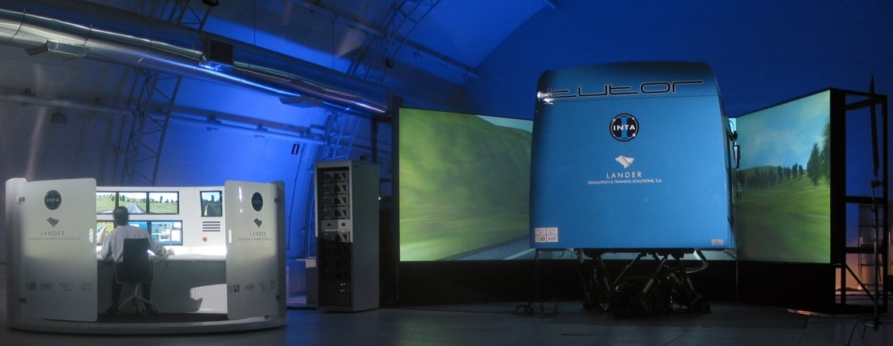
Applications – Simulation

Slide 36
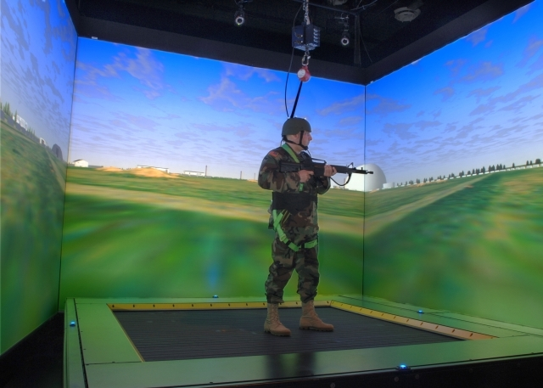
Applications – Simulation

Slide 37
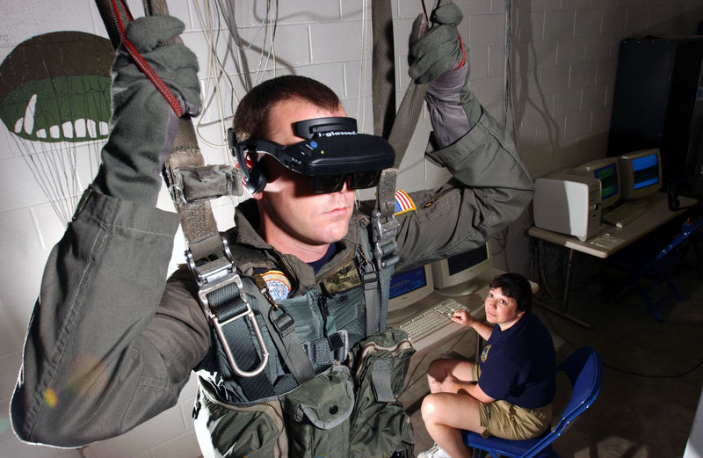
Applications – Simulation

Slide 38
Applications – Medical Imaging
Create meaningful images of scanned patient data
MRI/CT scans of density values
Large amounts of data
  Very small test sets have 256 × 256 × 128 ≈ 8.4 million samples

Slide 39
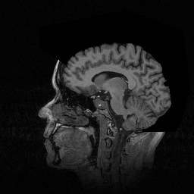
Applications – Medical Imaging

Slide 40
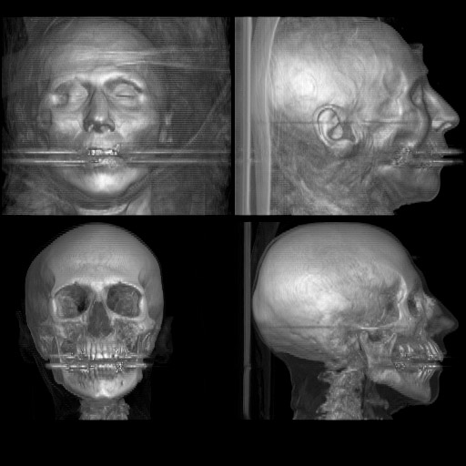
Applications – Medical Imaging

Slide 41
Applications – Visualization
Understanding 3D data
Creates images of data which do not have a “natural” visual depiction
Finding patterns in data

Slide 42
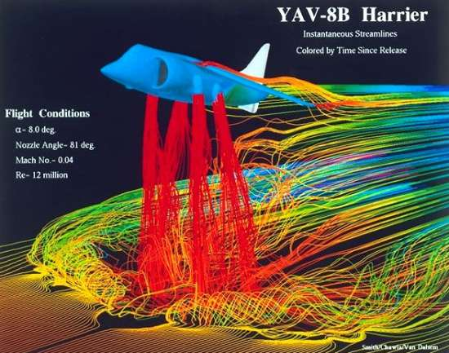
Applications – Visualization

Slide 43
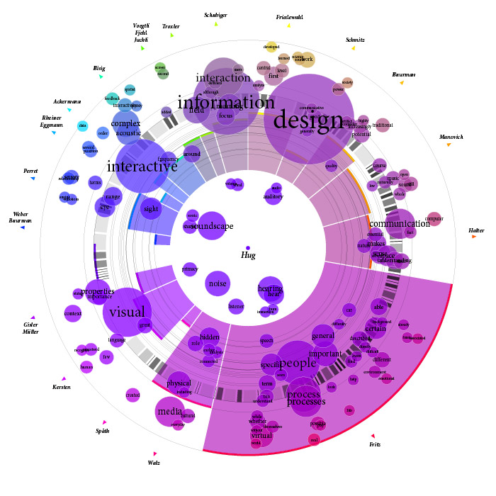
Applications – Visualization

Slide 44
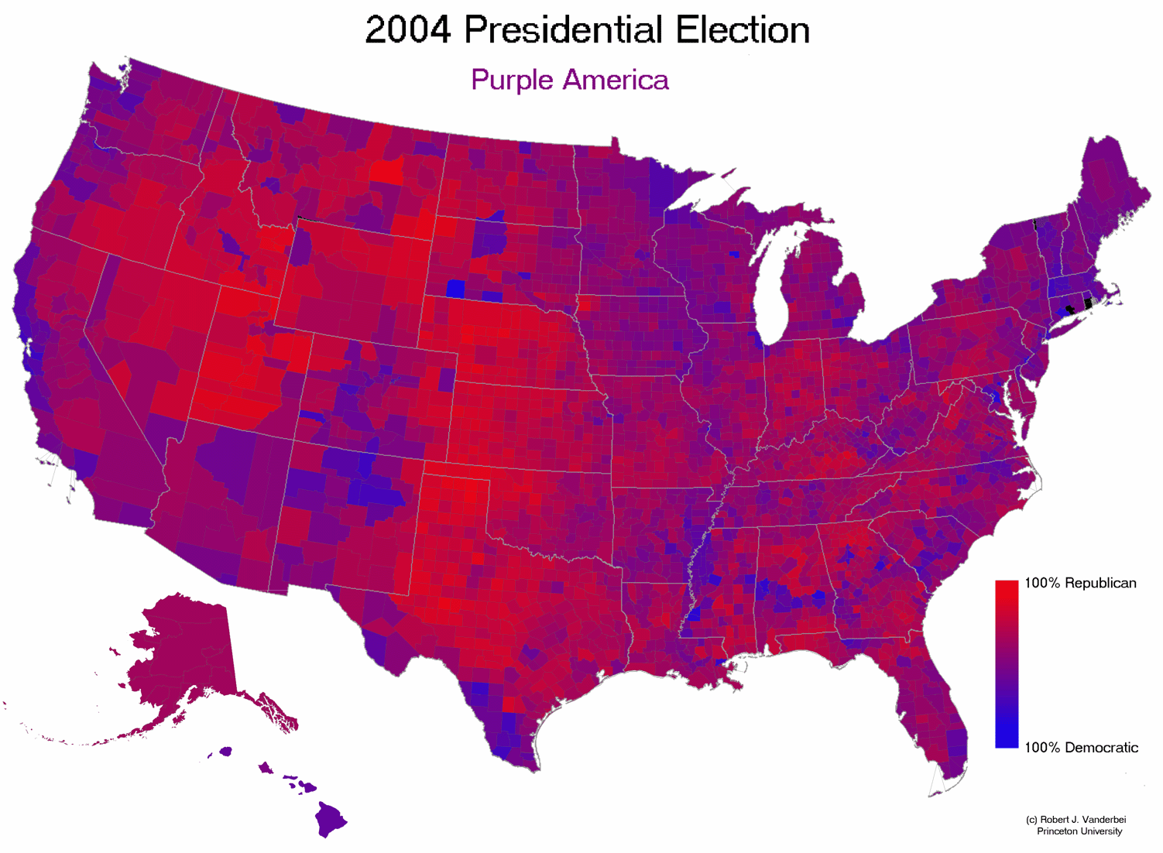
Applications – Visualization

