Slide 1
Displays
CMSC 435/634

Slide 2
Light
Visible Range: 390-700nm
Luminance has large dynamic range
0.00003 Moonless overcast night sky
30. Sky on overcast day
30000. Sky on clear day
16,000. Snowy ground in full sunlight
Actual colors result from spectral curves
dominant wavelength, hue
brightness, lightness
purity, saturation

Slide 3
Physiology
Rods
active at low light levels (scotopic vision)
only one wavelength sensitivity function
Cones
active at normal light levels
three types: sensitivity functions with different peaks

Slide 4
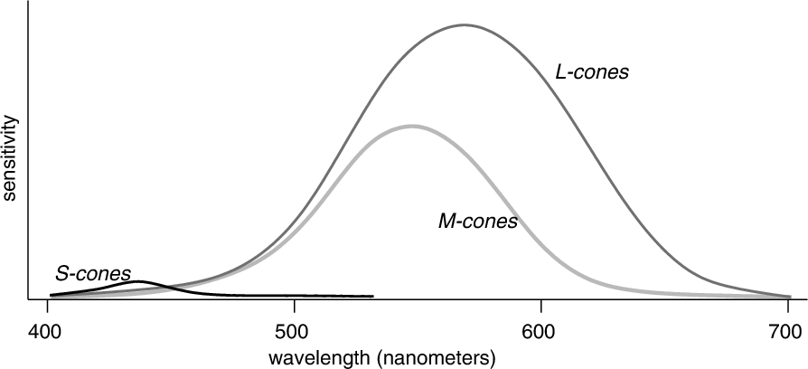
Spectral Sensitivity

Slide 5
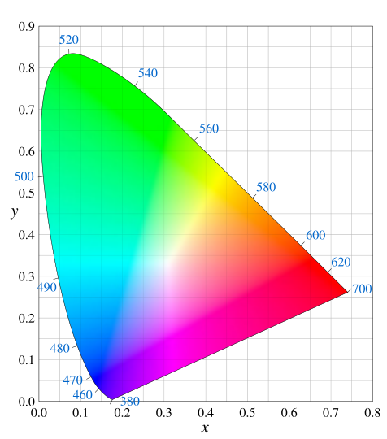
Gamut

Slide 6
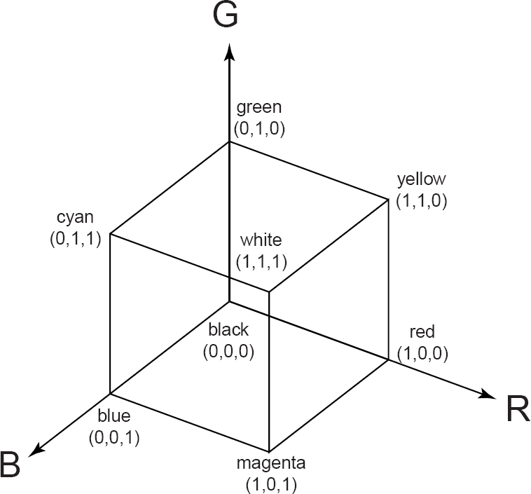
Additive Color Mixing

Slide 7
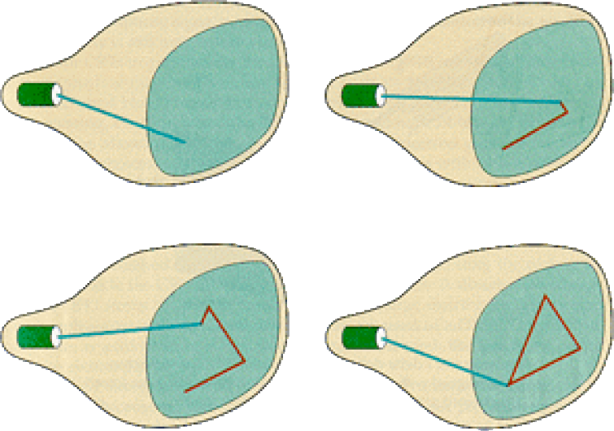
Random/Vector Display

Slide 8
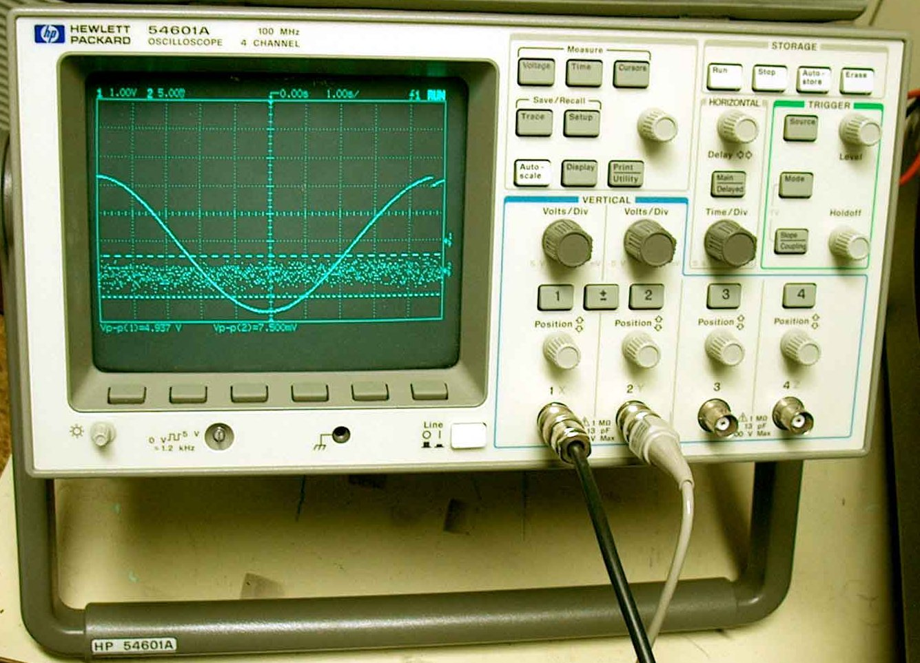
Examples of Random Scan

Slide 9
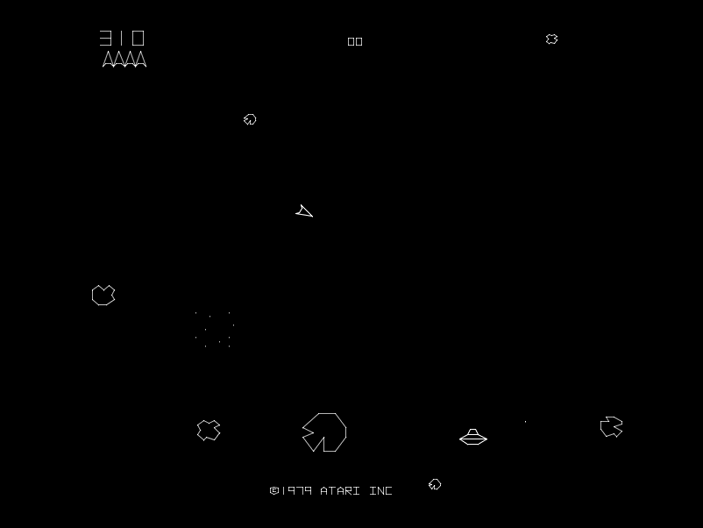
Examples of Random Scan

Slide 10
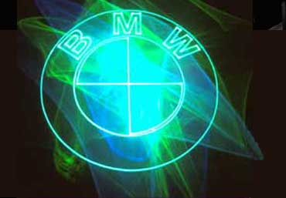
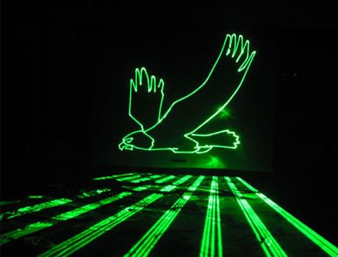
Examples of Random Scan

Slide 11
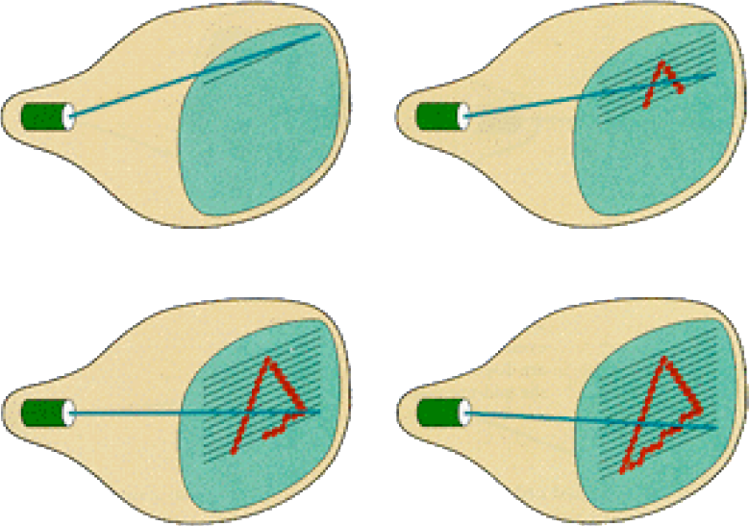
Raster Display

Slide 12
Raster Display
Each left-to-right trace is called a scan line
Each spot on the screen is called a pixel
Beam turned off to swipe back and up screen
Called a retrace or blanking interval

Slide 13
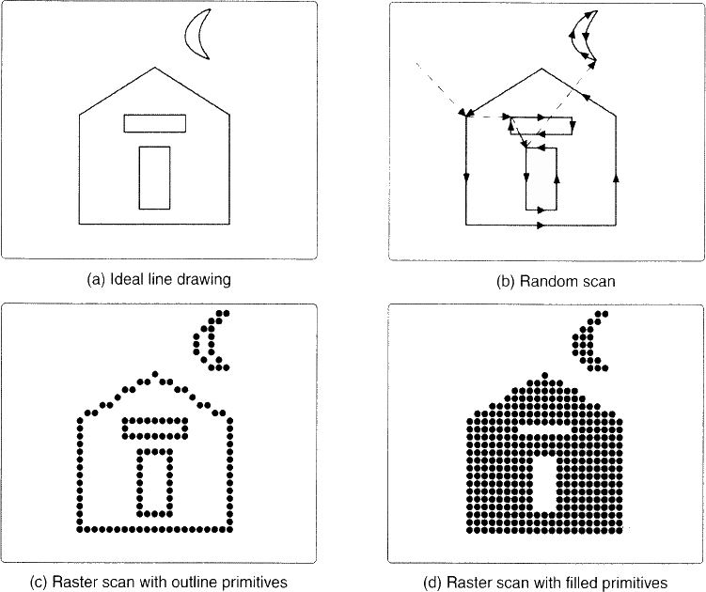
Vector vs. Raster

Slide 14
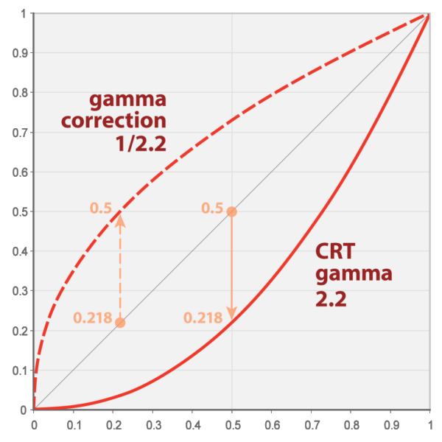
Gamma

Slide 15
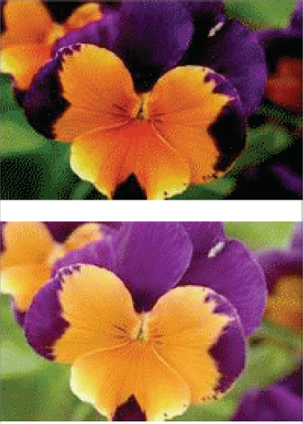
Gamma Correction

Slide 16
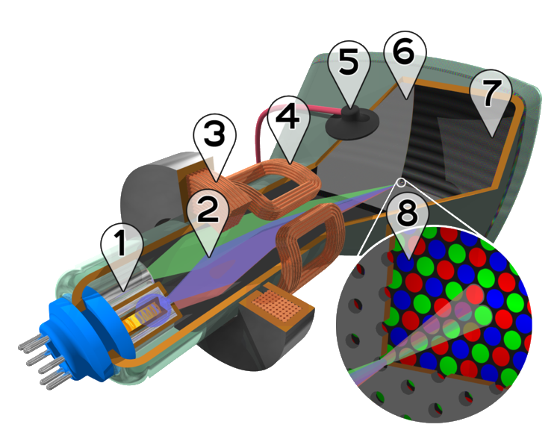
Color CRT
Electron guns
Electron beams
Focusing coils
Deflection coils
Anode connection
Shadow mask
Phosphor with RGB zones
Phosphor / Mask close-up

Slide 17
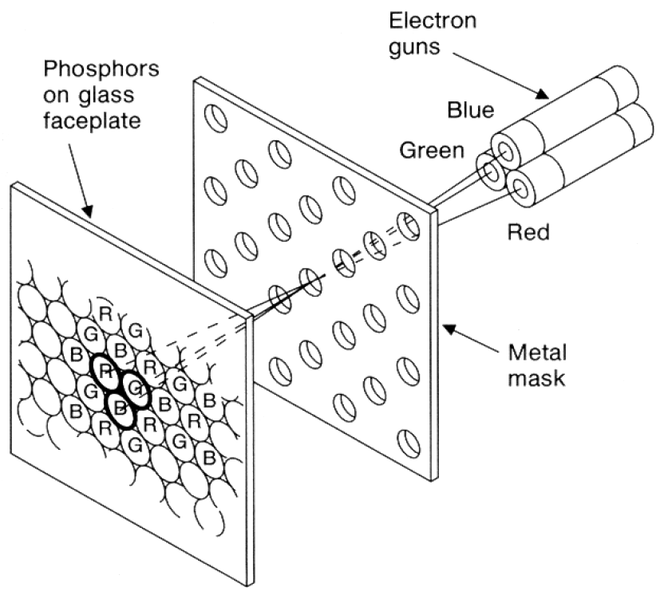
Color CRT
Uses triads of red, green & blue at each pixel
Uses 3 electron guns – one for each color
Shadow mask used to make each kind of phosphor only visible from one gun

Slide 18
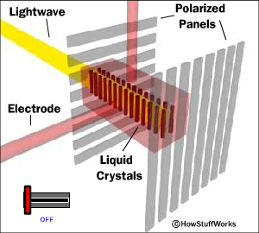
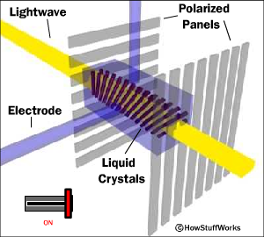
Liquid Crystal Display (LCD)‏
Light enters polarizer
Nematic crystals twist based on voltage
Allowing light to pass through to other polarizer

Slide 19
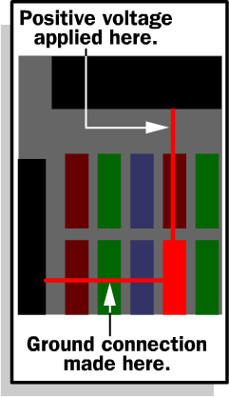
Passive Matrix
Two glass layers
One layer is given vertical transparent conductive material, the other is given horizontal
Integrated circuit sends charge/ground activation to complete circuit at given row/column
Simple, but slow response time

Slide 20
Active Matrix
Active matrix displays have a transistor at each cell
Thin film transistor (TFT)
Much faster crystal switching

Slide 21
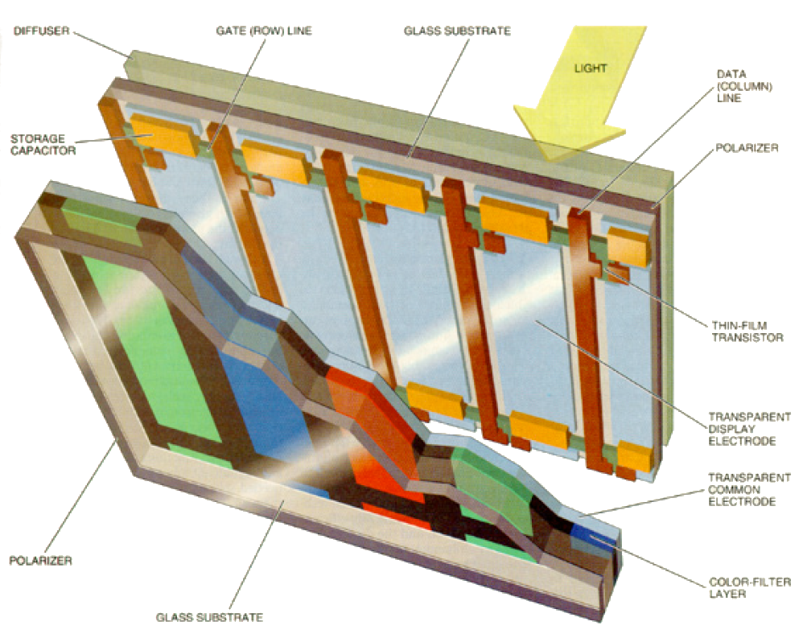
Color LCD

Slide 22
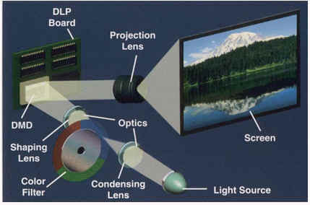
DLP Projector

Slide 23
DLP Projector

Slide 24
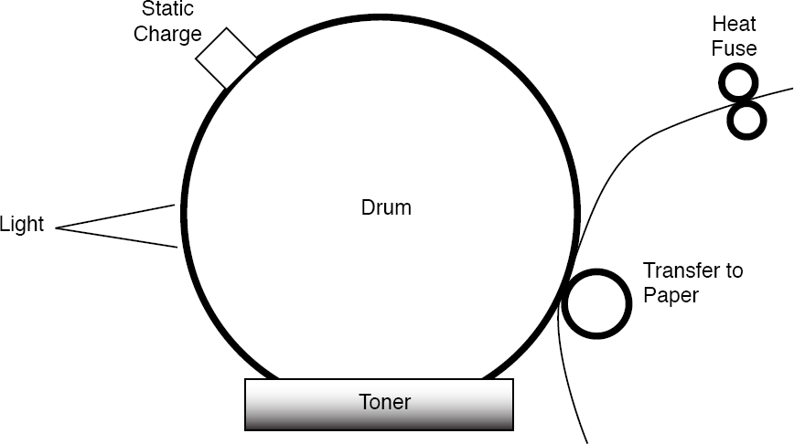
Laser Printer

Slide 25
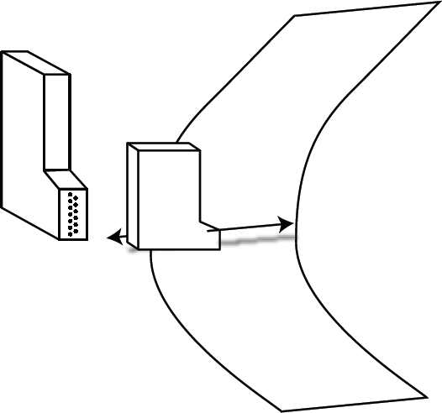
Ink Jet Printer

Slide 26
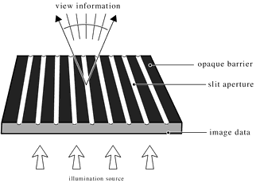
Auto-stereo Display: Barrier

Slide 27
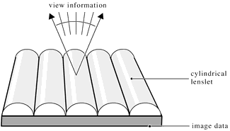
Auto-stereo Display: Lenticular

