Slide 1
Animation
CMSC 435/634

Slide 2
Keyframe Animation
From hand drawn animation
  Lead animator draws poses at key frames
  Inbetweener draws frames between keys
Computer animation
  Can have separate keys for different attributes
  Interpolate between values at key frames

Slide 3
How to Interpolate
Linear interpolation
  Value V₀ at time T₀, V₁ at time T₁
  Fraction of the way from T₀ to T₁
  Lerp/mix equation

Slide 4
Spline
Set of polynomials
1 constraint per coefficient
  Positions
  Velocities
  Acceleration

Slide 5
Bezier Spline
All constraints from control points:
Resulting equations:

Slide 6
Bezier Basis Functions
Computing position

Slide 7
Bezier Basis Functions
Group by t^{i}: coefficients

Slide 8
Bezier Basis Functions
Group by p_{i}: Basis Functions

Slide 9
Bezier Basis Functions
Cubic Bezier basis functions

Slide 10
Catmull-Rom Spline
Constraints
Resulting equations:

Slide 11
Catmull-Rom Basis Functions

Slide 12
What to Interpolate
What controls to artists need?
How to convert those into transformations?

Slide 13
Position and Orientation
Objects can move!
Keys:
  Separate control of position and orientation
  Never interpolate matrices!
    They won’t do what you want.
  Quaternions interpolate better than Euler angles
    But angles make a better animation interface
    Can still convert to and interpolate as quaternion
    Possible to use directly for rotation, or convert to matrix

Slide 14
Squash and Stretch
Defining the rigidity and mass of an object by distorting its shape during an action
Examples:
  Ball flattening during bounce
  Facial animation – cheeks squash during smile

Slide 15
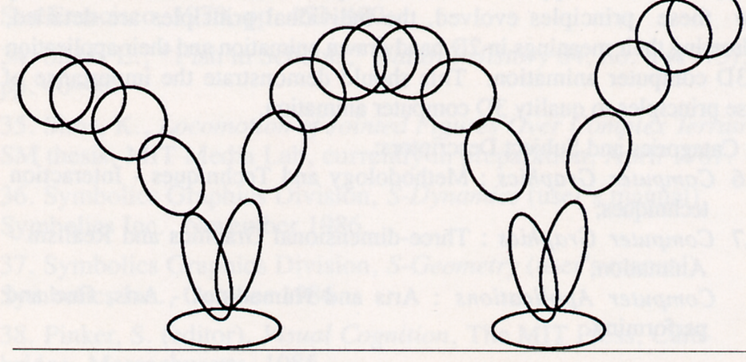

Slide 16
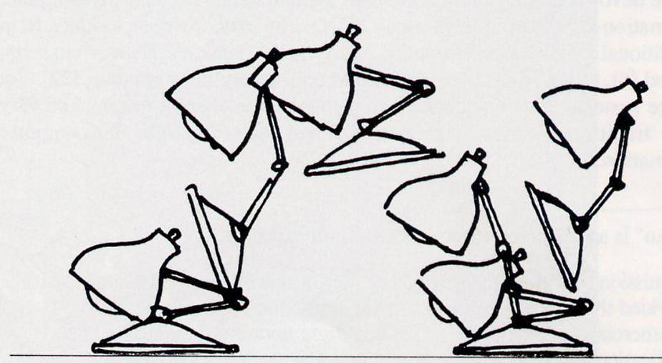

Slide 17
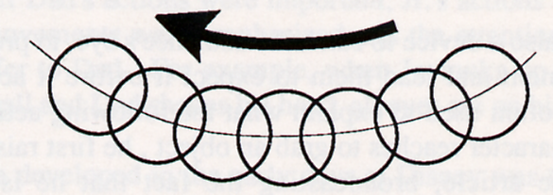
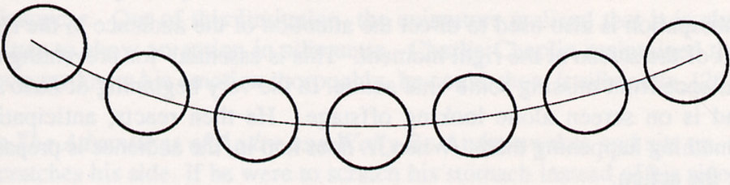
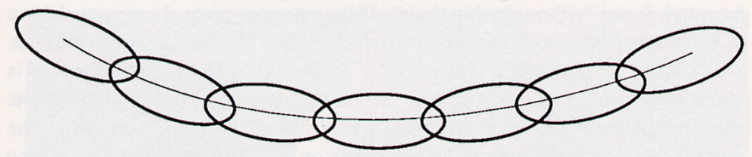

Slide 18
Squash and Stretch
Keys
  Volume constant
  Different materials respond differently
  Need not deform
  Use stretching to eliminate strobing from fast action
Method
  Can use scale to conserve volume (up in one dimension down in others)

Slide 19
Anticipation
The preparation for an action
Examples:
  Pull back foot to kick ball
  Luxo: big lamp looks off stage before Jr.’s entrance

Slide 20
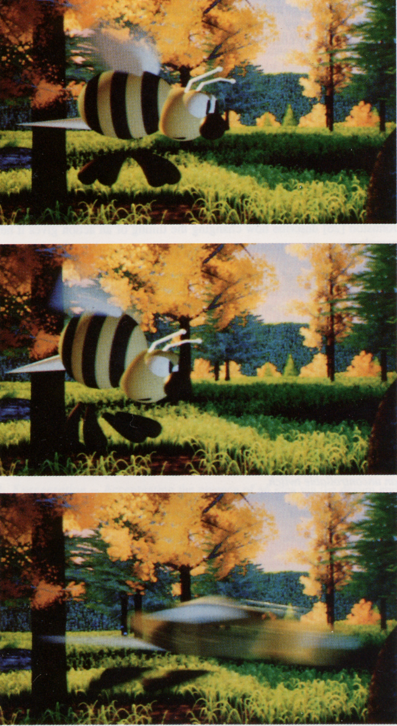

Slide 21
Anticipation
Keys
  Direct attention to upcoming action
  Anticipation can allow faster action

Slide 22
Slow In and Out
The spacing of the in between frames to achieve subtlety of timing and movement
Example:
  Moving from place to place: start and end slow

Slide 23
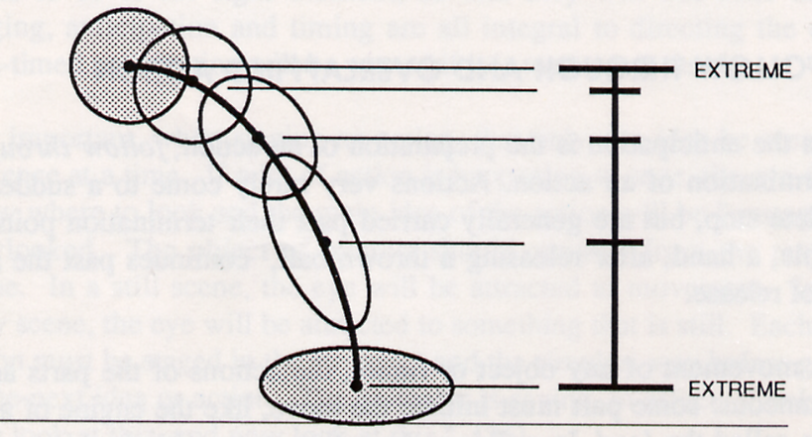

Slide 24
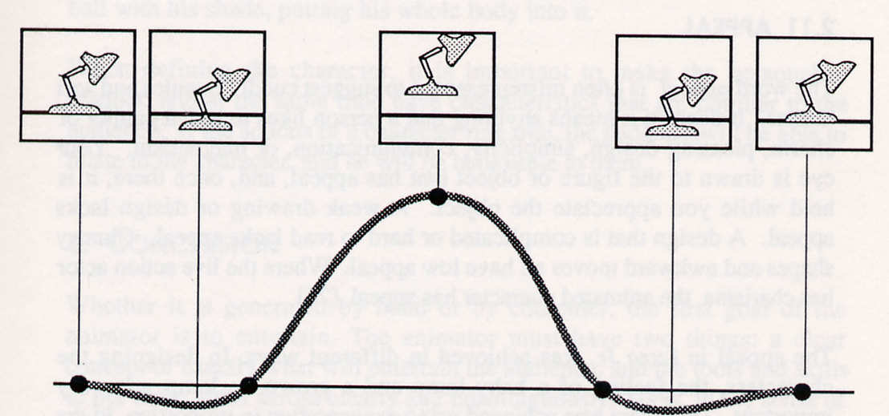

Slide 25
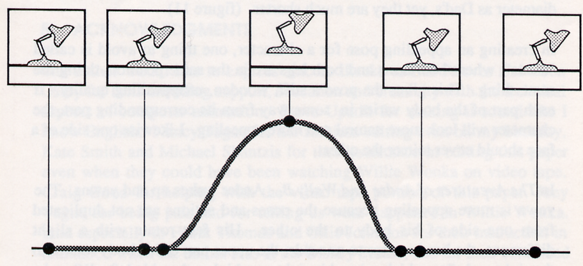

Slide 26
Slow In and Out
Keys
  Think about continuity of second and third order motion
Reparameterize time

Slide 27
Arcs
The visual path of action for natural movement
Examples:
  Thrown ball
Keys
  Arc movements are more natural than lines

Slide 28
Character Animation
Control
  Hierarchical model
  Forward kinematics
  Inverse kinematics
  Motion capture
Rendering
  Skinning
  Blend Shapes
  Deformation

Slide 29
Forward Kinematics
Given a set of joint angles, where’s the hand?
  (or foot or head or …)
  End effector
Just apply nested transforms
We know how to do that!

Slide 30
Forward Kinematics
Character is holding something in their right hand, want to shift it to the left hand
  Forward transform up tree
  Inverse transform back down
Think of matrices as X_from_Y
  X_from_Y⁻¹ = Y_from_X

Slide 31
Forward Kinematics
  LHand_from_LLowerArm*
  LLowerArm_from_LUpperArm*
  LUpperArm_from_LShoulder*
  LShoulder_from_Body*
  Body_from_RShoulder*
  RShoulder_from_RUpperArm*
  RUpperArm_from_RLowerArm*
  RLowerArm_from_RHand
  LLowerArm_from_LHand⁻¹*
  LUpperArm_from_LLowerArm⁻¹*
  LShoulder_from_LUpperArm⁻¹*
  Body_from_LShoulder⁻¹*
  Body_from_RShoulder*
  RShoulder_from_RUpperArm*
  RUpperArm_from_RLowerArm*
  RLowerArm_from_RHand

Slide 32
Inverse Kinematics
Find angles to match end effector position
Few joints: system of equations
Many joints: optimization
  Often with constraints
    (wrist doesn’t bend that way)
  And heuristics
    Minimal change
    Load support
    Physical data

Slide 33
Motion Capture (mocap)
Track markers on actor
Infer transforms
Often significant artistic cleanup

Slide 34
Skinning
Don’t like intersecting joints
Animate “skeleton”
  Just joint transforms, no geometry
Each vertex in “skin”
  Linear blend of one or more joint transforms
  E.g. α Shoulder + β Arm
Can retarget same animation to different skins

Slide 35
Blend Shapes
Sculpted vertex positions in key poses
Blend positions
Good when skeletons don’t work well
Most often used for facial animation

Slide 36
Deformation
Nonlinear function p’ = f(p)
Affine transform as a function of position
  Bend = RotateX(z), twist = RotateZ(z)
Free form deformation (FFD)
  3D spline: p(s,t,u)
  Like object is embedded in jello

Slide 37
Physics-based Animation
Generally: simulating the laws of physics to predict motion
Common applications:
  Fluids, gas
  Cloth, hair
  Rigid body motion
Approach: model change as differential equations

Slide 38
Autonomous Objects/Groups
Generally: create complex group behavior by defining relatively simple individual behavior
Common applications:
  Flocks, crowds
  Particle systems
Approach: leverage AI techniques

