Slide 1
Global Illumination
CMSC 435/634

Slide 2
Global Illumination
Local Illumination
  light – surface – eye
  Throw everything else into ambient
Global Illumination
  light – surface – surface – … – eye
  Multiple bounces
  All photon paths:
    Reflection, refraction, diffuse
    Participating media

Slide 3
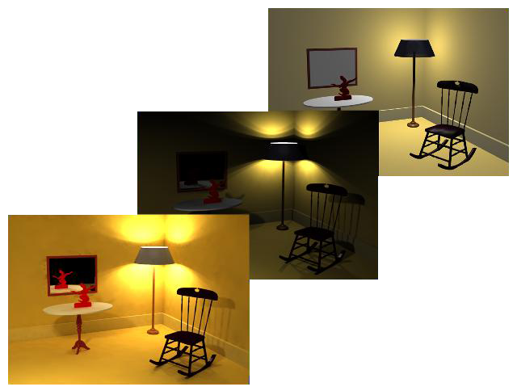
Global Illumination
ambient
no ambient
global illumination

Slide 4
Radiometric Units
Term | Symbol | Units
Radiant Energy | Q | J
Radiant Flux (Power) | Φ = dQ/dt | W = J/s
Radiant Intensity | I = dΦ/dω | W/sr
Radiosity (exiting) | B = dΦ/dA | W/m²
Irradiance (entering) | E = dΦ/dA | W/m²
Radiance | L = d²Φ/(dω dA) | W/(sr m²)

Slide 5
Radiant Energy (Q)
Total energy (Joules)
Over all time, directions, area, …

Slide 6
Radiant Flux (Φ)
Φ = dQ/dt in Watts = J/s
Radiant energy per unit time
This is the one you probably want
  Unless you are measuring total energy absorbed
  E.g. by a plant over hours of daylight

Slide 7
Radiant Intensity (I)
I = dΦ/dω in W/sr
Radiant Flux emitted per unit solid angle
  Light from a point in a small cone of directions

Slide 8
Radiosity (B)
B = dΦ/dA in W/m²
All light leaving a patch of surface
  Emitted or reflected
  All directions
  Measured per unit area

Slide 9
Irradiance (E)
E = dΦ/dA in W/m²
All light entering a patch of surface
  All directions
  Measured per unit area

Slide 10
Radiance (L)
L = d²Φ/(dω dA) in W/(sr m²)
Light entering patch of surface from a direction
  Per unit area
  Per unit solid angle
  Think of light coming into a patch of surface from a small cone of directions
Compare to Irradiance (over all directions)

Slide 11
Photometric Units
Considers human response
  How bright it seems
Term | Symbol | Units | Name
Luminous Energy | Q | T | Talbot
Luminous Flux | Φ = dQ/dt | lm = T/s | Lumen
Luminous Intensity | I = dΦ/dω | cd = lm/sr | Candella
Illuminance | E = dΦ/dA | lx = lm/m² | Lux
Luminance | L = d²Φ/(dω dA) | nt = cd/m² | Nits

Slide 12
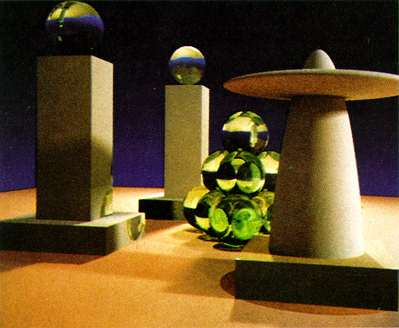
Backward Algorithms:
Ray / Path Tracing
Follow photons backwards: eye to light
Traditional ray tracing
  Follow primary reflection
Path tracing
  Monte-carlo integration
  Probabalistically choose
  path direction
  Many rays per pixel
Kajiya 1986

Slide 13
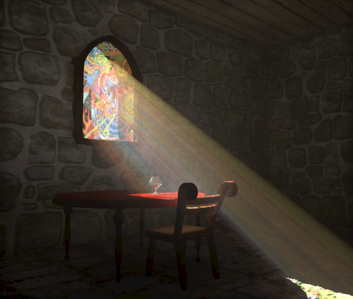
Forward Algorithms:
Photon Map
Follow photons forward: light to eye
Photon Map
  Bounce photons from
  surface to surface
  Collect in spatial data
  structure
  Final gather per pixel
Wann Jensen and Christensen 1998

Slide 14
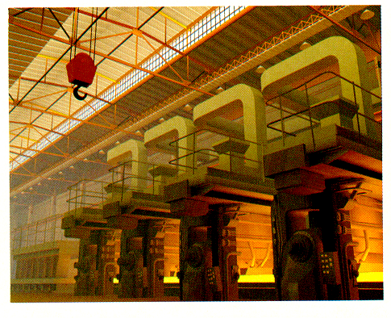
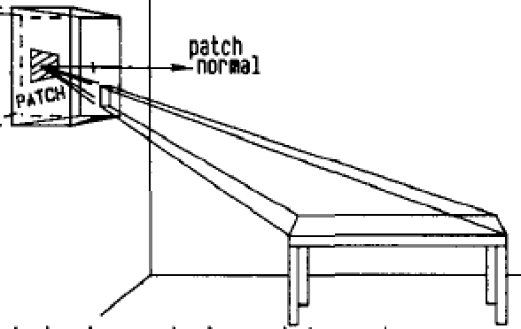
Forward Algorithms:
Radiosity
Diffuse only: Progressive Radiosity
Lights emit
Other surfaces collect
  rendering hemicube
Then emit
Cohen et al. 1988

Slide 15
Forward Algorithms:
Radiosity
Full Radiosity
Form Factor = contrib of patch i on patch j
  Radiosity_{i} = Emission_{i} + ∑ FormFactor_{i,j} * Radiosity_{j}
  Solve (big) matrix form

Slide 16
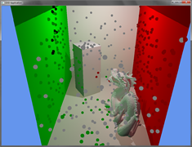
Forward Algorithms:
Virtual Point Lights (Instant Radiosity)
Bounce photons
Leave virtual point light at each bounce
Watch out for “weak singularity”
  Light too bright near point
Hayward

Slide 17
Bidirectional Path Tracing
Trace both light and view paths
Connect view path to light path
  Instead of view path to light
Metropolis
  Find paths that work
  Mutate them to make more

Slide 18
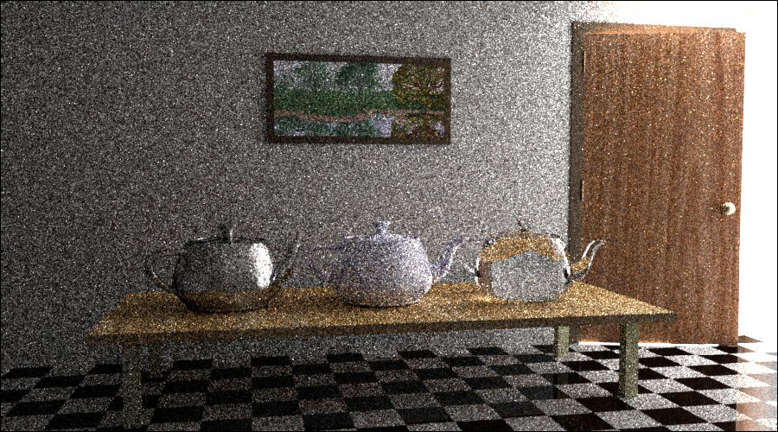
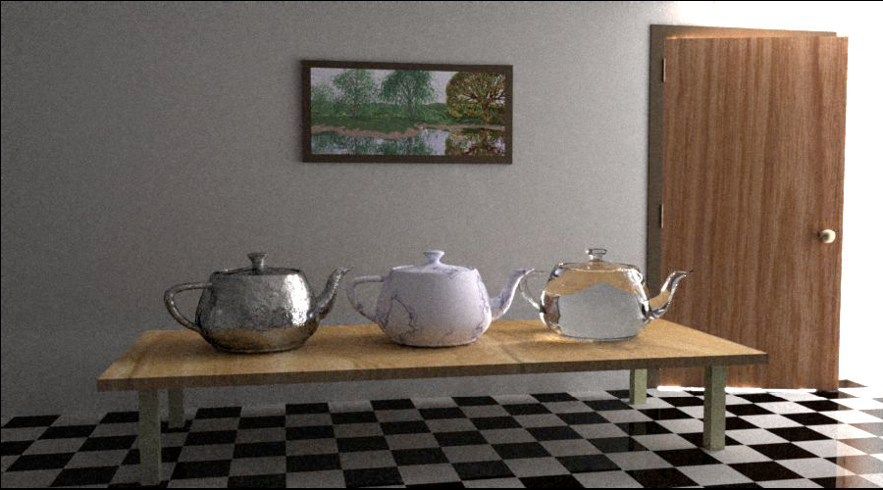
Bidirectional Path Tracing &
Metropolis Light Transport

Slide 19
Interactive Rendering
Viewpoint independent
  Diffuse surfaces only
Pre-compute and store radiosity
  As patch/vertex colors
  As texture
Separate solution for each light
  Linear combination to change lights

Slide 20
Interactive Rendering
Viewpoint dependent
Compute light probes at limited points
  Store in a form with direction
    Cube Map per probe
    Spherical Harmonics
Precomputed Radiance Transfer
  Directional representation per vertex or texel

