Slide 1
Graphics Hardware
CMSC 435/634

Slide 2
A Graphics Pipeline
Transform
Shade
Vertex
Clip
Project
Rasterize
Triangle
Interpolate
Texture
Fragment
Z-buffer

Slide 3
Computation and Bandwidth
Based on:
• 100 Mtri/sec (1.6M/frame@60Hz)
• 256 Bytes vertex data
• 128 Bytes interpolated
• 68 Bytes fragment output
• 5x depth complexity
• 16 4-Byte textures
• 223 ops/vert
• 1664 ops/frag
• No caching
• No compression
Vertex
75 GB/s
67 GFLOPS
Triangle
13 GB/s
335 GB/s Texture
45 GB/s Fragment
Fragment
1.1 TFLOPS

Slide 4
Data Parallel
Distribute
Task
Task
Task
Task
Merge

Slide 5
Sort First
Objects
Distribute objects by screen tile
Vertex
Vertex
Vertex
Some pixels
Some objects
Triangle
Triangle
Triangle
Fragment
Fragment
Fragment
Screen

Slide 6
Sort Middle
Objects
Distribute objects or vertices
Vertex
Vertex
Vertex
Some objects
Merge & Redistribute by screen location
Triangle
Triangle
Triangle
Triangle
Some pixels
Some objects
Fragment
Fragment
Fragment
Fragment
Screen

Slide 7
Screen Subdivision
Tiled
Interleaved

Slide 8
Sort Last
Objects
Distribute by object
Vertex
Vertex
Vertex
Full Screen
Some objects
Triangle
Triangle
Triangle
Fragment
Fragment
Fragment
Z-merge
Screen

Slide 9
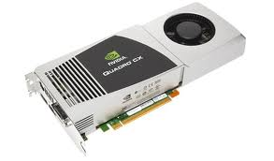
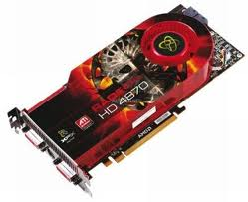
Graphics Processing Unit (GPU)
Sort Middle(ish)
Fixed-Function HW for clip/cull, raster, texturing, Ztest
Programmable stages
Commands in, pixels out

Slide 10
GPU Computation
Vertex
…
More Parallel
Parallel
Triangle
Pixel
Pipeline
More Parallel
More Pipeline

Slide 11
Architecture: Latency
CPU: Make one thread go very fast
Avoid the stalls
  Branch prediction
  Out-of-order execution
  Memory prefetch
  Big caches
GPU: Make 1000 threads go very fast
Hide the stalls
  HW thread scheduler
  Swap threads to hide stalls

Slide 12
Architecture (MIMD vs SIMD)
MIMD(CPU-Like)
SIMD (GPU-Like)
CTRL
ALU
CTRL
ALU
CTRL
ALU
ALU
ALU
ALU
CTRL
ALU
ALU
ALU
ALU
CTRL
ALU
ALU
ALU
ALU
Flexibility
Horsepower
Ease of Use

Slide 13
SIMD Branching
if( x ) // mask threads
// issue instructions
else // invert mask
// issue instructions
// unmask
Threads agree, issue if
Threads agree, issue else
Threads disagree, issue if AND else

Slide 14
SIMD Looping
Useful
Useless
while(x) // update mask
// do stuff
They all run ‘till the last one’s done….

Slide 15
GPU graphics processing model
CPU
Texture/Buffer
Vertex
Geometry
Rasterize
Fragment
Z-Buffer
Displayed
Pixels

Slide 16
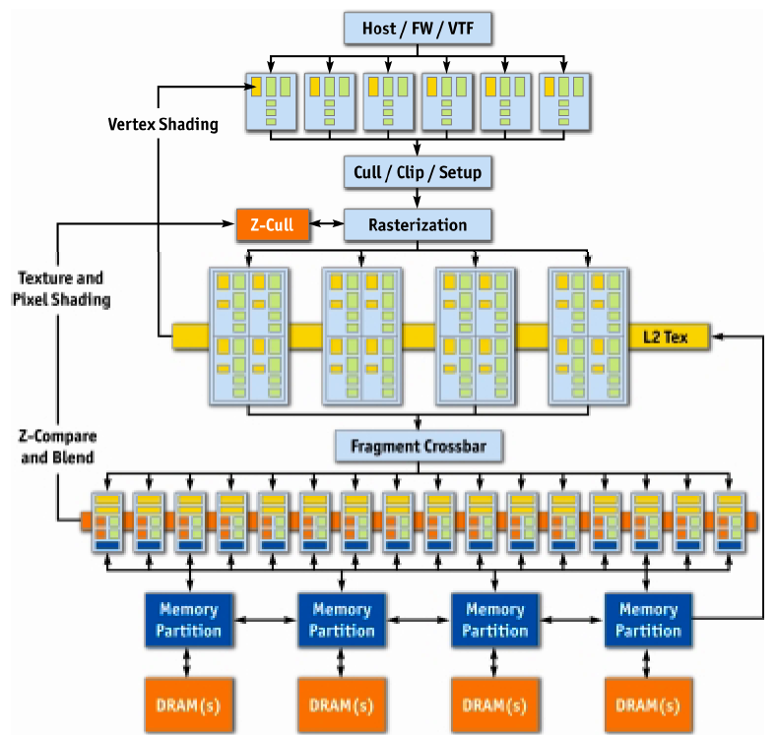
NVIDIA GeForce 6
Vertex
Rasterize
Fragment
Z-Buffer
Displayed
Pixels
[Kilgaraff and Fernando, GPU Gems 2]

Slide 17
GPU graphics processing model
CPU
Texture/Buffer
Vertex
Geometry
Rasterize
Fragment
Z-Buffer
Displayed
Pixels

Slide 18
GPU graphics processing model
CPU
Vertex
Texture/Buffer
Geometry
Fragment
Rasterize
Displayed
Pixels
Z-Buffer

Slide 19
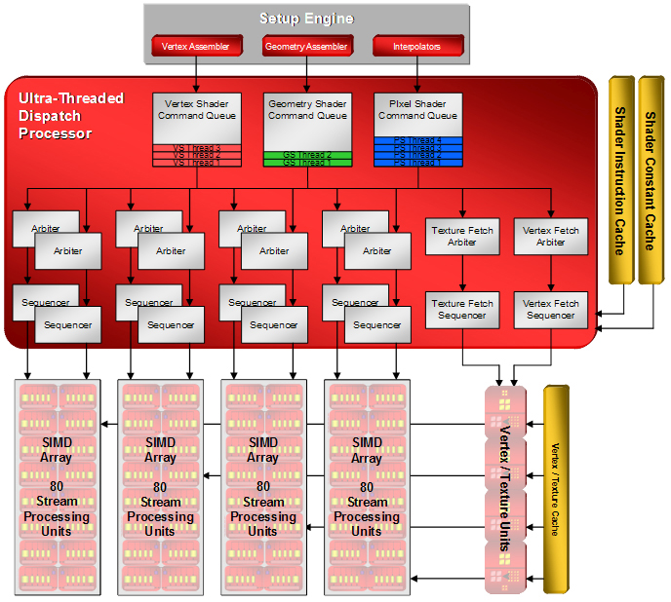
AMD/ATI R600 Dispatch

Slide 20
SIMD Units
2x2 Quads (4 per SIMD)
20 ALU/Quad (5 per thread)
“Wavefront” of 64 Threads, executed over 8 clocks
2 Waves interleaved
Interleaving + multi-cycling hides ALU latency.
Wavefront switching hides memory latency.
GPR Usage determines wavefront count.
General Purpose Registers
4x32bit
(THOUSANDS of them)

Slide 21
AMD/ATI R600
[Tom’s Hardware]

Slide 22
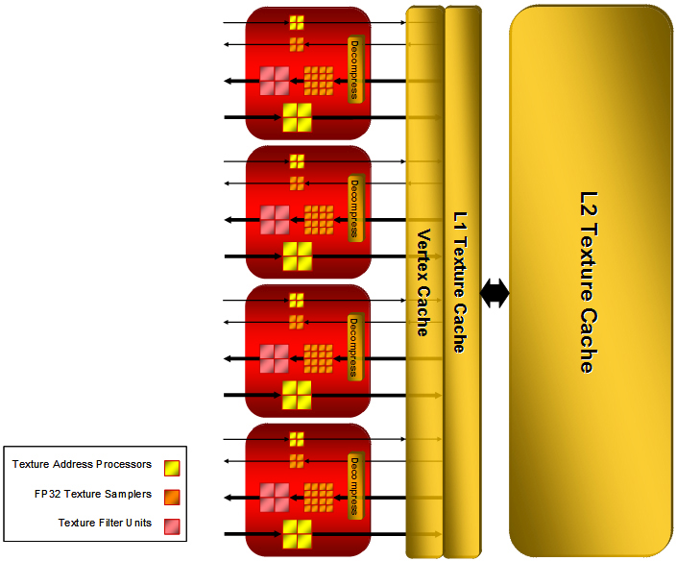
Texture

Slide 23
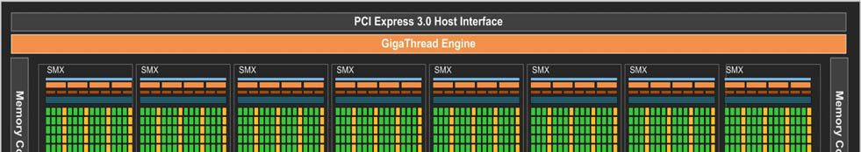
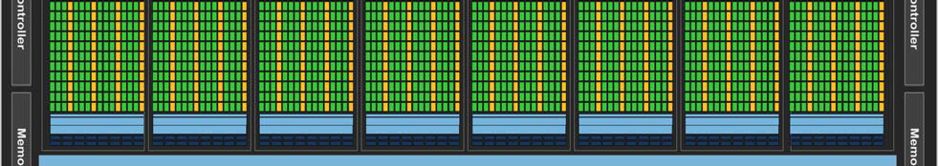
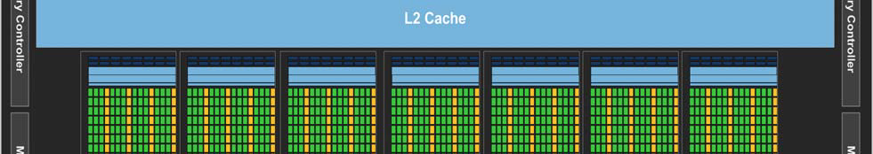
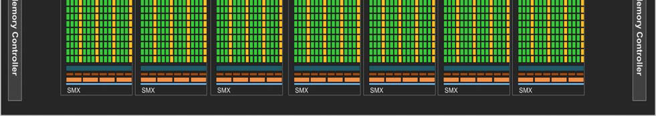
NVIDIA Kepler
[NVIDIA, NVIDIA’s Next Generation CUDA Compute Architecture: Kepler GK110, 2012]

Slide 24
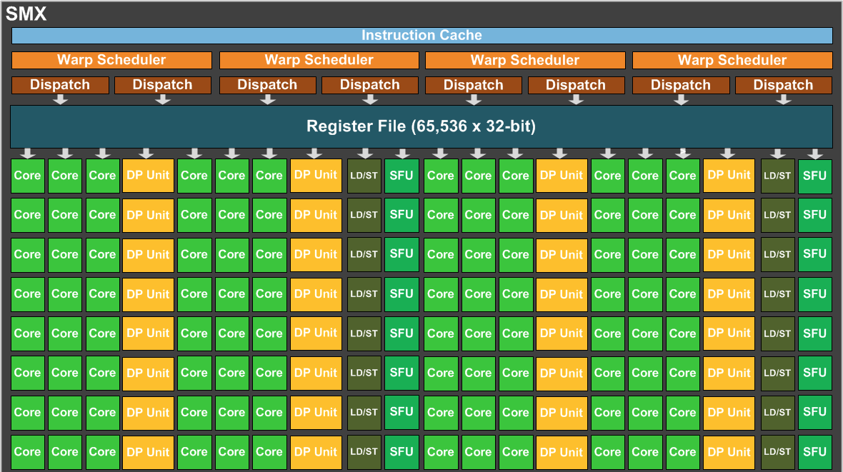
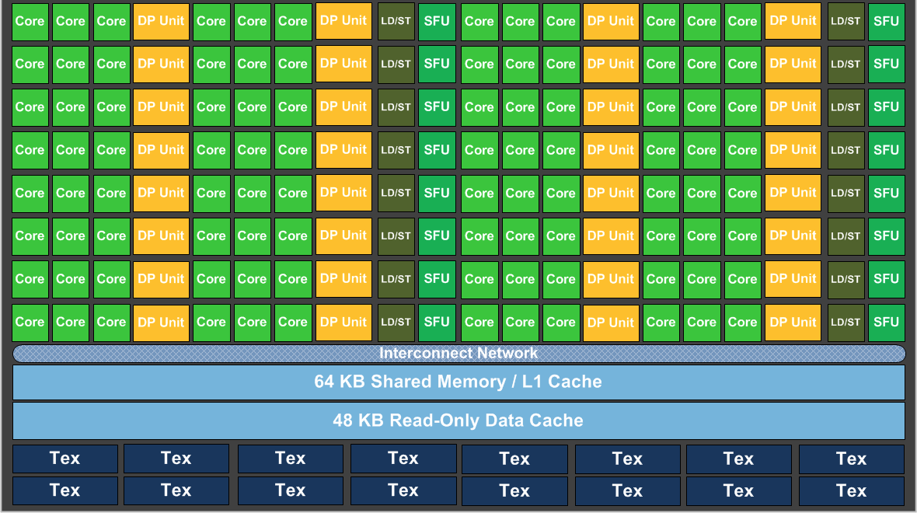
Kepler SMX
[NVIDIA, NVIDIA’s Next Generation CUDA Compute Architecture: Kepler GK110, 2012]

Slide 25
GPU Performance Tips

Slide 26
Graphics System Architecture
Your Code
Display
GPU
GPU
GPU(s)
API
Driver
Produce
Consume
Current Frame
(Buffering Commands)
Previous Frame(s)
(Submitted, Pending Execution)

Slide 27
GPU Performance Tips
API and Driver
  Reading Results Derails the train…..
    Occlusion Queries → Death
      When used poorly ….
    Framebuffer reads ➔ DEATH!!!
      Almost always…
    CPU-GPU communication should be one way
    If you must read, do it a few frames later…

Slide 28
GPU Performance Tips
API and Driver
  Minimize shader/texture/constant changes
  Minimize Draw calls
  Minimize CPU→GPU traffic
    glBegin()/glEnd() are EVIL!
    Use static vertex/index buffers if you can
    Use dynamic buffers if you must
      With discarding locks…

Slide 29
GPU Performance Tips
Shaders, Generally
  NO unnecessary work!
    Precompute constant expressions
    Div by constant → Mul by reciprocal
  Minimize fetches
    Prefer compute (generally)
    If ALU/TEX < 4, ALU is under-utilized
    If combining static textures, bake it all down…

Slide 30
GPU Performance Tips
Shaders, Generally
  Careful with flow control
    Avoid divergence
    Flatten small branches
    Prefer simple control structure
  Double-check the compiler
  Look over artists’ shoulders
    Material editors give them lots of rope….

Slide 31
GPU Performance Tips
Vertex Processing
  Use the right data format
    Cache-optimized index buffer
    Small, 16-byte aligned vertices
  Cull invisible geometry
    Coarse-grained (few thousand triangles) is enough
    “Heavy” Geometry load is ~2MTris and rising

Slide 32
GPU Performance Tips
Pixel Processing
  Small triangles hurt performance
    2x2 pixel quads ➔ Waste at edge pixels
  Respect the texture cache
    Adjacent pixels should touch adjacent texels
    Use the smallest possible texture format
  Avoid dependent texture reads
  Do work per vertex
    There’s usually less of those (see small triangles)

Slide 33
GPU Performance Tips
Pixel Processing
  HW is very good at Z culling
    Early Z, Hierarchical Z
  If possible, submit geometry front to back
  “Z Priming” is commonplace

Slide 34
GPU Performance Tips
Blending/Backend
  Turn off what you don’t need
    Alpha blending
    Color/Z writes
  Minimize redundant passes
    Multiple lights/textures in one pass
  Use the smallest possible pixel format
  Consider clip() in transparent regions

