Slide 1
Graphics Pipeline
Hidden Surface
CMSC 435/634

Slide 2
Visibility
We can convert simple primitives to pixels/fragments
How do we know which primitives (or which parts of primitives) should be visible?

Slide 3
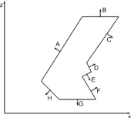
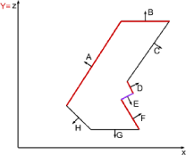
Back-face Culling
Polygon is back-facing if
  V•N > 0
Assuming view is along Z (V=0,0,1)
  V•N = (0 + 0 + z_{n})
Simplifying further
  If z_{n} > 0, then cull
Works for non-overlapping convex polyhedra
With concave polyhedra, some hidden surfaces will not be culled

Slide 4
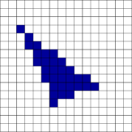
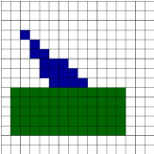
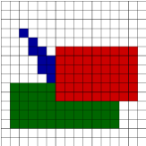
Painter’s Algorithm
First polygon:
  (6,3,10), (11, 5,10), (2,2,10)
Second polygon:
  (1,2,8), (12,2,8), (12,6,8), (1,6,8)
Third polygon:
  (6,5,5), (14,5,5), (14,10,5),( 6,10,5)

Slide 5
Painter’s Algorithm
Given
  List of polygons {P₁, P₂, …. P_{n})
  An array of Intensity [x,y]
Begin
  Sort polygon list on minimum Z (largest z-value comes first in sorted list)
  For each polygon P in selected list do
    For each pixel (x,y) that intersects P do
      Intensity[x,y] = intensity of P at (x,y)
  Display Intensity array

Slide 6

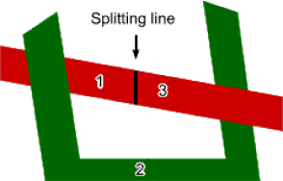
Painter’s Algorithm: Cycles
Which order to scan?
Split along line, then scan 1,2,3

Slide 7

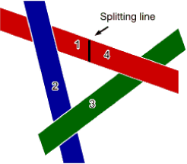
Painter’s Algorithm: Cycles
Which to scan first?
Split along line, then scan 1,2,3,4 (or split another polygon and scan accordingly)
Moral: Painter’s algorithm is fast and easy, except for detecting and splitting cycles and other ambiguities

Slide 8
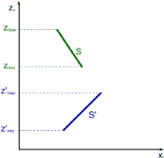
Depth-sort: Overlapping Surfaces
Assume you have sorted by maximum Z
  Then if Z_{min} > Z’_{max}, the surfaces do not overlap each other (minimax test)
Correct order of overlapping surfaces may be ambiguous. Check it.

Slide 9
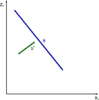
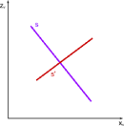
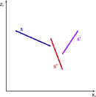
Depth-sort: Overlapping Surfaces
No problem: paint S, then S’
Problem: painting in either order gives incorrect result
Problem? Naïve order S S’ S”; correct order S’ S” S

Slide 10
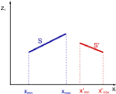

Depth-sort: Order Ambiguity
Bounding rectangles in xy plane do not overlap
  Check overlap in x
    x’_{min} > x_{max} or x_{min} > x’_{max} -> no overlap
  Check overlap in y
    y’_{min} > y_{max} or y_{min} > y’_{max} -> no overlap
Surface S is completely behind S’ relative to viewing direction.
  Substitute all vertices of S into plane equation for S’, if all are “inside” ( < 0), then there is no ambiguity

Slide 11
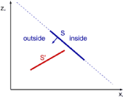
Depth-sort: Order Ambiguity
3. Surface S’ is completely in front S relative to viewing direction.
  Substitute all vertices of S’ into plane equation for S, if all are “outside” ( >0), then there is no ambiguity

Slide 12
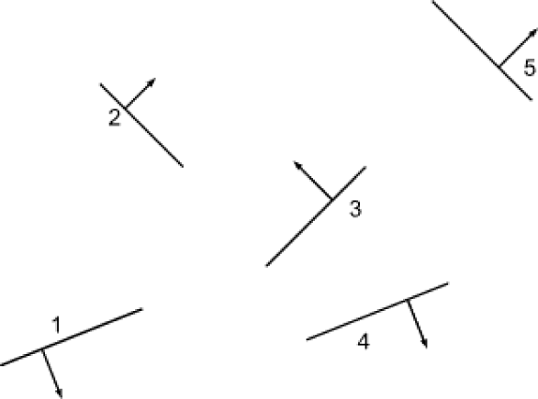
Binary Space Partitioning

Slide 13
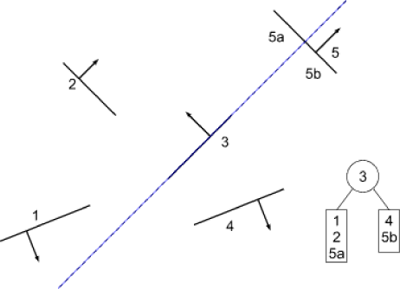
Building a BSP Tree
Use pgon 3 as root, split on its plane
Pgon 5 split into 5a and 5b

Slide 14
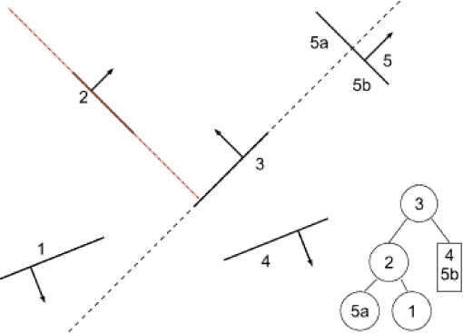
Building a BSP Tree
Split left subtree at pgon 2

Slide 15
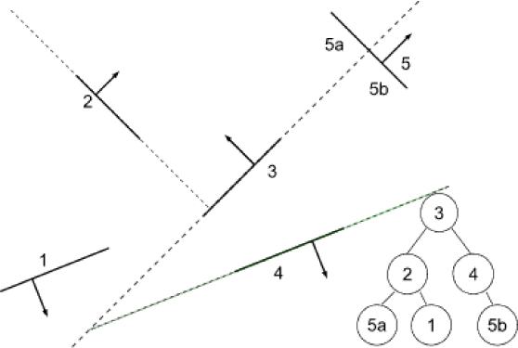
Building a BSP Tree
Split right subtree at pgon 4

Slide 16
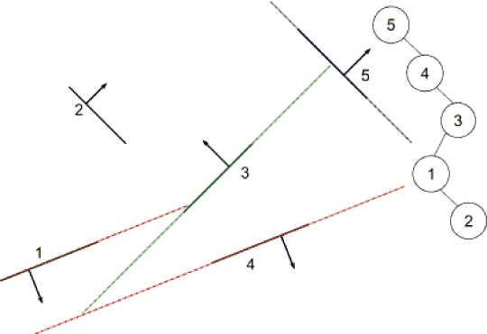
Building a BSP Tree
Alternate tree if splits are made at 5, 4, 3, 1

Slide 17
BSP Tree: Building the Tree
BSPTree MakeBSP ( Polygon list ) {
if ( list is empty ) return null
else {
root = some polygon ; remove it from the list
backlist = frontlist = null
for ( each remaining polygon in the list ) {
if ( p in front of root )
addToList ( p, frontlist )
else if ( p in back of root )
addToList ( p, backlist )
else {
splitPolygon (p,root,frontpart,backpart)
addToList ( frontpart, frontlist )
addToList ( backpart, backlist )
}
}
return (combineTree(MakeBSP(frontlist),root,
MakeBSP(backlist)))
}
}

Slide 18
BSP Tree: Displaying the Tree
DisplayBSP ( tree )
{
if ( tree not empty ) {
if ( viewer in front of root ) {
DisplayBSP ( tree -> back )
DisplayPolygon ( tree -> root )
DisplayBSP ( tree -> front )
}
else {
DisplayBSP ( tree -> front )
DisplayPolygon ( tree -> root )
DisplayBSP ( tree -> back )
}
}
}

Slide 19
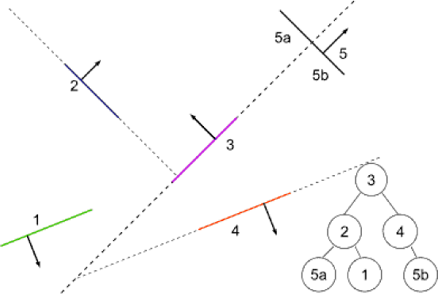
BSP Tree Display
Built BSP tree structure

Slide 20
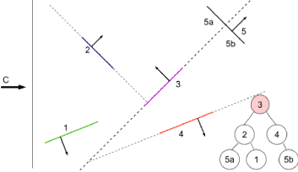
BSP Tree Display
C in front of 3

Slide 21
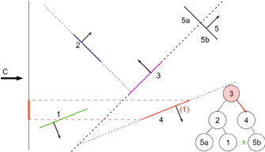
BSP Tree Display
C in front of 3
(<3) C behind 4
(>4) none

Slide 22
BSP Tree Display
C in front of 3
(<3) C behind 4
(>4) none
(=4) display 4

Slide 23
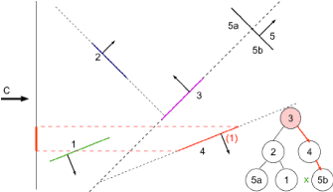
BSP Tree Display
C in front of 3
(<3) C behind 4
(>4) none
(=4) display 4
(<4) display 5b

Slide 24
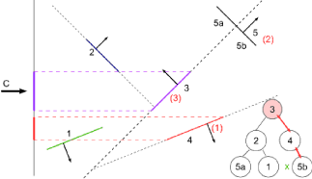
BSP Tree Display
C in front of 3
(<3) C behind 4
(>4) none
(=4) display 4
(<4) display 5b
(=3) display 3

Slide 25
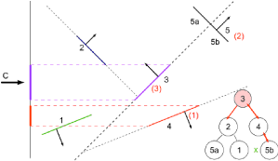
BSP Tree Display
C in front of 3
(<3) C behind 4
(>4) none
(=4) display 4
(<4) display 5b
(=3) display 3
(>3) C behind 2

Slide 26
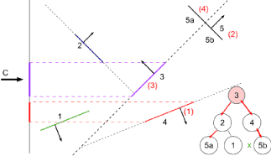
BSP Tree Display
C in front of 3
(<3) C behind 4
(>4) none
(=4) display 4
(<4) display 5b
(=3) display 3
(>3) C behind 2
(>2) display 5a

Slide 27
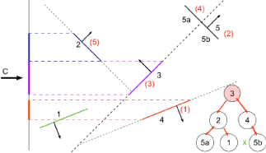
BSP Tree Display
C in front of 3
(<3) C behind 4
(>4) none
(=4) display 4
(<4) display 5b
(=3) display 3
(>3) C behind 2
(>2) display 5a
(=2) display 2

Slide 28
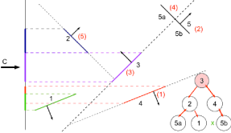
BSP Tree Display
C in front of 3
(<3) C behind 4
(>4) none
(=4) display 4
(<4) display 5b
(=3) display 3
(>3) C behind 2
(>2) display 5a
(=2) display 2
(<2) display 1

Slide 29
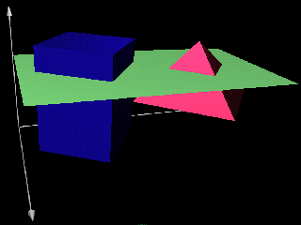
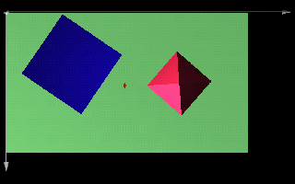
Scanline Algorithm
Simply problem by considering only one scanline at a time
intersection of 3D scene with plane through scanline

Slide 30
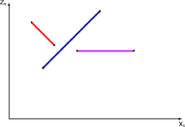
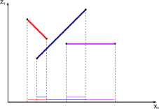
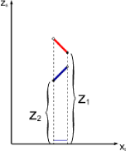
Scanline Algorithm
Consider xz slice
Calculate where visibility can change
Decide visibility in each span

Slide 31
Scanline Algorithm
Sort polygons into sorted surface table (SST) based on first Y
Initialize y and active surface table (AST)
  Y = first nonempty scanline
  AST = SST[y]
Repeat until AST and SST are empty
  Identify spans for this scanline (sorted on x)
  For each span
  determine visible element (based on z)
  fill pixel intensities with values from element
  Update AST
  remove exhausted polygons
  y++
  update x intercepts
  resort AST on x
  add entering polygons
Display Intensity array

Slide 32
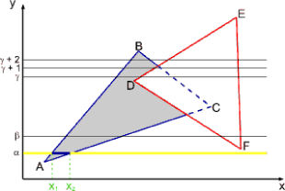
Scanline Visibility Algorithm
Scanline α
  AST: ABC
  Spans
    0 -> x₁
    x₁ -> x₂
    x₂ -> max
background
ABC
background

Slide 33
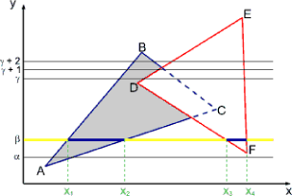
Scanline Visibility Algorithm
Scanline β
  AST: ABC DEF
  Spans
    0 -> x₁
    x₁ -> x₂
    x₂ -> x₃
    x₃ -> x₄
    x₄-> max
background
ABC
background
DEF
background

Slide 34
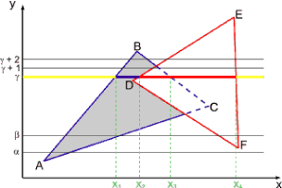
Scanline Visibility Algorithm
Scanline γ
  AST: ABC DEF
  Spans
    0 -> x₁
    x₁ -> x₂
    x₂ -> x₃
    x₃ -> x₄
    x₄-> max
background
ABC
DEF
DEF
background

Slide 35
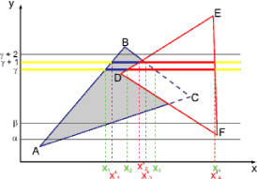
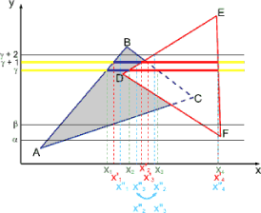
Scanline Visibility Algorithm
Scanline γ + 1
  Spans
    0 -> x₁
    x₁ -> x₂
    x₂ -> x₃
    x₃ -> x₄
    x₄-> max
background
ABC
DEF
DEF
background
Scanline γ + 2
  Spans
    0 -> x₁
    x₁ -> x₂
    x₂ -> x₃
    x₃ -> x₄
    x₄-> max
background
ABC
background
DEF
background

Slide 36
Characteristics of Scanline Algorithm
Good
  Little memory required
  Can generate scanlines as required
  Can antialias within scanline
  Fast
    Simplification of problem simplifies geometry
    Can exploit coherence
Bad
  Fairly complicated to implement
  Difficult to antialias between scanlines

Slide 37
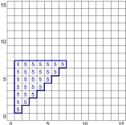
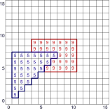
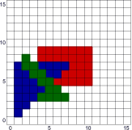
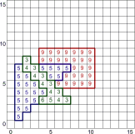
Z-Buffer
First polygon
  (1, 1, 5), (7, 7, 5), (1, 7, 5)
  scan it in with depth
Second polygon
  (3, 5, 9), (10, 5, 9), (10, 9, 9), (3, 9, 9)
Third polygon
  (2, 6, 3), (2, 3, 8),
  (7, 3, 3)

Slide 38
Z-Buffer Algorithm
Originally Cook, Carpenter, Catmull
Given
  List of polygons {P₁, P₂, …., P_{n}}
  An array z-buffer[x,y] initialized to +infinity
  An array Intensity[x,y]
Begin
  For each polygon P in selected list do
    For each pixel (x,y) that intersects P do
      Calculate z-depth of P at (x,y)
      If z-depth < z-buffer[x,y] then
        Intensity[x,y] = intensity of P at (x,y)
        Z-buffer[x,y] = z-depth
  Display Intensity array

Slide 39
Z-Buffer Characteristics
Good
  Easy to implement
  Requires no sorting of surfaces
  Easy to put in hardware
Bad
  Requires lots of memory (about 9MB for 1280x1024 display)
  Can alias badly (only one sample per pixel)
  Cannot handle transparent surfaces

Slide 40
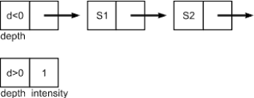
A-Buffer Method
Basically z-buffer with additional memory to consider contribution of multiple surfaces to a pixel
Need to store
  Color (rgb triple)
  Opacity
  Depth
  Percent area covered
  Surface ID
  Misc rendering parameters
  Pointer to next

Slide 41
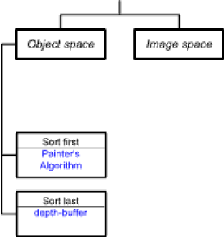
Taxonomy of Visibility Algorithms
Ivan Sutherland -- A Characterization of Ten Hidden Surface Algorithms
Basic design choices
  Space for operations
    Object
    Image
  Object space
    Loop over objects
    Decide the visibility of each
  Timing of object sort
    Sort-first
    Sort-last

Slide 42
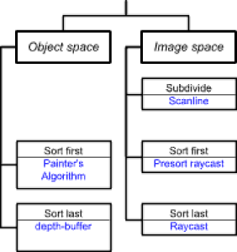
Taxonomy of Visibility Algorithms
Image space
  Loop over pixels
  Decide what’s visible at each
Timing of sort at pixel
  Sort first
  Sort last
  Subdivide to simplify

Slide 43
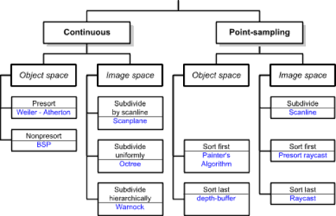
Taxonomy Revisted
Another dimension
  Point-sampling
  continuous

