Slide 1
Texturing
CMSC 435/634

Slide 2
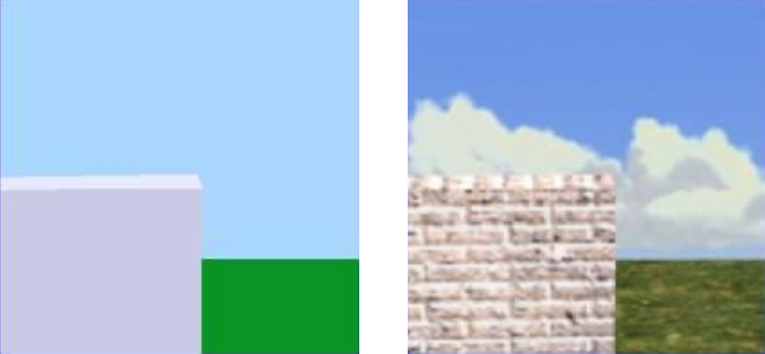
What is Texturing?

Slide 3
Texture Mapping
Definition: mapping a function onto a surface; function can be:
  1, 2, or 3D
  sampled (image) or mathematical function

Slide 4
Mapped Parameters
Surface color (Catmull 74)
Specular reflection (Blinn and Newell 76)
Normal vector perturbation (Blinn 78)
Specularity (Blinn 78)
Transparency (Gardner 85)
Diffuse Reflection (Miller and Hoffman 84)
Shadows, displacements, etc (Cook 84)
Local coord system (Kajiya 85)

Slide 5
Key Challenges
Mapping function determination
Resolution issues
Texture design/capture

Slide 6

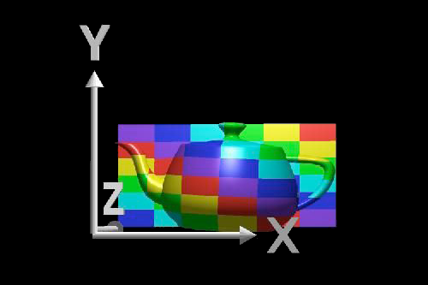
Planar Mapping
For xy aligned plane
Reverse projection

Slide 7
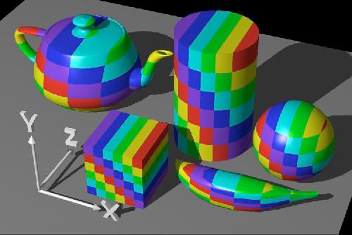
Planar Mapping

Slide 8
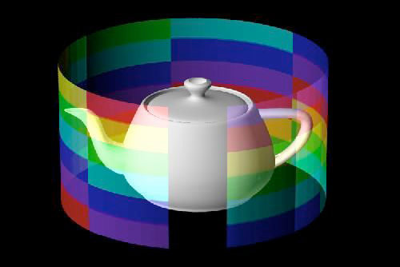
Cylindrical Mapping
For cylinder with point
  (r cos Θ, r sin Θ, h z)
Texture coordinates
  (u,v) =(Θ/2π, z)

Slide 9
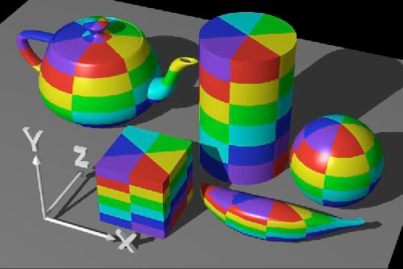
Cylindrical Mapping

Slide 10

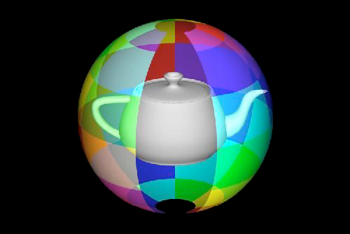
Spherical Mapping
For sphere with point
  (r cos Θ sin Φ, r sin Θ sin Φ, r cos Φ)
Texture coordinates

Slide 11
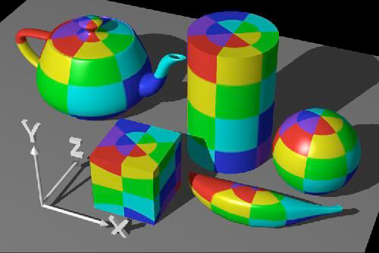
Spherical Mapping

Slide 12
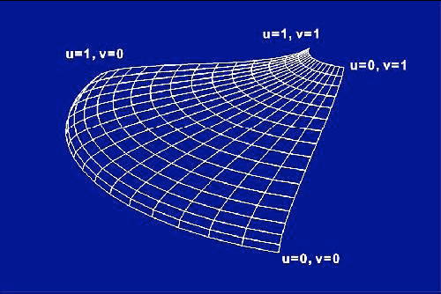
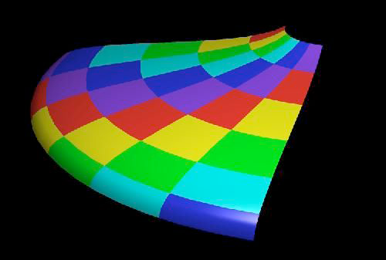
Mapping onto Parametric Patches
Use scaled surface u,v parameters for texture u,v

Slide 13
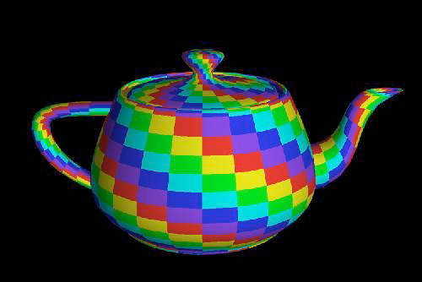
Mapping onto Parametric Patches

Slide 14
Mapping onto Polygons
Like parametric surfaces, but use explicit vertex texture coordinates
Interpolation during rasterization
  Per-pixel projection
  Interpolate (u/w, v/w, 1/w)
  Divide to get pixel (u,v)

Slide 15
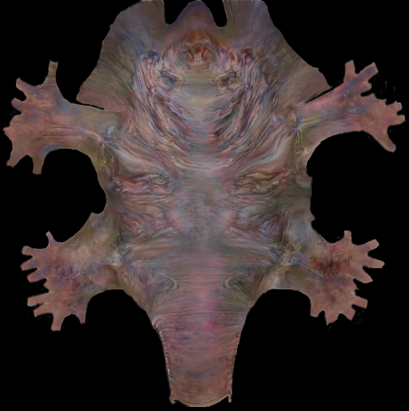
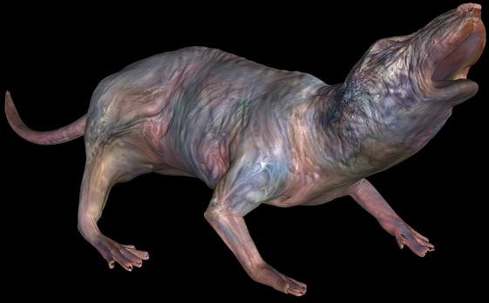
Non-linear mapping
Piponi and Borshukov, “Seamless Texture Mapping of Subdivision Surfaces by Model Pelting and Texture Blending”, SIGGRAPH 2000

Slide 16
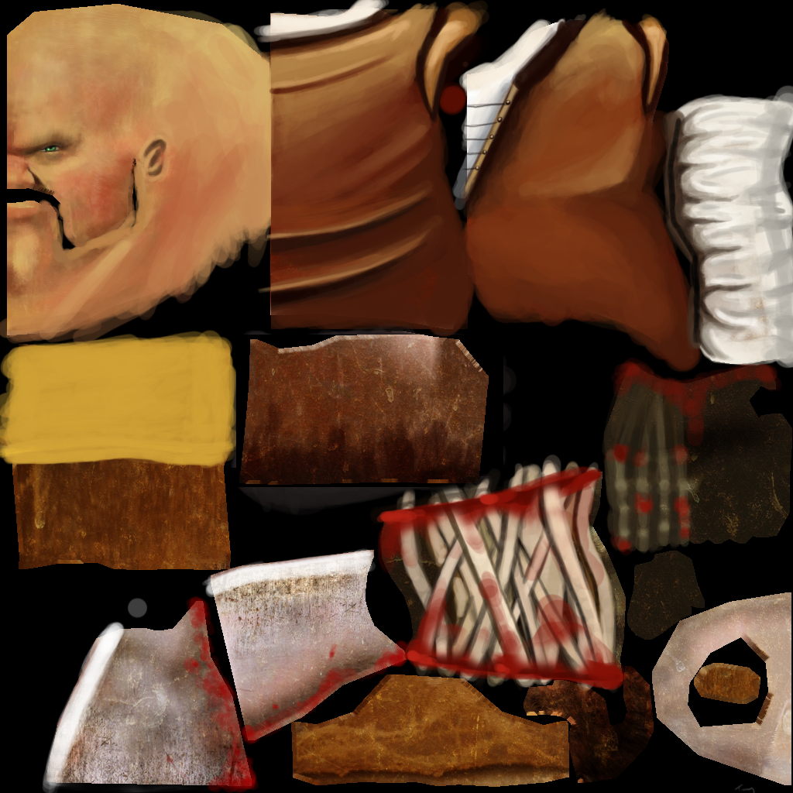
Texture Atlas
Break object into easy-to-texture parts

Slide 17
Other Mappings
Surface Position
  Shadow mapping
Ray direction
  Reflection/environment mapping
Surface normal direction
  Diffuse reflection mapping
  Transparency/refraction mapping

Slide 18

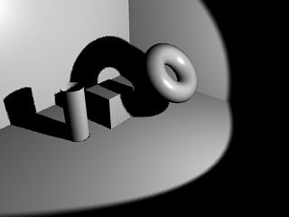
Shadow Map
Render Shadow Map
  Image from the light
  Record depth of closest object
  along each ray
Use a shadow map
  Render a pixel/fragment
  Transform to light projection
  Is pixel farther away
  Bias to avoid self shadowing

Slide 19
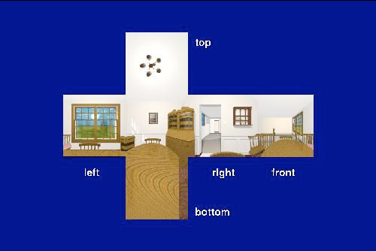
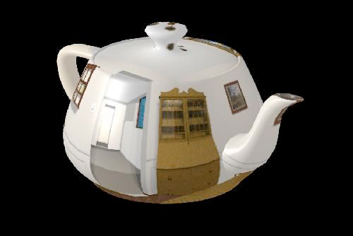
Distant Reflection
Look up reflection direction in reflection or environment map

Slide 20
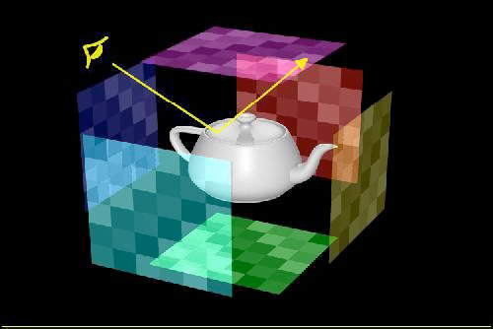
Environment Mapping
Surround scene with maps simulating surrounding detail

Slide 21
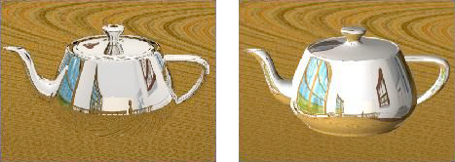
Ray Tracing vs. Environment Mapping
Ray Tracing
Environment Mapping

Slide 22
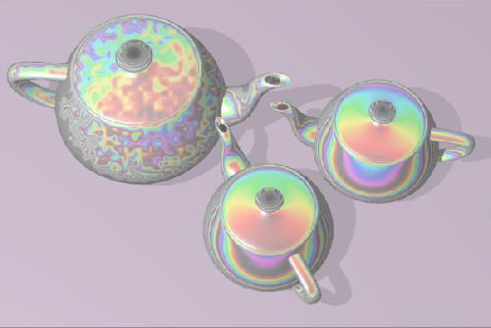
Refraction Mapping
Perturb refraction rays through transparent surface by disruption of surface normal

Slide 23
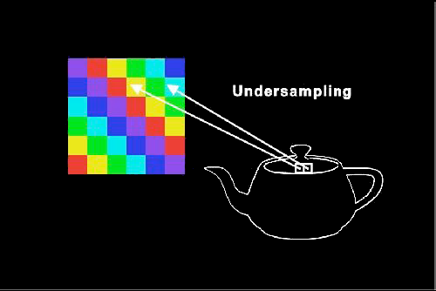
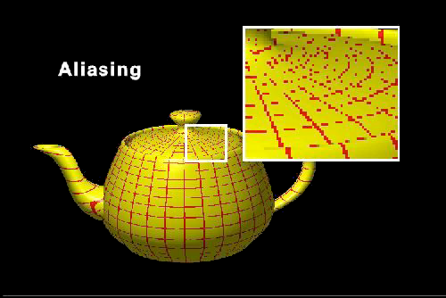
Texture Aliasing
Undersampling of texture map leads to texture aliasing
Oversampling can show limited texture resolution

Slide 24
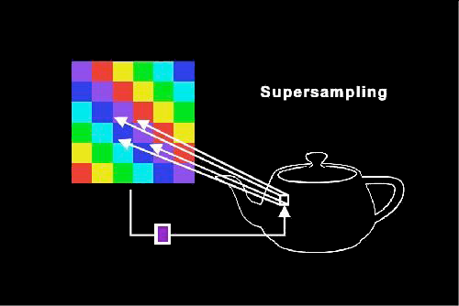
Supersampling
Sample texture multiple times per pixel and reconstruct

Slide 25
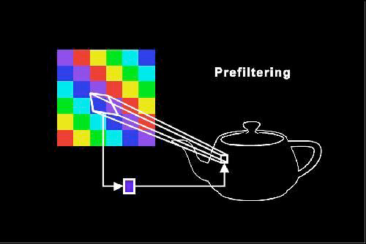
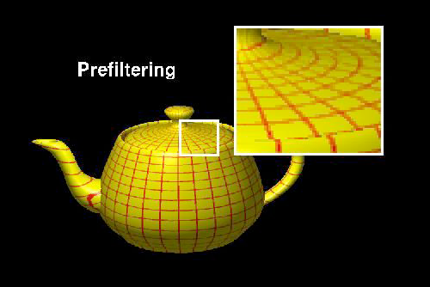
Filtering
Basic method (Catmull 78)
  Project pixel polygon onto texture map
  Average color over projected area

Slide 26
Filtering Types
Direct Convolution
  Average multiple samples from texture (usually selected in texture space)
Prefiltering
  Construct multi-resolution copies of texture
Fourier filtering
  Low pass filter texture in frequency space

Slide 27
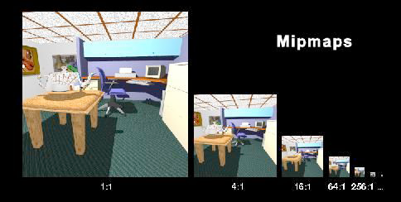
Mipmapping
Precalculate filtered maps at a range of resolutions (Williams 83)
Higher memory requirements

Slide 28
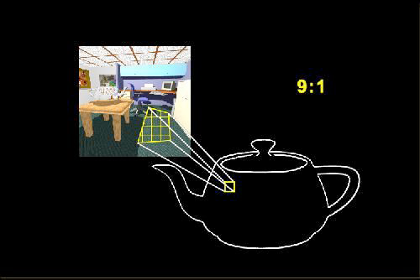
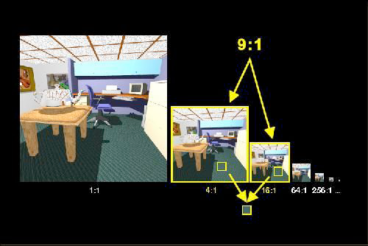
Mipmapping Process
Compute pixel area in mipmap
Average from two closest maps

Slide 29
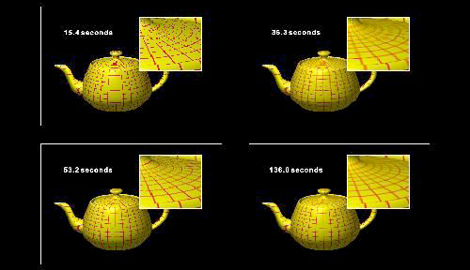
Comparison of Techniques
Anti-aliasing: none, mipmapped, supersampled, supersampling and mipmapping

