Slide 1
Advanced Ray Tracing
CMSC 435/634

Slide 2
Basic Ray Tracing
For each pixel
  Compute ray direction
  Find closest surface
  For each light
    Compute direct illumination

Slide 3
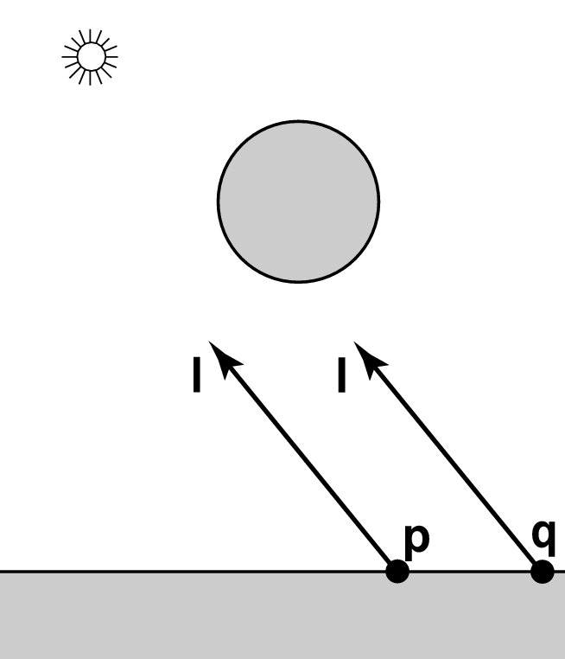
Shadows
What if there is an object between the surface and light?

Slide 4
Ray Traced Shadows
Trace a ray
  Start = point on surface
  End = light source
  t=0 at Suface, t=1 at Light
  “Bias” to avoid self shadowing
Test
  Bias ≤ t ≤ 1 = shadow
  t < Bias or t > 1 = use this light

Slide 5
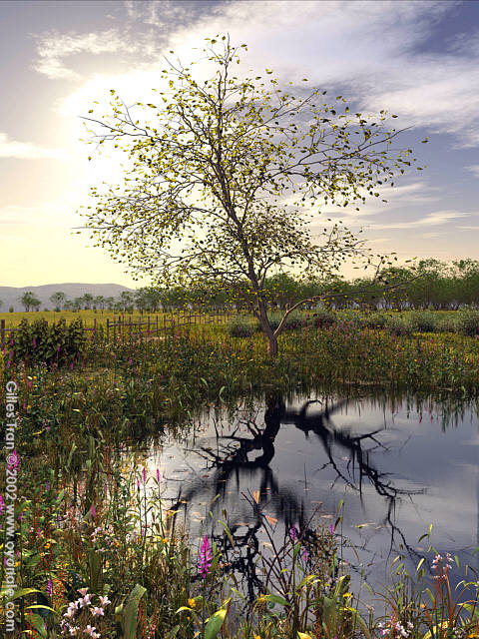
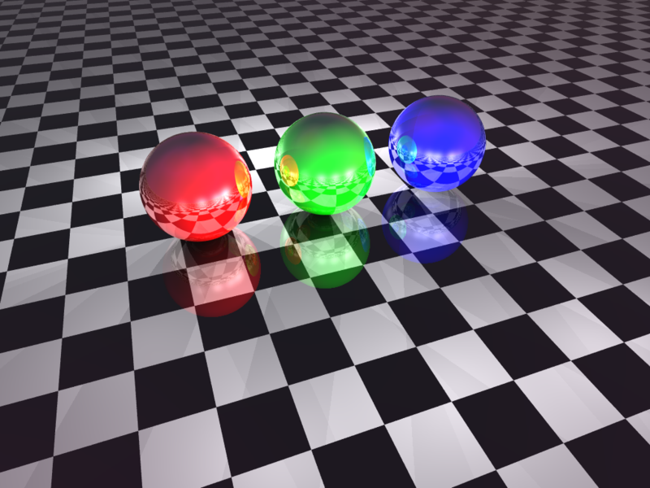
Mirror Reflection

Slide 6
Integral Approximations
Rendering Equation
Direct Illumination: only light directions
Add reflection direction

Slide 7
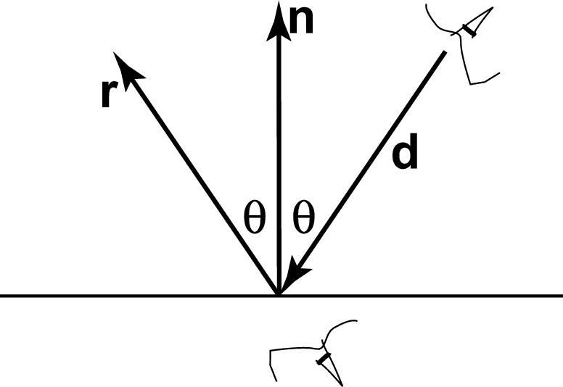
Ray Tracing Reflection
Viewer looking in direction d sees whatever the viewer “below” the surface sees looking in direction r
In the real world
  Energy loss on the bounce
  Loss different for different colors
New ray
  Start on surface, in reflection direction

Slide 8
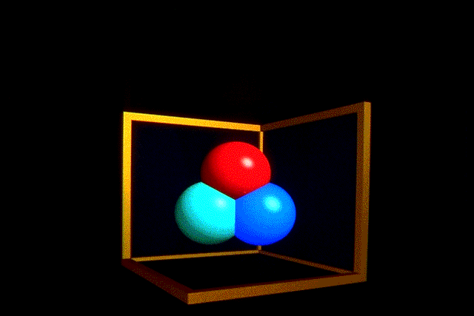
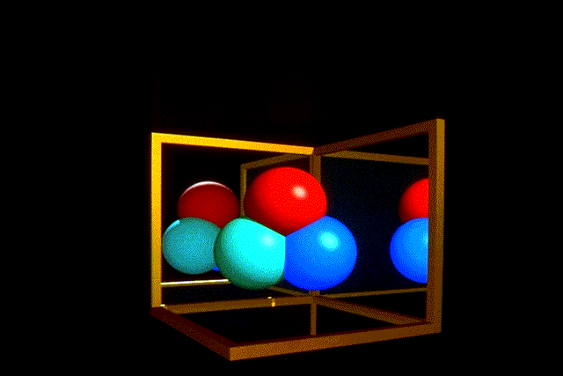
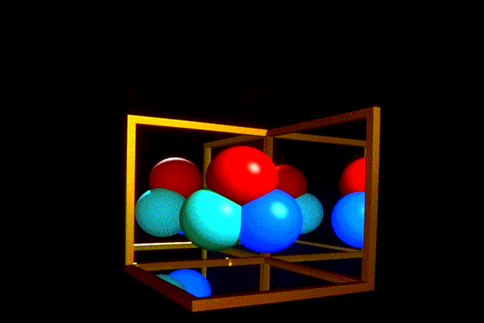
Ray Traced Reflection
Avoid looping forever
  Stop after n bounces
  Stop when contribution to pixel gets too small

Slide 9
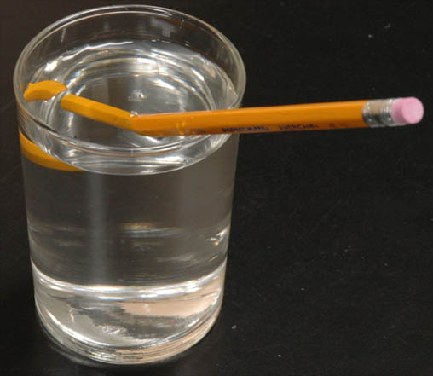
Refraction

Slide 10
Rendering Equation
Light that goes through the surface
  BTDF = Bidirectional Transmission Distribution Function
If refraction is only non-zero direction

Slide 11
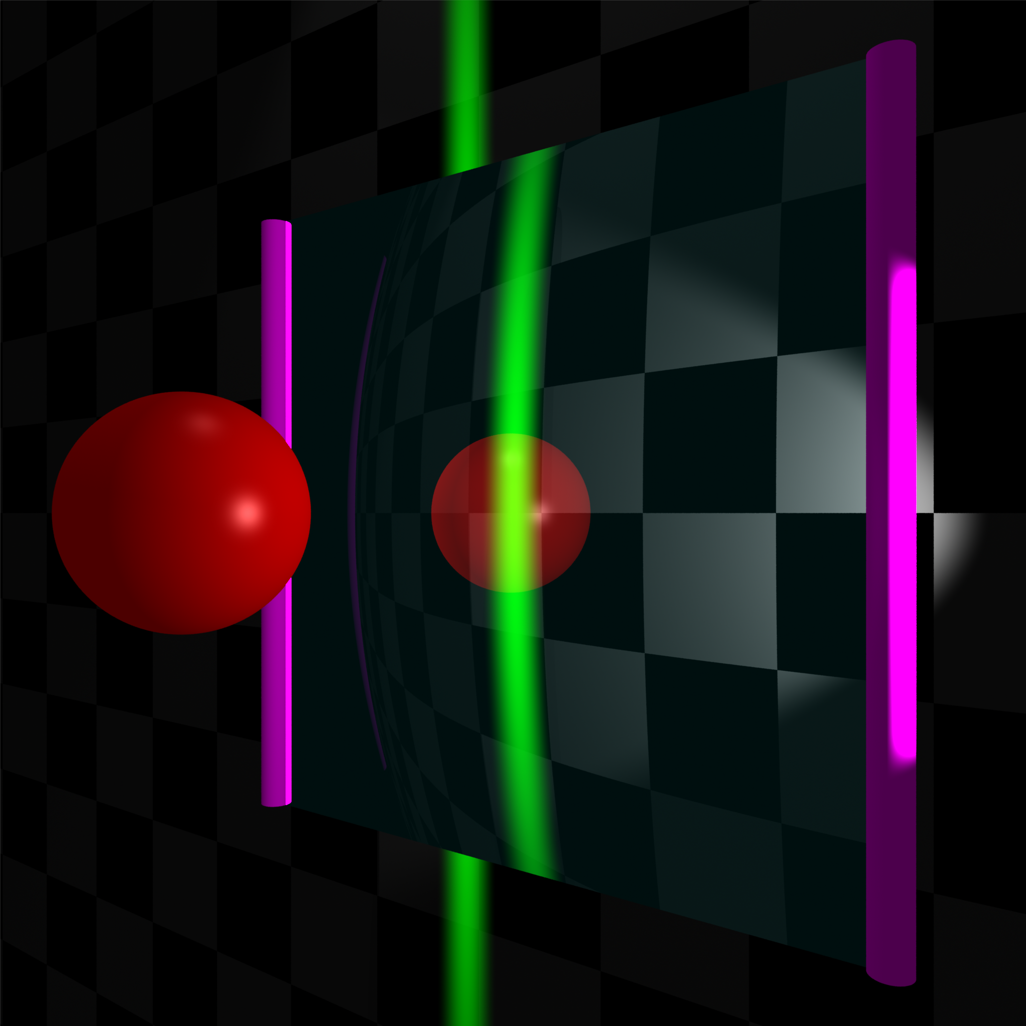
Side

Slide 12
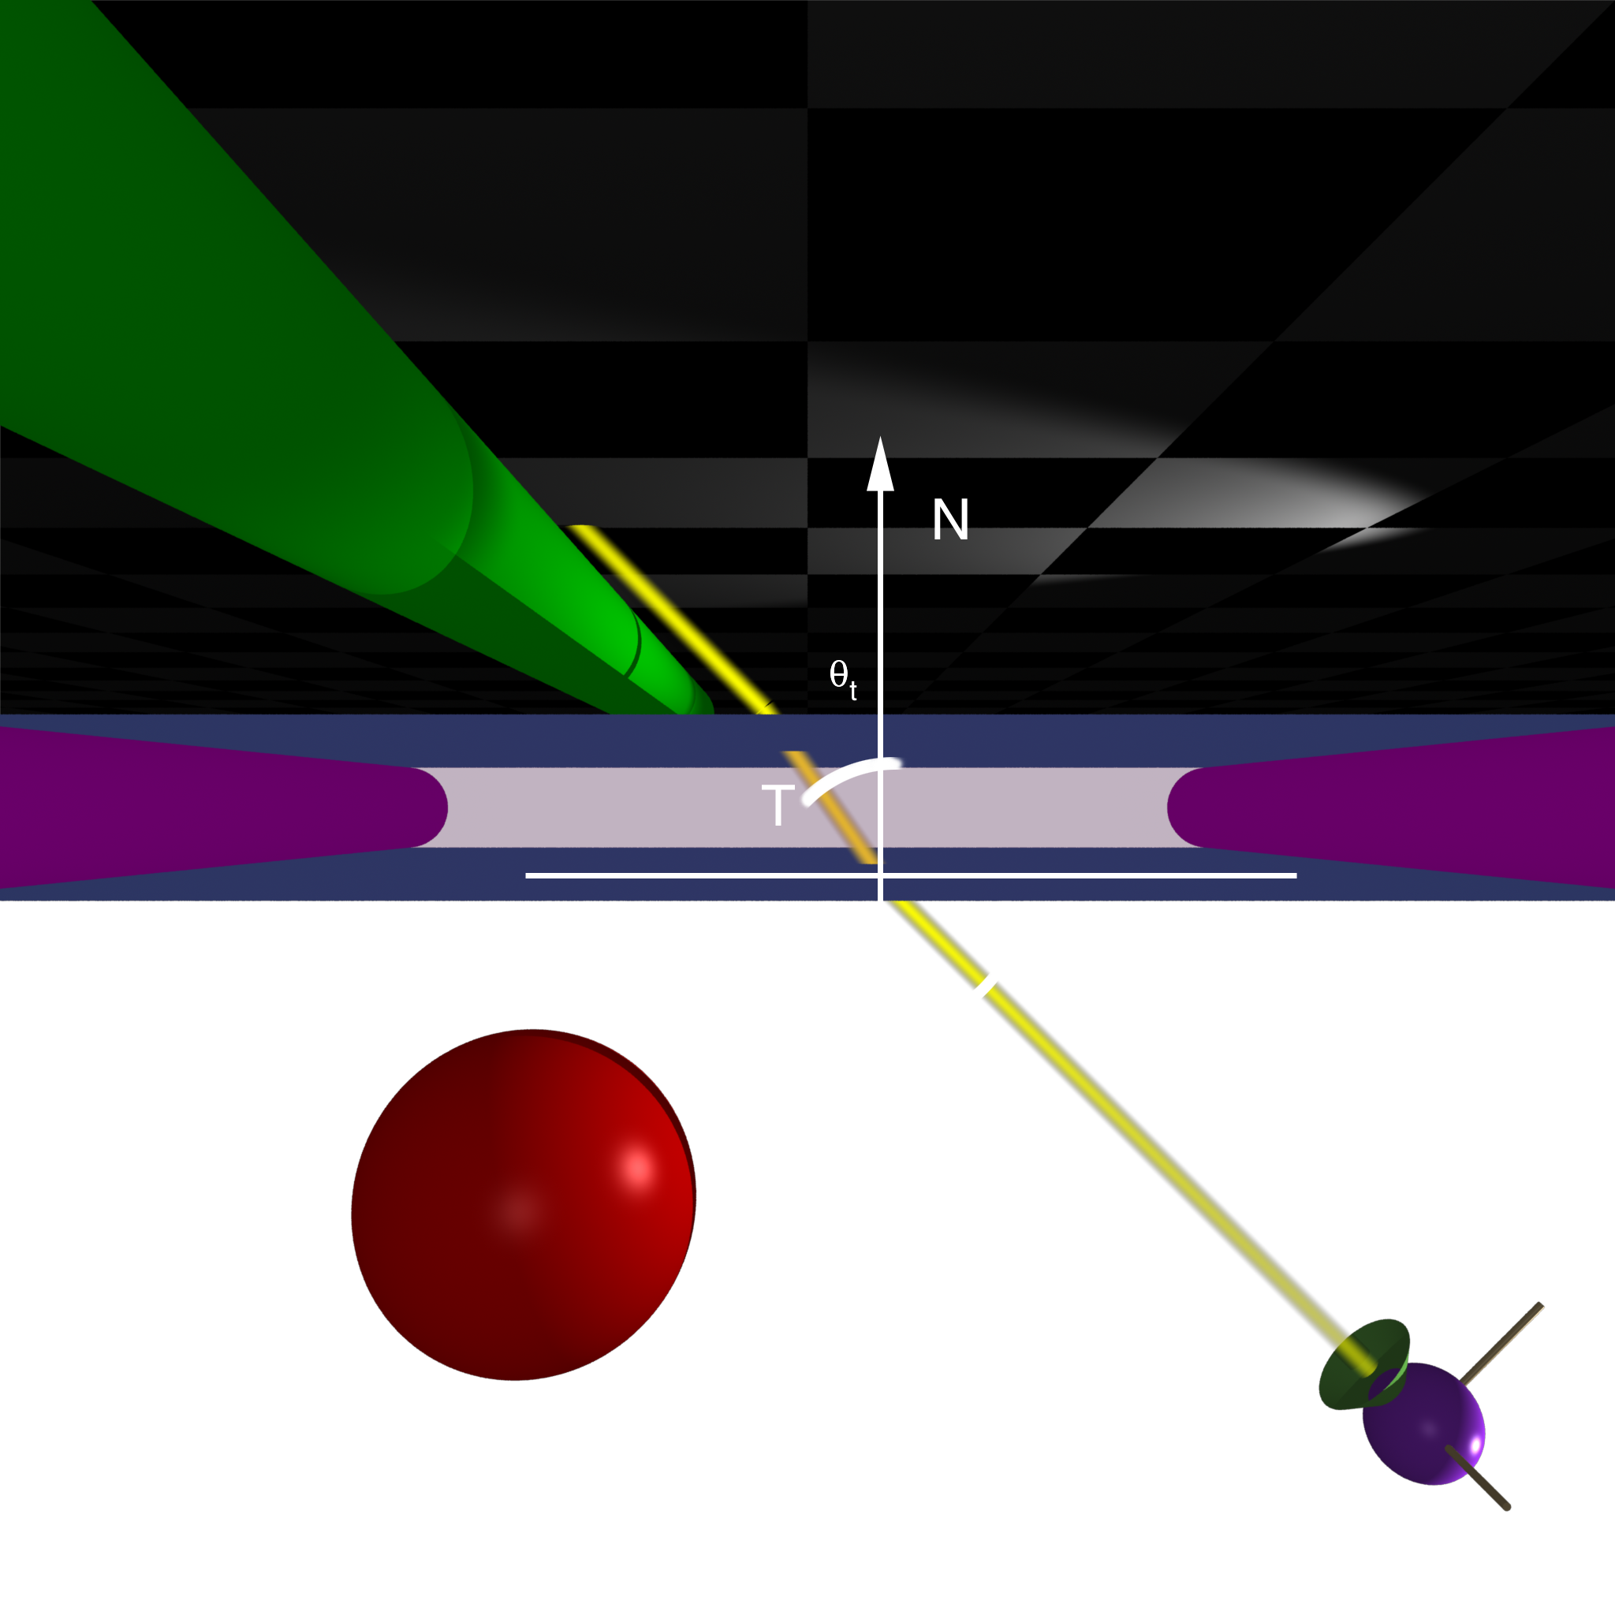
Top

Slide 13
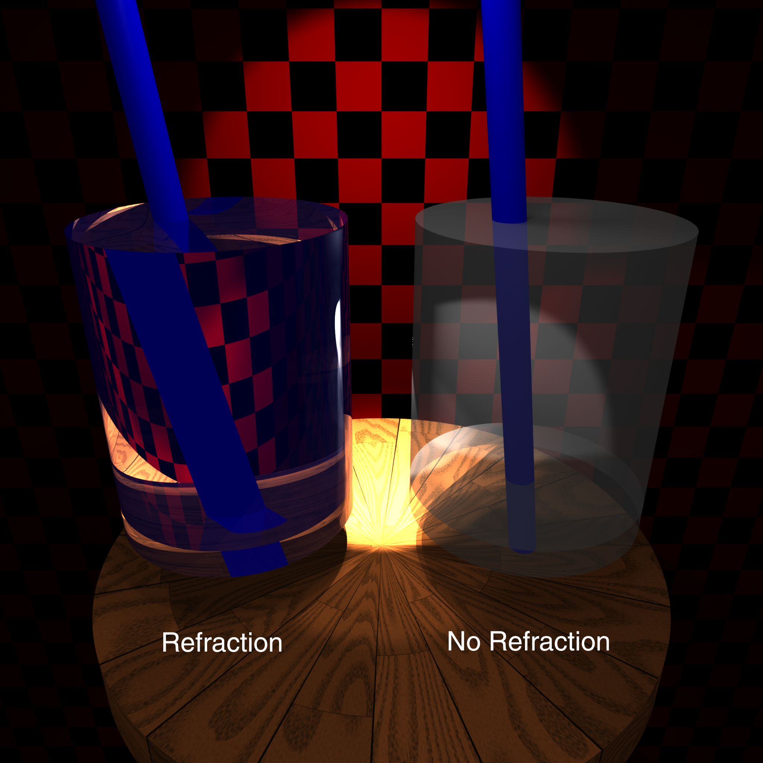

Slide 14
Calculating Refraction Vector
Snell’s Law
In terms of
term

Slide 15
Calculating Refraction Vector
Snell’s Law
In terms of
term

Slide 16
Calculating Refraction Vector
Snell’s Law
In terms of
In terms of and

Slide 17
Alpha blending
How much makes it through
α = opacity
  How much of foreground color 0-1
1-α = transparency
  How much of background color
Foreground*α + Background*(1-α)

Slide 18
Refraction and α
Refraction = what direction
α = how much
  Often approximate as a constant
  Better: Use Fresnel

Slide 19
Full Ray-Tracing
For each pixel
  Compute ray direction
  Find closest surface
  For each light
    Shoot shadow ray
    If not shadowed, add direct illumination
  Shoot ray in reflection direction
  Shoot ray in refraction direction

Slide 20
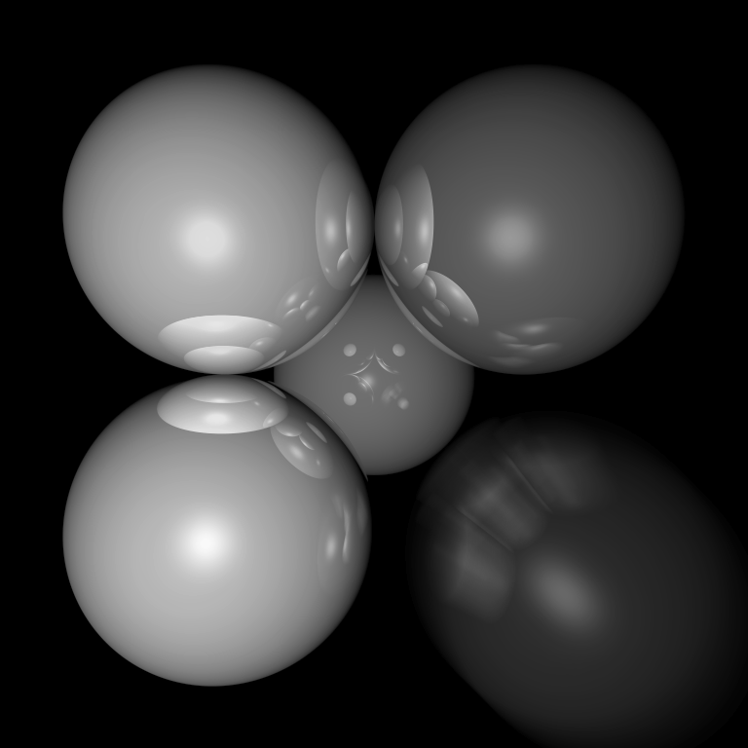
Motion Blur
Things move while the shutter is open

Slide 21
Ray Traced Motion Blur
Include information on object motion
Spread multiple rays per pixel across time

Slide 22
Rasterized Motion
Blend frames at different times
  Need a lot to avoid strobing
Analytically elongate and fade objects
Rasterize motion vectors and post-process

Slide 23
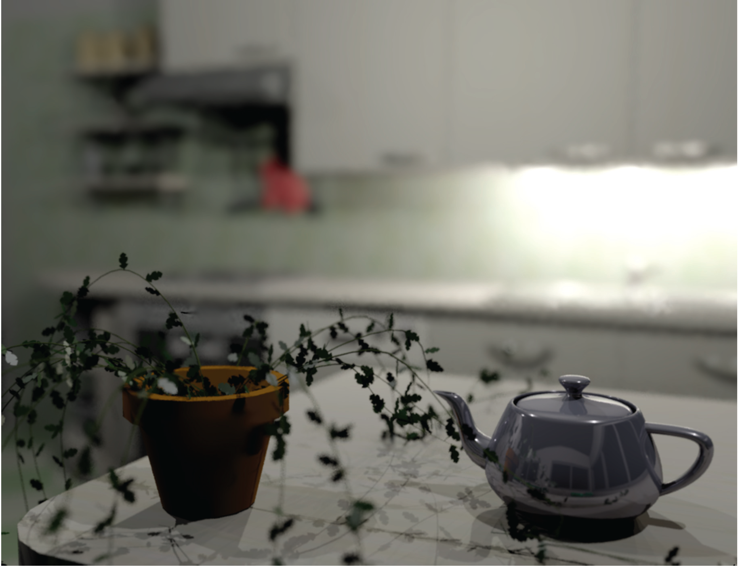
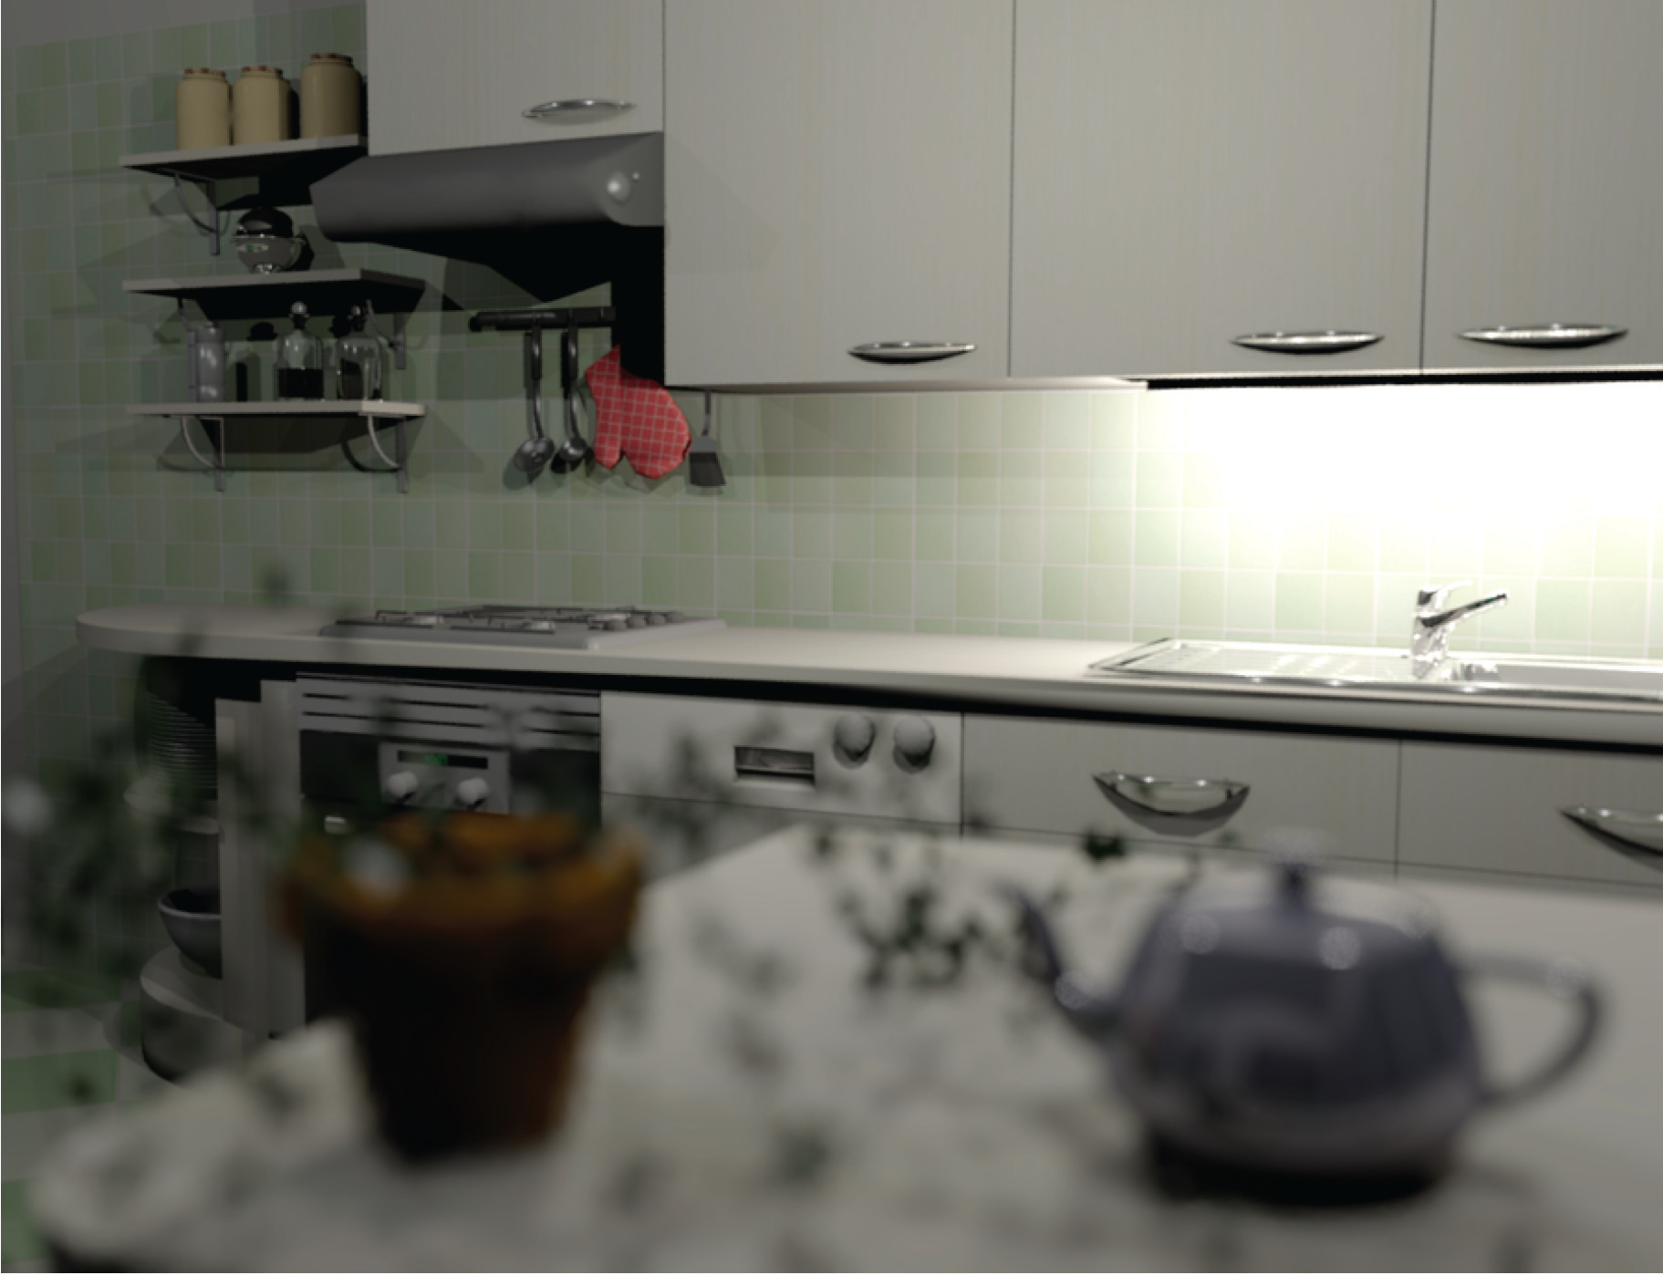
Depth of Field
Soler et al., Fourier Depth of Field, ACM TOG v28n2, April 2009

Slide 24
Pinhole Lens

Slide 25
Lens Model

Slide 26
Real Lens
Focal Plane

Slide 27
Lens Model
Focal Plane

Slide 28
Ray Traced DOF
Move image plane out to focal plane
Jitter start position within lens aperture
  Smaller aperture = closer to pinhole
  Larger aperture = more DOF blur

