Slide 1
Display
CMSC 435/634

Slide 2
Light
Visible Range: 390-700nm
Luminance has large dynamic range
0.00003 Moonless overcast night sky
30. Sky on overcast day
30000. Sky on clear day
16,000. Snowy ground in full sunlight
Actual colors result from spectral curves
dominant wavelength, hue
brightness, lightness
purity, saturation

Slide 3
Physiology
Rods
active at low light levels (scotopic vision)
only one wavelength sensitivity function
Cones
active at normal light levels
three types: sensitivity functions with different peaks

Slide 4
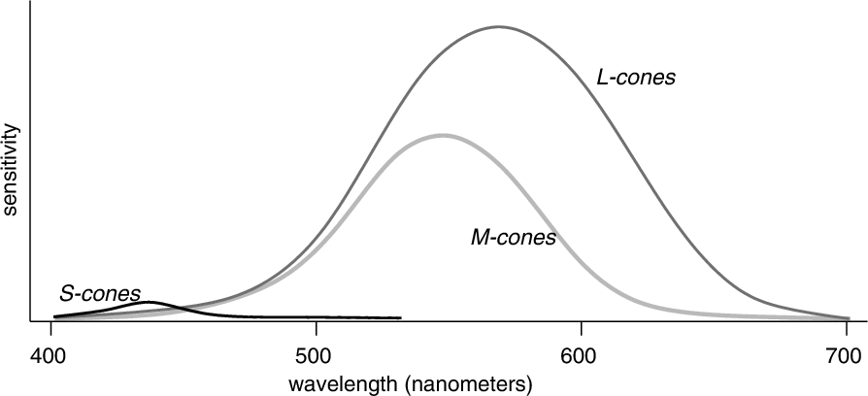
Spectral Sensitivity

Slide 5
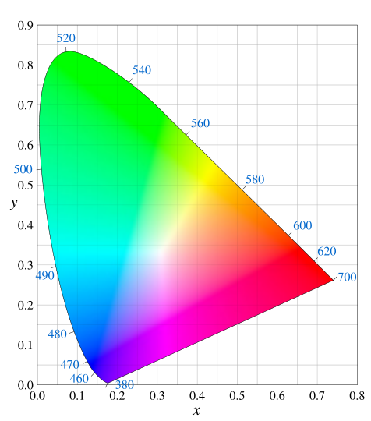
Gamut

Slide 6
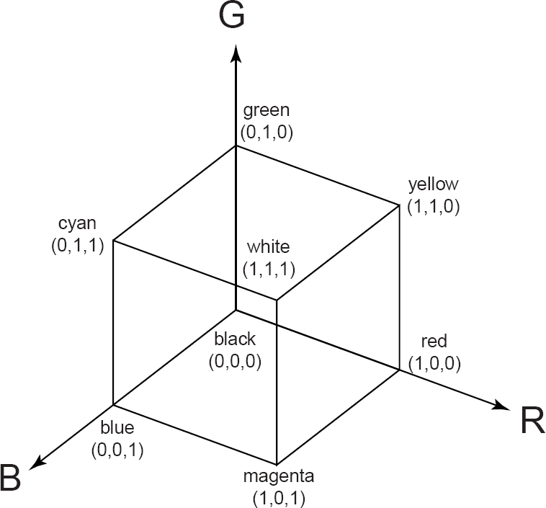
Additive Color Mixing

Slide 7
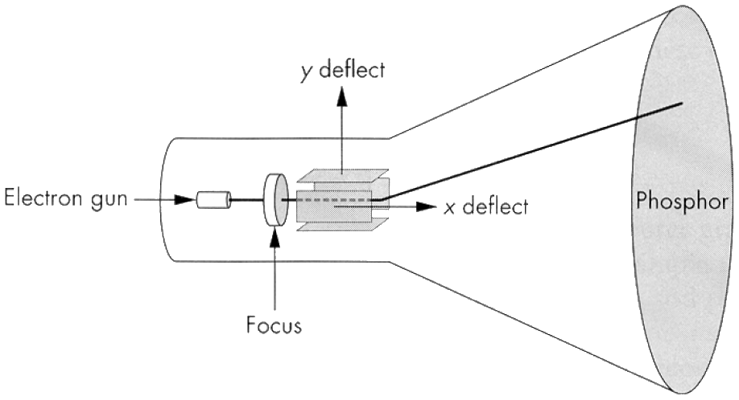
CRT
Electrons fire off of heated cathode and shoot in direction of anode
Electrons strike phosphors and create light
Fluorescence (fraction of usec)
Phosphorescence (10-60 usec)

Slide 8
Phosphors
Have different color based on makeup
Red: europium yttrium vanadate
Green: zinc calcium sulfide
Blue: zinc sulfide
May also have different persistence
Image mush be refreshed to avoid flicker
Below 60Hz can be unpleasant

Slide 9
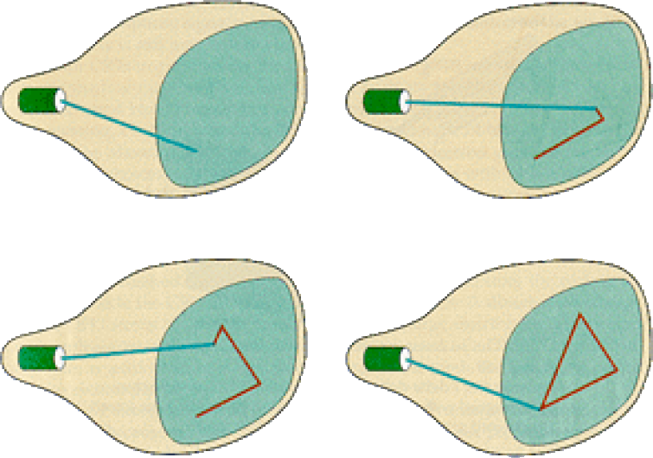
Random/Vector Display

Slide 10
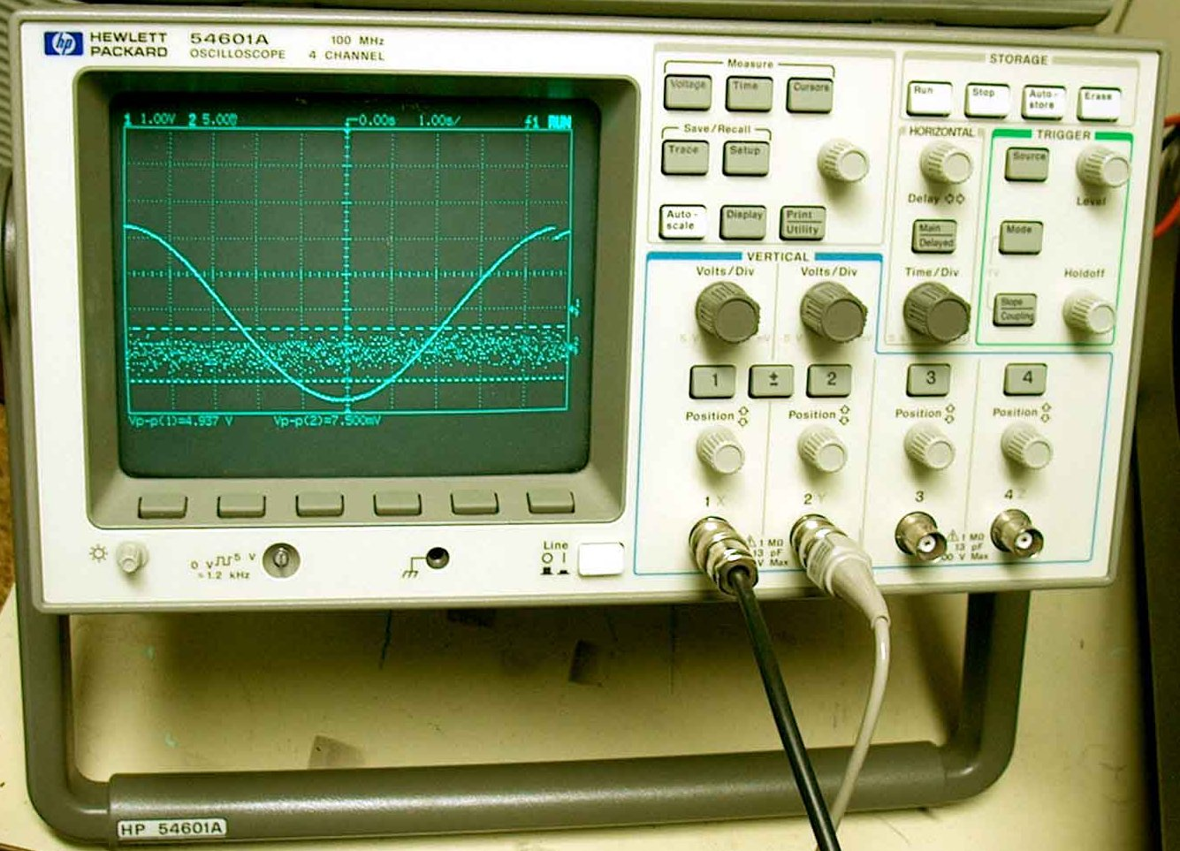
Examples of Random Scan

Slide 11
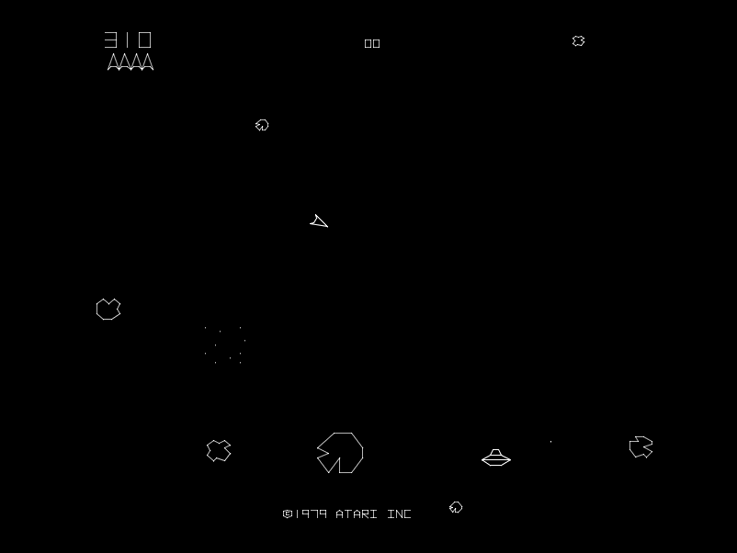
Examples of Random Scan

Slide 12
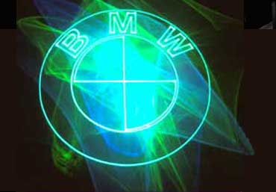
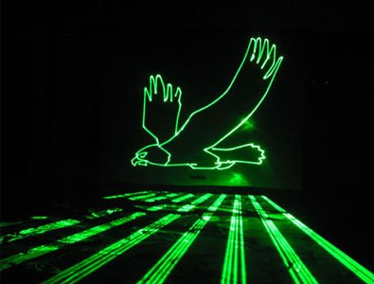
Examples of Random Scan

Slide 13
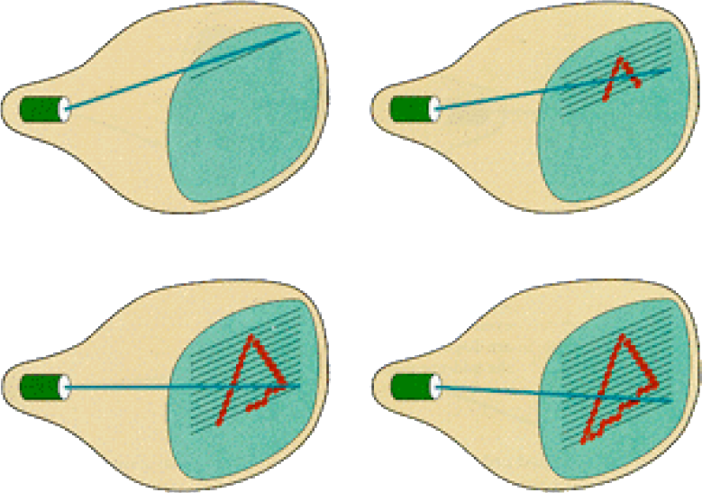
Raster Display

Slide 14
Raster Display
Each left-to-right trace is called a scan line
Each spot on the screen is called a pixel
Beam turned off to swipe back and up screen
Called a retrace or blanking interval

Slide 15
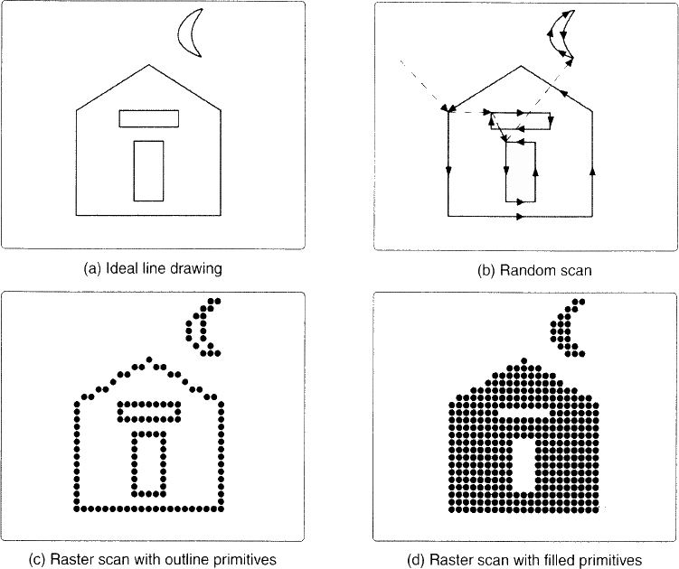
Vector vs. Raster

Slide 16
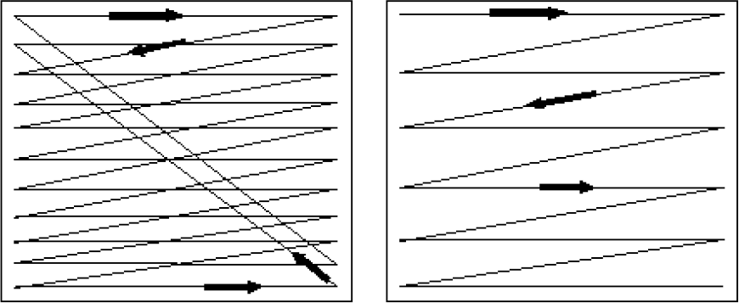
Interlacing
Interlacing is a technique used to improve video quality without additional bandwidth
480i (standard TV) is 480 scan lines, interlaced
1080i HD is 1080 scan lines, interlaced
1080p HD is 1080 scan lines, non-interlaced
Interlaced
Non-Interlaced
(progressive)‏

Slide 17
Interlacing
Odd Fields
Even Fields

Slide 18
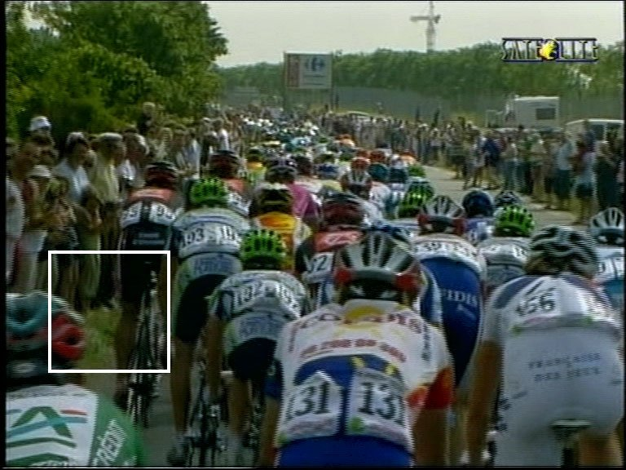
Problems with Interlacing

Slide 19
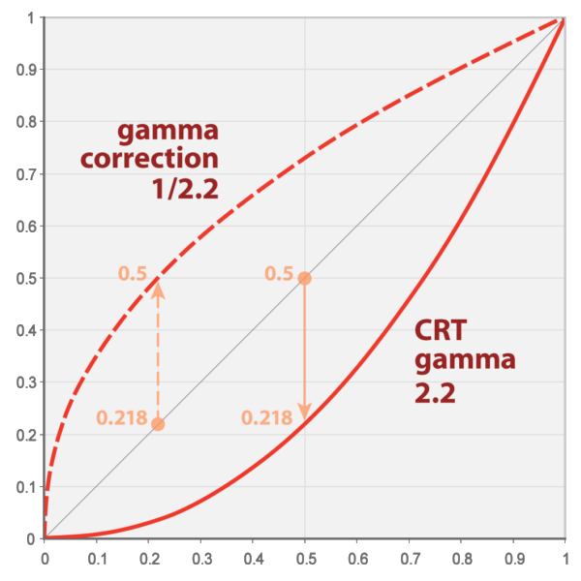
Gamma

Slide 20
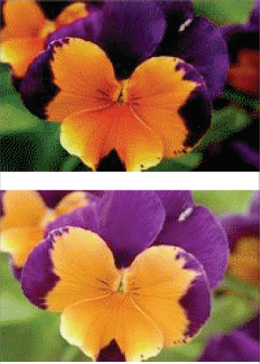
Gamma Correction

Slide 21
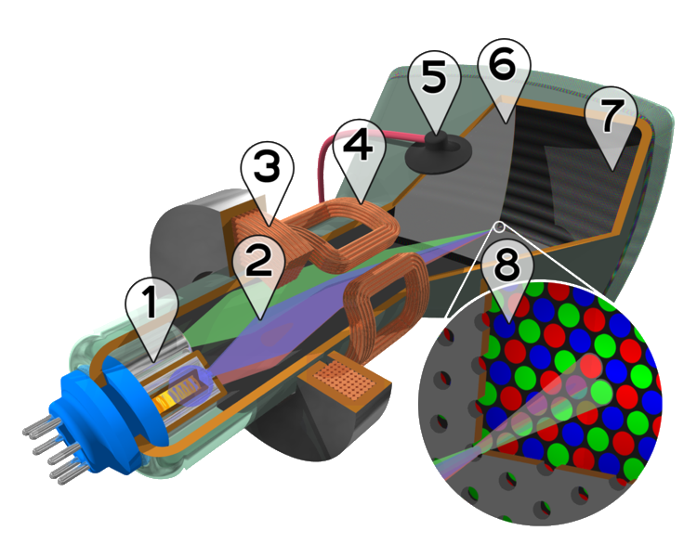
Color CRT
Electron guns
Electron beams
Focusing coils
Deflection coils
Anode connection
Shadow mask
Phosphor with RGB zones
Phosphor / Mask close-up

Slide 22
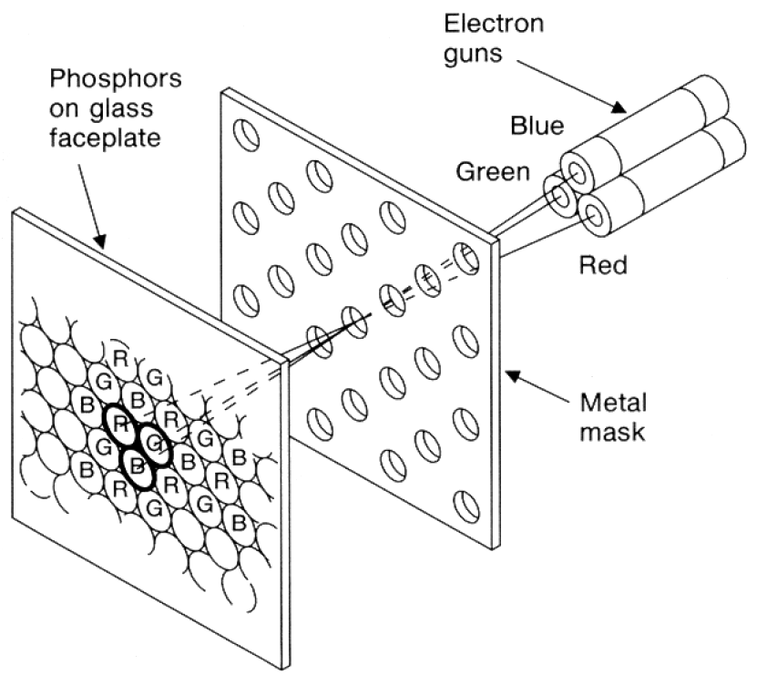
Color CRT
Uses triads of red, green & blue at each pixel
Uses 3 electron guns – one for each color
Shadow mask used to make each kind of phosphor only visible from one gun

Slide 23
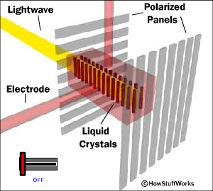
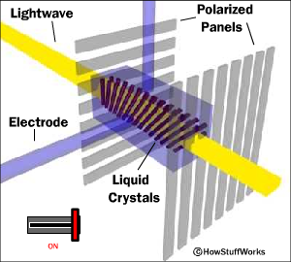
Liquid Crystal Display (LCD)‏
Light enters polarizer
Nematic crystals twist based on voltage
Allowing light to pass through to other polarizer

Slide 24
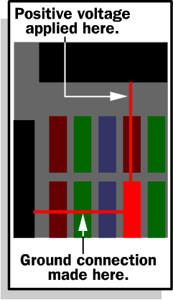
Passive Matrix
Two glass layers
One layer is given vertical transparent conductive material, the other is given horizontal
Integrated circuit sends charge/ground activation to complete circuit at given row/column
Simple, but slow response time

Slide 25
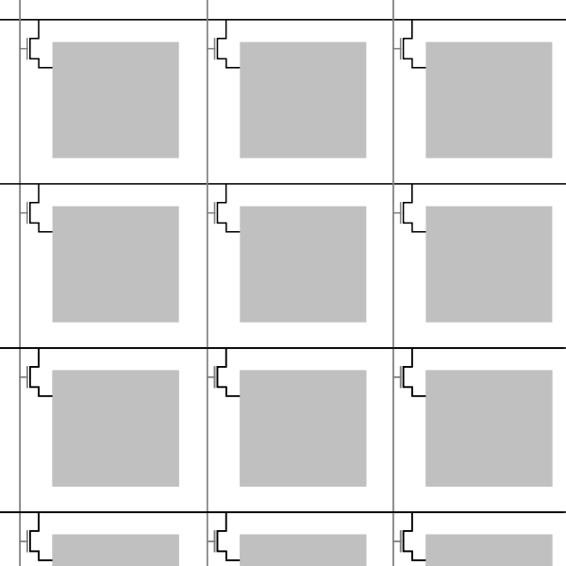
Active Matrix
Active matrix displays have a transistor at each cell
Thin film transistor (TFT)
Much faster crystal switching

Slide 26
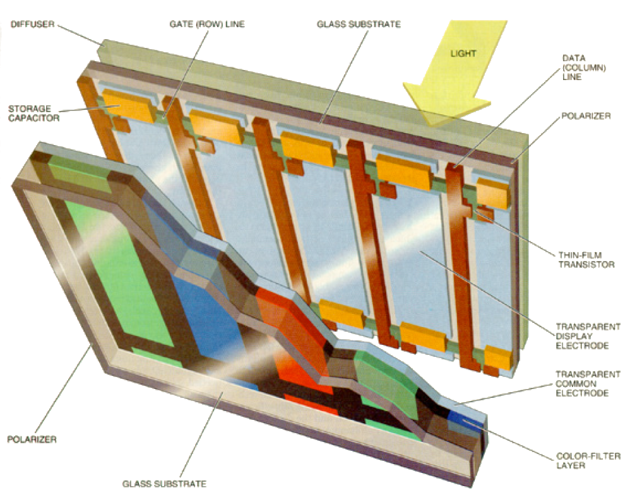
Color LCD

Slide 27
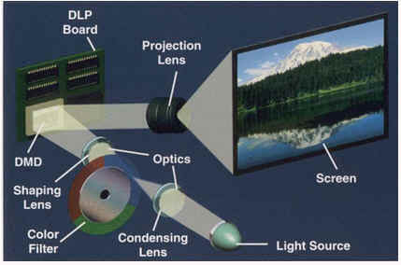
DLP Projector

Slide 28
DLP Projector

Slide 29
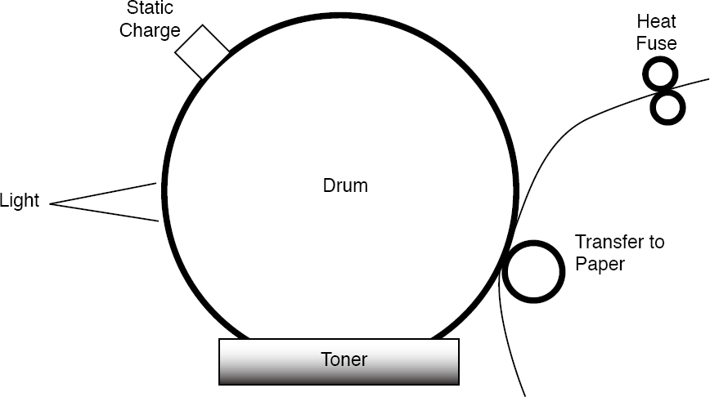
Laser Printer

Slide 30
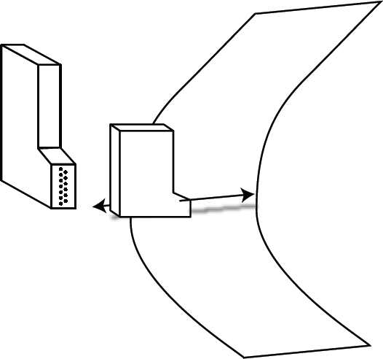
Ink Jet Printer

Slide 31
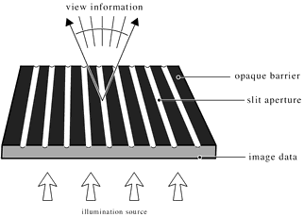
Auto-stereo Display: Barrier

Slide 32
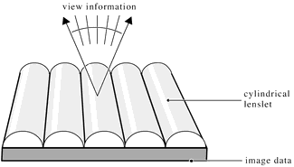
Auto-stereo Display: Lenticular

