Slide 1
Texturing

Slide 2
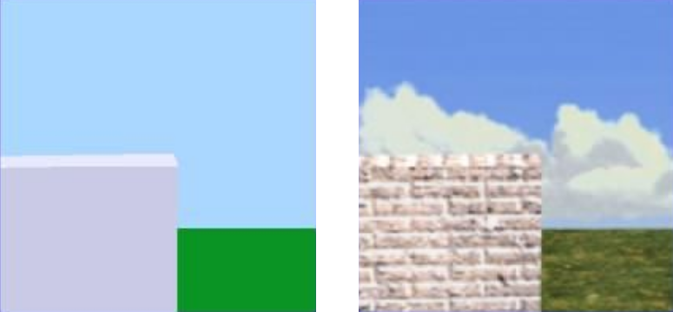
What is Texturing?

Slide 3
Texture Mapping
Definition: mapping a function onto a surface; function can be:
1, 2, or 3D
sampled (image) or mathematical function

Slide 4
Mapped Parameters
Surface color (Catmull 74)
Specular reflection (Blinn and Newell 76)
Normal vector perturbation (Blinn 78)
Specularity (Blinn 78)
Transparency (Gardner 85)
Diffuse Reflection (Miller and Hoffman 84)
Shadows, displacements, etc (Cook 84)
Local coord system (Kajiya 85)

Slide 5
Map Indices
Surface parameters
Ray direction
Reflection/environment mapping
Surface normal direction
Diffuse reflection mapping
Transparency/refraction mapping

Slide 6
Key Challenges
Mapping function determination
Resolution issues
Texture design/capture

Slide 7
Mapping Functions
Standard projecting functions
planar
cylindrical
spherical
Mechanism
Two-stage mapping
Reverse projection
Arbitrary

Slide 8
Two-stage Mapping
S-mapping
map to simple 3D shape
intermediate surfs: plane, cylinder, cube, sphere
O-mapping
map 3D texture onto surface
map entities: reflected view ray, surface normal, line through centroid, intermediate surface normal

Slide 9
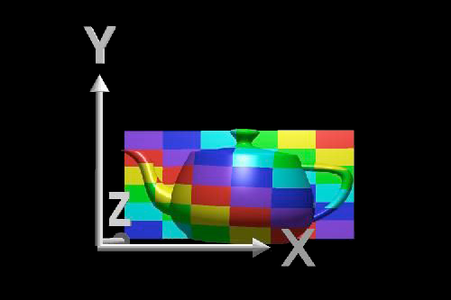
Planar Mapping
For xy aligned plane
Reverse projection

Slide 10
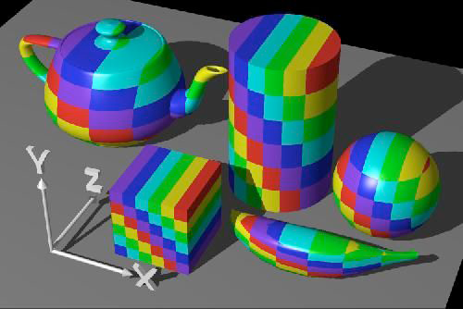
Planer Mapping

Slide 11
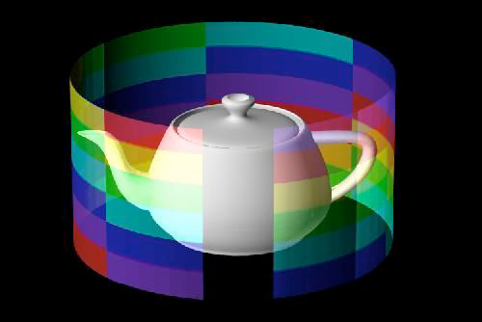
Cylindrical Mapping
For cylinder with point
(r cos Θ, r sin Θ, h z)
Texture coordinates
(u,v) =(Θ/2π, z)

Slide 12
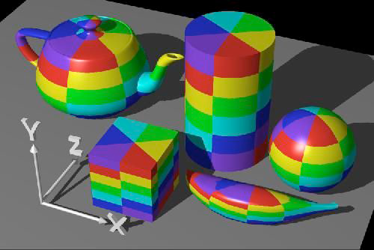
Cylindrical Mapping

Slide 13
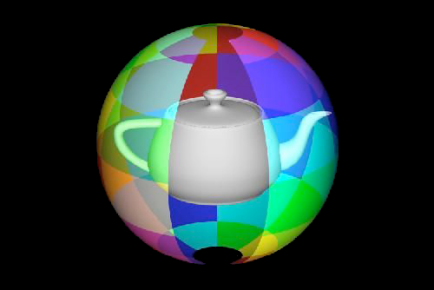
Spherical Mapping
For sphere with point
(r cos Θ sin Φ, r sin Θ sin Φ, r cos Φ)
Texture coordinates

Slide 14
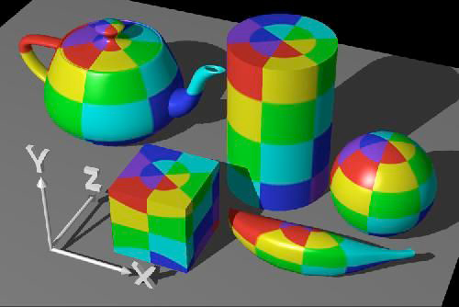
Spherical Mapping

Slide 15
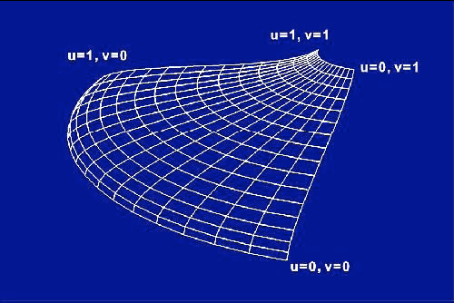
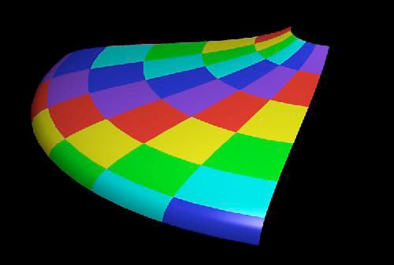
Mapping onto Parametric Patches
Use scaled surface u,v parameters for texture u,v

Slide 16
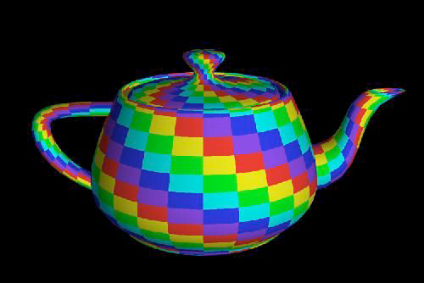
Mapping onto Parametric Patches

Slide 17
Mapping onto Polygons
Like parametric surfaces, but use explicit vertex texture coordinates
Screen-space Interpolation
Interpolate u,v
Nonlinearity and errors from lack of rotational invariance
Use small polygons to minimize artifacts
Correct solution: per-pixel projection
Interpolate (u/w, v/w, 1/w); divide to get pixel (u,v)

Slide 18
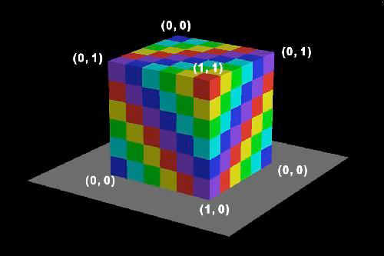
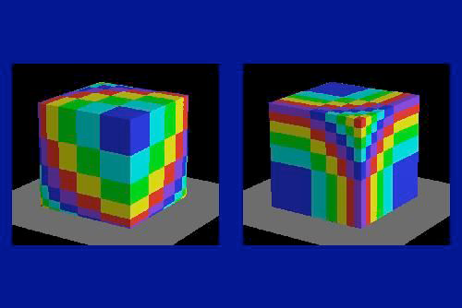
Mapping onto Polygons
Mapping need not be linear

Slide 19
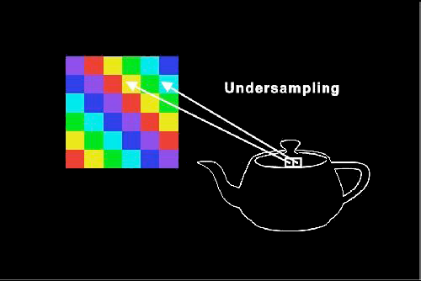
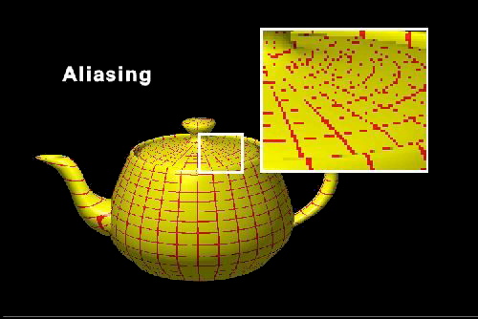
Texture Aliasing
Undersampling of texture map leads to texture aliasing
Oversampling can show limited texture resolution

Slide 20
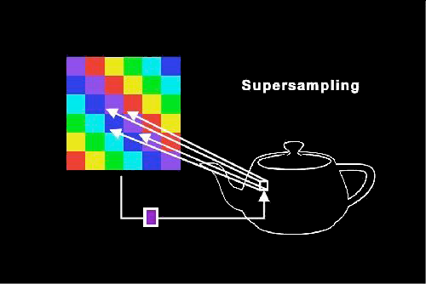
Supersampling
Sample texture multiple times per pixel and reconstruct

Slide 21
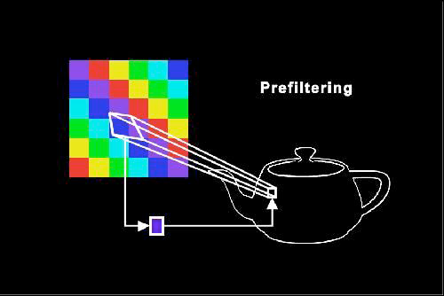
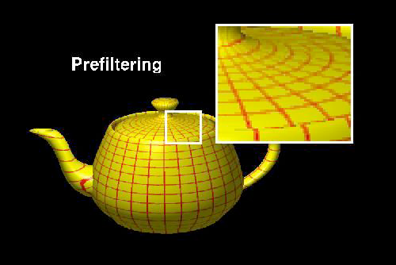
Filtering
Basic method (Catmull 78)
Project pixel polygon onto texture map
Average color over projected area

Slide 22
Filtering Types
Direct Convolution
Average multiple samples from texture (usually selected in texture space)
Prefiltering
Construct multi-resolution copies of texture
Fourier filtering
Low pass filter texture in frequency space

Slide 23
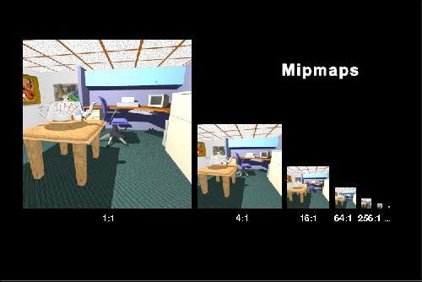
Mipmappng
Precalculate filtered maps at a range of resolutions (Williams 83)
Higher memory requirements

Slide 24
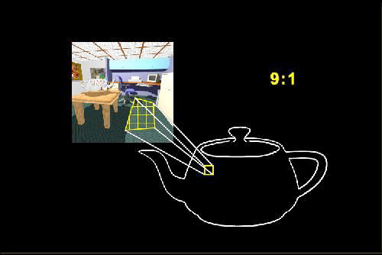
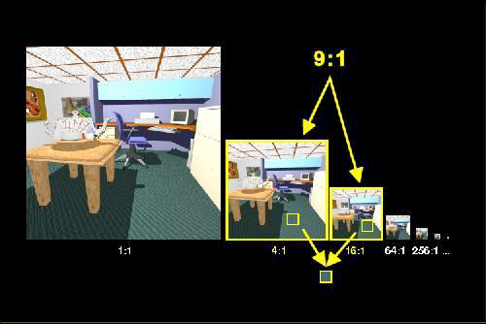
Mipmapping Process
Compute pixel area in mipmap
Average from two closest maps

Slide 25
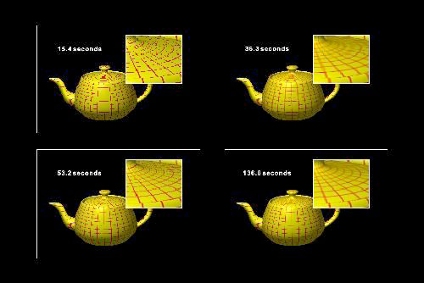
Comparison of Techniques
Anti-aliasing: none, mipmapped, supersampled, supersampling and mipmapping

