Slide 1
Graphics Pipeline
Rasterization
CMSC 435/634

Slide 2
Drawing Terms
Primitive
  Basic shape, drawn directly
  Compare to building from simpler shapes
Rasterization or Scan Conversion
  Find pixels for a primitive
  Usually for algorithms that generate all pixels for one primitive at a time
  Compare to ray tracing: all primitives for one pixel

Slide 3
Line Drawing
Given endpoints of line, which pixels to draw?

Slide 4
Line Drawing
Given endpoints of line, which pixels to draw?

Slide 5
Line Drawing
Given endpoints of line, which pixels to draw?
Assume one pixel per column (x index), which row (y index)?
Choose based on relation of line to midpoint between candidate pixels
?
?
?
?
?
?
?
?

Slide 6
Line Drawing
Choose with decision variable
Plug midpoint into implicit line equation
Incremental update

Slide 7
Line Drawing
Implicit line equation
Midpoint algorithm
  y = y₀
  d = f(x₀+1, y₀+0.5)
  for x = x₀ to x₁
    draw(x,y)
    if (d < 0) then
      y = y+1
      d = d + (x₁ - x₀) + (y₀ - y₁)
    else
      d = d + (y₀ - y₁)

Slide 8
Polygon Rasterization
Problem
  How to generate filled polygons (by determining which pixel positions are inside the polygon)
  Conversion from continuous to discrete domain
Concepts
  Spatial coherence
  Span coherence
  Edge coherence

Slide 9
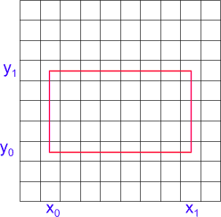
Scanning Rectangles
for ( y from y₀ to y₁ )
for ( x from x₀ to x₁ )
Write Pixel (x, y)

Slide 10
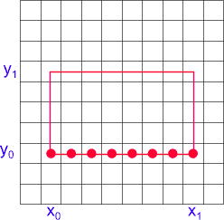
Scanning Rectangles (2)
for ( y from y₀ to y₁ )
for ( x from x₀ to x₁ )
Write Pixel (x, y)

Slide 11
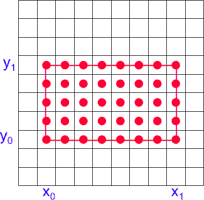
Scanning Rectangles (3)
for ( y from y₀ to y₁ )
for ( x from x₀ to x₁ )
Write Pixel (x, y)

Slide 12
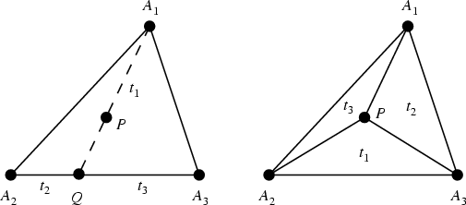
Barycentric Coordinates
Use non-orthogonal coordinates to describe position relative to vertices
  Scaled edge equations
    0 on edge, 1 at opposite vertex

Slide 13
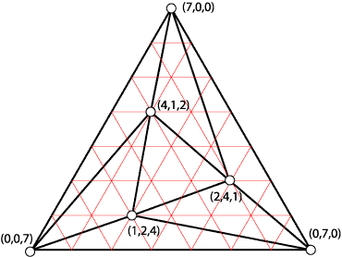
Barycentric Example

Slide 14
Barycentric Coordinates
Computing coordinates
  Equations for α, β and γ in book
  Solutions to linear equations of x,y
Ratio of areas / ratio of cross products
  Area = 0.5*b*h
  Length of cross product = 2*area of triangle
Matrix form

Slide 15
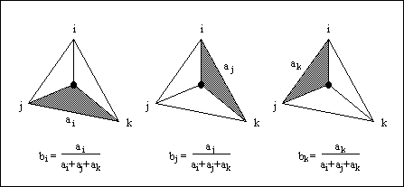
Area Computation

Slide 16
Barycentric Matrix Computation

Slide 17
“Clipless” Homogeneous Rasterization
Extra edge equations for clip edges
  Compute clip plane at each vertex
  Only visible (w>near) pixels will be drawn
Adds computation,
  But avoids branching and extra triangles
  Good for hardware

Slide 18
Barycentric Rasterization
For all x do
  For all y do
    Compute (α, β, γ) for (x,y)
    If (α ∈ [0,1] and β ∈ [0,1] and γ ∈ [0,1] then
      c = αc₀ + βc₁ + γc₂
      Draw pixel (x,y) with color c

Slide 19
Barycentric Rasterization
x_{min} = floor(min(x₀,x₁,x₂))
x_{max} = ceiling(max(x₀,x₁,x₂))
y_{min} = floor(min(y₀,y₁,y₂))
y_{max} = ceiling(max(y₀,y₁,y₂))
for y = y_{min} to y_{max} do
  for x = x_{min} to x_{max} do
    α = f₁₂(x,y)/f₁₂(x₀,y₀)
    β = f₂₀(x,y)/f₂₀(x₁,y₁)
    γ = f₀₁(x,y)/f₀₁(x₂,y₂)
    If (α ∈ [0,1] and β ∈ [0,1] and γ ∈ [0,1] then
      c = αc₀ + βc₁ + γc₂
      Draw pixel (x,y) with color c

Slide 20
Incremental Computation
α, β, and γ are linear in x and y
What about α(x+1,y)?

