Slide 1
Light, Color & Perception
CMSC 435/634

Slide 2
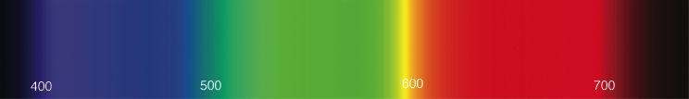
Light
Electromagnetic wave
  E & M perpendicular to each other & direction
Photon wavelength λ, frequency f = c/λ
  Visbile λ ≈ 380 nm (blue) to 720 nm (red)
Photon energy q = h f = h c/λ (in J)
  h = Planck’s constant
Spectral energy Q = J/nm

Slide 3
Radiometric Units
Term | Symbol | Units
Spectral Energy | Q | J
Spectral Power | Φ = dQ/dt | W = J/s
Irradiance | E = dΦ/dA | W/m²
Radiance | L = d²Φ/(dω dA) | W/(sr m²)
Radiant Intensity | I = dΦ/dω | W/sr
/nm dropped by graphics convention

Slide 4
Light
Infinite-dimensional function vector space
  spectrum(λ)
Shine two lights on something adds energies
Scale light energy, scales the intensity

Slide 5
Color Perception

Slide 6
Color Perception
Cones = function dot product
Projects to a 3D subspace
metamer = different spectrum, looks the same
Can transform to any 3D linear basis

Slide 7
Linear Bases
Additive (light)
  Tristimulus (SLM cone response)
  CIE XYZ (from color matching experiments)
  RGB (different for each device)
  Yuv, YC_{r}C_{b}, …
Subtractive (pigment)
  CMY = 1-RGB (grade school Blue, Red, Yellow)
  CMYK

Slide 8
Photometric Units
Visual intensity
Term | Symbol | Units
Luminous Energy | Q | talbot
Lumens | Φ = dQ/dt | lm = talbot/s
Illuminance (Lux) | E = dΦ/dA | lx = lm/m²
Luminance | L = d²Φ/(dω dA) | lm/(sr m²)
Candelas | I = dΦ/dω | cd = lm/sr

Slide 9
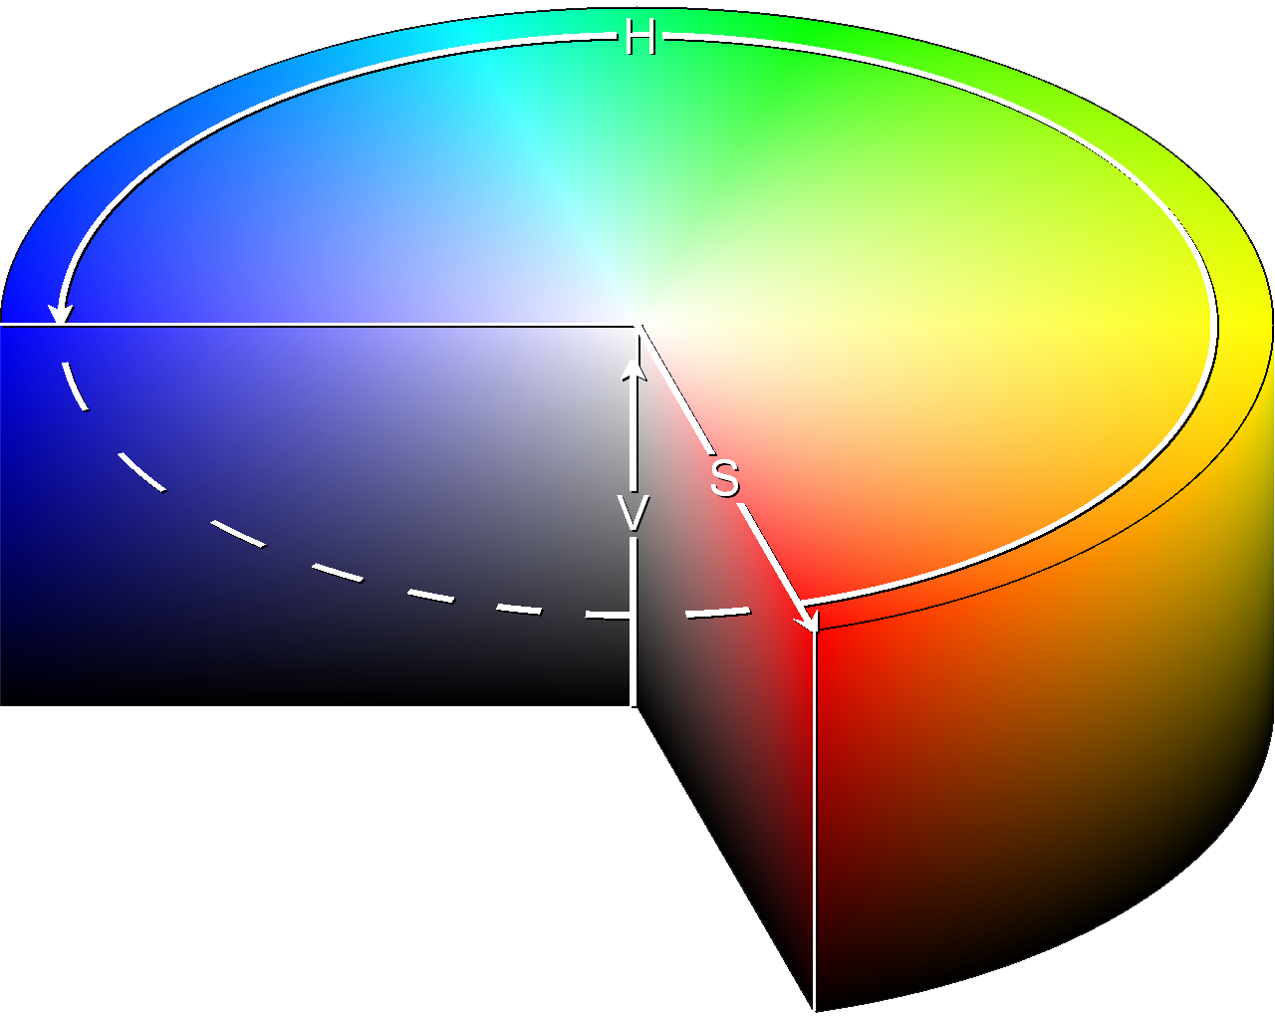
Nonlinear Color Picking
HSV: Cylindrical Coordinates
  Hue = angle
  Saturation = distance from central axis
  Value = distance along axis

Slide 10
Nonlinear Perception
Linear colors don’t look uniformly different
Nonlinear Luminance
  Gamma (sRGB), L*uv
Nonlinear Luminance & Color
  L*u*v*, L*a*b*
  Can measure color distances
Nonlinear colors do not add

Slide 11
Adaptation
White point
  Measure as equivalent to black body ºK
  Red-Orange-Yellow-Blue-White
  Incandescent,
Dynamic range (HDR)
  Dark room vs. Sunny day

Slide 12
Tone Mapping
Convert HDR to LDR
  Global intensity
  Local intensity
  Time
Film exposure
  Aperture, shutter speed, ISO

