Slide 1
Display

Slide 2
Light
Visible Range: 390-700nm
Luminance has large dynamic range
0.00003 Moonless overcast night sky
30. Sky on overcast day
30000. Sky on clear day
16,000. Snowy ground in full sunlight
Actual colors result from spectral curves
dominant wavelength, hue
brightness, lightness
purity, saturation

Slide 3
Physiology
Rods
active at low light levels (scotopic vision)
only one wavelength sensitivity function
Cones
active at normal light levels
three types: sensitivity functions with different peaks

Slide 4
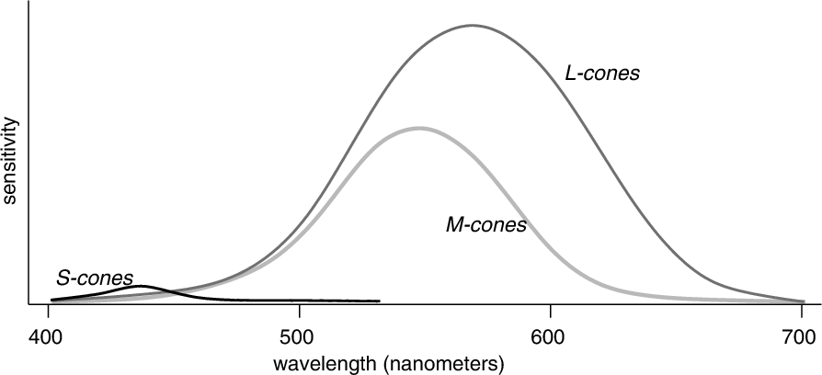
Spectral Sensitivity

Slide 5
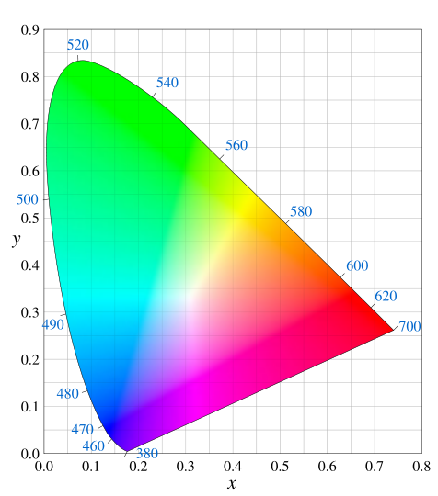
Gamut

Slide 6
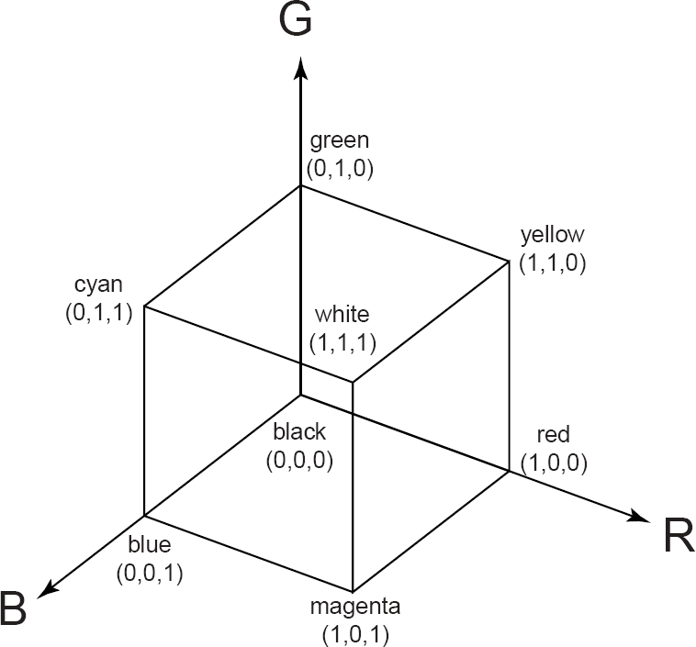
Additive Color Mixing

Slide 7
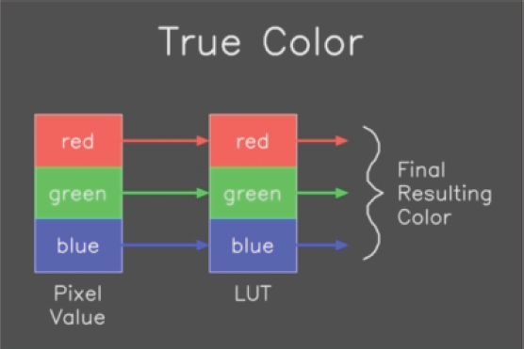
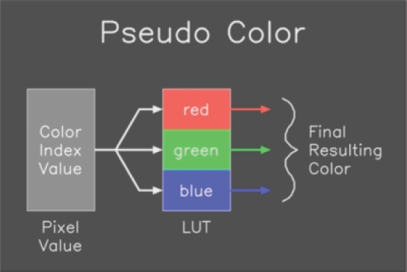
Color Options

Slide 8
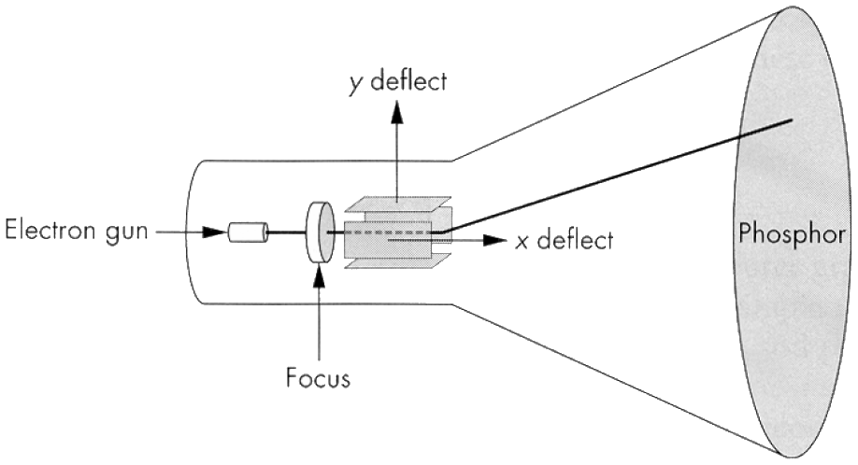
CRT
Electrons fire off of heated cathode and shoot in direction of anode
Electrons strike phosphors and create light
Fluorescence (fraction of usec)
Phosphorescence (10-60 usec)

Slide 9
Phosphors
Have different color based on makeup
Red: europium yttrium vanadate
Green: zinc calcium sulfide
Blue: zinc sulfide
May also have different persistence
Image mush be refreshed to avoid flicker
Below 60Hz can be unpleasant

Slide 10
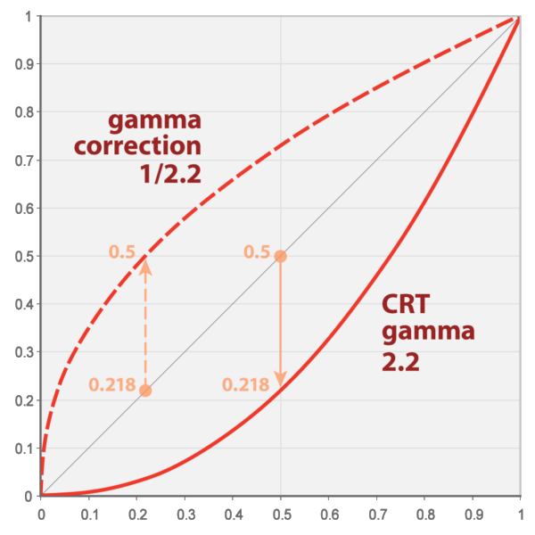
Gamma

Slide 11
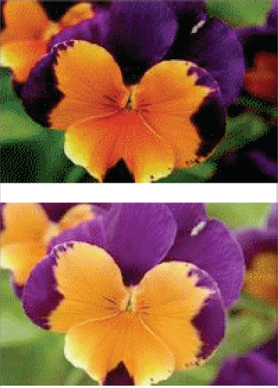
Gamma Correction

Slide 12
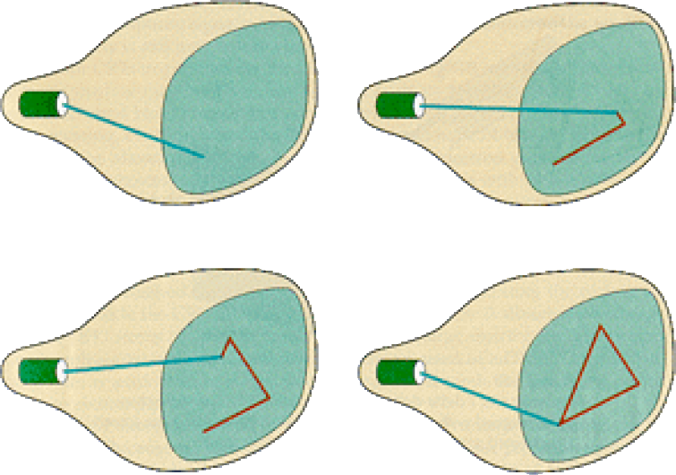
Random/Vector Display

Slide 13
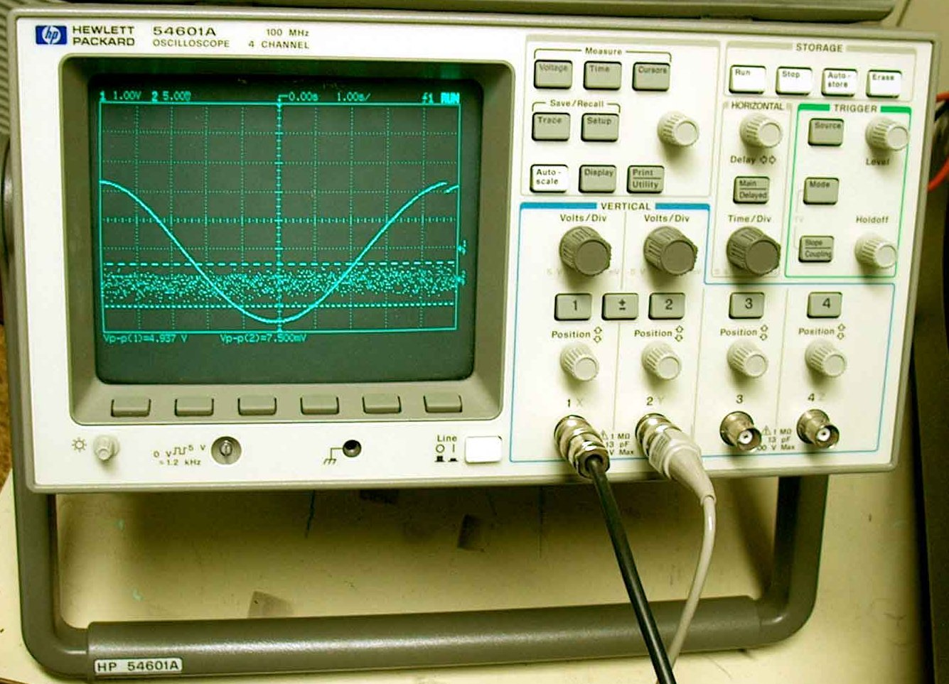
Examples of Random Scan

Slide 14
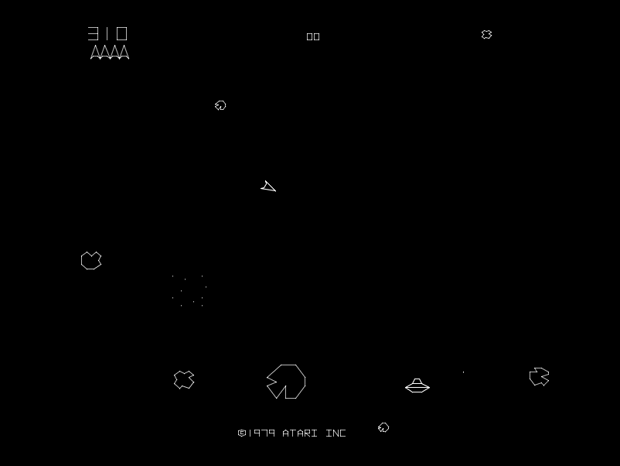
Examples of Random Scan

Slide 15
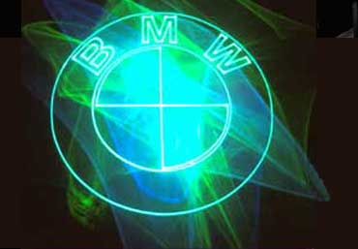
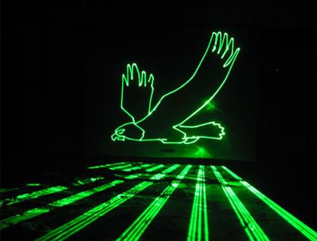
Examples of Random Scan

Slide 16
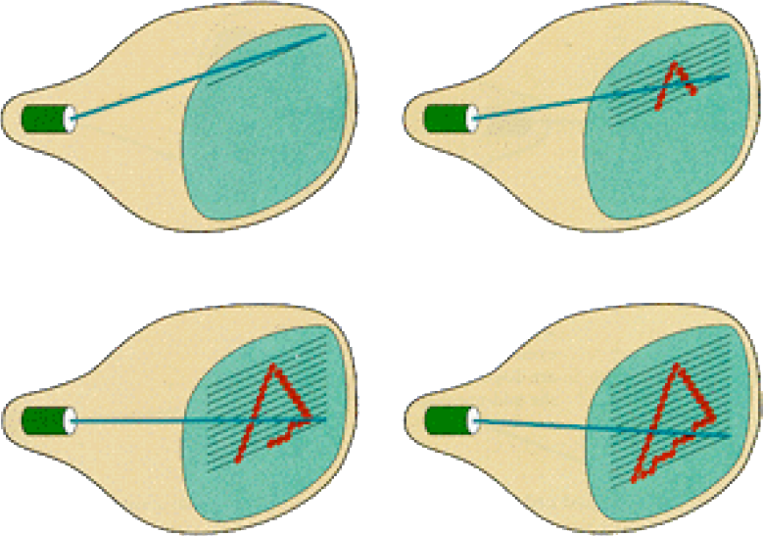
Raster Display

Slide 17
Raster Display
Each left-to-right trace is called a scan line
Each spot on the screen is called a pixel
Beam turned off to swipe back and up screen
Called a retrace or blanking interval

Slide 18
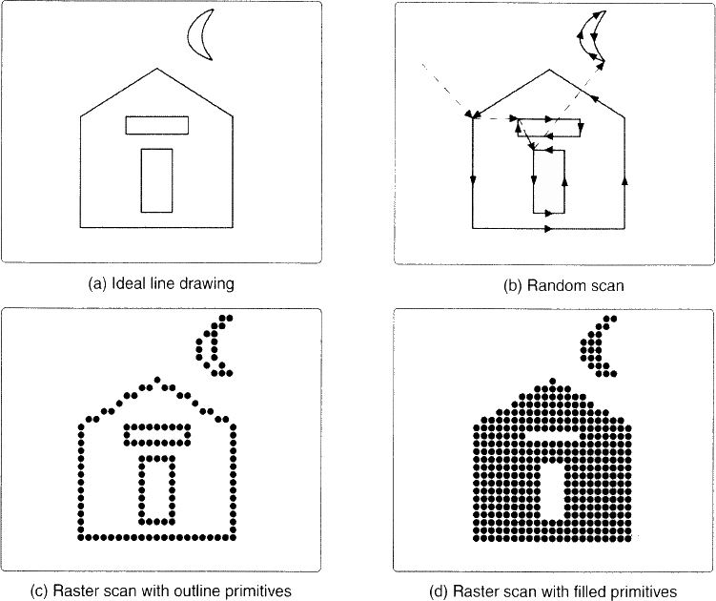
Vector vs. Raster

Slide 19
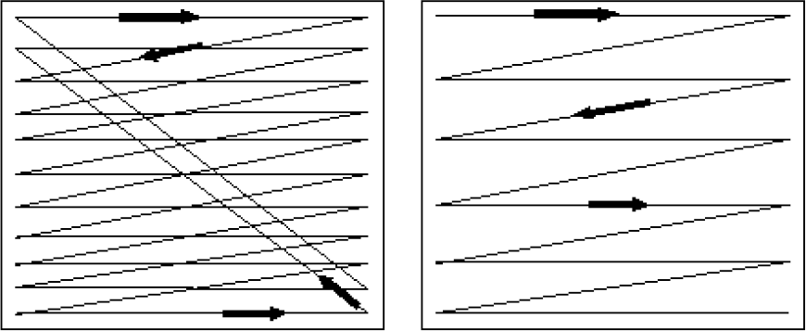
Interlacing
Interlacing is a technique used to improve video quality without additional bandwidth
480i (standard TV) is 480 scan lines, interlaced
1080i HD is 1080 scan lines, interlaced
1080p HD is 1080 scan lines, non-interlaced
Interlaced
Non-Interlaced
(progressive)‏

Slide 20
Interlacing
Odd Fields
Even Fields

Slide 21
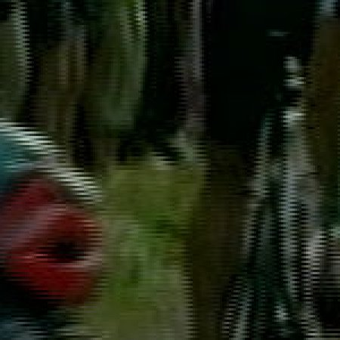
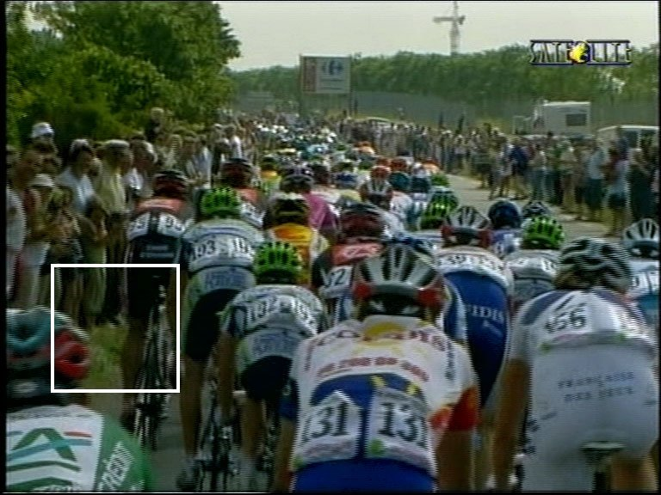
Problems with Interlacing

Slide 22
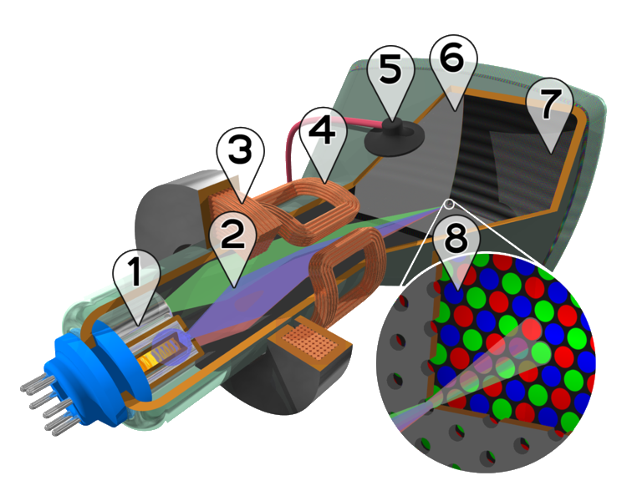
Color CRT
Electron guns
Electron beams
Focusing coils
Deflection coils
Anode connection
Shadow mask
Phosphor with RGB zones
Phosphor / Mask close-up

Slide 23
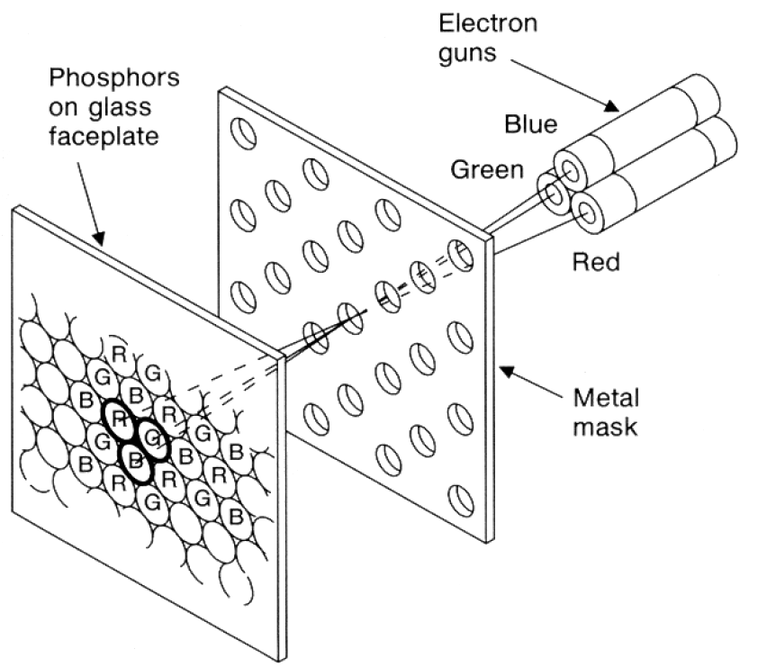
Color CRT
Uses triads of red, green & blue at each pixel
Uses 3 electron guns – one for each color
Shadow mask used to make each kind of phosphor only visible from one gun

Slide 24
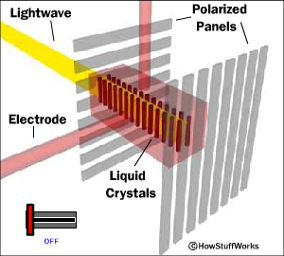
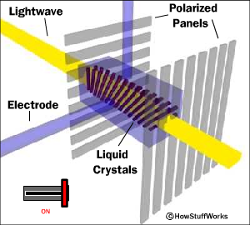
Liquid Crystal Display (LCD)‏
Light enters polarizer
Nematic crystals twist based on voltage
Allowing light to pass through to other polarizer

Slide 25
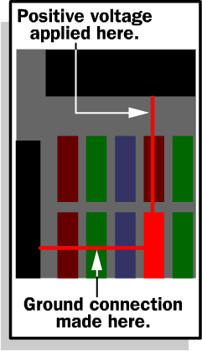
Passive Matrix
Two glass layers
One layer is given vertical transparent conductive material, the other is given horizontal
Integrated circuit sends charge/ground activation to complete circuit at given row/column
Simple, but slow response time

Slide 26
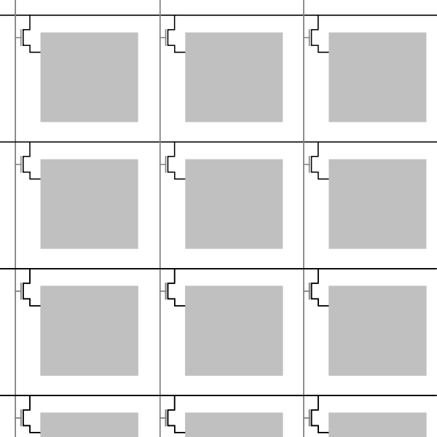
Active Matrix
Active matrix displays have a transistor at each cell
Thin film transistor (TFT)
Much faster crystal switching

Slide 27
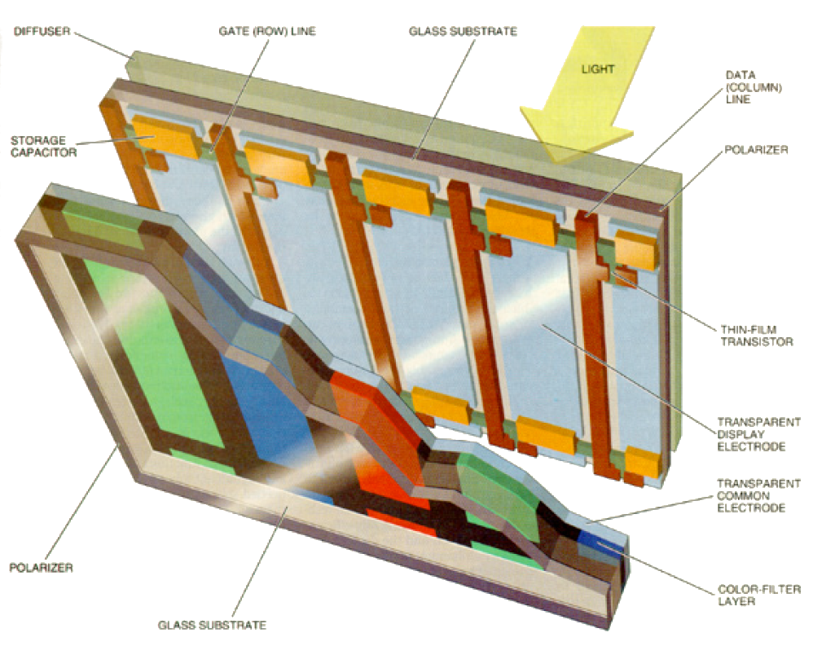
Color LCD

Slide 28
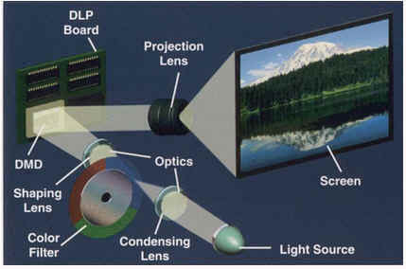
DLP Projector

Slide 29
DLP Projector

Slide 30
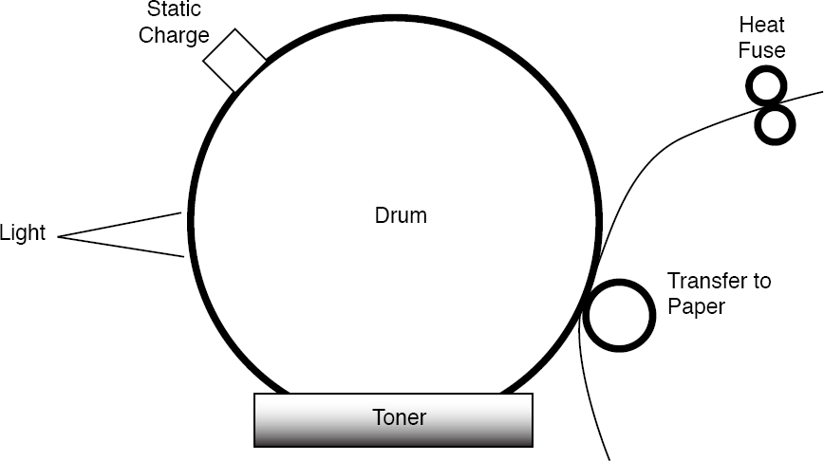
Laser Printer

Slide 31
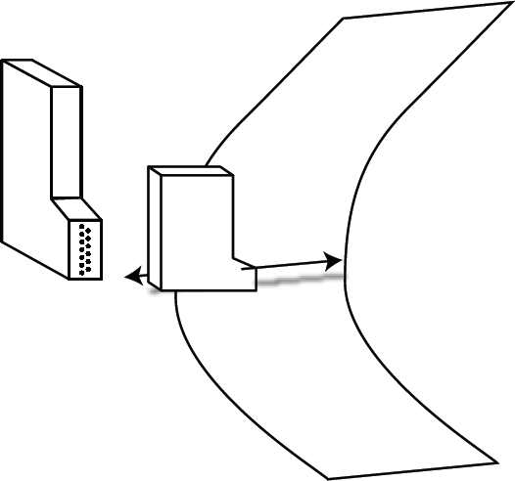
Ink Jet Printer

Slide 32
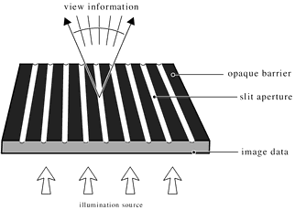
Auto-stereo Display: Barrier

Slide 33
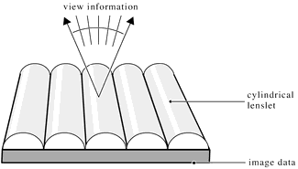
Auto-stereo Display: Lenticular

