Slide 1
Antialiasing
CMSC 435/634

Slide 2
Original Scene
Luminosity

Slide 3
Pixel Sampling
Samples

Slide 4
Displayed Image
Luminosity

Slide 5
What went wrong?

Slide 6
Aliasing
Visual artifacts
Jagged lines and edges
High frequencies appearing as low
Small objects missed
Texture distortions
Strobing and popping
Backward movement

Slide 7
Jagged Lines

Slide 8
Jagged Edges

Slide 9
Frequency Aliasing

Slide 10
Missed Detail

Slide 11
Missed Detail

Slide 12
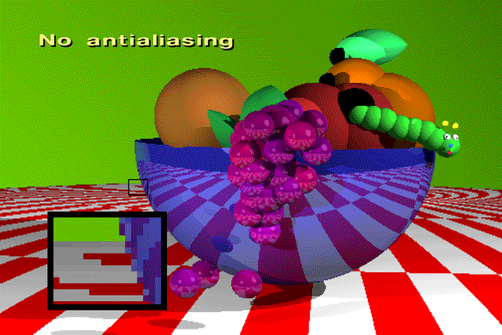

Slide 13
Strobing/Popping

Slide 14
How might you fix aliasing?

Slide 17
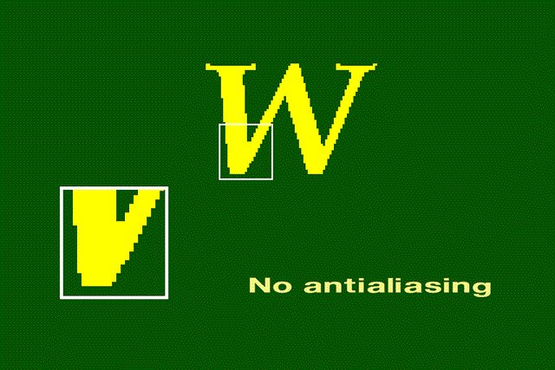

Slide 18
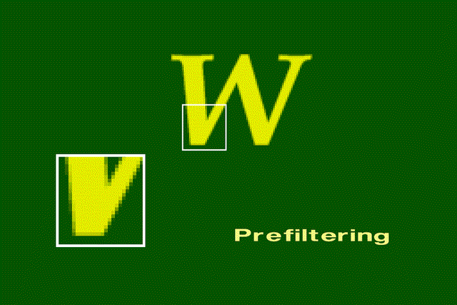

Slide 19
Sampling Theory
Shannon’s sampling theory (1D):
A band limited signal f(t) with cut off frequency w_{F} may be perfectly reconstructed from its samples f(nT₀) if 2π/T₀ >= 2w_{F}
w_{F} == Nyquist limit
Alternatively:
a signal can be reconstructed exactly from samples only if the highest frequency is less than half the sampling rate

Slide 20
Sampling a Sine Wave

Slide 21
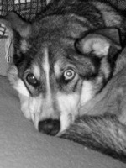
What Will Alias?
Plot based on frequency
Like audio equalizer
Fourier transform

Slide 22
How to Fix It?
Filter
Blur away high frequency
Blur is better than aliasing

Slide 23
Filters

Slide 24
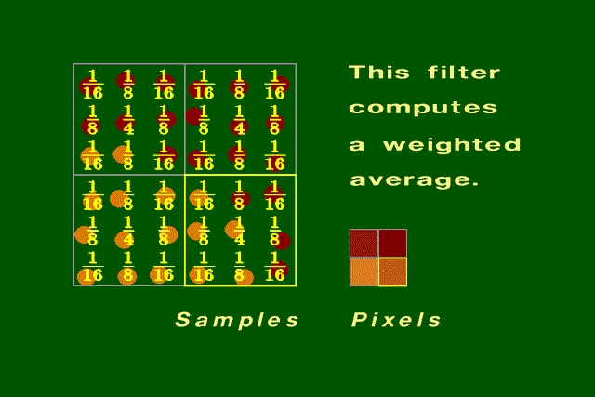
Using a Filter to Compute Pixel Color

Slide 25
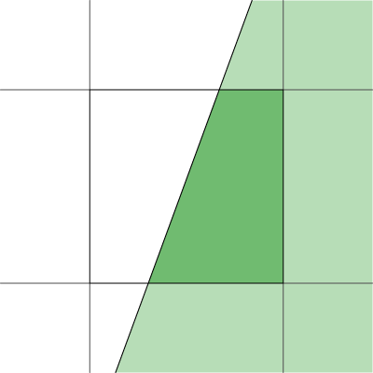
Analytic Area Sampling
Compute “area” of pixel covered
Box in spatial domain
Nice finite kernel
easy to compute
sinc in freq domain
Plenty of high freq
Still aliases

Slide 26
Analytic higher order filtering
Fold better filter into rasterization
Can make rasterization much harder
Usually just done for lines
Draw with filter kernel “paintbrush”
Only practical for finite filters

Slide 27
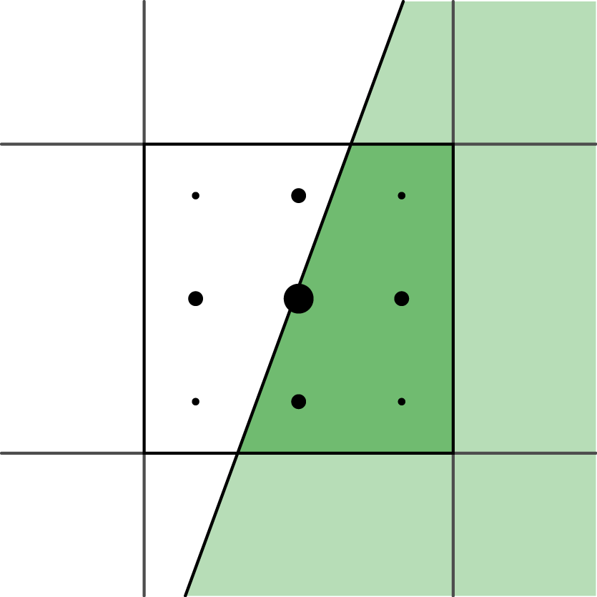
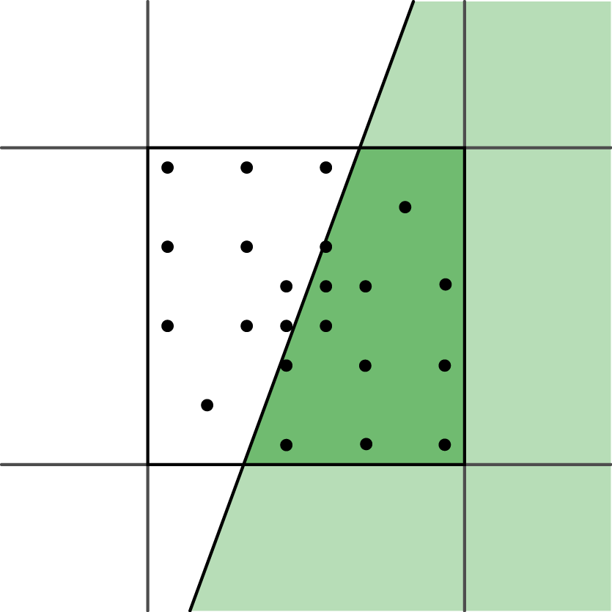
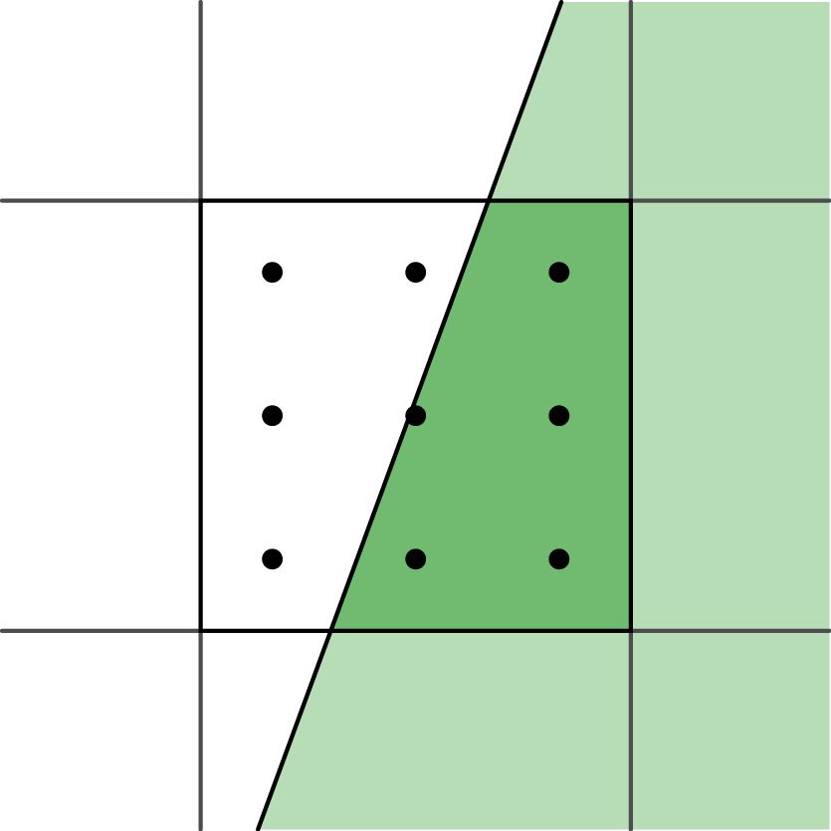
Supersampling
Numeric integration of filter
Grid with equal weight = box filter
Push up Nyquist frequency
Edges: ∞ frequency, still alias
Other filters:
Grid with unequal weights
Priority sampling

Slide 28
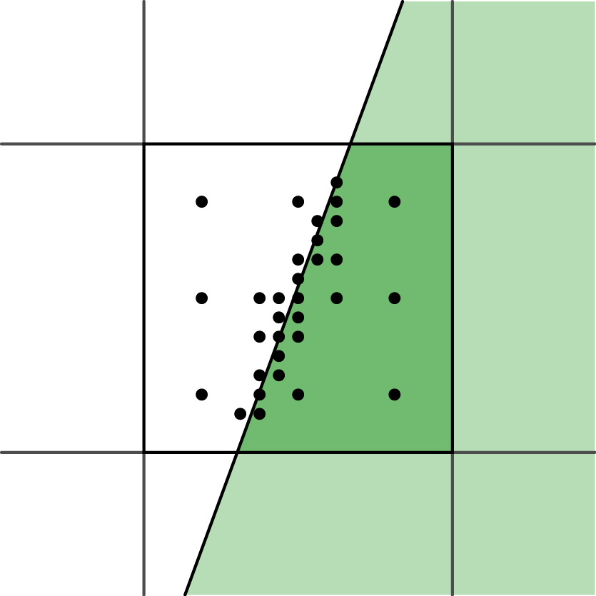
Adaptive sampling
Vary numerical integration step
More samples in high contrast areas
Easy with ray tracing, harder for others
Possible bias

Slide 29
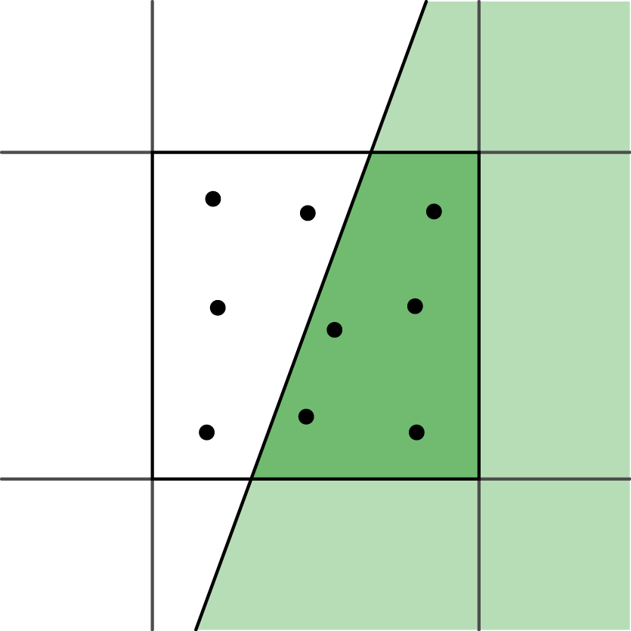
Stochastic sampling
Monte-Carlo integration of filter
Sample distribution
Poisson disk
Jittered grid
Aliasing ⇔ Noise

Slide 30
No Antialiasing

Slide 31
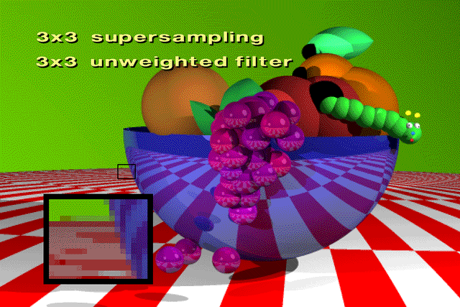
With Antialiasing

Slide 32
With Antialiasing

Slide 33
With Antialiasing

