Slide 1
Graphics Processors
CMSC 411

Slide 2
GPU graphics processing model
CPU
Texture /
Buffer
Vertex
Geometry
Fragment
Displayed
Pixels

Slide 3
GPU computation
NVIDIA GeForce 7800
~860M vertices/sec
~172M triangles/sec
~6.9G fragments/sec
~10.3G texels/sec
~165 GFLOPS
~2.4x increase/year
3 GHz Dual-core Pentium 4
~24.6 GFLOPS
~1.5x increase/year
[Luebke, GPGPU SIGGRAPH Course, 2005; Kilgard, Real-Time Shading SIGGRAPH course, 2006]

Slide 4
Pipeline vs. Parallel
Pipeline
Break task up
Overlap sub-tasks
Parallel
Processor per data element
Each runs full task
Many data elements
…

Slide 5
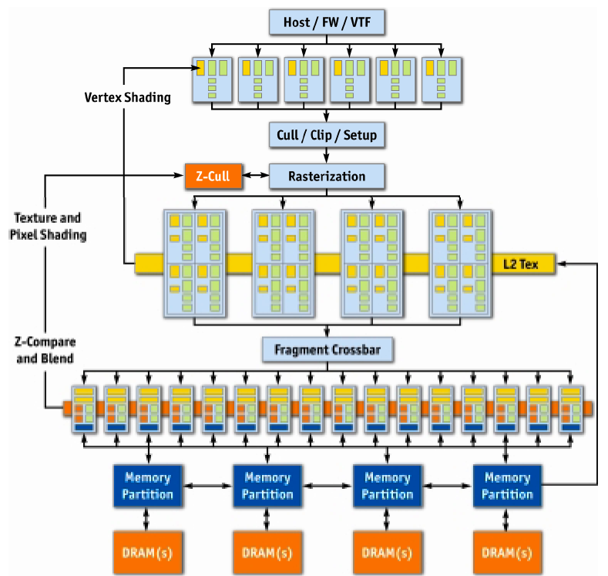
NVIDIA GeForce 6
[Kilgaraff and Fernando, GPU Gems 2]

Slide 6
GeForce 6
Vertex
…
More Parallel
Parallel
Triangle
Pixel
Pipeline
More Parallel
More Pipeline

Slide 7
Old GPU graphics processing model
CPU
Texture /
Buffer
Vertex
Geometry
Fragment
Displayed
Pixels

Slide 8
New GPU graphics processing model
CPU
Vertex
Texture /
Buffer
Geometry
Fragment
Displayed
Pixels

Slide 9
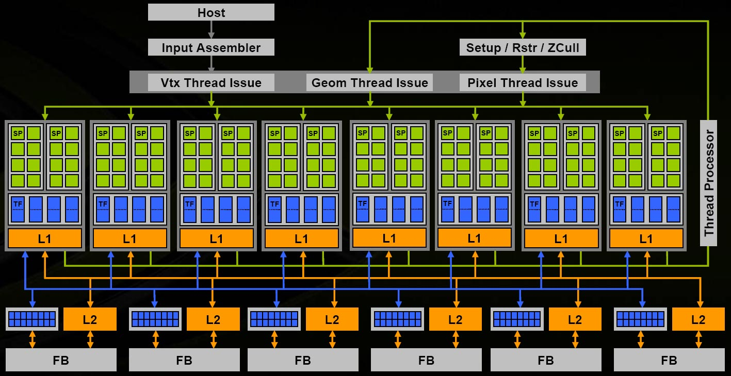
NVIDIA G80
[NVIDIA 8800 Architectural Overview, NVIDIA TB-02787-001_v01, November 2006]

Slide 10
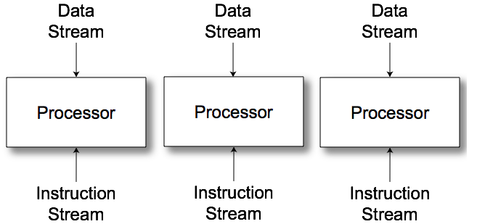
Multiple Instruction, Multiple Data (MIMD)
Multiple communicating processes

Slide 11
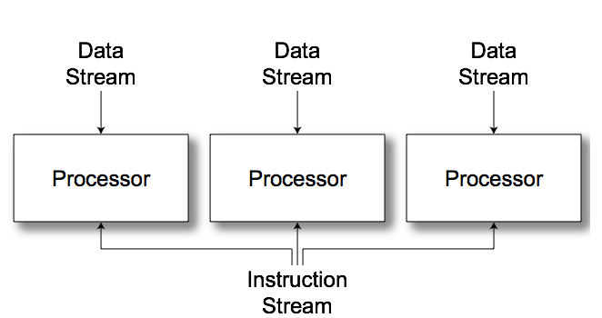
Single Instruction, Multiple Data (SIMD)
Vector/Array computers

Slide 12
Architecture (MIMD vs SIMD)
MIMD(CPU-Like)
SIMD (GPU-Like)
CTRL
ALU
CTRL
ALU
CTRL
ALU
ALU
ALU
ALU
CTRL
ALU
ALU
ALU
ALU
CTRL
ALU
ALU
ALU
ALU
Flexibility
Horsepower
Ease of Use

Slide 13
SIMD Branching
if( x ) // mask threads
// issue instructions
else // invert mask
// issue instructions
// unmask
Threads agree, issue if
Threads agree, issue else
Threads disagree, issue if AND else

Slide 14
SIMD Looping
Useful
Useless
while(x) // update mask
// do stuff
They all run ‘till the last one’s done….

Slide 15
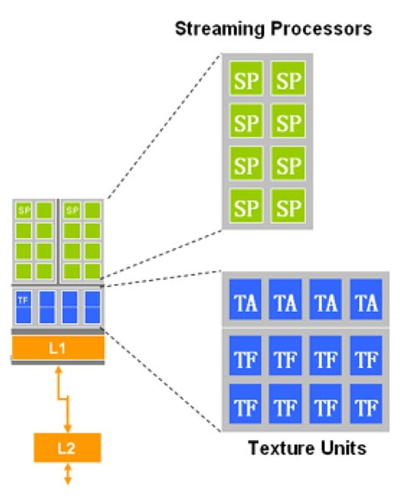
Streaming Processors

Slide 16
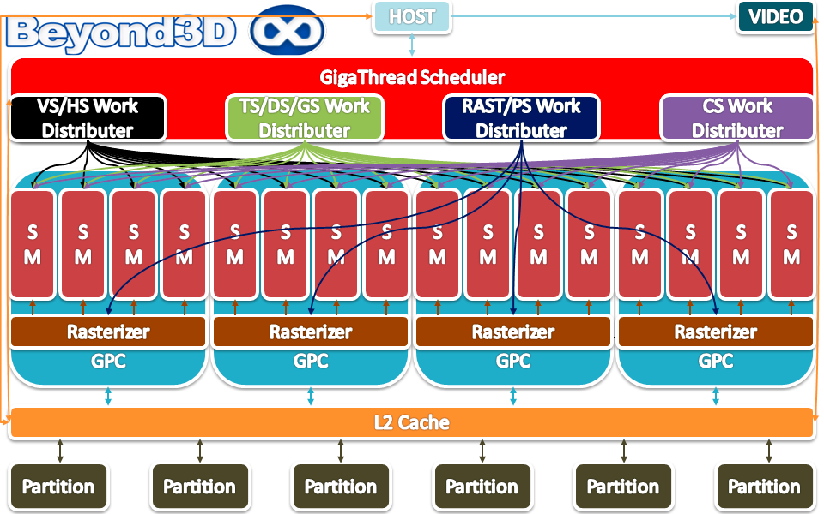
NVIDIA Fermi
[Beyond3D NVIDIA Fermi GPU and Architecture Analysis, 2010]

Slide 17
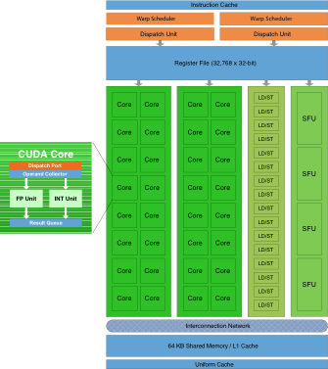
NVIDA Fermi SM
[NVIDIA, NVIDIA’s Next Generation CUDA Compute Architecture: Fermi, 2009]

Slide 18
Architecture: Latency
CPU: Make one thread go very fast
Avoid the stalls
Branch prediction
Out-of-order execution
Memory prefetch
Big caches
GPU: Make 1000 threads go very fast
Hide the stalls
HW thread scheduler
Swap threads to hide stalls

Slide 19
NVIDIA Kepler
[NVIDIA, NVIDIA’s Next Generation CUDA Compute Architecture: Kepler GK110, 2012]

Slide 20
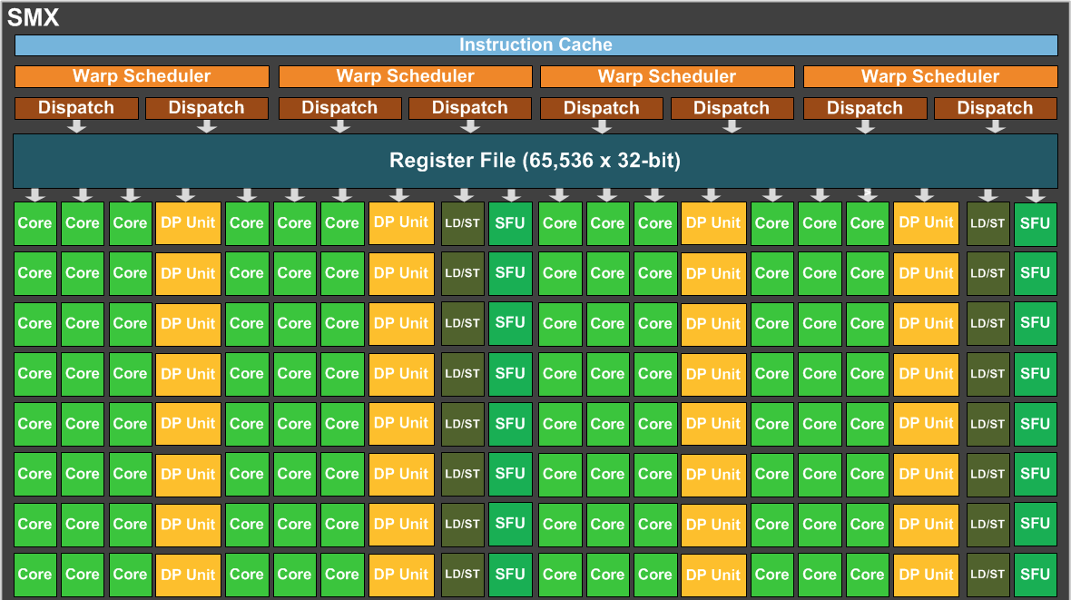
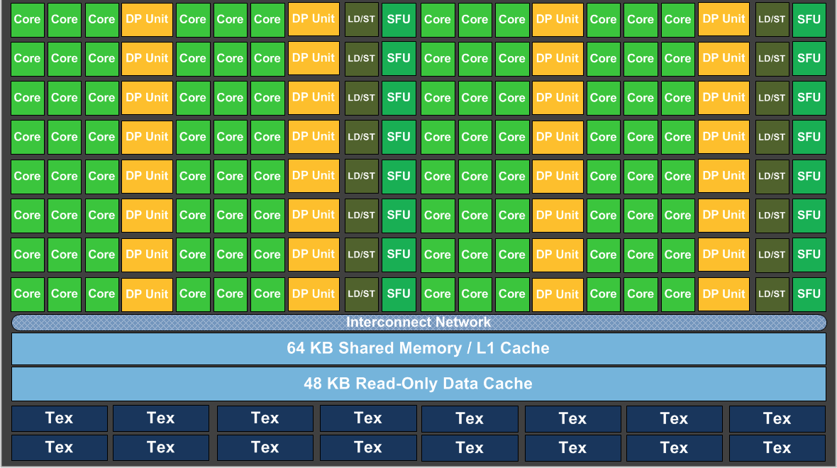
Kepler SMX
[NVIDIA, NVIDIA’s Next Generation CUDA Compute Architecture: Kepler GK110, 2012]

