Slide 1
Cloud Shader Walkthrough

Slide 2
Setting up the Project

Slide 3
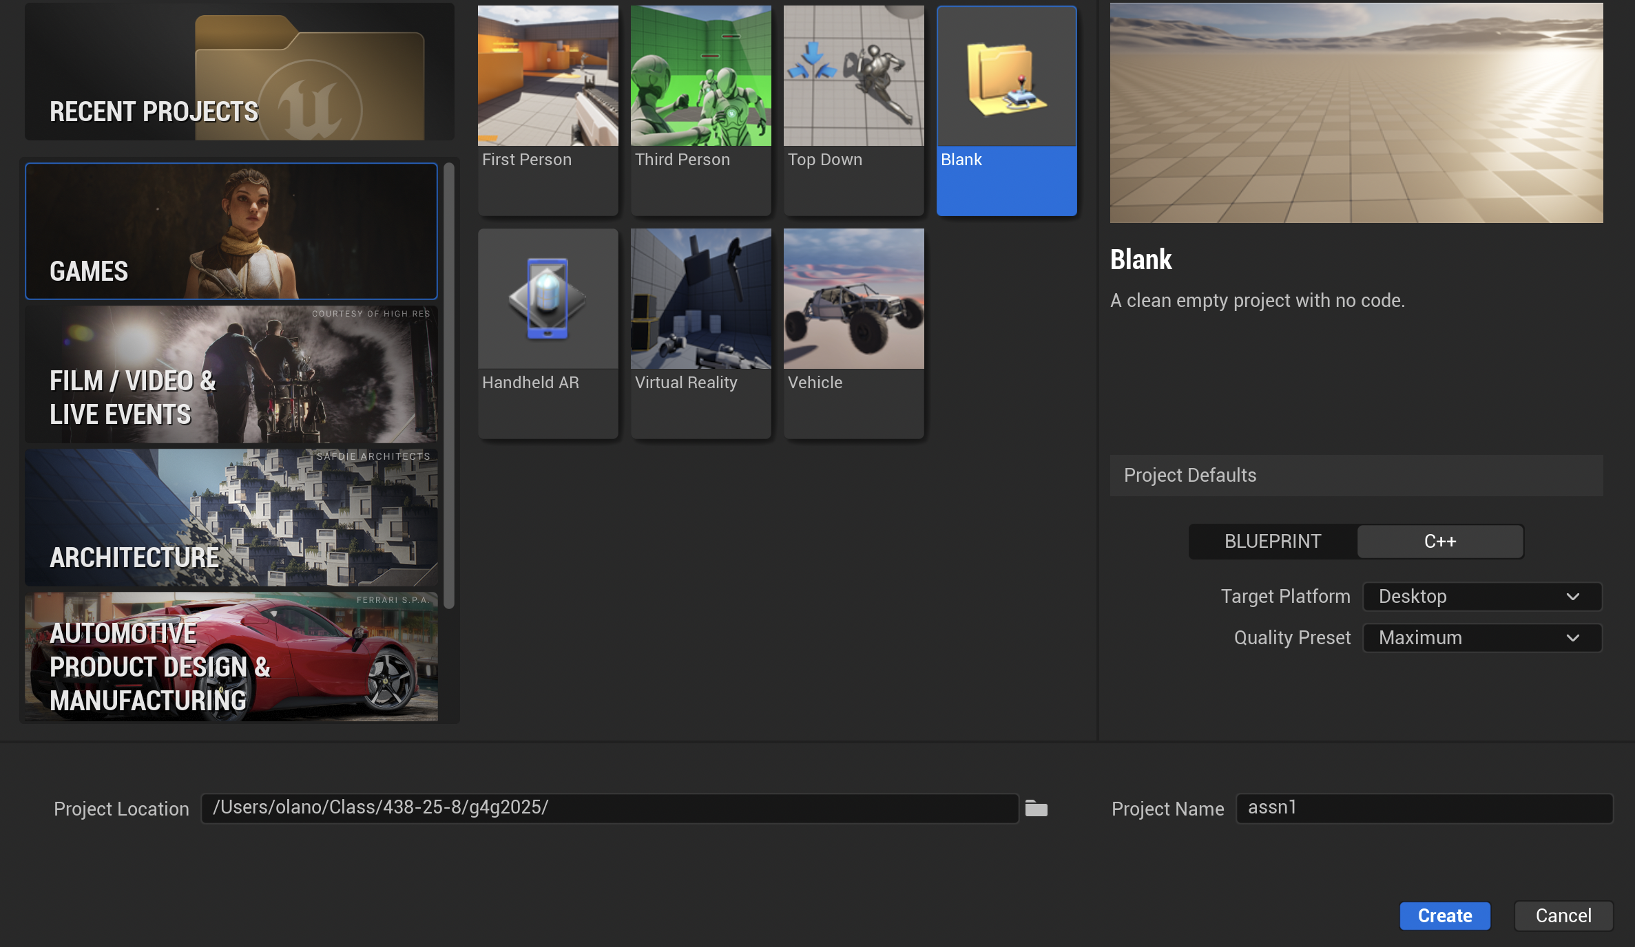
Create a Project
Launch your home-built UE5, choose the “Games” project category.
Use the Blank template, to create a C++ project.
Set the folder where your project will be created to the base folder of your git clone

Slide 4
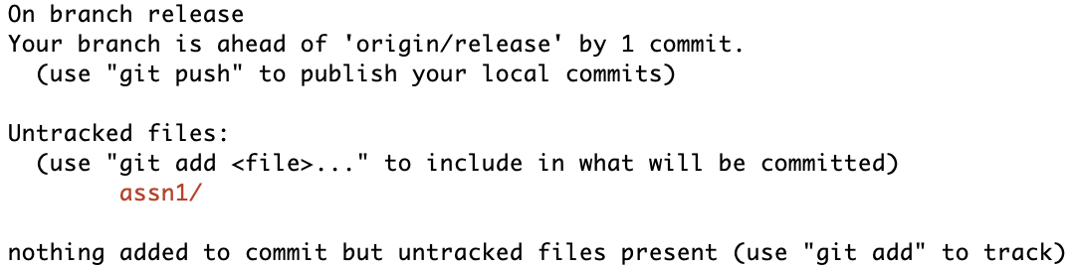
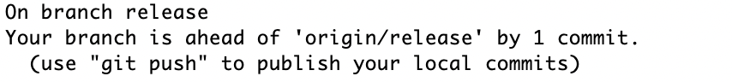
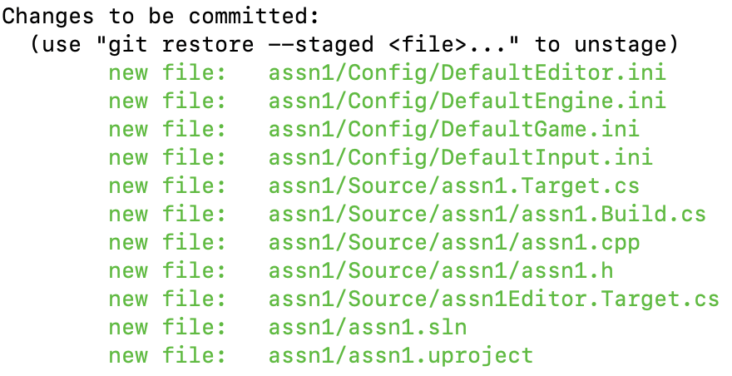
First Commit
git status
Once the project is created and launched, quit it and commit it to your local Git repository.
git add assn1
git status
git commit –m "created cloud project"

Slide 5
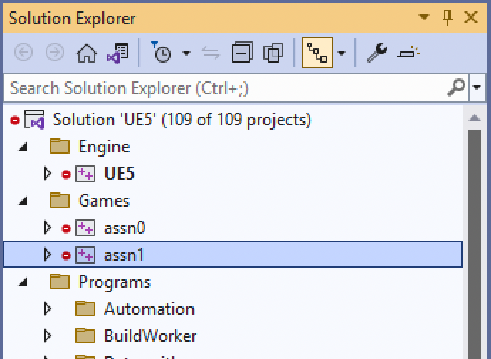
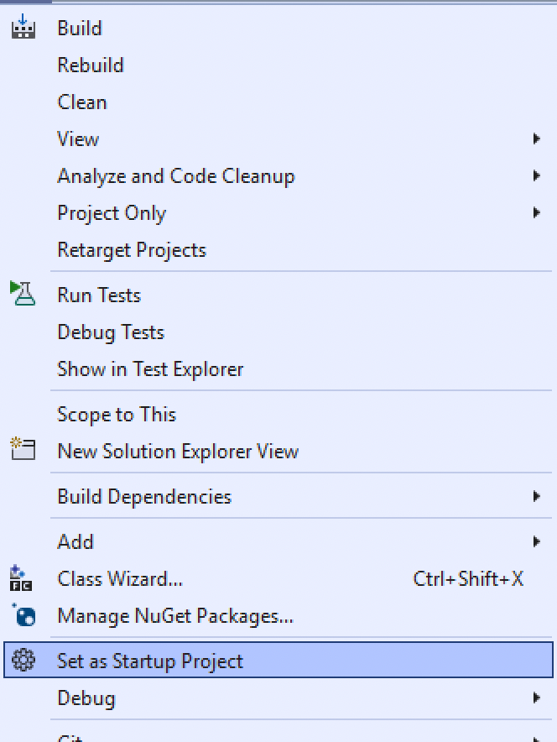
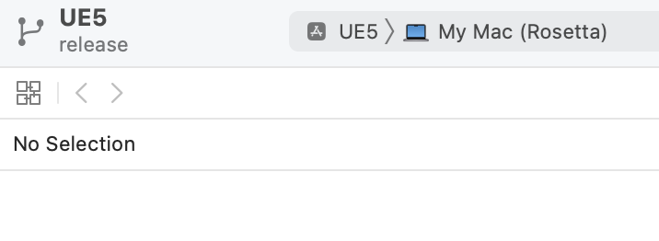
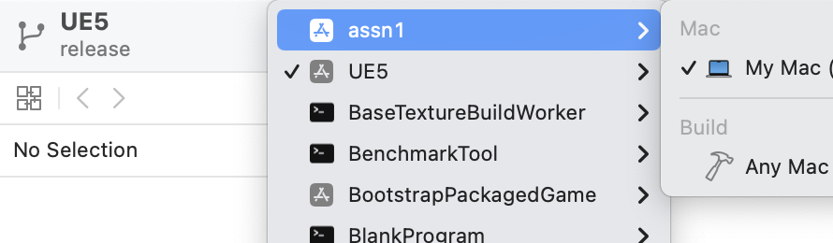
Run from your IDE
Creating the project runs a GenerateProjectFiles script to create an assn1.sln (Visual Studio) and/or
assn1 (Mac).xcworkspace (Xcode).
  If you do not see the project listed, you may need to quit and re-open Visual Studio or Xcode.
In Visual Studio, right click on the project to Select as Startup Project.
  In Xcode, choose the assn1Editor project from the drop-down list.
Run (using the Play button). It’ll launch directly into the project.

Slide 6
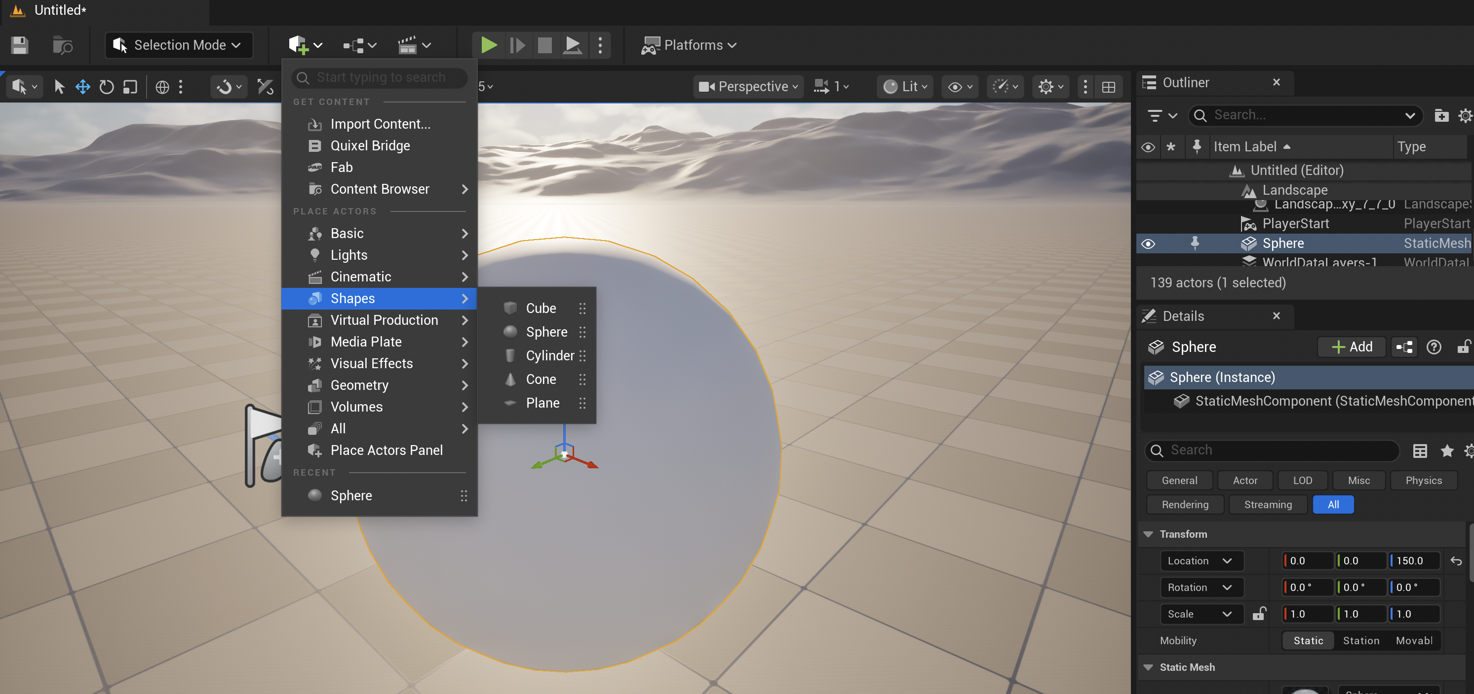
Set up a Scene
Add a new sphere shape into the scene and position it above the ground plane.
Press F when an object is selected to change the view to focus on it.
Save the current Level (you’ll have to name it), then set it as the Editor Startup Map in Settings > Project Settings ...
Add and commit the project Content directory and DefaultEngine.ini files to Git. This will add the .umap and .uasset files for the new Level.
It is reasonable to commit at each major step along the way. You don’t need to quit the Editor, but be sure to “Save All” before each commit to make sure you are not missing unsaved work.
UE5 has Git support for asset changes like this, but the support doesn’t apply to the source changes we’ll make later, so better to get used to using Git directly.

Slide 7
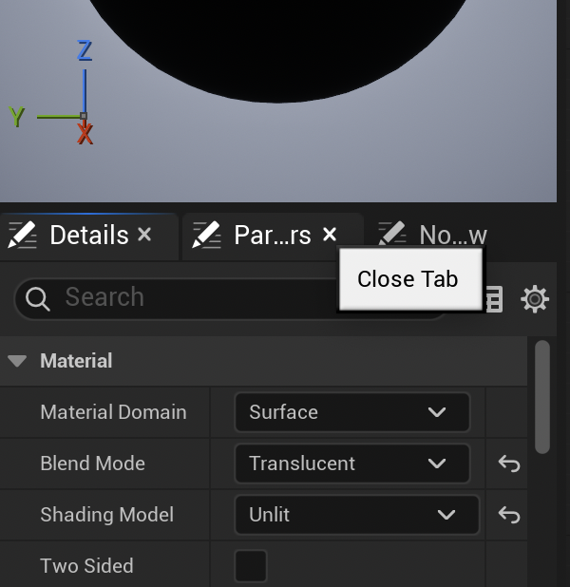
New Material
Create a new Material on the sphere, open it in the Material Editor, and change it to “Translucent” and “Unlit”.
We will ultimately include some lighting calculation, but the shader will do it, so we don’t want UE5 to add its own surface lighting on top of that.
The Emissive Color input is not affected by scene lighting, and we can use the Opacity input to make the cloud transparent.

Slide 8
Materials & HLSL

Slide 9
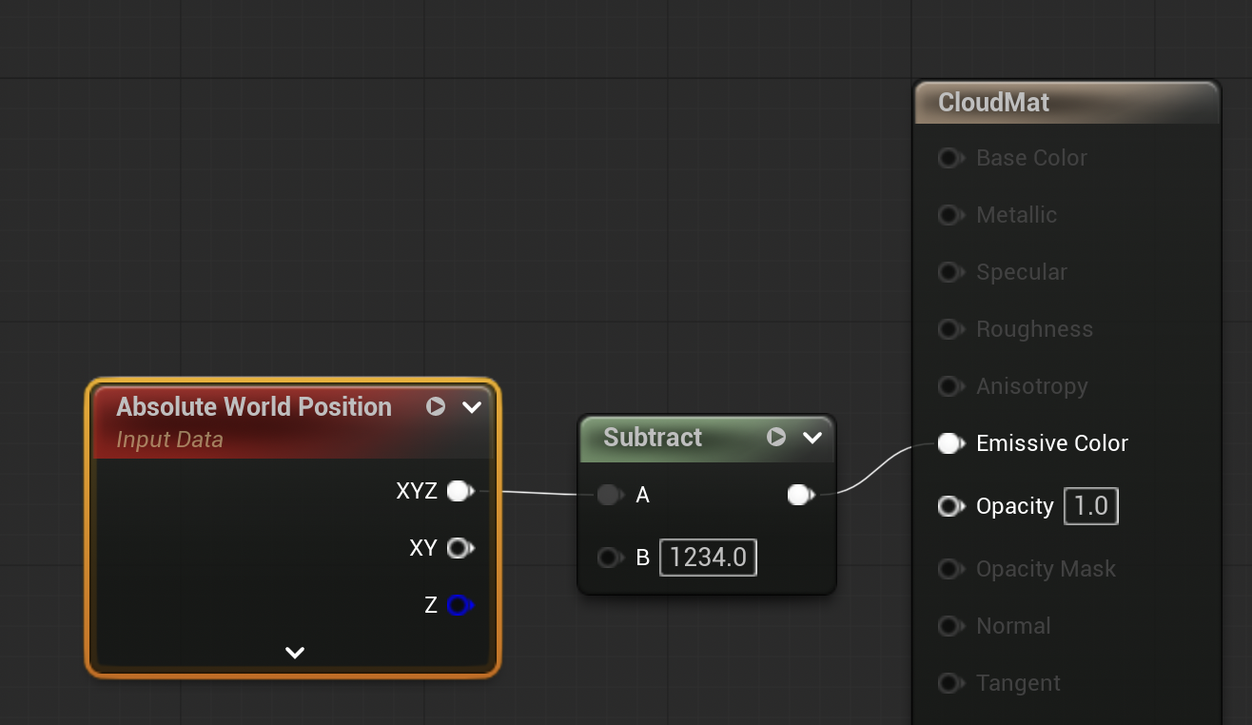
Accessing Data
We’ll need to access several pieces of data in shader code. The first of those is the 3D world position for each point on the surface of the sphere.
How do you figure out the shader code to get that position? Look at the source.
  Window > Shader Code > HLSL Code, or r.DumpShaderDebugInfo.
Add a searchable constant (like 1234) to make it easier to find

Slide 10
What is that FWSVector?
Floating point precision is not enough for large worlds
Float precision of x is [next lower power of 2] * 2⁻²³ ≈ x ∗ 10⁻⁷
  Earth radius 6.378 ∗ 10⁶ m; UMBC at 39.2498º N, 76.7115º W
  ∴ X=1.135∗10⁶ m; Y=4.807∗10⁶ m; Z=4.035∗10⁶ m
  Position resolution: X ± 0.125m; Y ± 0.5m; Z ± 0.25m
Use doubles … or recenter for better precision away from the origin
  UE defines Translated World or Large World Coordinates (LWC)
  Translated World is centered at camera (errors too far away to see)
  LWC uses a struct with tile location & offset within tile
    Tile locations exactly representable as float (0’s in least significant bits)
    Offsets are small numbers with higher precision
FWSVector is #defined in WorldSpaceMath.ush to either use double or LWC
Only really matters for huge worlds

Slide 11
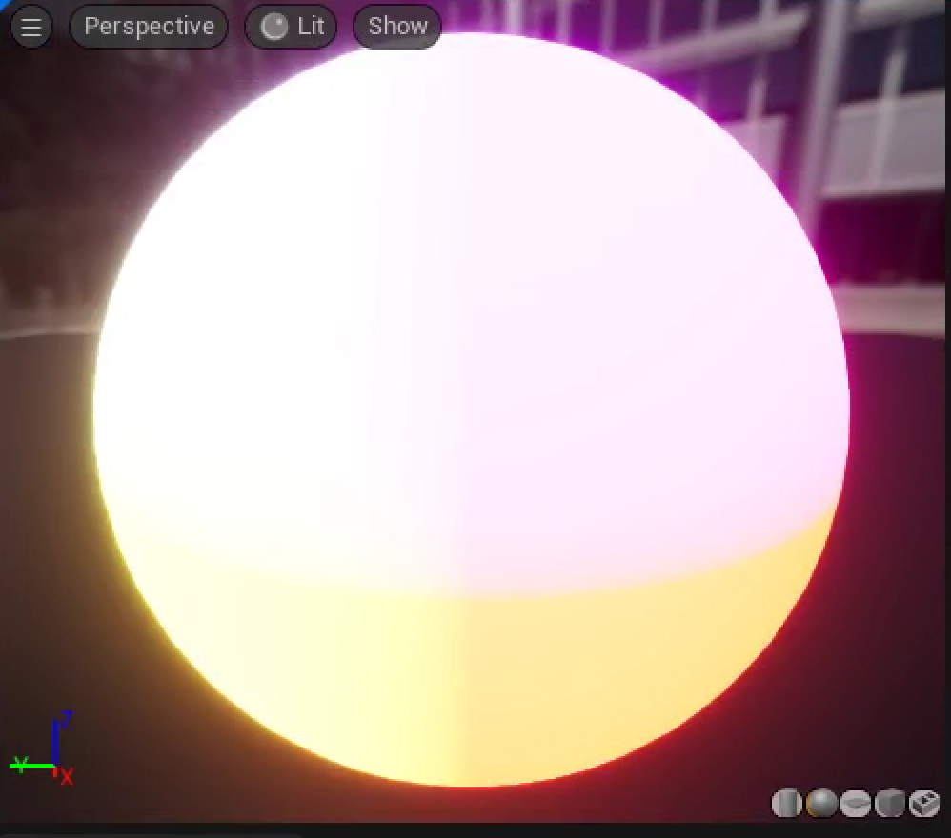
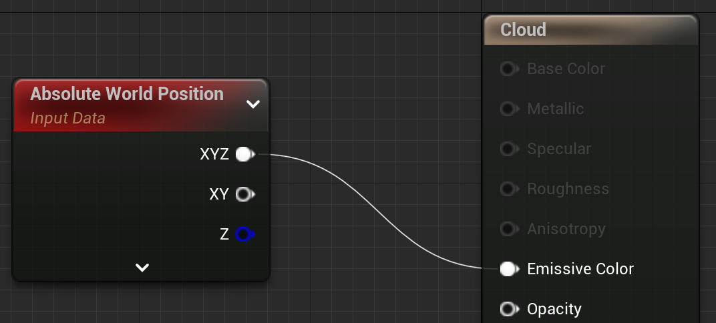
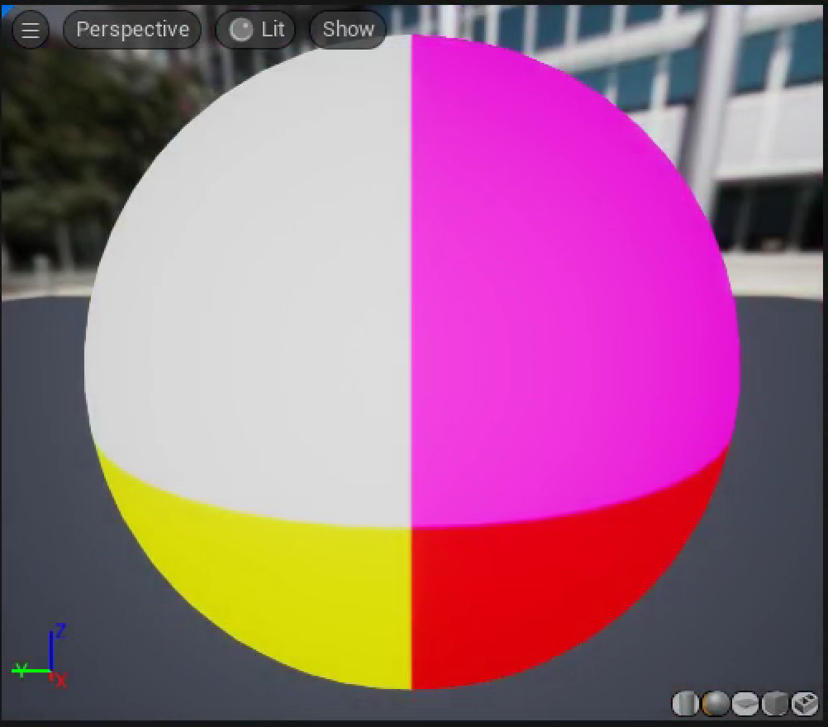
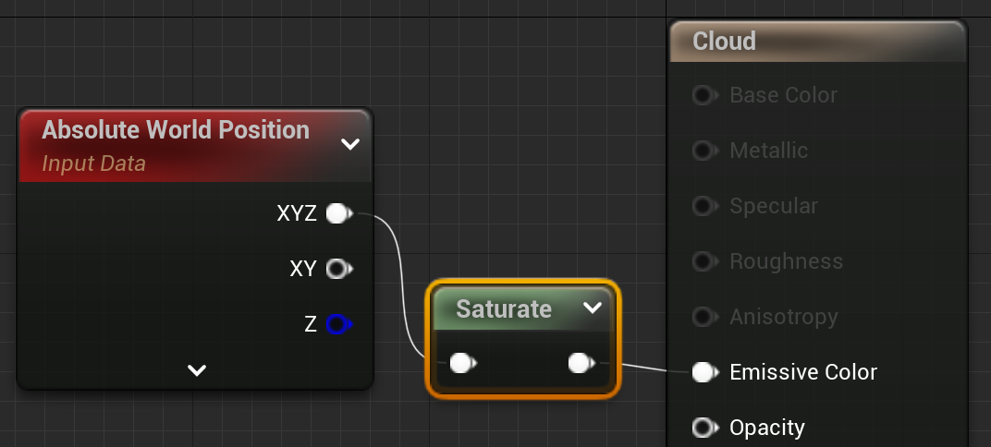
Visualize with saturate
Positions values are huge
Displayed as color is really bright
Clamp to 0 – 1 with saturate

Slide 12
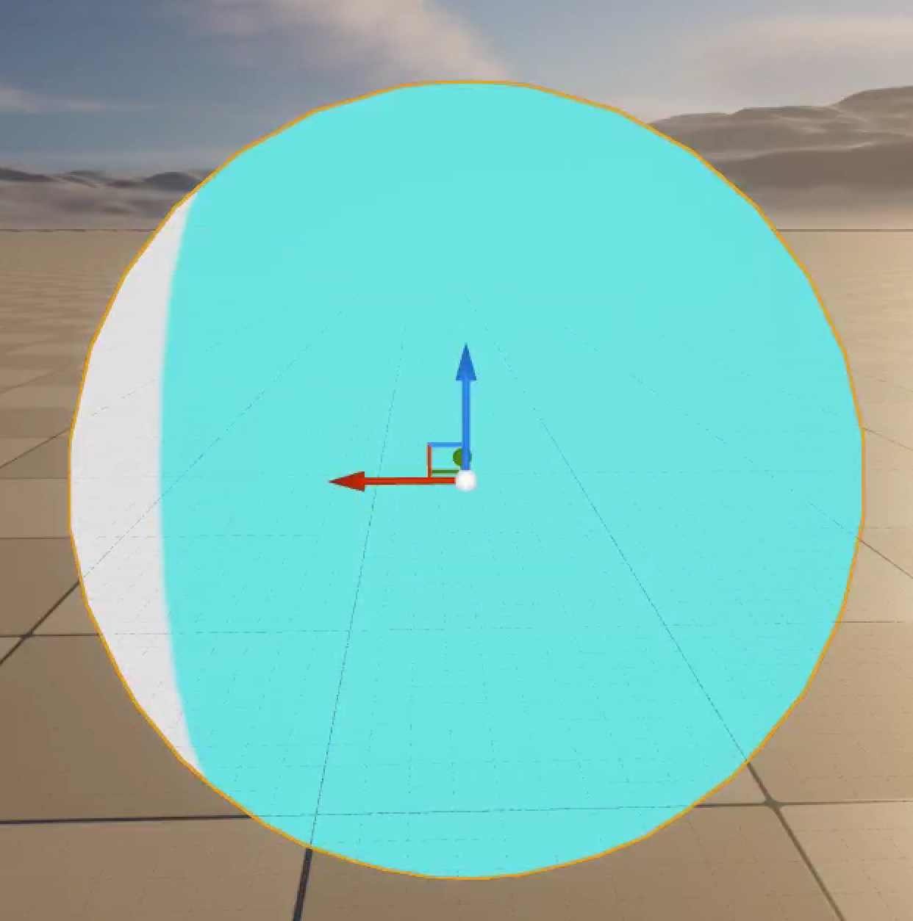
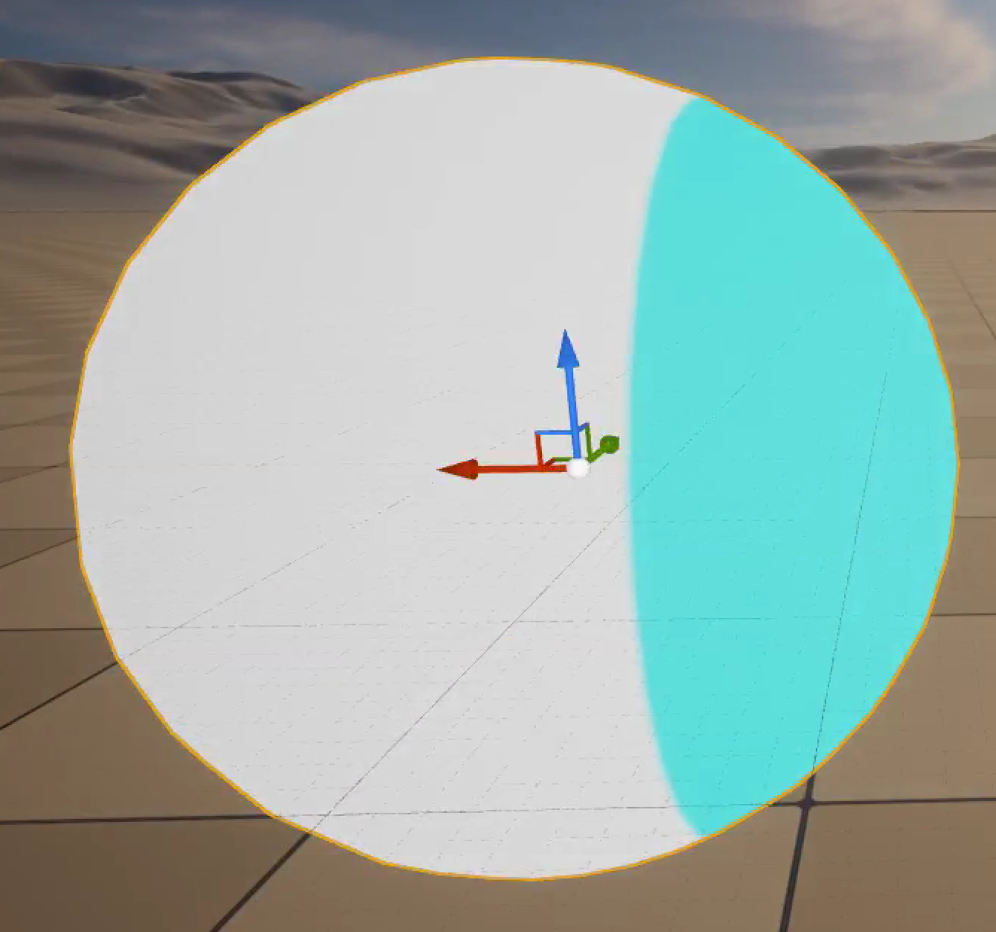
Where to View
Usually, updating and viewing a shader in the Material Editor gives the fastest iteration time to see shader changes, but you should still periodically check how the shader behaves in the scene.
If you apply this shader and switch back to the main view, you’ll see that when you move the sphere around the scene, the Material slides through it. That’s not what we want.
You’d miss this in the Material Editor because the preview object is always centered at the preview scene origin.

Slide 13
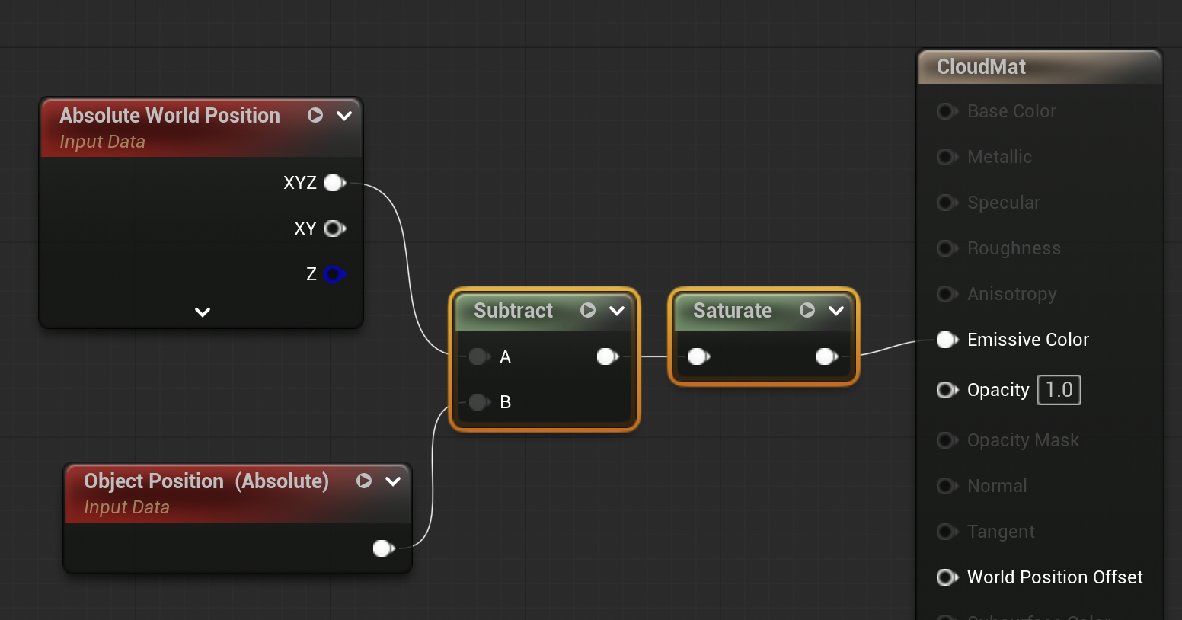
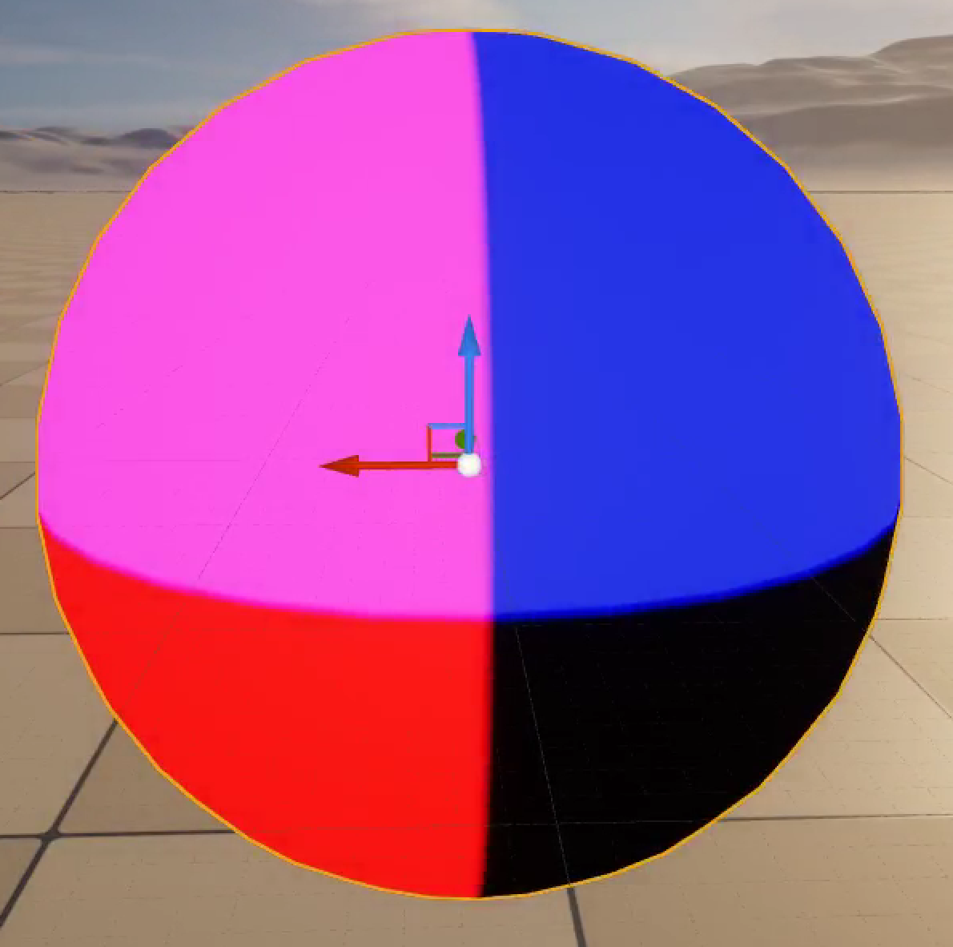
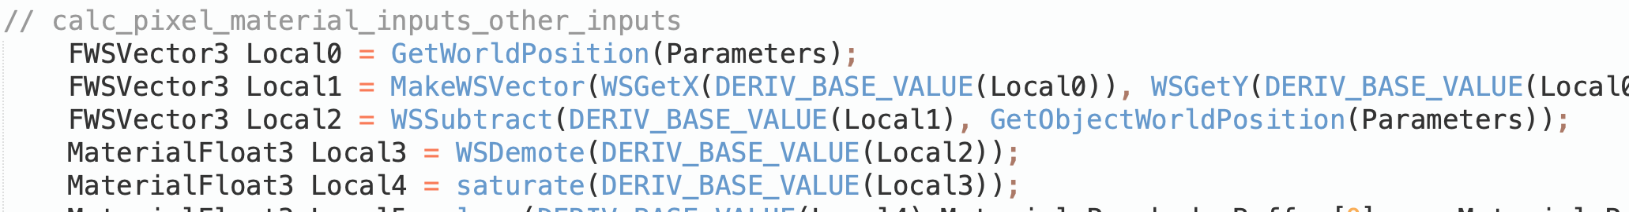
Locking to the Object
We can fix this by finding the position relative to the object position
Subtracting the AbsoluteWorldPosition from the Object Position gives position relative to the center of the sphere, which locks the shader to the object no matter how you move it.

Slide 14
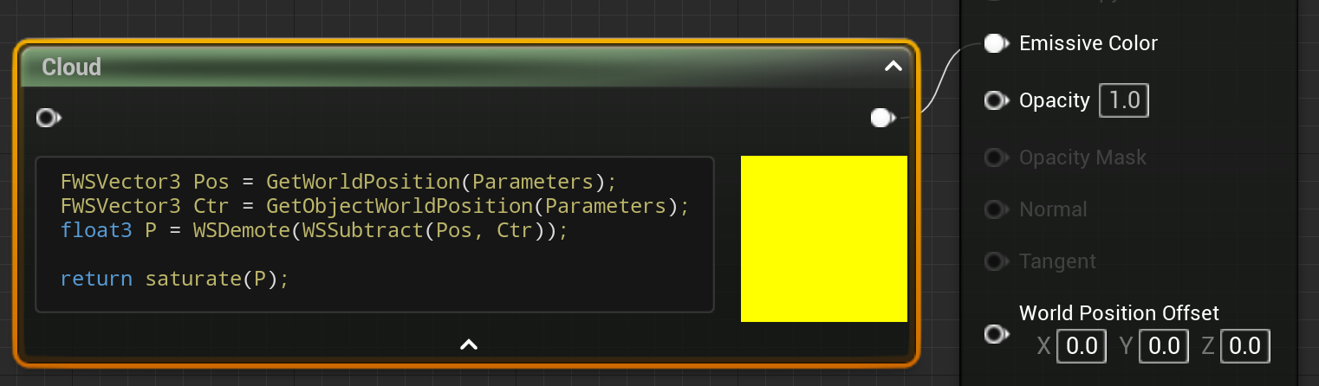
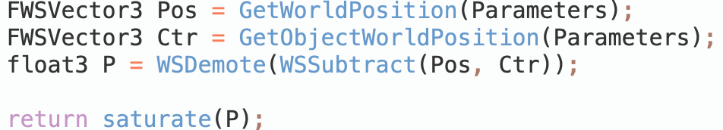
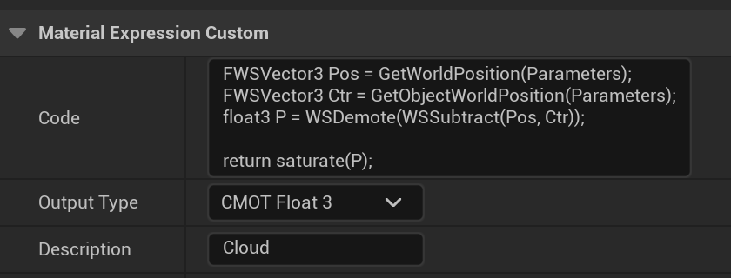
Custom Node
The Custom node lets you add short sections of HLSL code to a material
You can give it a name by changing the Description field
It is easiest to edit in an external editor then paste into the Code block.

Slide 15

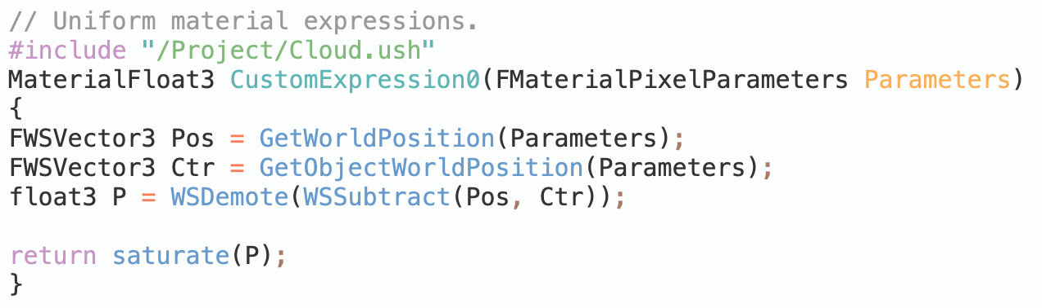
Getting Shader Code from a File
Create a new shader file:
  assn1/Shaders/Cloud.ush
  Put at least a space or comment in it (UE5 doesn’t like empty files)
Quit and restart your project
  Unreal converts /Project to your project/Shaders directory if that directory exists on launch
Add in the “Include File Paths” for the Custom Node

Slide 16
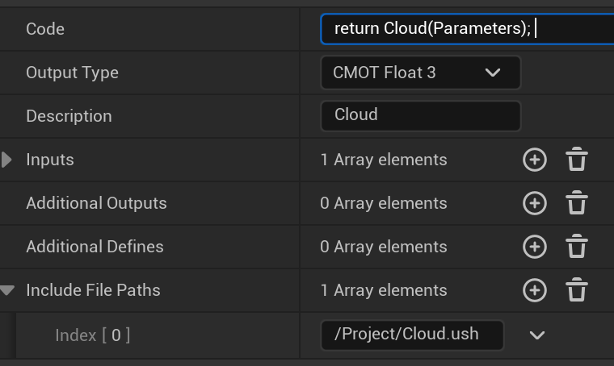
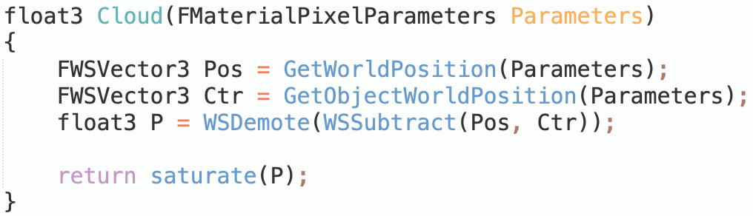
Move custom code to Cloud.ush
Custom node
Cloud.ush

Slide 17
Forcing a Shader Compile
UE5 won’t notice if the shader file changes if the custom node code is the same
Move the node, then hit Apply, or add a comment with a number so it knows something has changed.

Slide 18
Computing Cloud Density

Slide 19
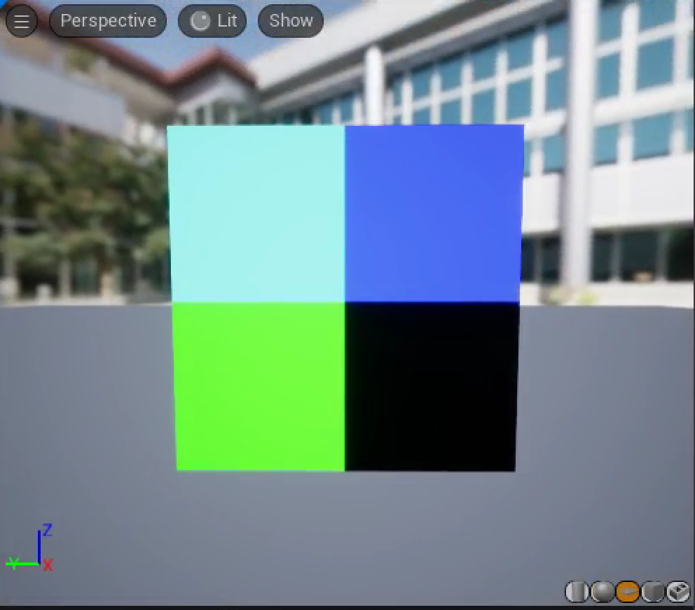
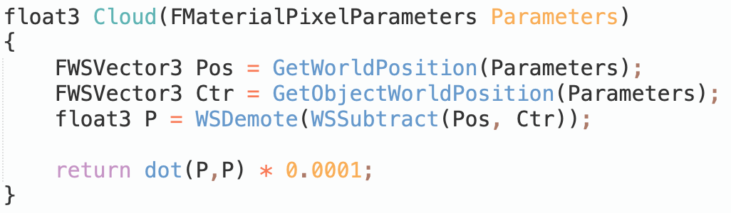
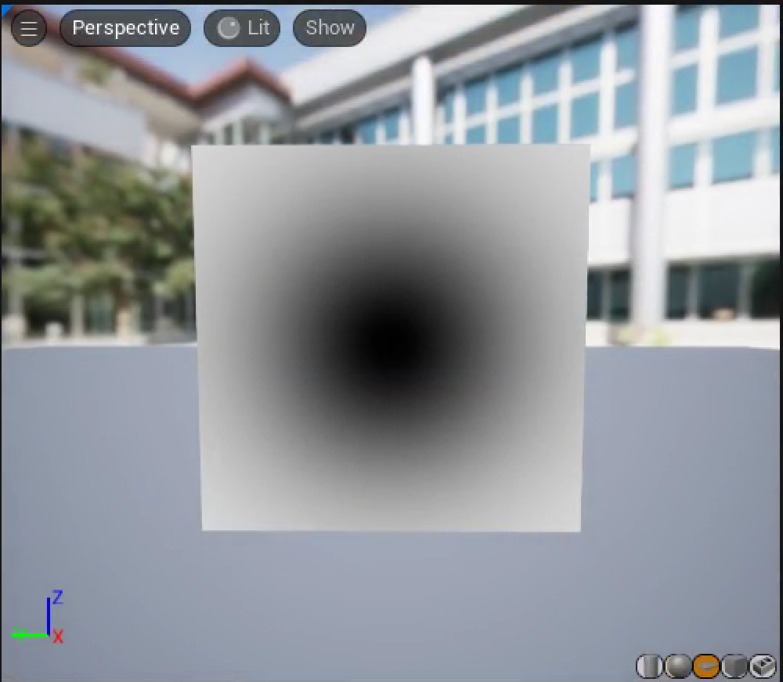
Radial Mask
Switch to a square as the preview object to see what’s happening inside the sphere
It’s invisible from the back, so you might need to spin the view around.
The dot product, P•P, gives the squared distance of each pixel from the object center.
Since the size of P is large, we can try a few scale factors until we find one that’ll show how the dot product changes over the surface.

Slide 20
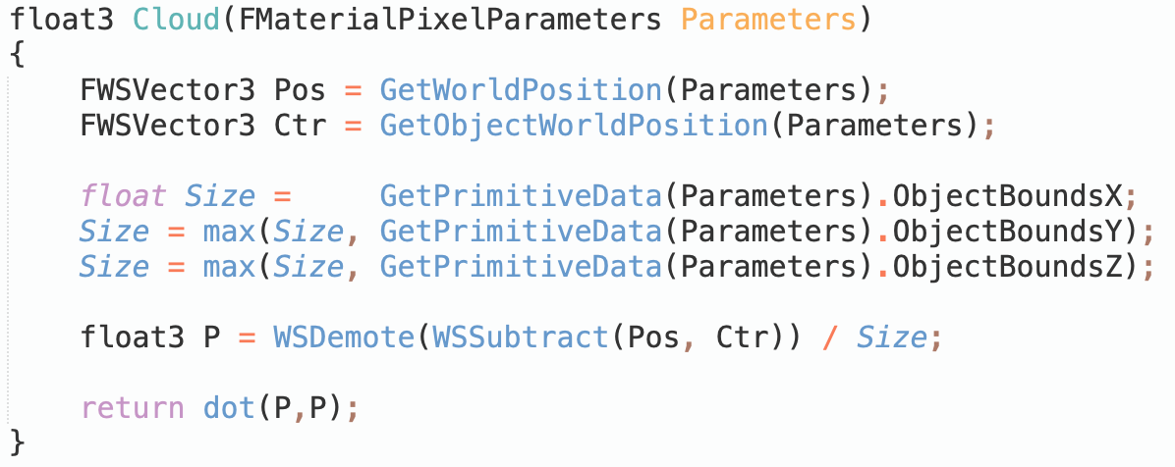
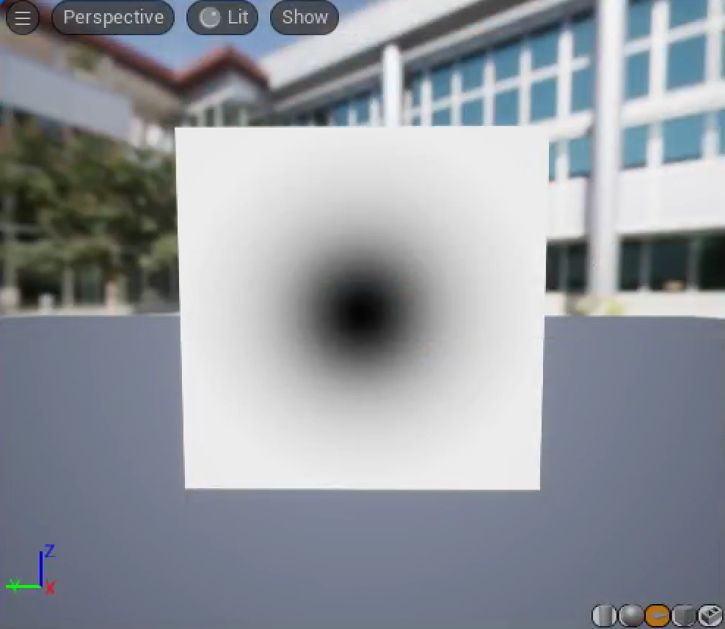

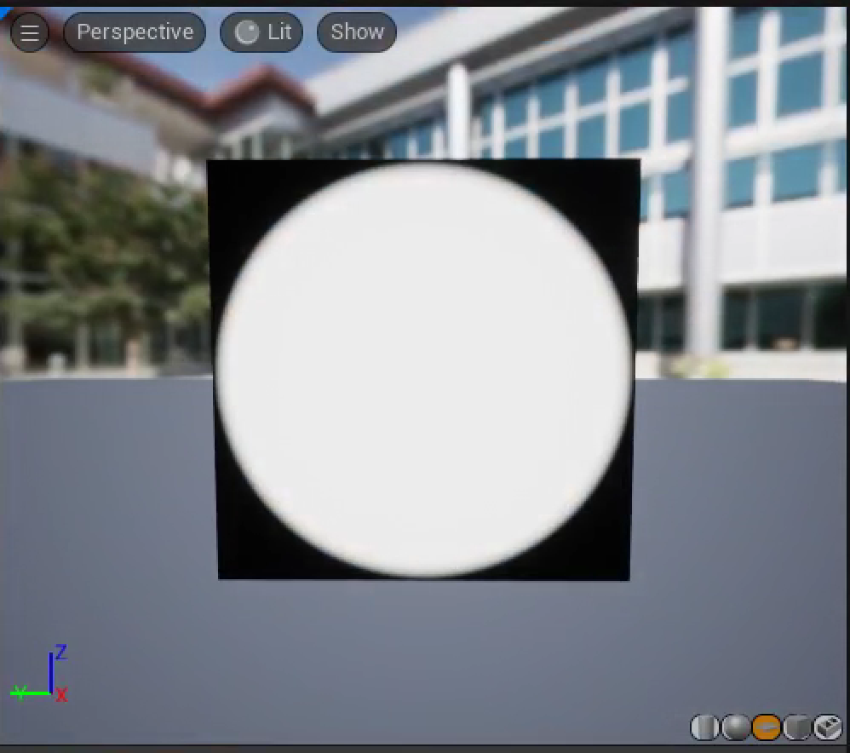
Scale by Object Size
Instead of choosing an ad hoc scale, we can check how ObjectBounds gets its result.
We can then turn that into a smooth-edged mask with the smoothstep shader function

Slide 21
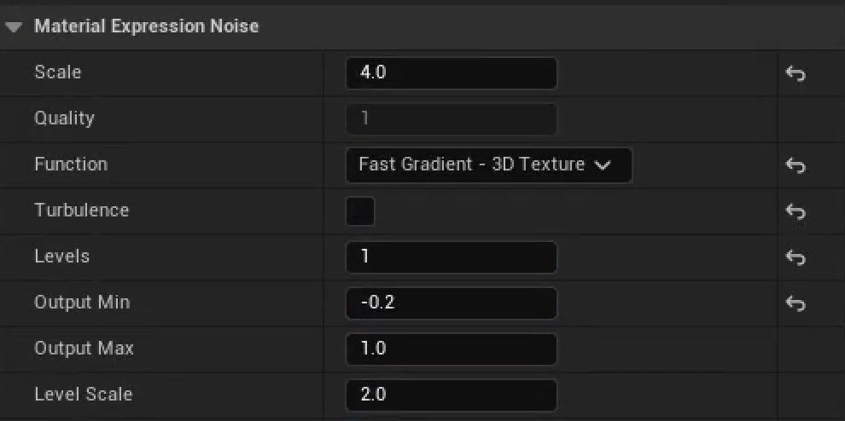
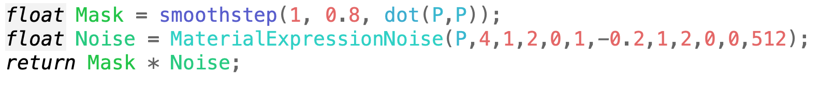
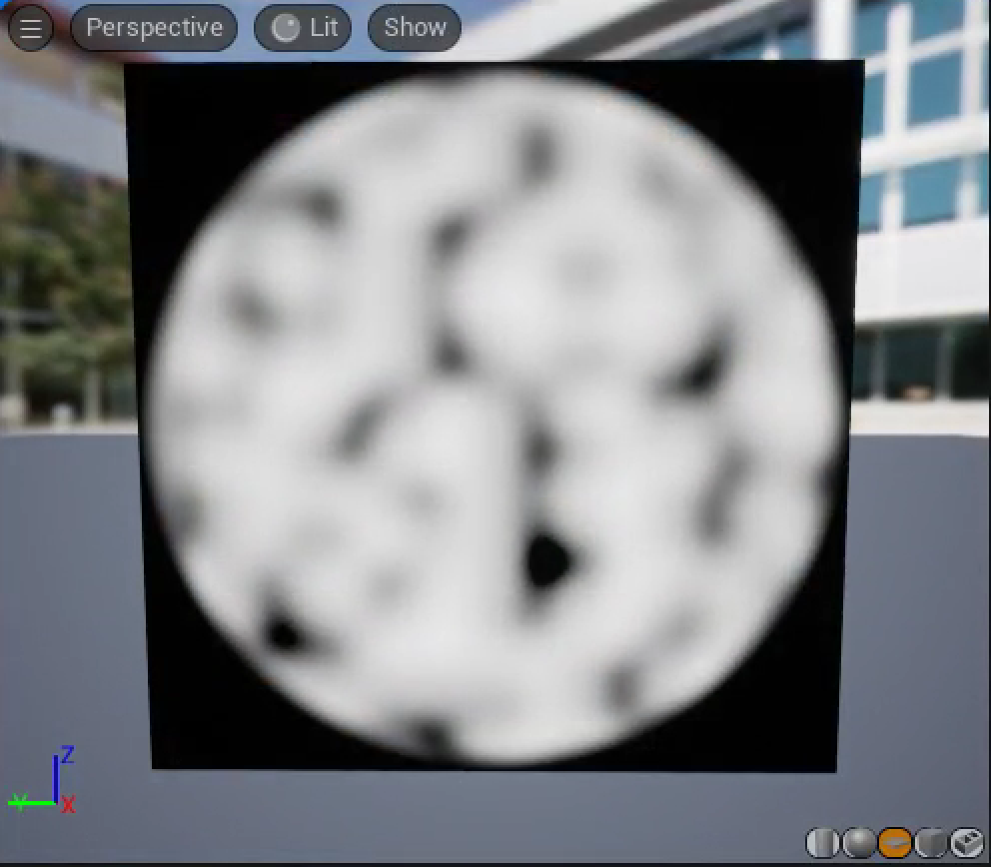
Cloud Base
The basic structure of our clouds will be built using a Noise function.
Noise has a bunch of obscure parameters, so it’s reasonable to start by tweaking some of them in the Material node, then looking at the corresponding code to include in the shader.

Slide 22
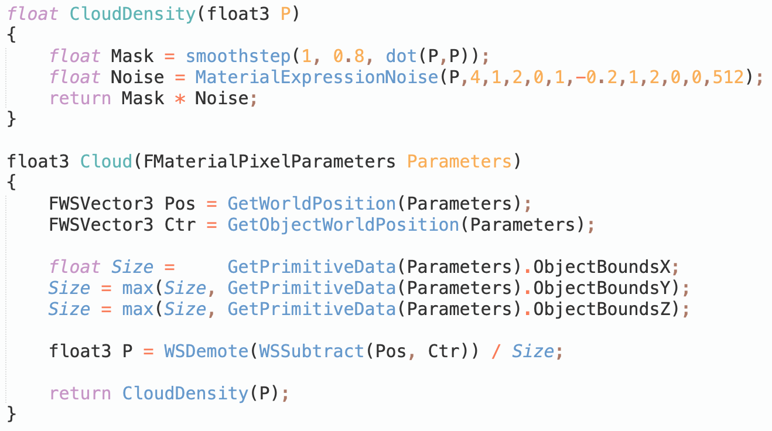
Moving to a Function
We’ll want to compute this cloud density many times in the shader, so it’d be convenient to have it in its own function.

Slide 23
Ray Marching

Slide 24
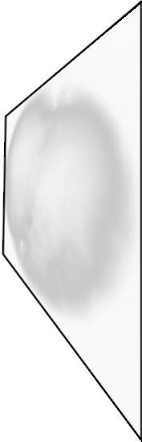
Ray Marching
To create a volumetric shader, we will use a technique called ray marching.
The shader runs on a surface. Ray marching takes steps through a volume imagined to be behind that surface.

Slide 25
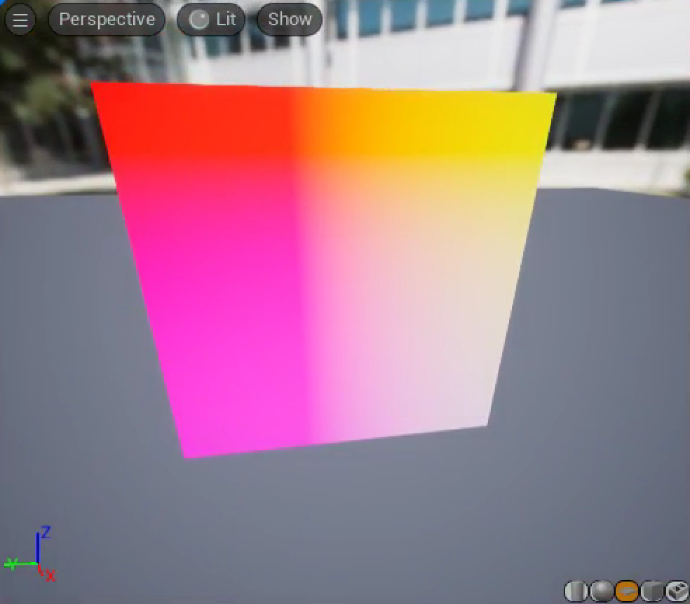
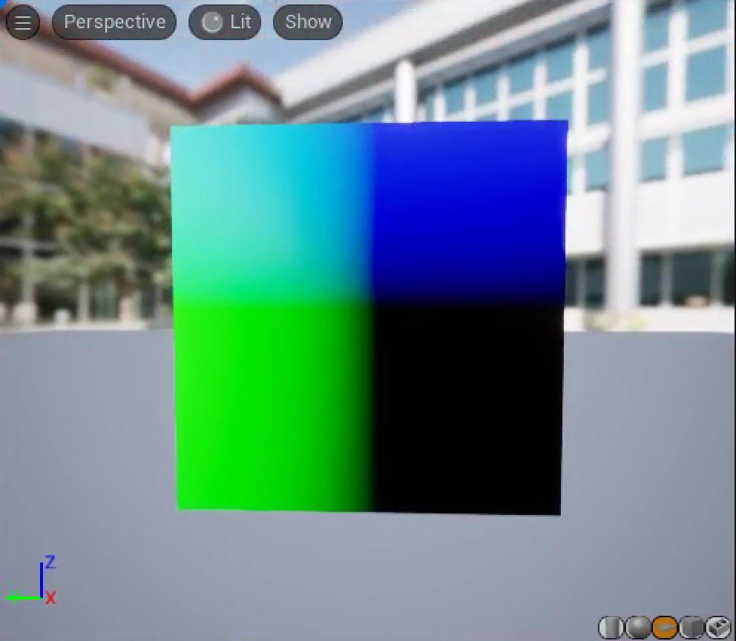
Direction to March
The first thing we need is the direction from the camera to the pixel. This is the direction to march.
From looking at the code generated by the CameraVector node, we know there’s a Parameters.CameraVector.
Comparing the color to the axes, it is mostly red, implying that the CameraVector appears to be pointing toward the camera.
–Parameters.CameraVector looks like what we need.

Slide 26
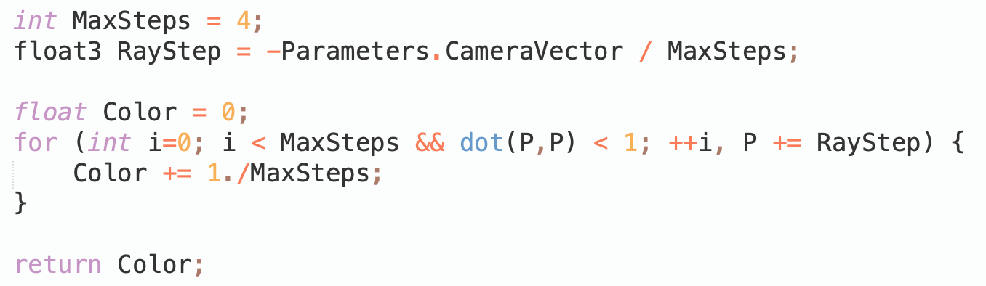
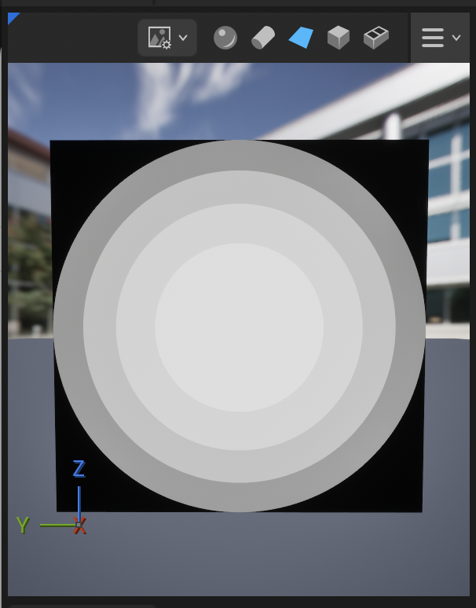
Basic March
Starting on the surface of the square, we’ll march into the hemisphere behind it until the marching point is outside the sphere’s radius.
The color just shows how many steps it took before the marching point was outside the sphere.

Slide 27
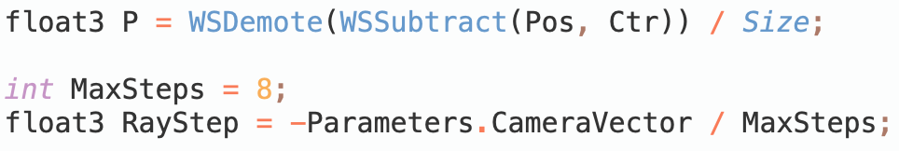
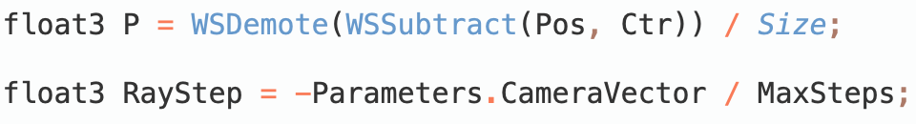
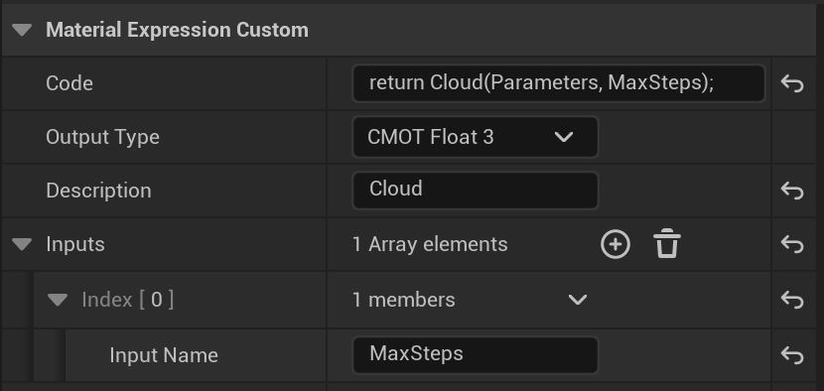
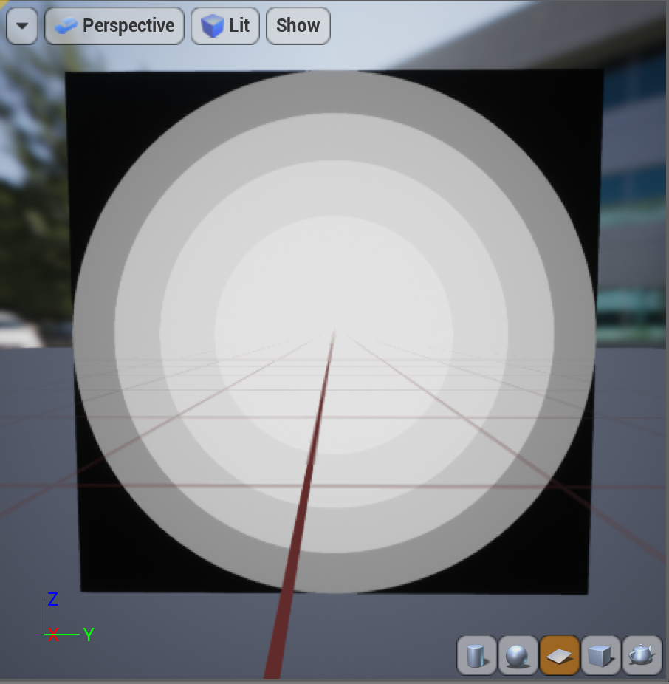
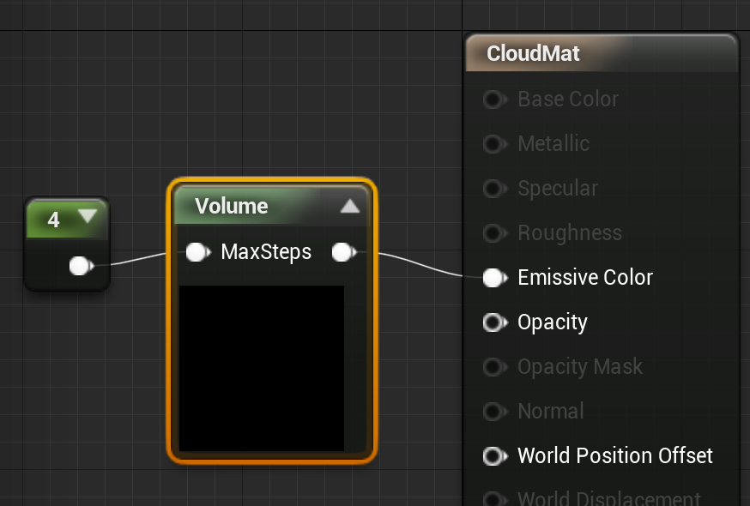
Shader Parameter
…
The value defining how many steps to take appears several places in the shader and may need to be adjusted for performance
Remove it from the shader and add it as a parameter to the Custom node to make it easier to change.

Slide 28
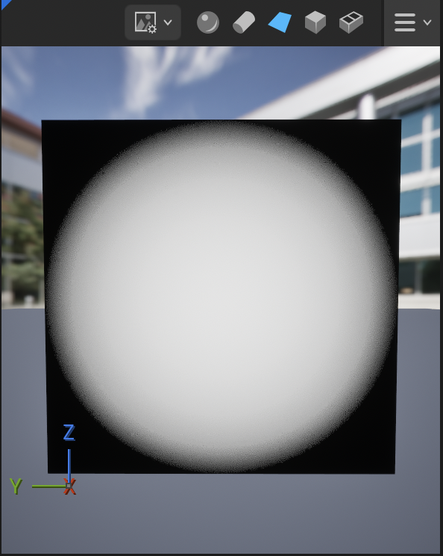
Removing Step Artifacts
There are bad stepping artifacts because many nearby rays all travel floor(distance) .
Temporal anti-aliasing blends across frames and can smooth the randomness out, but needs a different offset at every pixel, changing every frame.
We’re going to randomize the first step, with a different random factor each frame. See the ScalarBlueNoise node.

Slide 29
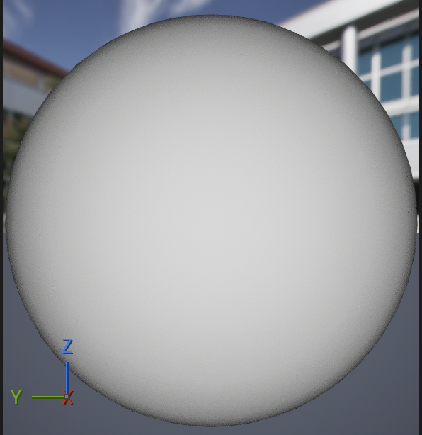
Back to a Sphere
The step size is scaled to go up to one unit distance in the maximum number of steps allowed.
That’s enough to get from the middle of the sphere to the back, but not to get from the front to the back.
A unit sphere has a diameter of 2, so the step sizes need to be twice as big to make sure we can make it all the way through.

Slide 30
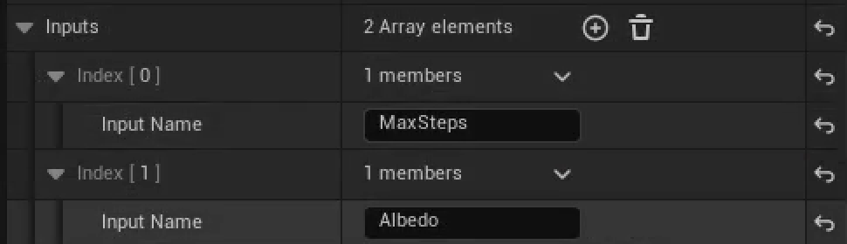
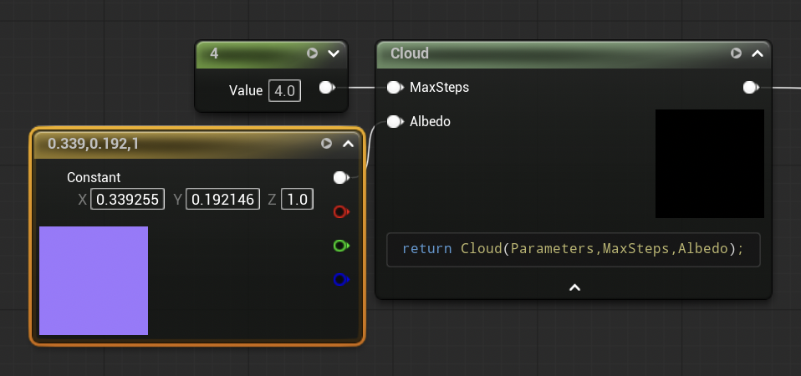


Marching Cloud Density
To account for the cloud density, we need to accumulate the color and opacity with each step. We’ll augment the Color variable with a fourth alpha component to track that opacity, and use that to tell how much of the local color we can see at each step through all of the cloud we’ve marched so far.
We also may want to define a color for our cloud, as an additional parameter.
We can use the CloudDensity function added to Cloud.ush to compute the actual density.

Slide 31


Cloud Opacity
Of course, the cloud doesn’t look very cloudlike with the dark border. We’re computing the opacity as we go, so it’s in Color.a at the end of the march, but we’re not using it.
We’ll need to change the Custom node to return all four components of the final color.
Then we’ll need to extract the alpha component using a Component Mask node.

Slide 32

Shadows
We’ll approximate shadowing at each step by tracing a ray from each step in the volume toward the light source and seeing how far until it exits the sphere.
Include a saturate so we’re all shadow once it’s gone too far, and subtract from 1 so it’s bright closest to the light and dark farthest from it.

Slide 33
Extensions

Slide 34
Step-Independent Extinction
We’ve been using Opacity,
Can also represent this with Extinction,
These are related by , for distance .
  For one unit of volume, , or
  doesn’t scale linearly with step size, but does.
  Scaling by a step size of .
  Often approximate as
If you change MaxSteps, the overall volume opacity will change as well.
That’s because we assume the same amount of light attenuation no matter how big the step is, but a thicker slab of translucent Material should block more light.
The UE5 built-in Volumetric Fog reformulates the ray march in terms of extinction instead of opacity in part to make the run-time step size adjustment cheaper.

Slide 35

Baked Densities
Densities are expensive to compute every step O(MaxSteps²), including the shadow steps. If you precompute them into a Texture, it’s just a lookup or two per step.
The engine supports 3D Textures, but you’d need C++ code to generate them.
You can also decompose a 3D Texture into a grid of 2D slices packed into a 2D Texture. There’s a function, PseudoVolumeTexture in Common.ush, designed to access a Texture built this way.

Slide 36

Embedded Objects
Opaque objects are drawn before any transparent objects. You can look in the depth buffer to tell when the marched ray would hit an embedded object and stop the march early.

Slide 37

Flow
This GLSL shader demonstrates a way to get an appearance of a smooth flow in 2D, given a flow map of flow directions. The same method works in 3D. Adapt this to HLSL and volumes to make an animated cloud.

