Slide 1
Development Environment
Getting Set Up for Engine Development

Slide 2
Accounts

Slide 3

GitHub account
Create a GitHub account if you don’t already have one.
Send me your git username so I can give you access to the class repository (see assn0 directions)

Slide 4

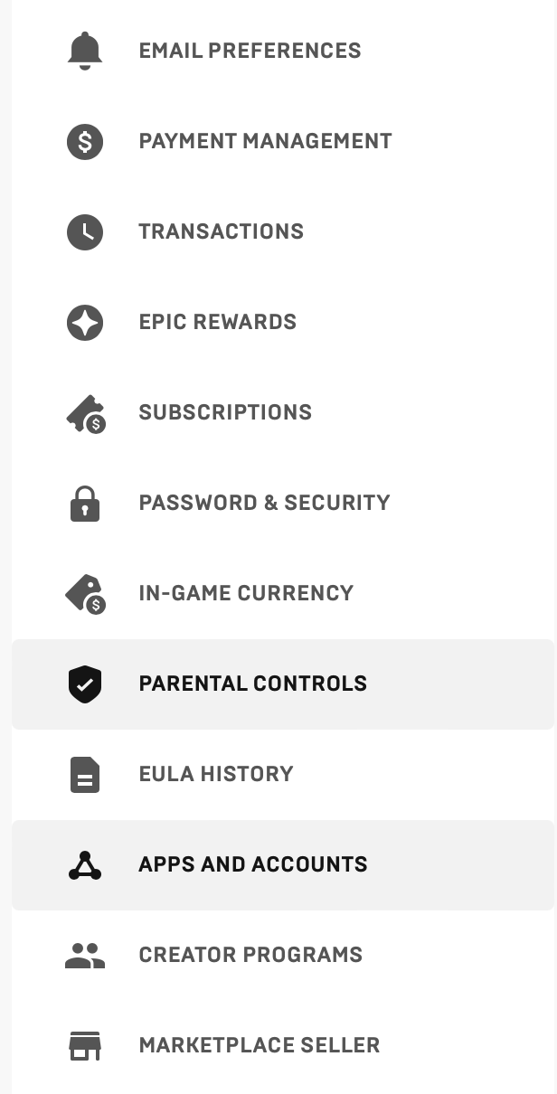
Unreal Account
Create an Unreal Engine account if you do not already have one, and link your GitHub account to your Unreal Engine profile.

Slide 5
Hardware

Slide 6
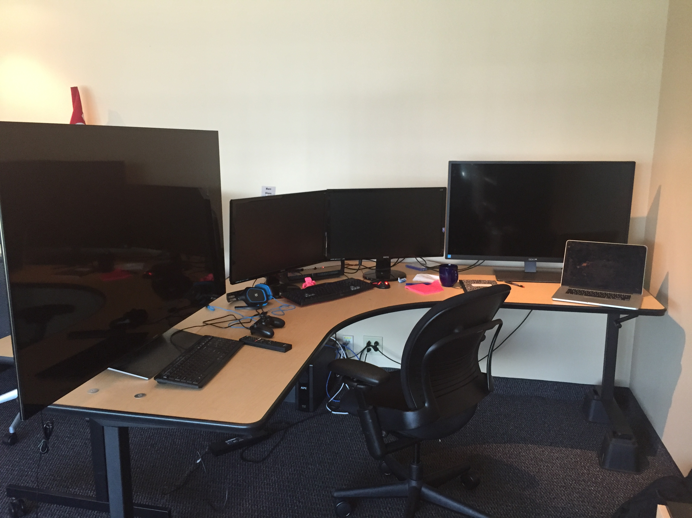
Hardware
“Hardware and Software Specifications” from docs.unrealengine.com
Also the Recommended Hardware page on the Unreal Community wiki
The biggest concern when doing UE5 software development, as opposed to using the pre-built Editor, is the engine build times.
Most of the time, you can use a shorter incremental compile, but a full compile from scratch on a 4-core PC can take several hours.

Slide 7
Disk
Even if you have already invested in a computer and cannot customize it for UE5, you can still get a lot out of a fast disk drive
It is possible to do UE5 development on a 256 GB USB, but you won’t enjoy it. A hard drive is faster, and an SSD is even better.
If you do not have an SSD drive with at least 256 GB of free space, you can get an external one for half the cost of most textbooks.
Most external drives are initially formatted as FAT or EXFAT format. This will not work with UE5, so you’ll need to reformat to NTFS (for Windows) or HFS+ (for Mac)
Disk
Cores
Memory

Slide 8
Memory
If you do not have enough memory, it is possible to add more to most computers or laptops, and certainly worth it.
Current UE5 specs recommend at least 8 GB on a 4 core PC, but also mention that adding more cores can improve build time. Scale your memory with the number of cores: at least 2-4 GB per core.
Disk
Cores
Memory

Slide 9
Cores
If you are buying a new system for UE5 development, more cores can definitely help. UE5 will use them for a build, so twice as many cores result in a build that’s almost twice as fast. A 32 core processor can trim your several hour full-build time down to under 25 minutes.
Disk
Cores
Memory

Slide 10
UMBC Computing Options
Home Windows (W)
  + Dedicated: can leave long builds running
  + Potential to upgrade
  + Well supported by UE5
  – Limited by your hardware
Home Mac (M)
  + Dedicated: can leave long builds running
  – Not as well supported as Windows
Lab Computer (L)
  + 4-core 3.4 GHz
  – Only 9 available
  – Cannot change configuration or install
  – Must provide external SSD
Amazon (A)
  + Totally configurable
  + Scalable
  – Costs can mount quickly!
In order of what I would recommend
Your own Windows (W) or Mac (M) computer, if capable
A lab computer (L)
Remote access to an Amazon instance (A)
Requirements in the following slides will be marked with one or more of W, M, L, or A.

Slide 11
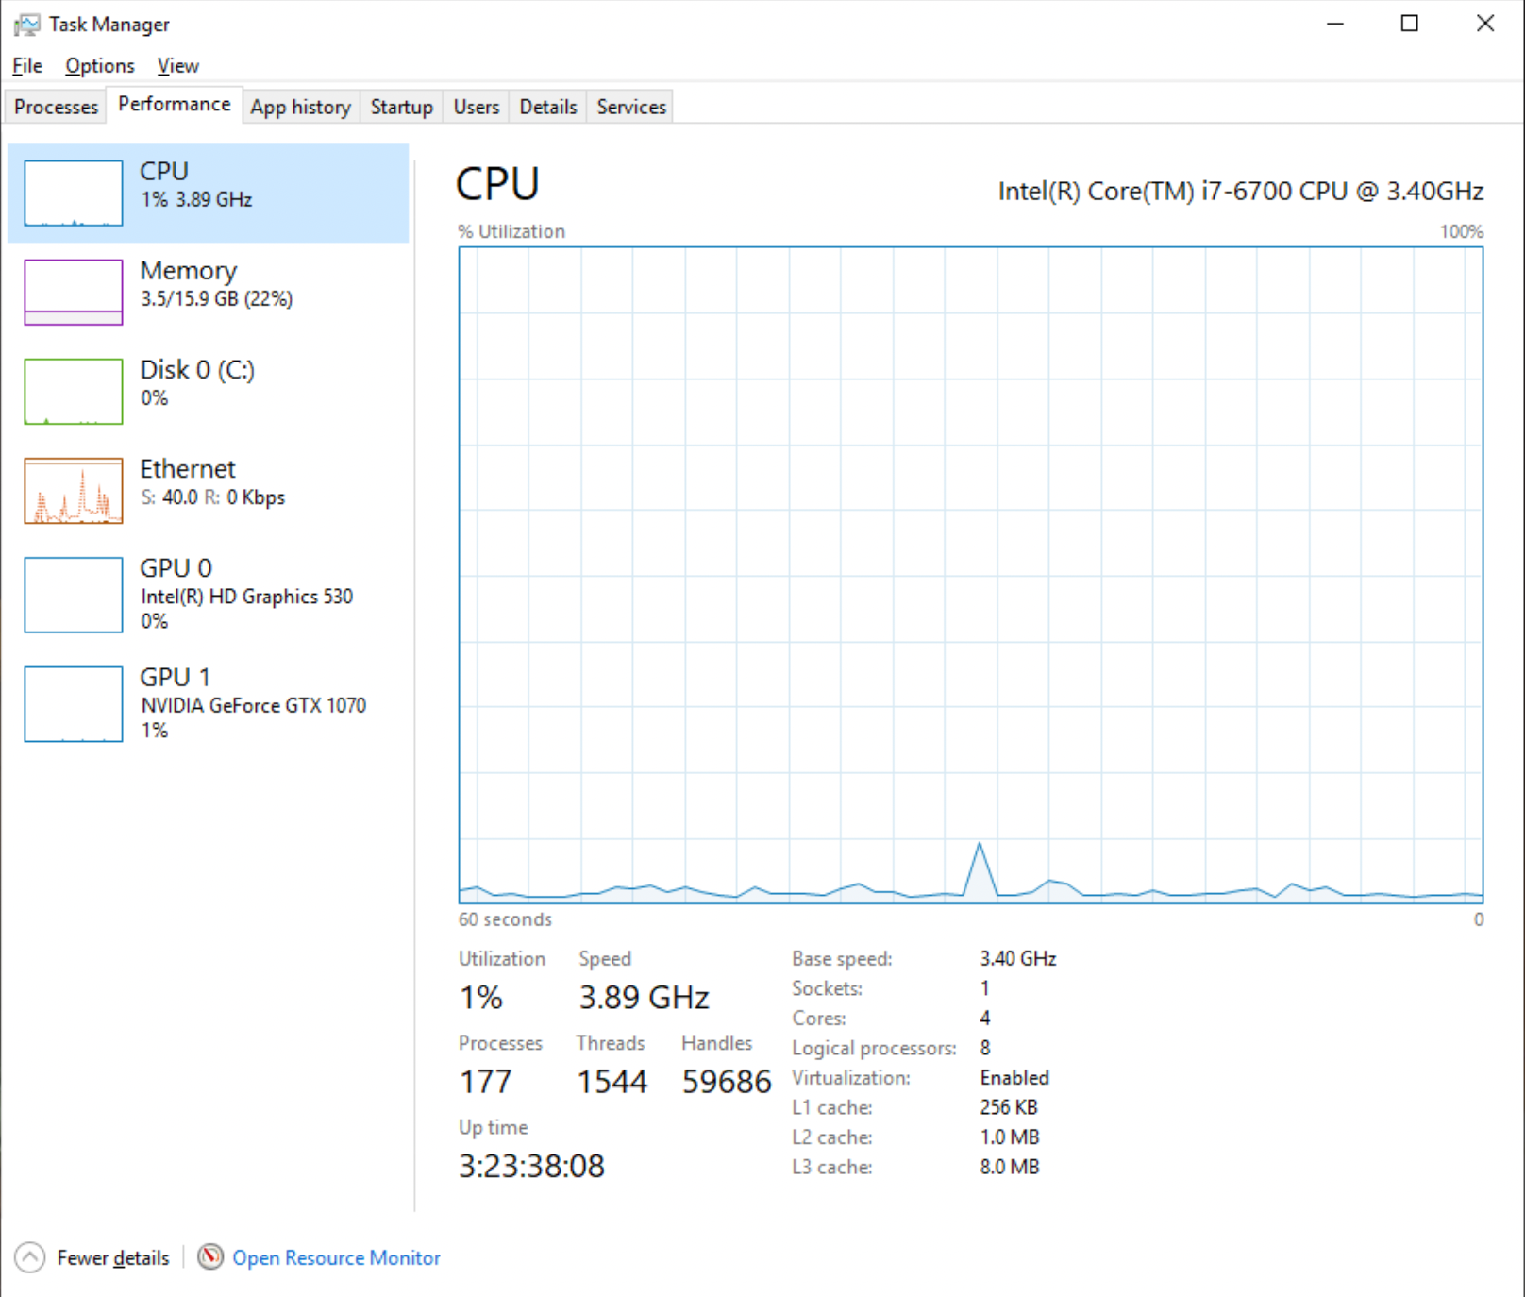
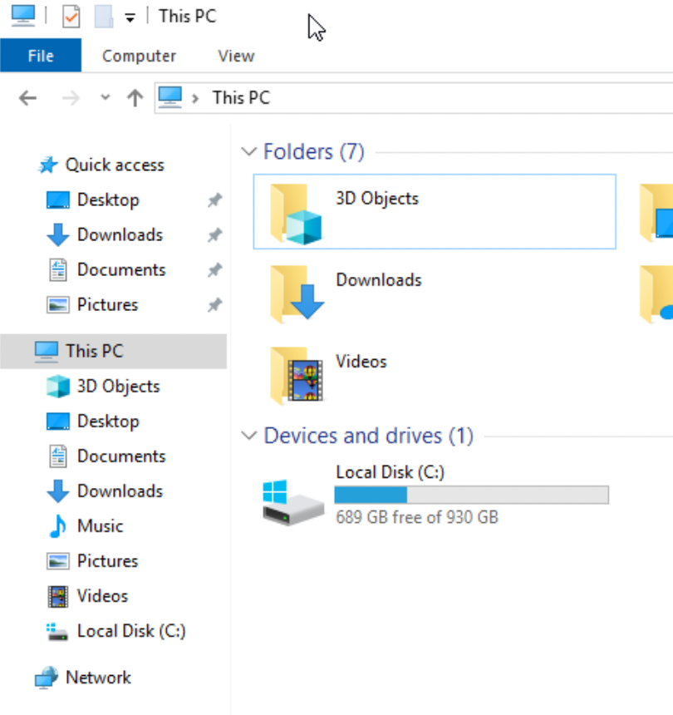
Home Windows (W)
Check system stats
CPU and Memory: Check Task Manager / Performance Tab
Disk: Check “This PC” in File Explorer
Consider adding memory or external SSD if necessary
Reformat SSD as NTFS

Slide 12
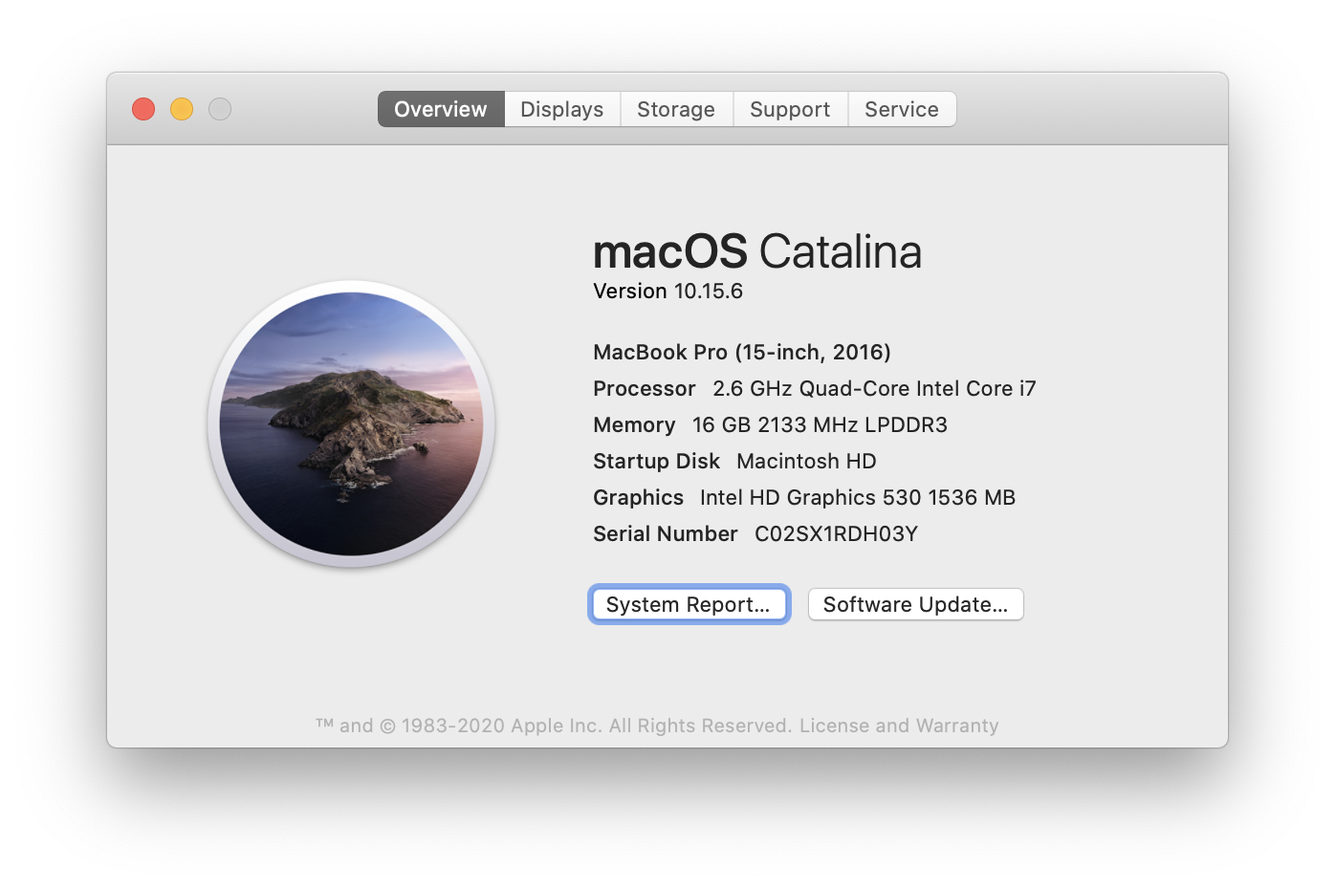
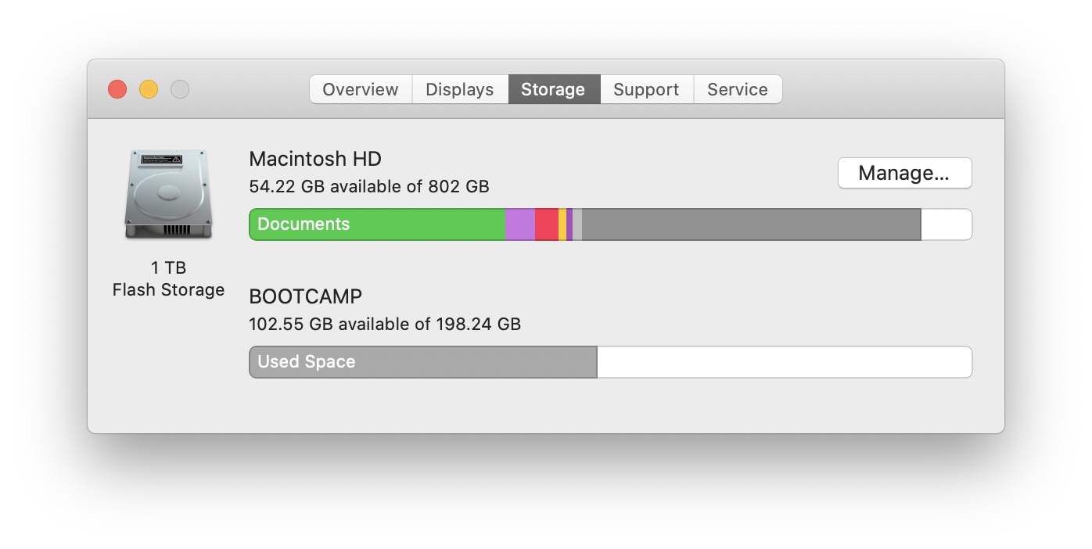
Home Mac (M)
Check system stats
Apple menu > About This Mac
Consider getting an external SSD if necessary
Reformat SSD as HFS+

Slide 13
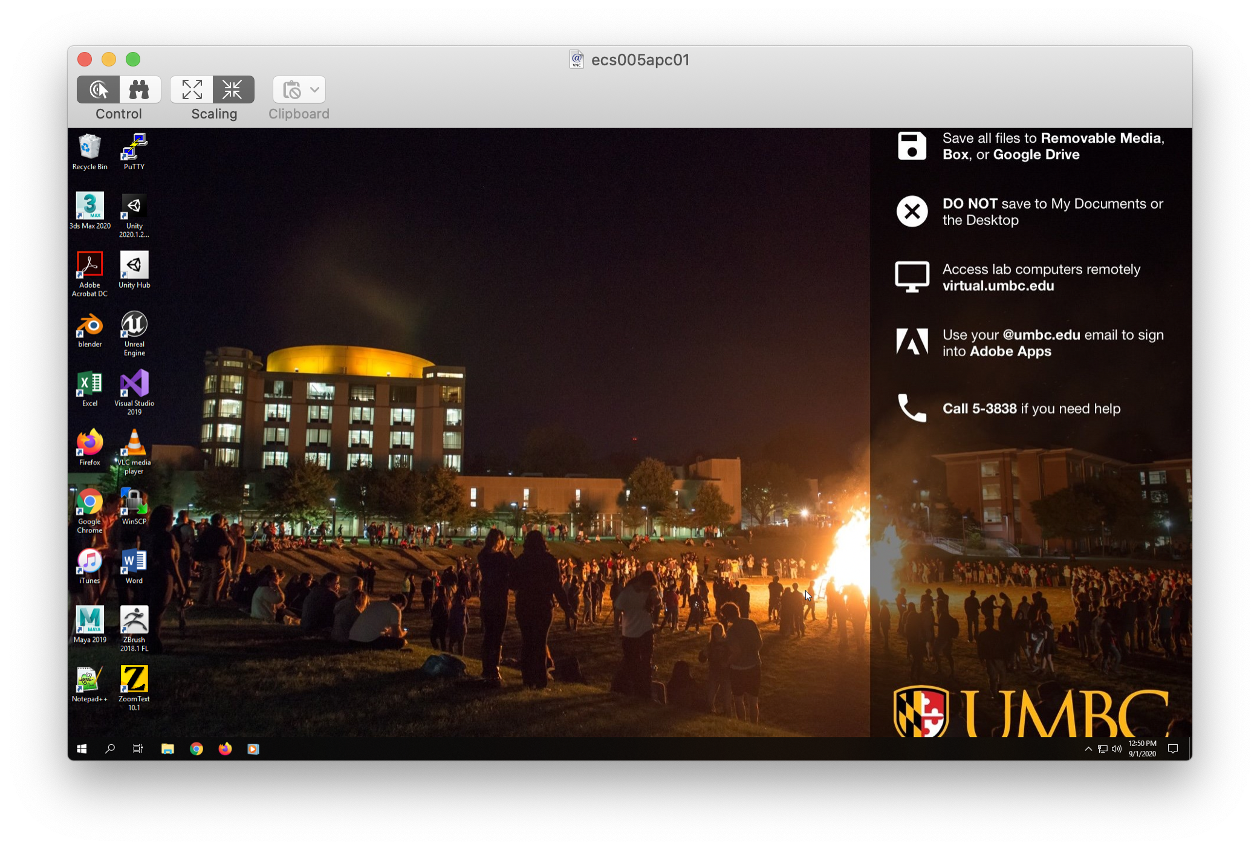
Lab Computer (L)
Get external SSD
Can store on local disk, but erased on reboot
Easier to switch computers
Shared lab
Game developers club, graphics class, other students.

Slide 14
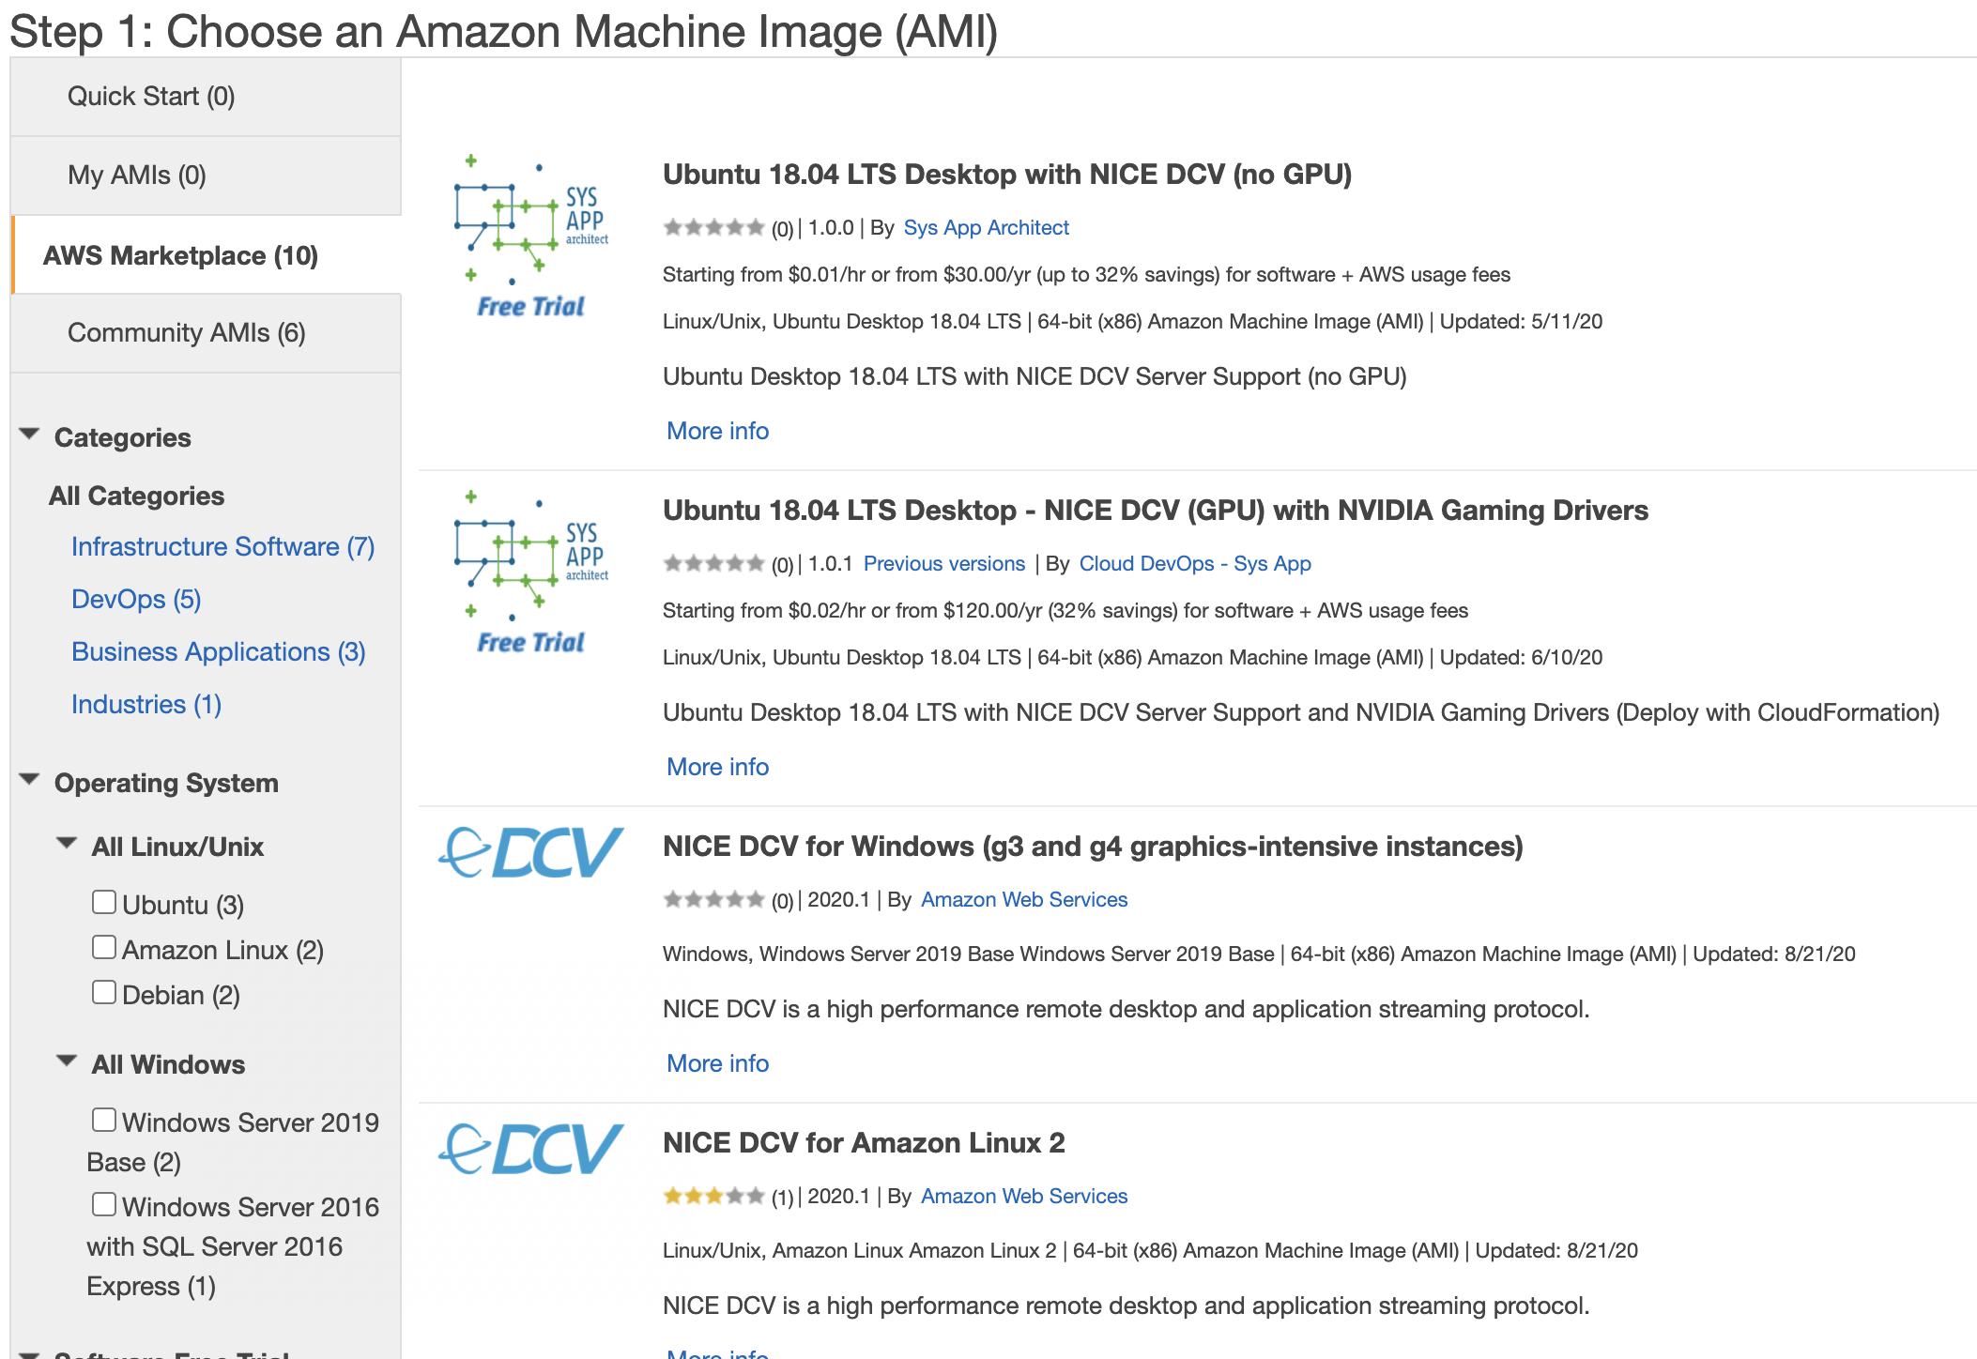
AWS EC2 Instance (A)
Create an AWS account
Download NICE DCV client
Default RDP doesn’t work well for graphics
Create an EC2 Instance
Use the Windows NICE DCV template from the Amazon Marketplace
Choose a GPU instance with at least 4 cores (e.g. g4dn.xlarge or g4ad.xlarge)
Configure Instance Details
  Add Terminate Protection (Terminate deletes your instance and its drive)
  Increase the Root SSD size to 350+ GB
  Ignore “you won’t be able to connect” message on the Security Group page

Slide 15
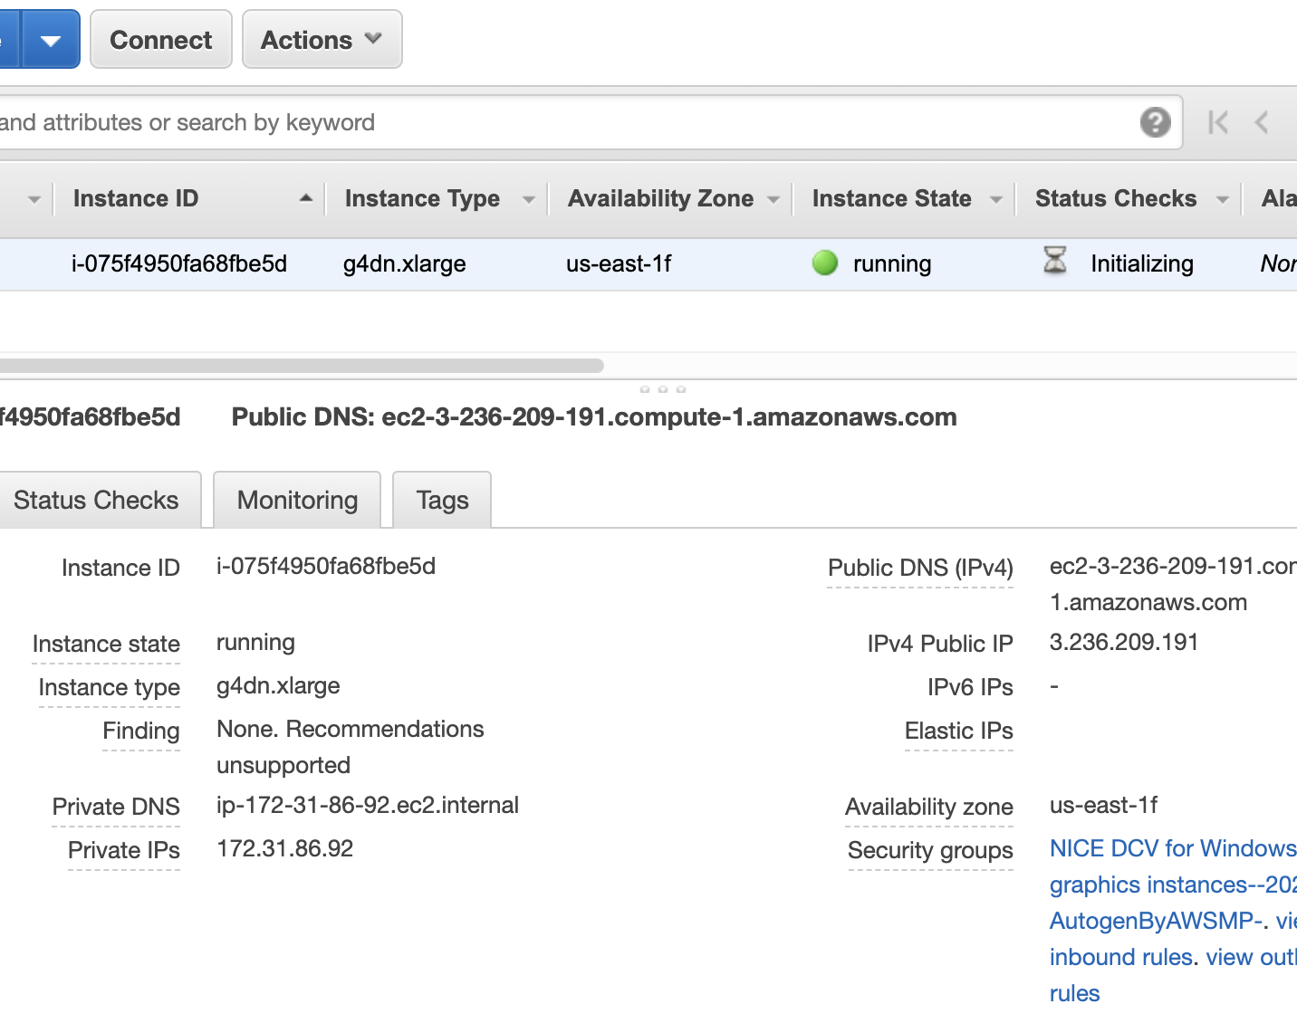
AWS Setup (A)
Launch & create and save a key pair
  Wait for instance state to show green
Connect with NICE DCV Client
  IP address from AWS console
  Username: Administrator
  Password from Actions > Get Windows Password (need your key from before)
Configure IE to allow downloading
  IE Settings > Internet Options > Security > Internet > Custom Level:
  Enable File Downloads and Active Scripting
ALWAYS STOP YOUR INSTANCE WHEN DONE!!!!!
  Running instances cost $$$

Slide 16
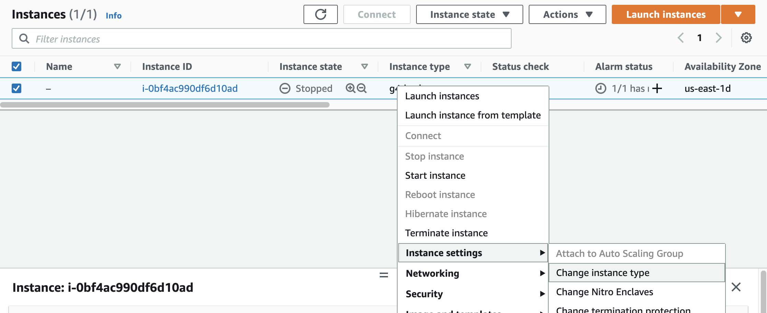
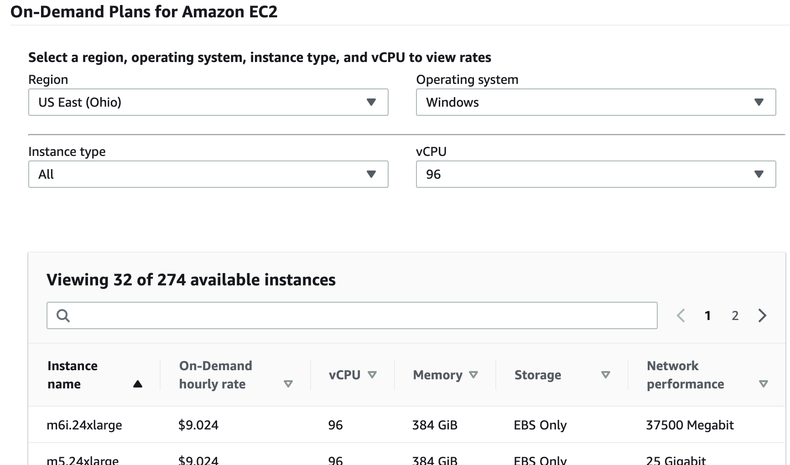
Switch Instance Type (A)
One advantage of using AWS is the ability to temporarily change from one instance type to another for configuration or price.
  Can only change when instance is stopped.
  Instances charge by the second, but consider shutdown/startup time when changing.
  Install virtual display driver for non-GPU
Examples (including pricing as of this writing)
  System setup (2 cores, 4 GiB)
    t3.medium — $0.06/hr
  Initial build & first launch (64 cores, 256 GiB)
    g4ad.16xlarge — $6.41/hr
  Normal work (4 cores, 16 GiB)
    g4ad.xlarge (AMD) — $0.56/hr
    g4dn.xlarge (NVIDIA) — $0.71/hr

Slide 17
Software

Slide 18
Critical Software
Git
Version Control Software (WMLA)
IDE
Integrated Development Environment
C++ Build and Debugging Tools
Visual Studio Community 2022 (WLA)
Xcode (M)

Slide 19
Version Control
A Version Control System (VCS) keeps track of every version of every file in a project.
  In this context, a version is just a set of changes to the files that you want to track. There are usually thousands of VCS versions before any new release.
  The Repository is a database of all the files and versions.
  You want to track source files and art assets, but not data that is automatically generated from them (like object files or executables). An Ignore File tells the VCS which files, types of files, or
  directories to ignore.

Slide 20
Version Control
A Checkin or Commit is the set of files that constitute the changes for a new version. For projects with multiple contributors, you want each version you commit to at least run. Each commit includes a brief description of what changed.
If multiple people are working on a project, you may need to merge your changes with ones they’ve already committed. The VCS can automatically handle non-overlapping changes in text and source files. If it can’t, you have a conflict that must be manually resolved.
Small projects sometimes have a policy of frequent commits to make merging easier. This causes many near-simultaneous commits in a large project, leading to a policy of rare big commits, or committing often in a private branch, with occasional merging to the master or trunk branch.

Slide 21
Distributed VCS
Some version control systems like Perforce or Subversion use a single central repository. When you checkout a version, your local copy has just that version of each file.
In contrast, Git is a distributed VCS. You clone a copy of the entire history to your local computer. Changes recorded in your local repository exist only there until you fetch and merge with any concurrent changes in the central repository, then push your merged changes back.

Slide 22
Git vs GitHub
Note that git is a version control system, while GitHub is a site that hosts git repositories. Github introduces the concept of a fork, which is a clone of a repository with both clones on GitHub, where GitHub knows the two repositories are related.
Github also includes a web interface for a limited number of git commands directly on the central hosted repository. Mostly, we will be ignoring these and doing git operations directly to the local clone of the repository, then pushing those changes back to the central repository on GitHub.

Slide 23
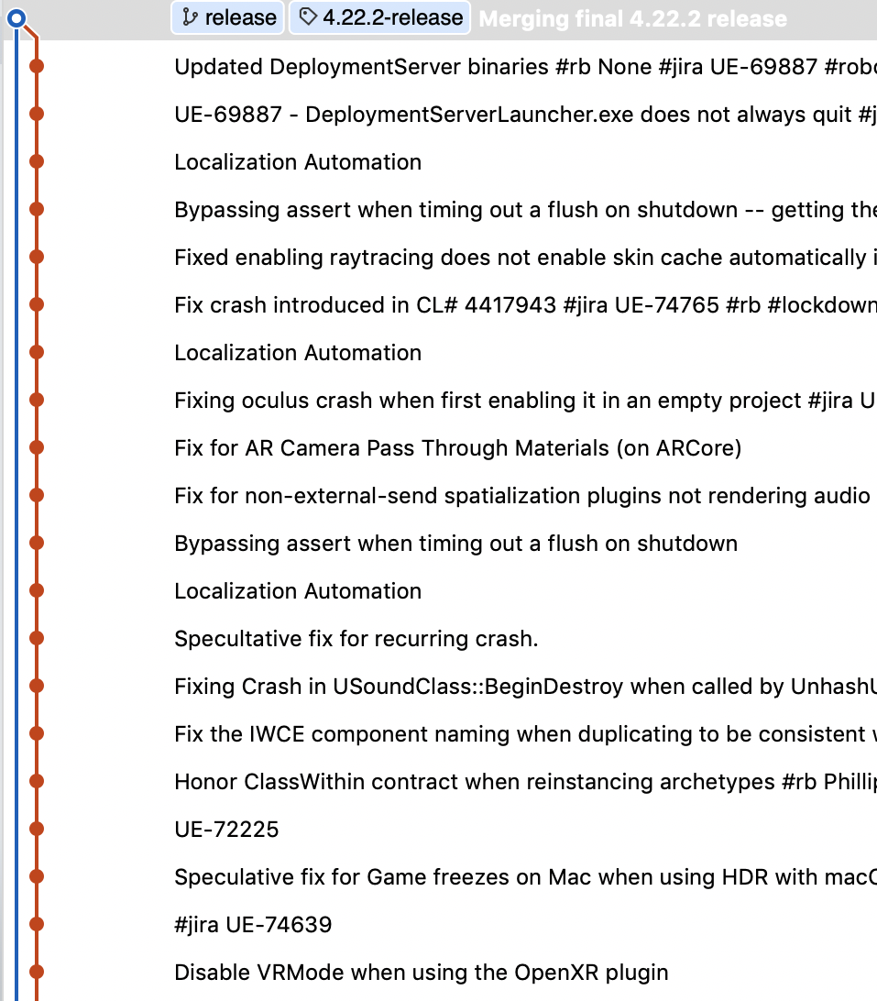
Git version control
Version control software keeps track of the history of changes made in a code project, For UE5 this is every change, thousands per version, back to when it was put on GitHub in 2014.
This is how UE5 software is distributed, so you will need the Git software to be able to get the source code and commit your own changes
On Windows, you can download the command-line git tools from git-scm.com (WA). On Mac and the lab computers, the command-line interface comes pre-installed (ML).
You might choose to also get a visual GUI like SourceTree, but this is not necessary.

Slide 24
Git Basics
git pull
git status
git add
Gets the latest changes from GitHub and attempts to merge them with your own changes. Conflicts (changes in binary files or in the same lines of code) may require you to assist with the merge by choosing which binary file to keep or editing the merged code.
git commit
git push
Tells you what files have changed, and what is ready to be committed.
Adds files to the list to include in the next commit. You use git add to add any change to the next commit (whether that change adds, changes, or removes files).
Checks in a new version to your local git repository. Only commits changes from git add.
Sends your local changes to the online repository at GitHub. Only works if
you have done a git pull, resolved any conflicts, and are up to date.
git fetch
Gets the latest changes from GitHub like git pull, but doesn't attempt to merge them with your changes yet.
git merge
Manual control over merging. git pull just does a streamlined fetch then merge.
git tag
Mark a version as a release.
There are plenty of online resources for doing anything complicated in git. For basic use, you need to know just six commands.

Slide 25
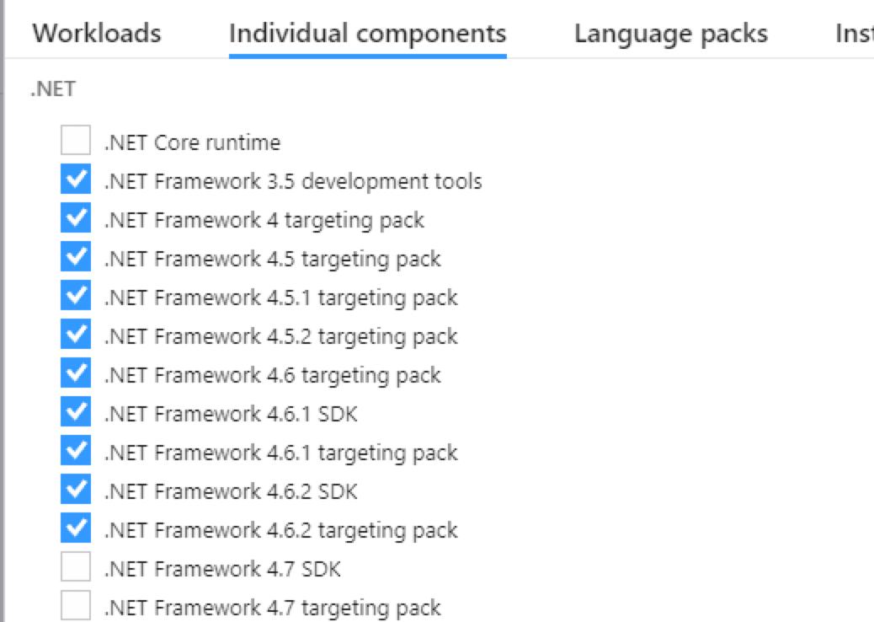
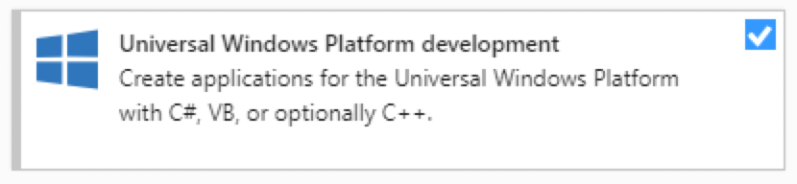
IDE & C++ Tools
On Windows, you’ll need Visual Studio (WA).
Be sure to configure it for the .NET desktop development, Desktop development with C++, Game Development with C++, and Universal Windows Platform Development workloads.
You’ll also need to add the 4.6.2 version of .NET as an individual component, since that version isn’t included in the basic .NET workload.
On Mac, you’ll need Xcode (M).

Slide 26
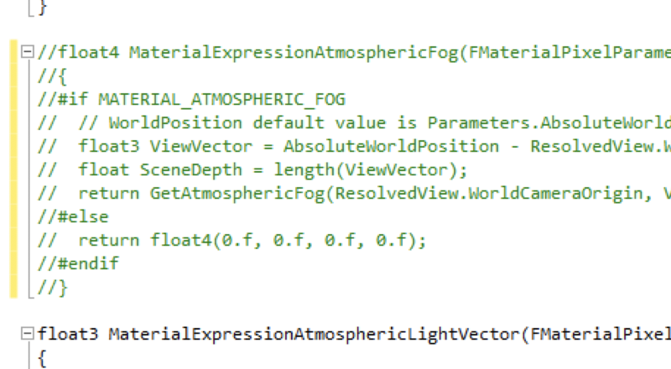
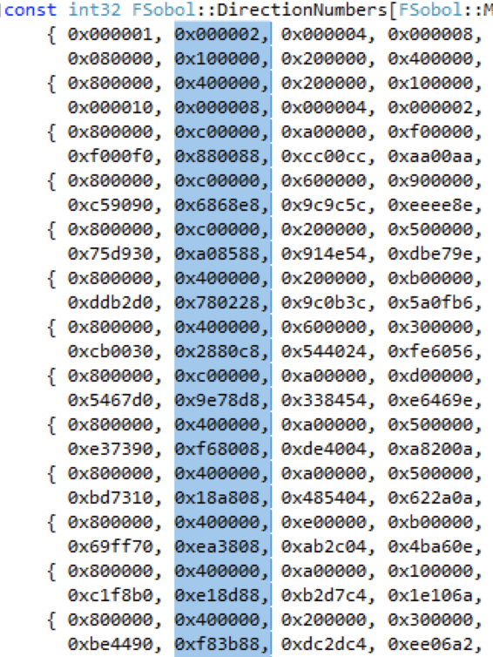
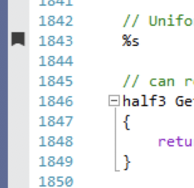
Visual Studio Tips
Turn on VS build timing (WLA)
  Tools > Options > Projects and Solutions > VC++ Project Settings > Build Timing;
  Tools > Options > Projects and Solutions > Build and Run > Build output verbosity = Normal
Handy keyboard shortcuts
  Comment/uncomment blocks of code:
  Ctrl-K Ctrl-C; Ctrl-K Ctrl-U
  Re-indent a block of C++ code:
  Ctrl-K Ctrl-F
  Bookmark / move between bookmarks
  Ctrl-K Ctrl-K / Ctrl-K Ctrl-N; Ctrl-K Ctrl-P
Rectangular select / edit
  Alt + select

Slide 27
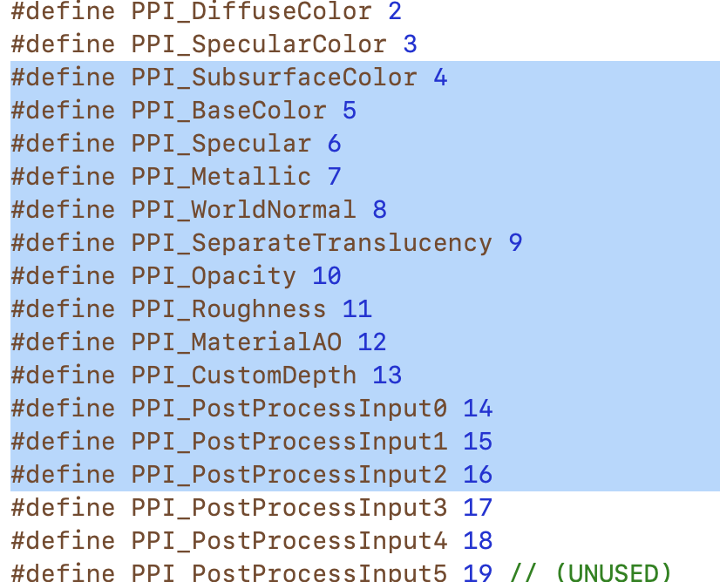
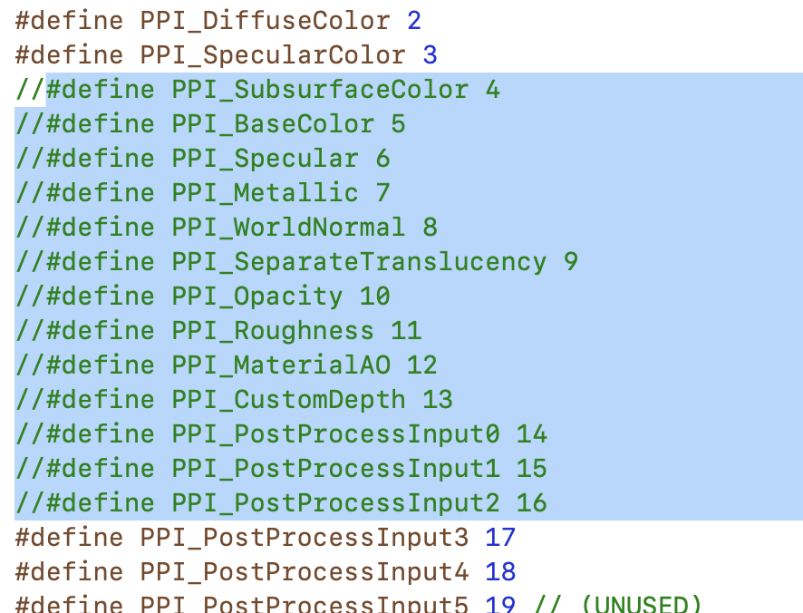
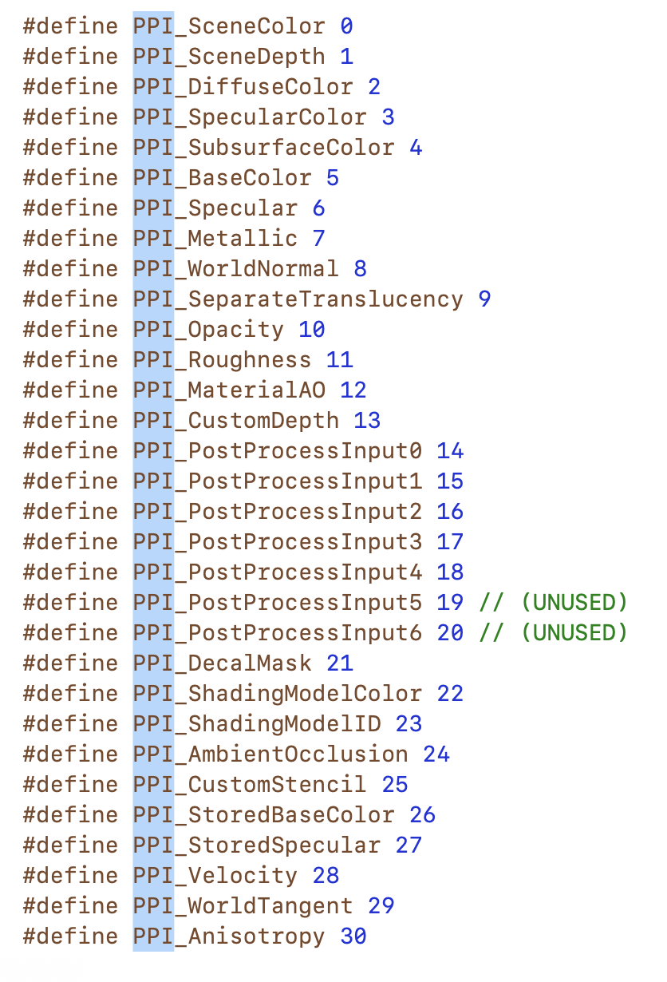
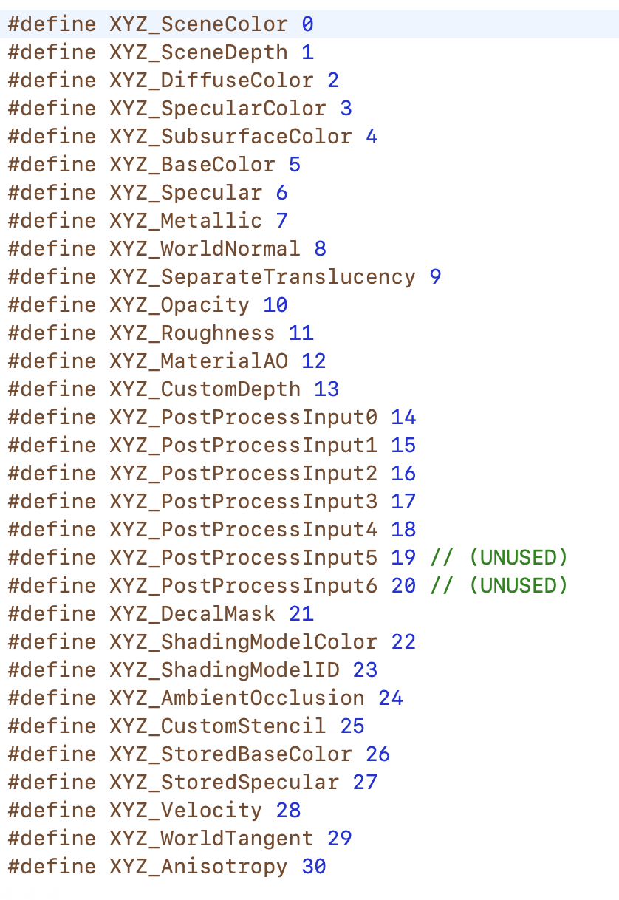
Xcode Tips
Comment Block
  ⌘ /
Editing a bunch of stuff at once (anything you type or paste applies to all lines or copies)
  Rectangle: ⌥ + select
  Additional matching words: ⌥⌘E
  Edit > Select All Find Matches

Slide 28
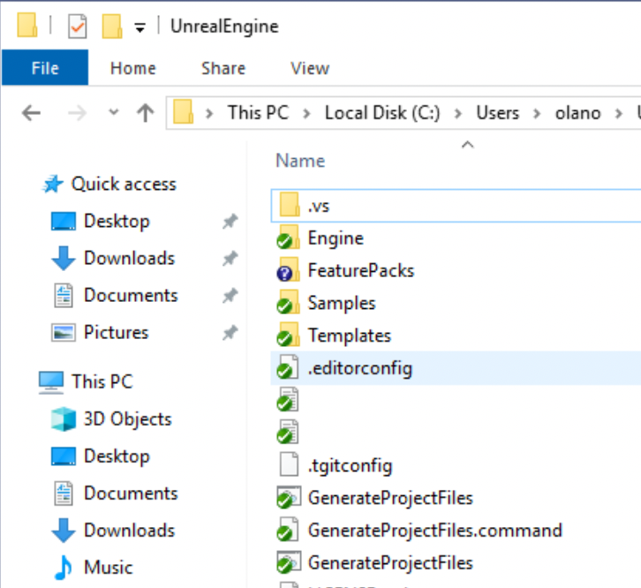
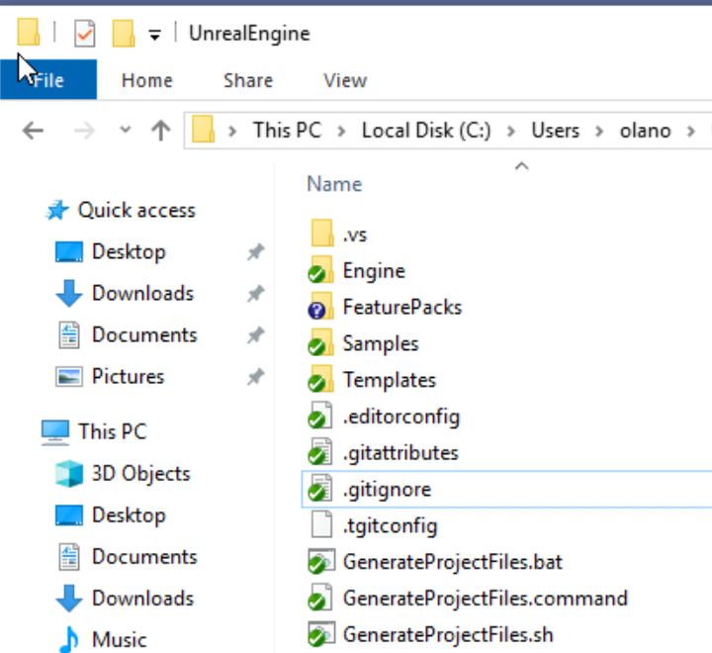
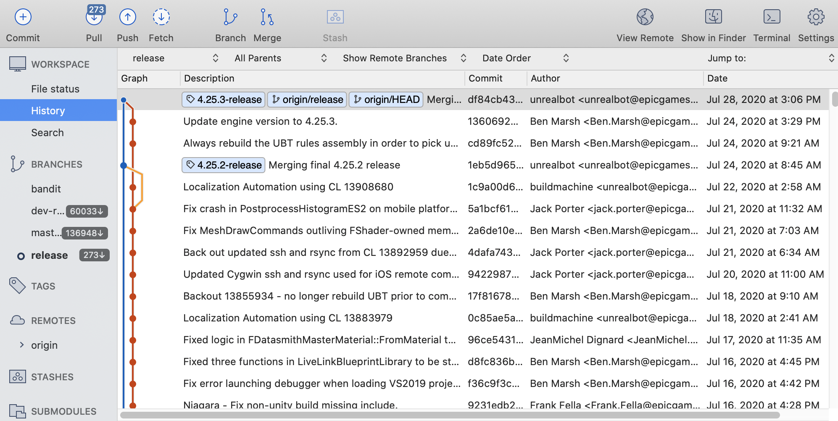
Additional Tips
Show file extensions (WLA)
  File Explorer > View > File name extensions
  Great for those config files starting with .
Consider a visual git GUI (WMLA)
  I like SourceTree or Fork
Turn off any non-security Windows or Mac auto-updates for the semester
  A new OS or IDE update can break your build!

Slide 29
Building UE5

Slide 30
Getting the UE5 Source
Make a fork of the g4g2024 repository on GitHub (which was forked from the main Unreal Engine repository). This will allow you to share access with the TA and instructor.
You can send changes of general interest back to Epic in a pull request.
GitHub only allows you to have one fork from the same base repository at a time, so if you already have a fork of the Unreal Engine, you may need to set up a new GitHub account for this class.

Slide 31
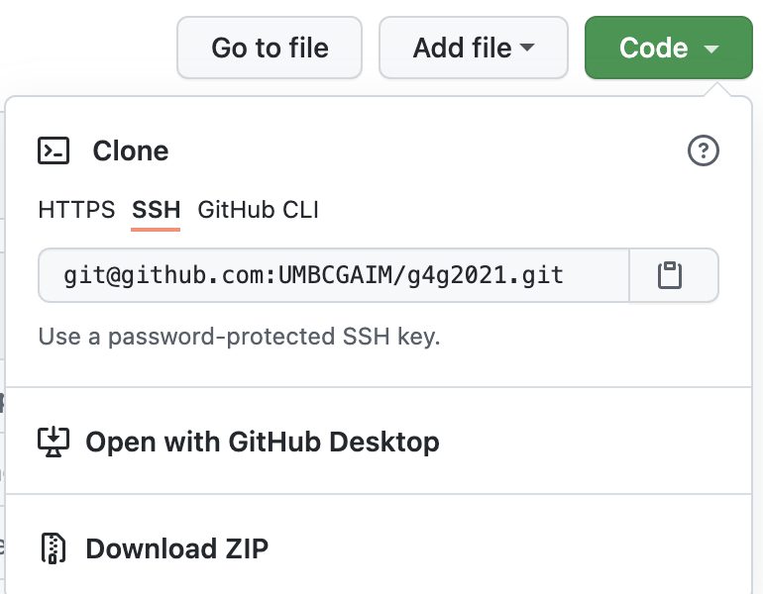
Making a Clone
Try HTTPS access
  If HTTPS doesn’t work, try SSH.
  Do not use the GitHub CLI access, it doesn’t support all of the git commands we need.
Clone your copy to a local drive.
  This gives you a copy of the git repository with all of its history.
  You can make changes to this copy, and even commit new versions of files.
  None of these are reflected on GitHub unless you push those changes back.
Run the UE5 Setup script to download some additional files and get your repository ready to use.
  This is in your clone directory
  Lab computers: cancel out of and ignore any admin permission pop-ups (L)

Slide 32
Git Cloning Tips
DON’T use the GitHub web interface except for overall repository actions (fork, pull request, repository permissions).
  For everything else, use local git commands or a local git GUI.
For a minimal repository size, consider a shallow clone with the “--shallow-since=7/15” option for git clone.
  This will limit how far back in the history your local copy goes.
  Saves time cloning and about 20 GB.

Slide 33

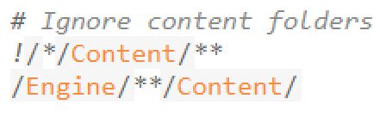
Git Ignore
Your git repository includes a .gitignore file that tells it which files should and should not be checked into git.
The base UE5 one is set to ignore all Content files
  When we put projects into the git directory, we will want those project Content files to be included.
  Don’t (!) ignore Content directories one level deep
  Do ignore Content anywhere under the Engine directory
This is already in the g4g2024 repo.

Slide 34
Tuning Git Performance
The size of the UE5 codebase can strain git, and online sources don’t always help. “I tried git on a large repository with hundreds of files, and performance was fine” is not much help when you are working with 100K files. Here are some things to try
git update-index --split-index
  This splits git’s internal index into smaller parts
git update-index --test-untracked-cache
  This tells you if the modification times on your file system are reliable enough to use in place of scanning individual files.
  If that says OK, use ”git update-index --untracked-cache”

Slide 35
Turning off Git Checks
If (and only if) you get a timeout message during your build:
  Edit Engine/Saved/UnrealBuildTool/BuildConfiguration.xml
  Between the “<Configuration…>” and “</Configuration>” add
    <SourceFileWorkingSet>
    <Provider>None</Provider>
    </SourceFileWorkingSet>
Skips a git check during the build that can time out if too slow.

Slide 36
Building the UE5 Editor
GenerateProjectFiles
Run this script to generate the Visual Studio solution or Xcode project. Rerun only when you add or remove a file.
Build
Open the UE5 file generated by GenerateProjectFiles. Do a Development Build of UE5. This will take at least an hour or two.
Run
Use the “Run” button in your IDE toolbar to start UE5. The first time you run, it will take a while to start as it does some first-time setup.

Slide 37
Distributed Builds
Local System
Remote Build
Remote Build
Remote Build
Remote Build
Remote Build
Remote Build
Remote Build
Remote Build
Remote Build
The easiest way to get a faster build is to spread the work. We can’t really use these, but if you are ever working with UE5 in a professional environment, you’ll want to know about them.
IncrediBuild is a commercial product on Windows that will distribute your build across multiple machines. If you install it, it is automatically integrated into the UE5 build process.
FastBuild is a free alternative, but the existing FastBuild configurations for the Unreal Engine on GitHub haven’t been updated for a couple of years.

Slide 38
Build Tips
Consider excluding the UE5 directory from your virus scan
Editing a single cpp file will be a quick incremental rebuild.
  Editing a widely used header can lead to rebuilding most of the engine (so avoid that as much as you can).
Try to practice include what you use to reduce the impact of header changes:
  Only include headers you directly use
  If a class interface only uses another class by pointer or reference, use a forward declaration of the class rather than including its header.
  Put class implementation code in a cpp file, not in the class header, to avoid having to recompile additional files if the implementation changes but the interface does not.

Slide 39
Running UE5 Projects
If you put UE5 game projects in the base directory of your UE5 git repository, GenerateProjectFiles will add them to the engine build files. This makes it easier to debug project and engine changes together.
On Windows, you can set the command line options in the Debugging pane of the UE5 project properties in the Visual Studio Solution Explorer.
  The UnrealVS plugin makes it easy to switch to a game project built this way, and to change the command-line options, but can hang on some systems. If this happens to you, open Visual Studio directly (without opening the UE5 solution) and disable the plugin in Tools > Extensions and Updates
On Mac, choose your game project from the selector in the Xcode window toolbar, and set command line options in the “Edit Scheme” dialog.

