Slide 1
Proxy Geometry
UMBC Graphics for Games

Slide 2
Graphics Hardware likes Triangles
Turn everything into meshes of triangles
  Paragon Murdock: ~75k triangles
Draw them really fast
But not everything likes tons of
tiny triangles…
Notes:
Find ”Paragon: Murdock” in the Epic Games Launcher / Unreal Engine / Marketplace
Add to any existing project
Open Murdoch Map
Select character, open skeletal mesh, counts on display

Slide 3
Physical Interaction

Slide 4
Physics Simulation
Simulate objects as rigid bodies
  Also sometimes see fluid simulation, but don’t worry about that now
Even complex objects as rigid parts with joints
Navigation (don’t run through walls)
Gravity (fall, but not through floors)
Rag doll (transition from scripted animation)

Slide 5
Collision Detection
Core component of physics simulation
Also event triggers

Slide 6
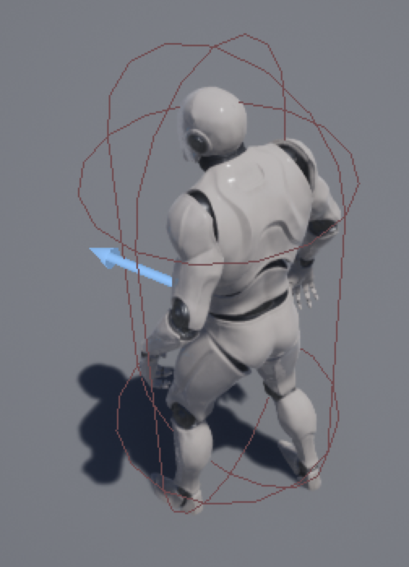
Simple Physics/Collision Proxies
Physics & collision detection with polygons is slow
Simple shapes are fast(er)
  Box, Sphere, Cylindrical Capsule
Just use one of those around each object or character.
Notes:
New 3rd person template project. Select character

Slide 7
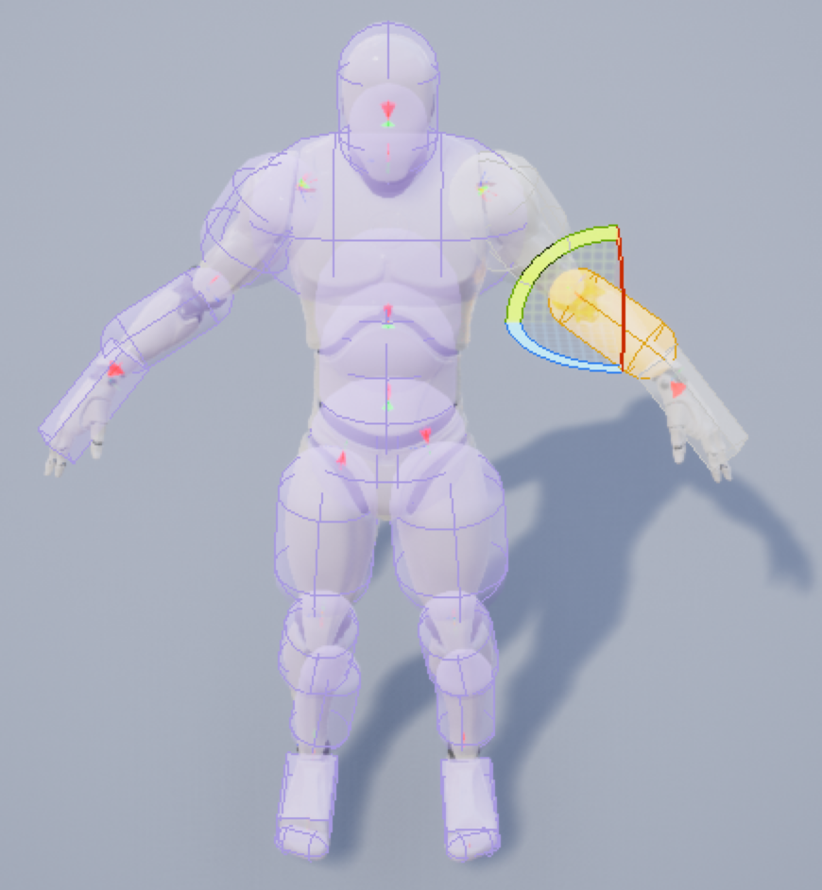
Composite Proxies
Physics animation of a character needs more
Build from basic shapes
  Sausage man!
Compute physics on basic shapes
Apply joint transforms to original model
Notes:
Open character skeletal mesh. Physics view

Slide 8
Hierarchical Proxies
Only use finer proxy when you hit the coarser one
All should contain the real object
  But do not need to strictly contain the extra empty space of the other levels
Notes:
Load static mesh into scene. Bounds view. Collision view (Simple Collision, Complex Collision)

Slide 9
What to Render

Slide 10
Occlusion Queries
Graphics Hardware supports Occlusion Queries
  Lets you ask “how many pixels would this draw?”
  Or ”how many did this draw?”
Can only get the answer 1-2 frames later
Draw a simple proxy shape to figure out whether to do the complicated one
  Often just a bounding box
Dilate box based on object and view velocities

Slide 11
Simplifying Rendering

Slide 12
Level of Detail
All polygonal models are proxies for an imagined smooth object
Use multiple polygonal proxies
Switch to simpler models when far away

Slide 13
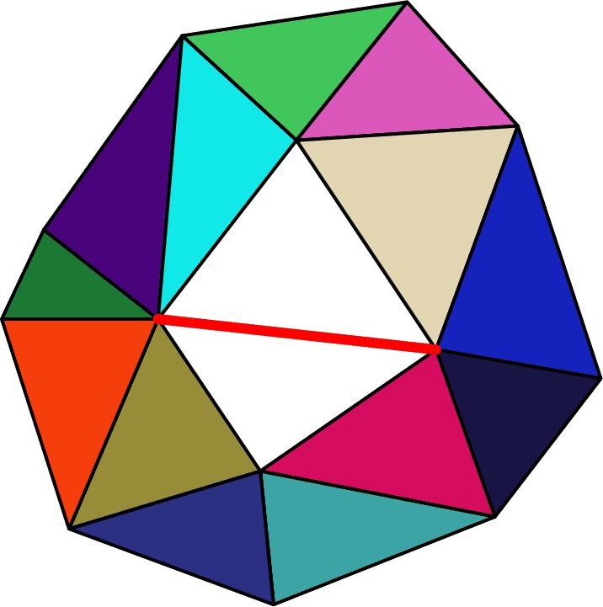
Level of Detail
Most common algorithm: Edge Collapse
  Choose an edge, shrink to nothing
  Removes two triangles, one vertex
Alternative: Vertex cluster
  Merge clusters of vertices
  Remove any degenerate triangles
Alternative: Volumetric remeshing
  Convert to volumetric signed distance grid
  Process as volume
  Remesh

Slide 14
Level of Detail
75,296 Triangles
Notes:
Murdoch Paragon character, view Skeletal Mesh & select LOD levels

Slide 15
Level of Detail
42,326 Triangles

Slide 16
Level of Detail
20,597 Triangles

Slide 17
Level of Detail
10,042 Triangles

Slide 18
Level of Detail
5,172 Triangles

Slide 19
“Maps” for missing detail
Map from mathematical mapping of 2D (image) domain to surface
Provides detail at a scale smaller than a triangle
Texture Map: surface color
Normal Map: normals provide shading variation
Gloss Map: shininess/roughness
Material/Metallic/Skin map: material to use

Slide 20
Displacement Map
Displace surface (typically along normal)
For fine mesh, move vertices
Proxy surface version: Relief Map or Parallax Occlusion Map

Slide 21
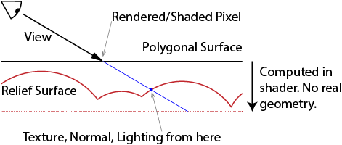
Relief / Parallax Occlusion Map
Photons travel in straight lines
Photon that reaches the viewer through a pixel came from somewhere on a ray through that pixel

Slide 22
Relief / Parallax Occlusion Map
Render polygonal envelope around surface
Compute actual color and depth along ray in a shader

Slide 23
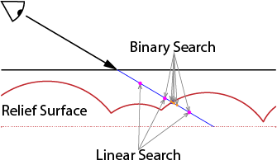
Finding the Intersection
Numerical root finding
Linear search (marching), Binary search, Secant method, Hybrid, …

Slide 24
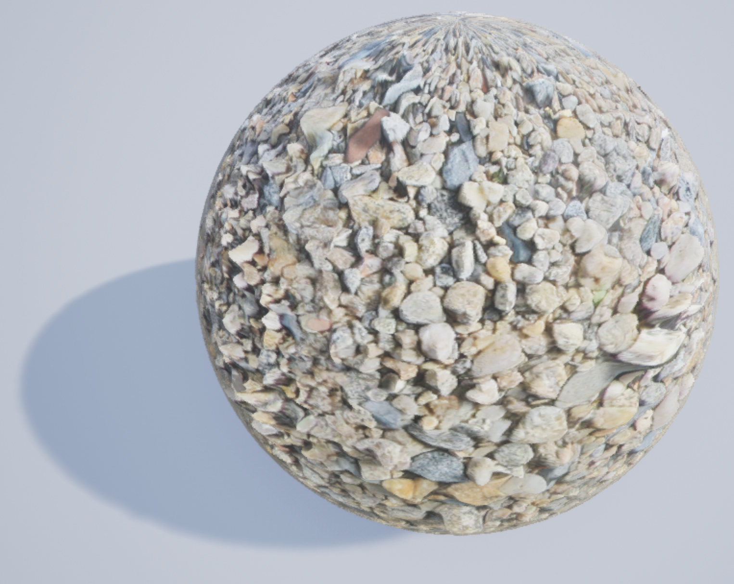
Relief Problems
Texture stretching on steep parts
  Can remap
Unbounded steps at silhouette edges
  Make displacement meet the proxy surface every so often
  Flatten when too steep
  Maximum number of steps
  Divide into prisms with side faces
Notes:
Add Parallax Occlusion Map node to a material
cc0-textures.com had a number of texture samples including diffuse, normal, displacement, …
Shader parameters for height and shadow toggle, light vector from Atmospheric Light Vector

Slide 25
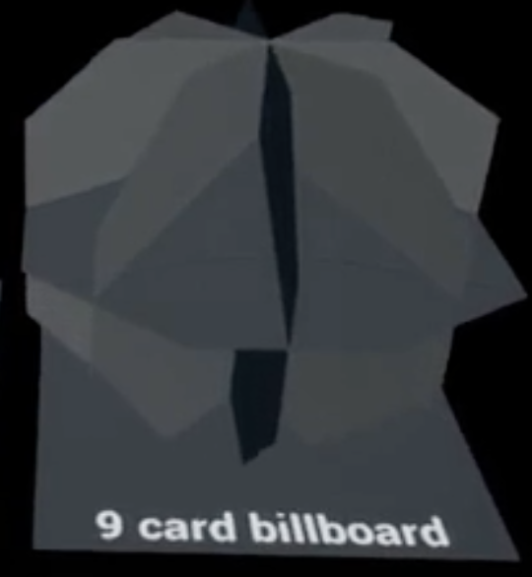
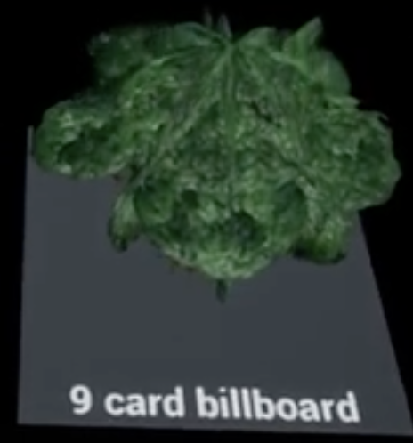
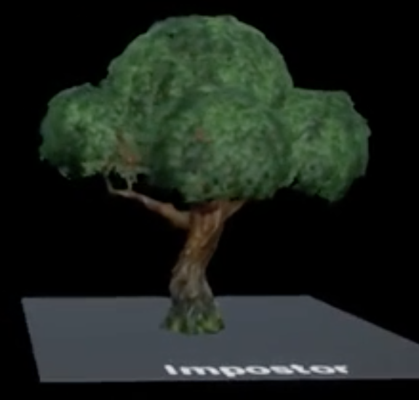
Billboards & Imposters
Billboard
  Rectangle that turns to face the viewer
  Sometimes a fixed set of intersecting planes
  Typically, a fixed static texture, common for particles
  Can also billboard gbuffer data (color, normal, etc.)
Imposter
  Change texture based on view direction
  Better yet to warp with POM and blend closest
  Used for Fortnite trees
    https://shaderbits.com/blog/octahedral-impostors/

Slide 26
Volumetrics

Slide 27
Volume effects
Total transparency between 0 and t
Smoke, fog, clouds
Typical algorithm marches ray through volume
Accumulate color and opacity as you go
Color at t

Slide 28

Proxy Volumes
Render transparent-pass proxy object around volume
  Or just as a plane in front of the viewer
Shader does ray march, returns color & opacity
  Blends over background objects
Acceleration data
  Hierarchical structure
  Distance field (can step “this far” without hitting anything)
Notes:
From my NoiseTest map.

Slide 29
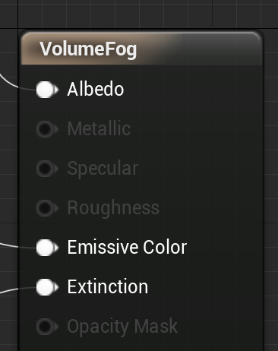
UE Volume Material
Re-samples volume to grid
Handles ray marching, accumulation & shadows
Albedo = Color of the material
Emissive color = Light emitted by the material
  Doesn’t act as a light source, just constant extra color
Extinction ∈ [0,∞) = – ln(1-alpha)
Notes:
Noise project, VectorNoise level, Volume Material example

