Slide 1
Precomputation
UMBC Graphics for Games

Slide 2
Rendering Equation
Compute = outgoing light in direction from a patch of surface
is the integral over all incoming light directions.
Including the change of variables for projection from directions to surface, the integral takes the form:
Body of the integral is the incoming light, , scaled by the bidirectional reflectance distribution function:
Full Rendering Equation:

Slide 3
Illumination
Global illumination = chain of integrals
  Outgoing is incoming somewhere else
Integrals are expensive to compute, chain of integrals is worse!
How to compute or approximate?

Slide 4
Monte-Carlo Integration

Slide 5

Stuff from Probability
Random variable X
  Like X = rand(): different value every time
Probability Density Function (PDF),
  is density near , not probability of
  Uniform density in [0, 1]
  Uniform density in [0, 2]
  Uniform density in [0, ½]

Slide 6
Expected Value
  Average value of for all
Expected value estimates integral
  For
  More samples = closer estimate
  Too few samples = noise in the result: 4x the samples for ½ the noise

Slide 7
Importance Sampling
Spend your samples where they’ll help the most
Scale contribution by density of samples
Works best when is roughly proportional to

Slide 8
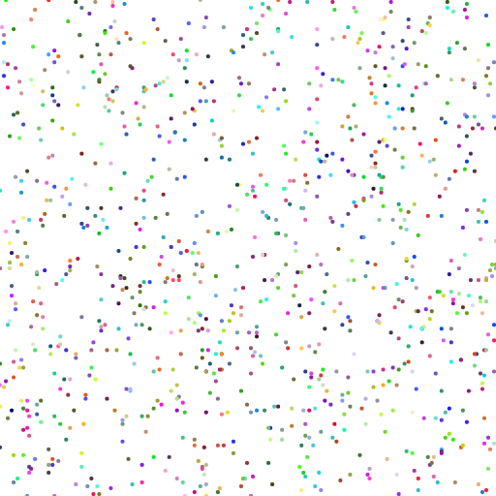

Quasi-Random & Blue Noise
Uncorrelated pseudo-random numbers are clumpy
More evenly spaced works better
  Especially at low sample counts
  Still uniformly distributed
  Samples are correlated to be aware of each other
Quasi-Random / Low Discrepancy
  Algorithm to generate a sequence
  Halton, Sobol
Blue Noise / Poisson
  Point sets with little or no low frequencies
  Usually built by some optimization algorithm

Slide 9
Denoising
Try to smooth out noise from too few samples
  Use samples from nearby pixels or previous frames
Cross-Bilateral blur
  Blur, weighted by extra terms (depths, normals, …)
Non-Local Means (NL-Means)
  Extra terms over image patches instead of individual pixels
Regression
  Linear fit over image and non-image features
Deep learning
  Train on noisy & clean images

Slide 10
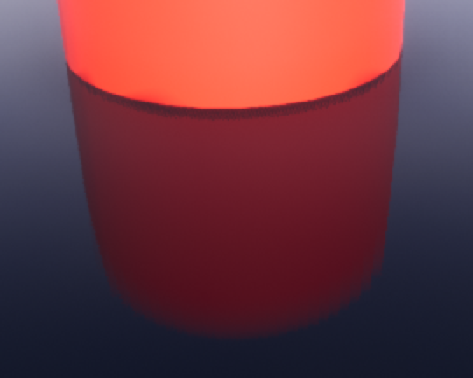
UE Screen Space Glossy Reflection
Monte-Carlo is not just for precomputation anymore!
N Halton-distributed rays, randomized between pixels
  1, 4, or 12, determined by r.SSR.Quality
Importance sampled by BRDF
Trace against screen color & depth buffer
Blend across frames with Temporal Antialiasing
  Repeating 8 frame pattern
  Effectively 8, 32, or 96 samples per pixel

Slide 11
TAA wins
Monte Carlo all the things
  Some samples per frame
  Multiply by TAA
Screen Space Reflection
  1-12 samples per pixel * 8 frames ≈ 8-96 samples
Ambient Occlusion
  1-6 samples per pixel * 8 frames ≈ 8-42 samples
Percentage Closer Soft Shadows
  32 samples per pixel * 4 pixels/quad * 8 frames = 1024 samples

Slide 12
Path Tracing
AKA Markov Chain Monte-Carlo

Slide 13
Paths for Global Illumination
Trace a photon through the scene
Importance sample next direction at each bounce
Average over many photons

Slide 14
Unidirectional Path Tracing
Algorithm
  Start at camera
  Trace photons backwards to see where they came from
  Check direct lighting each bounce
  Randomly kill and restart new photons
Strengths
  All photons known to contribute to the image
  Handles looking through refractive and reflective surfaces well
Weaknesses
  Doesn’t handle shining lights through refractive surfaces well (caustics)

Slide 15
Photon Mapping
Algorithm
  Trace photons from light sources
  Deposit energy in a spatial data structure
  When rendering, find nearby photons
Strengths
  Handles caustics well
Weaknesses
  Not so good at reflection or refraction of primary view rays

Slide 16
Virtual Point Lights (VPL)
Algorithm
  Trace photons from light sources
  Turn hits into point lights
  Render using methods for large numbers of lights
Strengths
  Can tie into deferred shading pipeline for real-time final render
  Can handle caustics and volumetrics well
Weaknesses
  Weak singularity near each VPL
    requires clamping to avoid infinitely bright spots
    But clamping = bias = darkening (need that energy, just not in an infinitely bright point)
  Can’t handle refracted primary view rays

Slide 17
Bidirectional Path Tracing
Algorithm
  Trace paths from both lights and view
  Connect view chain to light chain
  Variations like Metropolis mutate successful chains
Strengths
  Handles refracted view and caustics
  Metropolis can light even from rare paths
Weaknesses
  Complex: simpler methods can be less noisy for simple light paths

