Slide 1
Monte Carlo Rendering
UMBC Graphics for Games

Slide 2
Path Tracing
AKA Markov Chain Monte-Carlo

Slide 3
Rendering Equation
Compute = outgoing light in direction from a patch of surface
Integral of surface reflectance over all incoming light directions.
Including the change of variables for projection from directions to surface, the integral takes the form:
Body of the integral is the incoming light, , scaled by the bidirectional reflectance distribution function:
Full Rendering Equation:

Slide 4
Illumination
Local illumination = light to surface to eye
Numerical approximation to rendering equation integral
Monte-Carlo integration is one popular technique
Global illumination = chain of integrals
Outgoing is incoming somewhere else
Integrals are expensive to compute, chain of integrals is worse!
How to compute or approximate?

Slide 5
Paths for Global Illumination
Trace a photon through the scene
Randomly choose next direction at each bounce
Average over many photons

Slide 6
Unidirectional Path Tracing
Algorithm
Start at camera
Trace photons backwards to see where they came from
Check direct lighting each bounce
AKA next event estimation
Randomly kill and restart new photons
Strengths
All photons known to contribute to the image
Handles looking through refractive and reflective surfaces well
Weaknesses
Doesn’t handle shining lights through refractive surfaces well (caustics)

Slide 7
Photon Mapping
Algorithm
Trace photons from light sources
Deposit energy in a spatial data structure
When rendering, find nearby photons
Strengths
Handles caustics well
Weaknesses
Not so good at reflection or refraction of primary view rays

Slide 8
Virtual Point Lights (VPL)
Algorithm
Trace photons from light sources
Turn hits into point lights
Render using methods for large numbers of lights
Strengths
Can tie into deferred shading pipeline for real-time final render
Can handle caustics and volumetrics well
Weaknesses
Weak singularity near each VPL
requires clamping to avoid infinitely bright spots
But clamping = darkening (need that energy, just not in an infinitely bright point)
Can’t handle refracted primary view rays

Slide 9
Bidirectional Path Tracing
Algorithm
Trace paths from both lights and view
Connect view chain to light chain
Variations like Metropolis mutate successful chains
Strengths
Handles refracted view and caustics
Metropolis can light even from rare paths
Weaknesses
Complex: simpler methods can be less noisy for simple light paths

Slide 10
Monte-Carlo Integration

Slide 11

Stuff from Probability
Random variable X
Like X = rand(): different value every time
Probability Density Function (PDF),
is density near , not probability of
Uniform density in [0, 1]
Uniform density in [0, 2]
Uniform density in [0, ½]

Slide 12
Expected Value
Average value of for all
Expected value estimates integral
For
This is known as Monte-Carlo integration

Slide 13
Monte-Carlo Noise
Treat estimate from samples, as a random variable
How does it change with a different set of N samples?
AKA how much noise in the image?
Variance is squared error relative to the mean as
Bias is difference between the mean and real function
Biased = won’t converge to the right answer
Total RMS error = mean pixel value difference from real value

Slide 14
Reducing Noise: Adding Samples
4x samples for ¼ variance, ½ RMS error
16x samples for ¹/₁₆ variance, ¼ RMS error

Slide 15
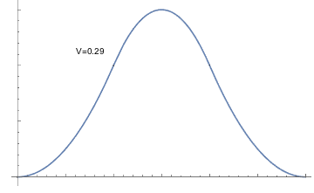
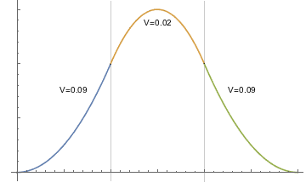
Reducing Noise: Shrinking Variance
Stratified Sampling
Divide into X domain into bins and do one or more random samples per bin
Less variance on subdomains than the whole

Slide 16
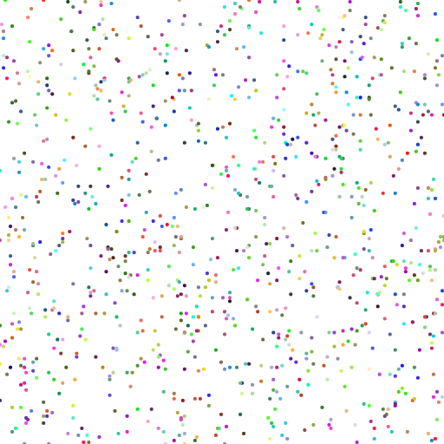
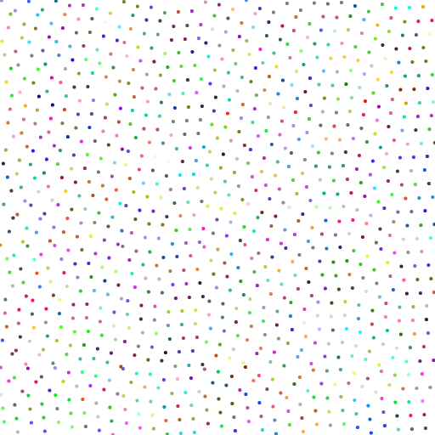
Quasi-Random & Blue Noise
Uncorrelated pseudo-random numbers are clumpy
More evenly spaced works better
Especially at low sample counts
Still uniformly distributed
Samples are correlated to be aware of each other
Quasi-Random / Low Discrepancy
Algorithm to generate a sequence
Halton, Sobol
Blue Noise / Poisson
Point sets with little or no low frequencies
Usually built by some optimization algorithm

Slide 17
Quasi-Random vs. Blue Noise
Quasi-random sequences evaluated by star discrepancy
Error in estimating volume of axis-aligned box
Blue noise evaluated by radial frequency analysis
Low or zero for low frequencies
Provably better convergence if actually 0 near 0
Only some point set generation algorithms achieve this
Quasi-random (and Mitchell’s) do not!

Slide 18
Variance Reduction: Importance Sampling
Spend your samples where they’ll help the most
Scale contribution by density of samples
Works best when is roughly proportional to
Unbiased if is non-zero everywhere is

Slide 19
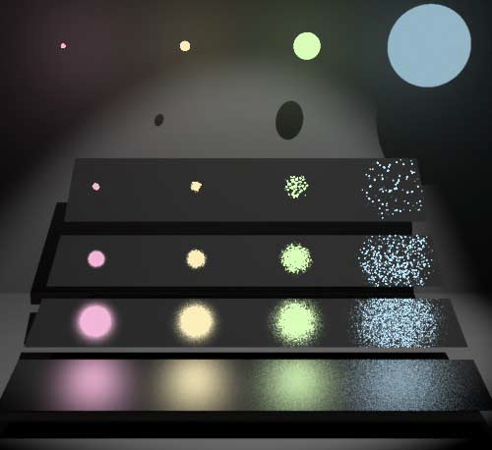
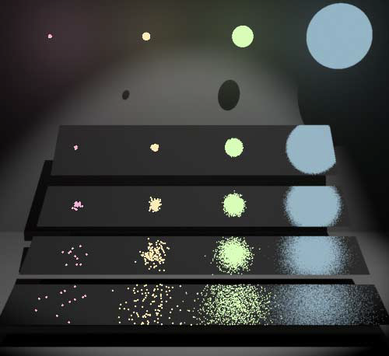
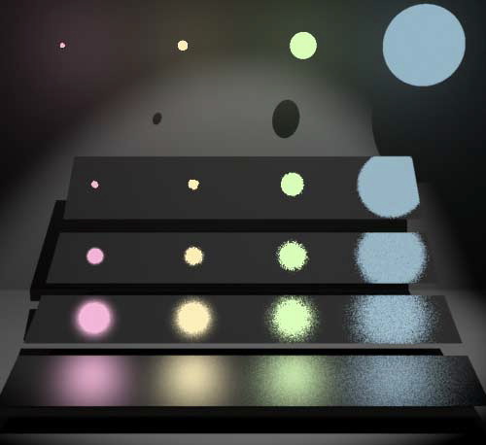
Multiple Importance Sampling
Often easier to importance sample just one term of integral
E.g. light * reflectance: sample by light or by reflectance?
Works well if that term dominates
Use a weighted blend of samples from different PDFs
Can vary weights across image
[Veach & Guibas, 1995]

Slide 20
ReSTIR
If is exactly proportional to , is constant
Average to compute doesn’t change with the number of samples
Could use just one!
Generate samples from another distribution
Choose a sample with probability
Assumes generating samples is cheap, but computing is not.
Can share sample pools between pixels, rays, frames, but either lose quality or need a way to retarget/adapt samples
Theory: Multiple Importance Sampling, Resampled Importance Sampling & Reservoir Sampling

Slide 21
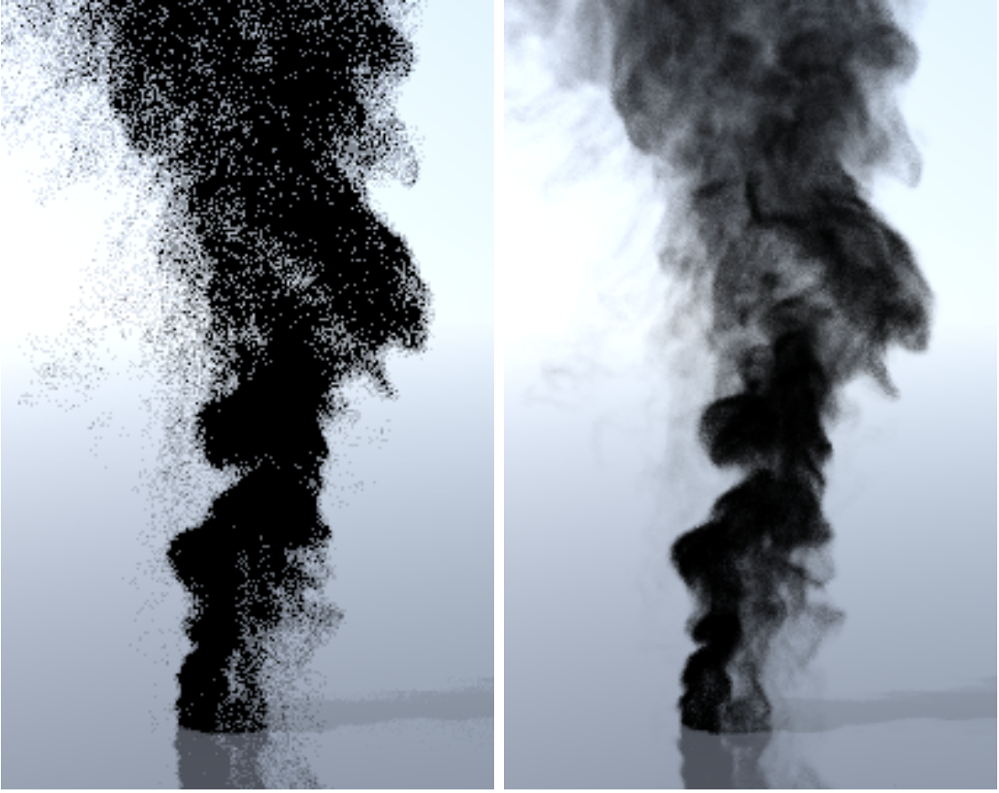
Reducing Variance: Control Variates
Find g(x) you can integrate analytically
Still need Monte Carlo for this piece
Often see with a scale factor on g
[Novák et al., 2014]

Slide 22
Reducing Noise: Adding Bias
Rather than reduce error, smooth it out
May never converge to correct answer
Stop ray paths after a fixed number of bounces or contribution
Adaptive sampling
Add samples in areas of high sample variance
May never notice features missed by early samples
(Naïve) path guiding
Drive path directions based on data from prior paths

Slide 23
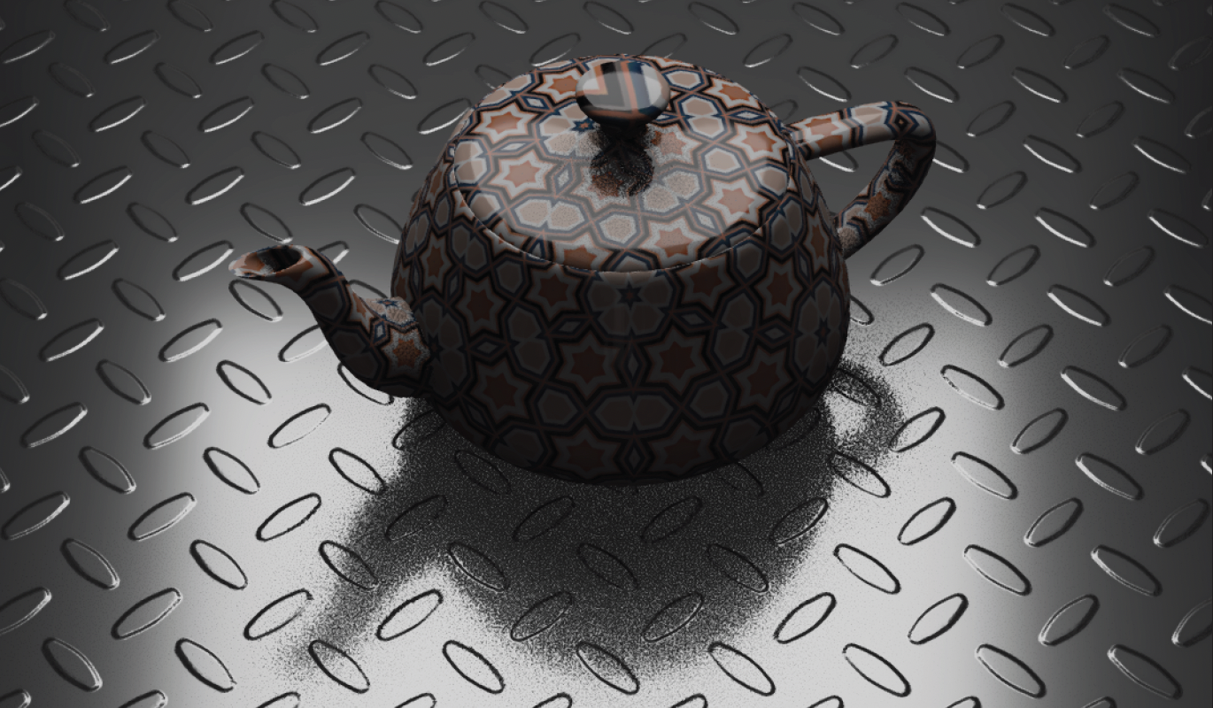
Ratio Control Variates
Instead of subtraction, use ratio
Only approximate (biased)
Lu et al. 2025 characterizes bias & provides method to debias
Heitz et al. 2018 adding shadows to unshadowed render
f = light * reflectance * shadow
g = light * reflectance

Slide 24
Denoising
Try to smooth out noise from too few samples
Use samples from nearby pixels or previous frames
Cross-Bilateral blur
Blur, weighted by extra terms (depths, normals, …)
Non-Local Means (NL-Means)
Compute over image patches instead of individual pixels
Regression
Linear fit over image and non-image features
Deep learning
Train on noisy & clean images

Slide 25
TAA: Denoising + Sample Multiplication
Screen Space Reflection
1-12 samples per pixel * 8 frames ≈ 8-96 samples
Ambient Occlusion
1-6 samples per pixel * 8 frames ≈ 8-42 samples
Percentage Closer Soft Shadows
32 samples per pixel * 4 pixels/quad * 8 frames ≈ 1024 samples

Slide 26
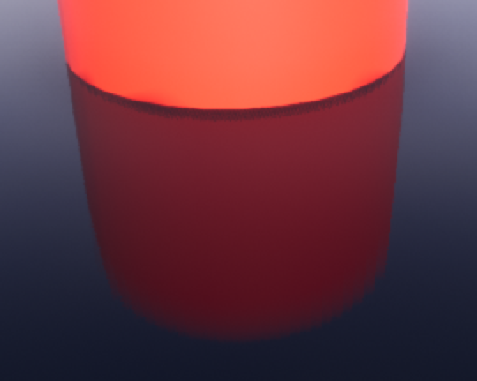
Game Example
UE Screen Space Glossy Reflection
N Halton-distributed rays, randomized between pixels & frames
1, 4, or 12, determined by r.SSR.Quality
Importance sampled by BRDF
Trace against screen color & depth buffer
Blend across frames with Temporal Antialiasing
Repeating 8 frame pattern
Effectively 8, 32, or 96 samples per pixel

