Slide 1
Approximation
UMBC Graphics for Games

Slide 2
Approximating Direct Illumination

Slide 3
Rendering Equation (again)

Slide 4
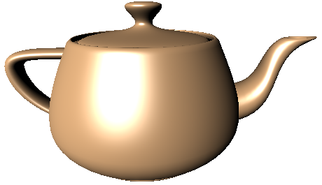
Point and Directional Direct Lighting
Light only comes from certain directions
Just sum over those directions
Notes:
Technically, in the limit as the light size goes to 0 and the light intensity remains the same, light becomes a delta function

Slide 5
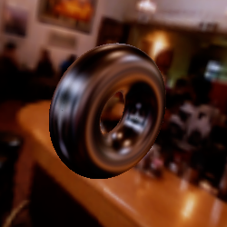
Environment Maps
Distance to reflected environment >> object size
  Incoming light only depends on direction, not position
Store reflection by direction in a texture
  Six faces of a cube
  Image of a reflective sphere
Layered maps at different distances
Warp for some local reflection effects

Slide 6
Approximating Global Illumination

Slide 7
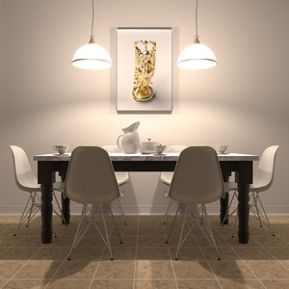
Global Illumination = Chained Integrals
Image: pbrt.org

Slide 8
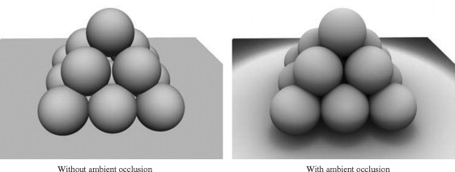
Ambient & Ambient Occlusion
Ambient: extra bounces are
constant extra light
Ambient Occlusion: scale based on
local visibility
Screen-Space AO: estimate using
position data in nearby pixels
Bent Normal: from environment
in average AO visibility direction

Slide 9
Traditional Ray Tracing
Only direct (to point & directional lights)
+ mirror reflection (no glossy/blurry reflections)
+ simple refraction (no blurry refractions)

Slide 10
Light Maps
Diffuse = part of BRDF that doesn’t depend on view direction
Precompute and store in per-object textures
  Radiosity diffuse-only global
  illumination algorithm
  Path trace (May include non-diffuse
  intermediate bounces)

Slide 11
Light Probes
Grid of precomputed environment captures
3D grid or 2D grid ~2m high (good for human-sized characters)
  Closest to correct at face
  Less important that feet are
  totally accurate
Represent in a compact format
At run-time, interpolate and
use for lighting
Be careful not to interpolate
through walls

Slide 12
Spherical Harmonics

Slide 13
Functions as Vectors
Express vectors in terms of coefficients for basis vectors
Functions form a vector space too
Value at every point on the real axis:
Power basis:
Fourier basis:

Slide 14
Function Dot Product
Regular real-valued dot product
  (e.g. )
Sum turns to integral for continuous real-valued functions
Orthonormal
  Orthogonal if
  Normal if
  When orthonormal,
  where

Slide 15
Light Probes
Grid of precomputed environment maps would be huge
Need a compact representation for a function of direction
  Directions = unit vectors
  = points on a sphere

Slide 16
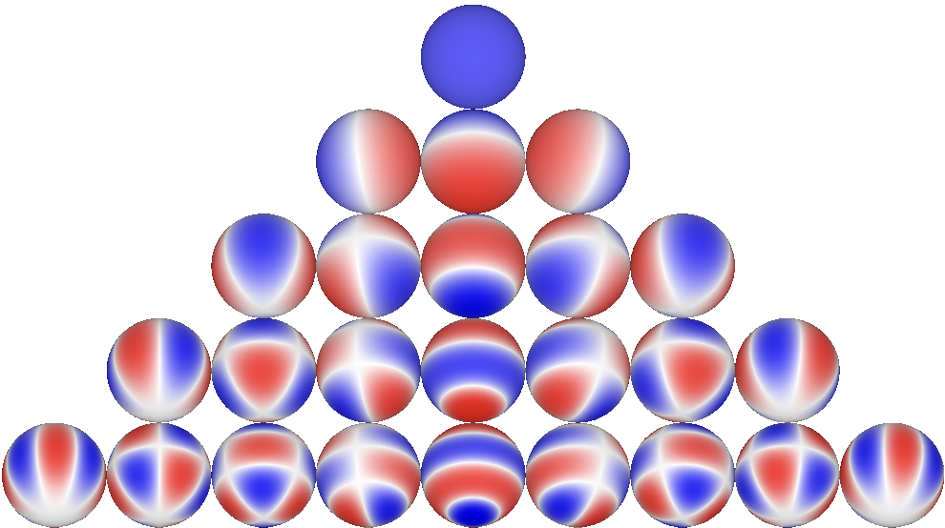
Spherical Harmonics
Orthonormal basis for functions on a sphere
  Indexed
–4
–3
–2
–1
0
1
2
3
4

Slide 17
Incoming Light as Spherical Harmonics
Integrals do not depend on the incoming light, can precompute
Double product: light & part of BRDF as SH
All: precompute integrals, just store coefficients

Slide 18
Light Probes (revisited)
Store as grid of SH coefficients (can store in a couple of textures)
  Few terms = blurry representation of incoming light
Run time: find closest, interpolate SH coefficients
  Be careful not to interpolate through walls!
Combine with other (higher frequency) lighting

Slide 19
Other Spherical Basis Functions
Zonal Harmonics (just the m = 0 ones + a rotation axis)
  , , , , …
Wavelets (multiresolution approximation & residuals)
Spherical Gaussians (+ an axis)
…

Slide 20
Approximating Subsurface Scattering

Slide 21
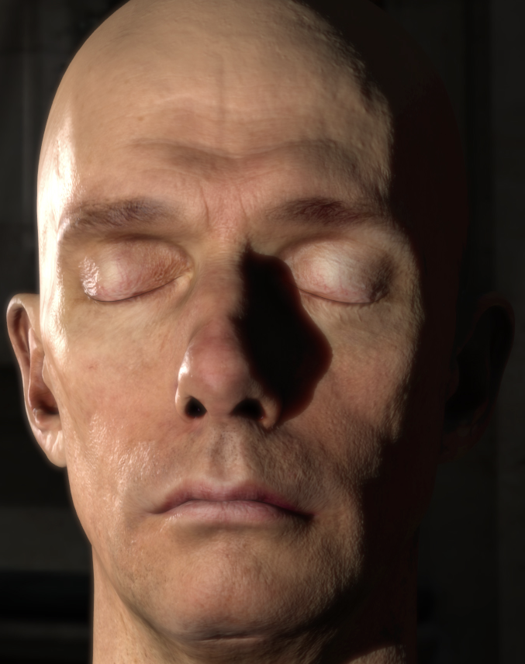
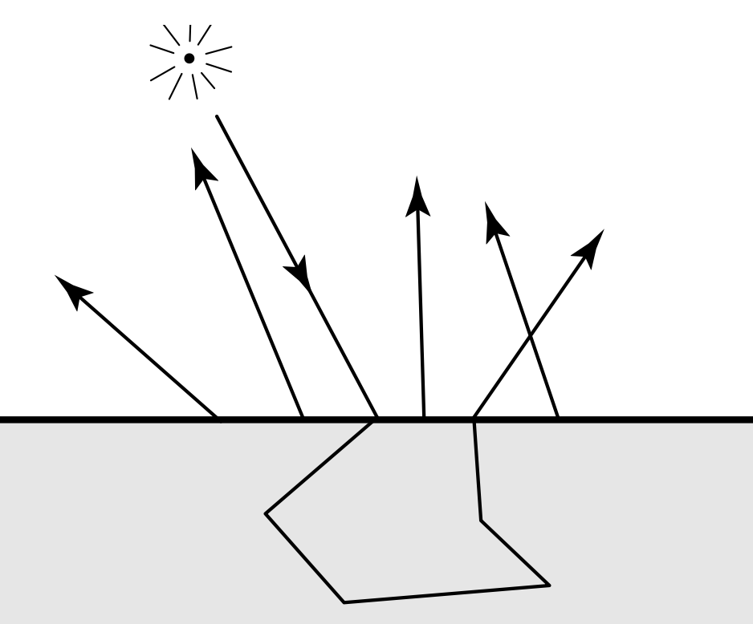
Subsurface Scattering
Some photons enter surface & bounce around
& come out somewhere nearby
Important for skin!
D’Eon et al. 2007
Jensen et al. 2001

Slide 22
Subsurface Approximations
Dipole [Jensen et al. 2001]
  Per-point put a fake light source above & below the surface
Diffusion [d’Eon & Luebke 2007]
  Capture illumination & combine multiple blurs of different sizes
  Approximate Jensen with sum of Gaussians
  Compute using illumination & position data per texel
Screen-Space Diffusion [Jimenez et al. 2009]
  Same as d’Eon & Luebke, but using pixel illumination & position data
Burley Normalized Diffusion [Burley 2015]
  Probability density for importance sampling, fit to Monte-Carlo data

Slide 23
Function Approximation

Slide 24
Still Too Expensive???
Even without integrals, can have trig functions, or lots of computation
Find a function close in shape to the original, but easier to evaluate
  Can include 2D or 3D lookups, though lookups are expensive too
Finding the coefficients
  Taylor series: Polynomial – good near 0, can blow up far away
  Padé: Rational Polynomial – good near 0 and ∞
  Minimax: Polynomial – minimizes max error
  Nonlinear optimization

Slide 25

Examples: Hair [Karis 2016]
Marschner [2003]: sum of reflection (R) and Transmission (T) paths
Just do R, TT, TRT paths
Many terms, each with its own approximation (see Karis)
For example:
  Start with
  Change variables to to avoid acos(dot(…))
  Graph, looks similar to exp(–…)
  Fit :

Slide 26
Refinements for fitting
Range reduction
  Piecewise fit
  This is how most math library functions work
Constraints
  Constrain endpoints
  Constrain critical features (is the derivative at 0 important?)
  Lock those down before doing fit for the rest
  Reduces degrees of freedom in optimization

Slide 27
More from Iwanicki & Pesce [2015]
Reduce dimensionality (project, factor)
Toolkit: Global and local optimization algorithms
  When ground truth is Monte-Carlo, avoid ones that need derivatives
Steps
  Graph the function to fit
  Hypothesize a form for the fit
    Zero out small coefficients
    Parameters near limits = probably not the right function
  Graph & render with result
  Add refinement terms & constraints (or change fit function)

Slide 28
Examples: Schlick Fresnel
Original Fresnel (for unpolarized light)
Constrain
  Where
Polynomial fit [Schlick 1994]

Slide 29
Refining approximations [Jakob 2014]
For importance sampling, want this CDF
To generate samples, need inverse CDF, but no closed form
Compute approximate as a function of
Refine with several steps of Newton method to find where

Slide 30
Numerical Error
Or how good is good enough

Slide 31
Representation Error
Floating or fixed point (e.g. 8-bit color values) have limited precision
  True number can be ±0.5 * least significant bit
  8-bit color represents values in [0,1] with an 8-bit number
  LSB is 2⁻⁸, true value within ±2⁻⁹ of stored value
Floating point LSB scale depends on exponent
  For float x, LSB ≈ |x|*2⁻²³, error ≈ ±|x|*2⁻²⁴

Slide 32
Propagated Error
If input to a function has error, result has error scaled by derivative
  Exact:
  With small error in input:

Slide 33
Generated Error
Approximations generate their own error
Do not need approximation significantly better than propagated error.
Do not need approximation significantly better than output precision.
How the error looks also matters
  Discontinuities in value or derivative may be worse than consistent bias

